Slide 2

Soils Overview

Slide 3
Soil Testing

Slide 4
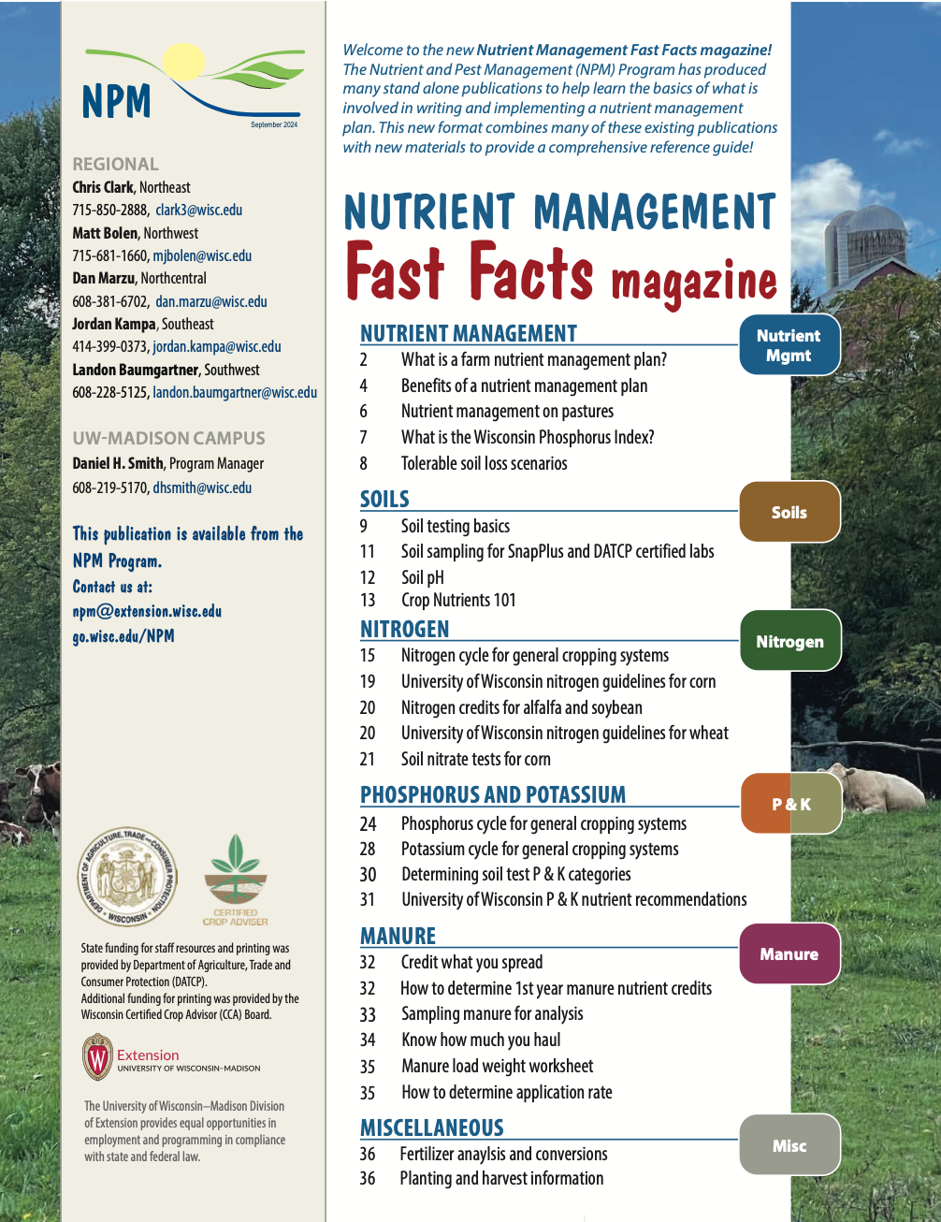

Following Along in Fast Facts?
Soils Testing: Pages 9-11 in Nutrient Management Fast Facts

Slide 5
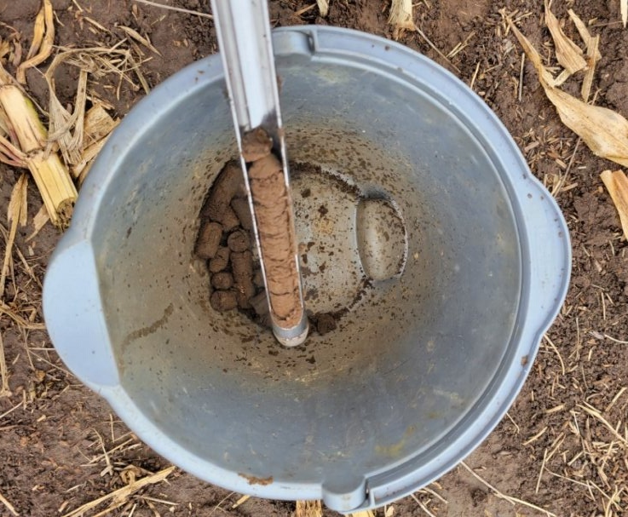
Goals and Economics of Soil Testing
Predicts the probability of a crop response to a nutrient application
Improved understanding of nutrient variability within a field
Monitor changes in nutrient status over time
Allocate on farm and commercial nutrient sources
Increase farm profitability
Protect local surface and groundwater quality
Notes:
S6.1.1 The proper collection of soil samples and interpretation of soil test results assists farmers in allocating on-farm and commercial nutrient sources in an agronomically and economically efficient manner.
S6.1.2 Proper interpretation and application of soil test results can result in nutrient applications that protect local surface and groundwater quality.
S6.1.3 Regular soil testing often provides a positive economic return through improved on-farm and commercial nutrient allocation and management.
S6.1.4 The basis of soil testing is to predict the probably of crop response to applied nutrients, thereby balancing crop productivity and profitability.

Slide 6
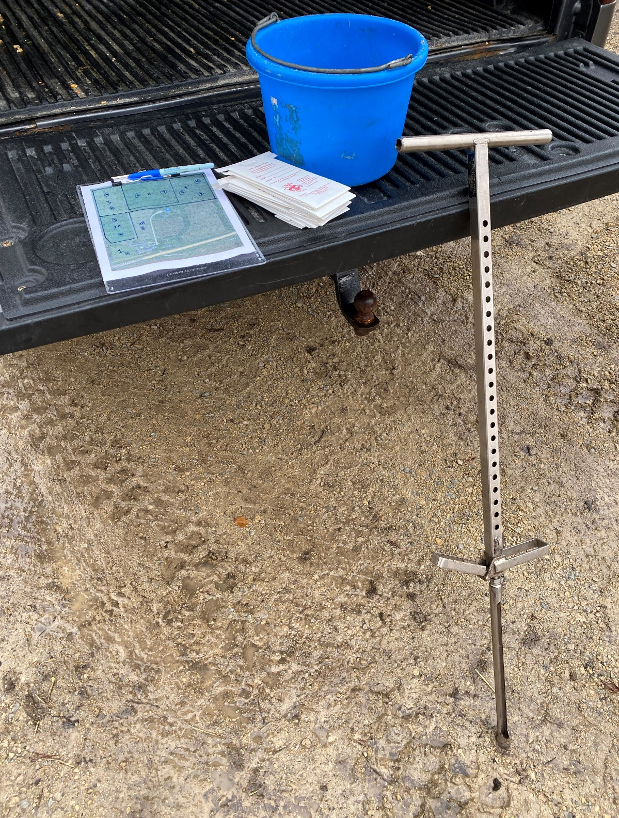
Soil Sampling Tools
Supplies Needed
Soil probe
Plastic Bucket (mixing composite sample)
Sample bags
Field/pasture maps
Permanent marker
Box/container for sample bags
Notes:
S6.3.1 Recommended soil sampling equipment includes: a field map with sampling areas clearly delineated, soil probe or auger, clean plastic bucket, and prelabeled soil sample bags. If collecting georeferenced samples, a GPS unit will be required.
S6.3.2 Soil sampling tools and supplies for sample collection should be selected upon soil texture/parent material and soil moisture level to ensure consistent and proper sample depth and volume collection, as well as to improve ease of sample extraction.
S6.3.3 Field maps and management history should be used to identify areas for sampling. General sampling points should be marked and labeled on the map post collection.

Slide 7
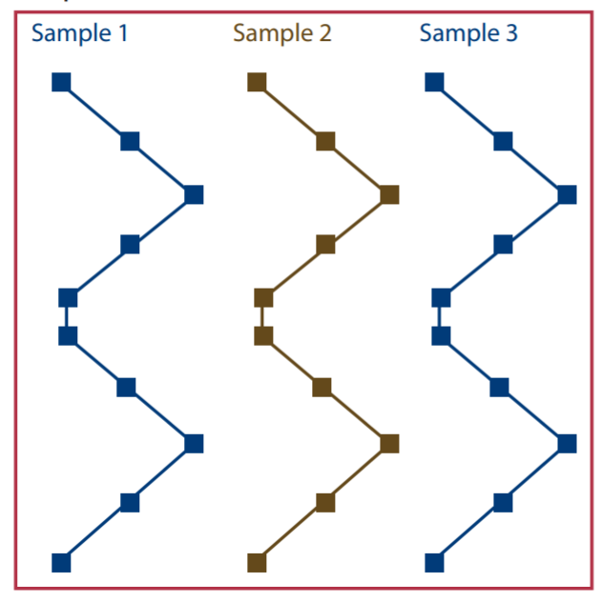
Soil Testing Procedures
Every 4 years or less
Maximum of 5 acres per sample
Remove soil surface residue at sample location
10 cores per sample
Sample timing
Avoid areas not typical of the field:
Dead furrows;
Lime, sludge or manure piles or animal droppings
Fences or roads
Fertilizer bands
Eroded or low spots
Notes:
S6.2.1 Sample collection timing can impact soil test results, so sample collection should be consistent between sampling periods.
S6.2.2 Soil sampling is required, at minimum, every 4 years for an approved NMP.
S6.2.3 Soil sampling more frequently than every four years may be warranted when producing high value crops, in high yielding corn silage and alfalfa rotations, or in fields with sand or loamy sand textures.
S6.2.4 Many agricultural fields are sampled so that a single recommendation is provided for the whole field. However, when nutrients will be varible rate applied to a field, site specific sampling is required.
S6.2.6 In-field soil sampling points should be based on the recommended collection pattern and in-field variability, avoiding any areas that are not representative of the field.
S6.3.4 Soil samples should be collected following the basic protocols for proper whole field soil sampling (minimum 10 cores for every 5 acres, all samples thoroughly mixed before placing in sample bag).

Slide 8


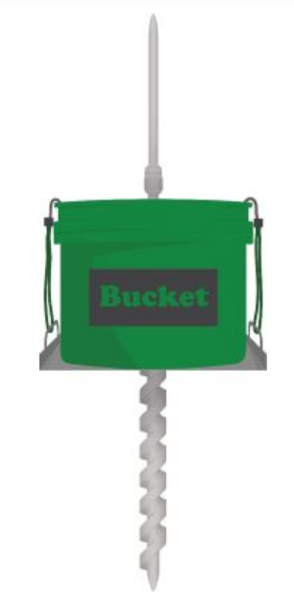
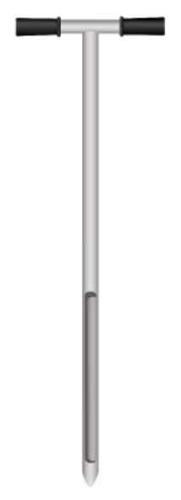
Soil Sample Depth
Moldboard: depth of tillage
Chisel or offset disk: ¾ of depth of tillage
No-till:
Fertilizer recommendations: 6 inches
If acid layer present: 2 inches for pH
Source: Soil Sample gov.bc.ca
Notes:
S6.2.5 In a moldboard plow system, soil samples should be collected to either the depth of tillage or at minimum, 6 inches. Specific sampling depth protocols are recommended for chisel plow/offset disking, ridge till, and no-till systems.
What are some basic guidelines for various tillage practices?
Below are guidelines to sampling soil in various tillage practices regardless of if using the traditional, grid-point or zone sampling methods:
Moldboard plow: sample to the depth of tillage
Chisel plow or offset disk: sample to ¾ of depth of tillage
Strip till or ridge till: sample equal number of soil cores from ridges and furrows or the area between the rows. If fertilizer was not banded in the strips or ridges, collect cores at the six inch depth on the ridges. In the furrow, take samples at four inches. Combine the cores to make a composite sample.
No-till: no-tilled fields of over five years may develop an acidic layer at the surface from nitrogen fertilizer applications. This acidic layer may cause triazine herbicides to lose effectiveness. To test the pH, sample at a two inch depth. It is important to note the sample depth on the soil submission form to be tested for pH. A phosphorus and potassium test can be requested to determine if these nutrients are also building up on the soil surface. A six inch sample is still required to determine fertilizer recommendations.

Slide 9
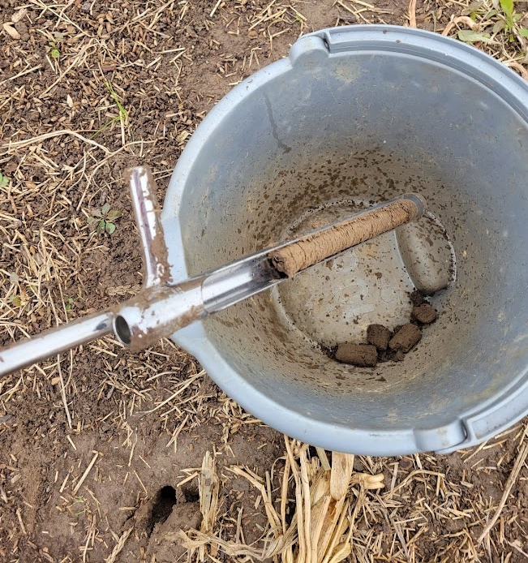
Other Soil Sampling Strategies
Grid-point sampling
Zone sampling
Contour strip sampling
Pasture sampling

Slide 10
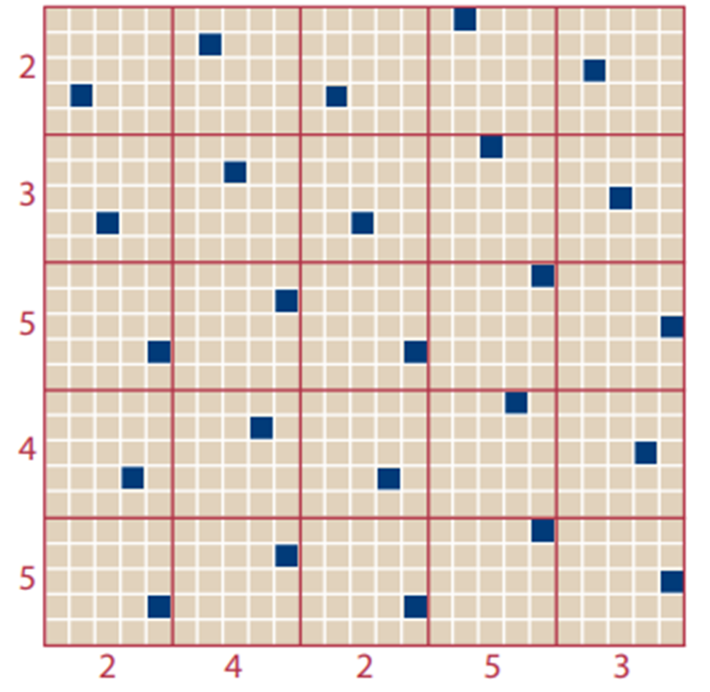
Other Soil Sampling Strategies
Grid-point sampling
Random, unaligned grid pattern prevents sampling in nutrient bands
Grids and points developed with GPS technology
Grids may be 1, 2.5, or 5 acres
Take 10 cores in a 10 ft area around the point
Zone sampling
Contour strip sampling
Pasture sampling
unaligned grid pattern for grid sampling
Notes:
What is grid point sampling?
Grid-point sampling is the process that uses a global positioning system (GPS) to develop equal size grids and sampling points for a field. To accurately capture nutrient variability throughout the field, the grids are as small as one acre or as large as two to two and half acres in size. The sample point is identified with geographical coordinates. Ten cores in a ten-foot area are taken around this point to make a sample. It is recommended to stagger the sampling points throughout the field to reduce bias in sampling similar areas in the field. Instead of using the soil test results to make a blanket fertilizer application recommendation, grid-point soil test results are used to make variable rate recommendations allowing the farmer to apply nutrients where they are needed.
Used where nutrients will be applied variably
Can be useful if purchase/rent new round and past history isn’t well known
Pro- good assessment of nutrient variability
Con – expensive
Choose grid size based on P and K responsiveness categories
- 1 ac if P or K are in responsive categories (below H)
- 2 to 2.5 ac if both P and K are in non-responsive categories (VH & EH)

Slide 11
Other Soil Sampling Strategies
Limed 5 years ago
Never limed
Grid-point sampling
Zone sampling
Utilizes information from yield maps, aerial images, or other precision agriculture maps to develop sampling areas that appear similar.
Sampling can be done through traditional soil sampling process or utilizing grid-point sampling.
Contour strip sampling
Pasture sampling
2 zones
Sand
Loam
Muck
2 zones
3 zones
Formerly 2 fields
now all 1 field
Notes:
What is zone sampling?
Zone sampling is another process that uses technology to determine sampling areas. Zone sampling uses information from yield maps, aerial photographs, or other precision agriculture maps to develop sampling areas that appear similar. Sampling can be done through the traditional soil sampling process or using a grid-point sampling. If grid-point sampling is done and the results show no or little difference between areas, take the average of the sample results to create a general fertilizer recommendation for the field.
Used where management may be different across a field
Zone borders and/or sampling points can be georeferenced
Plus/minus- provides an assessment of variability better than whole field, not as good as grid
More cost effective than grid sampling
Zone delineation – based on knowledge of the field
- soil and/or yield maps
- topography/elevation map
- past history
- nutrient maps from previous grid sampling
Follow whole field sampling intensity guidelines, considering the zone as a field

Slide 12
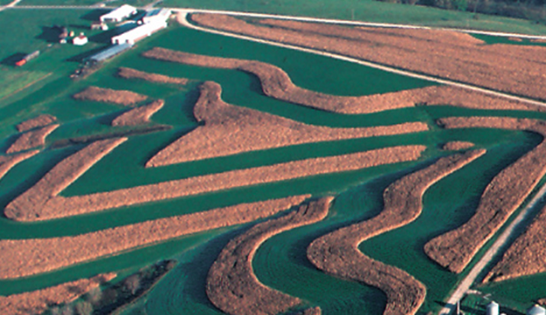
Other Soil Sampling Strategies
Grid-point sampling
Zone sampling
Contour strip sampling
More than 5 acres, use traditional sampling methods
Less than 5 acres, may combine strips if cropping and management histories are identical.
Pasture sampling
Source: SNAPPlus Help
Notes:
How do I sample contour strips?
Contour strips should be sampled separate if the strip is five acres or more using the traditional soil sampling techniques. If the strips are less than five acres, then the strips can be combined if the cropping and management histories are the same. Grid-point sampling contours may cause unusable soil test results if the grid covers more than one strip and all the cores come from one strip or if cores are taken from the edge of a strip.

Slide 13
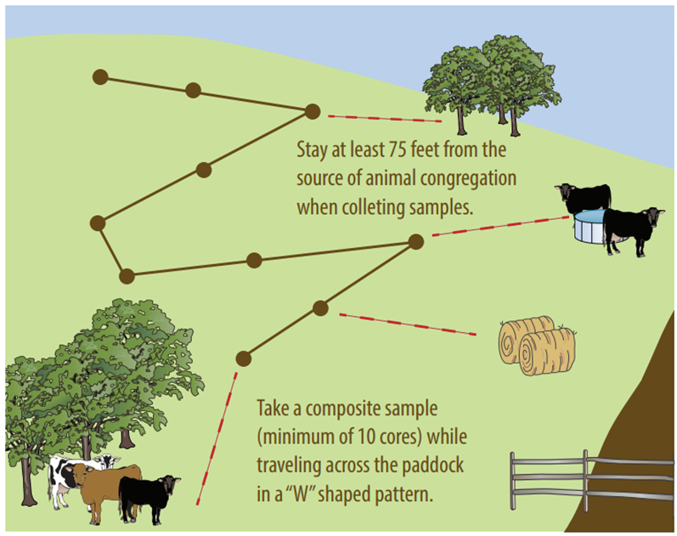
Other Soil Sampling Strategies
Grid-point sampling
Zone sampling
Contour strip sampling
Pasture sampling
Use traditional sampling techniques keeping away from areas where animals congregate
May combine congregation areas as a separate sample
Notes:
How do I sample contour strips?
Contour strips should be sampled separate if the strip is five acres or more using the traditional soil sampling techniques. If the strips are less than five acres, then the strips can be combined if the cropping and management histories are the same. Grid-point sampling contours may cause unusable soil test results if the grid covers more than one strip and all the cores come from one strip or if cores are taken from the edge of a strip.

Slide 14
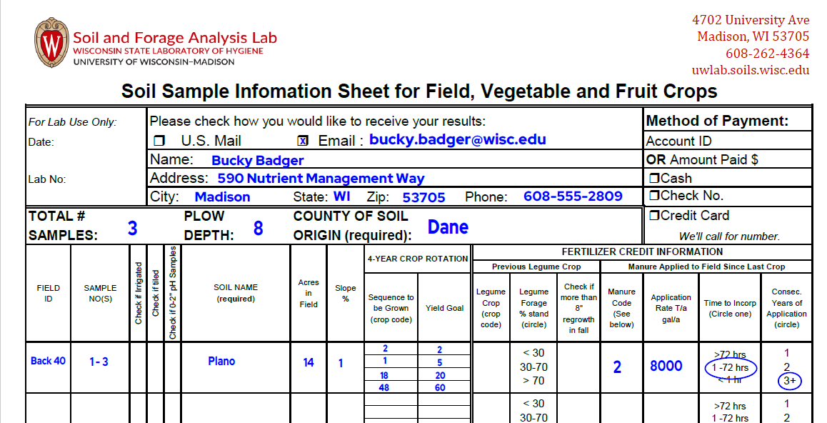
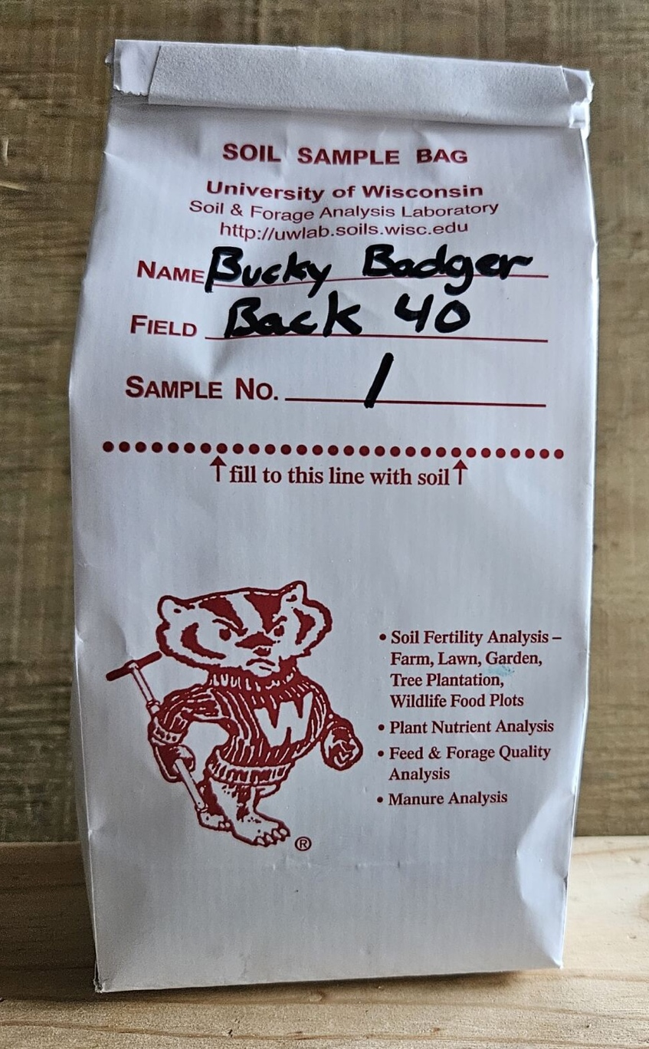
Submitting Your Samples
Notes:
S6.3.5 All sample bags should be appropriately labeled and the laboratory soil submission form should be completed accurately and with sufficient farm and field information to generate the proper recommendations and reports.
S6.3.6 You should ensure that the field name specified for the soil samples matches the field name in SnapPlus to allow for easy data import into SnapPlus.
Fill out the soil information sheet completely and send to lab with soil samples!
Provides lab with needed information on:
Field identification
Soil series
Crops to be grown and realistic yield goals
Manure and legume credits
If application rates and/or stand conditions are known

Slide 15
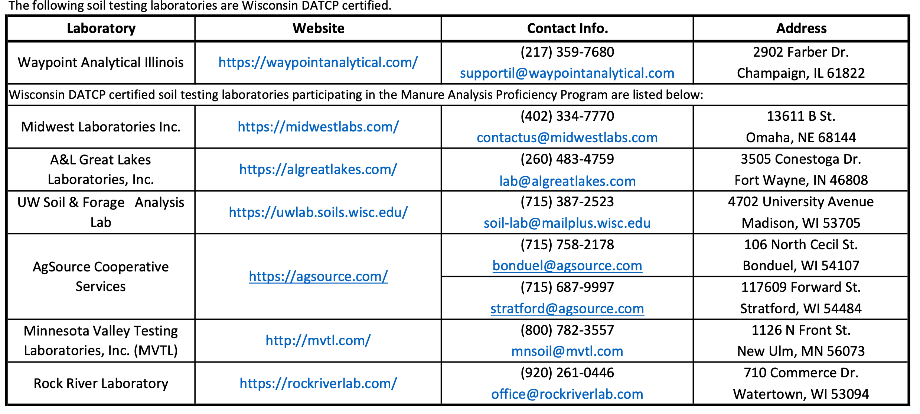
May 2024 Wisconsin Certified Soil & Manure Testing Laboratories
Verify at time of sample submission the lab is certified by WI DATCP and provides the correct results for WI Nutrient Management Planning
Notes:
S6.4.1 If soils are wet, they should be allowed to air dry before storing and/or shipping to the testing laboratory. Fresh, non-dried soils can be taken directly to the lab.
S6.4.2 Many commercial soil testing labs are available, but each offers different services and pricing.
S6.4.3 For a certified NMP, soil samples must be analyzed at a DATCP-certified lab using the appropriate protocols.
S6.4.4 When using a certified out-of-state laboratory, you should verify WI approved extraction methods are used.

Slide 16

How to Read Your Soil Report
Notes:
S7.1.1 Wisconsin’s nutrient management recommendations are based upon supplying crop nutrients at an economically optimal rate.
S7.1.2 Soil testing has limitations, but remains the best tool available for predicting lime, phosphorus, and potassium fertilizer needs. Additional soil and plant tissue nutrient tests are available.
7.1.3 The basic steps of a soil testing program are to: 1) provide an accurate estimate of the level of available nutrients in the soil; 2) evaluate the degree of nutrient deficiency or excess that exists for the crops grown; 3) Provide recommendations for supplemental nutrients to correct the deficiencies while balancing crop productivity and economic profitability.
7.1.4 Wisconsin nutrient recommendations are based upon more than 100 years of research and can be found in Nutrient Application Guidelines for Field, Vegetable, and Fruit Crops in Wisconsin (A2809).

Slide 17
Soil Test Results
% Organic Matter
Used for N recommendation (except corn and wheat)
Related to Soil Quality/Health
pH/Buffer pH
Lime requirement calculations
Available phosphorus
P₂O₅ recommendations
Available potassium
K₂O recommendation
Secondary and micronutrients- if requested
Nitrogen recommendation and nutrient credits- if entire sample submission sheet filled out.

Slide 18
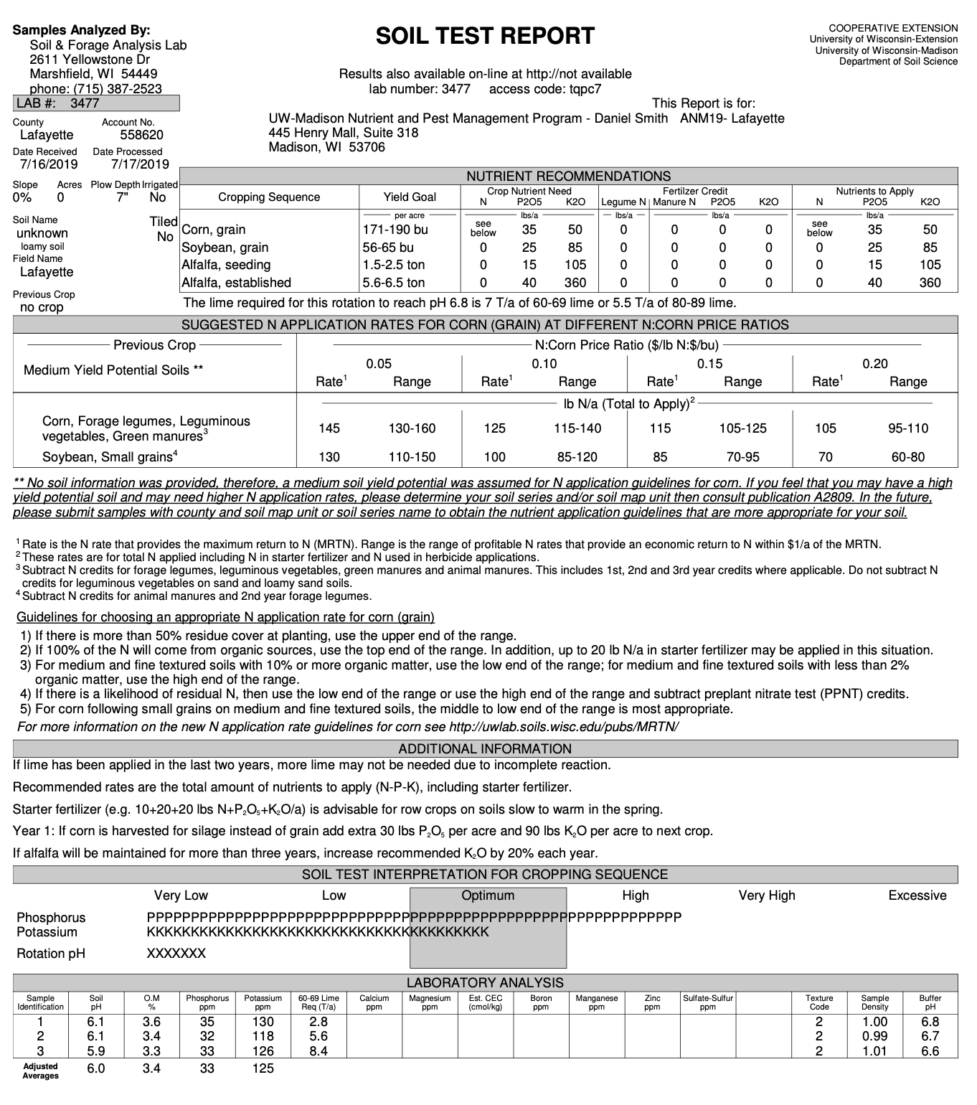
Your Soil Report Card- The Soil Test Report

Slide 19
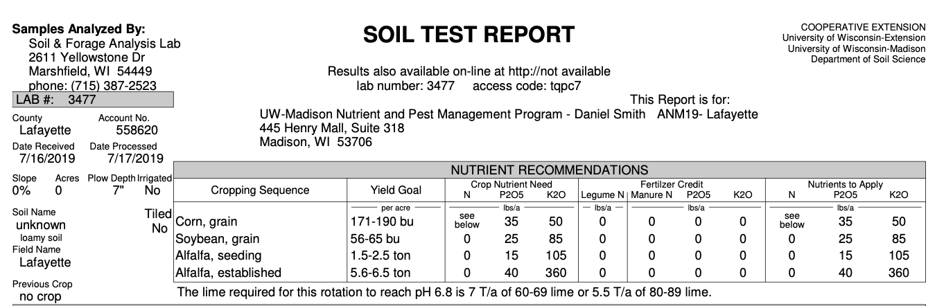
Your Soil Report Card- The Soil Test Report
The first section of the report contains recommendations and info based on the soil test submission sheet. If this was not fully filed out this top section will be incomplete.

Slide 20
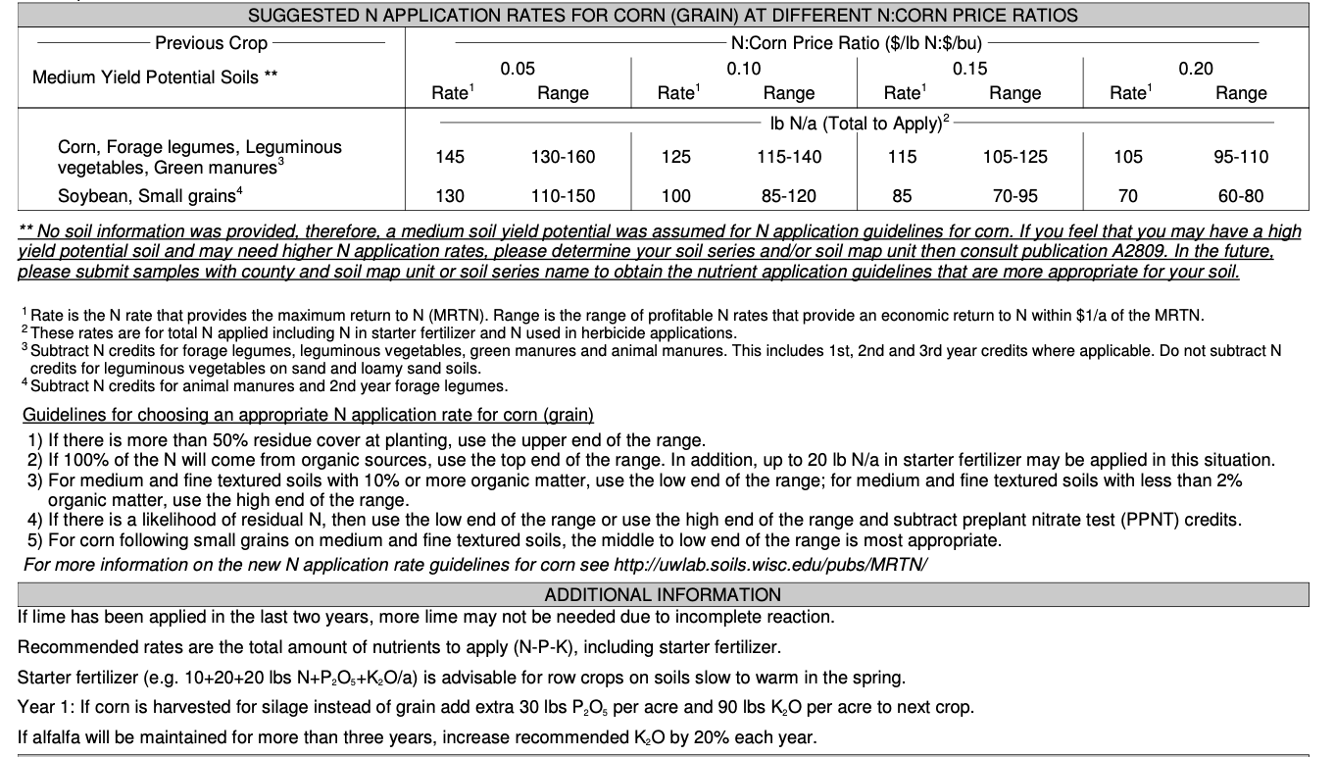
Your Soil Report Card- The Soil Test Report
The middle section provides info on nitrogen management and additional info and suggestions. This section is also based on the soil test submission sheet.

Slide 21
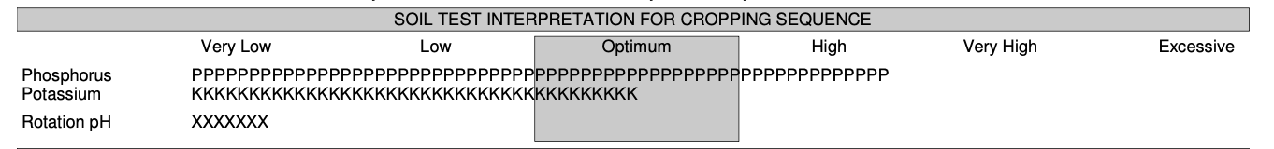
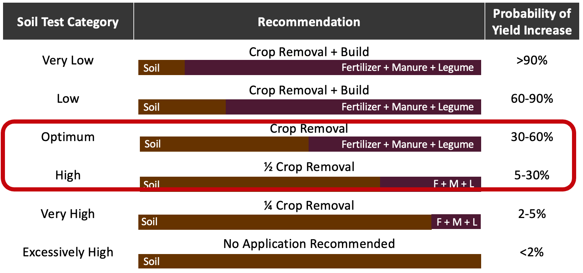
Your Soil Report Card

Slide 22
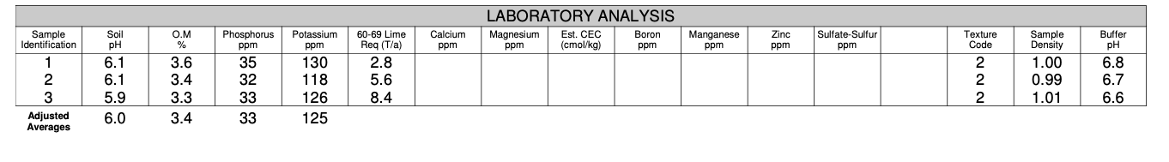
Your Soil Report Card
The lower section on the soil test provides:
Soil pH
Organic matter
Lime requirement
Plant available phosphorus
Plant available potassium.
This info is also contained in the spreadsheet often provided by the soil test lab for use by SnapPlus.

Slide 23
Take Away Message
Soil testing all starts with taking good soil samples.
The more info you provide about soil sample on the submission sheet the better the recommendations will be.
Soil type, location, yield goal, crop rotation
Maintain ideal soil pH.
Nitrogen recommendations are not based on routine soil test results.
Nutrient changes for low and excessively high testing fields.
Utilize your experts to answer questions based on lab results.
Lab
Agronomist/CCA
UW Extension NPM

Slide 24
Soil pH

Slide 25
Following Along in Fast Facts?
Soils pH: Page 12 in Nutrient Management Fast Facts

Slide 26
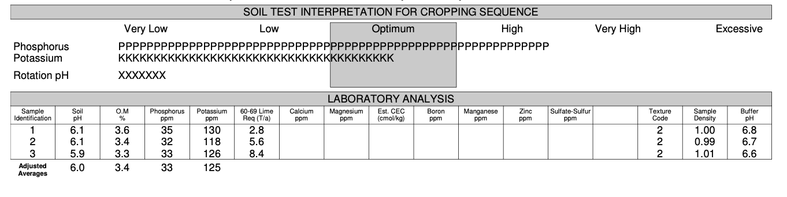
Your Soil Report Card- pH

Slide 27
What is soil pH?
0
1
2
3
Acidity
pH = -log[H⁺]
4
Concentration of acid
in soil water
1000x
5
10x
6
7
8
9
10
11
Alkalinity
12
Inverse relationship
More acid = lower pH
Logarithmic Scale (base 10)
13
14
Notes:
S5.1 Soil pH
S5.1.1 Soil pH is a measure of the acidity/alkalinity of a soil. This is an important soil metric to know, as the optimal range of soil pH for plant and microbial productivity often varies by species.
S5.1.2 Soil pH is the measurement of the concentration of hydrogen ions (acid) in the soil solution. It is reported on a scale of 0 to 14, with 0 being extremely acid and 14 being extremely alkaline (low acid). A pH of 7.0 is neutral.
S5.1.3 Soil pH is based on a logarithmic scale (base 10). This means for every unit increase or decrease in soil pH the concentration of acid in the soil changes tenfold.

Slide 28
NATURAL CAUSES
Mineral weathering
Decomposition of organic matter
Plant uptake
Leaching
HUMAN CAUSES
NH₄⁺ based fertilizer
Elemental S fertilizer
Grain & biomass removal
Change in soil pH
CHEMICAL & BIOLOGICAL EFFECTS OF CHANGE IN pH
Availability of most essential nutrients
Activity of microorganisms
Solubility of non-essential nutrients including heavy metals
Performance of some herbicides
Notes:
S5.2 Soil acidity causes
S5.2.1 Soil pH naturally decreases over time due to weathering of minerals, decomposition of organic matter, plant uptake, leaching of base cations, and natural rainfall.
S5.2.2. The addition of ammonium-based nitrogen and elemental sulfur fertilizers, increased leaching of anions (such as nitrate), as well as harvesting plant grains and biomass in agricultural systems also results in the acidification of soils.
S5.3 Soil pH impacts
S5.3.1 Soil pH has a direct impact on the availability of plant nutrients by influencing the chemical form of the nutrient present, the activity of nitrogen-fixing bacteria, and plant growth and productivity. When soils become strongly acidic (pH<5.5), aluminum, as well as other toxic metals, often become soluble significantly limiting plant growth.
S5.3.2 As a general rule of thumb, macronutrients (N, P, K, Ca, Mg, S) and Mo have increased plant availability at neutral pHs, while micronutrients (except Mo) are more plant available at lower pHs.

Slide 29
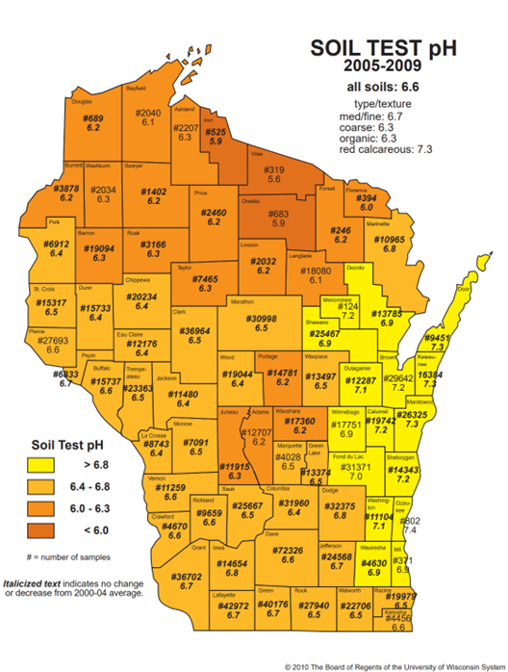
Wisconsin pH Levels
Notes:
How does soil pH vary across Wisconsin?
Wisconsin, generally soils forming on top of carbonate bedrock (soils in the east and south) will have higher soil pHs than those forming over the top of igneous rocks (soils in the central and western portions of the state). Agricultural management practices can have a dramatic impact on soil pH. Therefore, soil testing is the only way to know the pH of your soil.

Slide 30
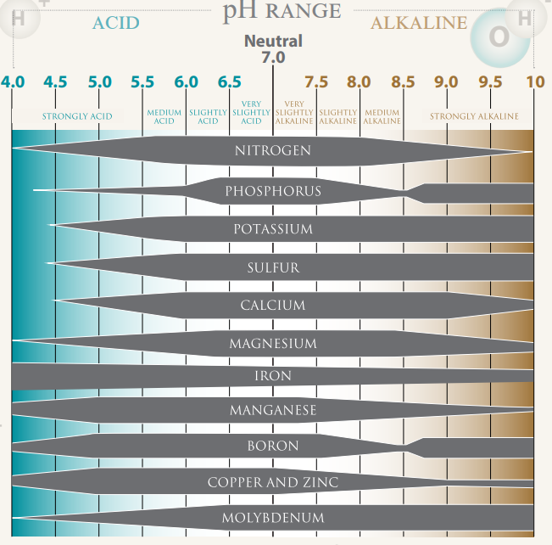
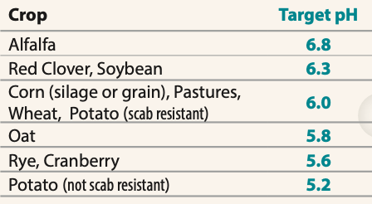
Target pH
Notes:
S5.4 Target pH values
S5.4.1 The acceptable range of pHs for most Wisconsin crops are listed in University of Wisconsin Extension publication A2809, along with the target pH when liming an acidic soil. A soil should be limed to reach the target pH of the crop with the highest pH requirement within the rotation.
S5.4.2 Crops do not require a single specific pH to optimize productivity. They will grow well within a range of acceptable pHs. In the case of legume crops, the acceptable range of pHs for the crop also take into account the optimal pH ranges for the symbiotic bacteria that live with the crop.
S5.4.3 While crops will often grow outside of the specified acceptable pH range, crop productivity may be limited. However, acid sensitive crops, such as alfalfa, may cease to grow when the soil pH drops too far below the acceptable range of pHs.

Slide 31
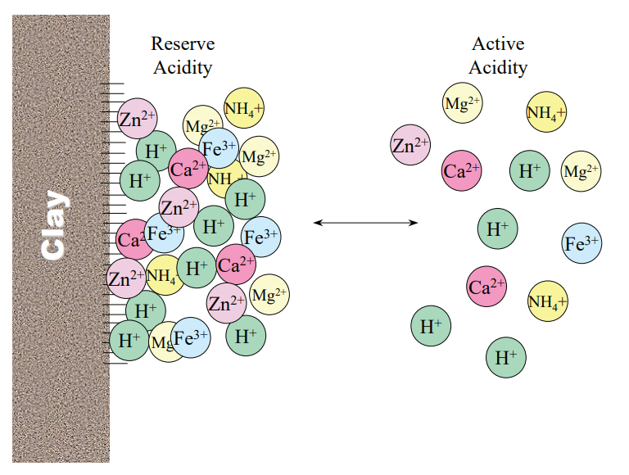
How much lime?
Do I need to lime?
Source: https://extensionpublications.unl.edu/assets/pdf/ec155.pdf
Notes:
S8.1.1 A soil’s pH is influenced by both active acidity, those H+ ions in the soil water, and exchangeable acidity, those H+ on the cation exchange sites.
S8.1.2 In order to change a soil’s pH, we must add enough lime to neutralize both active and exchangeable acidity. Neutralizing only active acidity will not result in a change in soil pH, as the H+ on the CEC will simply exchange with other cations and replace the neutralized H+ in the soil solution.
S8.1.3 When evaluating a soil’s pH and lime need, the pH reported on a soil test is a measurement of active acidity. The reported buffer pH is a measurement of both active and exchangeable acidity.
S8.1.4 The reported soil pH is used to answer the question, “Does my soil need lime?”. The buffer pH is used to answer the question, “How much lime should I apply to my soil to reach my target pH?”.
S8.2.1 A soil’s buffering capacity is defined as its ability to resist a change in pH. A soil’s buffering capacity is directly related to its CEC. Soils with higher CECs, such as those with higher clay and/or organic matter contents, are more resistant to pH change.
S8.2.2 Buffering capacity impacts the amount of lime required to induce a pH change. Given the same soil pH, a soil with a high buffering capacity will require more lime than a soil with low buffering capacity to increase the soil pH.
S8.2.3 Buffering capacity impacts the frequency lime may need to be applied to a soil. Given the same management practices, a soil with a high buffering capacity will require lime less frequently than a soil with low buffering capacity to maintain the soil within an ideal range for plant growth.

Slide 32
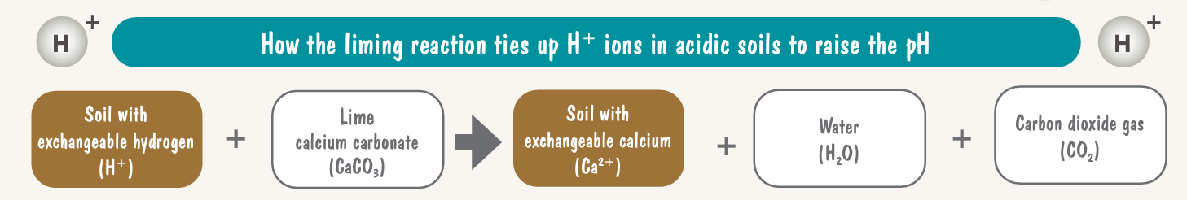
Incorporation decreases neutralizing reaction time
Reaction takes 2 to 3 years to occur
Adjustment if incorporating below 7 inches
Top-dress 1 ton/acre to no-till fields
More than 5 years in no-till management
Surface pH (0-2 inches) >.2 units below required pH
Retest 3 to 4 years
Plow depth (inches) | Multiplier
0-7.0 | 1.00
7.1-8.0 | 1.15
8.1-9.0 | 1.31
>9.0 | 1.46
Notes:
S8.3.1 In order to be a liming material, a compound must contain a basic cation (typically Ca, Mg, or K) and neutralize acidity. Common limes in Wisconsin include dolomite (calcium-magnesium carbonate) limestones.
S8.3.2 In order to change the soil pH, lime must dissolve into the soil solution. Finer ground lime will dissolve more quickly than coarser lime, given the same composition, and therefore, change the soil pH more quickly.

Slide 33
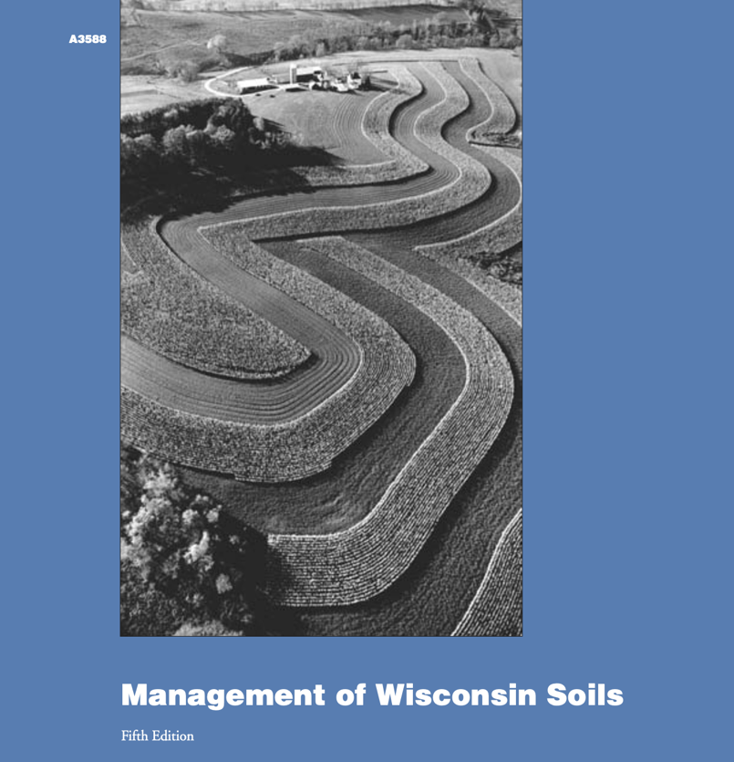
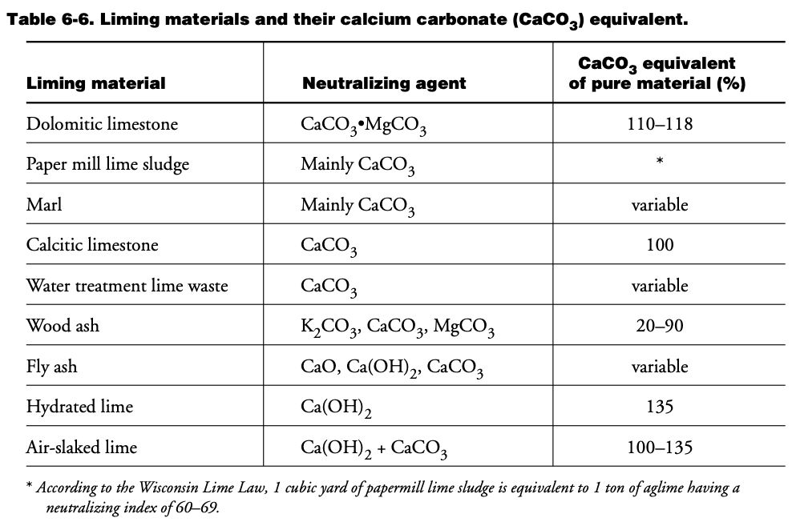
Lime Neutralizing Index
Determined by:
Purity (% CaCO₃ equivalent)
Fineness (particle size)
Expressed as Neutralizing Index (NI)
NI = (purity factor) x (fineness factor)
 | Coarse | Particle size |  | Fine
 | <8 | 8-20 | 20-60 | >60
 | ------% of lime reacted------
Percent effectiveness | 0 | 20 | 60 | 100
Notes:
S8.3.3 In Wisconsin, liming material effectiveness is evaluated using a neutralizing index. The neutralizing index takes into account the composition, purity and fineness of liming materials. Only materials that react within three years after application are factored into the neutralizing index.
S8.3.4 Lime is typically sold by neutralizing index zones of 10. Lime requirements listed on a soil test report are typically given for 60-69 limes and 80-89 limes. The amount of lime with neutralizing indexes other than those given on the soil test report can be calculated.

Slide 34
Soil Test Lime Recommendations
Limit of 12 tons per acre or if prior to potatoes 8 tons
Sandy soils with <1% OM minimum application is 1 ton lime per acre
For soils with >1% OM minimum application is 2 tons lime per acre
Incorporate at least 6 to 12 months prior to planting pH sensitive crops such as alfalfa
Lime requirement (ton/acre) of lime being used =
(ton/acre of 60-69 lime recommended) x (65 ÷ NI of lime being used)
Notes:
When is the best time to lime soil?
Lime should be applied and incorporated at least 6 to 12 months prior to planting an acid sensitive crop such as alfalfa.
What are typical application rates for lime?
Application rates for lime should never exceed 12 ton/acre (8 ton/acre for potato). The minimum application rate is 1 ton/acre on sandy soils with <1% OM; all other soils 2 ton/acre.
How often should I lime my soil?
Lime recommendations are made using the target pH for the most acid-sensitive crop in a 4-year rotation. No additional lime should be applied until the most recent application has had 2-3 years to equilibrate with the soil.

Slide 35
Adjusting High pH
 | Soil organic matter content (%)
Desired reduction in soil pH | 0.5-2 | 2-4 | 4-6 | 6-8 | 8-10 | >10
 | --------------------- pounds S/1,000 square feet --------------------
0.25 | 6 | 18 | 28* | 40* | 53* | 62*
0.50 | 12 | 35* | 56* | 80* | 106* | 125*
1.00 | 24* | 70* | 112* | 120* | 212* | 250*
* Do not apply more than 20 pounds/1,000 sq feet per year. Retest between applications.
Notes:
8.4.1 Alkaline soils are soils with a pH greater than 7. In Wisconsin, many soils naturally contain various amounts of carbonate limestone or marl, resulting in natural soil pHs above 7.
S8.4.2 Acidification of alkaline soils on a large scale is typically not economical. On a small scale or for high value crops, elemental sulfur is often used to lower the soil pH over time.
S8.4.3 Due to presence of naturally occurring liming materials in alkaline soils, the soils are buffered against pH change. Therefore, changing pH is difficult and requires repeated applications of acidifying materials.

Slide 36

Thanks!
Questions?
Name
Title
Nutrient and Pest Management (NPM) Program
UW-Madison Division of Extension
Email: Phone:

Slide 37

Additional Slides to Use as Needed

Slide 38

Soil Fertility Basics

Slide 39
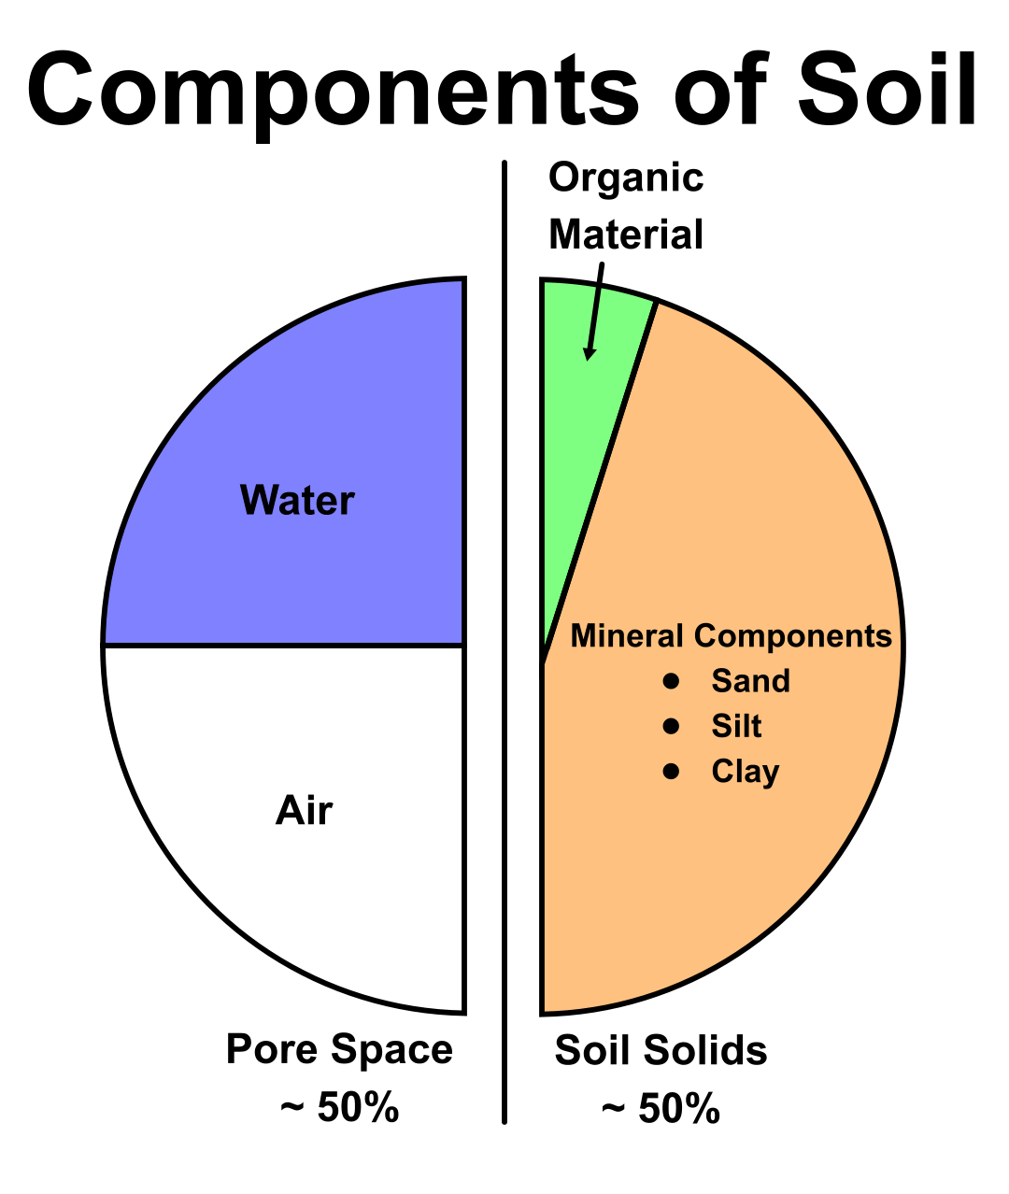
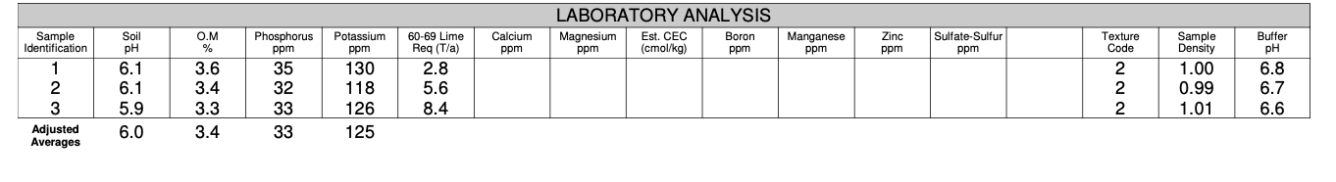
What is Soil?
A dynamic natural body composed of mineral (sand, silt, clay), organic matter, air, and water that acts on and is acted upon by living organisms in a thin layer covering the earth’s surface.
An "Ideal Soil's" components and percentages (see image)
https://blogs.cornell.edu/soilnow/the-science-of-soil/
Notes:
S1.1.1 Soil is a dynamic natural body composed of minerals, organic matter, air, and water that acts on and is acted upon by living organisms in a thin layer covering the earth’s surface.

Slide 40
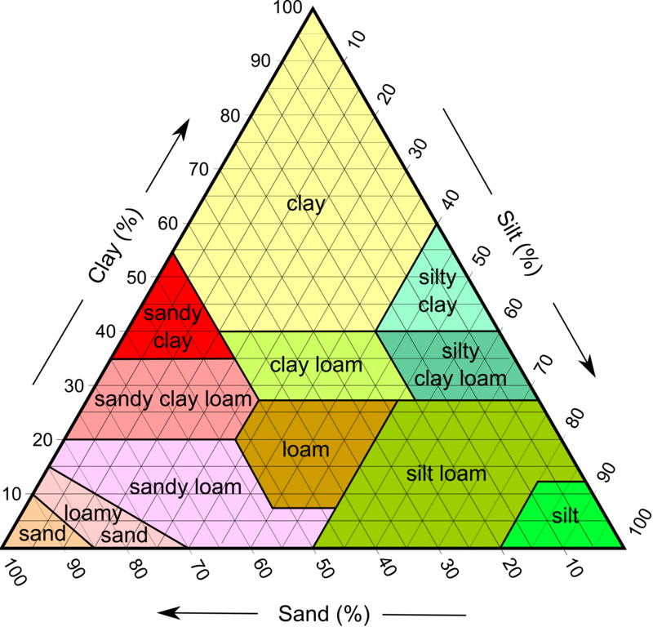
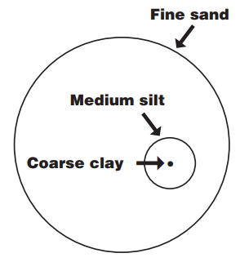
Soil Texture
Includes only the mineral fraction of soil.
Defined by particle size (sand, silt, and clay)
Each size fraction has a different impact on soil properties, function, crop growth, and nutrient management.
The USDA identifies 12 soil textures based upon the percentage of sand, silt, and clay in a soil.
The textural classes are represented on a soil textural triangle. (See image)
Soil nutrient recommendations are often differentiated by soil texture.
Sandy (1) Low yield potential
Loamy (2) High yield potential
Organic (3)
Notes:
S1.3 Soil composition
S1.3.1 Soil texture only includes the mineral fraction of soil. Soil textures is defined by particle size (sand, silt, and clay) and each size fraction has a different impact on soil properties, function, and nutrient management.
S1.3.2 The USDA identifies 12 soil textures based upon the percentage of sand, silt, and clay in a soil. The textural classifications are represented on a soil textural triangle. Soil nutrient recommendations are often differentiated by soil texture.
S1.3.3 Soil organic matter contributes to soil fertility, nutrient cycling, microbial communities, and soil water dynamics. Soil organic matter gains and losses are impacted by tillage, organic additions, and crop rotations.
For more info see Chapter 1, Chapter 2 A3358 Management of WI Soils Management of Wisconsin Soils

Slide 41
Soil Texture and Crops
Soil texture has substantial effect on crop growth
Coarse sandy soils have large pores that hold little water (droughty) and nutrients, and they are prone to wind erosion when bare.
Fine textured clays are hard to prepare for a seedbed, water moves thru slowly, (excessive wet).
Loam soils are an even mix of sand, silt, clay and are best suited for crop production.
The clay in most soils' accounts for the bulk of surface area that holds plant nutrients.

Slide 42
Essential Plant Nutrients
Nutrient required by the plant to carry out its full life cycle
To be essential a nutrient must:
Directly contribute to plant nutrition (i.e. be involved in plant metabolism/enzyme activity)
Purpose can not be substituted by another nutrient
There are 17 plant essential nutrients
Water/Air Derived: Carbon, hydrogen, oxygen, nitrogen (aka Structural)
Soil Derived: Phosphorus, potassium, calcium, magnesium, sulfur, iron, boron, manganese, copper, zinc, molybdenum, cobalt, nickel, and chloride
Notes:
S2.1.1 Plant essential nutrients are nutrients required by the plant to carry out its life cycle (go from seed to producing seed). To be essential, a nutrient must directly contribute to plant nutrition, such as be involved in plant metabolism or enzyme activity, and it cannot be substituted by another nutrient.
S2.1.2 The 17 plant essential nutrients include carbon, hydrogen, oxygen, nitrogen, phosphorus, potassium, calcium, magnesium, sulfur, iron, boron, manganese, copper, zinc, molybdenum, nickel, and chloride. Carbon, hydrogen, and oxygen are derived from air and water. The remaining nutrients are derived from the soil.

Slide 43
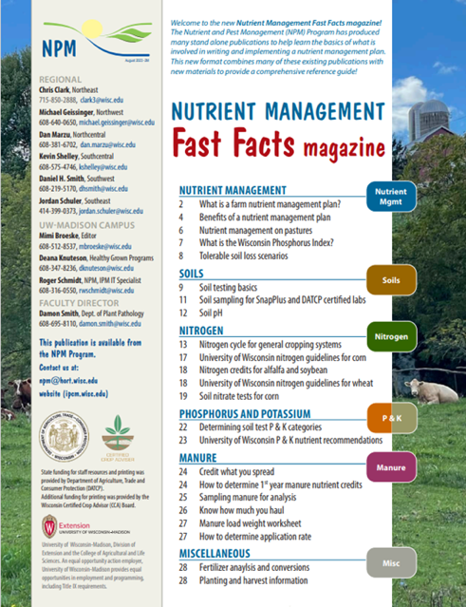
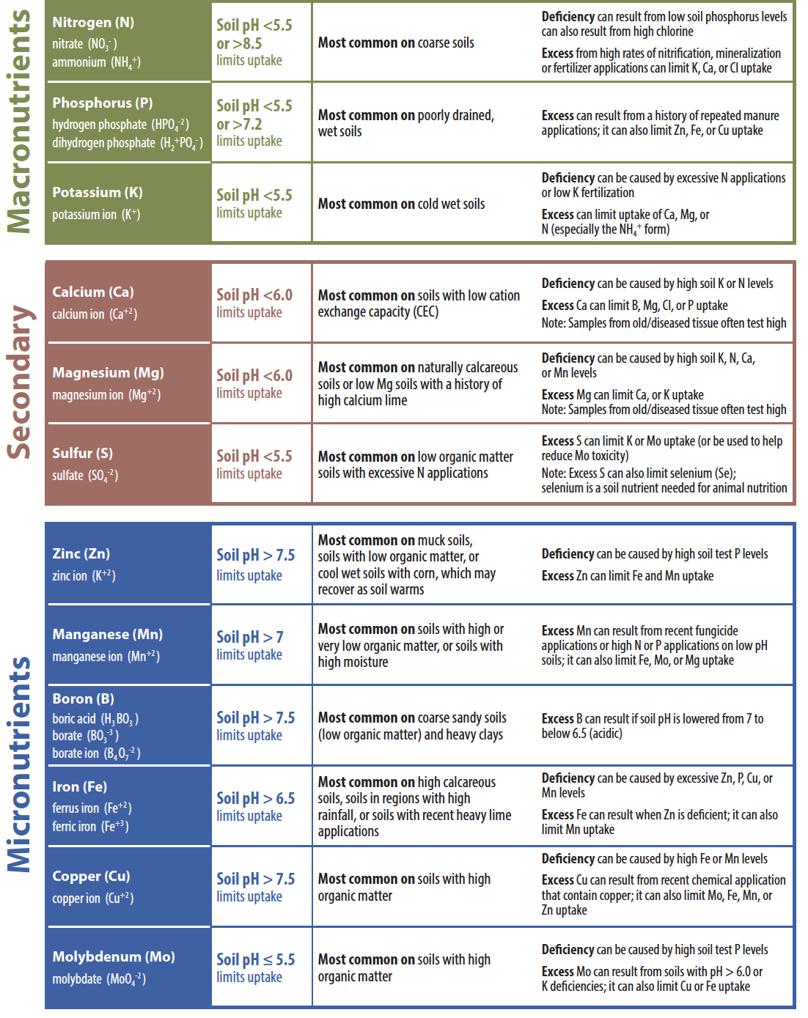
What do essential nutrients do?
Nutrients play specific roles in plant growth and metabolism. The major roles of select nutrients are outlined in the following table.
Additionally, carbon, hydrogen, and oxygen are needed for plant growth and development.
See page 13 in FastFacts for more info.

Slide 44
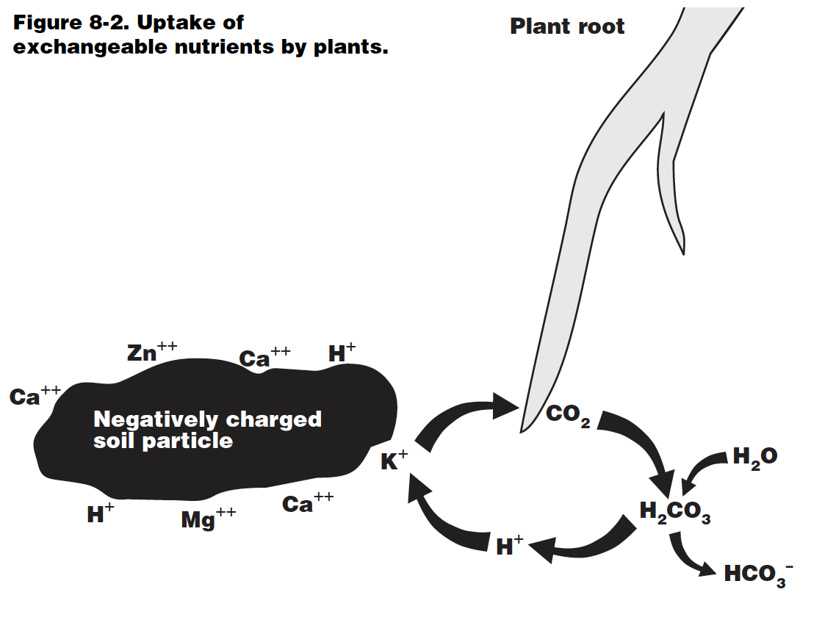
Cation Exchange Capacity (CEC)
Soils naturally contain a dominate negative charge. This negative charge is called cation exchange capacity, or CEC for short. Both clay and soil organic matter contribute negative charges to a soil’s CEC.
A soil’s cation exchange sites (negative charges) attracts positively charged nutrients and non-nutrients dissolved in the soil water.
This attraction helps reduce the leaching and/or gaseous losses of these nutrients. Additionally, cation exchange sites act as “storage” for plant essential nutrients.
Soils with higher CECs are better able to retain naturally-derived and supplementally applied nutrients.
In Wisconsin, fertilizer recommendations often consider differences in soils’ CEC and nutrient storage capacity, by recommending split, reduced amounts, and/or the use of nitrification inhibitors on coarse textured soils which have naturally low CECs.
Notes:
S3.3.1 Soils naturally contain a dominate negative charge. This negative charge is called cation exchange capacity, or CEC for short. Both clay and soil organic matter contribute negative charges to a soil’s CEC.
S3.3.2 A soil’s cation exchange sites (negative charges) attracts positively charged nutrients and non-nutrients dissolved in the soil water. This attraction helps reduce the leaching and/or gaseous losses of these nutrients. Additionally, cation exchange sites act as “storage” for plant essential nutrients.
S3.3.3 Soils with higher CECs are better able to retain naturally-derived and supplementally applied nutrients. In Wisconsin, fertilizer recommendations often take into account differences in soils’ CEC and nutrient storage capacity, by recommending split, reduced amounts, and/or the use of nitrification inhibitors on coarse textured soils which have naturally low CECs.

