Slide 2

Potassium Basics
Notes:
K1.1.1 Potassium (K) is another essential plant nutrient. K is utilized in plants for respiration, photosynthesis, water and nutrient transport, metabolism, protein & starch production, etc.
K1.1.2 K deficiency in crops is common in Wisconsin due to the large demand for it by many of the agricultural crops grown here – particularly dairy forage crops such as corn silage, alfalfa, etc. In addition, in tight financial years, supplemental K fertilizer applications are often cut or reduced out of economic necessity.
K1.1.3 K deficiency in crops: In corn and soybean, K deficiency appears a yellowing or browning of the margins of the older (bottom) leaves of the plant. In alfalfa, white/gray spots appear along the outer margins of the older leaves of a plant. Because K is a mobile element in the plant, deficiency symptoms appear on the oldest leaves first.
K1.1.4 Potassium, like most soil nutrients, moves through a series of chemical and biological cycles from soil to plant to animal.
K1.1.5 K is released slowly over time from the weathering of soil minerals and clay particles. This process is far too slow to meet the K needs of agricultural crops.
K1.1.6 K is also added to the soil through the breakdown of soil organic matter.
K1.1.7 Supplemental K is added to soils from commercial fertilizers, manure, and biosolid applications.
K1.1.8 Plants utilize K through root adsorption of K in the soluble (dissolved) form from the soil solution.
K1.1.9 K is removed from the soil by crop uptake and subsequent harvest.
K1.1.10 K can be lost due to leaching on sandy and organic soils. Sands do not contain enough clay (CEC) to hold potassium and K is weakly bound to organic matter. Because of this, sandy and organic soils often test low for K.
K1.1.11 K can also be removed from the soil by erosion and runoff; however, this is not a threat to water quality like P losses are.
K1.1.12 There exist three pools of K in soil: unavailable K, slowly-available K, and available K.
K1.1.13 Unavailable K: This form of K is contained within the structure of soil minerals and clay. Some of this form of K is released over time as minerals weather but does not occur rapidly enough to supply crop K need. The majority of K in soils is unavailable.
K1.1.14 Slowly available K: This is K that is trapped or “fixed” within clay particle layers. This K is slowly released in plant-available forms over time but usually in amounts much less than crop demand – particularly on sandy and organic soils. Slowly available K acts as a reservoir (or storehouse) of K – releasing K over extended periods of time.
K1.1.15 Available K is dissolved in the soil water and also held on the surface of clay particles – where it can easily move to the soil solution. Plants uptak

Slide 3
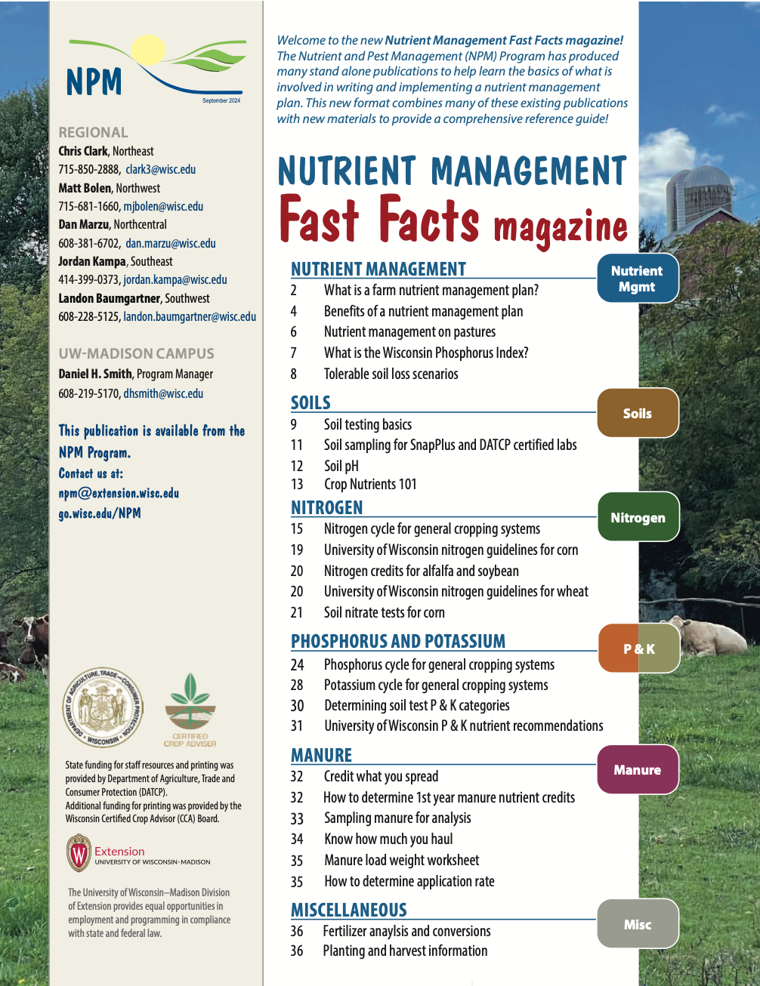

Following Along in Fast Facts?
Potassium: Pages 28-30 in Nutrient Management Fast Facts
Notes:
K1.1.1 Potassium (K) is another essential plant nutrient. K is utilized in plants for respiration, photosynthesis, water and nutrient transport, metabolism, protein & starch production, etc.
Plants need large quantities of potassium - involved in opening and closing of stomata
Stomata – regulates the exchange of water vapor, oxygen, and carbon dioxide. If K is deficient or not adequate amounts, it stunts plant growth and reduces yield.
Potassium uptake is linked to increased resistance to disease and lodging, increased carbohydrate production, and improved winter hardiness (of alfalfa)
K also plays a role in
Maintains turgor, reduces water loss and wilting
Aids in photosynthesis and food formation
Reduces respiration, preventing energy losses
Enhances translocation of sugars and starch
Produces grain rich in starch
Increases plants protein content
Builds cellulose and reduces lodging
Helps prevent crop diseases
increasing root growth and helping improve drought resistance
Winter hardiness

Slide 4
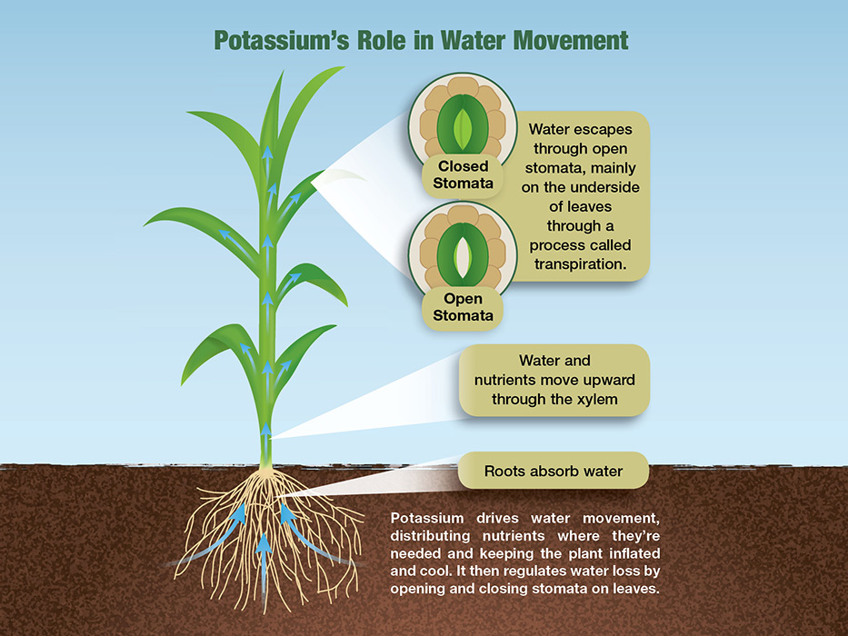
Function in Plants
Macronutrient
Movement of water, starches, and sugars
Stomata (leaf pores) opening and closing
Nutrients and carbohydrates
Regulates photosynthesis & respiration
Stand persistence
Stalk strength
Insect & disease defenses
Winter hardiness
Plants utilize K+ through root adsorption of K in the soluble (dissolved) form from the soil solution
Notes:
K1.1.1 Potassium (K) is another essential plant nutrient. K is utilized in plants for respiration, photosynthesis, water and nutrient transport, metabolism, protein & starch production, etc.
Plants need large quantities of potassium - involved in opening and closing of stomata
Stomata – regulates the exchange of water vapor, oxygen, and carbon dioxide. If K is deficient or not adequate amounts, it stunts plant growth and reduces yield.
Potassium uptake is linked to increased resistance to disease and lodging, increased carbohydrate production, and improved winter hardiness (of alfalfa)
K also plays a role in
Maintains turgor, reduces water loss and wilting
Aids in photosynthesis and food formation
Reduces respiration, preventing energy losses
Enhances translocation of sugars and starch
Produces grain rich in starch
Increases plants protein content
Builds cellulose and reduces lodging
Helps prevent crop diseases
increasing root growth and helping improve drought resistance
Winter hardiness

Slide 5
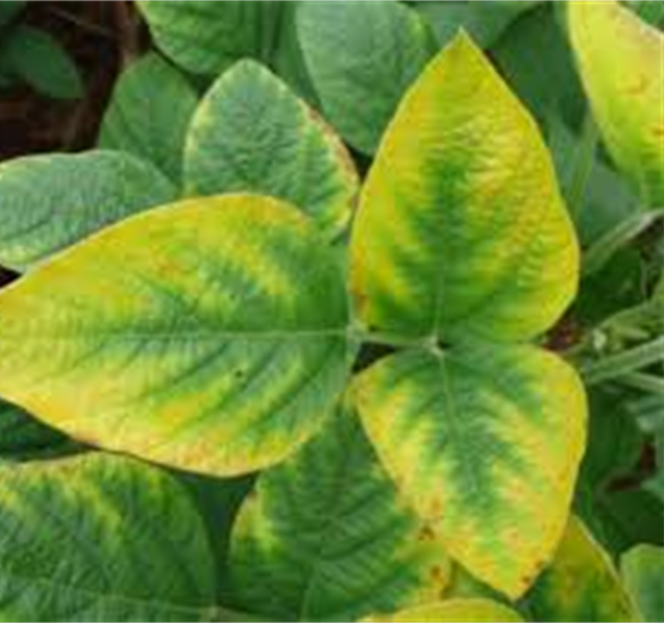
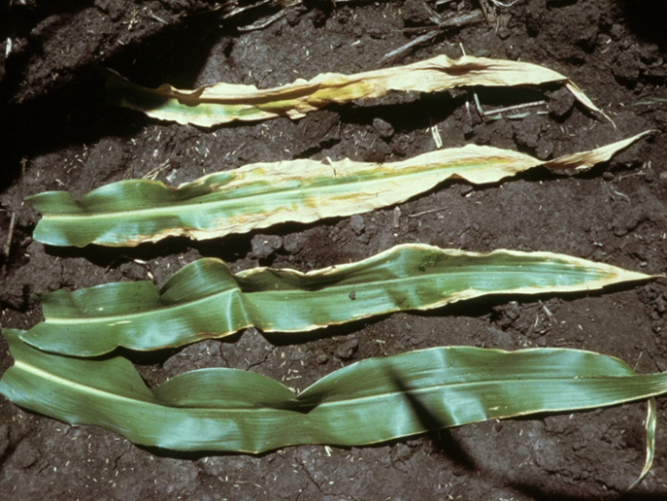
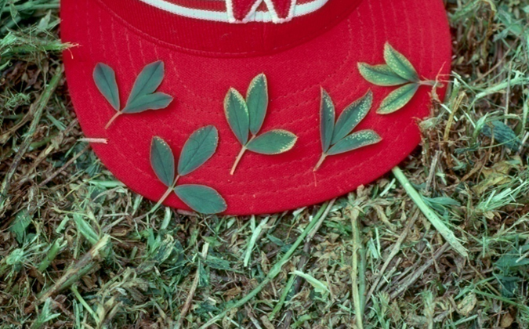
Potassium (K) Deficiency Symptoms
K deficiency in crops is common in Wisconsin. We grow many HIGH K demand crops: forages, corn silage & alfalfa.
Potassium is mobile in plants.
Deficiency symptoms on older leaves.
Notes:
K1.1.2 K deficiency in crops is common in Wisconsin due to the large demand for it by many of the agricultural crops grown here – particularly dairy forage crops such as corn silage, alfalfa, etc. In addition, in tight financial years, supplemental K fertilizer applications are often cut or reduced out of economic necessity.
K1.1.3 K deficiency in crops: In corn and soybean, K deficiency appears a yellowing or browning of the margins of the older (bottom) leaves of the plant. In alfalfa, white/gray spots appear along the outer margins of the older leaves of a plant. Because K is a mobile element in the plant, deficiency symptoms appear on the oldest leaves first.
In corn: chlorosis starting at corn leaf tip and progressing down leaf margins.

Slide 6
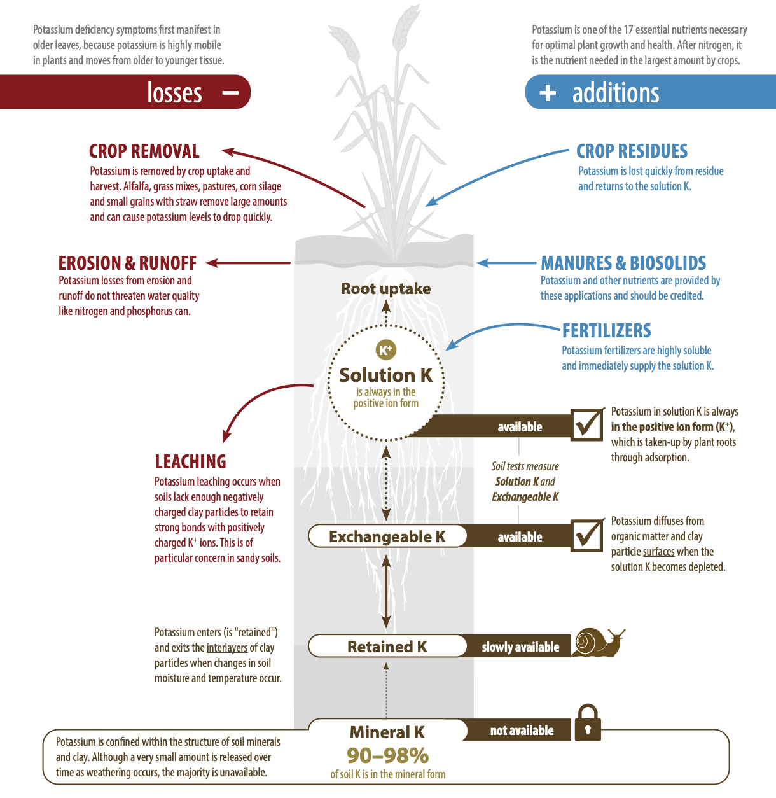

The K Cycle
Potassium: Pages 28-29

Slide 7
Potassium Management

Slide 8
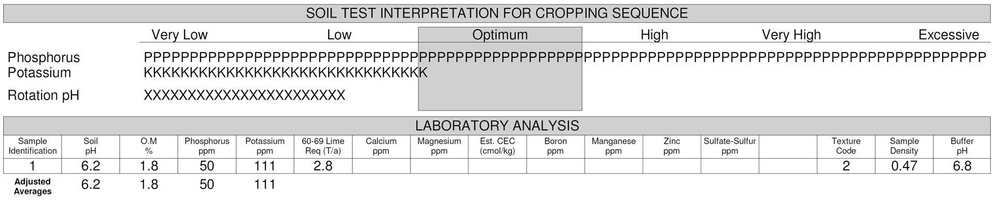
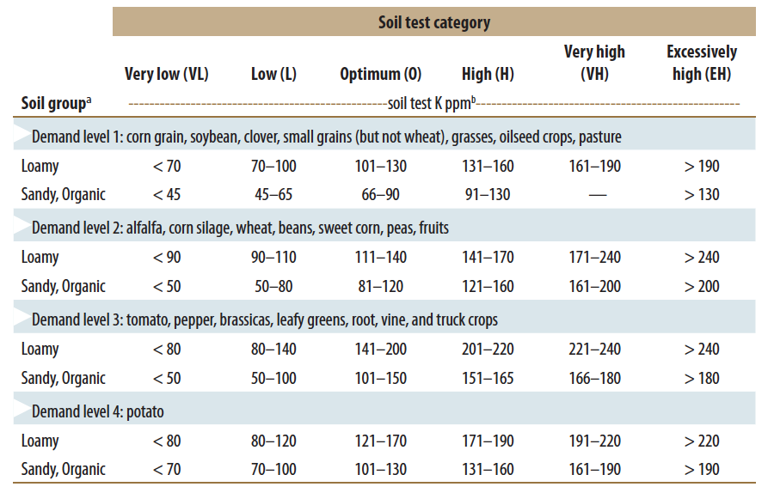
Your Soil Report Card- Potassium (K₂O)
Find the highest demanding crop in your rotation? (Light Blue)
What is the dominate soil group for the field? (Loamy, Sand/organic)
Find your soil analysis test category
Very Low, Low
Optimal High
High, Excessively High

Slide 9
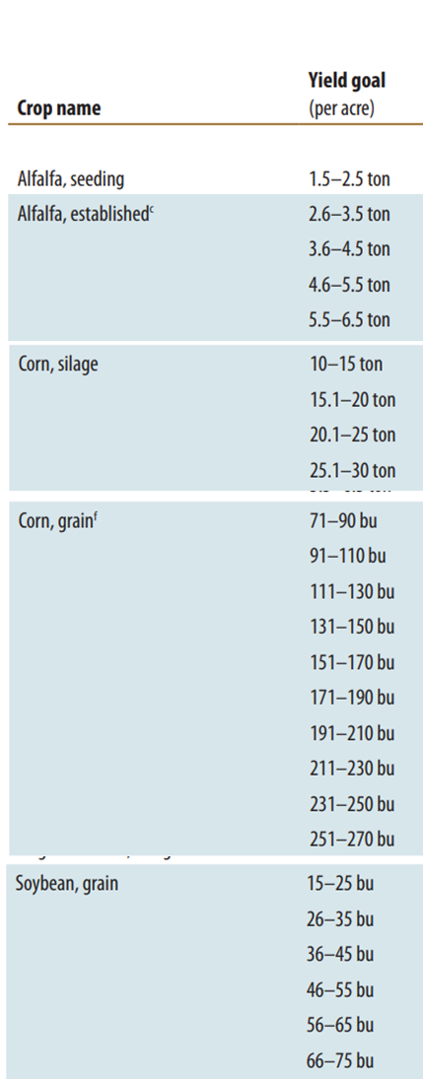
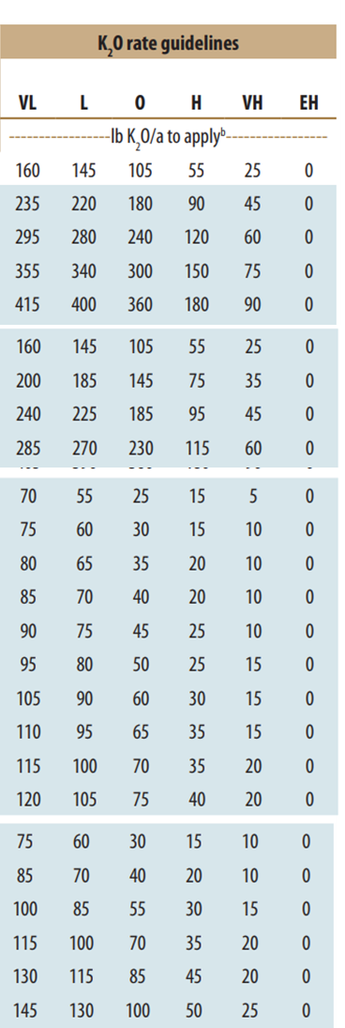
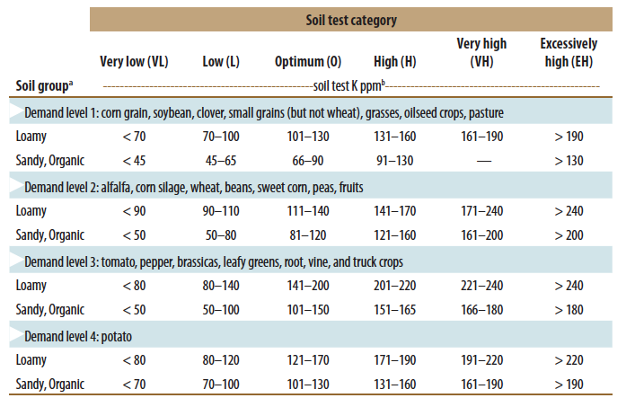
K₂O Recommendations
Notes:
Recommendations depend on Crop, Realistic yield goal, and soil texture.
To determine your soil test K category
Choose the highest demanding crop in your rotation
Choose the soil group for the predominant soil in the field
Find your soil test category by using the analysis number for potassium from your soil test results.
Speaker: Refer audience to the P and K recommendations tables in the Fast Facts publication. Be certain audience knows where to find this information. – This information can be found in the Fast Facts Magazine on pages 22 and 23.
The P and K recommended from the soil test report can often be applied via a starter fertilizer application. The minimum recommendation for starter fertilizer (10 lbs N/a, 20lbs P₂O₅/a, and 20 lbs K₂O/a) is included in the P and K recommendations.

Slide 10
Soil Test K Changes Quickly
Soil buffering capacity
The amount of fertilizer needed to change the soil test level by 1 ppm
6 - 7 lbs K₂O/acre = 1 ppm change in soil K
Less time is required to either lower or raise soil test K levels
Larger crop demand for K than P
Notes:
K1.2.1 Monitor soil K levels with regular, routine soil testing.
K1.2.2 Soil K levels can change quickly – just the opposite of phosphorus. This is due to large K removal rates of corn silage, alfalfa and other forages.

Slide 11
Crop Nutrient Removal
N P₂O₅ K₂O
- - - - - - - - - - lb/a/yr - - - - - - - -
Corn (160 bu/a) 190* 60 45
Corn silage (23 ton/a) 190* 80 190
Soybean (40 bu/a) 160 30 55
Alfalfa (5 ton/a) 300 65 300
*Recommended N application rate at 0.05 N:Corn price ratio.

Slide 12
Soil Test K Changes Quickly: Example
Soil test K = 200 ppm (EH)
Track draw-down of K over a CCOHHH rotation
Notes:
This example tracks the change in soil test K values over the course of a 6-year crop rotation where there are NO additions of K of any kind (fertilizer, starter or manure applications) over the length of the rotation.
C = corn; O = oats; H = hay
Note that the soil test K value of 200 ppm at the start of this exercise is in the excessively high (EH) range (for corn and oats), very high (VH) range for alfalfa.

Slide 13
Soil Test K Changes Quickly: Example
Soil test K = 200 ppm (EH)
Track draw-down of K over a CCOHHH rotation
Corn @ 160 bu/a removes 45 lb K₂O/a/yr x 2
Oats @ 100 bu/a removes 20 lb K₂O/a/yr
Alfalfa @ 5 tons/a removes 300 lb K₂O/a/yr x 3
Removal of K₂O over rotation = 1,010 lbs K₂O
Notes:
This calculation shows the removal of K by each crop over the course of the 6-year rotation.

Slide 14
Soil Test K Changes Quickly: Example
Soil test K = 200 ppm (EH)
Track draw-down of K over a CCOHHH rotation
Removal of K₂O over rotation = 1,010 lbs K₂O
Change in soil test K = 1,010 K₂O/7 = 144 ppm K
Notes:
The amount of K removed by the crops over the 6-year rotation is divided by the soil buffering capacity of 7 lbs K₂O per 1 ppm change in soil test K.
The result is a reduction in soil test K of 145 ppm over the course of this 6-year rotation. Remember NO additional K from any source was added.

Slide 15
Soil Test K Changes Quickly: Example
Soil test K = 200 ppm (EH)
Track draw-down of K over a CCOHHH rotation
Removal of K₂O over rotation = 1,010 lbs K₂O
Change in soil test K = 1,010 K₂O/7 = 144 ppm K
Soil test K = 56 ppm (VL) after the 6-year rotation
(200 ppm K – 144 ppm K = 56 ppm K)
Notes:
The end result over the 6-year rotation with NO K additions is a soil test K value of 55 ppm - - Very low for any crop in this rotation!!!
The Point: Soil test K values can change very quickly! They need to be monitored with regular soil testing.

Slide 16
Soil Testing to Monitor K
Try to maintain soil test levels in the optimum range
Use soil test results to identify field that need additional nutrients and prioritize fields for manure applications
Targe fields low in K
Sands and organic soils may require annual applications
Base K applications on soil test results AND realistic crop yield
Realistic crop yield = multi-year yield avg + 10-15%
Be sure to credit non-commercial fertilizer sources
Crop removal = nutrient additions
Notes:
K1.2.3 Sands & organic soils may require annual K applications. It is difficult to build up K levels in these soils as they do not retain K.
K1.2.4 Use soil test results to ID fields that need or do NOT need additional nutrients.
K1.2.5 Use soil test results to prioritize fields for manure applications. Target fields low in K.
K1.2.6 Likewise, use soil test results to prioritize fields for commercial fertilizer applications if financial resources are limited and do not allow all fields in need of K to be fertilized. Prioritizing fields low in K will yield the greatest return from fertilizer applications.
K1.2.7 Follow UW nutrient guidelines for K applications which are based on K soil test results AND realistic crop yield goals.
K1.2.8 Realistic yield goals should be based on multi-year yield averages for a given crop on a specific field plus 10-15%.
K1.2.9 Strive to maintain soil test levels for K (and P) in the “optimum” range.
K1.2.10 At optimum, nutrients applied are approximately equal to nutrients removed by the crop.
K1.2.11 Be certain credit any K supplied by non-commercial fertilizer sources such as manure, biosolids, etc. See manure management section for more information.

Slide 17

Thanks!
Questions?
Name
Title
Nutrient and Pest Management (NPM) Program
UW-Madison Division of Extension
Email: Phone:

