Slide 2
Phosphorus

Slide 3
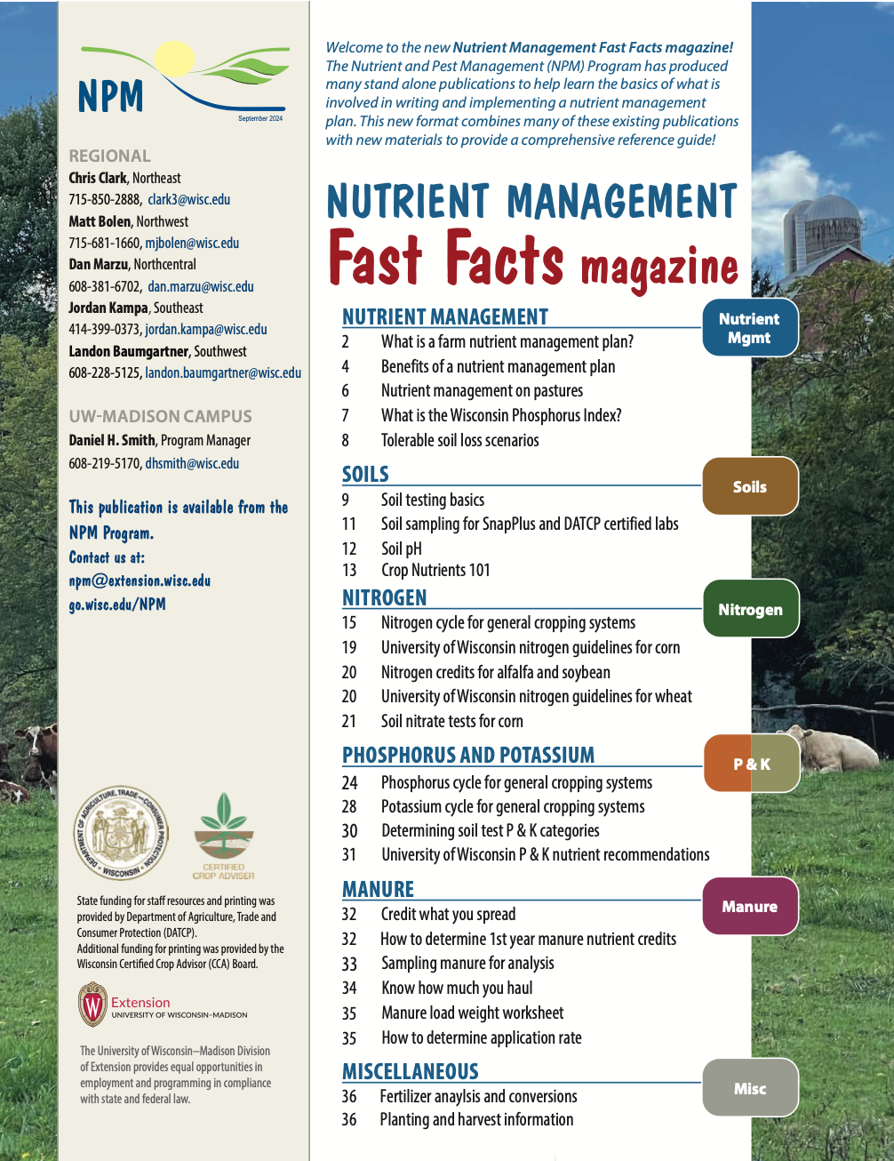

Following Along in Fast Facts?
Phosphorus: Pages 24-27 and page 30 in Nutrient Management Fast Facts
Notes:
P1.1.1 Phosphorus (P) is an essential plant nutrient. P is required for photosynthesis, respiration, seed production, etc.

Slide 4
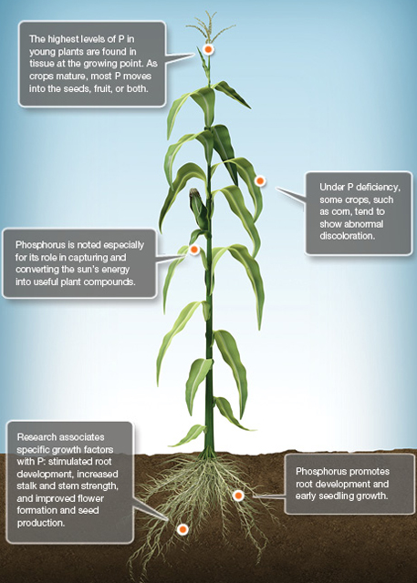
Phosphorus (P) in Plants
P is an essential plant nutrient
Functions
Photosynthesis
Respiration
Seed Production
Root Growth
and more!
Notes:
P1.1.1 Phosphorus (P) is an essential plant nutrient. P is required for photosynthesis, respiration, seed production, etc.

Slide 5
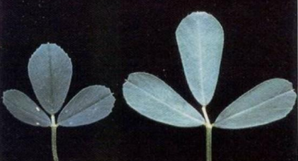
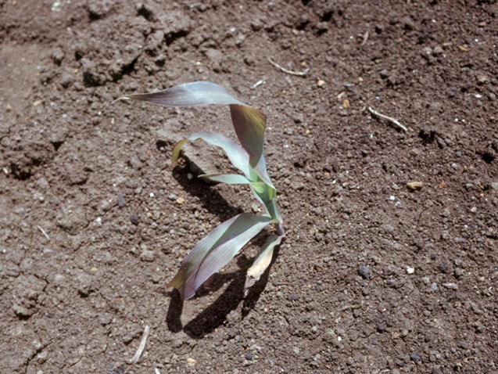
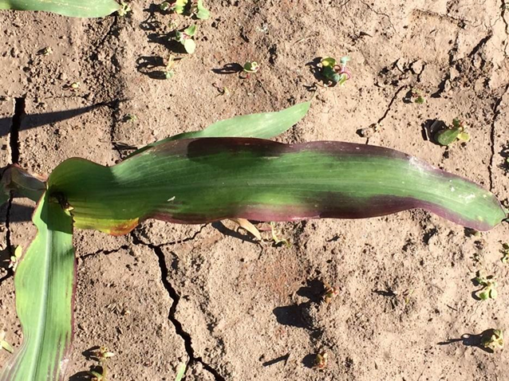
Phosphorus Deficiency
Rare in Wisconsin
Long term P additions exceeding P removal by crops
Deficiency Symptoms
P is mobile in plants, so deficiency shows up on older leaves first
Corn: seedling appears purple (caused by factors besides soil Test P)
Slow root development, hybrid characteristic, herbicide injury, etc.
Notes:
P1.1.2 P deficiency in crops is rare in Wisconsin because most of our soils contain P levels in excess of crop demand. This has been the result of long-term P additions to fields exceeding P removal from crops.
P1.1.3 P deficiency in crops: In corn, the seedling will often appear purple in color. Often times factors other than P deficiency can cause the purpling of corn. Such factors could be: slow root development due to a cold start to growing season with the roots not yet reaching out to the surrounding soil and/or starter fertilizer band); hybrid characteristics; herbicide injury.

Slide 6
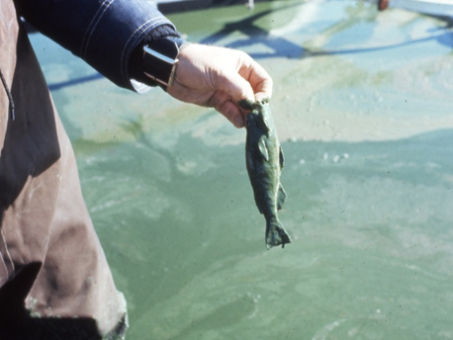
Phosphorus & Surface Water Quality
Eutrophication-aging of lakes and streams accelerated by excess nutrient additions
In freshwater for Wisconsin, P is the nutrient that increases this
P stimulates algae and aquatic vegetative growth, resulting in poor water quality
Reductions in water quality affects the recreational, aesthetic, and functional values of water
Goal: prevent P from reaching lake and streams
Notes:
P1.1.4 Eutrophication, which is the aging of lakes and streams, is accelerated by nutrient additions.
P1.1.5 In freshwater ecosystems, P is the nutrient that increases eutrophication.
P1.1.6 P additions to surface waters stimulates algae and aquatic vegetation growth.
P1.1.7 The result can be green weed-choked water, foul odors, low dissolved oxygen levels as this material decomposes, fish kills from the low dissolved oxygen, and potential formation of toxic blue-green algae.
P1.1.8 Degraded water quality can reduce the recreational, aesthetic, and functional value of water.
P1.1.9 It is very important to prevent P from reaching lakes and streams. Runoff water and eroded soil from landscapes are major contributors of P to surface waters.

Slide 7
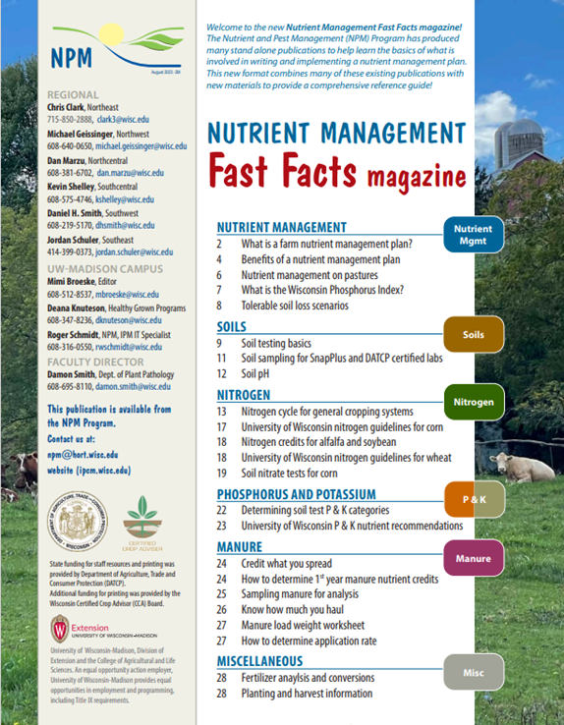
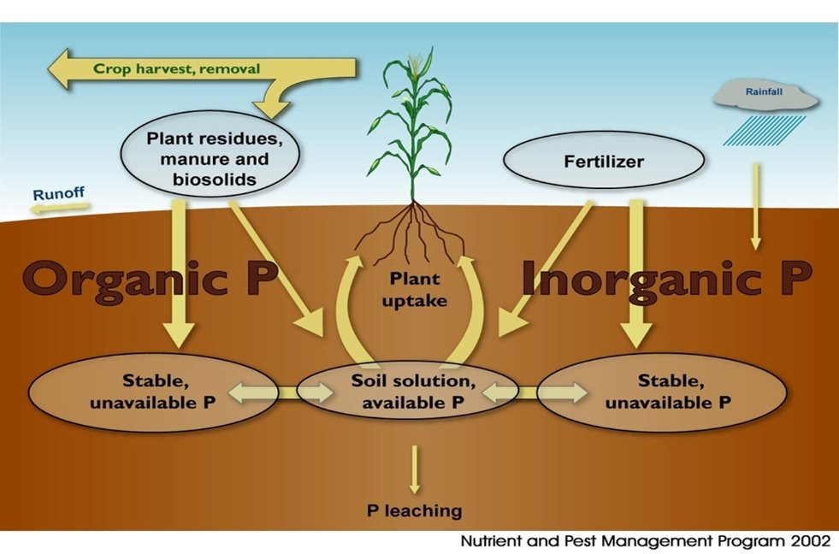
The Phosphorus Cycle
More info on the phosphorus cycle on pages 24-27.
Photo Credit: Permaculture Research Institute
P1.2.1 Phosphorus, like most soil nutrients, moves through a series of chemical and biological cycles from soil to plant to animal. P1.2.2 P naturally originates in the soil from the weathering of soil minerals and bedrock.
Notes:
P1.2.1 Phosphorus, like most soil nutrients, moves through a series of chemical and biological cycles from soil to plant to animal. P1.2.2 P naturally originates in the soil from the weathering of soil minerals and bedrock.

Slide 8
Assessing the Need for P Applications
P applications to cropland should be based on:
Soil test results
Realistic crop yield goals
Assessment/crediting of any P nutrient credits from manure or other sources
Notes:
P2.2.1 P applications to cropland should be based on recent soil test results, realistic crop yield goals, and assessment/crediting any P nutrient credits from manure and other soil amendments.

Slide 9
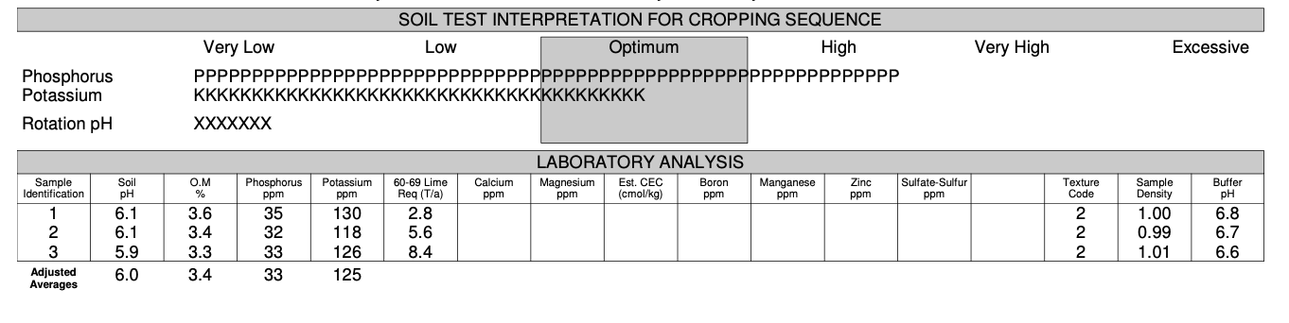
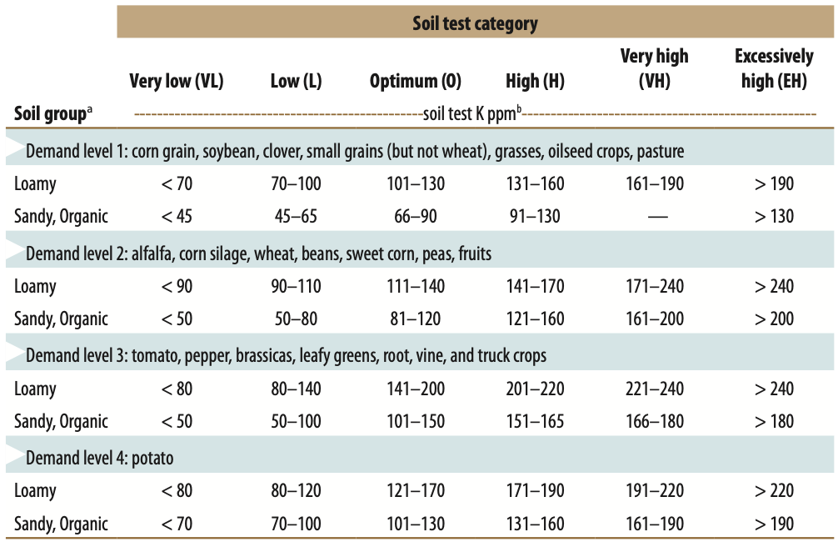
Your Soil Report Card- Phosphorus (P)
Find the highest demanding crop in your rotation? (Light Blue)
What is the dominate soil group for the field? (Loamy, Sand/organic)
Find your soil analysis test category
Very Low, Low
Optimal High
High, Excessively High

Slide 10
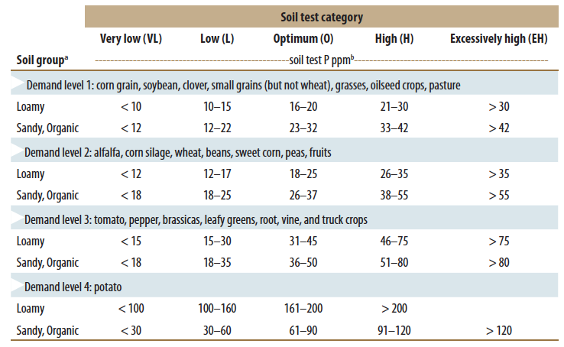
Soil Test P Categories
Notes:
P2.2.2 Regular and systematic soil testing is required for determining P application rates. See S6 Soil Testing and Sampling Procedures for guidance on how and when to collect soil samples.
P2.2.3 Optimum soil test levels are the goal for the soil fertility status of fields. At optimum, recommended P additions are approximately equal to crop removal of P. Soil test levels for P (and K) range from very low, low, optimum, high, and excessively Nutrient applications at rates higher than crop utilization are unwise from both an environmental and economic perspective.

Slide 11
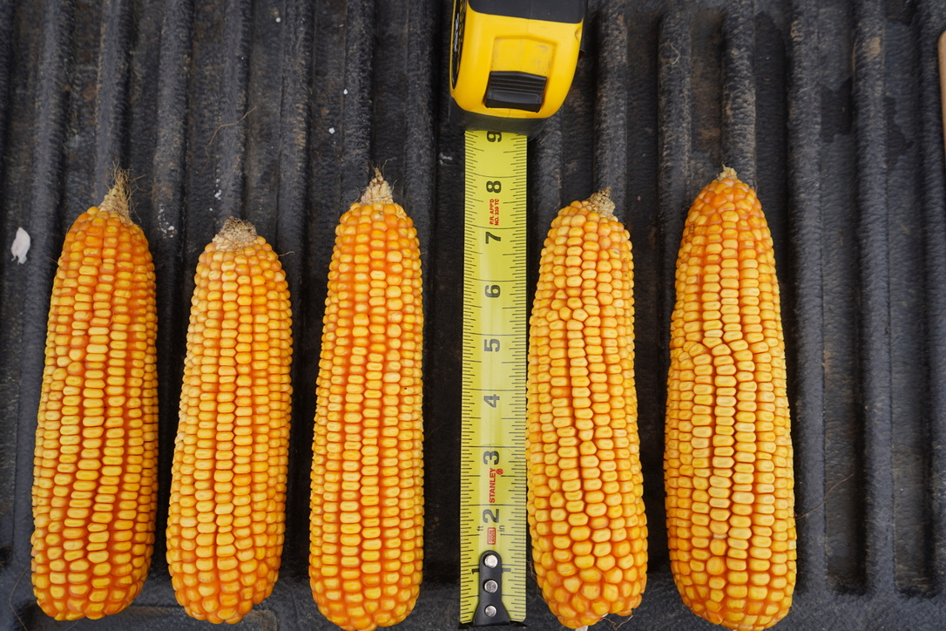
Crop Yield Goal
Realistic yield goals go hand in hand with soil testing to assess the need for P applications
Use a multi-year average (3-5 years) for yield plus 10-15%
Notes:
P2.2.4 An additional parameter impacting P fertilizer rates is crop yield goal. Use a multi-year average (3-5 years) for yield plus 10-15%. Yield goal estimates too low will underestimate nutrient need of the crop. Yield goals too high will overestimate the nutrient need of the crop resulting in over-application of fertilizer and a higher likelihood for P contributions to water bodies.

Slide 12
P2O5 Recommendations for Corn
Realistic Yield Goal Soil Test Level
bu/a V. Low Low Optimum High Ex. High
- - - - - - - - - - - - - - lb/acre - - - - - - - - - - - - - -
151-170 100 90 60 30 0
171-190 110 100 70 35 0
191-210 115 105 75 40 0
211-230 125 115 85 45 0

Slide 13
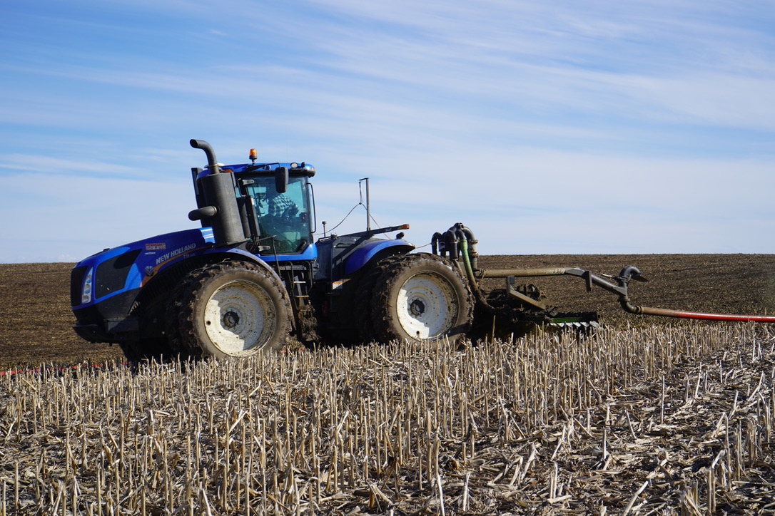
P Crediting
Important that P contributed from sources like manure, biosolids, whey, etc. are properly credited
Notes:
P2.2.5 For both economic and environmental benefits, it is important that the P (and other nutrients) contributed from cropland-applied non-commercial fertilizer sources is credited against the P recommendation from the soil test report. These sources include manure, biosolids/sludge, whey, etc. See the manure management section of this curriculum for information on how to do this.

Slide 14
Soil Test P Changes Slowly
Soil buffering capacity
The amount of fertilizer needed to change the soil test level by 1 ppm.
18 lbs P2O5/acre = 1 ppm change in soil P.
Time is required to either lower or raise soil test P levels.
Notes:
To change soil test P levels by 1 ppm, 18 lbs of P₂O₅ must be either added or removed from the soil. 12 lbs of P₂O₅ for sandy soils.
P2.2.10 Just as it takes time to build-up STP values, it takes time to also draw them down. Explain soil buffering capacity and illustrate a crop removal / soil drawdown scenario.

Slide 15
Soil Test P Changes Slowly: Example
Soil test P = 75 ppm (EH)
Track draw-down of P over a CCOHHH rotation.
Corn @160 bu/a removes 60 lb P2O5/a/yr
Oats @ 100 bu/a removes 30 lb P2O5/a/yr
Alfalfa @ 5 tons/a removes 65 lb P2O5/a/yr
Removal of P2O5 over rotation = 345 lbs P2O5
Change in soil test P = 345 lb P2O5/18 = 19 ppm P
Final Soil Test Level: 56 ppm (Still EH!)
Notes:
This example tracks the change in soil test P values over the course of a 6-year crop rotation where there are NO additions of P of any kind (fertilizer, starter or manure applications) over the length of the rotation.
C = corn; O = oats; H = hay
Note that the soil test P value of 75 ppm at the start of this exercise is in the excessively high (EH) range.
P2.2.10 Just as it takes time to build-up STP values, it takes time to also draw them down. Explain soil buffering capacity and illustrate a crop removal / soil drawdown scenario.

Slide 16
Soil Tests Monitors P Variability on Farm
Notes:
P2.2.10 Monitor STP variability among fields and use this information to plan manure applications. Prioritize those fields with lower P (and K) values for future manure applications – if possible.

Slide 17
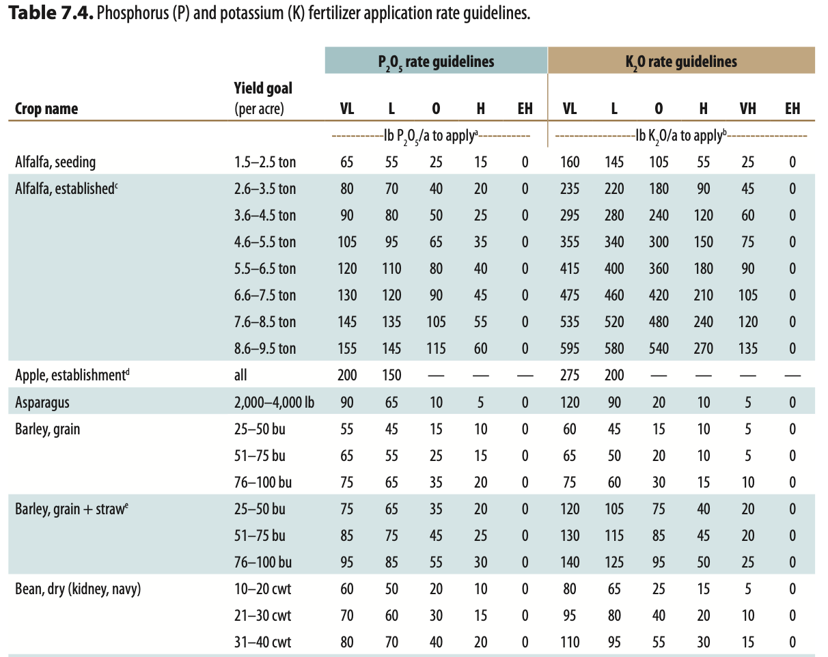
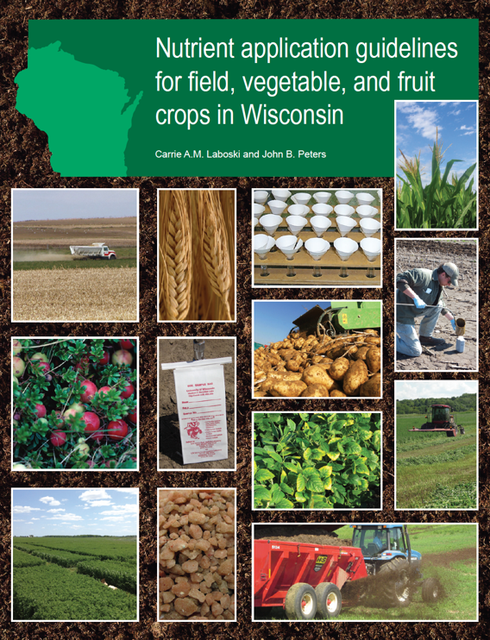
Phosphorus Recommendations for Other Crops
A2809 provides phosphorus recommendation for most crops grown in Wisconsin based on soil test category and yield.

Slide 18
Wisconsin’s Phosphorus Index

Slide 19
What is the P-Index (PI)?
A model with multiple site-specific factors to assess the potential for a field to deliver P to surface water
PI considers both source of nutrients and potential of nutrient transport to water
P Source
P Transport
P Loss
Notes:
P3.4.1 The phosphorus index (PI) is a model that contains multiple site-specific factors to assess the potential for a field (landscape) to deliver P to surface waters.
P3.4.2 The PI considers both source of nutrients and potential for transport of nutrients to water.

Slide 20
What is the P-Index (PI)?
Evaluates Site loading (quantity of P) and transport potential (erosion and runoff) from individual fields
Requires field characteristics
Recommends changes to agricultural mgt practices if PI critical value is exceeded
Does not dictate specific practices
Multiple ways to lower PI values
Notes:
P3.4.1 The phosphorus index (PI) is a model that contains multiple site-specific factors to assess the potential for a field (landscape) to deliver P to surface waters.

Slide 21
Phosphorus Index: Source & Transport
Source
Field with high levels of STP
Fields that have received manure or fertilizer applications
Transport
Runoff and Erosion Losses from Land
Notes:
P3.4.3 Source of P includes fields with high levels of STP, and/or fields that have received manure or fertilizer applications.
P3.4.4 Transport of P is directly related to runoff and erosion losses from land.

Slide 22
Components of the Phosphorus Index (PI)
PI = (PP + DP) x TPDR
PI = Total P Index Value
PP = Particulate P
DP = Dissolved (soluble) P
TPDR = Total P Delivery Ratio
Notes:
P3.4.1 The phosphorus index (PI) is a model that contains multiple site-specific factors to assess the potential for a field (landscape) to deliver P to surface waters.

Slide 23
Interpretation of the Wisconsin P-Index
Critical value of 6 over the course of the crop rotation
Critical value of 12 in individual crop year
Wisconsin 590 standard restricts manure and P fertilizer applications on fields with an average PI value greater than 6 over the crop rotation
Exception: P applications allowed if needed according to UW soil fertility recommendations
Sometimes P Index allows greater flexibility than UW Phosphorus recommendations based on soil tests
Notes:
P3.4.5 The PI identifies areas within a landscape where both the source of P and potential for transport to water are high. These critical areas require the application of management practice to reduce P loss while other areas of the landscape can be more flexible in fertilizer and manure management.
P3.4.6 In the NMP process, the PI can occasionally provide greater flexibility to the selection of fields for manure spreading than using the soil test P thresholds contained in the 590 NM standard.

Slide 24

Thanks!
Questions?
Name
Title
Nutrient and Pest Management (NPM) Program
UW-Madison Division of Extension
Email: Phone:

