Slide 2
Nitrogen Management

Slide 3
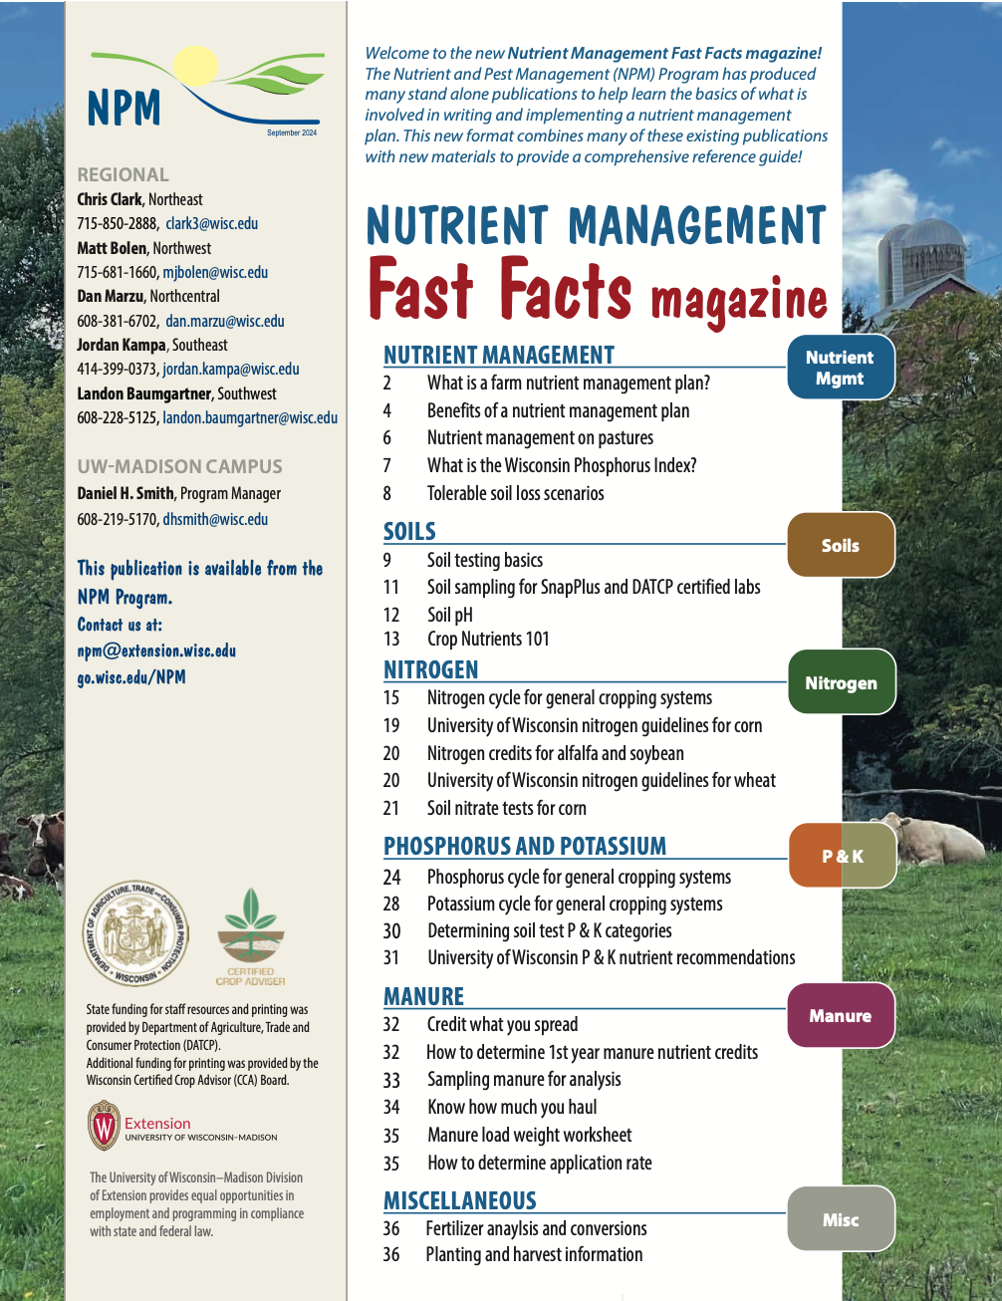

Following Along in Fast Facts?
Nitrogen: Pages 15-23 in Nutrient Management Fast Facts

Slide 4
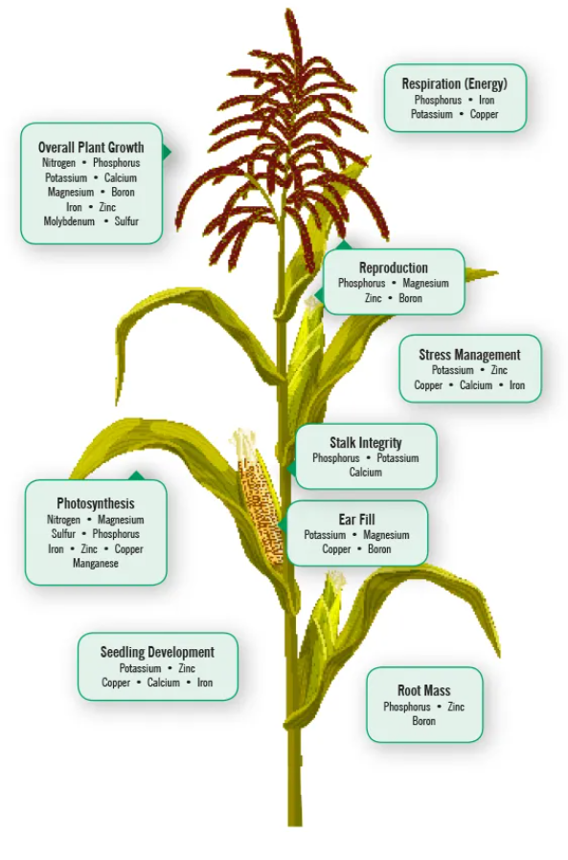
Function in Plants
Plants uptake more nitrogen (N) than any other element
N is essential for many plant cell structures such as:
  Protein
  Chlorophyll
  Nucleic acids in DNA
  Enzymes
Plant available forms of N are ammonium (NH4+) and nitrate (NO3-)
Image from Nachurs Nutrient Function & Interactions (nachurs.com)
Notes:
N1.1.1 Plants absorb more nitrogen than any other element. It is essential for structural, genetic and metabolic compounds in plant cells. ​
N1.1.4 Plants use nitrogen in the ammonium (NH4+) and nitrate (NO3-) forms.

Slide 5
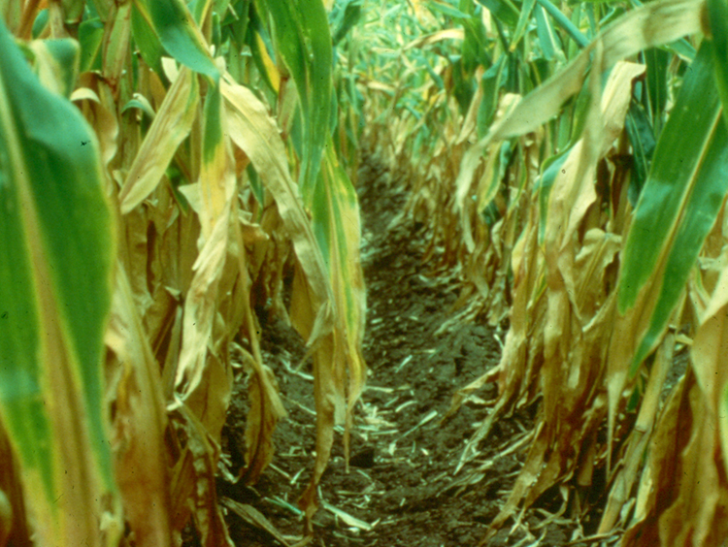
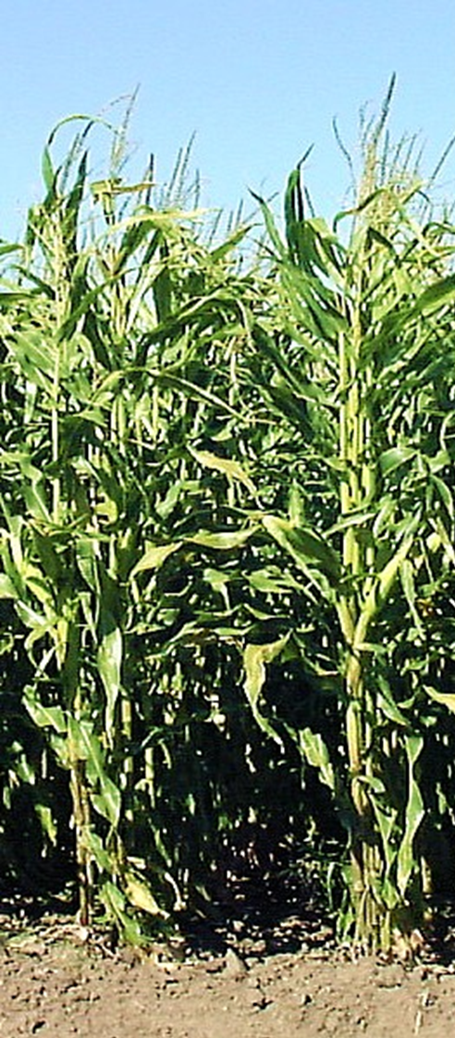
Nitrogen Deficiency
Nitrogen is mobile in the plant
  Deficiency symptoms (yellowing) occur in older leaves.
Excessively green plants at the end of summer can indicate too much nitrogen was available to the plant.
Notes:
N1.1.2 Nitrogen deficiency symptoms (yellowing) occur in older leaves. ​
N1.1.3 Excessively green plants at the end of summer can indicate too much nitrogen was available to the plant. ​

Slide 6
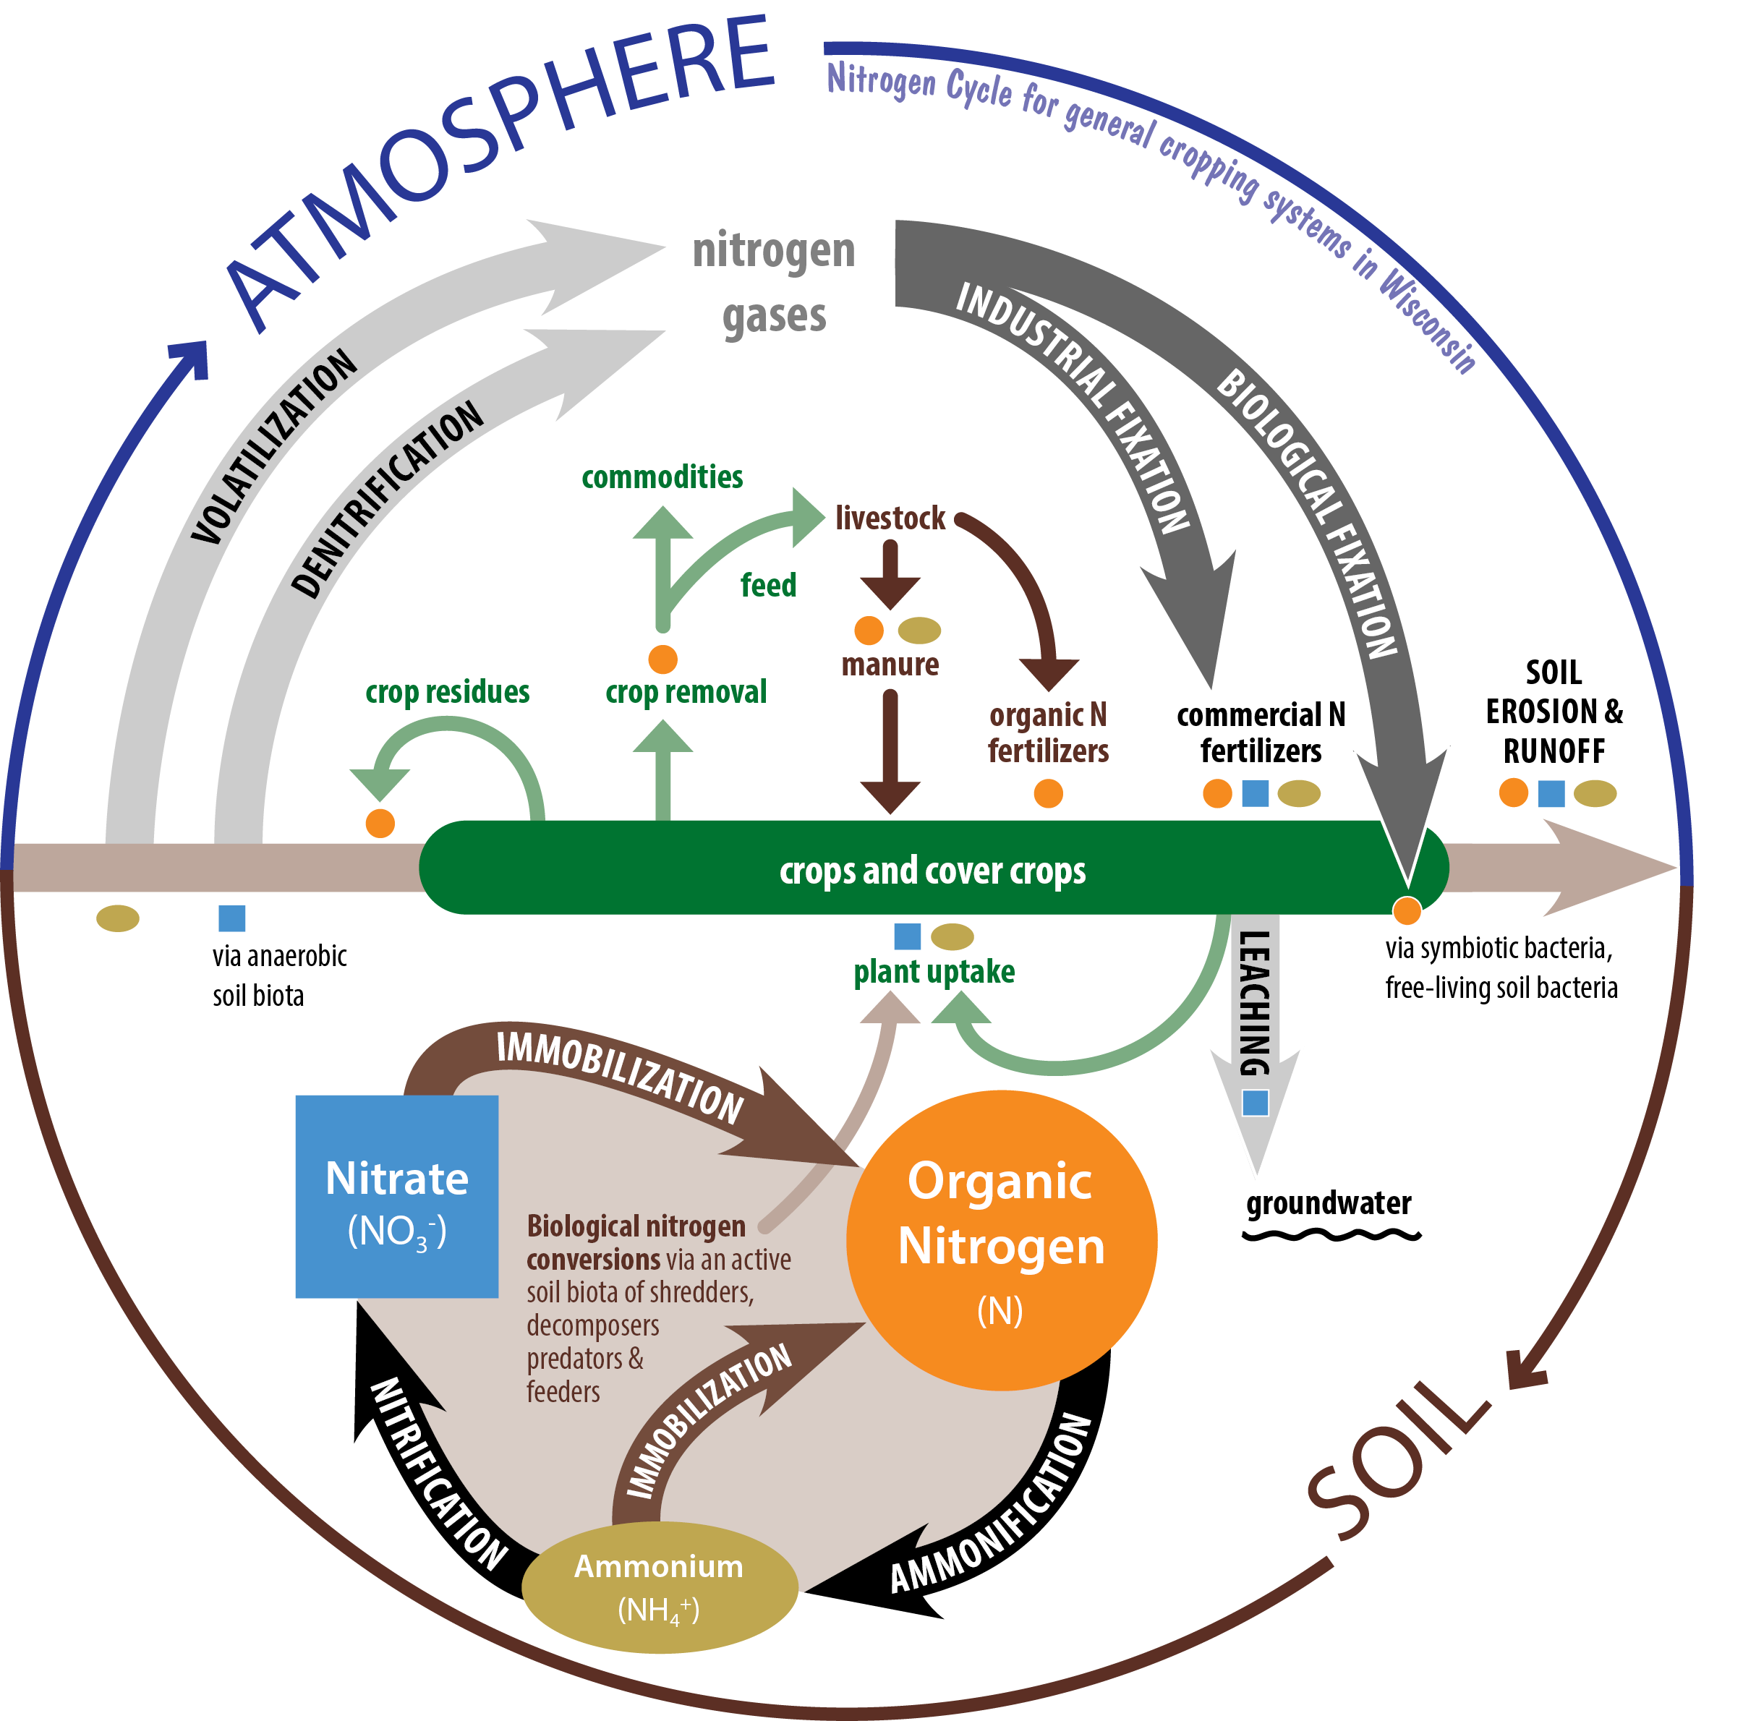
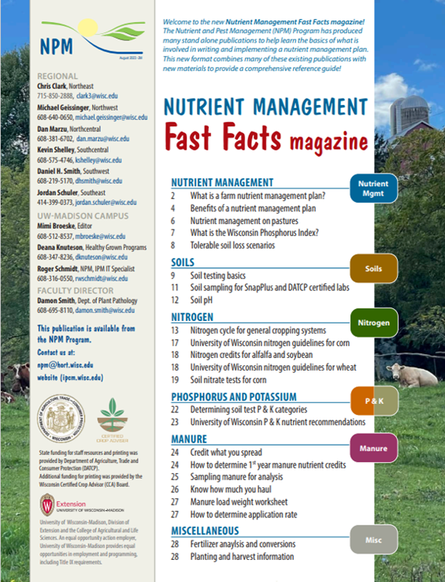
The Nitrogen Cycle
N₂
Nitrogen: Pages 15-18
Notes:
N1.2.1 Nitrogen is present in several forms, some available and some not available for plant uptake.​
N1.2.2 Nitrogen is added into an agricultural system via biological fixation by legume plants, soil organic matter, crop residue, manures and biosolids, commercial fertilizer, and atmospheric fixation and deposition. ​
N1.2.3 During the normal nitrogen cycle, nitrogen can be lost via denitrification, volatilization, leaching, and NH4+ fixation. ​
N1.2.4 Nitrogen losses in an agronomic cropping system include harvest, leaching, runoff and erosion.
Atmosphere contains 78% nitrogen as N₂ gas - Plants cannot use this N directly
Plants use N in ammonium (NH4+) and nitrate (NO3-) forms
Nitrogen from air must be converted for plant use
Biological fixation (Rhizobia bacteria and legumes)
Chemical fixation (fertilizers)
Nitrogen can also be provided through Soil Organic Matter

Slide 7
Goals of Nitrogen Management
Avoid environmental risks due to above-optimum N use
Maximize economic return with optimum N rates

Slide 8

Economic Optimum N Rate (EONR)
Cost of last increment of N added | Value of yield increase produced
=
Economic return
Crop recovery of N
Potential for N loss
As N Rates Align with EONR

Slide 9
UW Nitrogen Recommendations for Corn
Based on:
  Corn & nitrogen prices
  Soil yield potential
  Soil texture (sands vs. others)
  Previous crop
  Irrigation (sands and loamy sands)
**Not Corn Yield Goal**

Slide 10
Price Adjusted N Guidelines for Corn
Maximum Return to N (MRTN)
  Flexibility in rates based on economics
    Cost of N
    Price of Corn
Cropping Systems approach
  Corn after soybeans, small grains
  Corn after corn, forage legumes, green manures, etc.
Multi-state, regional approach
  WI, IA, IL, MN, OH, IN, MI
Notes:
N2.1.1 University of Wisconsin uses a MRTN philosophy for base nitrogen recommendations for corn and wheat. MRTN stands for Maximum Return to Nitrogen, which determines N rate that provides for maximum economic return based on both the cost of N and an anticipated crop price.

Slide 11
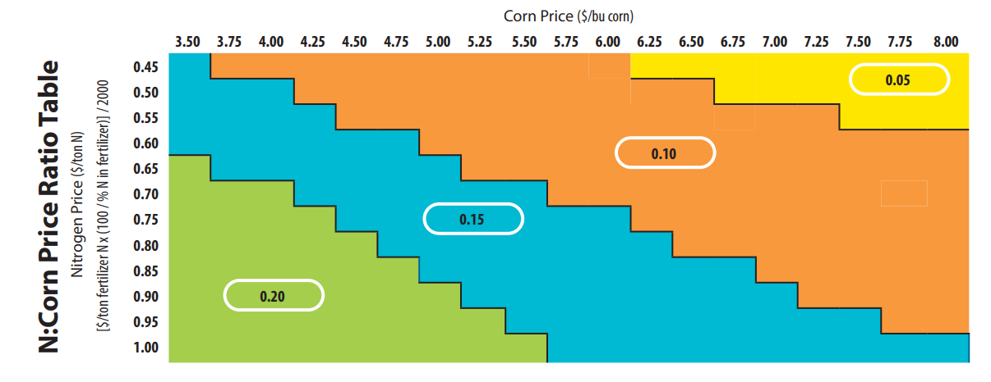
Determining MRTN Example
NM Fast facts magazine pg. 17
Notes:
N2.1.2 A MRTN example: First determine your nitrogen to corn price ratio. If nitrogen is $0.60/lb and the projected price for corn is $4.50 bu/ac, the ratio would be .15 (blue). If your field’s soil has high yield potential and the previous crop was corn, then the range for the recommended N rate is 135-160 lb/A. In the notes section, there are further considerations to take into account in refining the recommendation.

Slide 12
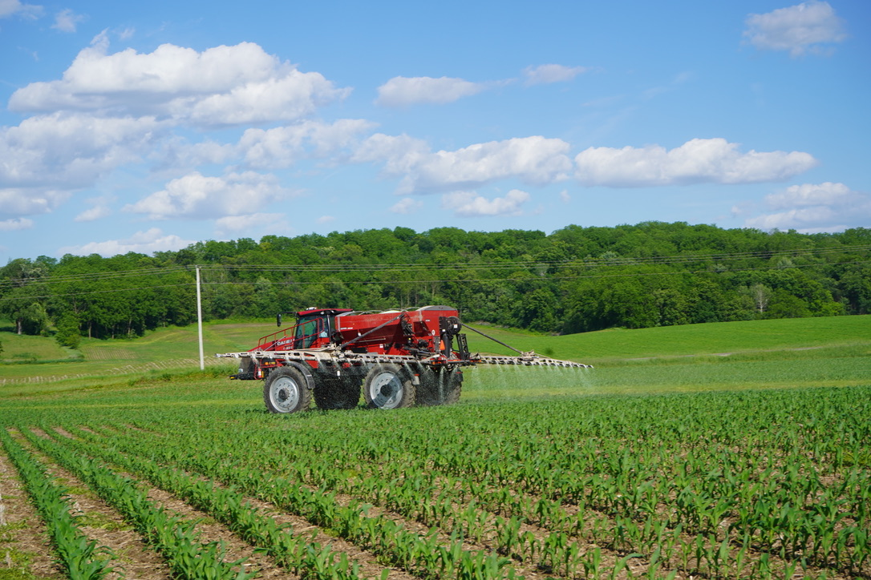
Determining MRTN Example
2025 Example
Urea $599/ Ton (46-0-0)
2000 lbs. X .46= 920 lbs. N
$599/920 lbs. = $0.65/lb.
Grain Price $3.89
$0.65 lb./ N $3.89 bu= N:Corn Price Ratio = 0.15
Notes:
N2.1.2 A MRTN example: First determine your nitrogen to corn price ratio. If nitrogen is $0.60/lb and the projected price for corn is $4.50 bu/ac, the ratio would be .15 (blue). If your field’s soil has high yield potential and the previous crop was corn, then the range for the recommended N rate is 135-160 lb/A. In the notes section, there are further considerations to take into account in refining the recommendation.

Slide 13
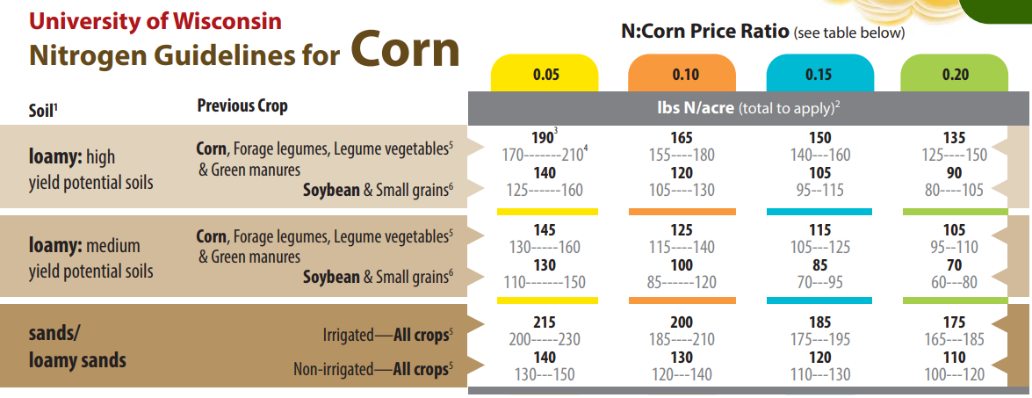
NM Fast facts magazine pg. 17
Notes:
Notes from the card image:
- These N recommendations include N in starter
- The profitability range within $1/acre of MRTN rate
- Subtract N credits for legumes or manure

Slide 14
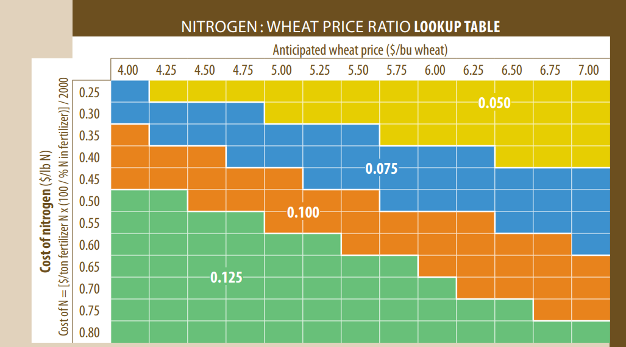
NM Fast facts magazine pg. 18

Slide 15
Additional MRTN Guidelines
For maximum silage yield, use N rate for the 0.05 price ratio. To adjust rates for silage, use price ratio that reflects typical prices for N and grain.
If >50% residue at planting, use upper end of range.
If all N is from organic sources, use top end of range. Plus, up to 20 lb N/a as starter.
For loamy (medium & fine-textured) soils with >10% soil organic matter, use low end of range.
For all soils with <2% OM, use high end of range.
Notes:
N2.1.2 A MRTN example: First determine your nitrogen to corn price ratio. If nitrogen is $0.60/lb and the projected price for corn is $4.50 bu/ac, the ratio would be .15 (blue). If your field’s soil has high yield potential and the previous crop was corn, then the range for the recommended N rate is 135-160 lb/A. In the notes section, there are further considerations to take into account in refining the recommendation.

Slide 16
Additional MRTN Guidelines
For sands with <2% OM, use high end of range; 2-10% OM, use mid- to low-end of range; 10-20% OM, use non-irrigated guidelines – regardless of irrigation status; >20% OM, apply 80 lb N/a.
When corn follows small grains on loamy soils, use the mid- to low-end of range.
For loamy irrigated or drained soils, use rates for high yield potential soils.
If potential for carry-over (residual) N, use low end of range or use the high end and subtract preplant soil nitrate test (PPNT) credits.
Notes:
N2.1.2 A MRTN example: First determine your nitrogen to corn price ratio. If nitrogen is $0.60/lb and the projected price for corn is $4.50 bu/ac, the ratio would be .15 (blue). If your field’s soil has high yield potential and the previous crop was corn, then the range for the recommended N rate is 135-160 lb/A. In the notes section, there are further considerations to take into account in refining the recommendation.

Slide 17
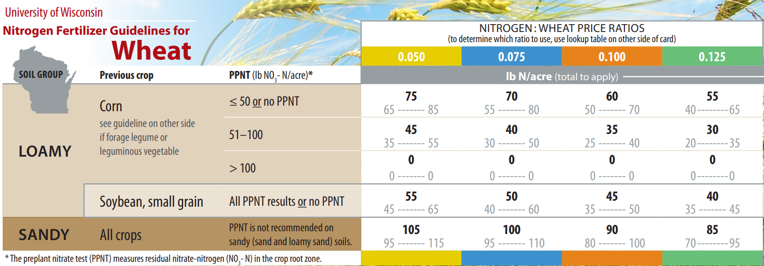
NM Fast facts magazine pg. 18

Slide 18
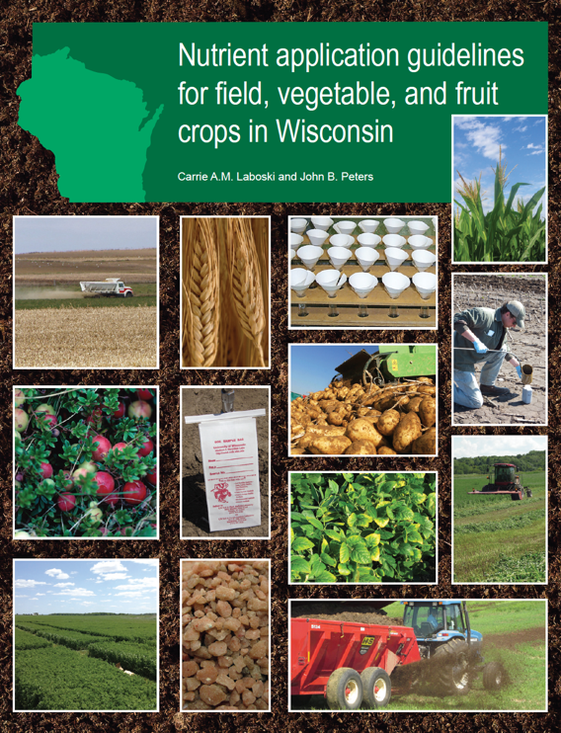
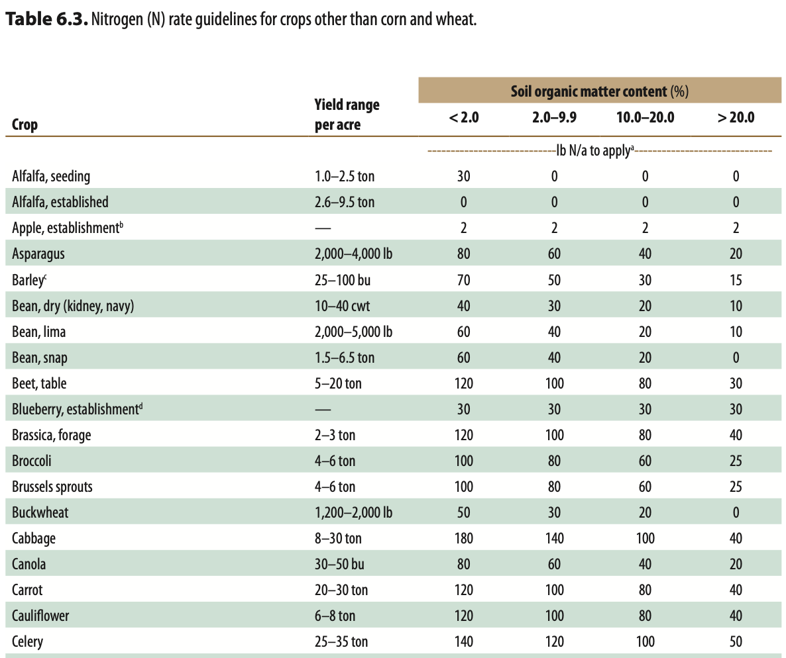
Nitrogen Recommendations for Other Crops
A2809 provides nitrogen recommendations for most crops grown in Wisconsin based on soil organic matter.

Slide 19
Fertilizer Additives Used to Reduce Potential N. Losses
Additive | Common Name(s) | N Content | N Process | Inhibition Duration
 |  | % |  | weeks
Nitrification Inhibitors
Nitrapyrin | N-Serve Stay-N 2000 | - | Nitrification Denitrification | 2-6
DCD | DCD Ensan | 1.6 | - | 4-8
DMPP | DMPP ENTEC | - 12-26 | - | 6-8
Urease Inhibitors
NBPT | Agrotain Super U | - 46 | Volatilization | 2-3
Thiosulfate | ATS CaTS | 12 | Volatilization Nitrification | 2-3
Combination Products
DCD + NBPT | Agrotain Plus HYDREXX | - | Volatilization Nitrification Denitrification | 6-8
DCD + NBPT + urea | UMAXX UFLEXX Super U | 47 46 | - | 8-12 6-8
Polymer | Nutrisphere | - | - | 6-12
Polymer + urea | SSN | 46 | - | 6-12
Source: Soil Fertility and Fertilizers 8th ed. Havlin et al.

Slide 20
Legume Nitrogen Considerations
Notes:
N2.3.3 A legume credit example: the crop being grown the first year after terminating a good (70-100% stand density) alfalfa stand with greater than 8 inches of regrowth on medium-textured soil should have 190 lb/a nitrogen subtracted from the base N recommendation. ​
N2.3.4 With the MRTN approach to nitrogen recommendations for corn, any soybean nitrogen credit is accounted for in the base recommendation. ​

Slide 21
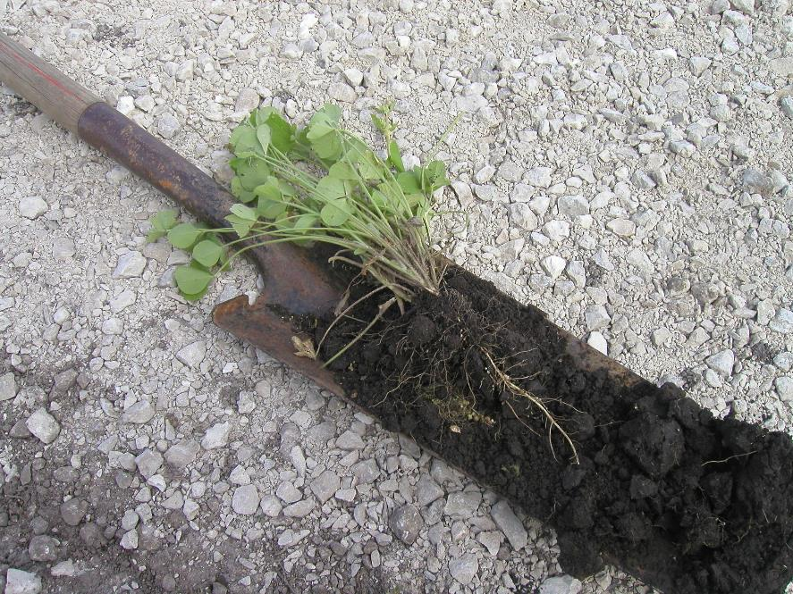
Legumes and the biological fixation of Nitrogen
N Fixation via Rhizobia (bacteria) that live symbiotically with legume roots – Nodules
Seeds of legume species should be inoculated with the correct rhizobia bacteria (inoculant)
Photo: Kevin Shelley
Notes:
N2.3.1 Legumes interact with soil bacteria to biologically fix nitrogen for the plant. After the legume is harvested, there is still plant-available nitrogen in the soil for the next crop. This nitrogen needs to be credited to the base N recommendation.​

Slide 22
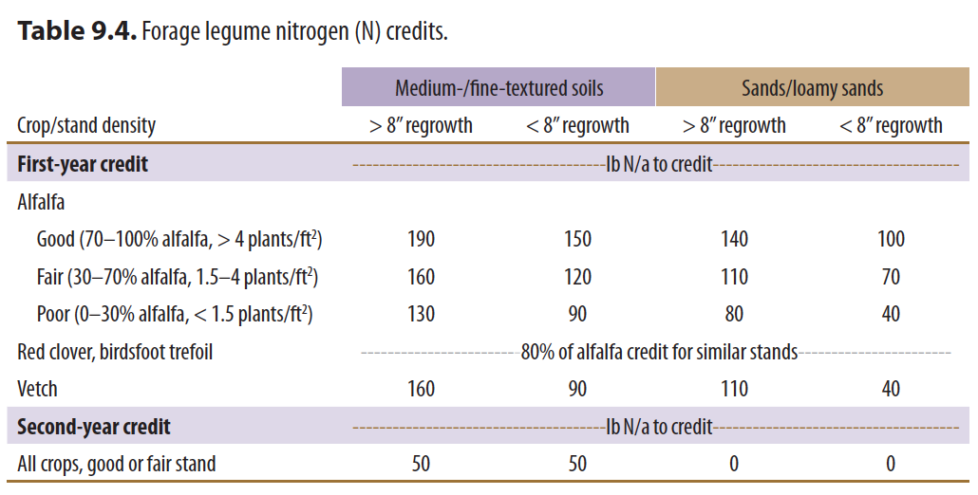
NM Fast facts magazine pg. 18

Slide 23
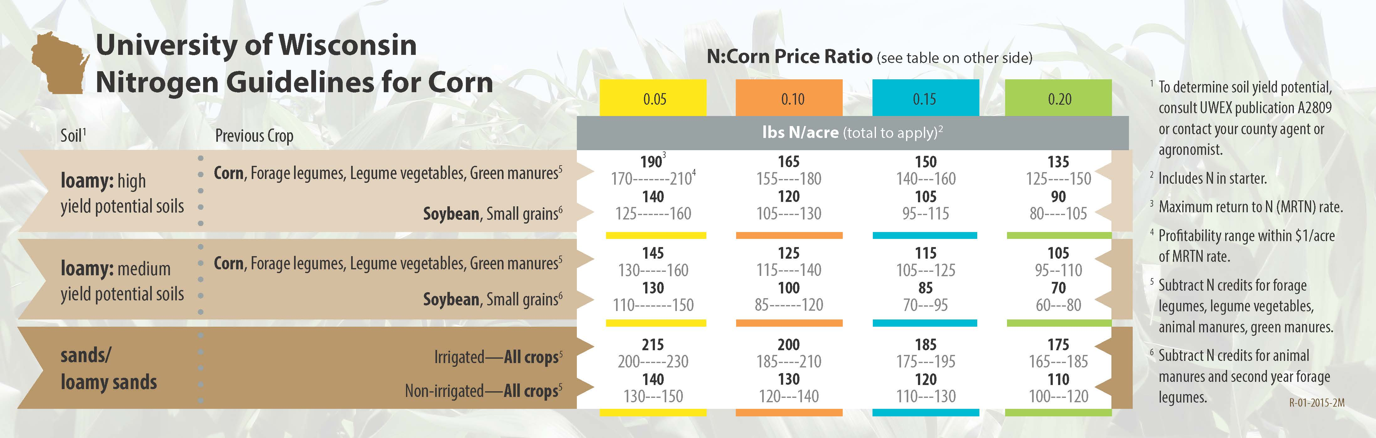
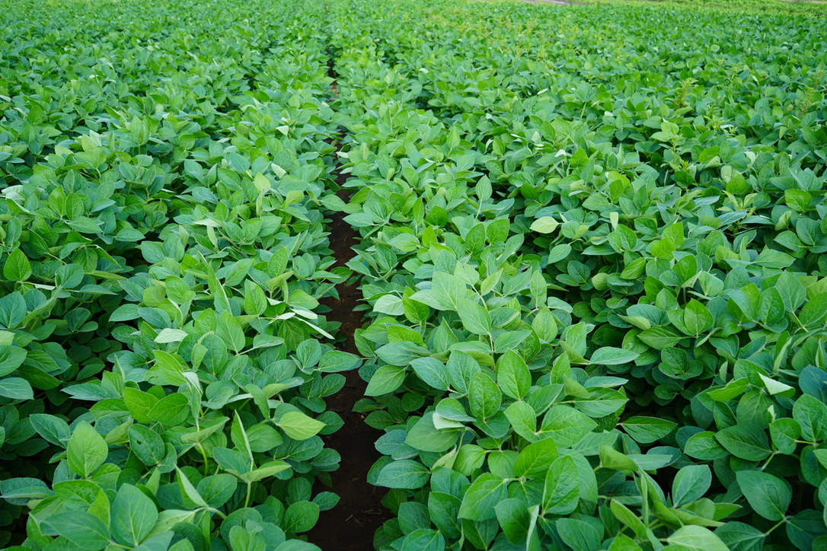
What about soybeans?
MRTN incorporates an adjustment for corn following soybean to credit the nitrogen available following soybean

Slide 24
Other Nitrogen Credit Considerations
Manure applied in the fall retains a full nitrogen credit the following spring.
Legume hay killed in the fall retains the same credit as hay killed in the spring.
A cool spring may delay release of nitrogen and cause an early-season nitrogen deficiency.
Notes:
Lower temperatures delay N conversions to nitrate - which is the most mobile form of N.
Remember: The assumption of 70% loss of N (total vs. available). (i.e. Losses of N are accounted when determining N credits.)
N credits are present regardless of the methods used to kill the stand - tillage, herbicide, winter-kill, etc.
Remember mineralization is temperature dependent. A cool spring may cause early season N deficiency symptoms. In almost all years, the corn will catch up as N is released with warmer temperatures.
Also remember N leaches. Abundant precipitation in the spring has the potential to result in loss of N - regardless of the source.

Slide 25
Managing Nitrogen Applications

Slide 26
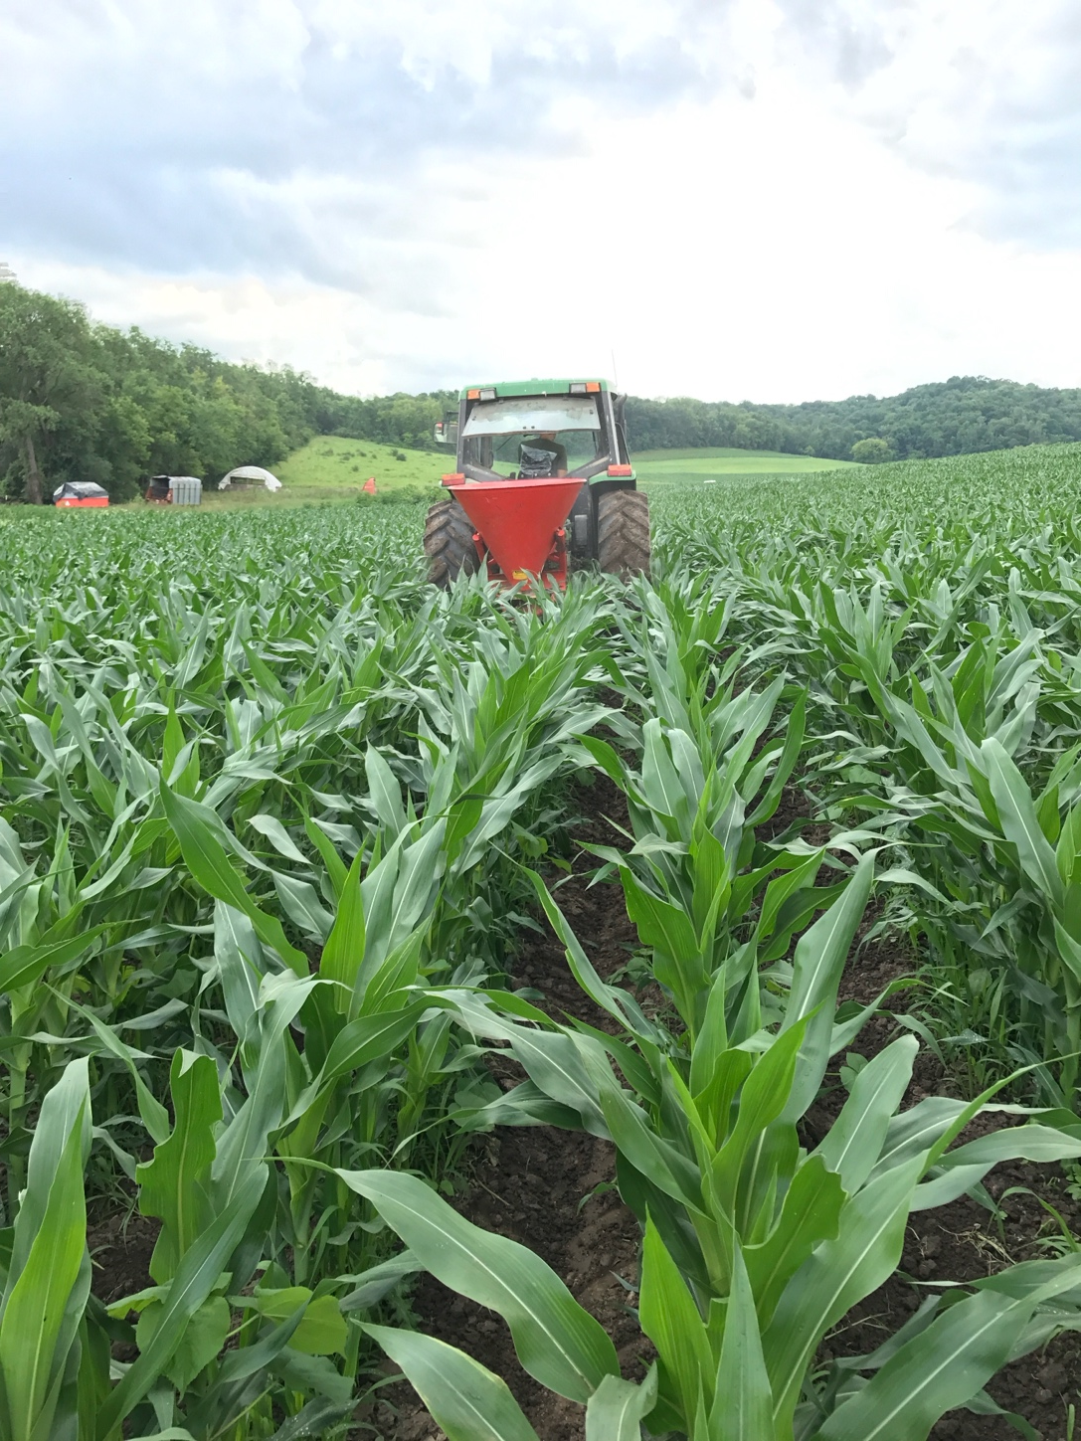
Nitrogen Fertilizers: Differences in Effectiveness?
All equally effective if losses are minimized
  Flexibility in rates based on economics
Different susceptibility to loss processes
  Leaching
  Denitrification
  Ammonia volatilization
Timing may heavily influence fertilizer purchased due to application method available.
Photo courtesy of Dan Smith
Notes:
N4.1.2 Nitrogen fertilizers are interchangeable, however, due to application methods of liquid, dry, and gas products, application timing may heavily influence fertilizer type purchased.

Slide 27

Nitrogen Application Rate
 | Nitrogen | Phosphorus (P₂O₅) | Potassium (K₂O)
Base Recommendations | 180 | 60 | 60
Dairy manure application (12 tons/ac) 3-3-6 book value | 36 | 36 | 72
Proceeding Crop= Alfalfa Poor stand (0-30% alfalfa, <8” regrowth) | 90 | 0 | 0
Commercial Fertilizer that could be applied | 54 | 24 | 0
Notes:
N4.1.3 Nitrogen application rates are adjusted based on previous crop and nutrient credits from manure and legumes.

Slide 28
Fertilizer Blends
Fertilizer blends commonly used to meet field crop needs.
Fertilizer blends are based on:
  soil test values
  application rate
  crop need
  fertilizer product purchased.
Notes:
N4.1.4 Fertilizer blends are commonly applied to Wisconsin field crops needing nitrogen and other macronutrients; these blends are based on application rate, soil test value, crop need, and fertilizer product purchased.

Slide 29
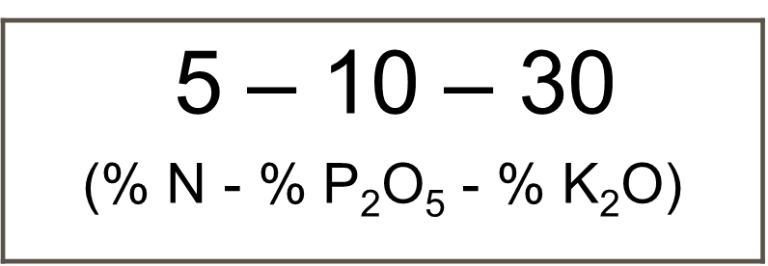
Fertilizer 101 and Fertilizer Grades
By definition, a fertilizer is substance added to the soil to increase its nutrient concentrations.
Fertilizer can be naturally occurring or manufactured substances.
Fertilizers can be solids, liquids, or gasses.
Fertilizer selection is typically based upon cost per pound of nutrient, ease of handling and application, as well as specific soil and cropping system factors, such a crop, crop growth stage, soil pH, etc.
A guaranteed analysis must be provided for all materials sold as a fertilizer.
Calculated as a % of total weight
Notes:
S9.2.1 By definition, a fertilizer is substance added to the soil to increase its nutrient concentrations. Fertilizer can be naturally occurring or manufactured substances.
S9.2.2 Fertilizers can be solids, liquids, or gasses. Fertilizer selection is typically based upon cost per pound of nutrient, ease of handling and application, as well as specific soil and cropping system factors, such a crop, crop growth stage, soil pH, etc.
S9.2.3 A guaranteed analysis must be provided for all materials sold as a fertilizer. The three numbers in a fertilizer guaranteed analysis represent the % N, % P₂O₅, and % K₂0 content of the fertilizer on a weight basis.

Slide 30
Fertilizer Blends Math Example
MRTN recommends 160 lb./ac N and the soil test values indicate a need for 60 lb./ac P₂O₅.
Products available: DAP- 18-46-0 and Urea- 46-0-0
      60 lb./ac P₂O₅ / .46= 130 lb./ac DAP application
      130 DAP x .18 (N in DAP)= 23 lb. N
      160 lb. N (MRTN Rate) – 23 lb. (DAP) = 137 lb. N still needed
      137 / .46 (N in Urea) = 298 lb./ac urea application
      298 lb. urea/ac and 130 lb./ac DAP

Slide 31
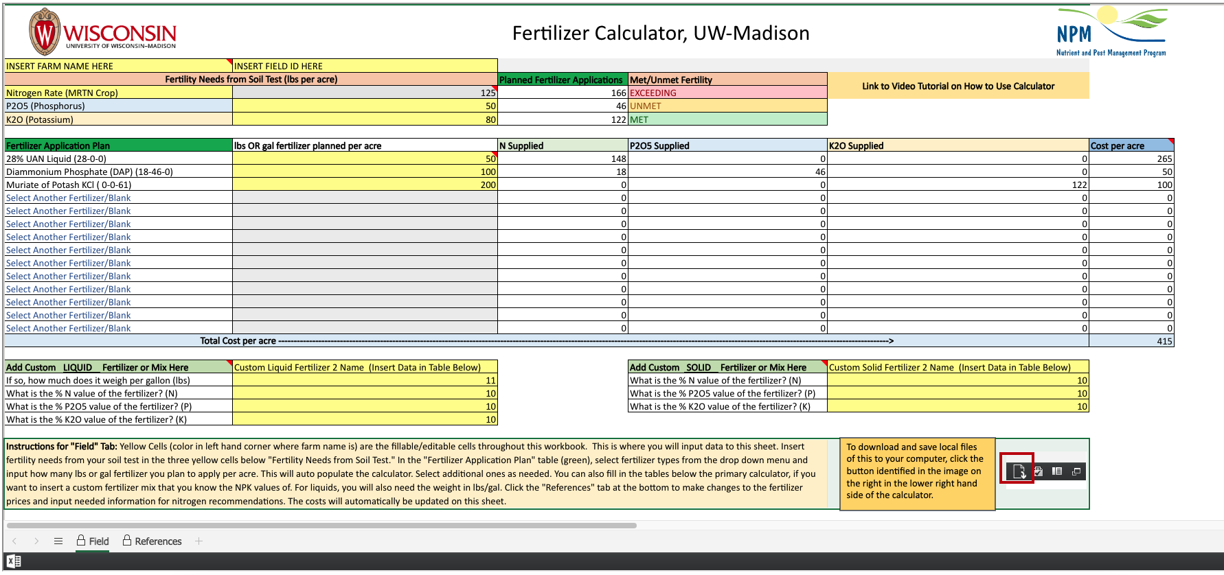
Fertilizer Calculator Available

Slide 32
N Uptake and Loss Potential

Slide 33
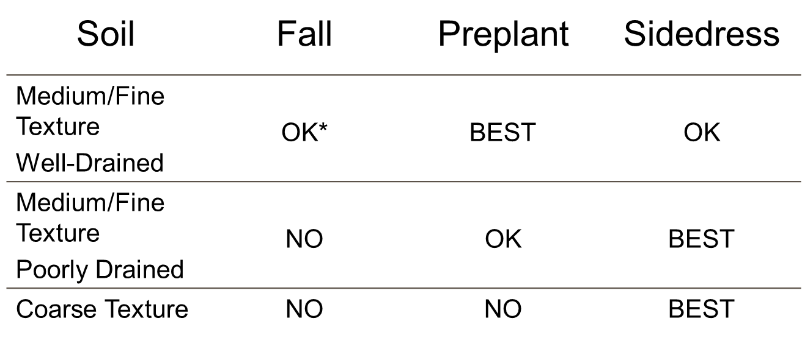
When to apply Nitrogen in Wisconsin?
* Includes use of BMPs for fall-applied N.
Notes:
N4.2.1 The best times to apply nitrogen in Wisconsin depends on soil type and soil temperature. Generally, from a water quality protection and farm economics perspective, fall applications of commercial fertilizer nitrogen should be avoided.

Slide 34
Thanks!
Questions?
Name
Title
Nutrient and Pest Management (NPM) Program
UW-Madison Division of Extension
Email: Phone:

