Slide 2
Manure Considerations

Slide 3
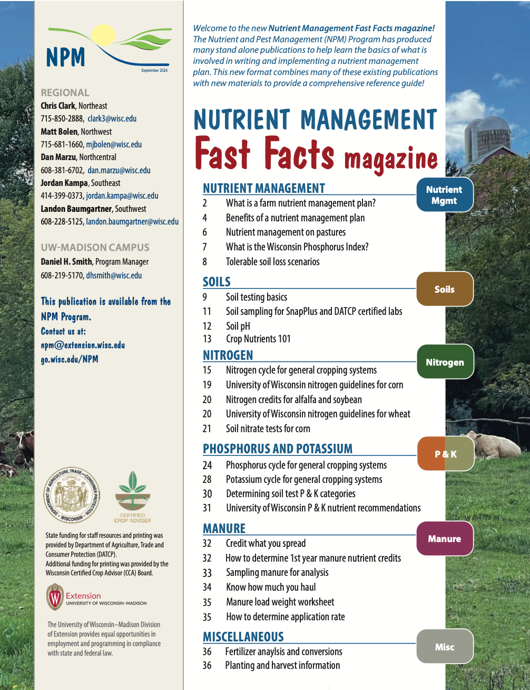

Following Along in Fast Facts?
Manure: Pages 33-35 in Nutrient Management Fast Facts

Slide 4
Manure Nutrients
Manure provides essential plant nutrients
  N, P, K, and S
  Other essential plant nutrients
Nutrients in organic and mineral forms
  Affects plant availability over time
Manure N undergoes chemical transformations
  Affects plant availability
  Potential for environmental loss
Notes:
M1.1.1 Manure provides nitrogen, phosphorous, potassium, sulfur and other essential plant nutrients.
M1.1.2 Manure nutrients exist in both mineral forms and organic forms, which affect plant availability over time. Manure nitrogen undergoes chemical transformations when applied to soil that affect both plant availability and potential for environmental loss.

Slide 5
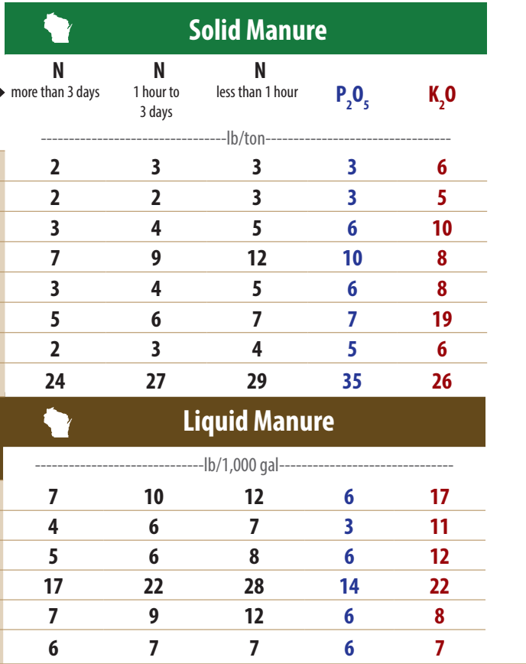

Manure Nutrient Content
Livestock species
Solid
Liquid
  DM content
Application
  Surface
  Incorporated
1st-year / 2nd-year
Fast Facts Magazine pg. 24
Notes:
M1.1.3 Differences exist in manure nutrient content between animal species. Livestock feeding and nutrition also influence manure nutrient content.
M1.1.4 Nutrient content and crop availability differ according to storage and handling methods (liquid versus solid) as well as method and timing of land application (surface application versus soil incorporation).

Slide 6
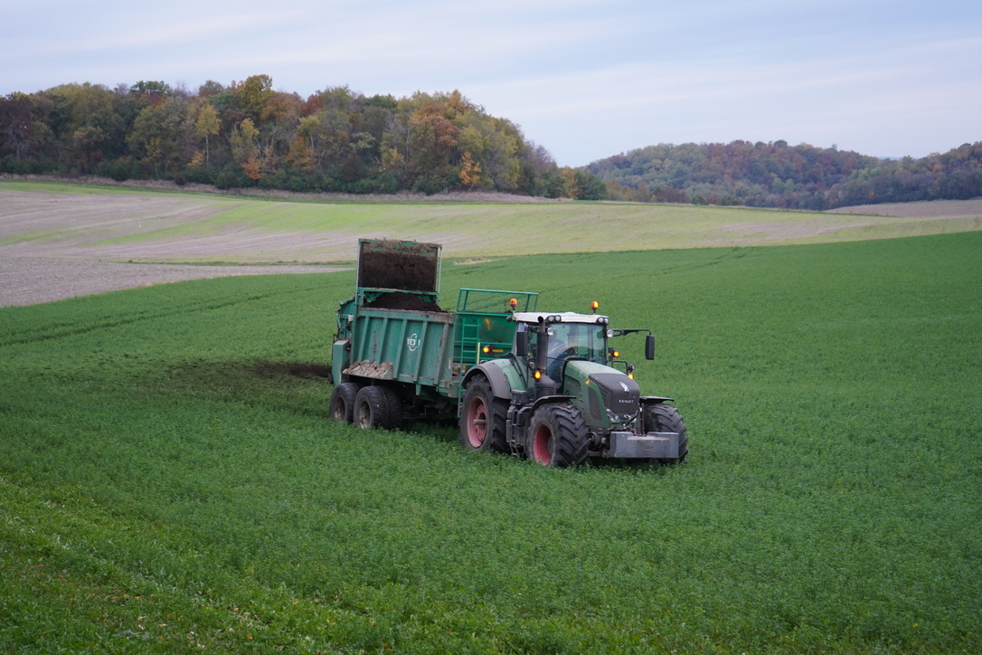
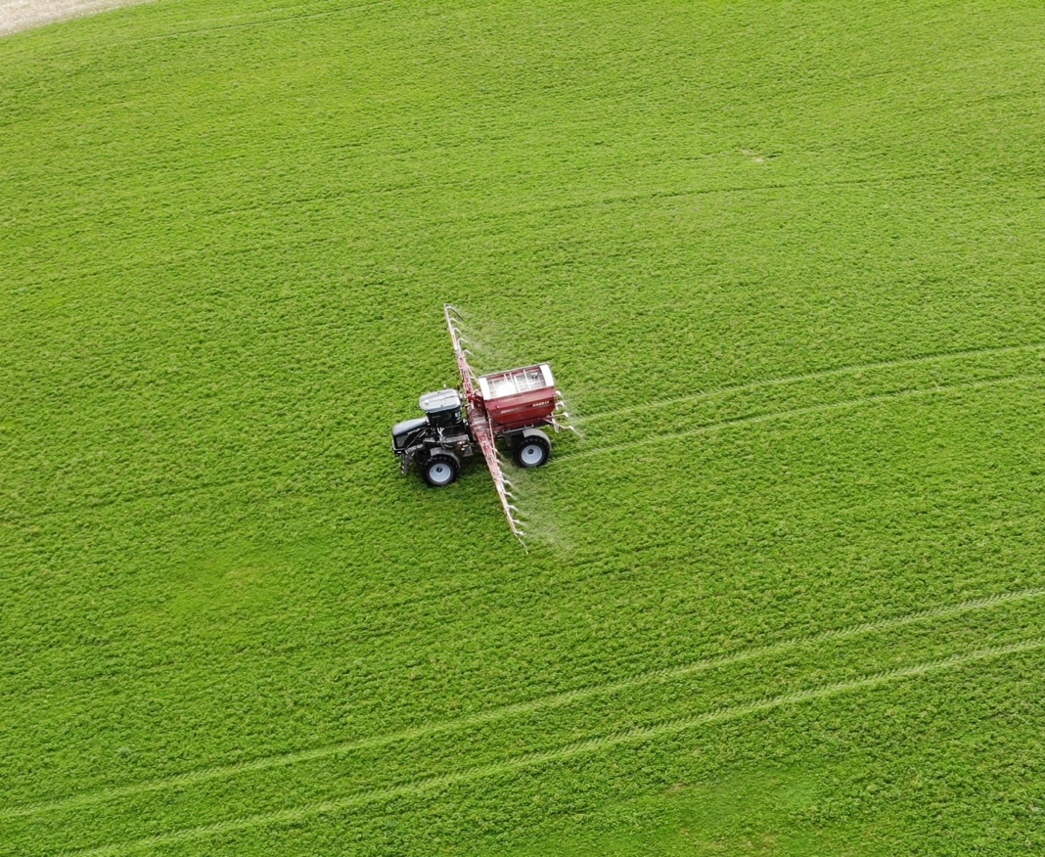
Information Needed to Properly Credit Manure Nutrients:
Available nutrient content
X
Manure application rate
= Nutrient credits N-P-K
Notes:
M1.1.7 Nutrient credits are determined using the manure’s nutrient content and the application rate in tons or gallons/acre.
The second piece of information needed for crediting the nutrients in manure is the manure application rate.
Application rate information is more difficult to get than nutrient content and can be highly variable if manure is not handled in a consistent manner.
Estimates of manure application rates must be reasonably accurate in order to credit manure nutrients. If not, then manure nutrient credits can not be taken.
These are some of the major reasons farmers, as well as co-op agronomists and fertilizer dealers, are reluctant to credit manure nutrients.

Slide 7
Manure + Natural Resource Concerns
Field losses of manure can cause environmental contamination
  Groundwater quality
  Aquatic ecosystems in surface water bodies
    Weed and algae growth
    Oxygen depletion for fish and aquatic organisms
Primary nutrient loss concerns:
  Nitrate-N leaching to groundwater
  P + N losses to surface water bodies
    Via runoff and soil erosion
Manure application guidelines to prevent + minimize risk
Notes:
M1.3 Natural resource concerns
M1.3.1 Field losses of nutrients in manure can be sources of environmental contamination affecting groundwater quality and the health of aquatic ecosystems in surface water resources (ponds, lakes and streams).
M1.3.2 The primary nutrient loss mechanisms include leaching of nitrate-N to groundwater and phosphorous and nitrogen losses to lakes and streams from surface water runoff and soil erosion. Negative effects from nutrient deposition to lakes and streams include weed and algae growth and oxygen depletion for fish and other aquatic organisms (biological oxygen demand).
M1.3.3 There are manure application guidelines, and in some cases legal requirements, intended to prevent or minimize the risk of manure contamination of water resources (See M4 Manure Application Precautions).

Slide 8
Manure Sampling
Available nutrient content of manure varies based on:
Nutritional program
Bedding content and type
Age and structure of stacked manure
Rainwater / milk house waste / flush systems
Liquid-solid separation
Composting
Manure analysis may provide more accurate results
Notes:
M2.1.1 Collecting a representative sample is critical for obtaining accurate results. There are different ways to sample various manure types, storage structures, and pumping equipment.
Representative sampling is a must!!
Results from analysis are only as good as the sample collection techniques.
Solid or stacked – Use a soil probe, auger, or shovel to collect several samples from various places in the stack. Combine and mix the subsamples to obtain a composite sample. It is best to sample stacked manure while loading. Take at least 5 samples while loading several spreader loads and combine to form a composite sample.
Liquid - During the course of emptying a manure storage system, collect 3 to 5 samples at the beginning, middle, and end of pit agitation. Combine into a single composite sample.
Speaker: See Appendix 2 in the curriculum guidebook for more information on collecting manure samples.

Slide 9
Solid Manure Sample Collection
When loading:
Collect 3-5 sub-samples from different spreader loads and combine to form 1 single composite sample
Mix composite sample and place a one pound subsample in a gallon plastic bag. Label with date and source.
Sampling from stack or bedded pack is not recommended.

Slide 10
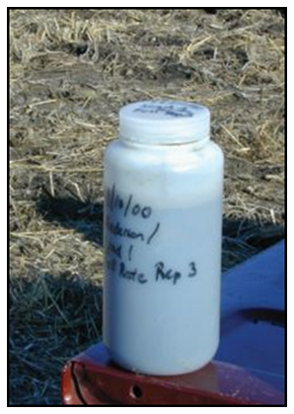
Collecting a Liquid Manure Sample
Sampling manure from storage - while loading
Agitate storage facility thoroughly
Collect 3 sub-samples while loading successive tankers
Mix sub-samples in a bucket and pour into a plastic container for a composite sample. Label with date and source.
Take at least 3 composite samples throughout the storage structure
  Top 1/3, Middle 1/3, Bottom 1/3

Slide 11
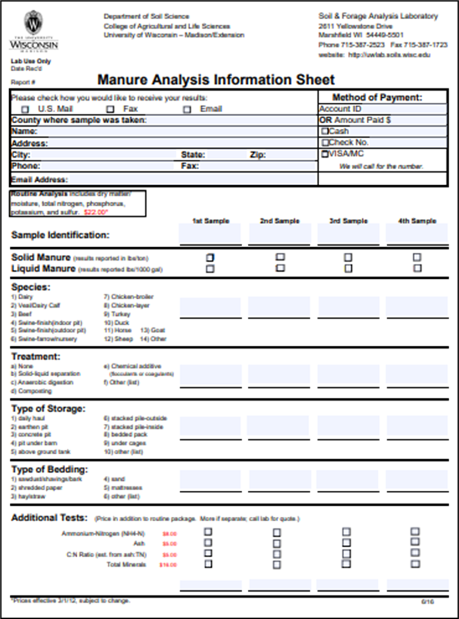
Manure Sample Submission Form
https://uwlab.soils.wisc.edu/
UW Soil & Forage Lab Marshfield, WI
A & L Great Lakes Laboratories, Inc. Fort Wayne, IN
AgSource Cooperative Services Bonduel, WI
Dairyland Laboratories Arcadia, WI
Rock River Laboratory Watertown, WI
Minnesota Valley Testing Laboratories New Ulm, MN
Midwest Laboratories Inc. Omaha, NE
Always confirm lab is WI state certified for manure testing if using results in a WI nutrient management plan.
Notes:
M2.1.2 Commercial laboratories accepting manure samples have guidelines for submission.

Slide 12
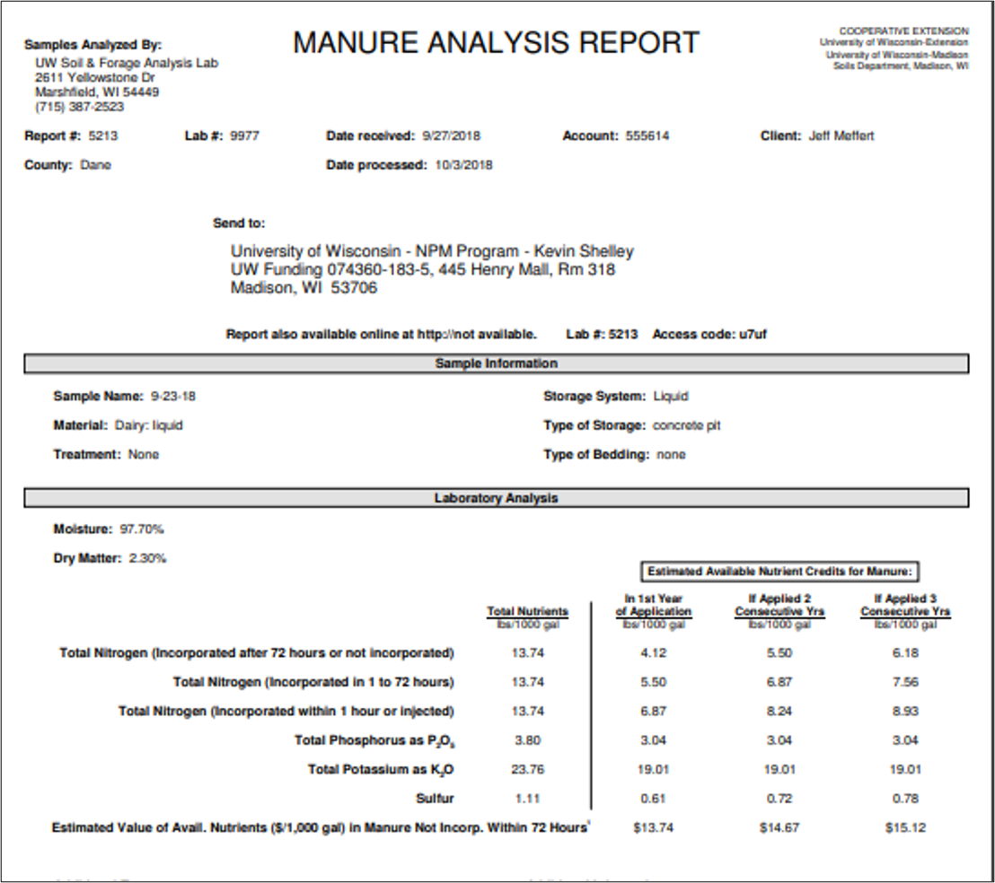
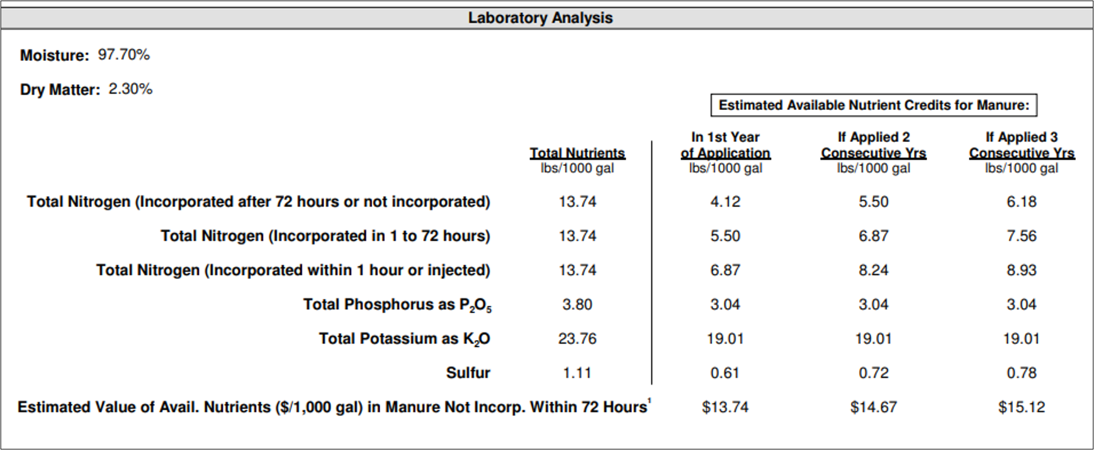
Manure Analysis
Notes:
M2.2 Manure analysis – interpreting the results
M2.2.1 It is important to distinguish between total nutrient content and plant-available nutrient content of manure.
M2.2.2 Reports may list both 1st year and 2nd year credits, as well as total nutrient content.
M2.2.3 Additional analyses for carbon, ammonium or nitrate may be useful for manipulated or processed manures.

Slide 13
Determining Application Rates
Rates should be calculated to meet nutrient requirements on fields across the farm
  NOT EXCEED
Hauled manure from production facility to field must determine average amount of manure contained in each load in tons (solid) or gallons (liquid)
Notes:
M2.4 Determining and adjusting manure application rates
M2.4.1 Manure application rates should be calculated to meet, but not exceed, nutrient requirements on fields across the farm.
M2.4.2 For manure hauled from production facilities to crop production fields for application, the average amount of manure contained in each load in tons (solid) or gallons (liquid) must be determined.
M2.4.6 In all cases, the amount hauled or pumped needs to be divided by acres applied to determine the application rate. Application rates can be adjusted to match crop nutrient needs in a process of calibration.

Slide 14
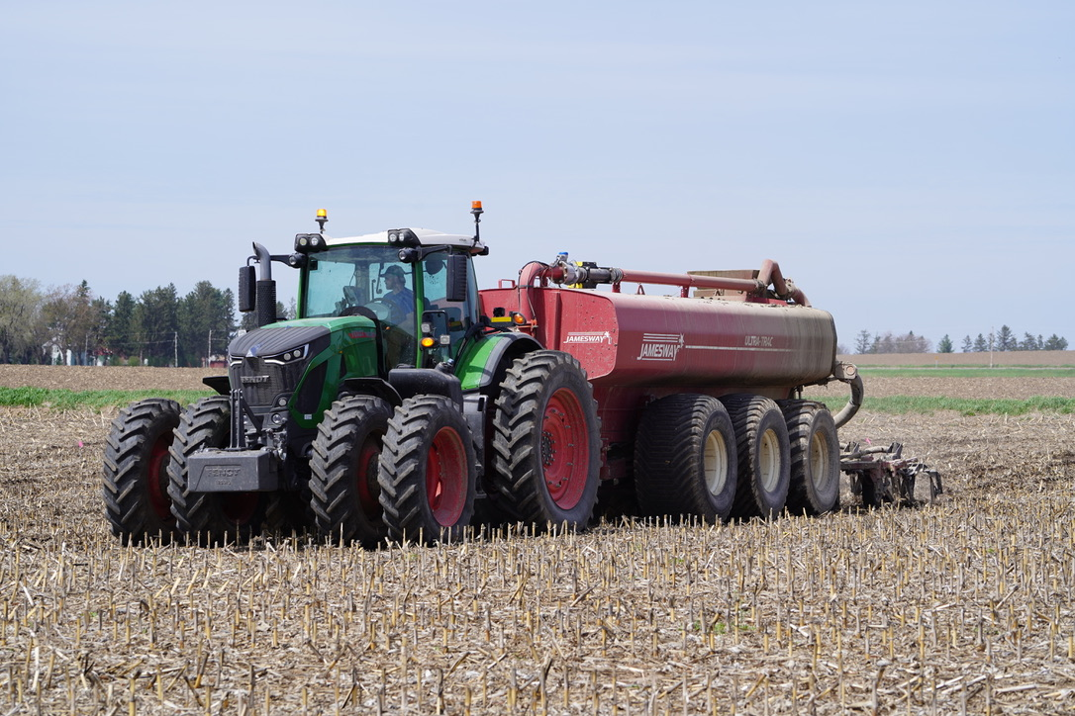
Manure Application Rates: How Much Am I Spreading?
Liquid Manure:
Use 85% of rated tank volume to estimate gallons/load
Equation:
Application rate =
Loads per acre
X
Gallons per load
Example:
6000 gal tank X 0.85 = 5100 gallons per load
2 loads per acre = 10,200 (10,000 gallons/acre)
Notes:
M2.43.4 For liquid manure, use 80 percent of the manufacturer’s tank volume rating as an estimate for gallons per load.
M2.4.5 For liquid manure pumped to the field for drag line injection or irrigation, gallons applied can be estimated according to storage volume emptied.
M2.4.6 In all cases, the amount hauled or pumped needs to be divided by acres applied to determine the application rate. Application rates can be adjusted to match crop nutrient needs in a process of calibration.

Slide 15
Field Conditions and Seasonal Considerations
Manure applications should be planned in accordance with standards for prevention of manure and nutrient losses to surface and groundwater on a field-level basis
USDA-NRCS conservation standard 590
  Specifies performance requirements for nutrient applications, including manure, on cropland.
Additional county or local requirements for manure application
Notes:
M2.5 Field condition and seasonal considerations
M2.5.1 Manure applications to cropland should be planned in accordance with standards for prevention of manure and nutrient losses to surface waters on a field-level basis.
M2.5.2 Manure applications to cropland should be planned in accordance with standards for prevention of manure and nutrient losses to groundwater on a field-level basis.
M2.5.3 The USDA NRCS conservation standard 590 specifies performance requirements for applications all nutrients, including manure, to cropland in Wisconsin.
M2.5.4 There may be additional county or local legal requirements controlling manure applications.

Slide 16
Manure Application Precautions

Slide 17
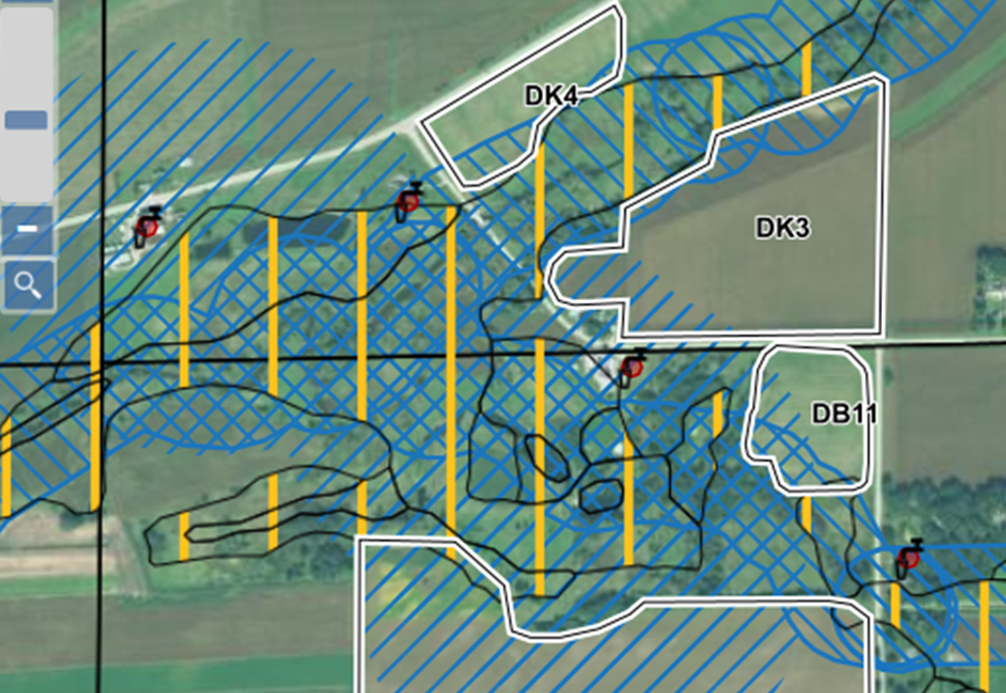
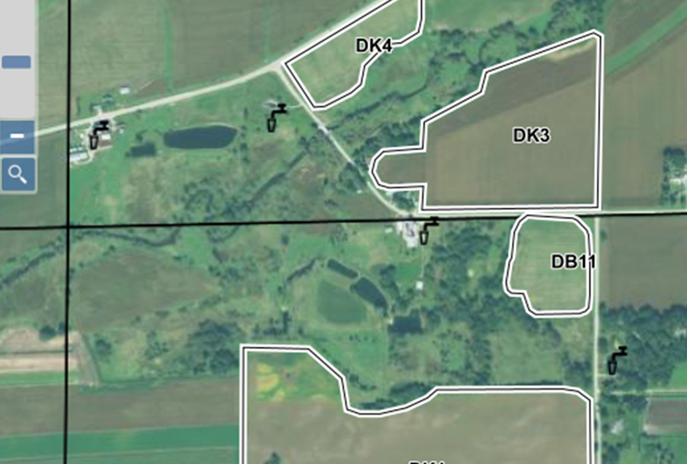
Surface Water Quality Management Areas (SWQMA)
Mechanical applications of manure
  1000’ buffer from ponds or lakes
  300’ buffer from rivers or streams

Slide 18
Surface Water Quality Management Areas (SWQMA)
Install and maintain vegetative buffers or filter strips.
Maintain ≥ 30% cover after nutrient application.
Incorporate within 3 days after application.
Plant a crop prior to, at, or immediately after application.
Apply nutrients within 7 days of planting on long term no-till soil with less than 30% residue.
Notes:
If you are going to be applying manure in a SWQMA, there are a couple of things that you need to consider. First of all you must use ONE or more of the following:

Slide 19
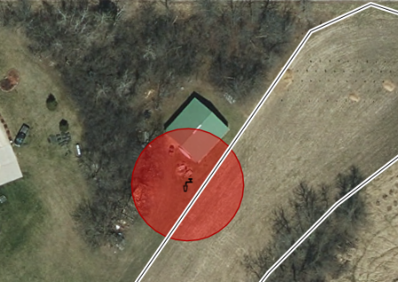
Wells And Other Conduits To Groundwater
No mechanical applications within 50’ of direct conduits to groundwater.
  Gleaning or pasturing animals is allowed.
Examples of Direct Conduits:
  Wells
  Sinkholes
  Swallets
  Fractured bedrock at the surface
  Mines/mine-shafts
  Quarries
  Tile inlets discharging to groundwater.

Slide 20
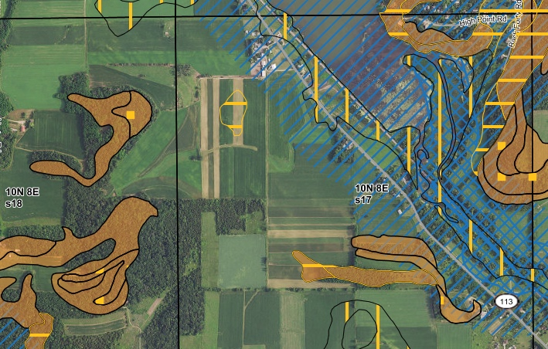
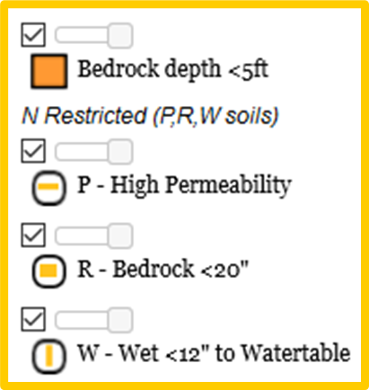
Nitrogen Restricted Soils-soils that are at high risk for leaching or shallow depth to bedrock
Late summer or fall manure or organic by-products
  Limit rates to 90 or 120 lbs N/ac
  Rate depends on manure dry matter, crops, and restricted soil type—P, W, or R soils

Slide 21
For late summer or fall manure or organic by-products with greater than 4% dry matter:
On W or W combination soils:
Limit to either 120 lbs available N/acre OR rates from A2809 –whichever is LESS.
On P and R Soils:
For established cover crops, overwintering annual crops, or perennial crops, limit rates to either120 lbs available N/acre OR rates from A2809 –whichever is LESS.
For annual crops that won’t be planted until Spring or Summer, delay application until soil temperatures are < 50 degrees F
AND limit rates to either120 lbs available N/acre OR rates from A2809 - whichever is LESS.

Slide 22
For late summer or fall manure or organic by-products with less than or equal to 4% Dry Matter:
On W or W combination soils:
Limit to either 90 lbs available N/acre OR
Use 120 lbs available N/acre AND do one of the following:
Apply on an established cover crop, overwintering annual crops, or perennial crop.
Use a nitrification inhibitor.
Establish a cover crop within 2 weeks of application.
Surface apply and do not incorporate for at least three days.
Delay application until after soil temperatures are < 50 degrees F.
On P and R Soils:
Limit to 120 lbs available N/acre
Delay application until soil temperatures are < 50 degrees F.
AND use a nitrification inhibitor
OR surface apply and do not incorporate for at least 3 days.

Slide 23
Winter Spreading Precautions
Notes:
M2.5.6 There are winter spreading restrictions in Wisconsin for surface water quality management areas (SWQMAs), slopes, and shallow soils over fractured bedrock. It is important to know the rules developed by the state and local government.

Slide 24

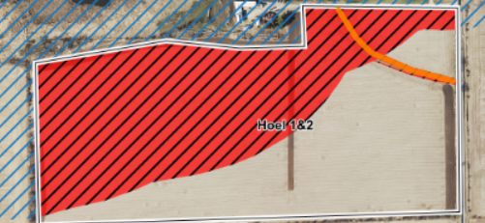
SWQMAs
Do not mechanically apply manure within the SWQMA.
Gleaning or pasturing of animals is allowed in SWQMA and on all slopes in winter.
SWQMA Map in non-winter season
Winter Spreading Map: Red=no spread

Slide 25
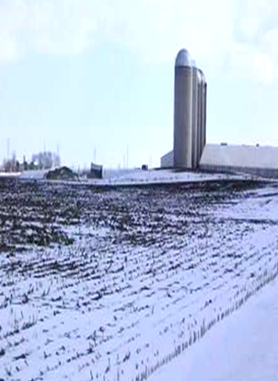
Application limitations
Manure applications cannot exceed the P removal of the following growing season’s crop.
Limit all winter manure applications to 60 lbs. of P2O5/ac or less.
Limit liquid manure applications to 7,000 gal/acre.

Slide 26
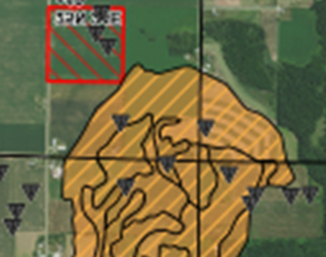
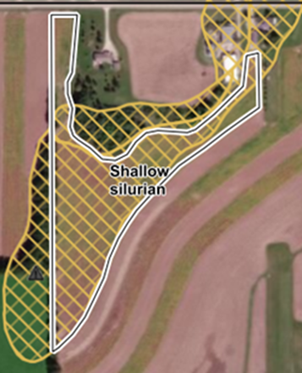
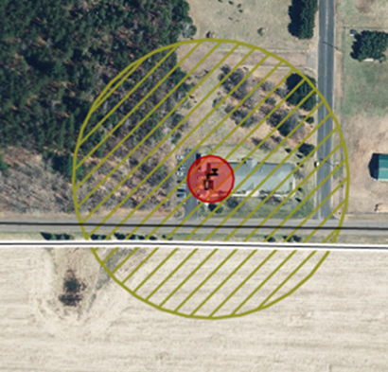
Spreading restrictions
Do not apply within 300 feet of direct conduits to groundwater.
Do not surface apply liquid manure during February and March on:
  DNR Well Compensation areas funds provided to replace wells when contaminated with livestock manure or;
  Silurian dolomite within five feet of soils surface.

Slide 27
Spreading Precautions
Do not apply manure and/or organic by-products on slopes greater than 6%, unless the plan documents that no other accessible fields are available for winter spreading and two or more of the following are implemented:
  Contour buffer strips or contour strip cropping.
  Leave all crop residue and no fall tillage.
  Apply manure in intermittent strips on no more than 50% of field.
  Apply manure on no more than 25% of the field during each application, waiting a minimum of 14 days between applications.
  Reduce manure app. rate to 3,500 gal. or 30 lbs. P2O5, whichever is less.

Slide 28
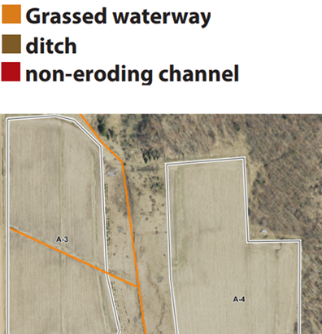
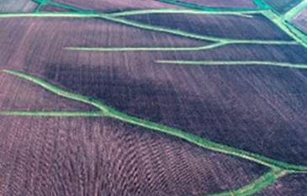
Spreading Precautions
Do not apply manure and/or organic by-products to fields where concentrated flow channels are present unless two or more of the following are implemented:
  Contour buffer strips or contour strip cropping.
  Leave all crop residue and no fall tillage.
  Apply manure in intermittent strips on no more than 50% of field.
  Apply manure on no more than 25% of the field per application, waiting at
  least two weeks between applications.
  Reduce manure app. rate to 3,500 gal. or 30 lbs. P2O5, whichever is less.
  No manure application within 200 feet of all concentrated flow channels.
  Fall tillage is on the contour and slopes are lower than 6%.

Slide 29
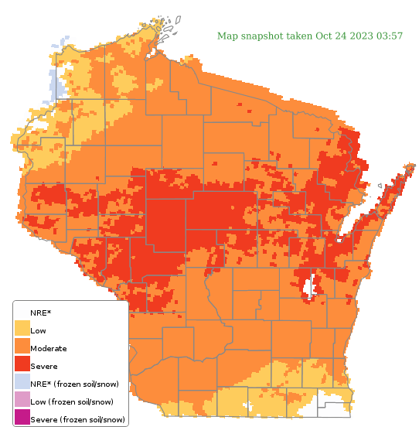
Runoff Risk Advisory Forecast
Tool to help determine risk of a runoff event before you spread.
If it’s RED, DON’T SPREAD
http://www.manureadvisorysystem.wi.gov/runoffrisk/index
Notes:
M2.5.5 The Manure Runoff Risk Advisory System can assist in identifying when and where spreading manure poses risks to surface waters.

Slide 30

Thanks!
Questions?
Name
Title
Nutrient and Pest Management (NPM) Program
UW-Madison Division of Extension
Email: Phone:

