Slide 2
Introduction to Nutrient Management Planning
Educator
Title
Program

Slide 3
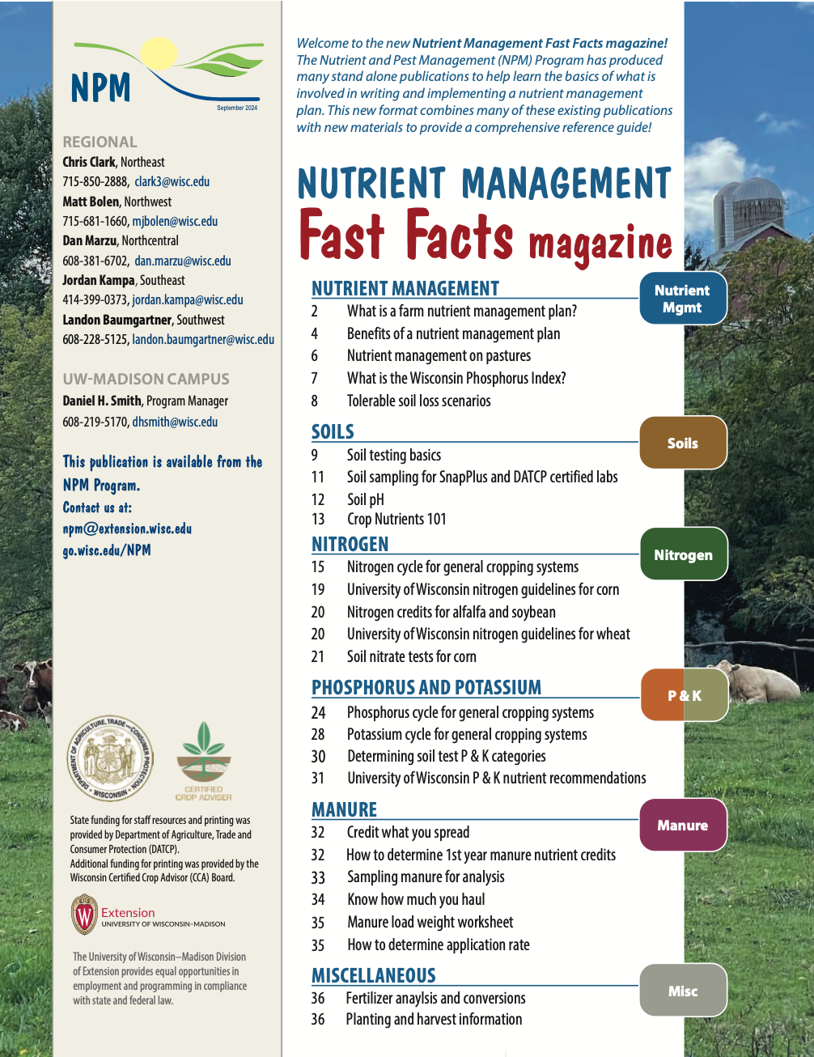

Following Along in Fast Facts?
Benefits of Nutrient Management: Pages 4-5 in Nutrient Management Fast Facts

Slide 4
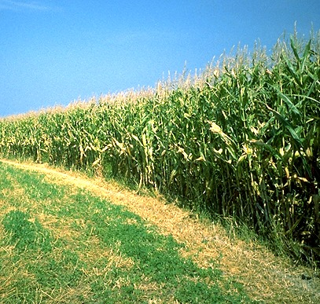
What is a Nutrient Management Plan?
Combine on-farm nutrient sources with commercial fertilizer to, meet crop need, maximize crop profitability, and minimize environmental impact
On-farm nutrient sources
(manure and legumes)
Commercial fertilizer
Minimize nutrient losses
Notes:
NM1.1.1 A NM plan is a strategy for obtaining the maximum economic return from both on- and off-farm fertilizer resources in a manner that promotes soil conservation and protects the quality of nearby water resources.
NM1.1.2 A successful plan has agronomic, economic, and environmental benefits.
NM1.1.3 The overall goal of a NM plan is to balance nutrient applications with crop needs and to minimize losses to the environment.

Slide 5
Why Nutrient Management Planning?
Nitrogen @ $0.40/lb.; P₂O₅ @ $0.50/lb.; K₂O @ $0.55/lb.
Alfalfa N = $ 2,400
(50 acres/yr. @ 120 lbs. N/a)
Manure N = $ 3,240
(27 tons/cow/year @ 3 lbs. N/ton)
Manure K₂O = $ 8,910
(27 tons/cow/year @ 6 lbs. K₂O/ton)
Manure P₂O₅ = $ 4,050
(27 tons/cow/year @ 3 lbs. P₂O₅/ton)
Total On-Farm N + P₂0₅ + K₂O = $18,600
Notes:
NM1.1.4 Writing and following an nutrient management plan often increases a farm’s profitability by improving soil fertility and cropping practices.

Slide 6

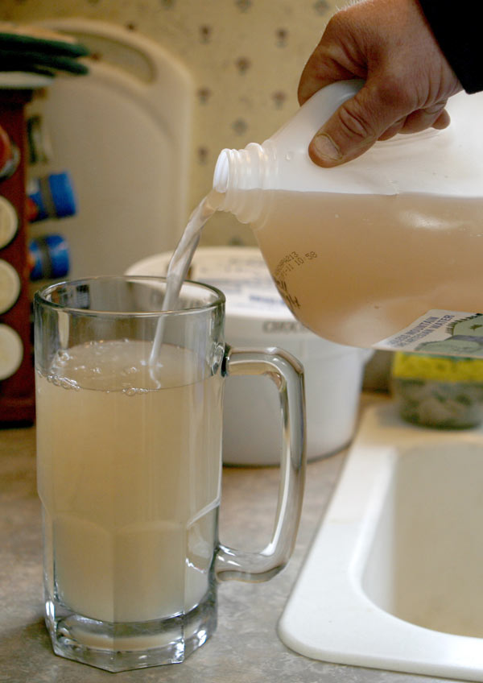
Why Nutrient Management Planning?
Notes:
NM1.1.5 Writing and following a nutrient management plan can potentially reduce the loss of nutrients to both surface and groundwater through improved understanding of a farm’s management practices, underlying soil attributes and potential sensitive areas. Phosphorus movement from the landscape can impair surface water quality. Nitrogen can leach from the soil and impair groundwater quality.

Slide 7
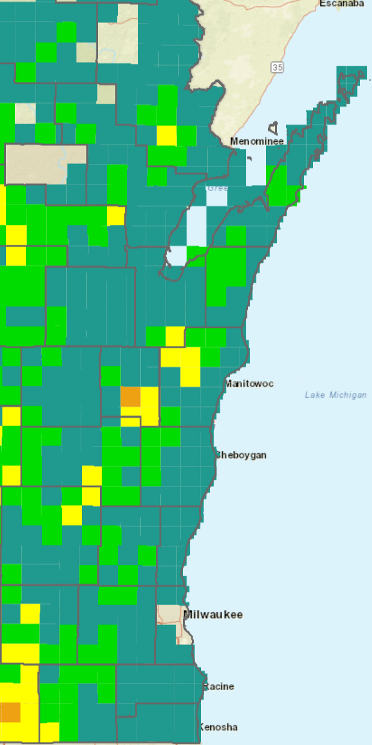
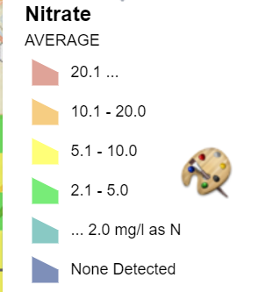
Why Nutrient Management Planning?
Nitrate is the most detected groundwater contaminant in WI.
10 to 15% of well water samples exceed the drinking water health standard of 10 ppm nitrate-N
Phosphorus in runoff degrades lakes and streams.
Notes:
NM1.1.5 Writing and following a nutrient management plan can potentially reduce the loss of nutrients to both surface and groundwater through improved understanding of a farm’s management practices, underlying soil attributes and potential sensitive areas. Phosphorus movement from the landscape can impair surface water quality. Nitrogen can leach from the soil and impair groundwater quality.

Slide 8
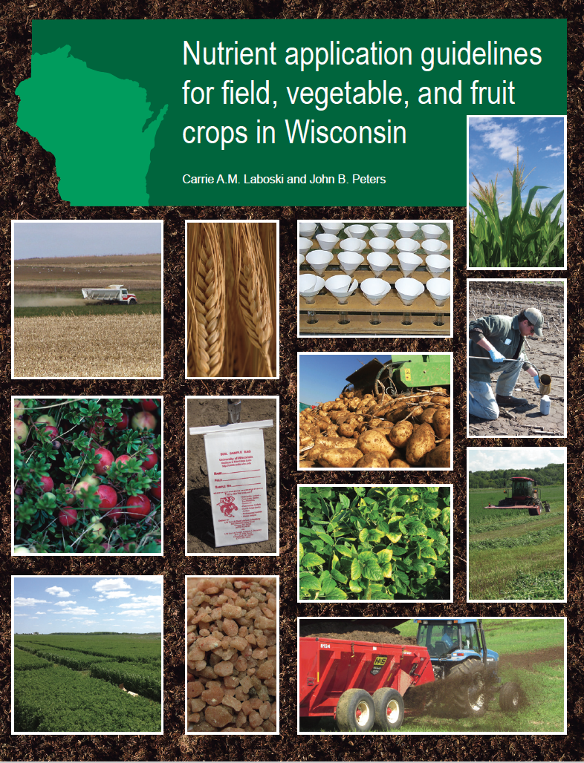
A2809- Nutrient Application Guidelines for Field, Vegetable, and Fruit Crops in Wisconsin
Provides info on how to collect soil samples, interpret soil test results, and determine nutrient application rates and nutrient credits for most crops grown in Wisconsin.
A2809 is available online for free through the UW-Madison Division of Extension.
Notes:
S7.2.1 Nutrient Application Guidelines for Field, Vegetable, and Fruit Crops in Wisconsin (A2809) describes how to collect soil samples, interpret soil test results, and determine nutrient application rates and nutrient credits for most crops grown in Wisconsin. A2809 also provides guidelines for nutrient applications to improve nutrient uptake efficiency and reduce environmental risk. A compliant Wisconsin NMP follows the nutrient application guidelines outlined in A2809.
S7.2.2 The chapters in A2809 are grouped as such: 1) soil sampling protocols, 2) required soil testing procedures, 3) base soil and crop information from which recommendations are based, 4) lime and nutrient recommendations, 5) nutrient crediting for manure, organic wastes, and legumes, 6) starter fertilizers, and 7) supplemental information. You are quickly able to find information using the PDF bookmarks.
S7.2.3 A2809 is revised periodically.
S7.2.4 A2809 is available online through UW-Madison Division of Extension.

Slide 9
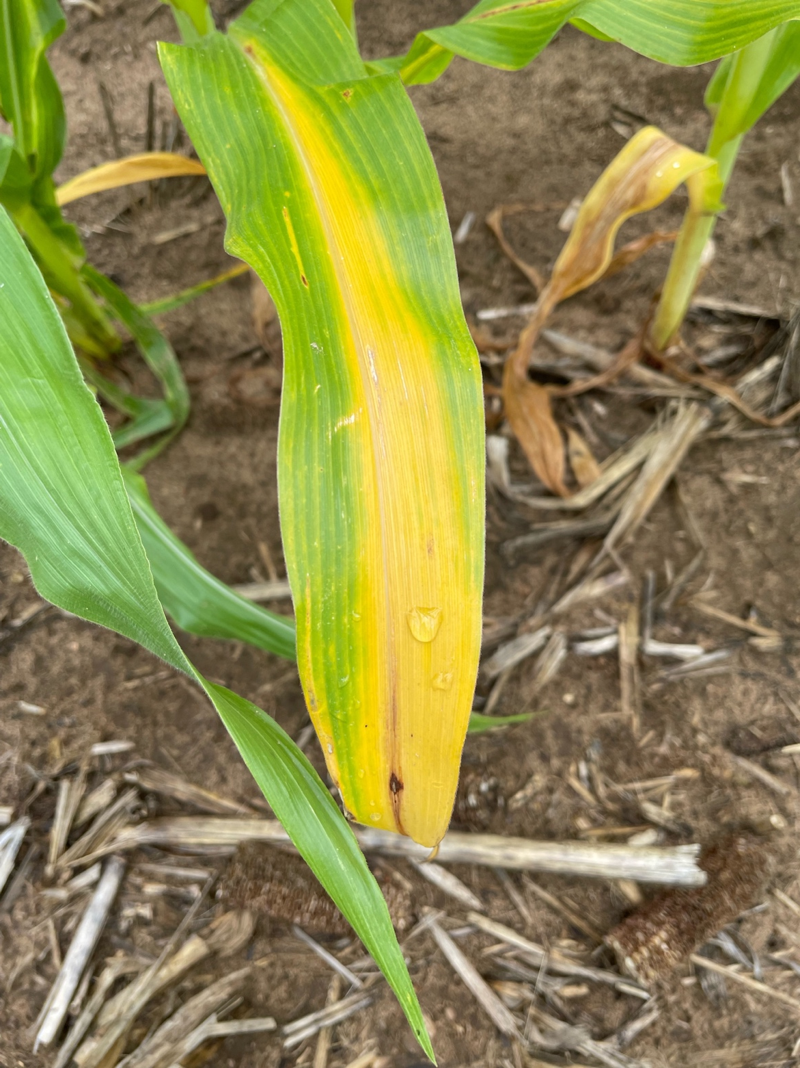
A Nutrient Management Plan Will:
Measure current levels of soil fertility
Determine crop nutrient needs
Account for on-farm nutrient resources
Manure applications
Legumes in crop rotation
Residual soil nitrate
Adjust commercial fertilizer application rates
Notes:
NM2.1.1 A nutrient management plan has five basic components: 1) Soil test results, 2) On-farm nutrient resources inventory and nutrient crediting of those resources, 3) Cropping plan, 4) On-farm conservation practices inventory, 5) Nutrient application plan.

Slide 10
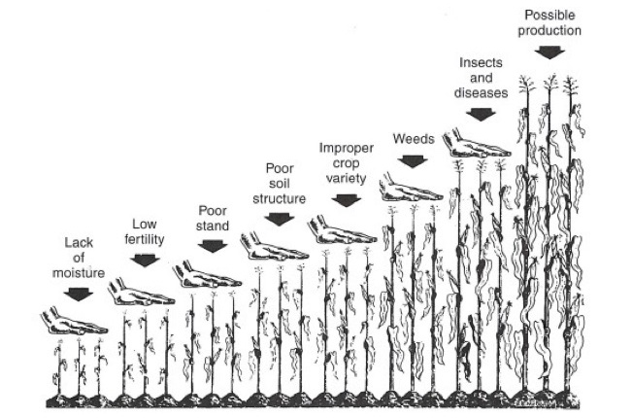
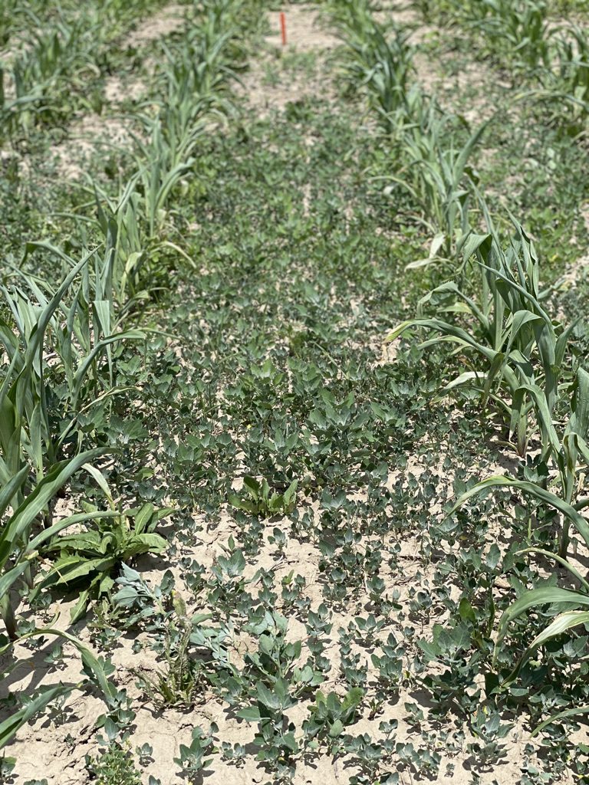
More Fertilizer does not always = More Yield
Source: Potash and Phosphate Institute and Dr. Chris Baxter- UW Platteville
Notes:
NM2.1.1 A nutrient management plan has five basic components: 1) Soil test results, 2) On-farm nutrient resources inventory and nutrient crediting of those resources, 3) Cropping plan, 4) On-farm conservation practices inventory, 5) Nutrient application plan.

Slide 11

Additional Slides to Use as Needed

Slide 12

Strip Till
Strip till allows producers to apply fertilizer to the root zone and perform tillage for similar planting conditions as full tillage systems.
Strip till reduces soil and phosphorus loss when compared to full tillage systems but will see greater losses than no-till.
Soil fertility inputs should still be managed using A2809 recommendations.
Cover crops and manure can be used in strip till systems with proper planning.

Slide 13
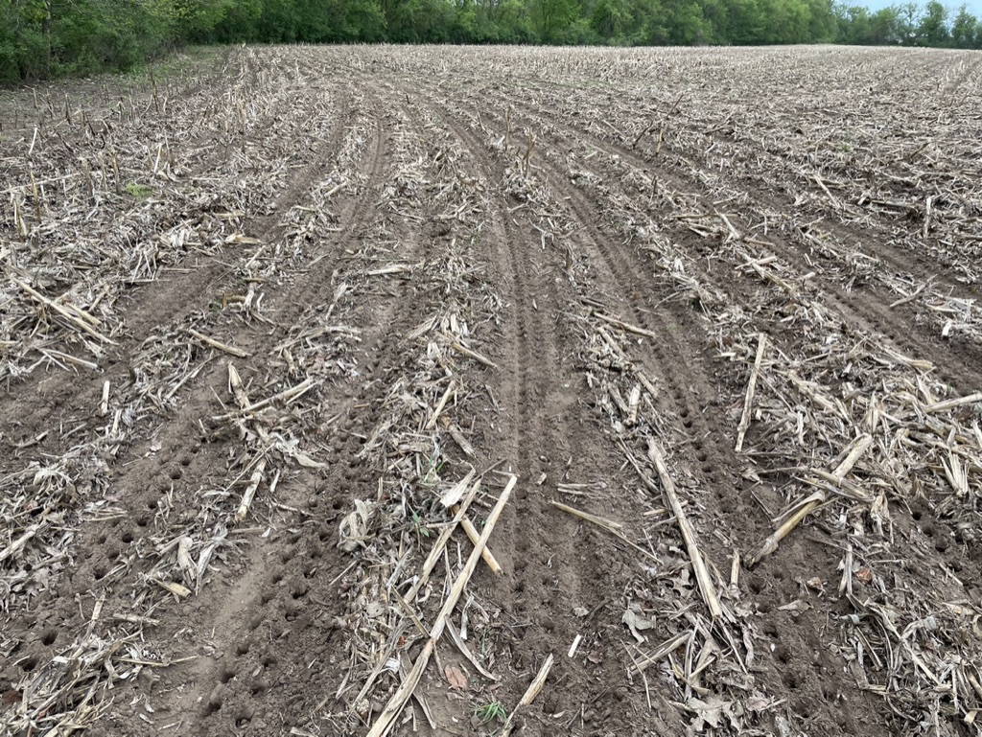
No-Till
No-till cropping systems help reduce the loss of soil and nutrients to the environment.
No tillage is done in this system and the planter set-up and maintenance is critical for success.
Soil pH can change on the surface in long-term no-till systems and separate soil samples should be collected to measure pH and soil fertility.
Starter fertilizer often shows positive return on investment.

Slide 14
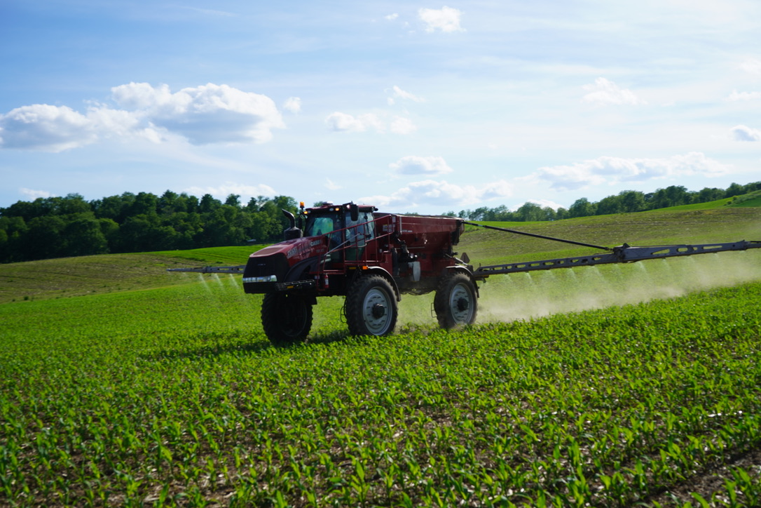
Base Cation Saturation Ratio
University of Wisconsin recommendations are based on building and maintaining soil test values to optimum levels.
Base cation saturation ratio states an “ideal” soil has a certain calcium to magnesium ratio or these being in “balance.”
No evidence of Calcium to Magnesium ration effect on crop yield.
Fertilize the crop and not the soil.
https://extension.soils.wisc.edu/wp-content/uploads/sites/68/2016/03/Gaspar-Laboski-WCMC-2016-Base-saturation.pdf

Slide 15
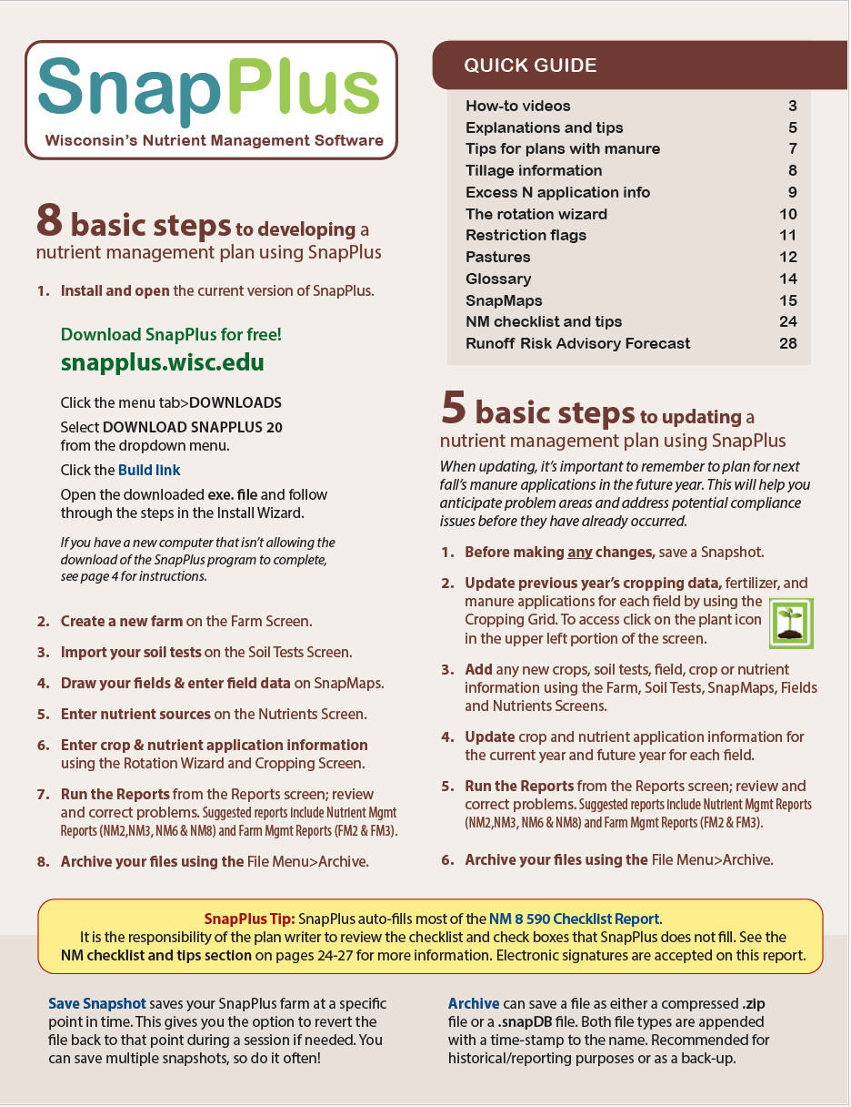
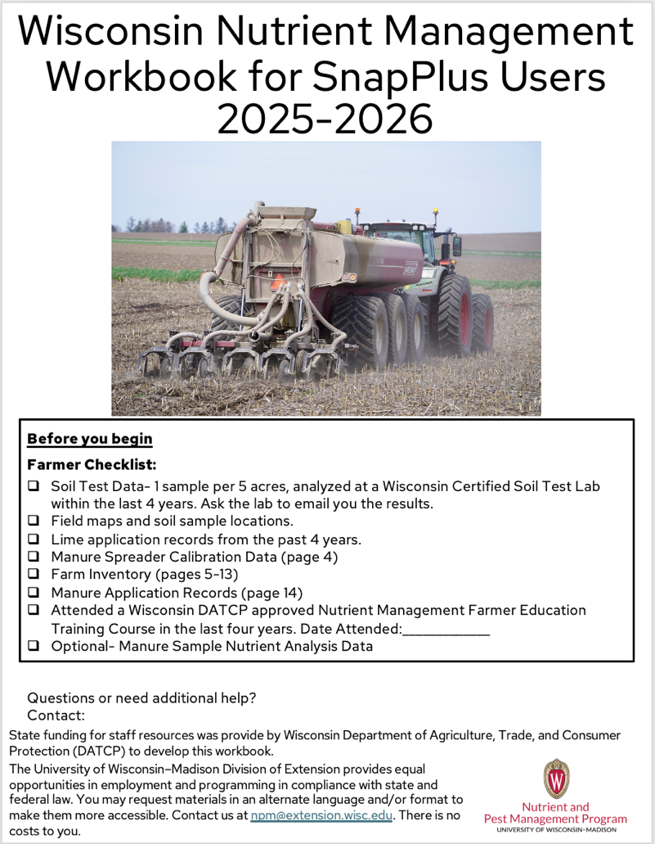

SnapPlus Version 2 Time to switch to the SnapPlus Quick Guide
SnapPlus Quick Guide
Use data from your workbook for SnapPlus users to complete many sections in the program.

Slide 16

Nutrient Management Planning in WI= SnapPlus
SNAP=Soil Nutrient Application Planner
The SnapPlus program produces field-by-field nutrient management plans that meet the 590 standard
Calculates Phosphorus Index (PI) values
Estimates soil loss
Available for free at snapplus.wisc.edu

Slide 17
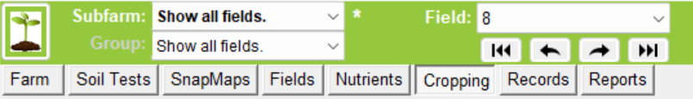
Nutrient Management Components
General farm info and narrative
Soil test results
Field Maps
On-farm nutrient resources inventory and nutrient crediting of those resources
Cropping plan/rotation
On-farm conservation practice inventory
Nutrient application plan and precautions
Checklist and optional reports
Notes:
NM2.1.1 A nutrient management plan has five basic components: 1) Soil test results, 2) On-farm nutrient resources inventory and nutrient crediting of those resources, 3) Cropping plan, 4) On-farm conservation practices inventory, 5) Nutrient application plan.

Slide 18
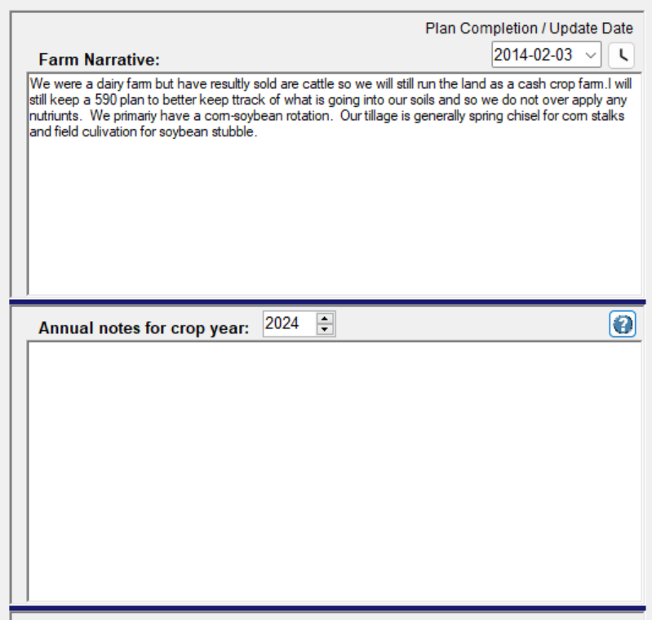
Nutrient Management Components- Farm Narrative
Provide a plan narrative
Explain deviations from the 590 standard
Explain manure application restrictions
No winter spreading
Critical areas
Surface water setbacks
Verify ability to utilize all the manure produced
Manure spreading agreements, etc.
Soil fertility and liming alerts
Notes:
NM2.2.6 Most NM plans should include a plan narrative that explains issues such as deviations from the 590 standard, soil fertility or liming alerts, and/or manure application restrictions.

Slide 19
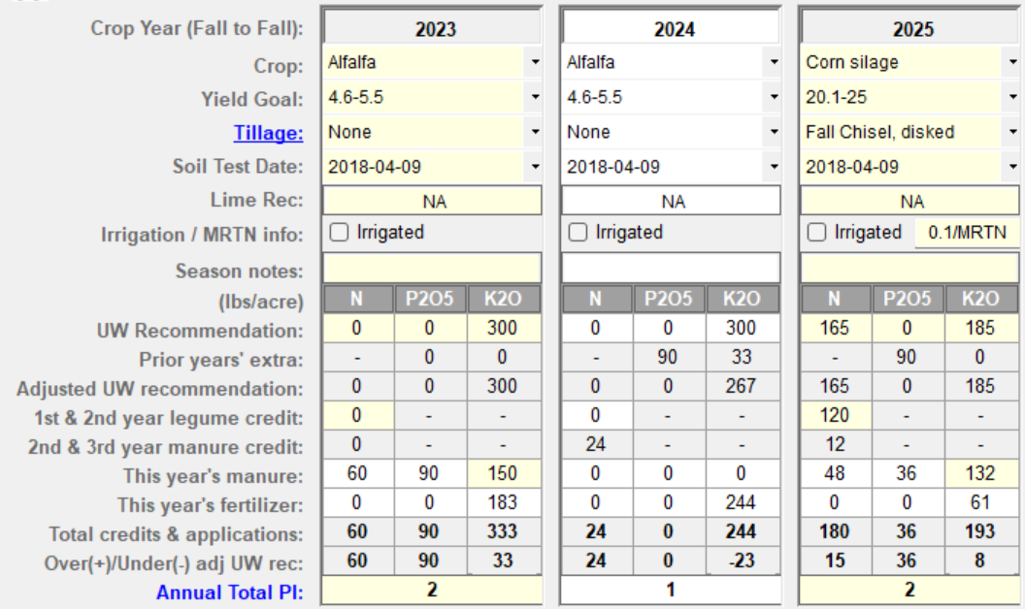
Nutrient Management Components
A well written NMP provides guidance for the future based on soil test data and planned applications and provides excellent cropping records. For the best data, annual updates are critical.
Notes:
NM2.1.2 A NM plan is a dynamic tool that can be used to access current soil fertility practices and develop future farm goals.
NM2.1.3 A NM plan can be a very effective record-keeping tool.
NM2.1.4 NM plans require annual updating.

Slide 20
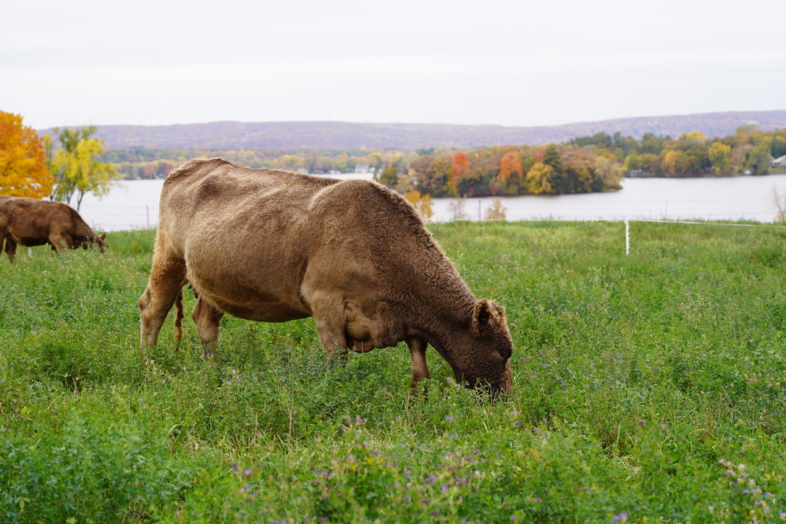
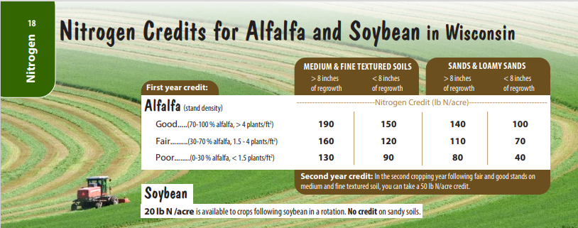
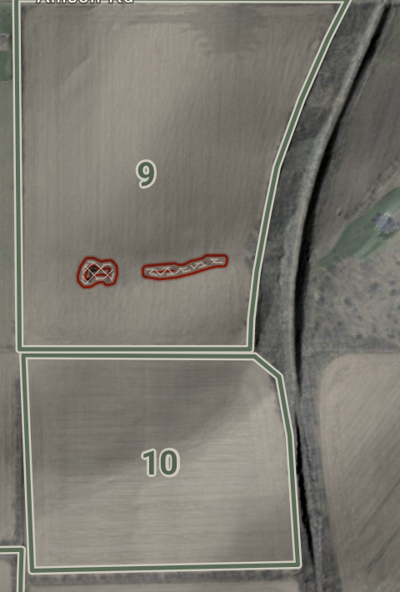
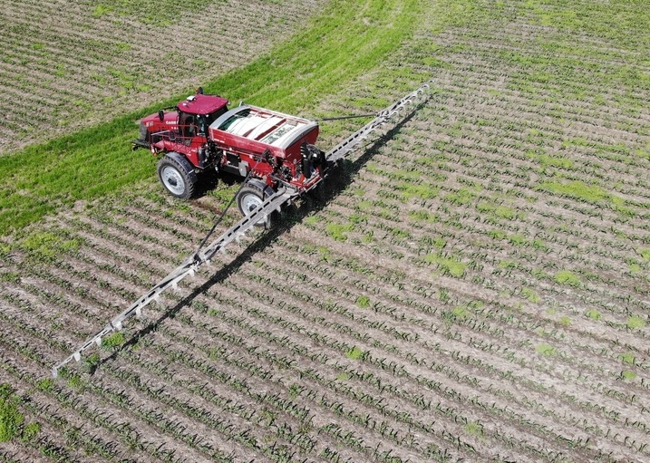
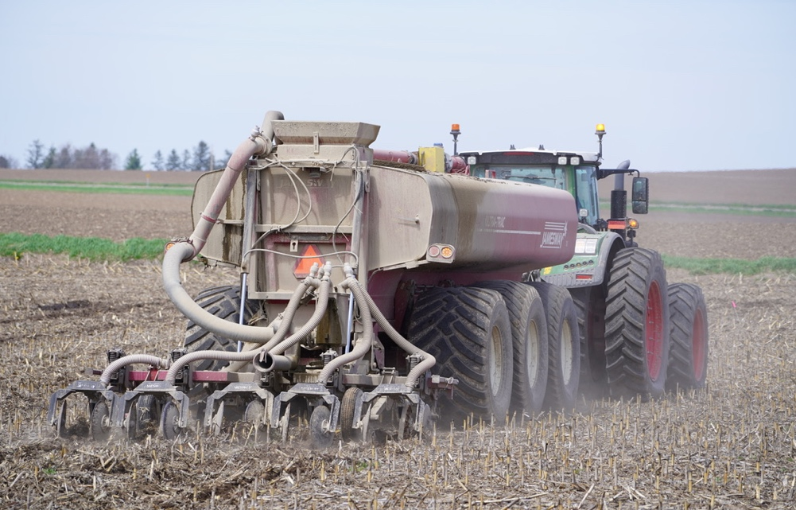
Nutrient Management Components- Nutrients
Notes:
NM2.2.1 Soil test results provide the base nutrient recommendations for each field.
NM2.2.2 All on-farm nutrient resources – manure, legumes in the crop rotation, biosolids and other organic amendments, residual soil nitrate – must be included since they all contain nutrients and need to be accounted for or “credited.”
Inventory of manure production and equipment capabilities
Annual manure production estimate
Manure nutrient content
Manure spreader calibration
Manure spreader capabilities

Slide 21
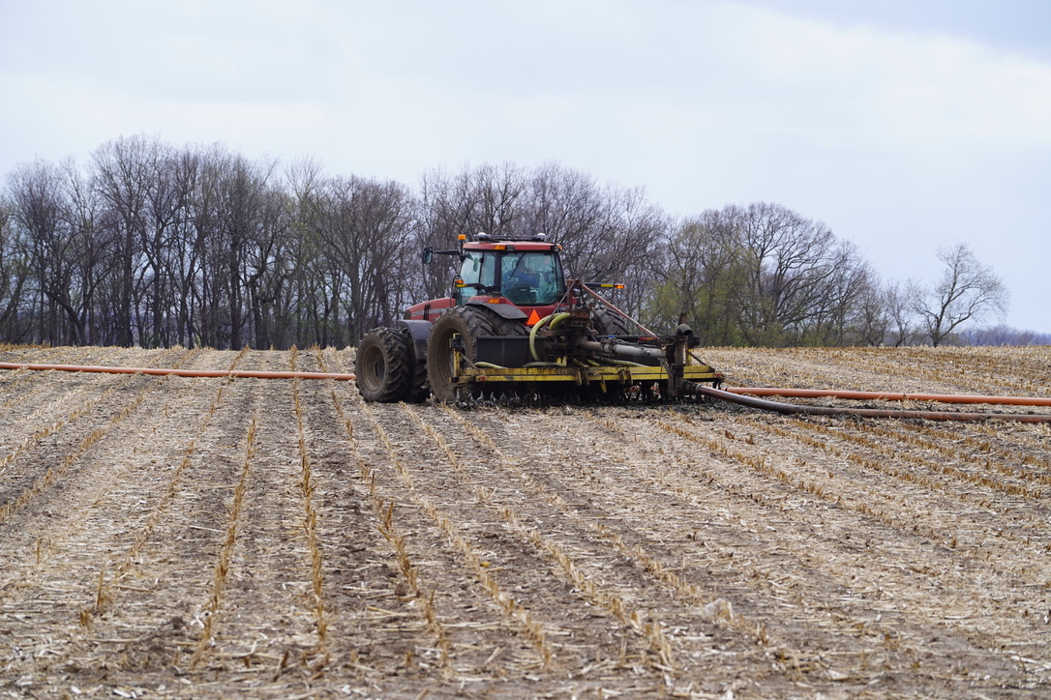
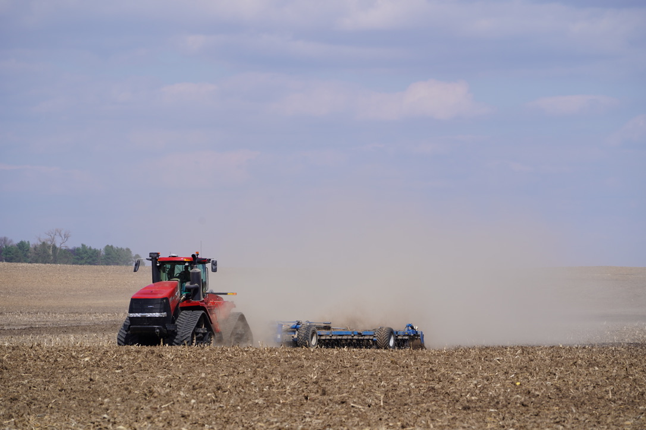
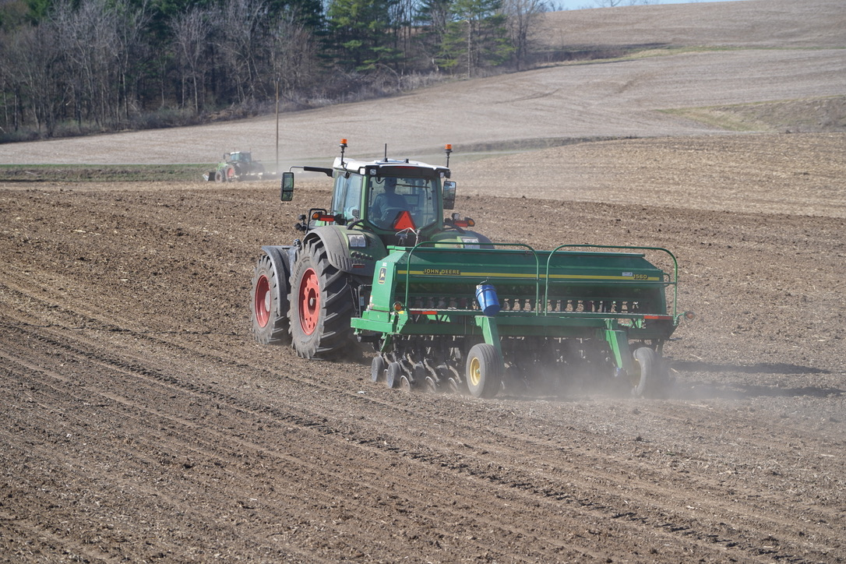
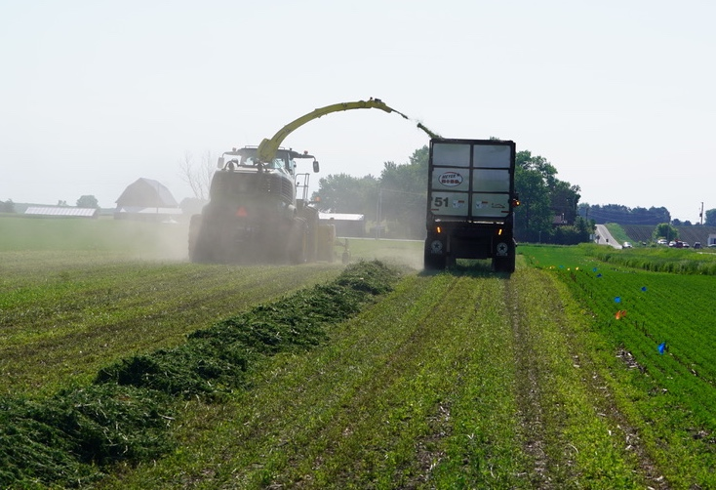
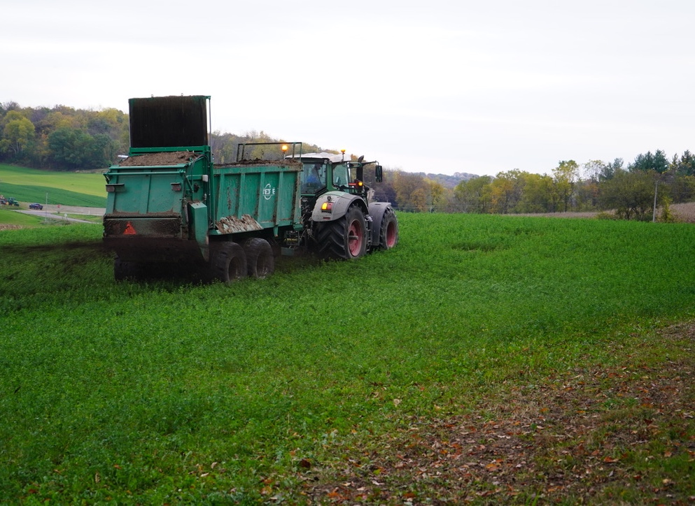
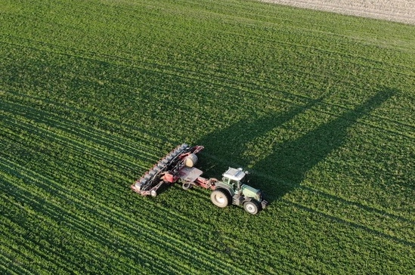
Nutrient Management Components- Crop Rotation
The plan must include all planned tillage, nutrient, planting, and crop harvests, including cover crops. Four complete crop years is recommended for planning purposes.
Notes:
NM2.2.3 The plan must be written for the entire crop rotation.
NM2.2.5 The nutrient application plan includes all manure, biosolids, lime and fertilizer applications.

Slide 22
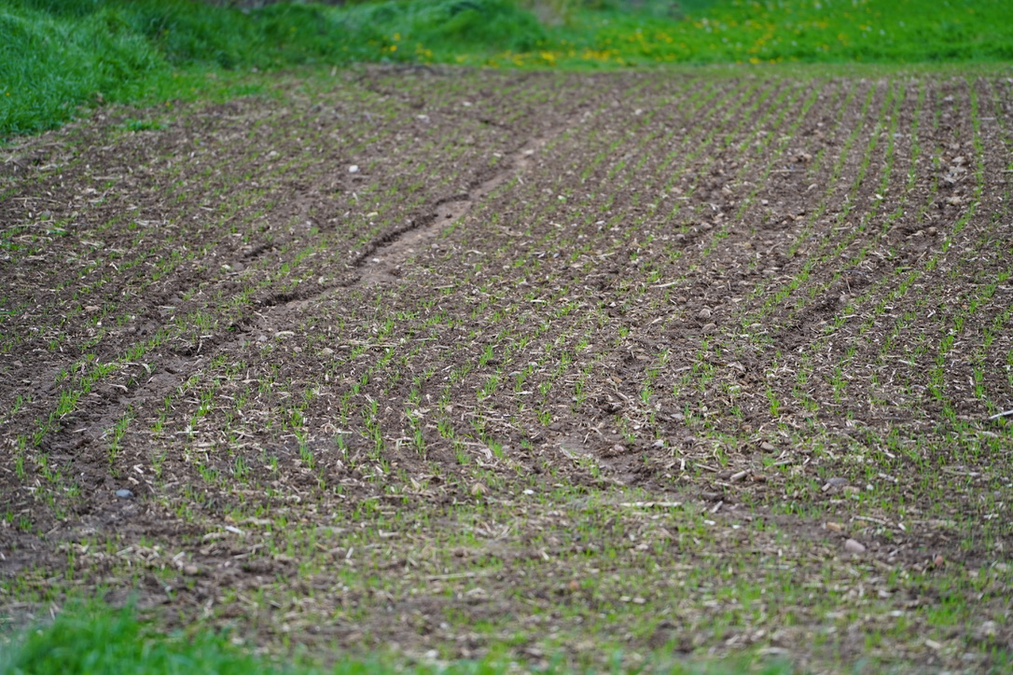
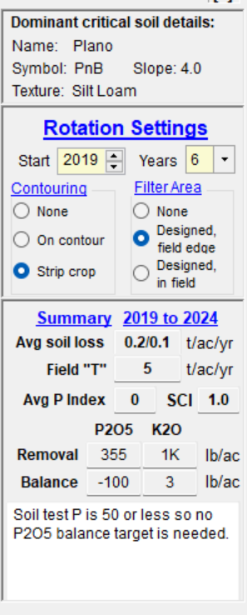
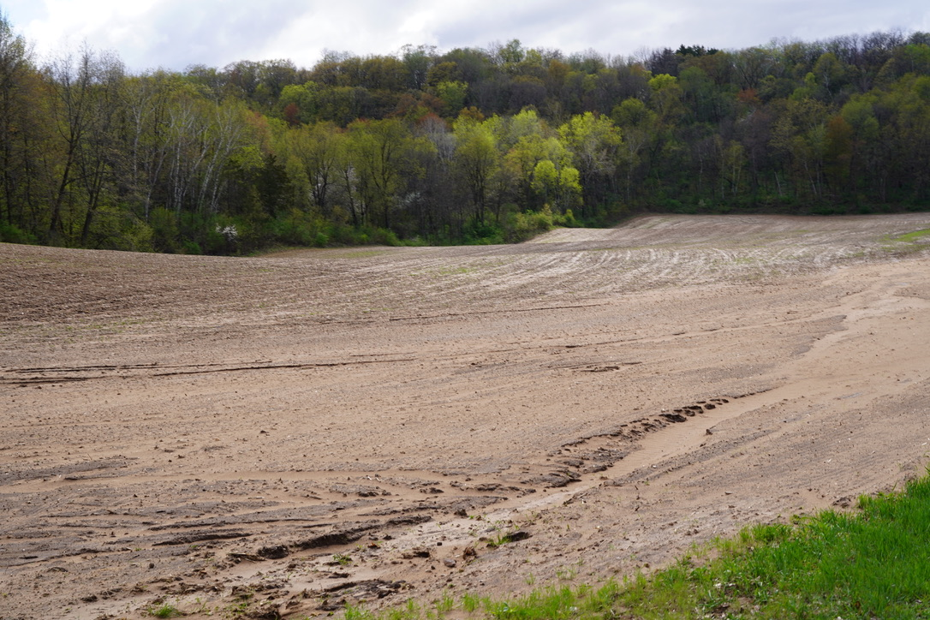
Nutrient Management Components- Soil Conservation
Notes:
NM2.2.4 The farm conservation plan must be updated so that all field receiving nutrients are at tolerable soil loss (T) limits.

Slide 23
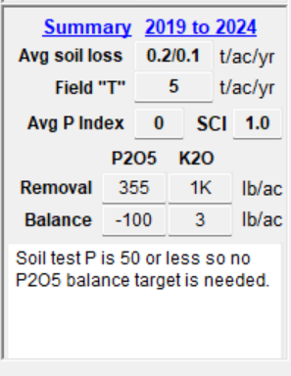
Nutrient Management Components- WI Phosphorus Index
The P Index uses general cropping, soil test and long-term weather information to estimate a field’s annual phosphorus runoff to nearby surface waters.
The P Index is reported as a whole number — the higher the number, the greater the potential for that field to contribute phosphorus to nearby lakes and streams.
The crop rotation average P Index must be below 6 and the field P Index must be below 12 for compliance.
See Page 7 in the Fast Facts Magazine on info on managing the P Index.
Reducing soil loss = reducing P Index values.

Slide 24
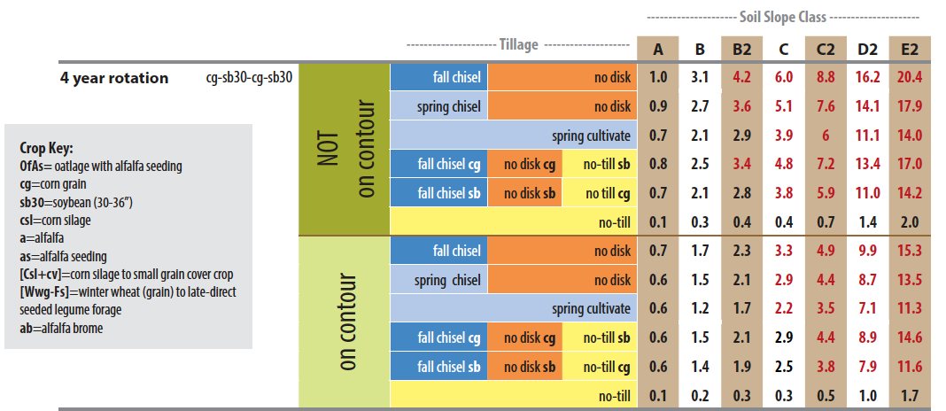
Nutrient Management Components- Average Soil Loss and Field “T”
Soil loss tolerance (T) is the maximum amount of soil loss in tons per acre per year that can be tolerated and still permit a high level of productivity to be sustained economically and indefinitely. No amount of soil loss is easy to replace.
Notes:
NM2.2.4 The farm conservation plan must be updated so that all field receiving nutrients are at tolerable soil loss (T) limits.

Slide 25
Nutrient Management Components- Soil Conservation
A plan to minimize soil erosion from cropland fields using various management or structural practices.
Management: crop rotations, residue management/tillage, contour strips, etc.
Structures: terraces, waterways, diversions, etc.
Conservation plan information
Soil loss (T)
Crop rotation
Field slope
Residue/tillage
Soil maps
Aerial photos
Field boundary + acreage accuracy
Notes:
NM2.2.4 The farm conservation plan must be updated so that all field receiving nutrients are at tolerable soil loss (T) limits.

Slide 26
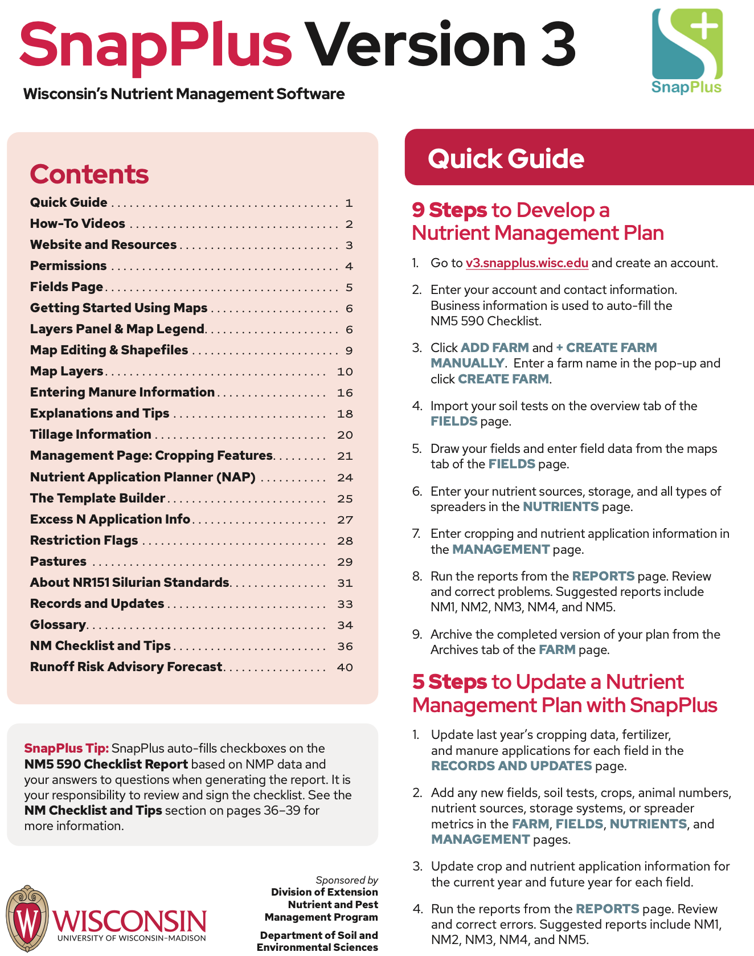
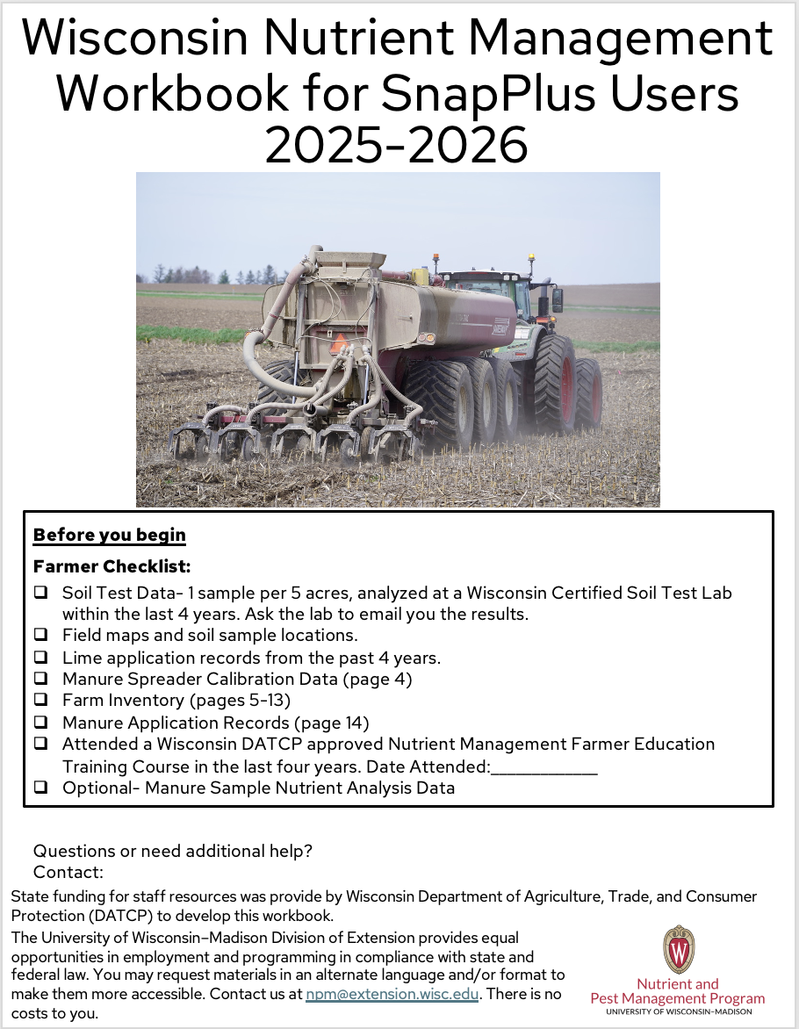
SnapPlus Version 3 Time to switch to the SnapPlus Quick Guide
Use data from your workbook for SnapPlus users to complete many sections in the program.

Slide 27
Nutrient Management Planning in WI= SnapPlus
SNAP=Soil Nutrient Application Planner
The SnapPlus program produces field-by-field nutrient management plans that meet the 590 standard
Calculates Phosphorus Index (PI) values
Estimates soil loss
Available for free online: https://snapplus.wisc.edu/snapplus-3/

Slide 28
Nutrient Management Components
General farm info and narrative
Soil test results
Field Maps
On-farm nutrient resources inventory and nutrient crediting of those resources
Cropping plan/rotation
On-farm conservation practice inventory
Nutrient application plan and precautions
Checklist and optional reports
Notes:
NM2.1.1 A nutrient management plan has five basic components: 1) Soil test results, 2) On-farm nutrient resources inventory and nutrient crediting of those resources, 3) Cropping plan, 4) On-farm conservation practices inventory, 5) Nutrient application plan.

Slide 29
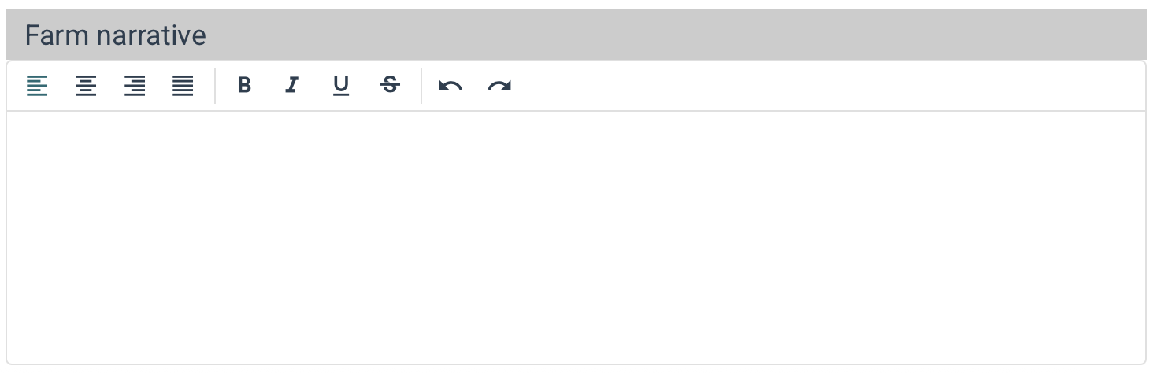
Nutrient Management Components- Farm Narrative
Provide a plan narrative
Explain deviations from the 590 standard
Explain manure application restrictions
No winter spreading
Critical areas
Surface water setbacks
Verify ability to utilize all the manure produced
Manure spreading agreements, etc.
Soil fertility and liming alerts
Notes:
NM2.2.6 Most NM plans should include a plan narrative that explains issues such as deviations from the 590 standard, soil fertility or liming alerts, and/or manure application restrictions.

Slide 30
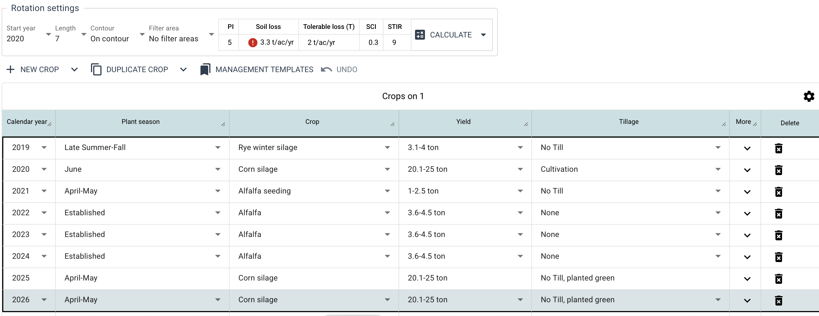
Nutrient Management Components
A well written NMP provides guidance for the future based on soil test data and planned applications and provides excellent cropping records. For the best data, annual updates are critical.
Notes:
NM2.1.2 A NM plan is a dynamic tool that can be used to access current soil fertility practices and develop future farm goals.
NM2.1.3 A NM plan can be a very effective record-keeping tool.
NM2.1.4 NM plans require annual updating.

Slide 31
Nutrient Management Components- Nutrients
Notes:
NM2.2.1 Soil test results provide the base nutrient recommendations for each field.
NM2.2.2 All on-farm nutrient resources – manure, legumes in the crop rotation, biosolids and other organic amendments, residual soil nitrate – must be included since they all contain nutrients and need to be accounted for or “credited.”
Inventory of manure production and equipment capabilities
Annual manure production estimate
Manure nutrient content
Manure spreader calibration
Manure spreader capabilities

Slide 32
Nutrient Management Components- Crop Rotation
The plan must include all planned tillage, nutrient, planting, and crop harvests, including cover crops. Four complete crop years is recommended for planning purposes.
Notes:
NM2.2.3 The plan must be written for the entire crop rotation.
NM2.2.5 The nutrient application plan includes all manure, biosolids, lime and fertilizer applications.

Slide 33
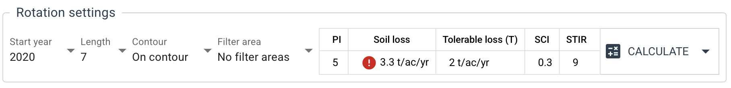
Nutrient Management Components- Soil Conservation
Notes:
NM2.2.4 The farm conservation plan must be updated so that all field receiving nutrients are at tolerable soil loss (T) limits.

Slide 34
Nutrient Management Components- WI Phosphorus Index
The P Index uses general cropping, soil test and long-term weather information to estimate a field’s annual phosphorus runoff to nearby surface waters.
The P Index is reported as a whole number — the higher the number, the greater the potential for that field to contribute phosphorus to nearby lakes and streams.
The crop rotation average P Index must be below 6 and the field P Index must be below 12 for compliance.
See Page 7 in the Fast Facts Magazine on info on managing the P Index.
Reducing soil loss = reducing P Index values.

Slide 35
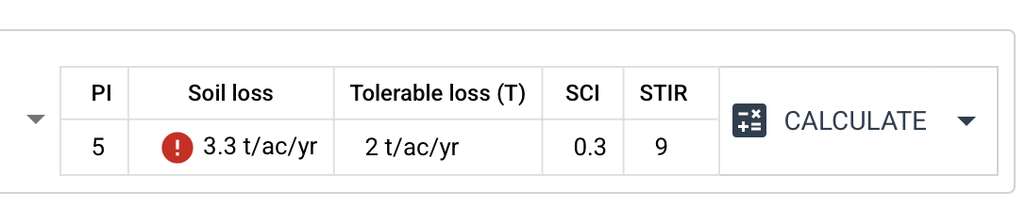
Nutrient Management Components- Average Soil Loss and Field “T”
Soil loss tolerance (T) is the maximum amount of soil loss in tons per acre per year that can be tolerated and still permit a high level of productivity to be sustained economically and indefinitely. No amount of soil loss is easy to replace.
Notes:
NM2.2.4 The farm conservation plan must be updated so that all field receiving nutrients are at tolerable soil loss (T) limits.

Slide 36
Nutrient Management Components- Soil Conservation
A plan to minimize soil erosion from cropland fields using various management or structural practices.
Management: crop rotations, residue management/tillage, contour strips, etc.
Structures: terraces, waterways, diversions, etc.
Conservation plan information
Soil loss (T)
Crop rotation
Field slope
Residue/tillage
Soil maps
Aerial photos
Field boundary + acreage accuracy
Notes:
NM2.2.4 The farm conservation plan must be updated so that all field receiving nutrients are at tolerable soil loss (T) limits.

