Slide 2
Soil Health
Notes:
Would this be a better into slide?

Slide 3
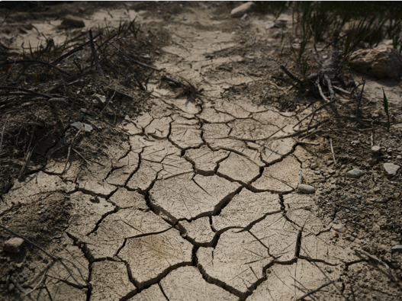
All over the country [some soils are] worn out, depleted, exhausted, almost dead. But here is comfort: These soils possess possibilities and may be restored to high productive power, provided you do a few simple things.
- C.W. BURKETT, 1907 -

Slide 4
Is it really that bad?
The productivity of some lands worldwide has declined by 50% due to soil erosion & desertification
The estimated annual cost of erosion from agriculture in the USA is about $44 billion per year or about $100 per acre
Some of the best soil has already washed away
Globally the annual loss of 75 billion tons of soil costs the world about $400 billion per year, or approximately $70 per person per year

Slide 5
Is it really that bad?
Yield reductions of 20 to 40% have been measured for row crops in the Midwestern states (Schumacher et al., 1994)
Soil compaction is a worldwide problem, causing yield reductions of 25 to 50% in some regions of Europe (Ericksson et al., 1974) and North America
On-farm losses through compaction in the USA have been estimated at $1.2 billion per year (Gill, 1971).

Slide 6
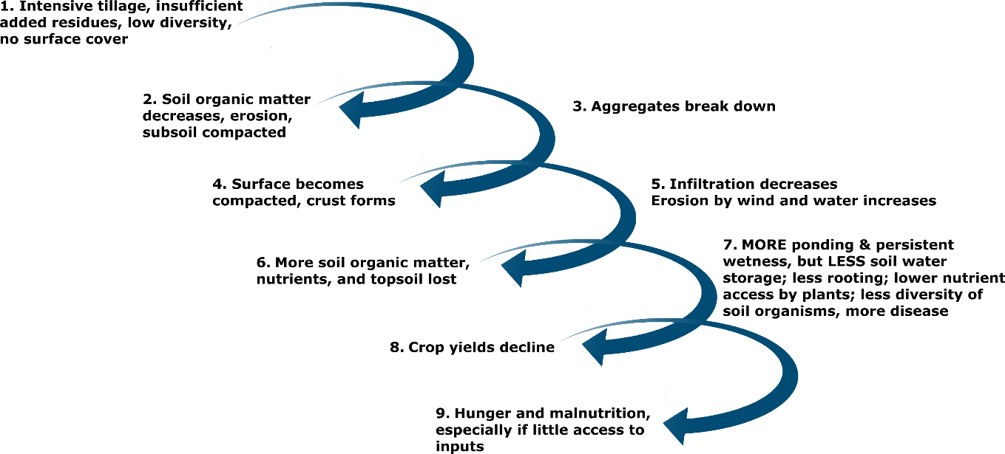
How does it happen?

Slide 7
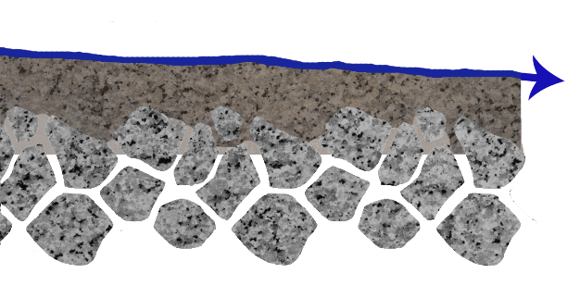
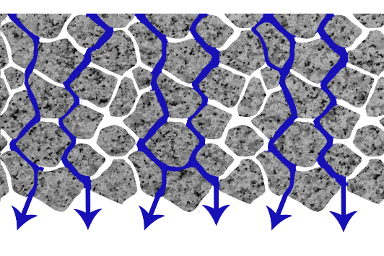
Erosion and Soil Health
Runoff
Soil Seals and Crusts after Aggregates Break Down
Infiltration
Aggregated Soil

Slide 8
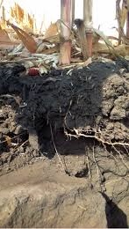
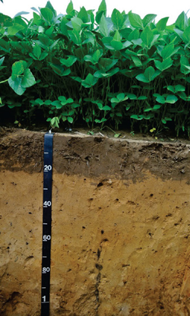
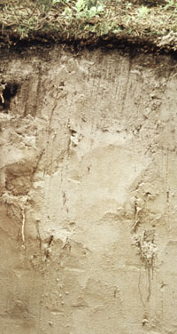
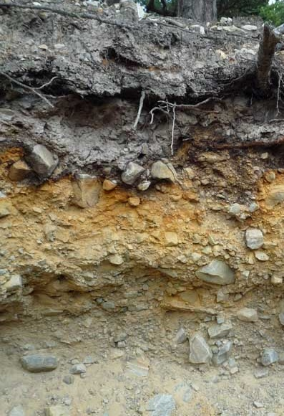
What kind of soil do you want for your crops?
A. B. C. D.

Slide 9
What kind of soil do you want on the farm?
High Quality crops to feed cows
Lack of erosion
High yield
Low weed pressure
Takes less horsepower to till
Higher water infiltration
Healthy Vigorous Plants better able to resist diseases/insects
Provides excellent seed bed with ease of root growth
Healthy Soil

Slide 10
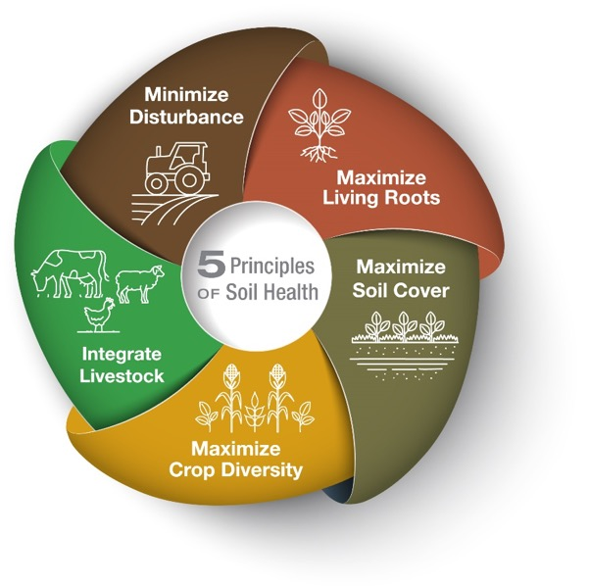
Soil Health and Conservation
Source: Randy Zogbaum – WI DATCP Land & Water Resources Bureau

Slide 11
Soil Health Definition
The USDA-NRCS defines soil health as:
…the continued capacity of soil to function as a vital living ecosystem that sustains plants, animals, and humans
Key components of this definition:
The soil contains a wide variety of living organisms, habitats, and environments and is an ecosystem in and of itself.
+
The maintenance and improvement of soil ecosystems and soil function contributes to agricultural sustainability and environmental quality.
Source: Randy Zogbaum – WI DATCP Land & Water Resources Bureau

Slide 12
Soil Health=Soil Function
Soil health is achieved through improving the soil’s properties, which are linked to the
soil’s functions.
nutrient cycling
regulating water
filtering and buffering pollutants
sustaining plant and animal life
Providing physical stability and support
Source: Randy Zogbaum – WI DATCP Land & Water Resources Bureau

Slide 13
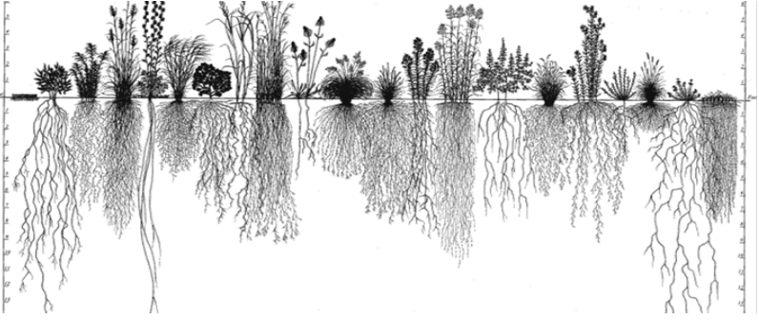
Aboveground diversity is a mirror for belowground diversity.
Roots normally account for 10-20% of the total plant weight
But contribute 12% of soil organic C, 31% soluble organic C, and 52% of the microbial biomass C (Liang et al. 2002)

Slide 14
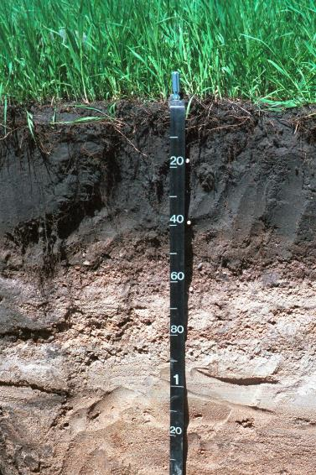
Soil Health – Start thinking C-N-P-K
Agronomy and farmers are trained and so used to feeding the crop.
Yet there needs to be a mindset shift to feeding the soil. Creating a healthy soil that will do more work for you.
C-Carbon is the food source for soil life.
Good management creates a resilient soil ready for all types of weather

Slide 15
Ask yourself – Which side do you have more check marks for?
Increases Soil Health
No-till/minimum till
Cover crops/relay crops
Diverse crop rotations
Increases biomass in fields above ground variety = underground variety
Perennial crops in crop rotation
Manure
Increase crop residue
Integrated pest management
Weed control by cultivation/mulching
Rotational/prescribed grazing
Variable rate/prescription fertilizer use
Decreases Soil Health
Aggressive/recreational tillage
Fields left fallow in off season
Bare soil can erode which reduces productivity
When do you get the most rain? Make sure your fields are covered during that time
Mono-cropping
Annual crops
Extensive/excessive fertilizer
Excessive crop residue removal
Broad spectrum pest control
Broad spectrum weed control

Slide 16
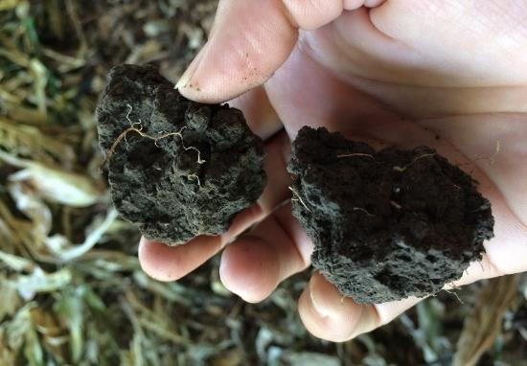
Keys to building healthy, high-quality soil
Stick to the basics:
  Manage soil fertility status with regular soil testing
  Maintain optimal pH levels for your crops and a sufficient supply of nutrients for crop need
  Follow a crop/nutrient management plan
Apply lime to adjust pH
Work toward keeping soils covered year round
Add diverse sources of organic materials to the soil
Reduce tillage and prevent compaction

Slide 17
Insert Local NOPP Soil Health Example

Slide 18
Current Soil Health Limitations
Requires long-term investment in changes to soil.
Short history of testing/research on a large scale, more research needed to determine yield advantages, management practices changes.
  varies on soil type, throughout the year, soil close to root vs just 6 in away in the row).
Lack of association between soil health metrics and yield.
One magic soil health number is unlikely. Results are specific to field history, crop type and genetics, soil type, environment, management, time …..
Work continues and soil health tests will evolve.

Slide 19


DATCP Soil Health Training Videos
Module 1 | Soil Health Overview
Module 2 | Cropping System Practices to Improve Soil Health | 6 Sections
Module 3 | The Basics of Soil Properties | 3 Sections
Module 4 | Applied Soil Health Strategies | 4 Sections – Under Construction
Additional Soil Health Support for ATCP 50
https://datcp.wi.gov/Pages/Programs_Services/SoilHealthTraining.aspx

Slide 20
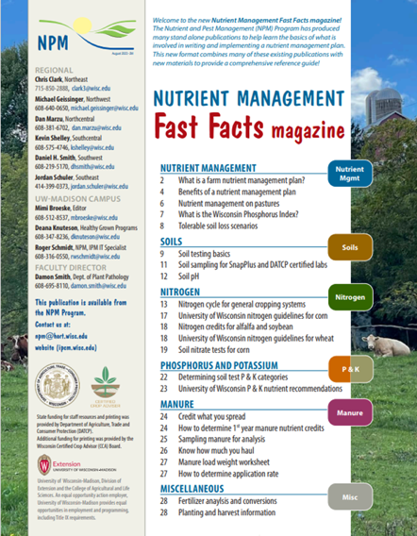
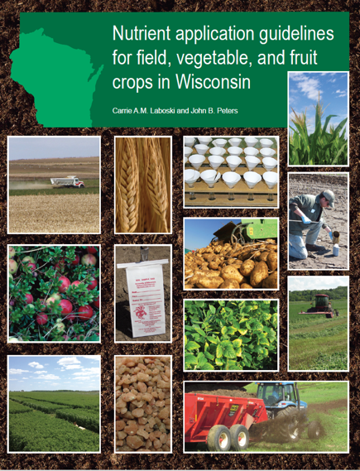
Soil Resources

Slide 21

Thanks!
Questions?
Name
Title
Nutrient and Pest Management (NPM) Program
UW-Madison Division of Extension
Email: Phone:

