Slide 1
Nutrient Management for Grazing/Pastures

Slide 2
On the Agenda
Identify Requirements of Nutrient Management for Grazing Systems
Name Advantages of Grazing for Nutrient Management
Understand Soil Testing for Pastures
Comprehend Recommendations for N,P, & K in Wisconsin Pastures
Properly Credit Nutrients from Manure in Pastures
Consider Environmental Risk of Grazing

Slide 3
Nutrient Management Requirements for Graziers
Pastures do need to be included in a nutrient management plan if one or more of the following applies to the pasture:
Receives mechanically applied nutrients (manure or fertilizer)
Has an average of more than one animal unit (1,000 pounds of animal) per acre throughout the grazing season
Has a herd present during winter for feeding activities such as bale grazing and the pasture is not considered a feedlot.
Notes:
G1.1.1 Pastures need to be included in a nutrient management plan if one or more of the following applies to the farm: The pasture receives nutrients such as fertilizer or manure applied by tractor and spreader, has an average of more than one animal unit (1,000 pounds of animal) per acre throughout the grazing season, has a herd present during winter for feeding activities such as bale grazing and the pasture is not considered a feedlot.

Slide 4
Requirements for Graziers
Pastures do not have to be included in a nutrient management plan if the pasture does not receive applications of nutrients AND one of the following applies:
The pasture is a feedlot or an area that is considered a barnyard, exercise area, or other area where livestock are concentrated
Vegetation is not maintained for forage or the pasture has an average of less than one animal unit per acre throughout the grazing season.
…but having a plan is still a good idea!
Notes:
G1.1.2 Pastures do not have to be included in a nutrient management plan if the pasture does not receive applications of nutrients AND one of the following applies: the pasture is a feedlot or an area that is considered a barnyard, exercise area, or other area where livestock are concentrated, and vegetation is not maintained for forage or the pasture has an average of less than one animal unit per acre throughout the grazing season.

Slide 5
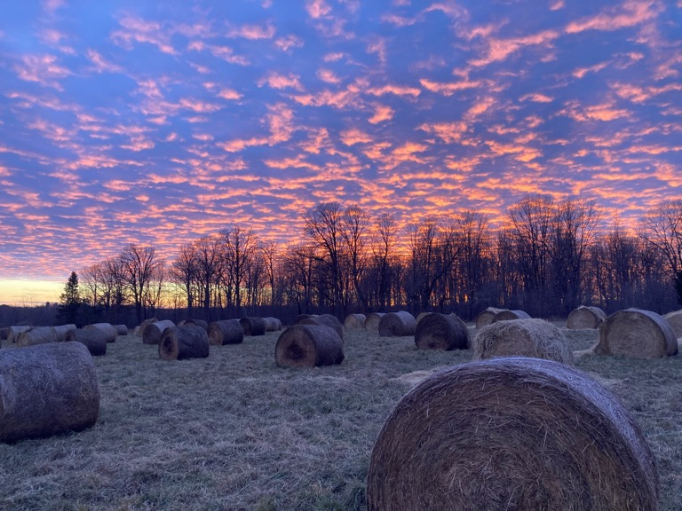
Advantages of Grazing
Permanent cover, deep roots, and manure from grazing livestock stimulate soil biological processes
Decrease the need for commercial fertilizer
Legume fixing nitrogen
Growing plants use available manure nutrients
Build soil fertility through management practices such as bale grazing
Notes:
G1.2.1 Incorporating livestock and grazing into a cropping system is often touted as a fifth soil health principle. Adding livestock into a cropping system can increase soil health by incorporating permanent vegetation or grazed cover crops, and animal manures into the cropping system. The addition of additional and diverse cover and root systems, as well as manure additions, can stimulate soil biology and biological processes.
G1.2.2 Grazing systems afford farmers unique opportunities to decrease the need for outside commercial fertility inputs. For example, the integrity of nitrogen from urine and manure is less likely to be lost to volatilization when compared to a confinement operation with a manure pit. Practices like bale grazing can be used strategically to build soil fertility in areas of poor fertility.

Slide 6
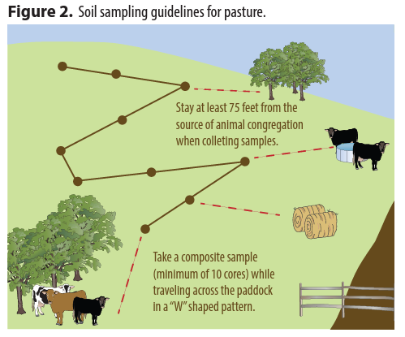
Soil Testing Pastures
Every 5 Acres/Management Unit:
1 composite sample (10, 6” soil cores)
Avoid High Traffic Areas
Watering areas
Outwintering areas
Notes:
G1.3.1 Like other nutrient management plans, one composite sample made up of 10, 6” soil cores are required for every 5 acres or management unit. The cores for this sample can be collected in a W pattern.
G1.3.2 When soil sampling, there are areas which can throw off a soil test result that a farm will want to avoid. For example, avoid areas like watering areas, outwintering areas, and any area of congregation that is not indicative of the pasture as a whole (i.e. shade).

Slide 7
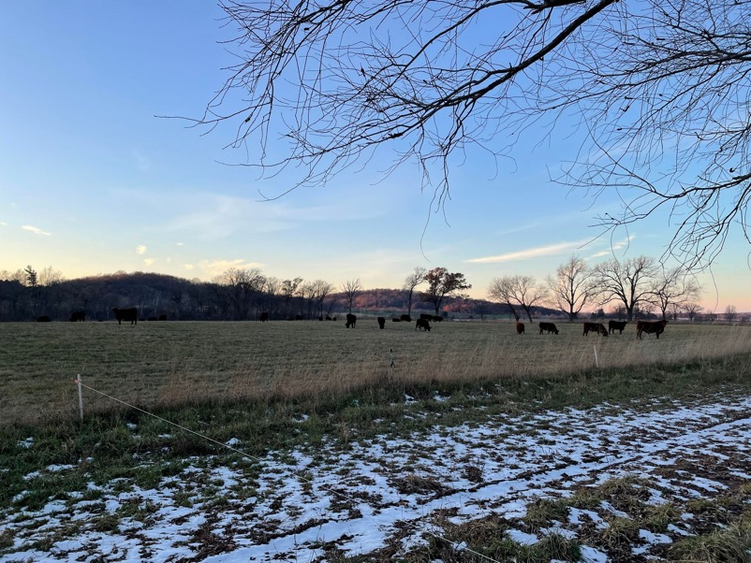
Soil Testing Pastures
Option to Sample by Paddock
If paddocks are managed as separate fields, a farm might want to consider having a composite sample for each one.
This will help streamline the data in SnapPlus and might make it more useful for management considerations.
Notes:
G1.3.2 If each paddock is managed as a separate field, a farm might want to consider having a composite sample for each one. This will help streamline the data in SnapPlus and might make it more useful for management considerations.

Slide 8
Use Wisconsin DATCP Certified Labs
UW Soil & Forage Analysis Lab
A&L Great Lakes Laboratories, Inc.
AgSource Laboratories
Minnesota Valley Testing Laboratories, Inc.
Rock River Laboratory
Farmers Edge
Midwest Laboratories, Inc.
Soil Only: Waypoint Analytical Illinois
Always confirm lab is WI state certified for soil testing if using in a WI nutrient management plan.
Notes:
https://datcp.wi.gov/Documents/NMSoilManureLabs.pdf

Slide 9
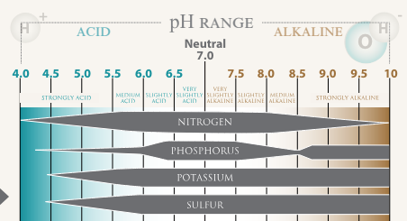
Managing Pasture Soil pH
Maintain pastures at 6.0 to 6.3 pH depending on legume content
Microbial nitrogen fixation
Amend soil pH prior to establishing permanent pasture
Notes:
G1.4.1 pH. Pastures will typically want to maintain 6.0 to 6.3 pH (depending on legume content). pH influences a nutrient’s affinity to become plant-available and affects the efficiency of microbial nitrogen fixation in legumes.

Slide 10
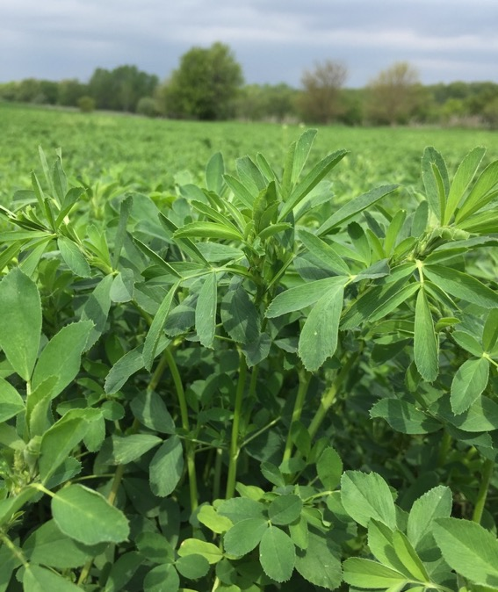
Pasture Nitrogen Management
Often met through legume forages (~30% legumes) & manure deposited by grazing animals
Nitrogen is most pertinent for new seedings and grass-only pastures
Recommendations are based on SOM, pasture type, & yield
Notes:
G1.4.2 Nitrogen. Oftentimes, nitrogen needs can be met in a pasture through a combination of legume forages established in an approximate 30% legume/70% grass pasture and manure/urine deposited by grazing animals. Nitrogen recommendations typically most relevant for new seedings of pasture or grass pastures are based on soil organic matter content.

Slide 11
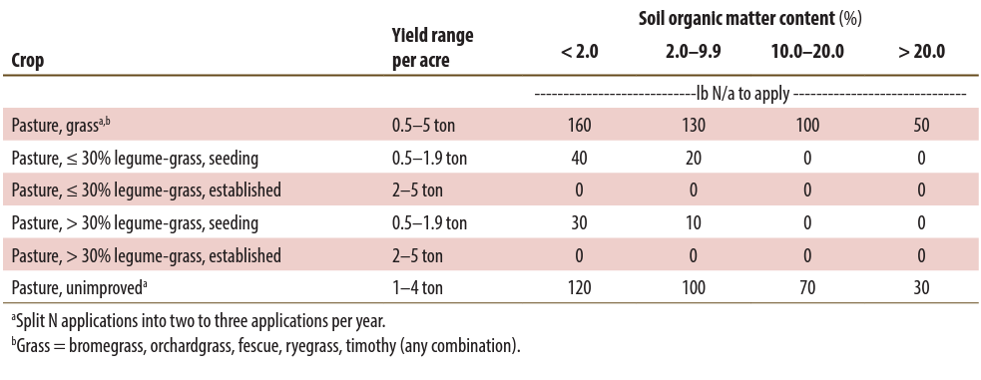
Pasture Nitrogen Management
Notes:
G1.4.2 Nitrogen. Oftentimes, nitrogen needs can be met in a pasture through a combination of legume forages established in an approximate 30% legume/70% grass pasture and manure/urine deposited by grazing animals. Nitrogen recommendations typically most relevant for new seedings of pasture or grass pastures are based on soil organic matter content.

Slide 12
Soil Test Categories for Phosphorus & Potassium
Soil Test Category | Recommendation | Probability of Yield Increase
Very Low | Crop Removal + Build | >90%
Low | Crop Removal + Build | 60-90%
Optimum | Crop Removal | 30-60%
High | ½ Crop Removal | 5-30%
Very High | ¼ Crop Removal | 2-5%
Excessively High | No Application Recommended | <2%
Soil
Fertilizer + Manure + Legume
Soil
Fertilizer + Manure + Legume
Soil
Fertilizer + Manure + Legume
Soil
F + M + L
Soil
F + M + L
Soil
Notes:
G1.4.3 Phosphorus. Application recommendations are based on soil test category (VL, L, O, H, VH, and EH) based on ppm of P, soil type, and a realistic yield goal. It is unlikely that phosphorus applications on pastures are likely to either be needed in the first place or yield an economic return.
G1.4.4 Potassium. Application recommendations are based on soil test category (VL, L, O, H, VH, and EH) based on ppm of P, soil type, and a realistic yield goal.
VL: occur over 4 to 8 years, response to secondary or micronutrients is likely on high demanding crops and medium on medium demanding crops
L: Response to secondary or micronutrients is possible for high demanding crops but unlikely for medium or low demanding crops
O: economically and environmentally the most desirable soil test, optimize yields apply equal amounts that are removed, response to secondary or micronutrients is unlikely of crop demand level
H:
VH: only used for potassium, gradual drawdown is recommended
EH: no fertilizer is recommended

Slide 13
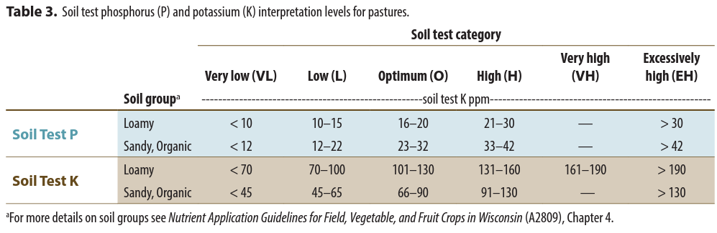
Pasture Phosphorus Recommendations
Recommendations based on soil test category soil type, and realistic yield goal
P applications on pasture are not commonly needed and usually won’t yield an economic return
Notes:
G1.4.3 Phosphorus. Application recommendations are based on soil test category (VL, L, O, H, VH, and EH) based on ppm of P, soil type, and a realistic yield goal. It is unlikely that phosphorus applications on pastures are likely to either be needed in the first place or yield an economic return.
G1.4.4 Potassium. Application recommendations are based on soil test category (VL, L, O, H, VH, and EH) based on ppm of P, soil type, and a realistic yield goal.
VL: occur over 4 to 8 years, response to secondary or micronutrients is likely on high demanding crops and medium on medium demanding crops
L: Response to secondary or micronutrients is possible for high demanding crops but unlikely for medium or low demanding crops
O: economically and environmentally the most desirable soil test, optimize yields apply equal amounts that are removed, response to secondary or micronutrients is unlikely of crop demand level
H:
VH: only used for potassium, gradual drawdown is recommended
EH: no fertilizer is recommended

Slide 14
Pasture Potassium Recommendations
Recommendations based on soil test category (VL, L, O, H, VH, and EH), soil type, and realistic yield goal
Potassium deficiencies and need for fertilizer is common in pastures in Wisconsin
Buffering capacity
Harvesting forage, meat, milk, etc.
Notes:
G1.4.4 Potassium. Application recommendations are based on soil test category (VL, L, O, H, VH, and EH) based on ppm of P, soil type, and a realistic yield goal. Chances are that potassium is the most likely nutrient to be deficient in pastures. Potassium levels change quickly in the soil due to its buffering capacity, when compared to other nutrients like phosphorus. The harvesting of leafy plants by grazing or mechanical hay harvest and subsequent removal as hay, meat, milk, or egg products expedites the removal of potassium. It is not uncommon for a potassium fertility recommendation to be very high for pasture ground. Even if the full recommendation cannot be applied, some potassium application can make a big difference in terms of forage productivity.

Slide 15
Managing Potassium to Manage Nitrogen
We manage potassium to manage nitrogen.
Potassium deficiency affects legume stands. Poor legume stands negatively affect nitrogen fixation and availability. Poor nitrogen availability negatively affects grass stands. Result: poor pasture!
Hay making demands more K than grazing-only
Notes:
G1.4.4 Potassium. Application recommendations are based on soil test category (VL, L, O, H, VH, and EH) based on ppm of P, soil type, and a realistic yield goal. Chances are that potassium is the most likely nutrient to be deficient in pastures. Potassium levels change quickly in the soil due to its buffering capacity, when compared to other nutrients like phosphorus. The harvesting of leafy plants by grazing or mechanical hay harvest and subsequent removal as hay, meat, milk, or egg products expedites the removal of potassium. It is not uncommon for a potassium fertility recommendation to be very high for pasture ground. Even if the full recommendation cannot be applied, some potassium application can make a big difference in terms of forage productivity.
G1.4.5 Potassium for Nitrogen. Potassium is managed to help manage nitrogen. Potassium deficiency affects legume stands. Poor legume stands negatively affect nitrogen fixation and availability. Poor nitrogen availability negatively affects grass stands. Result: poor pasture!

Slide 16
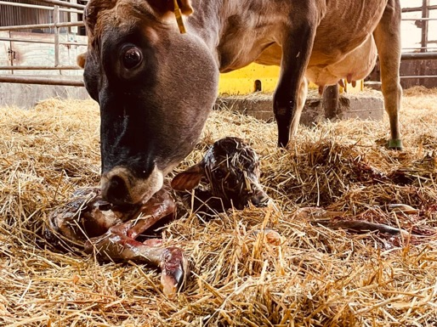
High Potassium & Milk Fever
Milk Fever is a metabolic condition affect fresh cows
Apply K based only on soil tests
Harvest mature or rained-on forage for transition cows (lower K content) (Kelling et al., 2002)
Forage Test to Check K levels
Photo by Aerica Bjurstrom
Laboratory | Website | Contact Info. | Address
UW Soil & Forage Analysis Lab | https://uwlab.soils.wisc.edu/ | 608-262-4364 soil-lab@mailplus.wisc.edu | 4702 University Avenue Madison, WI 53705
Dairyland Laboratories | https://www.dairylandlabs.com | 715-687-9997 dairylandlabs.com/contact-us | 117609 Forward Street Stratford, WI 54484
Rock River Laboratory | https://rockriverlab.com/ | 920-261-0446 office@rockriverlab.com | 710 Commerce Drive Watertown, WI 53094
Notes:
G1.4.5 Potassium for Nitrogen. Potassium is managed to help manage nitrogen. Potassium deficiency affects legume stands. Poor legume stands negatively affect nitrogen fixation and availability. Poor nitrogen availability negatively affects grass stands. Result: poor pasture!

Slide 17
A Note on Micronutrients?
Micronutrients are rarely needed on Wisconsin soils, especially farms that receive manure from livestock (i.e. pasture)

Slide 18
Nutrient Crediting
1. Calculate Manure Deposition
2. Credit Nutrients as Appropriate
From: NPM Fast Facts Magazine
Notes:
G1.5.1 We know that the nitrogen credit earned from legumes in the pasture is accounted for in the nitrogen recommendations from A2809. Pastures also receive manure from grazing animals, though, which has nutrients in it and should be credited onto any fertility recommendations.
G1.5.2 Manure credits can be calculated by first calculating manure deposition using SnapPlus or the Grazing manure application rate estimator worksheet, adapted from the Midwest Plan Service Technical Bulletin #18. Then, nutrients are credited based on A2809’s estimated total and available nutrient content in deposited manure/urine in pasture systems.

Slide 19
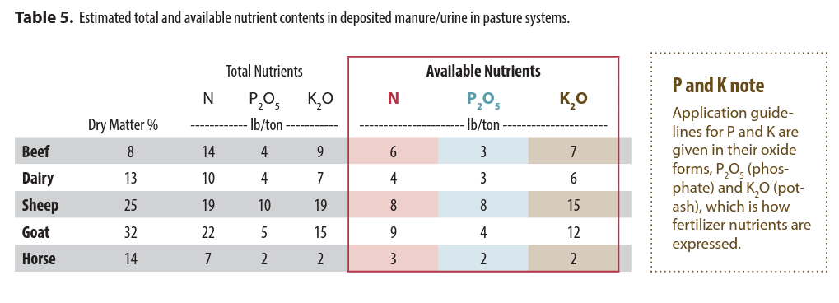
Manure Nutrients
Notes:
G1.5.2 Manure credits can be calculated by first calculating manure deposition using SnapPlus or the Grazing manure application rate estimator worksheet, adapted from the Midwest Plan Service Technical Bulletin #18. Then, nutrients are credited based on A2809’s estimated total and available nutrient content in deposited manure/urine in pasture systems.

Slide 20
So, if you had…
Twenty 750 lb steers on a high forage diet on pasture 6 months/year…
10
180
1
55.8 tons
20
180
1
111.6 tons
…you’d have 111.6 tons of manure!
Notes:
G1.5.2 Manure credits can be calculated by first calculating manure deposition using SnapPlus or the Grazing manure application rate estimator worksheet, adapted from the Midwest Plan Service Technical Bulletin #18. Then, nutrients are credited based on A2809’s estimated total and available nutrient content in deposited manure/urine in pasture systems.

Slide 21
Which is…
10
180
1
55.8 tons
669.6 lbs of N, 335 lbs of P2O5, and 781.2 lb of K2O
On a 20-acre pasture, that’s: 33 lb N, 17 lb P2O5, and 39 lbs of K2O/A
Notes:
G1.5.2 Manure credits can be calculated by first calculating manure deposition using SnapPlus or the Grazing manure application rate estimator worksheet, adapted from the Midwest Plan Service Technical Bulletin #18. Then, nutrients are credited based on A2809’s estimated total and available nutrient content in deposited manure/urine in pasture systems.

Slide 22
Environmental Considerations
Outwintering Livestock
High risk of nutrient loss and negatively impacting water quality
Select outwintering areas based on low soil test P and away from surface water bodies or highly permeable soils, if possible
Surface Water Intersections
Avoid giving livestock unrestricted access to surface water or a stream crossing.
Occasional stream crossings can be permissible
Notes:
G1.6.1 Outwintering livestock carries the largest risk for negatively impacting surface and groundwater quality. Avoid areas near surface water like perennial streams, ponds, and lakes and highly permeable soils, if possible.
G1.6.2 Pastures that intersect with surface water like streams or ponds can put surface water quality at risk. An occasional pass through a paddock near surface water or a stream crossing can be okay, but farms should take care to avoid open and continuous access to surface water by livestock.

Slide 23
Review
Identify Requirements of Nutrient Management for Grazing Systems
Name Advantages of Grazing for Nutrient Management
Understand Soil Testing for Pastures
Comprehend Recommendations for N,P, & K in Wisconsin Pastures
Properly Credit Nutrients from Manure in Pastures

Slide 24
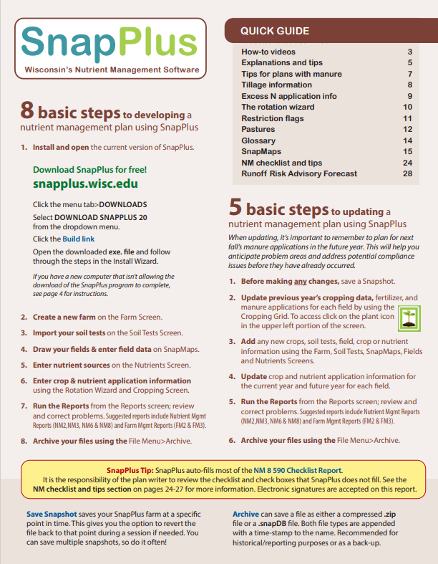
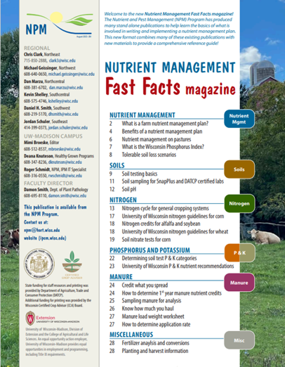
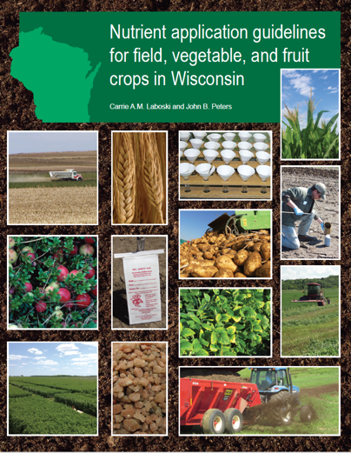
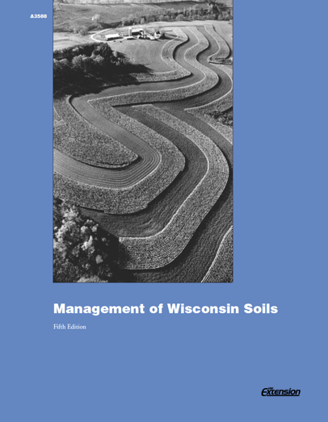
Resources

Slide 25
Thanks!
Questions?
Name
Title
Nutrient and Pest Management (NPM) Program
UW-Madison Division of Extension
Email: Phone:

