Slide 2
Precision Nutrient Management

Slide 3
Variable rate nutrient management
Smart nutrient management
Precision fertilization
Notes:
We’ve probably heard these terms before… all of these mean the same thing… it really boils down to precision nutrient management.

Slide 4
What is precision nutrient management?
A strategy to optimize nutrient applications to better match nutrient supply and crop nutrient demand in amount, space, and time for increased nutrient efficiency, yield, crop quality, economic returns, and protection of the environment.
Notes:
NM4.1.1 Precision nutrient management refers to optimizing nutrient applications by using technology and data to help choose the right product, rate, time, place, and rate to match crop demand and maintain or build soil fertility. It also aims to use the right method to achieve the right amount of fertility in the right spot, and at the right time for increased nutrient use efficiency, yield, crop quality, farm profitability, and environmental benefits.

Slide 5
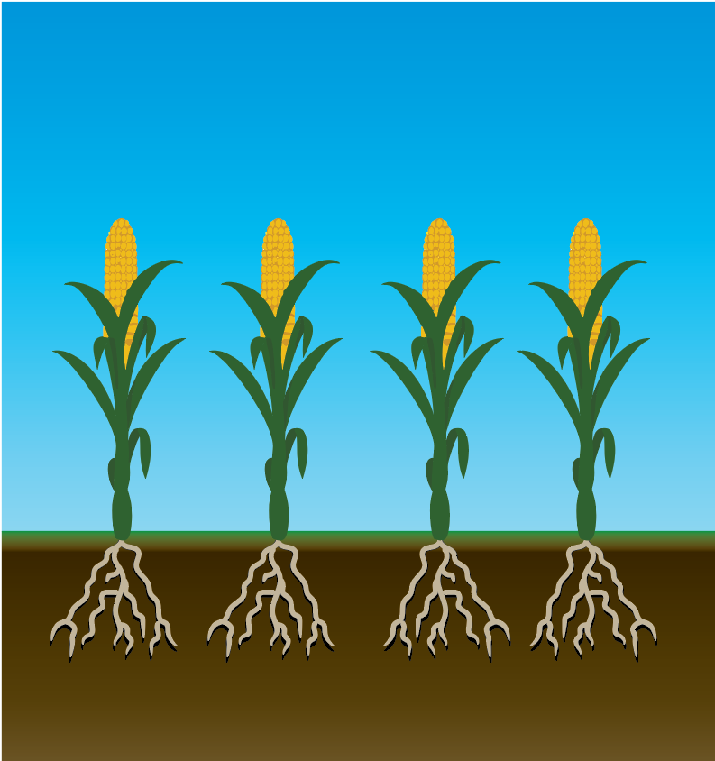
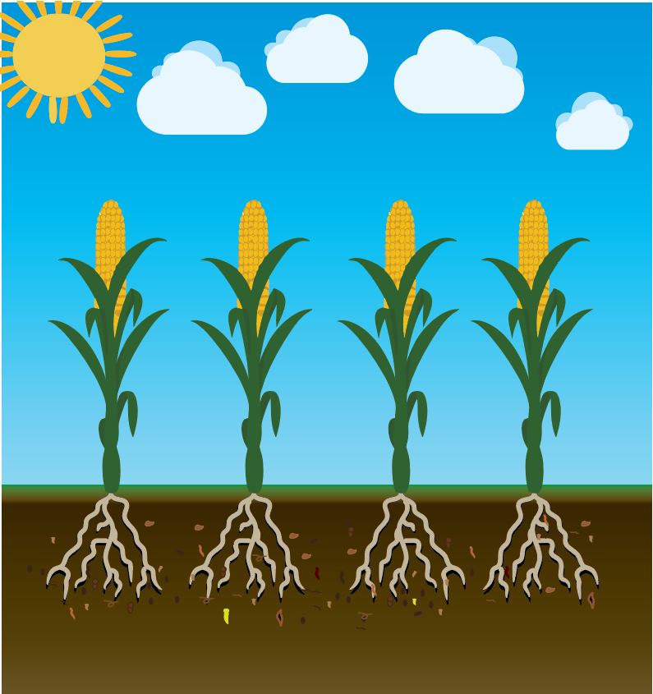
A systems approach…
Notes:
NM4.1.2 Precision nutrient management is a holistic approach that considers the impact and interactions of all factors affecting a farm’s ability to achieve their objectives of optimized yield, quality, profit, and/or environmental protection.
We traditionally think of precision nutrient management as optimizing nutrient applications based on spatial variability of soil fertility and crop yield… but its much more than that

Slide 6
Which includes…
Site specific management
Weather specific management
Time specific management
Variety specific management
End-use specific management
Notes:
NM4.1.3 A precision nutrient management system should include site-, weather-, time-, variety-, and end use- specific information to make the best management decisions to optimize and achieve farm goals.
A precision nutrient management system should include each of these management strategies.

Slide 7
Principles of PNM
4R’s of nutrient management
Right source at the right rate, time and place/method.
Soil information
From soil samplings or soil sensing technology
Field management information
Crop health information
Fertilizer + On-farm nutrient sources = Total crop need
Notes:
4R’s – right source, right rate, right time, right place
But this also includes soil sensing technologies, soil lab data, crop sensing technologies,
We use these principles to determine if we should be utilizing precision nutrient management to better manage our nutrient supply to our crops.

Slide 8
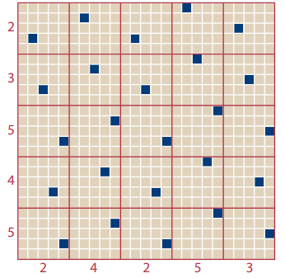
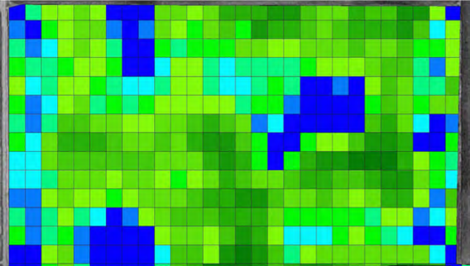
Should I use precision nutrient management?
Determine if farm or field has enough variability in soil nutrient content or crop growth
Soil sampling
Yield data or maps
Satellite or remote sensing (UAV) images
Soil sensing technologies
Sand
Loam
Muck
3 zones
Yield map
unaligned grid sampling pattern
USDA-NRCS precision nutrient management planning
Notes:
NM4.4.1 Before deciding to implement precision nutrient management, determine if the farm or field has sufficient variability in soil nutrient content or crop growth. Precision nutrient management should only be adopted if variability is sufficient and not random (spatially dependent in the field) and can be practically managed to achieve increased productivity, profitability, and environmental benefits.
NM4.2.1 Soil sampling can be used to decide if precision nutrient management techniques should be adopted. If precision nutrient management makes sense for the operation, using grid or zone sampling techniques can help determine areas of variability and delineate zones for management.
NM4.2.2 Soil sensing technologies can be used instead of intensive soil sampling, sometimes. Such technologies like soil EC meters, visible, near infrared and mid-infrared sensors, Ion selective potentiometric sensors and portable x-ray fluorescence sensors can be used to evaluate soil properties and nutrients faster than sampling. Farms should still make sure they have a composite sample for every five acres, for 590 compliance.
NM4.2.3 Crop sensing technologies can be used to measure in-field variability. Such technologies like SPAD chlorophyll meter, NDVI and RVI, active canopy sensors, UAVs and remote sensing technologies, and yield monitors can be used to estimate crop growth, biomass, and nutrient status and nutrient removal for in-season or post-season nutrient management planning.
We utilize these methods to understand our in-field variability. Once we’ve identified there is enough variability present, the field should be delineated into zones for management. These zones will help in building prescription maps for fertilizer applications.
Due to the higher cost for the use of precision technologies or intensive soil sampling, it’s important to your bottom line that you have enough variability in your field to implement precision nutrient management techniques. If you don’t have a lot of variability in-field (soil fertility, topography, yield), the in-season nutrient management strategy may be a good choice.

Slide 9
Approaches – How are we collecting field information?
Map-based approach
Prescription maps created to indicate locations with adjusted fertilizer rates
Sensor-based approach
Data from real-time soil or crop sensors to estimate parameters on-the-go and convert data to decisions on fertilizer rates based on models.
Combined approach?
Notes:
NM4.2.1 Soil sampling can be used to decide if precision nutrient management techniques should be adopted. If precision nutrient management makes sense for the operation, using grid or zone sampling techniques can help determine areas of variability and delineate zones for management.
NM4.2.2 Soil sensing technologies can be used instead of intensive soil sampling, sometimes. Such technologies like soil EC meters, visible, near infrared and mid-infrared sensors, Ion selective potentiometric sensors and portable x-ray fluorescence sensors can be used to evaluate soil properties and nutrients faster than sampling. Farms should still make sure they have a composite sample for every five acres, for 590 compliance.
NM4.2.3 Crop sensing technologies can be used to measure in-field variability. Such technologies like SPAD chlorophyll meter, NDVI and RVI, active canopy sensors, UAVs and remote sensing technologies, and yield monitors can be used to estimate crop growth, biomass, and nutrient status and nutrient removal for in-season or post-season nutrient management planning.

Slide 10
Strategies – How are we utilizing the information?
Site-specific nutrient management
In-season nutrient management
In-season site-specific management
Notes:
NM4.3.1 There are three types of application strategies for implementing precision nutrient management, site-specific, in-season, and in-season site-specific nutrient management.

Slide 11
Site-specific nutrient management
AKA Predictive management strategy
Main idea: adjust fertilizer rates according to variability in soil nutrient content
Example: Variably applying P due to areas of non-responsive and responsiveness
Notes:
NM4.3.2 Site-specific nutrient management (predictive management strategy) utilizes either or both map-based or sensor-based data to adjust fertilizer rates according to spatial variability in soil nutrient content.

Slide 12
In-season nutrient management
AKA Responsive management strategy
Main idea: adjust fertilizer rates during the growing season based on various factors
Weather
Soil nutrient status
Plant growth conditions
Example: utilizing a drone to obtain NDVI data of your field mid-season to determine sidedress N rates
Notes:
NM4.3.3 In-season nutrient management (responsive management strategy) utilizes sensor or map-based data to adjust fertilizer rates applied during the growing season according to weather conditions, soil nutrient status, and/or plant growth conditions.
AKA responsive or real-time management strategy. This method is also suitable for fields with relatively small in-field variability.

Slide 13
In-season site-specific nutrient management
Considers both spatial and temporal variability to sync nutrient supply and demand in total rate, space and time
Either map-based or sensor-based technologies used for this strategy.
Example: Variably applying P at planting based on non-responsive and responsive soil test levels AND utilizing drone NDVI data in-season to variably apply sidedress N
Notes:
NM4.3.4 In-season site-specific nutrient management combines the previous strategies and uses map or sensor-based technologies to consider spatial and temporal variability to synchronize nutrient supply with nutrient demand in total rate, space, and time.

Slide 14
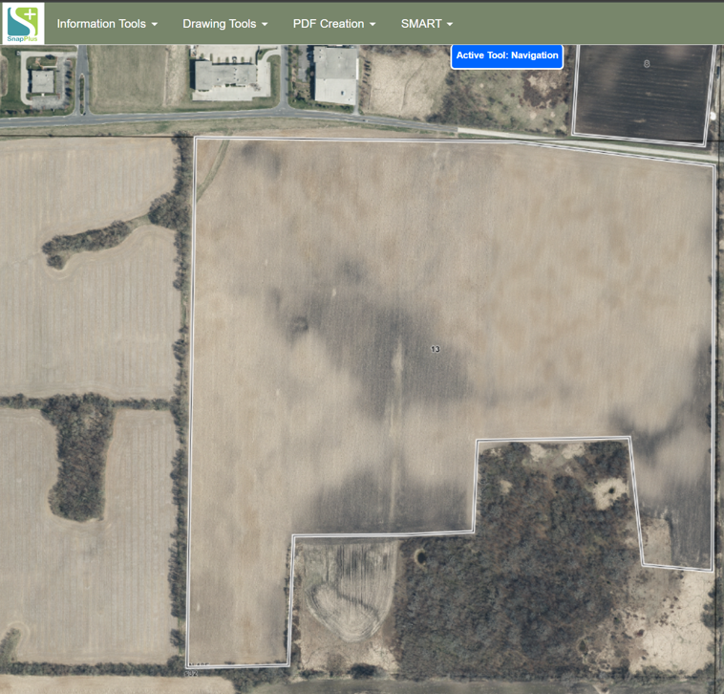
Example – Utilizing grid sampling + VRT
Notes:
NM4.4.2 Utilizing Grid Sampling + VRT example.
First, divide the field into equal square or rectangular (grid) sections of several acres in size (can range from 1–5-acre grid sizes). Grid sampling is best suited for fields that are expected to have significant areas in the responsive soil test range.
Grid sampling is a great way to map variability in soil test levels to guide precision nutrient applications. Grid samples should always have fewer than 5 acres per sample with an ideal grid size having no more than 1 to 2 acres per sample. Consider the cost, time, and site variability when choosing the sampling grid size. Typically, a field with more variability in soil fertility could benefit from sampling at a smaller grid size, but it must also be appropriate for the field topography and size. Creating a grid map for your fields can be done through an agronomist or via various smart phone apps available.
Once zones are delineated, consequent soil samples in following years could be done by zone sampling method (rather than grid point).
Submit soil samples for standard soil analysis (N, P, K, OM, pH). Be cautious when utilizing smart phone mapping software as they may require soil sample submissions to be sent to a specific lab which may not be certified in WI. Double check the lab is certified through the DATCP website.
Determine management zones based on the variability in the results. For example, your grid point samples indicate there are areas in the field in the non-responsive range for P and K, while another portion of the field is in the responsive range for P and K. The field variability based on responsiveness to fertilizer P and K applications could be the delineated zones for nutrient applications.
Once management zones are determined, a variable rate application prescription can be created based on the field nutrient variability.
This is my 115 acre field that I have a Soybean – Corn grain rotation on. I’ve never established grid sampling on this field but want to see what variability in fertility and soil OM I have throughout the field. So, I established grids to follow while soil sampling.

Slide 15
Example – Utilizing grid sampling + VRT
Non-responsive range for P and K
Responsive range for P
Responsive range for P and K
Notes:
NM4.4.2 Utilizing Grid Sampling + VRT example.
First, divide the field into equal square or rectangular (grid) sections of several acres in size (can range from 1–5-acre grid sizes). Grid sampling is best suited for fields that are expected to have significant areas in the responsive soil test range.
Grid sampling is a great way to map variability in soil test levels to guide precision nutrient applications. Grid samples should always have fewer than 5 acres per sample with an ideal grid size having no more than 1 to 2 acres per sample. Consider the cost, time, and site variability when choosing the sampling grid size. Typically, a field with more variability in soil fertility could benefit from sampling at a smaller grid size, but it must also be appropriate for the field topography and size. Creating a grid map for your fields can be done through an agronomist or via various smart phone apps available.
Once zones are delineated, consequent soil samples in following years could be done by zone sampling method (rather than grid point).
Submit soil samples for standard soil analysis (N, P, K, OM, pH). Be cautious when utilizing smart phone mapping software as they may require soil sample submissions to be sent to a specific lab which may not be certified in WI. Double check the lab is certified through the DATCP website.
Determine management zones based on the variability in the results. For example, your grid point samples indicate there are areas in the field in the non-responsive range for P and K, while another portion of the field is in the responsive range for P and K. The field variability based on responsiveness to fertilizer P and K applications could be the delineated zones for nutrient applications.
Once management zones are determined, a variable rate application prescription can be created based on the field nutrient variability.
Based on my soil sample results, I found that SW corner of my field has lower soil fertility all around and the E ½ of my field tests in the non-responsive range for P while the rest of the field is in the responsive range. I decide to apply 5 gal/ac of 10-34 starter and variable rate apply P as MAP throughout the field and I only apply K to the SW corner of the field. A sidedress application of N helps meet my crop N need.
Non-responsive areas (50 acres): P2O5 rec = 0, K2O rec = 15 ------ averaged 30 lbs/ac P2O5 and 20 lbs/acre K2O
Responsive areas (65 acres): P2O5 rec = 100-115 lbs/acre , K2O rec = 80-95 lbs/acre
Overall field averages: applied 80 lbs/acre of P2O5 and 65 lbs K2O

Slide 16
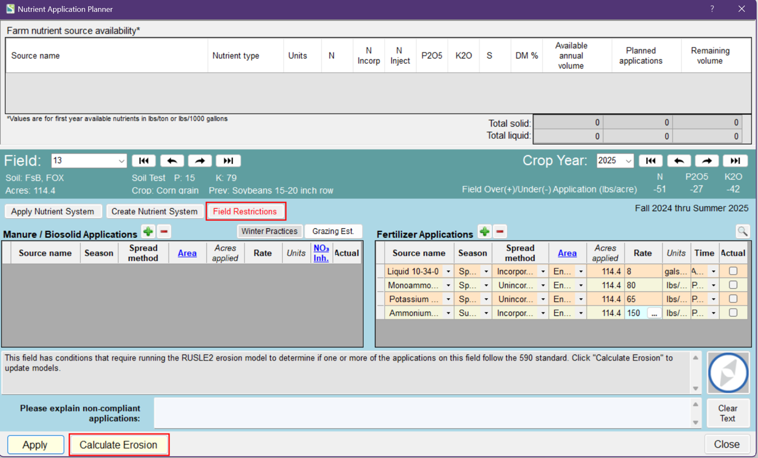
Precision NM in SnapPlus
Notes:
NM4.4.3 Currently, the SnapPlus nutrient management program does not have the ability to manage entire fields on a 1-5 acre grid scale and input variable rate fertilizer applications. Where nutrients were variably applied, the applications should be input as an overall field average. Farms should still make sure the number of soil samples collected is compliant with the 590 standards and that fertilizer applications do not exceed the limits set on restricted soils.
Currently, SnapPlus doesn’t have the capabilities to input variable-rate fertilizer or manure applications. Custom blends of fertilizers can be input into SnapPlus and the timing of the applications can be input, but only one rate across the entire field can be entered. The recommended practice is to input the average fertilizer rate applied across the field.

Slide 17
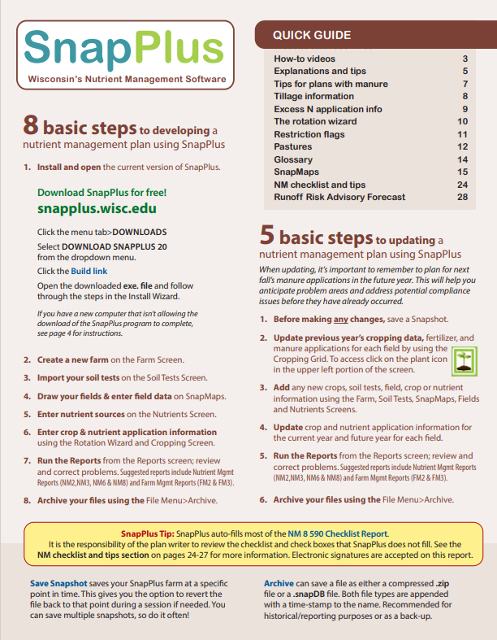
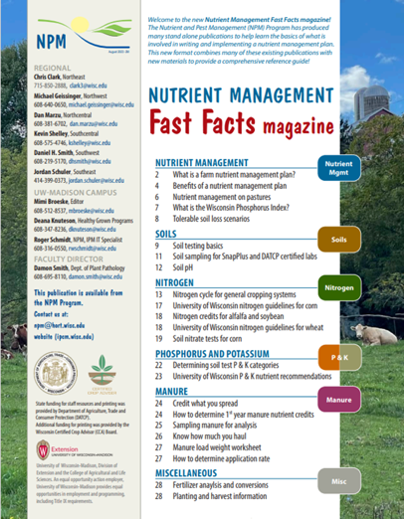
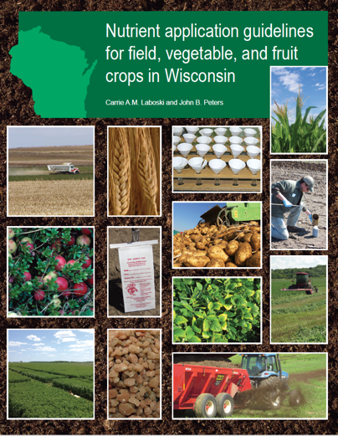
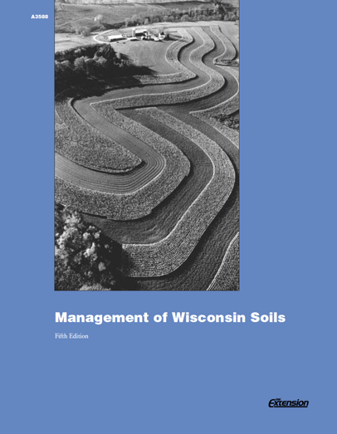
Resources

Slide 18
Thanks!
Questions?
Name
Title
Nutrient and Pest Management (NPM) Program
UW-Madison Division of Extension
Email: Phone:

