Slide 1
Manure Considerations

Slide 2
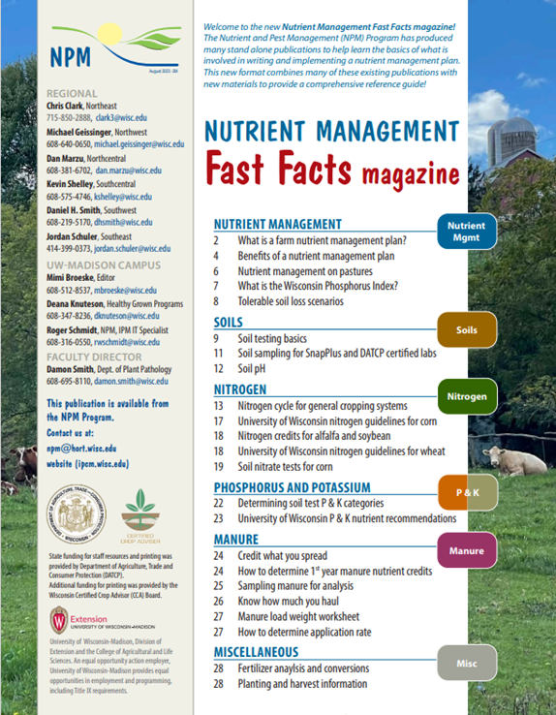

Following Along in Fast Facts?
Manure: Pages 24-27 in Nutrient Management Fast Facts

Slide 3
Manure Nutrients
Manure provides essential plant nutrients
  N, P, K, and S
  Other essential plant nutrients
Nutrients in organic and mineral forms
  Affects plant availability over time
Manure N undergoes chemical transformations
  Affects plant availability
  Potential for environmental loss
Notes:
M1.1.1 Manure provides nitrogen, phosphorous, potassium, sulfur and other essential plant nutrients.
M1.1.2 Manure nutrients exist in both mineral forms and organic forms, which affect plant availability over time. Manure nitrogen undergoes chemical transformations when applied to soil that affect both plant availability and potential for environmental loss.

Slide 4
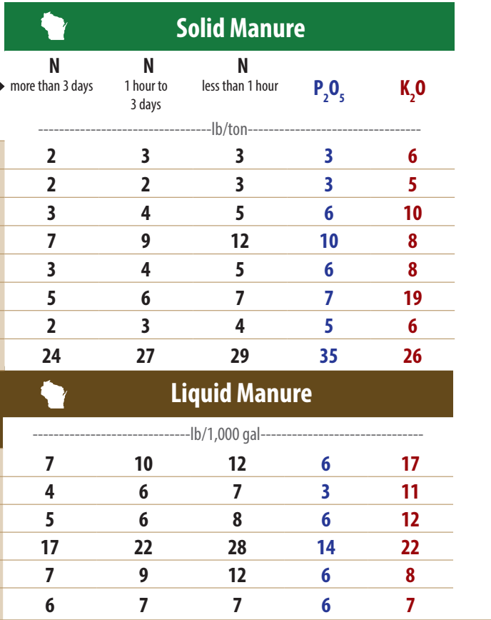

Manure Nutrient Content
Livestock species
Solid
Liquid
  DM content
Application
  Surface
  Incorporated
1st-year / 2nd-year
Fast Facts Magazine pg. 24
Notes:
M1.1.3 Differences exist in manure nutrient content between animal species. Livestock feeding and nutrition also influence manure nutrient content.
M1.1.4 Nutrient content and crop availability differ according to storage and handling methods (liquid versus solid) as well as method and timing of land application (surface application versus soil incorporation).

Slide 5
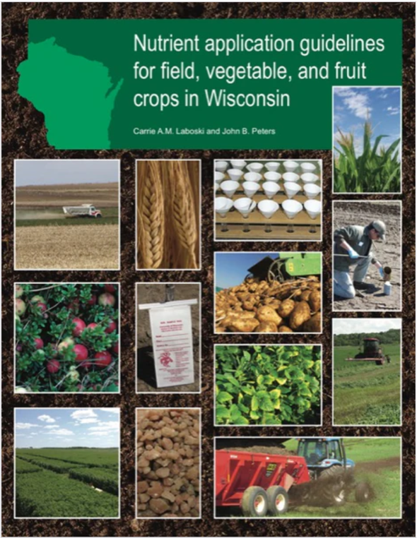
Manure Nutrient Credits
Manure nutrients can be used to meet crop nutrient need
NRCS 590: Offset fertilizer applications according to nutrient credits
Consistent with UWEX A2809 Guidelines
  https://learningstore.extension.wisc.edu/
UW- Extension A2809
Notes:
M1.1.5 UW Extension provides guidelines for determining nutrient credits from manure applications. Manure nutrients can be used to meet soil test recommendations for crop production.
M1.1.6 Nutrient content and availability from manures can be estimated according to published crediting guidelines or according to chemical analysis of a manure sample conducted by an accredited laboratory.

Slide 6
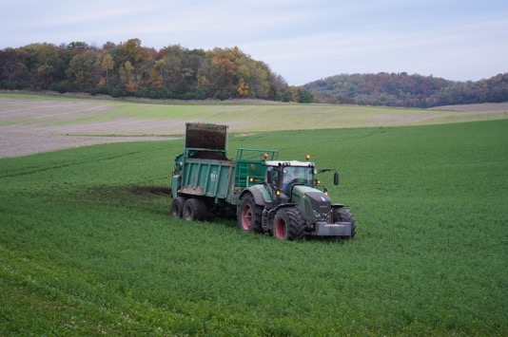
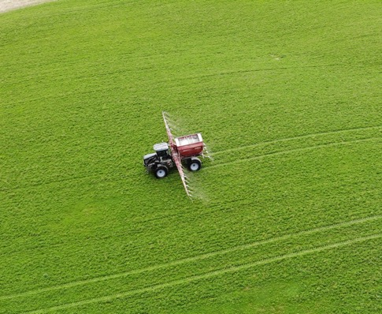
Information Needed to Properly Credit Manure Nutrients:
Available nutrient content
X
Manure application rate
= Nutrient credits N-P-K
Notes:
M1.1.7 Nutrient credits are determined using the manure’s nutrient content and the application rate in tons or gallons/acre.
The second piece of information needed for crediting the nutrients in manure is the manure application rate.
Application rate information is more difficult to get than nutrient content and can be highly variable if manure is not handled in a consistent manner.
Estimates of manure application rates must be reasonably accurate in order to credit manure nutrients. If not, then manure nutrient credits can not be taken.
These are some of the major reasons farmers, as well as co-op agronomists and fertilizer dealers, are reluctant to credit manure nutrients.

Slide 7
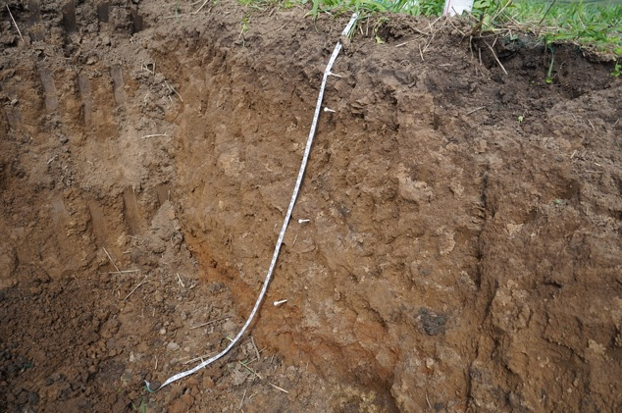
Manure for Soil health
Manure supplies OM
Different types of organic materials in manure
  Degradable carbon from bedding, feedstuffs, etc.
  Microbial biomass
Contributes to the soil ecosystem
  Plant growth + crop productivity benefits
Manure benefits to soil health
  Food for microbes
  Nutrient cycling
  Soil aggregation
  Resiliency benefits
Notes:
M1.2 Organic amendment for soil health
M1.2.1 Manure supplies organic matter to the soil and has potential benefits to soil health.
M1.2.2 There are many different types of organic material in manures (degradable carbon from bedding, digested feedstuffs, etc.).
M1.2.3 Degradable carbon and microbial biomass from manure contribute to a functioning soil ecosystem, thus benefiting plant growth and crop productivity.
M1.2.4 Manure benefits to soil health include provision of food for microbes, nutrient cycling and soil aggregation and resiliency benefits (water, air, productivity).

Slide 8
Manure + Natural Resource Concerns
Field losses of manure can cause environmental contamination
  Groundwater quality
  Aquatic ecosystems in surface water bodies
    Weed and algae growth
    Oxygen depletion for fish and aquatic organisms
Primary nutrient loss concerns:
  Nitrate-N leaching to groundwater
  P + N losses to surface water bodies
    Via runoff and soil erosion
Manure application guidelines to prevent + minimize risk
Notes:
M1.3 Natural resource concerns
M1.3.1 Field losses of nutrients in manure can be sources of environmental contamination affecting groundwater quality and the health of aquatic ecosystems in surface water resources (ponds, lakes and streams).
M1.3.2 The primary nutrient loss mechanisms include leaching of nitrate-N to groundwater and phosphorous and nitrogen losses to lakes and streams from surface water runoff and soil erosion. Negative effects from nutrient deposition to lakes and streams include weed and algae growth and oxygen depletion for fish and other aquatic organisms (biological oxygen demand).
M1.3.3 There are manure application guidelines, and in some cases legal requirements, intended to prevent or minimize the risk of manure contamination of water resources (See M4 Manure Application Precautions).

Slide 9


Manure Inventory
The amount of manure produced and collected or imported to the farm needs to be determined on an annual basis
Storage structure capacity can be used to determine spreadable liquid manure inventory
Total manure production must be allocated to cropland in NMP according to NRCS 590 standards
  Crop nutrient need
  Environmental protection
Know How Much You Haul (UW-NPM)
Notes:
M2.3 Manure inventory
M2.3.1 The amount of manure produced and collected by the farm, or imported to the farm, on an annual basis, needs to be determined in order to know how much is available for spreading.
M2.3.2 Use the Midwest Plan Service (MWPS) and UW Extension (UWEX) factsheets to estimate manure generated per animal unit of various species and feeding management; SnapPlus also has tools for estimating manure production and collection.
M2.3.3 Storage structure capacity can be used to determine spreadable liquid manure inventory.
M2.3.4 Total manure production must be allocated to cropland in a nutrient management plan according to crop nutrient needs and environmental protection criteria within each field (NRCS 590).

Slide 10
Collecting a representative sample is KEY
Available nutrient content of manure varies based on:
Nutritional program
Bedding content and type
Age and structure of stacked manure
Rainwater / milk house waste / flush systems
Liquid-solid separation
Composting
Manure analysis may provide more accurate results
Notes:
M2.1.1 Collecting a representative sample is critical for obtaining accurate results. There are different ways to sample various manure types, storage structures, and pumping equipment.
Representative sampling is a must!!
Results from analysis are only as good as the sample collection techniques.
Solid or stacked – Use a soil probe, auger, or shovel to collect several samples from various places in the stack. Combine and mix the subsamples to obtain a composite sample. It is best to sample stacked manure while loading. Take at least 5 samples while loading several spreader loads and combine to form a composite sample.
Liquid - During the course of emptying a manure storage system, collect 3 to 5 samples at the beginning, middle, and end of pit agitation. Combine into a single composite sample.
Speaker: See Appendix 2 in the curriculum guidebook for more information on collecting manure samples.

Slide 11
Solid Manure Sample Collection
When loading:
Collect 3-5 sub-samples from different spreader loads and combine to form 1 single composite sample
Mix composite sample and place a one pound subsample in a gallon plastic bag. Label with date and source.
Sampling from stack or bedded pack is not recommended.

Slide 12
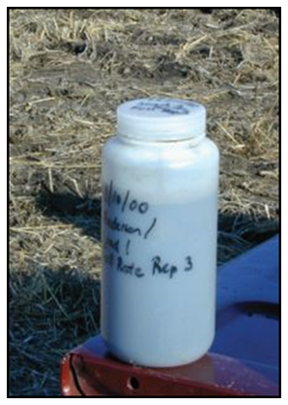
Collecting a Liquid Manure Sample
Sampling manure from storage - while loading
Agitate storage facility thoroughly
Collect 3 sub-samples while loading successive tankers
Mix sub-samples in a bucket and pour into a plastic container for a composite sample. Label with date and source.
Take at least 3 composite samples throughout the storage structure
  Top 1/3, Middle 1/3, Bottom 1/3

Slide 13
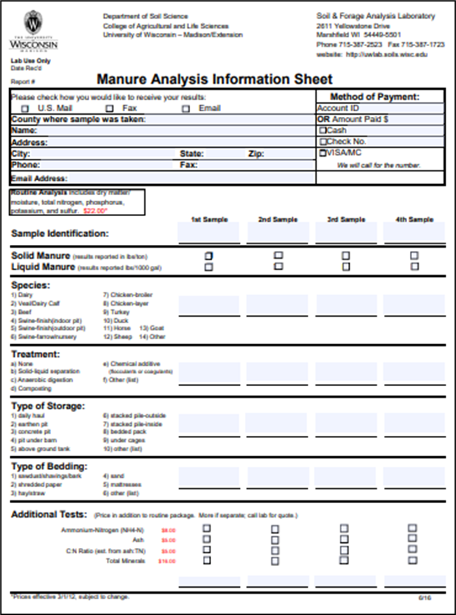
Manure Sample Submission Form
https://uwlab.soils.wisc.edu/
UW Soil & Forage Lab Marshfield, WI
A & L Great Lakes Laboratories, Inc. Fort Wayne, IN
AgSource Cooperative Services Bonduel, WI
Dairyland Laboratories Arcadia, WI
Rock River Laboratory Watertown, WI
Minnesota Valley Testing Laboratories New Ulm, MN
Midwest Laboratories Inc.Omaha, NE
Always confirm lab is WI state certified for manure testing if using results in a WI nutrient management plan.
Notes:
M2.1.2 Commercial laboratories accepting manure samples have guidelines for submission.

Slide 14
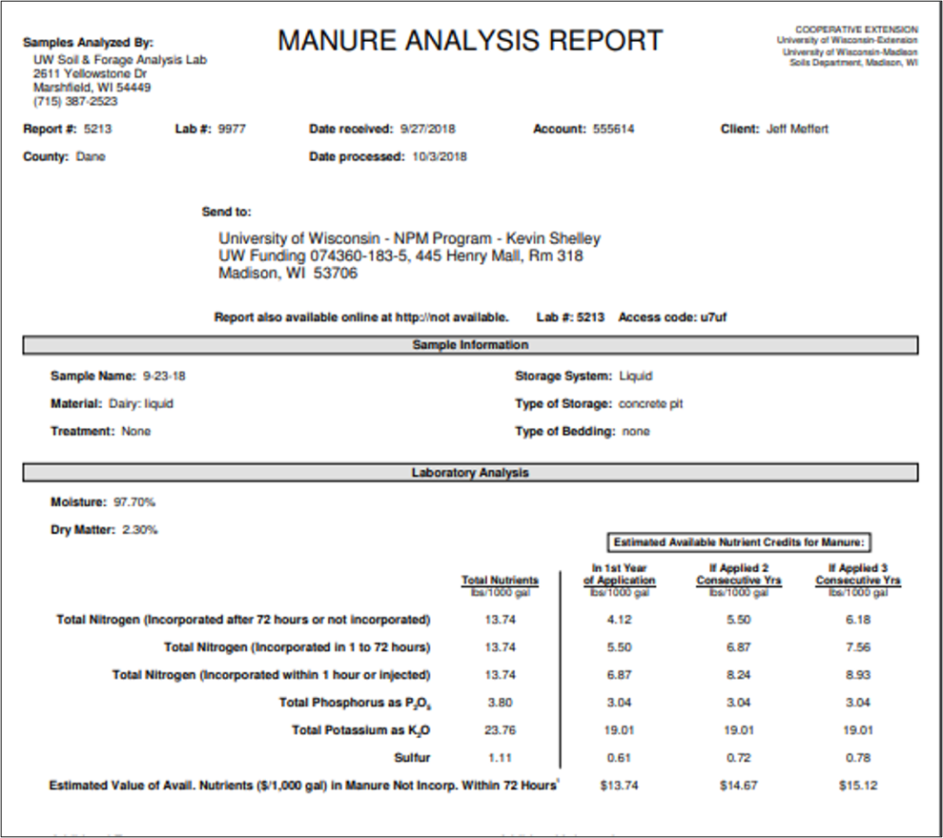
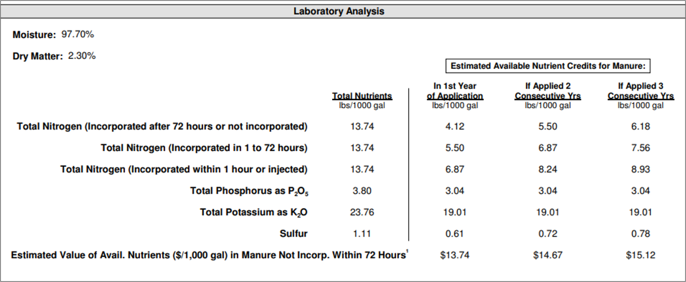
Manure Analysis
Notes:
M2.2 Manure analysis – interpreting the results
M2.2.1 It is important to distinguish between total nutrient content and plant-available nutrient content of manure.
M2.2.2 Reports may list both 1st year and 2nd year credits, as well as total nutrient content.
M2.2.3 Additional analyses for carbon, ammonium or nitrate may be useful for manipulated or processed manures.

Slide 15
Determining Application Rates
Rates should be calculated to meet nutrient requirements on fields across the farm
  NOT EXCEED
Hauled manure from production facility to field must determine average amount of manure contained in each load in tons (solid) or gallons (liquid)
Notes:
M2.4 Determining and adjusting manure application rates
M2.4.1 Manure application rates should be calculated to meet, but not exceed, nutrient requirements on fields across the farm.
M2.4.2 For manure hauled from production facilities to crop production fields for application, the average amount of manure contained in each load in tons (solid) or gallons (liquid) must be determined.
M2.4.6 In all cases, the amount hauled or pumped needs to be divided by acres applied to determine the application rate. Application rates can be adjusted to match crop nutrient needs in a process of calibration.

Slide 16
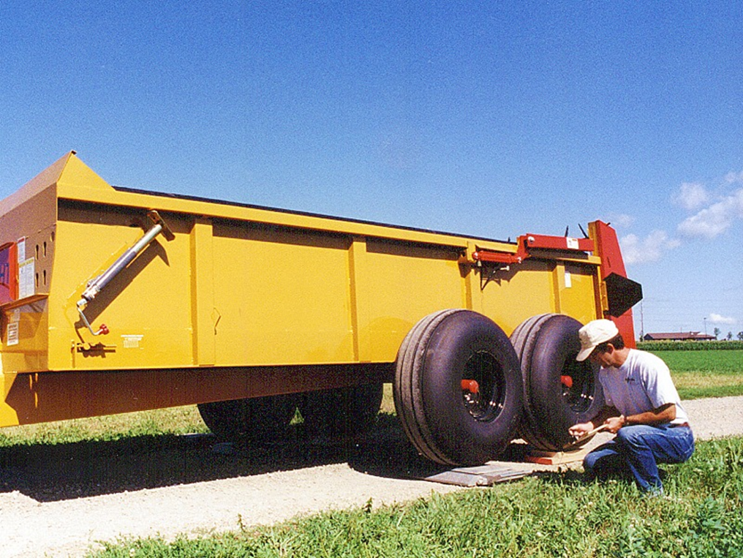
Manure Application Rates: How Much Am I Spreading?
Solid Manures:
Utilizing portable axle scales
Weigh an average load to determine tons/load
Loads/acre
X
Tons/load =
Tons per acre
Notes:
M2.4.3 For solid or semi-solid manure, weighing the manure spreader both empty and full (a representative load) is one method for determining an average load’s weight.
M2.4.6 In all cases, the amount hauled or pumped needs to be divided by acres applied to determine the application rate. Application rates can be adjusted to match crop nutrient needs in a process of calibration.
Manure spreader calibration in action.
Speaker: Comment on availability of scales locally.

Slide 17
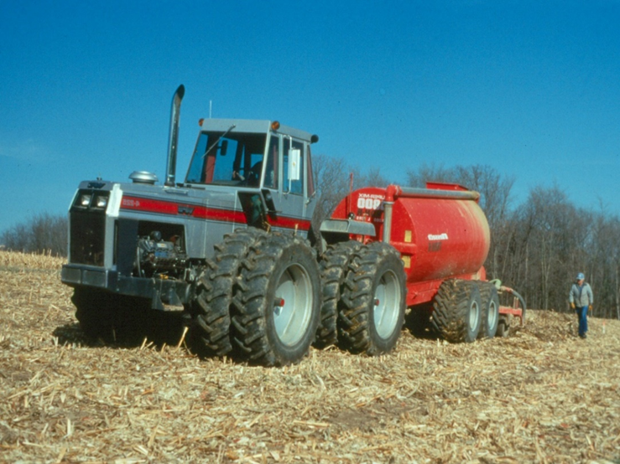
Manure Application Rates: How Much Am I Spreading?
Liquid Manure:
Use 85% of rated tank volume to estimate gallons/load
Equation:
Application rate =
Loads per acre
X
Gallons per load
Example:
6000 gal tank X 0.85 = 5100 gallons per load
2 loads per acre = 10,200 (10,000 gallons/acre)
Notes:
M2.43.4 For liquid manure, use 80 percent of the manufacturer’s tank volume rating as an estimate for gallons per load.
M2.4.5 For liquid manure pumped to the field for drag line injection or irrigation, gallons applied can be estimated according to storage volume emptied.
M2.4.6 In all cases, the amount hauled or pumped needs to be divided by acres applied to determine the application rate. Application rates can be adjusted to match crop nutrient needs in a process of calibration.

Slide 18
Field Conditions and Seasonal Considerations
Manure applications should be planned in accordance with standards for prevention of manure and nutrient losses to surface and groundwater on a field-level basis
USDA-NRCS conservation standard 590
  Specifies performance requirements for nutrient applications, including manure, on cropland.
Additional county or local requirements for manure application
Notes:
M2.5 Field condition and seasonal considerations
M2.5.1 Manure applications to cropland should be planned in accordance with standards for prevention of manure and nutrient losses to surface waters on a field-level basis.
M2.5.2 Manure applications to cropland should be planned in accordance with standards for prevention of manure and nutrient losses to groundwater on a field-level basis.
M2.5.3 The USDA NRCS conservation standard 590 specifies performance requirements for applications all nutrients, including manure, to cropland in Wisconsin.
M2.5.4 There may be additional county or local legal requirements controlling manure applications.

Slide 19
Manure Application Precautions

Slide 20
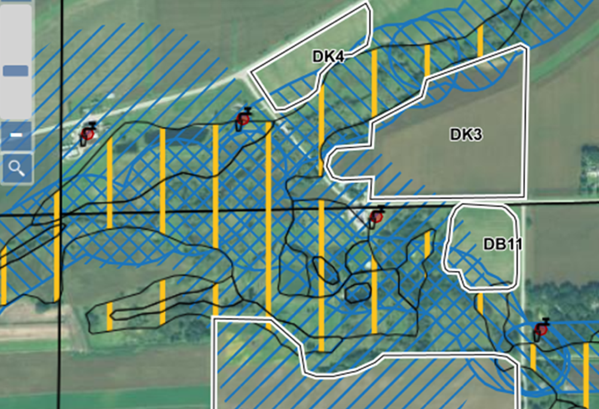
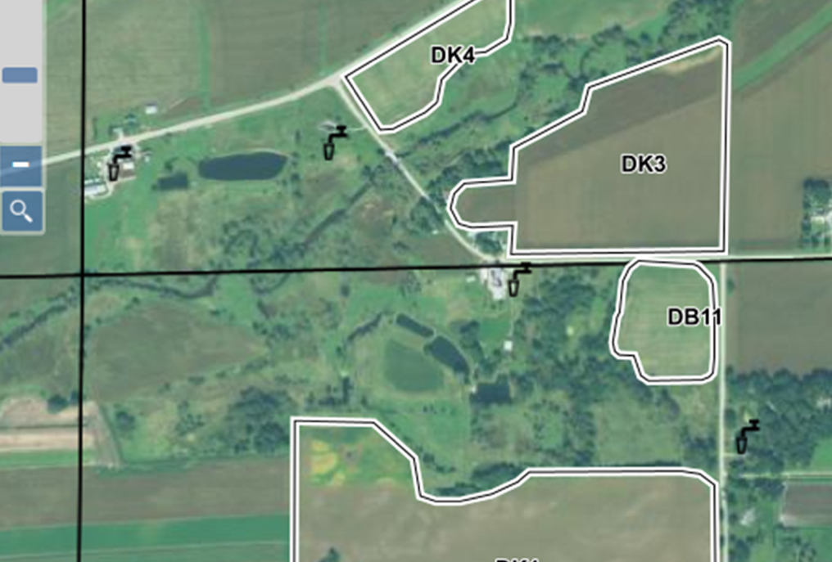
Surface Water Quality Management Areas (SWQMA)
Mechanical applications of manure
  1000’ buffer from ponds or lakes
  300’ buffer from rivers or streams

Slide 21
Surface Water Quality Management Areas (SWQMA)
Install and maintain vegetative buffers or filter strips.
Maintain ≥ 30% cover after nutrient application.
Incorporate within 3 days after application.
Plant a crop prior to, at, or immediately after application.
Apply nutrients within 7 days of planting on long term no-till soil with less than 30% residue.
Notes:
If you are going to be applying manure in a SWQMA, there are a couple of things that you need to consider. First of all you must use ONE or more of the following:

Slide 22
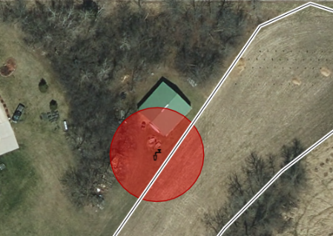
Wells And Other Conduits To Groundwater
No mechanical applications within 50’ of direct conduits to groundwater.
  Gleaning or pasturing animals is allowed.
Examples of Direct Conduits:
  Wells
  Sinkholes
  Swallets
  Fractured bedrock at the surface
  Mines/mine-shafts
  Quarries
  Tile inlets discharging to groundwater.

Slide 23
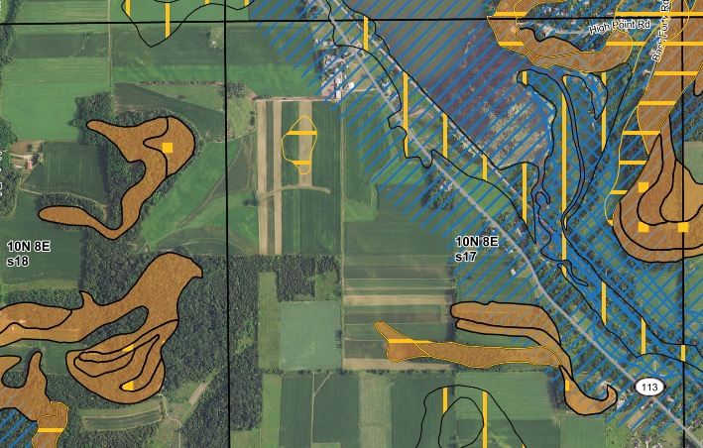
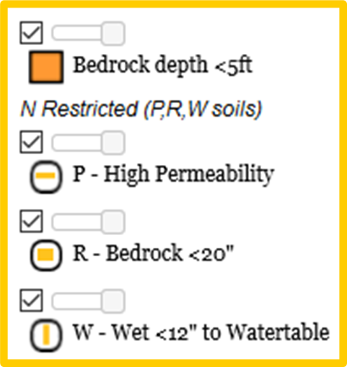
Nitrogen Restricted Soils-soils that are at high risk for leaching or shallow depth to bedrock
Late summer or fall manure or organic by-products
  Limit rates to 90 or 120 lbs N/ac
  Rate depends on manure dry matter, crops, and restricted soil type—P, W, or R soils

Slide 24
For late summer or fall manure or organic by-products with greater than 4% dry matter:
On W or W combination soils:
Limit to either 120 lbs available N/acre OR rates from A2809 –whichever is LESS.
On P and R Soils:
For established cover crops, overwintering annual crops, or perennial crops, limit rates to either120 lbs available N/acre OR rates from A2809 –whichever is LESS.
For annual crops that won’t be planted until Spring or Summer, delay application until soil temperatures are < 50 degrees F
AND limit rates to either120 lbs available N/acre OR rates from A2809 - whichever is LESS.

Slide 25
For late summer or fall manure or organic by-products with less than or equal to 4% Dry Matter:
On W or W combination soils:
Limit to either 90 lbs available N/acre OR
Use 120 lbs available N/acre AND do one of the following:
Apply on an established cover crop, overwintering annual crops, or perennial crop.
Use a nitrification inhibitor.
Establish a cover crop within 2 weeks of application.
Surface apply and do not incorporate for at least three days.
Delay application until after soil temperatures are < 50 degrees F.
On P and R Soils:
Limit to 120 lbs available N/acre
Delay application until soil temperatures are < 50 degrees F.
AND use a nitrification inhibitor
OR surface apply and do not incorporate for at least 3 days.

Slide 26
Winter Spreading Precautions
Notes:
M2.5.6 There are winter spreading restrictions in Wisconsin for surface water quality management areas (SWQMAs), slopes, and shallow soils over fractured bedrock. It is important to know the rules developed by the state and local government.

Slide 27

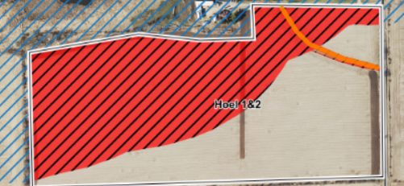
SWQMAs
Do not mechanically apply manure within the SWQMA.
Gleaning or pasturing of animals is allowed in SWQMA and on all slopes in winter.
SWQMA Map in non-winter season
Winter Spreading Map: Red=no spread

Slide 28
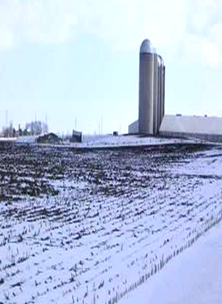
Application limitations
Manure applications cannot exceed the P removal of the following growing season’s crop.
Limit all winter manure applications to 60 lbs. of P2O5/ac or less.
Limit liquid manure applications to 7,000 gal/acre.

Slide 29
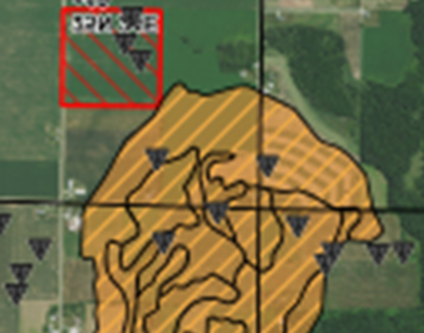
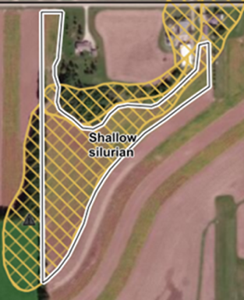
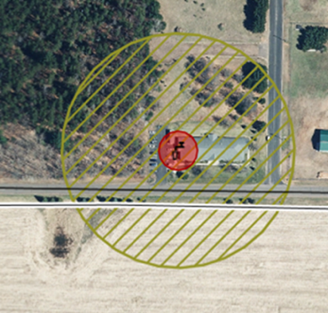
Spreading restrictions
Do not apply within 300 feet of direct conduits to groundwater.
Do not surface apply liquid manure during February and March on:
  DNR Well Compensation areas funds provided to replace wells when contaminated with livestock manure or;
  Silurian dolomite within five feet of soils surface.

Slide 30
Spreading Precautions
Do not apply manure and/or organic by-products on slopes greater than 6%, unless the plan documents that no other accessible fields are available for winter spreading and two or more of the following are implemented:
  Contour buffer strips or contour strip cropping.
  Leave all crop residue and no fall tillage.
  Apply manure in intermittent strips on no more than 50% of field.
  Apply manure on no more than 25% of the field during each application, waiting a minimum of 14 days between applications.
  Reduce manure app. rate to 3,500 gal. or 30 lbs. P2O5, whichever is less.

Slide 31
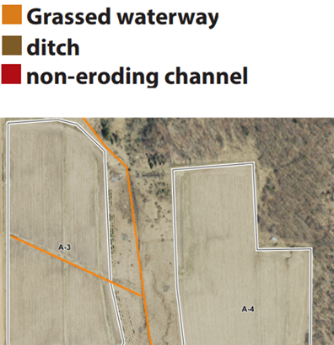
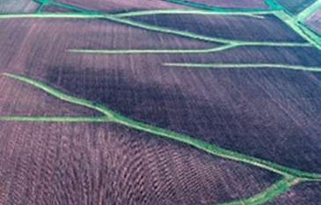
Spreading Precautions
Do not apply manure and/or organic by-products to fields where concentrated flow channels are present unless two or more of the following are implemented:
  Contour buffer strips or contour strip cropping.
  Leave all crop residue and no fall tillage.
  Apply manure in intermittent strips on no more than 50% of field.
  Apply manure on no more than 25% of the field per application, waiting at
  least two weeks between applications.
  Reduce manure app. rate to 3,500 gal. or 30 lbs. P2O5, whichever is less.
  No manure application within 200 feet of all concentrated flow channels.
  Fall tillage is on the contour and slopes are lower than 6%.

Slide 32
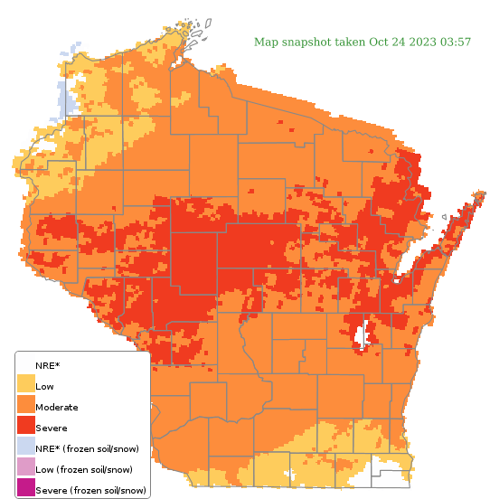
Runoff Risk Advisory Forecast
Tool to help determine risk of a runoff event before you spread.
If it’s RED, DON’T SPREAD
http://www.manureadvisorysystem.wi.gov/runoffrisk/index
Notes:
M2.5.5 The Manure Runoff Risk Advisory System can assist in identifying when and where spreading manure poses risks to surface waters.

Slide 33

Manure Resources

Slide 34

Thanks!
Questions?
Name
Title
Nutrient and Pest Management (NPM) Program
UW-Madison Division of Extension
Email: Phone:

