Slide 2
Potassium Basics
Notes:
K1.1.1 Potassium (K) is another essential plant nutrient. K is utilized in plants for respiration, photosynthesis, water and nutrient transport, metabolism, protein & starch production, etc.
K1.1.2 K deficiency in crops is common in Wisconsin due to the large demand for it by many of the agricultural crops grown here – particularly dairy forage crops such as corn silage, alfalfa, etc. In addition, in tight financial years, supplemental K fertilizer applications are often cut or reduced out of economic necessity.
K1.1.3 K deficiency in crops: In corn and soybean, K deficiency appears a yellowing or browning of the margins of the older (bottom) leaves of the plant. In alfalfa, white/gray spots appear along the outer margins of the older leaves of a plant. Because K is a mobile element in the plant, deficiency symptoms appear on the oldest leaves first.
K1.1.4 Potassium, like most soil nutrients, moves through a series of chemical and biological cycles from soil to plant to animal.
K1.1.5 K is released slowly over time from the weathering of soil minerals and clay particles. This process is far too slow to meet the K needs of agricultural crops.
K1.1.6 K is also added to the soil through the breakdown of soil organic matter.
K1.1.7 Supplemental K is added to soils from commercial fertilizers, manure, and biosolid applications.
K1.1.8 Plants utilize K through root adsorption of K in the soluble (dissolved) form from the soil solution.
K1.1.9 K is removed from the soil by crop uptake and subsequent harvest.
K1.1.10 K can be lost due to leaching on sandy and organic soils. Sands do not contain enough clay (CEC) to hold potassium and K is weakly bound to organic matter. Because of this, sandy and organic soils often test low for K.
K1.1.11 K can also be removed from the soil by erosion and runoff; however, this is not a threat to water quality like P losses are.
K1.1.12 There exist three pools of K in soil: unavailable K, slowly-available K, and available K.
K1.1.13 Unavailable K: This form of K is contained within the structure of soil minerals and clay. Some of this form of K is released over time as minerals weather but does not occur rapidly enough to supply crop K need. The majority of K in soils is unavailable.
K1.1.14 Slowly available K: This is K that is trapped or “fixed” within clay particle layers. This K is slowly released in plant-available forms over time but usually in amounts much less than crop demand – particularly on sandy and organic soils. Slowly available K acts as a reservoir (or storehouse) of K – releasing K over extended periods of time.
K1.1.15 Available K is dissolved in the soil water and also held on the surface of clay particles – where it can easily move to the soil solution. Plants uptak

Slide 3
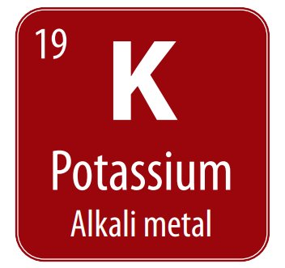
Potassium Basics
Chemical symbol K comes from Kalium
Common fertilizer potash (K20)
Plants utilize K+ through root adsorption of K in the soluble (dissolved) form from the soil solution
Notes:
K1.1.1 Potassium (K) is another essential plant nutrient. K is utilized in plants for respiration, photosynthesis, water and nutrient transport, metabolism, protein & starch production, etc.
Plants need large quantities of potassium - involved in opening and closing of stomata
Stomata – regulates the exchange of water vapor, oxygen, and carbon dioxide. If K is deficient or not adequate amounts, it stunts plant growth and reduces yield.
Potassium uptake is linked to increased resistance to disease and lodging, increased carbohydrate production, and improved winter hardiness (of alfalfa)
K also plays a role in
Maintains turgor, reduces water loss and wilting
Aids in photosynthesis and food formation
Reduces respiration, preventing energy losses
Enhances translocation of sugars and starch
Produces grain rich in starch
Increases plants protein content
Builds cellulose and reduces lodging
Helps prevent crop diseases
increasing root growth and helping improve drought resistance
Winter hardiness

Slide 4
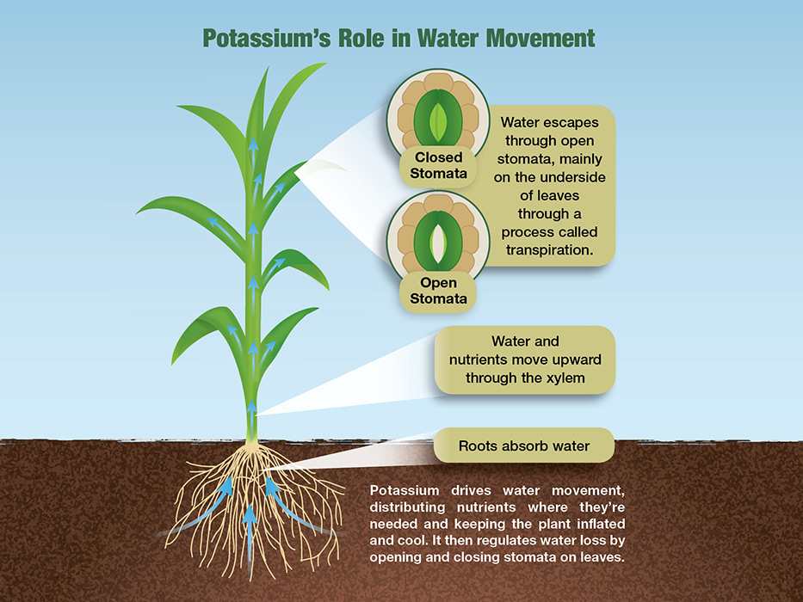
Why is Potassium Important?
Macronutrient
Movement of water, starches, and sugars
Stomata (leaf pores) opening and closing
Nutrients and carbohydrates
Regulates photosynthesis & respiration
Stand persistence
Stalk strength
Insect & disease defenses
Winter hardiness
Notes:
K1.1.1 Potassium (K) is another essential plant nutrient. K is utilized in plants for respiration, photosynthesis, water and nutrient transport, metabolism, protein & starch production, etc.
Plants need large quantities of potassium - involved in opening and closing of stomata
Stomata – regulates the exchange of water vapor, oxygen, and carbon dioxide. If K is deficient or not adequate amounts, it stunts plant growth and reduces yield.
Potassium uptake is linked to increased resistance to disease and lodging, increased carbohydrate production, and improved winter hardiness (of alfalfa)
K also plays a role in
Maintains turgor, reduces water loss and wilting
Aids in photosynthesis and food formation
Reduces respiration, preventing energy losses
Enhances translocation of sugars and starch
Produces grain rich in starch
Increases plants protein content
Builds cellulose and reduces lodging
Helps prevent crop diseases
increasing root growth and helping improve drought resistance
Winter hardiness

Slide 5
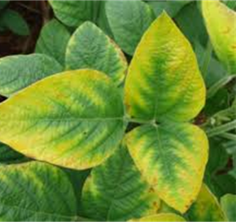
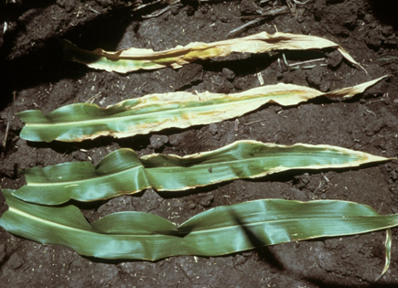
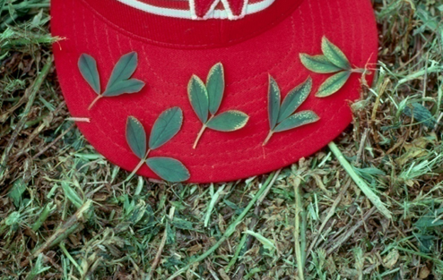
K Deficiency Symptoms
K deficiency in crops is common in Wisconsin. We grow many HIGH K demand crops: forages, corn silage & alfalfa.
Potassium is mobile in plants.
Deficiency symptoms on older leaves.
Notes:
K1.1.2 K deficiency in crops is common in Wisconsin due to the large demand for it by many of the agricultural crops grown here – particularly dairy forage crops such as corn silage, alfalfa, etc. In addition, in tight financial years, supplemental K fertilizer applications are often cut or reduced out of economic necessity.
K1.1.3 K deficiency in crops: In corn and soybean, K deficiency appears a yellowing or browning of the margins of the older (bottom) leaves of the plant. In alfalfa, white/gray spots appear along the outer margins of the older leaves of a plant. Because K is a mobile element in the plant, deficiency symptoms appear on the oldest leaves first.
In corn: chlorosis starting at corn leaf tip and progressing down leaf margins.

Slide 6
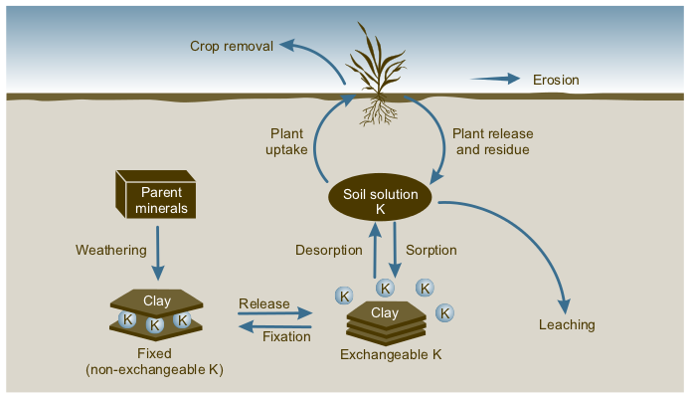
Potassium (K) Cycle
Fertilizer
Manure/Biosolids
(Slow)
(concerning in sandy and organic soils)
(Slow)
Adapted from: www.kingstoncompassion.org/horticulture/nutrients/potassium-k/
Notes:
K1.1.4 Potassium, like most soil nutrients, moves through a series of chemical and biological cycles from soil to plant to animal.
K1.1.5 K is released slowly over time from the weathering of soil minerals and clay particles. This process is far too slow to meet the K needs of agricultural crops.
K1.1.6 K is also added to the soil through the breakdown of soil organic matter.
K1.1.7 Supplemental K is added to soils from commercial fertilizers, manure, and biosolid applications.
K1.1.8 Plants utilize K through root adsorption of K in the soluble (dissolved) form from the soil solution.
K1.1.9 K is removed from the soil by crop uptake and subsequent harvest.
K1.1.10 K can be lost due to leaching on sandy and organic soils. Sands do not contain enough clay (CEC) to hold potassium and K is weakly bound to organic matter. Because of this, sandy and organic soils often test low for K.
K1.1.11 K can also be removed from the soil by erosion and runoff; however, this is not a threat to water quality like P losses are.
K1.1.12 There exist three pools of K in soil: unavailable K, slowly-available K, and available K.
K1.1.13 Unavailable K: This form of K is contained within the structure of soil minerals and clay. Some of this form of K is released over time as minerals weather, but does not occur rapidly enough to supply crop K need. The majority of K in soils is unavailable.
K1.1.14 Slowly available K: This is K that is trapped or “fixed” within clay particle layers. This K is slowly released in plant-available forms over time but usually in amounts much less than crop demand – particularly on sandy and organic soils. Slowly available K acts as a reservoir (or storehouse) of K – releasing K over extended periods of time.
K1.1.15 Available K is dissolved in the soil water and also held on the surface of clay particles – where it can easily move to the soil solution. Plants uptake K in the dissolved form. As dissolved K is taken up by plants, K is released into the soil solution from the surface of clay and organic matter particles. Soil tests measure K that is in the available form.
There are three forms of soil potassium. Unavailable, slowly available/fixed, and readily available or exchangeable potassium. Plants can only use the exchangeable potassium on the surface of soil particles and potassium dissolved in the soil water
Potassium comes from primary minerals in soil like micas and feldspars and some other clay minerals. these materials typically hold unavailable soil K and need to undergo weathering to release K. Weathering occurs over long periods of time, those minerals break down releasing potassium as available K+ (not crop sustainable due to length of time)
Slowly available potassium is also associated with clay minerals. Potassium is fixed within layers of certain clay particles, but plants can’t use much during a single growing season. The amount is also soil dependent.
Associated with clay minerals
Potassium is fixed within layers of certain clay particles - plants can’t use much during single growing season
Soil dependent
Readily available potassium is dissolved in soil water or held on the surface of clay particles within expanded clay layers, or other soil colloids. Plants absorb dissolved K readily – once K concentration in the soil solution drops, more is released into the solution from exchangeable forms. Some leaching can occur in very sandy soils.
Most soil potassium is present in insoluble minerals that release potassium very slowly upon chemical weathering.
Low amounts in sandy and organic soils, which usually corresponds to needing to annually apply K on these soils
Leaching losses of K on sands and organic soils. Sands = little or no clay, thus low CEC. OM = while high in CEC and holds most cations, holds K ions weakly.
Readily available K is dissolved in soil water or held on by soil particles.
Regardless of the fertilizer form – potassium breaks down to K+ ion
Unavailable soil K contained in mica, feldspars, and some clay minerals
Slowly available K held by other clay minerals
Released over time

Slide 7
Factors affecting K availability
Type of soil & clay minerals
Soil moisture
Soil temperature
Aeration
Soil pH
Notes:
Soil moisture: moisture is needed to move K
Soil temperature: Low soil temperature reduces the availability and uptake
Soil aeration: When aeration is reduced, plants have less energy to extract potassium (and other nutrients) from the soil - affected more by poor aeration than other nutrients
Soil Test K: level decreases, the lower plant uptake
Fixation: minerals that trap and hold K unavailable
CEC: Greater K storage - Silty and clay soils hold 3 to 10 times more cations than sandy soils

Slide 8
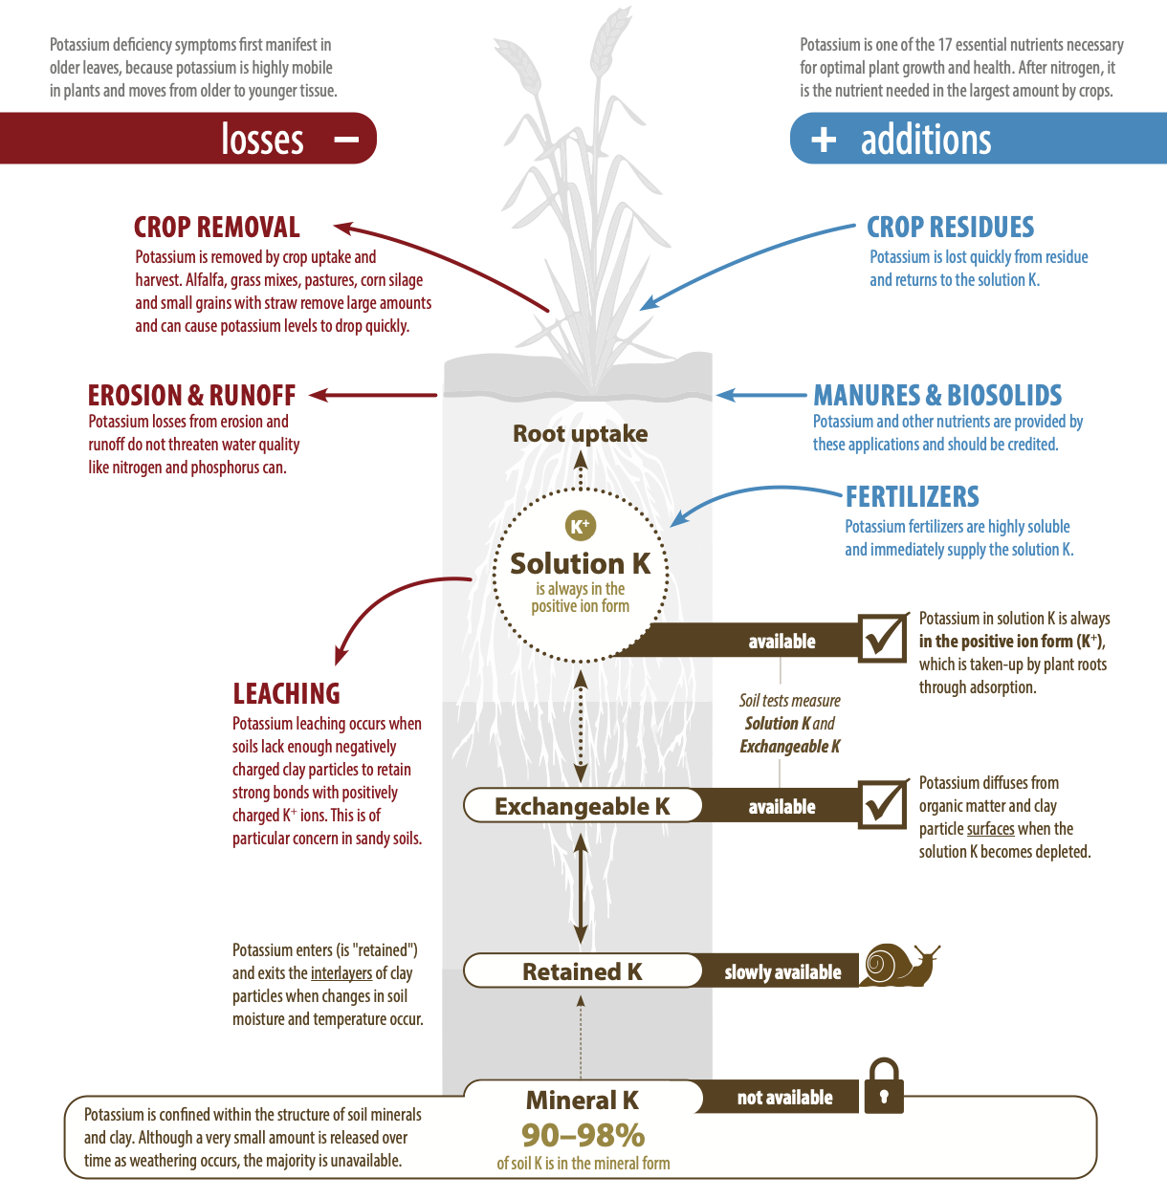
The K Cycle
Potassium, like most plant nutrients, moves through a series of chemical and biological cycles from soil to plant to animal.​

Slide 9
K Additions & Losses
K Additions
K is released slowly over time from the weathering of soil minerals and clay particles. This process is too slow to meet crop need.
K is also added to the soil through the breakdown of soil organic matter.
Supplemental K is added to soils from commercial fertilizers, manure, and biosolid applications.
K Losses
K is removed from the soil by crop uptake and subsequent harvest.
K can be lost due to leaching on sandy and organic soils. Sands do not contain enough clay (CEC) to hold potassium and K is weakly bound to organic matter. Because of this, sandy and organic soils often test low for K.
K can also be removed from the soil by erosion and runoff; however, this is not a threat to water quality like P losses are.

Slide 10
Seasonal Effect on Soil Test K
Seen almost yearly and can be large.
The net effect is that soil test K drops until the crop reaches physiological maturity and then increases slowly as the K is leached from the residue.
Soil sampling in the FALL for grain crops often results in a lower K soil test than spring sampling.
The difference can be as much as 50 to 100 lb per acre
Effect will be greatest if sampling is done immediately after harvest in a dry fall with little rain to leach the K from the plants.
A SPRING sample is a more accurate measurement of what the plant will see during the season
For crops where the entire plant is harvested such as hay, and corn silage, K removal is highest since everything taken up by the plant is removed from the field. In these cases, the K soil test can drop very quickly.

Slide 11
Potassium Management

Slide 12
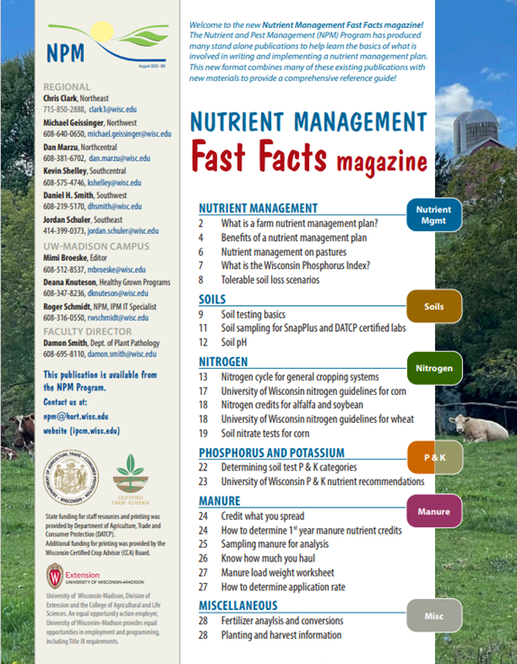
Following Along in Fast Facts?
Potassium: Pages 22-23 in Nutrient Management Fast Facts

Slide 13
Potassium Fertilizer Sources
Fertilizer | Fertilizer Analysis | Salt Index
Potassium chloride (potash) | 0-0-60 (62) | 116
Potassium-magnesium sulfate | 0-0-22 | 43
Potassium nitrate | 13-0-44 | 74
Potassium sulfate | 0-0-50 | 43
Notes:
K1.4.1 Manure applications to hay, either prior to seeding or as a topdress fertilizer, are techniques for supplying potassium and efficiently distributing manure on a farm.
K1.4.2 If a soil test report recommends potassium for a new alfalfa stand, manure could be applied to the field prior to the seeding to deliver the needed K. Caution: if oats are also seeded, the chances of lodging are high if the oats are intended for grain due to the additional N being supplied by the manure.
K1.4.3 Another method of using manure to supply K to hay is the use of manure as a top-dress fertilizer. If considering this, be certain to:
1) Target older hay stands (don’t damage young stands with increased traffic, weed seed introduction, stimulation of grass growth).
2) Limit application rates to 10-12 tons/acre or 3,000-5,000 gallons/acre (avoid smothering and salt injury).
3) Spread on firm, dry soils to avoid compaction.
4) Spread as soon as possible after cutting to avoid burning the alfalfa regrowth.
K1.4.4 Be aware of forage from fields with excessively high potassium levels. Excessive potassium levels in forages (> 3%) can cause increased incidences of milk fever and other related illnesses in cattle.
Another method of using manure to supply potash to hay is the use of manure as a topdress fertilizer.
Some caution needs to be exercised relative to:
- Low application rates - avoid smothering or salt injury to the stand,
- Spread the manure evenly - avoid clumping,
- Target older hay stands - don’t risk damage to young stands. The N in manure will stimulate grass growth in older stands, which may result in increased tonnage, but lower quality.
- Spread ASAP - within 3 days and prior to the stand “greening-up.” This is to avoid burning the alfalfa regrowth.

Slide 14
Soil Test K Changes Quickly
Soil buffering capacity
The amount of fertilizer needed to change the soil test level by 1 ppm
6 - 7 lbs K₂O/acre = 1 ppm change in soil K
Less time is required to either lower or raise soil test K levels
Larger crop demand for K than P
Notes:
K1.2.1 Monitor soil K levels with regular, routine soil testing.
K1.2.2 Soil K levels can change quickly – just the opposite of phosphorus. This is due to large K removal rates of corn silage, alfalfa and other forages.

Slide 15
Crop Nutrient Removal
N P₂O₅ K₂O
- - - - - - - - - - lb/a/yr - - - - - - - -
Corn (160 bu/a) 190* 60 45
Corn silage (23 ton/a) 190* 80 190
Soybean (40 bu/a) 160 30 55
Alfalfa (5 ton/a) 300 65 300
*Recommended N application rate at 0.05 N:Corn price ratio.

Slide 16
Soil Test K Changes Quickly: Example
Soil test K = 200 ppm (EH)
Track draw-down of K over a CCOHHH rotation
Notes:
This example tracks the change in soil test K values over the course of a 6-year crop rotation where there are NO additions of K of any kind (fertilizer, starter or manure applications) over the length of the rotation.
C = corn; O = oats; H = hay
Note that the soil test K value of 200 ppm at the start of this exercise is in the excessively high (EH) range (for corn and oats), very high (VH) range for alfalfa.

Slide 17
Soil Test K Changes Quickly: Example
Soil test K = 200 ppm (EH)
Track draw-down of K over a CCOHHH rotation
Corn @ 160 bu/a removes 45 lb K₂O/a/yr x 2
Oats @ 100 bu/a removes 20 lb K₂O/a/yr
Alfalfa @ 5 tons/a removes 300 lb K₂O/a/yr x 3
Removal of K₂O over rotation = 1,010 lbs K₂O
Notes:
This calculation shows the removal of K by each crop over the course of the 6-year rotation.

Slide 18
Soil Test K Changes Quickly: Example
Soil test K = 200 ppm (EH)
Track draw-down of K over a CCOHHH rotation
Removal of K₂O over rotation = 1,010 lbs K₂O
Change in soil test K = 1,010 K₂O/7 = 144 ppm K
Notes:
The amount of K removed by the crops over the 6-year rotation is divided by the soil buffering capacity of 7 lbs K₂O per 1 ppm change in soil test K.
The result is a reduction in soil test K of 145 ppm over the course of this 6-year rotation. Remember NO additional K from any source was added.

Slide 19
Soil Test K Changes Quickly: Example
Soil test K = 200 ppm (EH)
Track draw-down of K over a CCOHHH rotation
Removal of K₂O over rotation = 1,010 lbs K₂O
Change in soil test K = 1,010 K₂O/7 = 144 ppm K
Soil test K = 56 ppm (VL) after the 6-year rotation
(200 ppm K – 144 ppm K = 56 ppm K)
Notes:
The end result over the 6-year rotation with NO K additions is a soil test K value of 55 ppm - - Very low for any crop in this rotation!!!
The Point: Soil test K values can change very quickly! They need to be monitored with regular soil testing.

Slide 20
Soil Testing to Monitor K
Try to maintain soil test levels in the optimum range
Use soil test results to identify field that need additional nutrients and prioritize fields for manure applications
Targe fields low in K
Sands and organic soils may require annual applications
Base K applications on soil test results AND realistic crop yield
Realistic crop yield = multi-year yield avg + 10-15%
Be sure to credit non-commercial fertilizer sources
Crop removal = nutrient additions
Notes:
K1.2.3 Sands & organic soils may require annual K applications. It is difficult to build up K levels in these soils as they do not retain K.
K1.2.4 Use soil test results to ID fields that need or do NOT need additional nutrients.
K1.2.5 Use soil test results to prioritize fields for manure applications. Target fields low in K.
K1.2.6 Likewise, use soil test results to prioritize fields for commercial fertilizer applications if financial resources are limited and do not allow all fields in need of K to be fertilized. Prioritizing fields low in K will yield the greatest return from fertilizer applications.
K1.2.7 Follow UW nutrient guidelines for K applications which are based on K soil test results AND realistic crop yield goals.
K1.2.8 Realistic yield goals should be based on multi-year yield averages for a given crop on a specific field plus 10-15%.
K1.2.9 Strive to maintain soil test levels for K (and P) in the “optimum” range.
K1.2.10 At optimum, nutrients applied are approximately equal to nutrients removed by the crop.
K1.2.11 Be certain credit any K supplied by non-commercial fertilizer sources such as manure, biosolids, etc. See manure management section for more information.

Slide 21
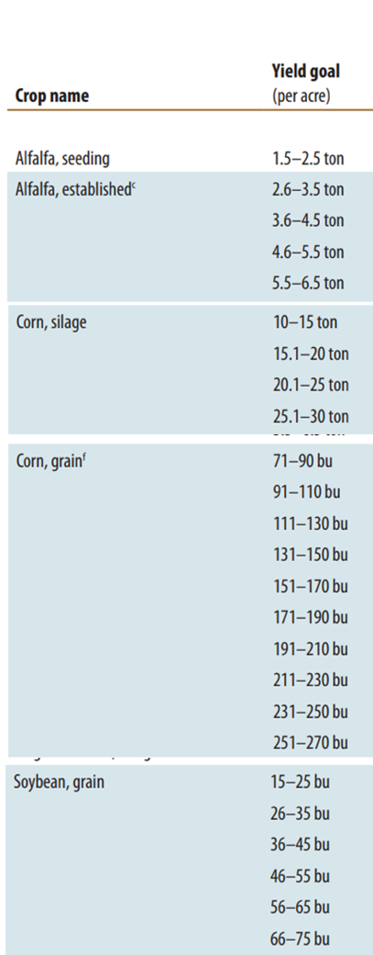
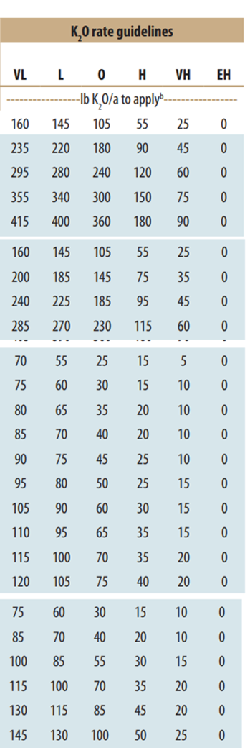
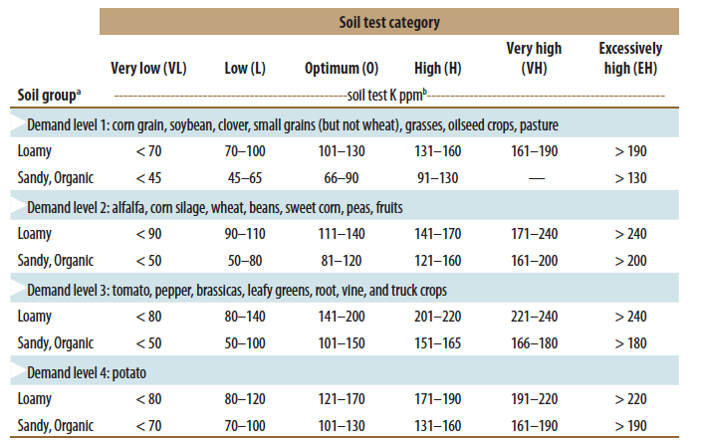
K₂O Recommendations
Notes:
Recommendations depend on Crop, Realistic yield goal, and soil texture.
To determine your soil test K category
Choose the highest demanding crop in your rotation
Choose the soil group for the predominant soil in the field
Find your soil test category by using the analysis number for potassium from your soil test results.
Speaker: Refer audience to the P and K recommendations tables in the Fast Facts publication. Be certain audience knows where to find this information. – This information can be found in the Fast Facts Magazine on pages 22 and 23.
The P and K recommended from the soil test report can often be applied via a starter fertilizer application. The minimum recommendation for starter fertilizer (10 lbs N/a, 20lbs P₂O₅/a, and 20 lbs K₂O/a) is included in the P and K recommendations.

Slide 22
Manure Applications to Hay
Apply the manure before the new seeding to meet partial potash demands of the rotation.
Top-dress established hay with manure.
Limit rate to 10-12 tons/acre or 3,000 – 5,000 gallons/acre
Spread on older hay stands
Spread on firm soils – avoid compaction
Spread ASAP after cutting
Notes:
K1.4.1 Manure applications to hay, either prior to seeding or as a topdress fertilizer, are techniques for supplying potassium and efficiently distributing manure on a farm.
K1.4.2 If a soil test report recommends potassium for a new alfalfa stand, manure could be applied to the field prior to the seeding to deliver the needed K. Caution: if oats are also seeded, the chances of lodging are high if the oats are intended for grain due to the additional N being supplied by the manure.
K1.4.3 Another method of using manure to supply K to hay is the use of manure as a top-dress fertilizer. If considering this, be certain to:
1) Target older hay stands (don’t damage young stands with increased traffic, weed seed introduction, stimulation of grass growth).
2) Limit application rates to 10-12 tons/acre or 3,000-5,000 gallons/acre (avoid smothering and salt injury).
3) Spread on firm, dry soils to avoid compaction.
4) Spread as soon as possible after cutting to avoid burning the alfalfa regrowth.
K1.4.4 Be aware of forage from fields with excessively high potassium levels. Excessive potassium levels in forages (> 3%) can cause increased incidences of milk fever and other related illnesses in cattle.
Another method of using manure to supply potash to hay is the use of manure as a topdress fertilizer.
Some caution needs to be exercised relative to:
- Low application rates - avoid smothering or salt injury to the stand,
- Spread the manure evenly - avoid clumping,
- Target older hay stands - don’t risk damage to young stands. The N in manure will stimulate grass growth in older stands, which may result in increased tonnage, but lower quality.
- Spread ASAP - within 3 days and prior to the stand “greening-up.” This is to avoid burning the alfalfa regrowth.

Slide 23
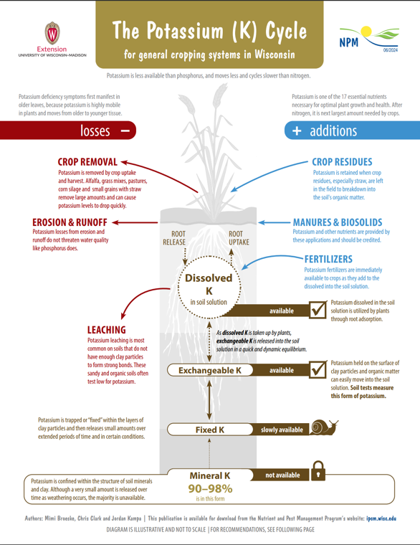
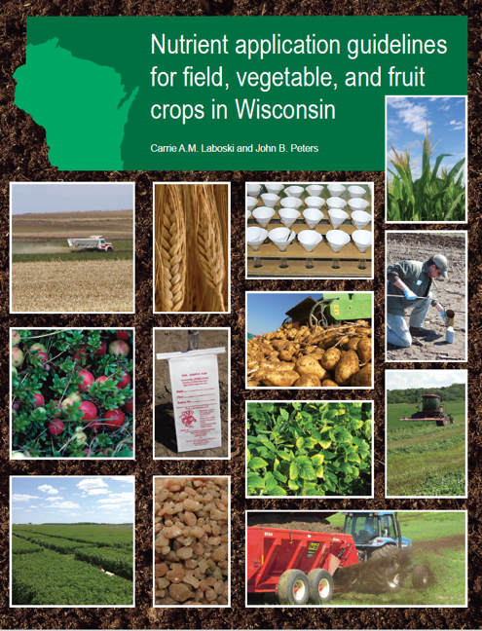
Potassium Resources

Slide 24
Thanks!
Questions?
Name
Title
Nutrient and Pest Management (NPM) Program
UW-Madison Division of Extension
Email: Phone:

