Slide 2
Phosphorus Introduction

Slide 3
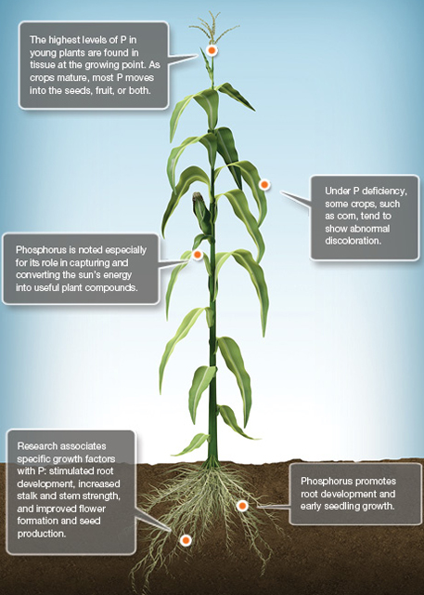
Phosphorus (P) in Plants
P is an essential plant nutrient
Functions
  Photosynthesis
  Respiration
  Seed Production
  Root Growth
  and more!
Notes:
P1.1.1 Phosphorus (P) is an essential plant nutrient. P is required for photosynthesis, respiration, seed production, etc.

Slide 4
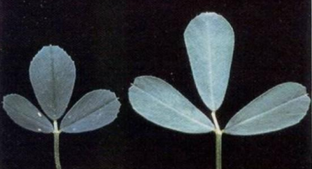
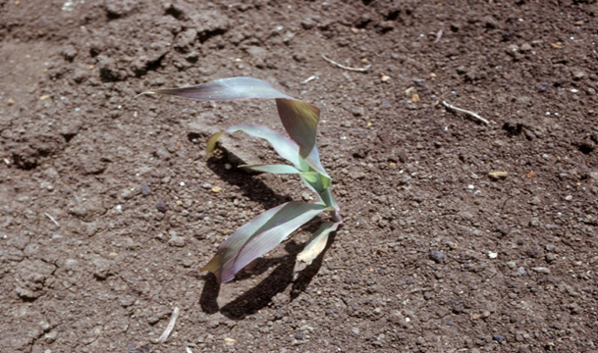
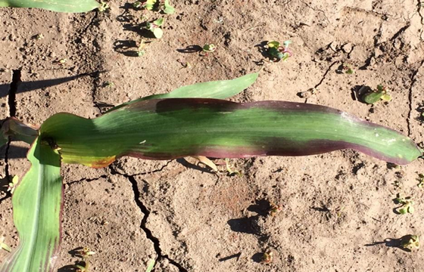
Phosphorus Deficiency
Rare in Wisconsin
  Long term P additions exceeding P removal by crops
Deficiency Symptoms
  P is mobile in plants, so deficiency shows up on older leaves first
  Corn: seedling appears purple (caused by factors besides soil Test P)
    Slow root development, hybrid characteristic, herbicide injury, etc.
Notes:
P1.1.2 P deficiency in crops is rare in Wisconsin because most of our soils contain P levels in excess of crop demand. This has been the result of long-term P additions to fields exceeding P removal from crops.
P1.1.3 P deficiency in crops: In corn, the seedling will often appear purple in color. Often times factors other than P deficiency can cause the purpling of corn. Such factors could be: slow root development due to a cold start to growing season with the roots not yet reaching out to the surrounding soil and/or starter fertilizer band); hybrid characteristics; herbicide injury.

Slide 5
Phosphorus & Surface Water Quality
Eutrophication-aging of lakes and streams accelerated by excess nutrient additions
  In freshwater for Wisconsin, P is the nutrient that increases this
  P stimulates algae and aquatic vegetative growth, resulting in poor water quality
Reductions in water quality affects the recreational, aesthetic, and functional values of water
Goal: prevent P from reaching lake and streams
Notes:
P1.1.4 Eutrophication, which is the aging of lakes and streams, is accelerated by nutrient additions.
P1.1.5 In freshwater ecosystems, P is the nutrient that increases eutrophication.
P1.1.6 P additions to surface waters stimulates algae and aquatic vegetation growth.
P1.1.7 The result can be green weed-choked water, foul odors, low dissolved oxygen levels as this material decomposes, fish kills from the low dissolved oxygen, and potential formation of toxic blue-green algae.
P1.1.8 Degraded water quality can reduce the recreational, aesthetic, and functional value of water.
P1.1.9 It is very important to prevent P from reaching lakes and streams. Runoff water and eroded soil from landscapes are major contributors of P to surface waters.

Slide 6
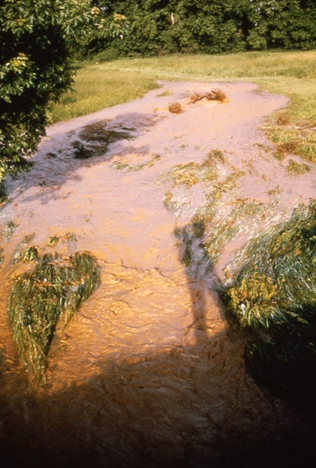

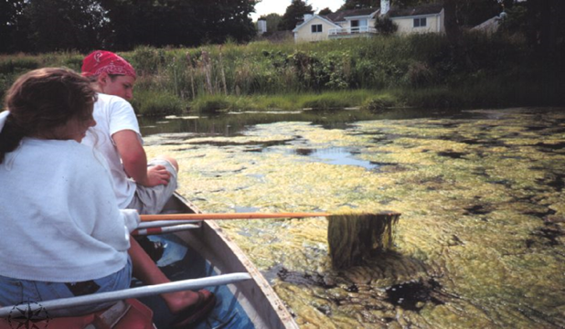
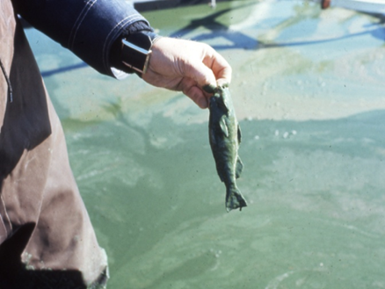
Phosphorus & Surface Water Quality
Notes:
P1.1.4 Eutrophication, which is the aging of lakes and streams, is accelerated by nutrient additions.
P1.1.5 In freshwater ecosystems, P is the nutrient that increases eutrophication.
P1.1.6 P additions to surface waters stimulates algae and aquatic vegetation growth.
P1.1.7 The result can be green weed-choked water, foul odors, low dissolved oxygen levels as this material decomposes, fish kills from the low dissolved oxygen, and potential formation of toxic blue-green algae.
P1.1.8 Degraded water quality can reduce the recreational, aesthetic, and functional value of water.
P1.1.9 It is very important to prevent P from reaching lakes and streams. Runoff water and eroded soil from landscapes are major contributors of P to surface waters.

Slide 7
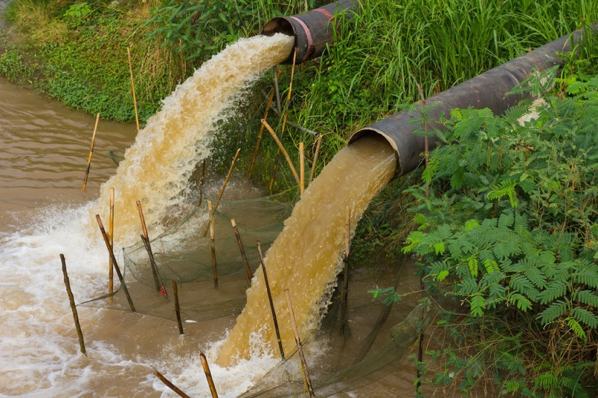
Point Source Pollution
Occurs through specific, identifiable source (i.e. a discharge pipe)
Notes:
P1.1.10 Point source pollution occurs through a specific, identifiable source such as a discharge pipe, etc. Nonpoint source pollution occurs over a large area, such as a watershed. Overland flow of water (i.e. runoff) is the main delivery mechanism in nonpoint source pollution.

Slide 8
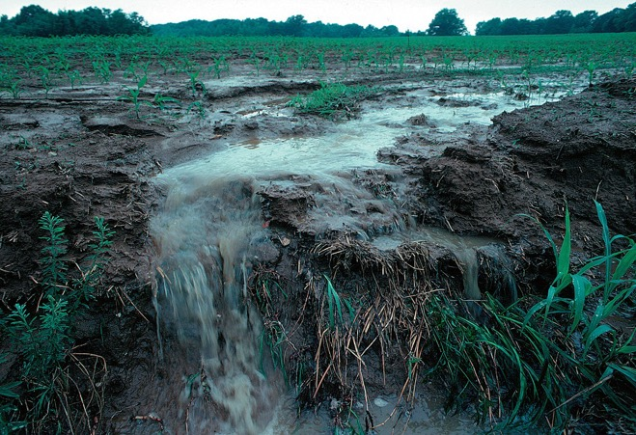
Nonpoint Source Pollution
Occurs over a large area, like a watershed. Runoff is the main delivery mechanism
  Can be urban, industrial, or agricultural
Notes:
P1.1.10 Point source pollution occurs through a specific, identifiable source such as a discharge pipe, etc. Nonpoint source pollution occurs over a large area, such as a watershed. Overland flow of water (i.e. runoff) is the main delivery mechanism in nonpoint source pollution.
P1.1.11 Non-point sources can be urban ( lawns, construction erosion, streets), industrial (sewage sludge applications) or agricultural (fertilizers and manure).
P1.1.12 The contribution of each non-point source can be significant and is a function of the land use within a given area, such as a watershed.

Slide 9
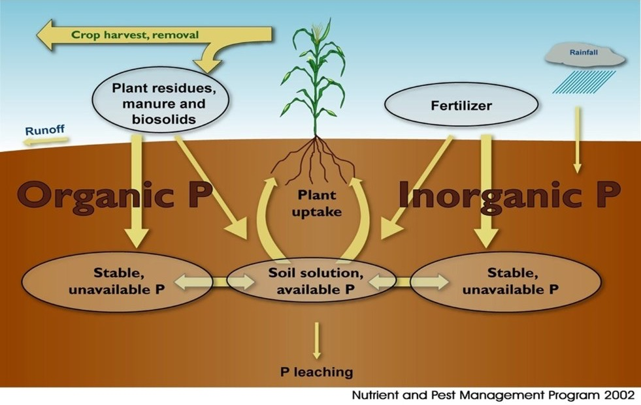
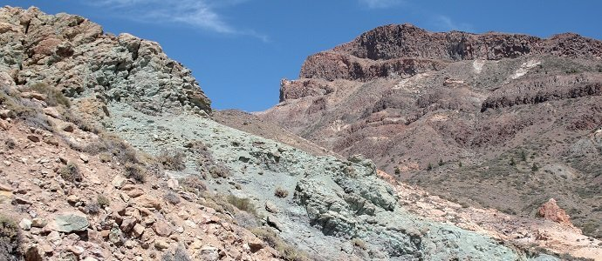
LIFECYCLE OF PHOSPHORUS
P is largely derived from weathering of subsoil minerals and bedrock before entering the P cycle at large.
P is also mined from larger deposits and refined as fertilizer.
Photo Credit: Permaculture Research Institute
P1.2.1 Phosphorus, like most soil nutrients, moves through a series of chemical and biological cycles from soil to plant to animal. P1.2.2 P naturally originates in the soil from the weathering of soil minerals and bedrock.
Notes:
P1.2.1 Phosphorus, like most soil nutrients, moves through a series of chemical and biological cycles from soil to plant to animal. P1.2.2 P naturally originates in the soil from the weathering of soil minerals and bedrock.

Slide 10
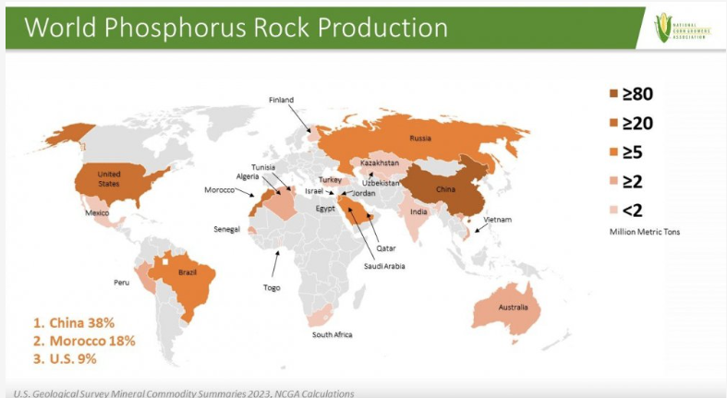
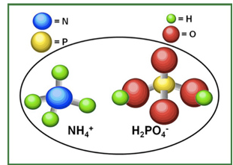
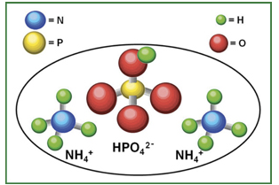
Fertilizer sourcing
Molecular structure images credit: Mosaic
Notes:
P1.2.4 P is often added to the soil as commercial fertilizer.

Slide 11
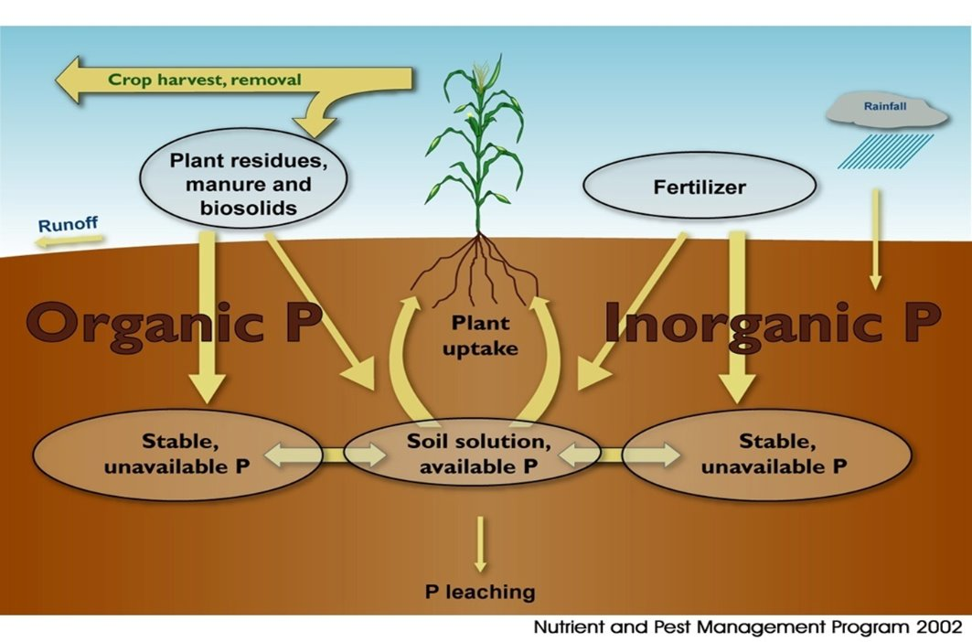
P Cycle: Additions
Notes:
P1.2.3 The breakdown of soil organic matter as well as plant/crop residues also adds P to the soil.

Slide 12
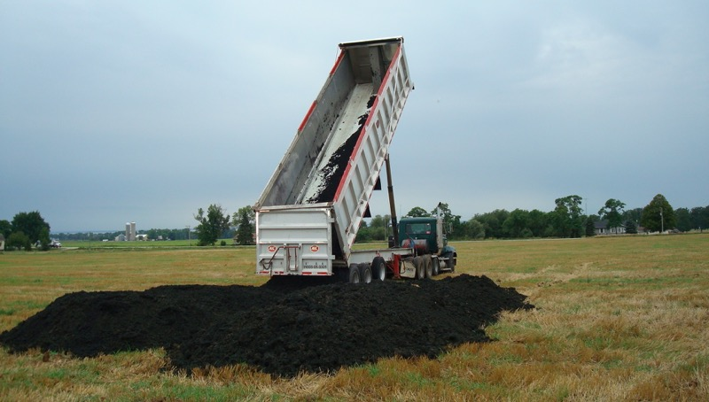
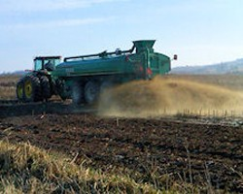
Manure and Biosolids
Photo Credit: Appleton.org
Photo Credit: Cornell Cooperative Extension
Biosolid P levels pound for pound tend to be higher than manure in P, comparable in N, and very low in K.
P credits range from
3 - 35 lbs/ton and
2 - 14 lbs/1,000 gallons, depending on species.
Notes:
P is also added to the soil from manure and biosolid applications.

Slide 13
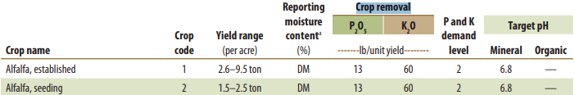
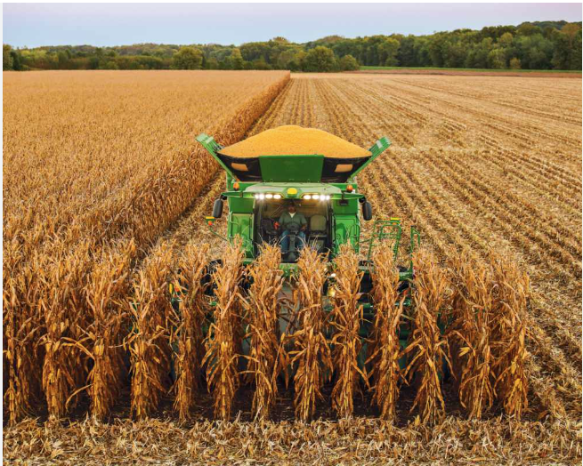


P removal by crop
photo credit: agriculture.com
Notes:
P is removed from the soil by crop uptake and subsequent harvest.

Slide 14
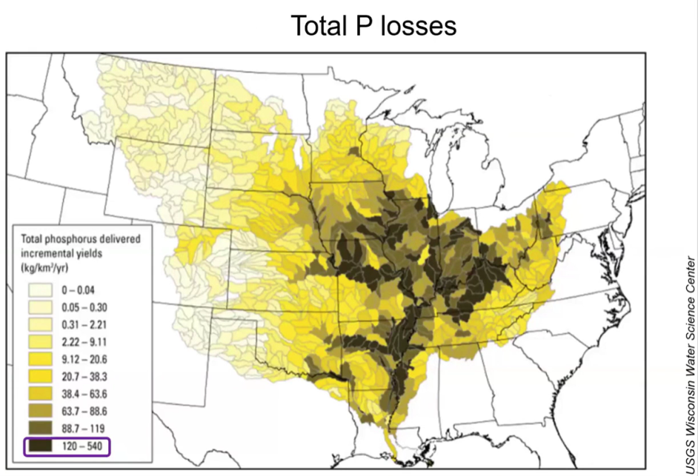
Erosion & Runoff Losses
Can be both sediment bound P, as well as dissolved P.
Losses can occur through subsurface tile drainage and seepage, as well as overland flow carrying sediment over the surface.
While plants will only uptake inorganic forms of P, erosion will take with it both plant available, and stores of organic P.
Notes:
P1.2.7 P is removed from the soil by erosion and runoff (overland flow of water).

Slide 15
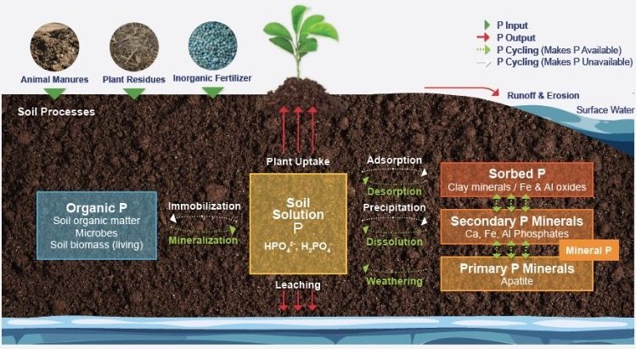
Forms of P in the Environment
Like nitrogen, inorganic forms of P are more plant available than organic forms.
P is largely held in place to finer soil particles and strong positively charged ions.
Losses through leaching are negligible.
Image Credit: Alabama Cooperative Extension Service
Soil Testing Procedures in Wisconsin account for plant available P.
Not for fixed pools still awaiting desorption, dissolution, weathering, or mineralization.
Notes:
P1.2.8 P can sometimes be moved from the rootzone by leaching (downward water movement through soil); however, this is rare due to the ability of soil particles to tightly hold (fix) P.
P1.2.9 The majority of soil P is located in the topsoil as mixture of organic and inorganic forms.
P1.2.11 Organic P includes plant, animal, microorganism residues. Organic P is NOT available to plants.

Slide 16
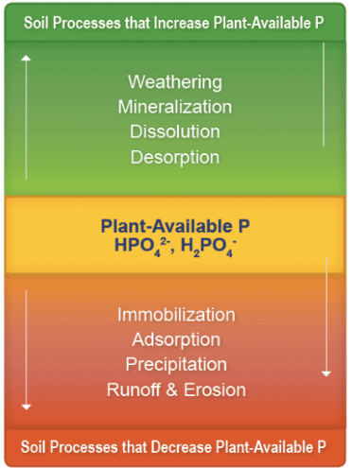
Mineralization
Active pools of plant available phosphorus are replenished over time from the more fixed inorganic P sources as plants uptake solute.
The rate at which this occurs varies widely, largely dependent on environmental conditions like climate.
Place adequate P in bands/in furrow as starter fertilizer where seedlings can access before soils have a chance to warm and make P accessible.
Ensure your pH is optimal for the crops you are growing. This is especially important for nutrients that bind tightly to soil.
Image Credit: Alabama Cooperative Extension Service
Notes:
P1.2.12 Organic P must be converted by soil microorganisms in order for it to be transformed into an inorganic, plant-available form. This process is called mineralization.
P1.2.13 Inorganic P is the plant-available form of P.
P1.2.14 Plant roots adsorb P in the inorganic soluble (or dissolved) form from the soil solution.
P1.2.18 As soluble P is depleted in the soil thru plant uptake, additional P is released from clay particles as well as from iron, aluminum, and calcium in the soil. A much slower release of P comes from the weathering of phosphorus-containing soil minerals.

Slide 17
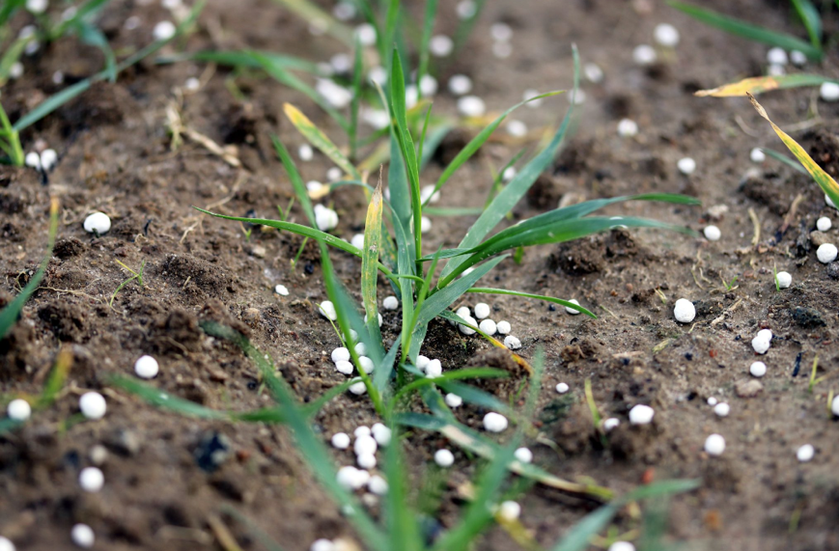
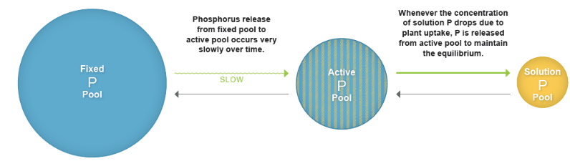
Manure and Fertilizer P Availability
After application, a vast majority of P will become soil bound and fixed in place where it is applied.
P in solution is a small fraction of P in soil, even where test levels are high.
60% of manure P is made available in the first year.
Image Credit: Alabama Cooperative Extension Service
Notes:
P1.2.15 Practically all soluble (dissolved), plant-available P from manure or fertilizer is soon converted to soil-bound P shortly after application.
P1.2.16 The concentration of plant-available, soluble P in soil is very low even though soils typically contain very high levels of total P (inorganic and organic).
P1.2.17 The majority of soil P is strongly bound (fixed) to clay particles and soil minerals and is unavailable for plant use. Soluble-P is quickly converted to soil-bound P (or particulate P (PP)) shortly after application.

Slide 18




P runoff effects on water quality
1 lb. of P in water instigates 500 lbs. of algae growth.
Resulting in low dissolved oxygen levels, blue-green algae potential, and odor.
Notes:
P1.3.1 When P enters freshwater surface waters, it stimulates the growth of algae and aquatic plants. The result is accelerated eutrophication (aging) of lakes.
P1.3.2 Accelerated eutrophication results in green weed-choked water, foul odors, low dissolved oxygen levels in water that can result in fish kills, and the potential for toxic blue-green algae. All of this degrades water quality and reduces the recreational, aesthetic, and functional value of water.
P1.3.4 The amount of P that can cause water quality problems is very small. Much less than the amount of P required for crops or applied as fertilizer.

Slide 19
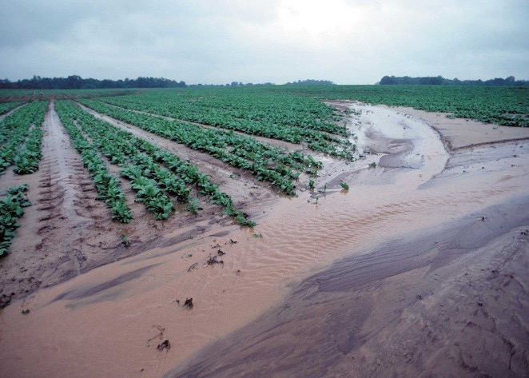
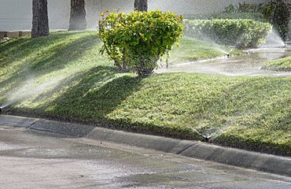
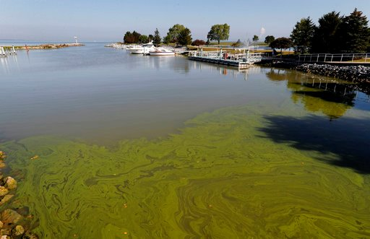
Notes:
P1.3.5 P enters lakes & streams mainly from runoff and erosion of landscapes.
P1.3.3 It is very important to prevent P from reaching lakes and streams. Runoff water and eroded soil from landscapes are major contributors of P to surface waters.

Slide 20
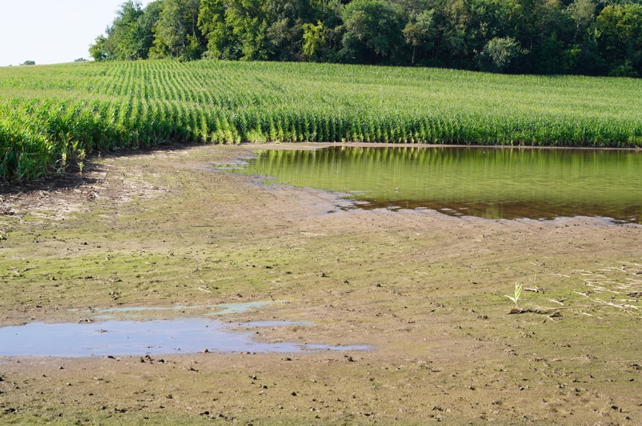
First, Terminology.
DP = Dissolved Phosphorus
SP = Soluble Phosphorus
PP = Particulate Phosphorus
TP = Total Phosphorus
BAP = Bioavailable Phosphorus

Slide 21
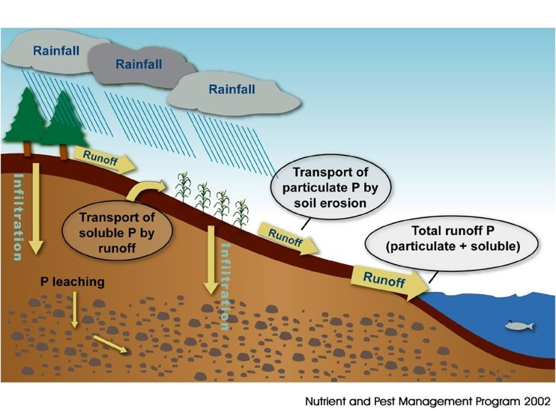
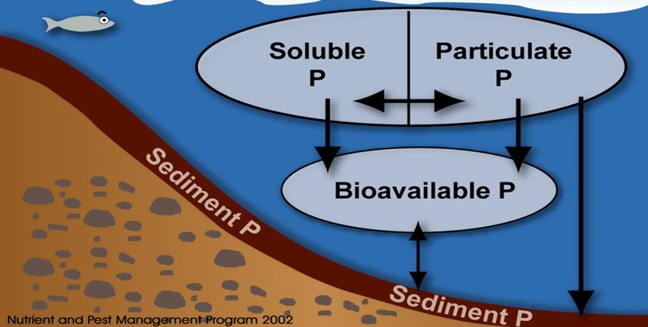
Largely driven by overland flow, surface runoff carries both particulate and soluble P. Majority lost in Ag is PP.
BAP includes all SP lost to water bodies + the legacy P from deposited PP that can later cause algae growth.
High discharge events where preferential can occur in tiled watersheds creates an especially risky environment for DP loading.
Notes:
P1.3.6 As runoff water moves downslope, it picks up soil, plant residue, manure and other soil amendments – all of which can contain P.
P1.3.7 Runoff water contains P in both the dissolved/soluble form and the particulate/sediment-bound form.
P1.3.9 Total P (TP) is the total amount of P, both PP and SP, carried in runoff water.
P1.3.10 Bioavailable P (BAP) is a term that includes all the SP (immediately available) plus an estimate of the PP that will eventually become SP and be available to algae and aquatic plants.
P1.3.13 Once runoff and eroded sediment reach a lake, the SP can be come immediately available to algae. The eroded sediment – containing PP – settles to the bottom of the lake where it serves as a reservoir of P. P in lakebeds may eventually be released as SP over time impacting water quality.

Slide 22
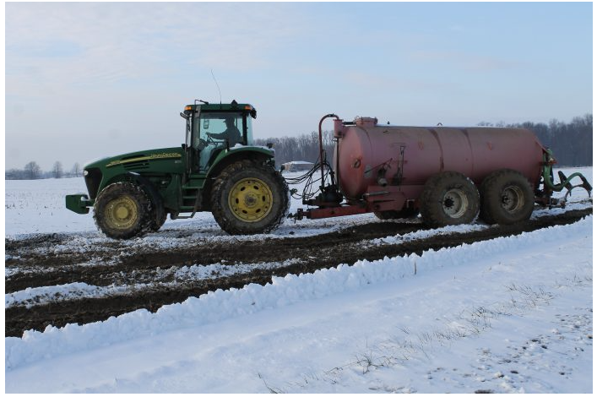
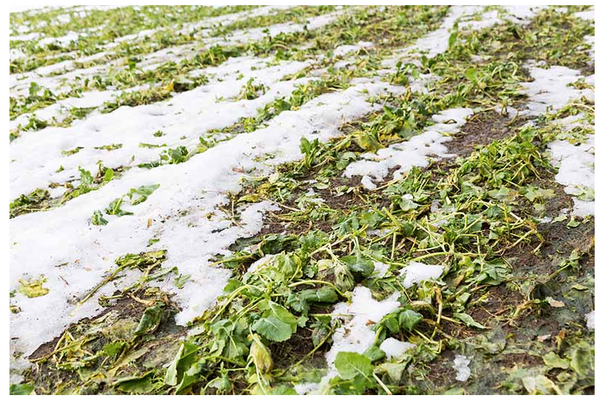
Conservation and SP Runoff
Photo Credit: https://www.farmanddairy.com/columns/tips-for-best-manure-application-in-winter/804086.html
Winterkilled Forage Radish image credit: https://gardenerspath.com/how-to/composting/winter-cover-crop/
Soluble P runoff events are more common in frozen conditions with low/no tillage or freezing/thawing vegetation on the surface.
Fields especially high in soil test P levels, and tiled fields with high shrink/swell potential are especially high risk fields.
Notes:
P1.3.8 The soluble P (SP) portion of runoff is important because SP can have an immediate impact on spurring the growth of algae and weeds in surface waters. Remember: SP is the form of P taken up by plants from the soil. SP is also the form of P utilized by algae when it enters surface water.
P1.3.11 Erosion and runoff from fields high in P contribute more P to surface waters.
P1.3.12 Vegetation that is freezing and thawing is an additional source of P (in the DP form) that can be transported to water via runoff.

Slide 23
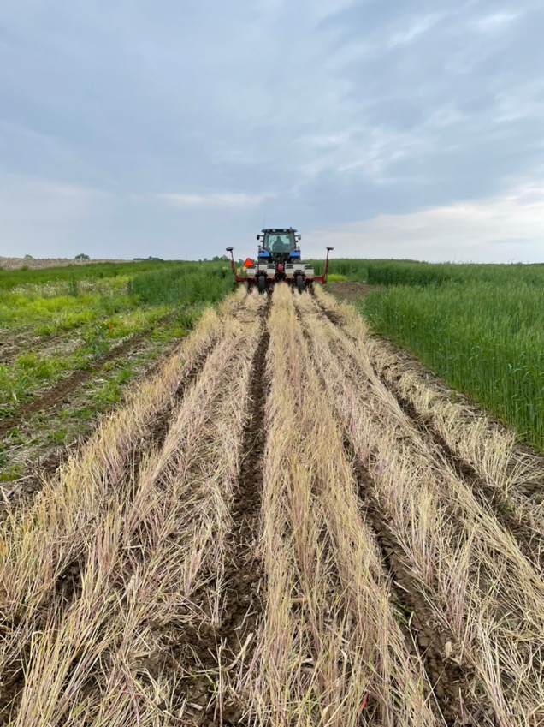
Soil Conservation
Minimizing runoff and soil erosion from cropland is the most effective way to protect surface water quality from P
Notes:
P2.1.1 The most effective agricultural management practice for protecting surface water quality is to minimize runoff and soil losses from cropland.

Slide 24
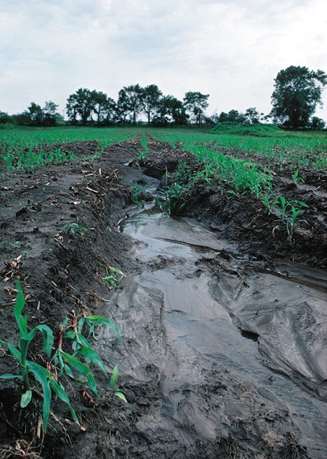
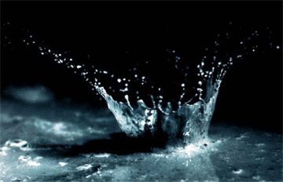
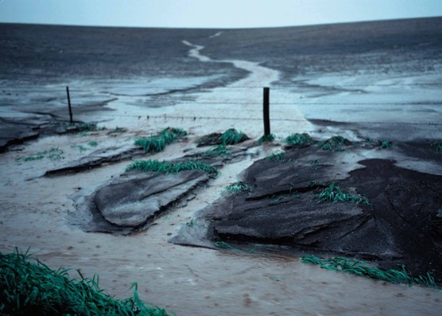
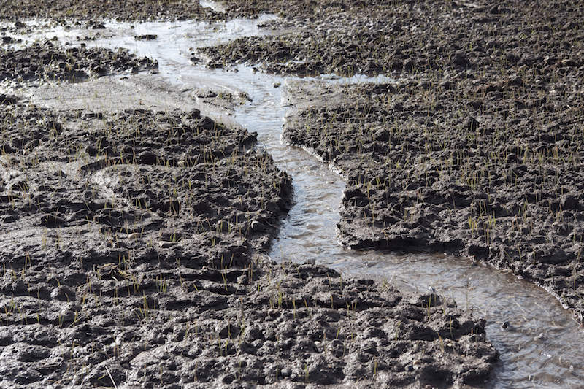
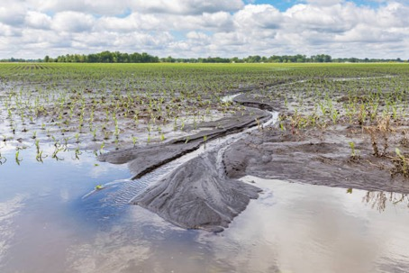
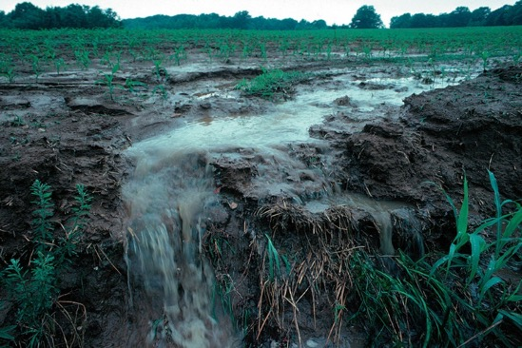

Slide 25
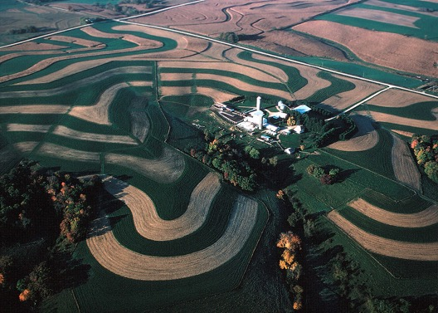
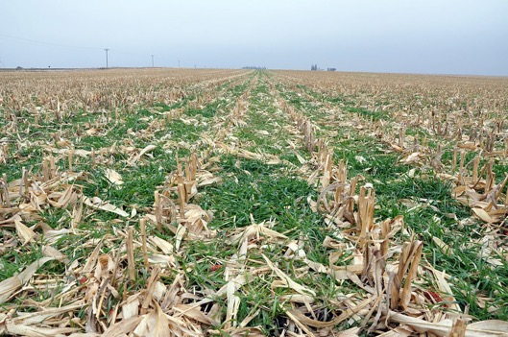
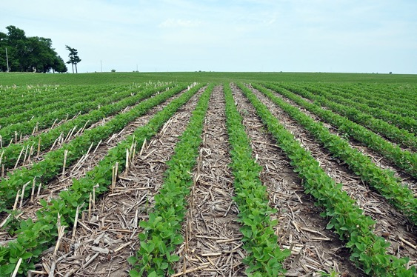
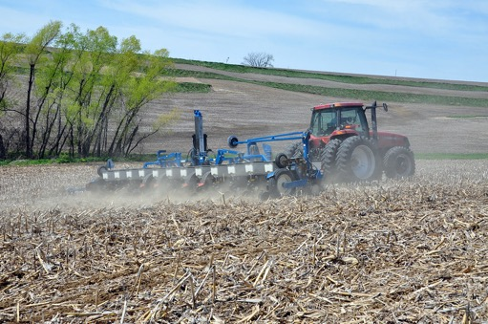
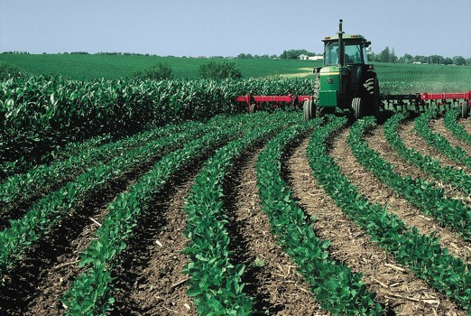

Slide 26
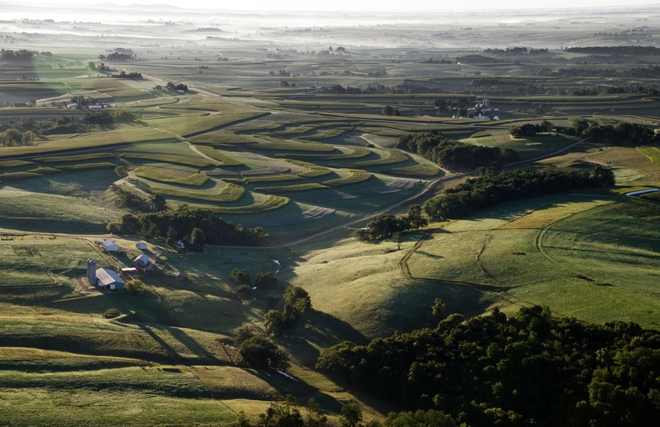
Soil Conservation: Management & Structural
Management Practices
  Conservation Tillage
  Diversified Crop Rotations
  Contour Farming
  Contour Strip Cropping
  Cover Crops
https://www.flickr.com/photos/uwmadisoncals/
Notes:
P2.1.2 Soil conservation practices include management practices (cover crops, diverse crop rotations, conservation tillage, contour farming, etc.) and structural practices such as buffer strips, waterways, diversions, terraces, etc.

Slide 27
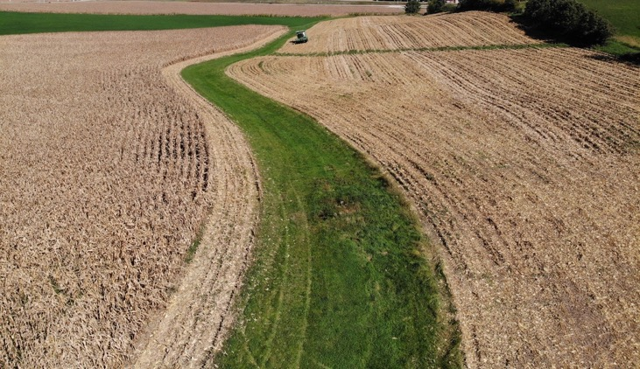
Soil Conservation: Management & Structural
Structural Practices
  Grassed Waterways
  Buffer Strips
  Terraces
  Diversions
Notes:
P2.1.2 Soil conservation practices include management practices (cover crops, diverse crop rotations, conservation tillage, contour farming, etc.) and structural practices such as buffer strips, waterways, diversions, terraces, etc.

Slide 28
Agronomic Phosphorus Management

Slide 29
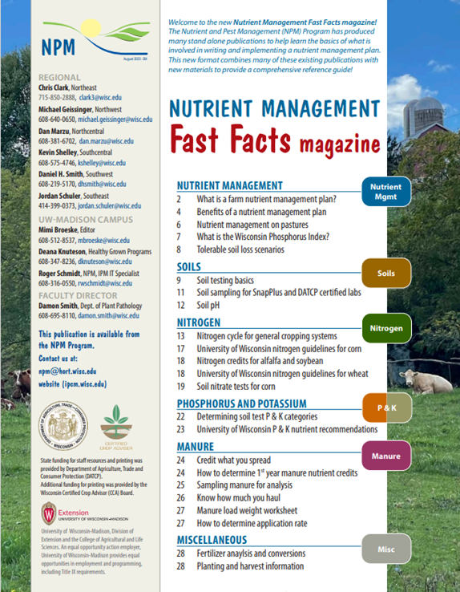

Following Along in Fast Facts?
Phosphorus: Pages 22-23 in Nutrient Management Fast Facts

Slide 30
Assessing the Need for P Applications
P applications to cropland should be based on:
  Soil test results
  Realistic crop yield goals
  Assessment/crediting of any P nutrient credits from manure or other sources
Notes:
P2.2.1 P applications to cropland should be based on recent soil test results, realistic crop yield goals, and assessment/crediting any P nutrient credits from manure and other soil amendments.

Slide 31
Soil Testing for P
Regular soil testing is required for determining P application rates
Soil Test Categories
  Rates higher than crop utilization are unfavorable for the environment and your wallet
Notes:
P2.2.2 Regular and systematic soil testing is required for determining P application rates. See S6 Soil Testing and Sampling Procedures for guidance on how and when to collect soil samples.
P2.2.3 Optimum soil test levels are the goal for the soil fertility status of fields. At optimum, recommended P additions are approximately equal to crop removal of P. Soil test levels for P (and K) range from very low, low, optimum, high, and excessively Nutrient applications at rates higher than crop utilization are unwise from both an environmental and economic perspective.

Slide 32
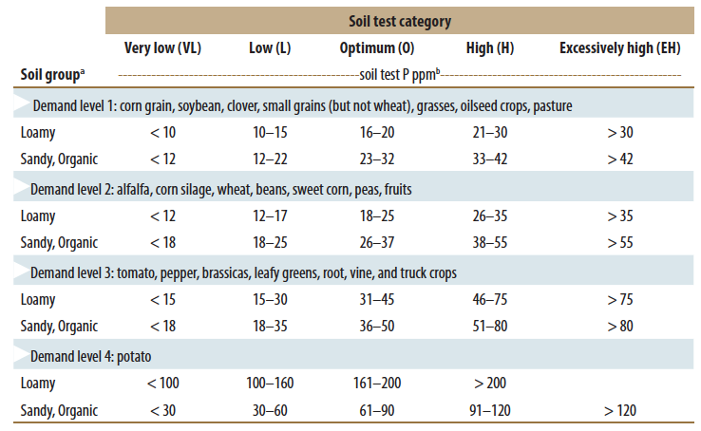
Soil Test P Categories
Notes:
P2.2.2 Regular and systematic soil testing is required for determining P application rates. See S6 Soil Testing and Sampling Procedures for guidance on how and when to collect soil samples.
P2.2.3 Optimum soil test levels are the goal for the soil fertility status of fields. At optimum, recommended P additions are approximately equal to crop removal of P. Soil test levels for P (and K) range from very low, low, optimum, high, and excessively Nutrient applications at rates higher than crop utilization are unwise from both an environmental and economic perspective.

Slide 33
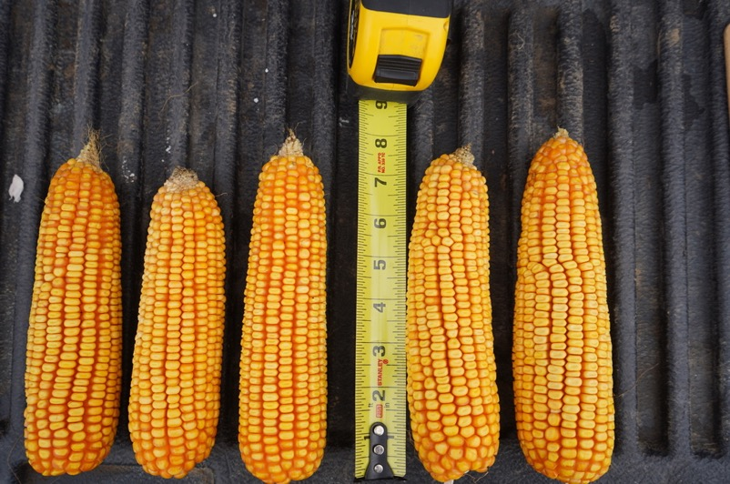
Crop Yield Goal
Realistic yield goals go hand in hand with soil testing to assess the need for P applications
Use a multi-year average (3-5 years) for yield plus 10-15%
Notes:
P2.2.4 An additional parameter impacting P fertilizer rates is crop yield goal. Use a multi-year average (3-5 years) for yield plus 10-15%. Yield goal estimates too low will underestimate nutrient need of the crop. Yield goals too high will overestimate the nutrient need of the crop resulting in over-application of fertilizer and a higher likelihood for P contributions to water bodies.

Slide 34
P2O5 Recommendations for Corn
Realistic Yield Goal Soil Test Level
bu/a V. Low Low Optimum High Ex. High
- - - - - - - - - - - - - - lb/acre - - - - - - - - - - - - - -
151-170 100 90 60 30 0
171-190 110 100 70 35 0
191-210 115 105 75 40 0
211-230 125 115 85 45 0

Slide 35
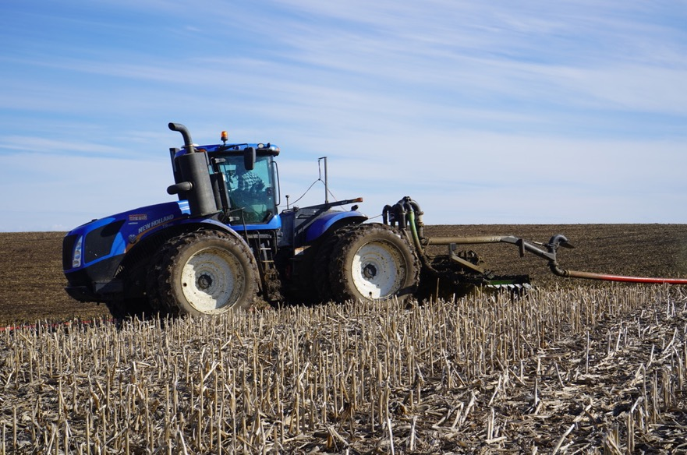
P Crediting
Important that P contributed from sources like manure, biosolids, whey, etc. are properly credited
Notes:
P2.2.5 For both economic and environmental benefits, it is important that the P (and other nutrients) contributed from cropland-applied non-commercial fertilizer sources is credited against the P recommendation from the soil test report. These sources include manure, biosolids/sludge, whey, etc. See the manure management section of this curriculum for information on how to do this.

Slide 36
Soil Testing Helps Track Trends
Notes:
P2.2.6 Average soil test P (STP) levels of Wis. cropland have been steadily increasing over the past over 50 years. Since the mid-1970s, STP levels have exceeded the excessively high levels for most crops.
P2.2.7 The build-up of STP values over time is due to additions of P exceeding crop removal.
P2.2.8 Build-up of P is not always a bad thing, provided runoff and erosion are minimized, but high STP increases the risk for P loss to water bodies.
P2.2.9 Good news: Over the past 15 years average STP values in Wisconsin appear to have leveled off and may be slightly decreasing. Due to improved nutrient management planning?

Slide 37
Soil Test P Changes Slowly
Soil buffering capacity
  The amount of fertilizer needed to change the soil test level by 1 ppm.
  18 lbs P2O5/acre = 1 ppm change in soil P.
Time is required to either lower or raise soil test P levels.
Notes:
To change soil test P levels by 1 ppm, 18 lbs of P₂O₅ must be either added or removed from the soil. 12 lbs of P₂O₅ for sandy soils.
P2.2.10 Just as it takes time to build-up STP values, it takes time to also draw them down. Explain soil buffering capacity and illustrate a crop removal / soil drawdown scenario.

Slide 38
Soil Test P Changes Slowly: Example
Soil test P = 75 ppm (EH)
Track draw-down of P over a CCOHHH rotation.
  Corn @160 bu/a removes 60 lb P2O5/a/yr
  Oats @ 100 bu/a removes 30 lb P2O5/a/yr
  Alfalfa @ 5 tons/a removes 65 lb P2O5/a/yr
Removal of P2O5 over rotation = 345 lbs P2O5
Change in soil test P = 345 lb P2O5/18 = 19 ppm P
Final Soil Test Level: 56 ppm (Still EH!)
Notes:
This example tracks the change in soil test P values over the course of a 6-year crop rotation where there are NO additions of P of any kind (fertilizer, starter or manure applications) over the length of the rotation.
C = corn; O = oats; H = hay
Note that the soil test P value of 75 ppm at the start of this exercise is in the excessively high (EH) range.
P2.2.10 Just as it takes time to build-up STP values, it takes time to also draw them down. Explain soil buffering capacity and illustrate a crop removal / soil drawdown scenario.

Slide 39
Soil Tests Monitors P Variability on Farm
Notes:
P2.2.10 Monitor STP variability among fields and use this information to plan manure applications. Prioritize those fields with lower P (and K) values for future manure applications – if possible.

Slide 40
P Fertilizers & Application Strategies

Slide 41
Phosphorus Fertilizers
Fertilizer Fertilizer Water
Analysis Solubility
N-P₂O₅-K₂O - - % - -
Ammonium polyphosphate (liq/dry) 10-34-0/15-62-0. 100
Diammonium phosphate (DAP) 18-46-0 95+
Monoammonium phosphate (MAP) 11-48-0 92
Triple superphosphate 0-46-0 87
Superphosphate 0-20-0 85
Rock phosphate 0-32-0 <1
Notes:
P2.3.1 Common commercial P fertilizer products: triple super phosphate and diammonium phosphate.

Slide 42

P Fertilizer Application Methods
If large amounts are needed:
Broadcast and incorporate with tillage as soon as possible after application
Notes:
P2.3.2 If large amounts of commercial P are required, the fertilizer should be broadcast and followed with incorporation as soon as possible after application. Remember P is strongly bound to soil particles, but adequate soil and P contact must occur via tillage.

Slide 43

P Fertilizer Application Methods
Subsurface band-applied fertilizer can be used for smaller, annual applications in a 2x2 fertilizer band below the soil surface
Notes:
P2.3.2 If large amounts of commercial P are required, the fertilizer should be broadcast and followed with incorporation as soon as possible after application. Remember P is strongly bound to soil particles, but adequate soil and P contact must occur via tillage.

Slide 44

P Fertilizer Application Methods
Injection can also be used to minimize P runoff and improve P to soil contact
Notes:
P2.3.2 If large amounts of commercial P are required, the fertilizer should be broadcast and followed with incorporation as soon as possible after application. Remember P is strongly bound to soil particles, but adequate soil and P contact must occur via tillage.

Slide 45

P Starter Fertilizer
Reducing excessive start fertilizer application rates can save substantial money
Any nutrients applied as starter fertilizer need to be credited against the overall nutrient recommendation
  Sometimes all the P & K needed can go on as starter
Notes:
P2.3.4 Many producers find through the NM planning process that they can significantly reduce starter fertilizer application rates and save substantial money as a result. Excessive application rates of starter fertilizer should be avoided.
P2.3.6 Any nutrients (N, P and K) applied as starter fertilizer need to be credited/accounted against the overall nutrient recommendation from the soil test report.

Slide 46
P Starter Fertilizer Rates for Corn
Starter applications are recommended for corn
  Especially on cool spring soils and no-till
  10 lbs N/a; 20 lbs P2O5/a; 20 lbs K2O/a
Excessively high P & K Soils:
  The rates listed above are the maximum rate allowed for starter
Notes:
P2.3.4 Many producers find through the NM planning process that they can significantly reduce starter fertilizer application rates and save substantial money as a result. Excessive application rates of starter fertilizer should be avoided.
P2.3.6 Any nutrients (N, P and K) applied as starter fertilizer need to be credited/accounted against the overall nutrient recommendation from the soil test report.
P2.3.5 For corn grown on soils that are slow to warm in the spring, it is often beneficial to apply a minimal amount of starter fertilizer that delivers approximately 10 lb N, 20 lb P2O5, and 20 lbs of K2O. No more than this amount of starter should be applied to soils that are in the excessively high range.

Slide 47
Phosphorus Management and Manure

Slide 48



Needed to Properly Manage Manure Nutrients
Available Nutrient Content
  Book Values
  Laboratory Analysis
Application Rate
Uniform Application
Total Manure Production
Notes:
P3.1.1 To properly use manure as a nutrient resource, the manure’s plant-available nutrient content along with its application rate must be known. In addition, the manure must be applied uniformly across a field. See the manure management section of this curriculum for additional information about manure nutrient crediting.

Slide 49
Manure Application Rates
Either:
1. Meeting the Crop’s Nitrogen Need
Or
2. Meeting the Crop’s Phosphorus Need
Notes:
P3.1.2 When applying manure to cropland, one of two nutrient use strategies can be used: 1) a nitrogen (N) strategy that applies manure at rates to meet the crop’s N demand, or 2) a phosphorus (P) strategy that applies manure at rates to meet the crop’s need for P.

Slide 50
Crop Nutrient Removal
N P₂O₅ K₂O
- - - - - - - - - - lb/a/yr - - - - - - - -
Corn (160 bu/a) 190* 60 45
Corn silage (23 ton/a) 190* 80 190
Soybean (40 bu/a) 160 30 55
Alfalfa (5 ton/a) 300 65 300

Slide 51
Comparing Crop Removal with Manure Nutrients
Corn, soybean, and alfalfa utilize approximately three times more nitrogen than phosphorus
Manure supplies N & P2O5 at approximately a 1:1 ratio
Result = Soil test phosphorus levels build up if applying manure to meet crop nitrogen needs

Slide 52
Manure Application Based on Crop N Needs
Maximize manure application rates
Supplies P and K in excess of crop need
Efficient with time and labor
Preferred when land is limited
Notes:
A N-based strategy for manure applications has a number of advantages:
1) It allows for maximum manure application rates. Often in the 40 to 60 tons per acre range.
2) P and K values are built-up in the soil over time.
3) This method is the most time-efficient. Manure is applied at high rates to fewer fields.
4) Manure applied at higher rates needs to go to fewer fields.
P3.1.3 The N strategy is most common as it allows higher manure application rates than a P-based strategy. However applications at a N rate supply P (and K) at rates greater than crop need – if that crop is corn. The result is a build-up in STP (and K) with repeated applications. This method is more time and labor efficient than a P-based strategy and is preferred when spreadable acres are limited.

Slide 53
Manure Application Based on Crop N Needs
lb/acre
Notes:
This slide indicates a manure application strategy that meets the N needs of the crop.
Dairy manure applied at a 60 ton/acre rate.
Notice the P applications in excess of crop need.

Slide 54
Manure Application Based on Crop P Needs
Maximizes efficiency of manure nutrients
Reduces manure application rates
Requires supplemental nitrogen
Increases time and labor
Increases spreading acreage
Potential Water Quality Benefits
Required for field with soils test P 50-100 ppm
Notes:
With a P-strategy for manure, the applications rates are lower - - in the range of 10-15 tons per acre.
Commercial fertilizer will be required to meet corn N needs.
More time is required to apply manure at lower rates to additional fields.
P3.1.4 A manure application strategy to meet the P needs of the crop will result in lower manure application rates than a N-based strategy, but will not build up STP. However, additional commercial N fertilizer will need to be applied to crop’s N need. This manure application strategy is less efficient relative to labor, time, and economics as manure must be spread on more acres than a N-based strategy.

Slide 55
Manure Applications Based on Crop P Needs
lb/acre

Slide 56
Making a Manure Application Based on P More Management-Friendly
Supply the crop rotational P need rather than the single year need
  Allows practical application rates
  Permissible under current regulations
Notes:
P3.1.5 A P-based manure application strategy is more acceptable if the crop rotation need for P is supplied with a single manure application rather than single year P needs. Allows for practical manure application rates and meets the 590 NM standard.

Slide 57
Manure Application & Phosphorus:
Tillage, Timing, & Site Considerations

Slide 58
Manure & Tillage Considerations
Unincorporated Manure/No-Till
  Potential for dissolved (soluble) P losses
  Crop production concerns
    Varies with manure types (i.e. bedding)
Compromise = Limited Incorporation
  Chisel, Disking, Injection
    Maintain residue and surface roughness
    Reduces total P losses
    Other benefits: odor reduction, nutrient distribution, warmer soils, improved seedbed mechanics
Notes:
P3.1.7 Unincorporated manure applications, including no-till, can increase the loss of P in the DP form. This form of P can have immediate impacts on water quality. Incorporation of manure within three days of application is a recommended practice for reducing DP losses from manure. However, incorporation of manure has the potential to increase TP (DP plus PP) losses through increased soil erosion.
P3.1.8 A compromise may be limited incorporation of manure by chisel, disk or injection - preferably on the land contour – maintaining soil residue and surface roughness. Such a practice can reduce both DP and TP.

Slide 59
Manure Application: Timing & Site Considerations
Slopes
  Reduce potential for winter/spring runoff
    Minimize winter manure applications
    Limit to slopes of 6% or less
    Up to 12% only if soil conservation measures are in place (i.e. contour strips, crop residue, etc.)
Notes:
P3.1.9 Winter/late fall/early spring manure applications to sloping land have the potential to add P to runoff. Manure applications should be limited to those fields with slopes of 6% or less. The 590 NM standard allow for manure applications to slopes >6% IF soil conservation measures (contour strips, crop residue, etc.) are in place.

Slide 60
Manure Application: Timing & Site Considerations
Setback from Lakes & Streams
  Do not apply within 1,000 or 300 feet, respectively unless, you incorporate within 3 days; no applications to frozen soils
Do not apply manure in areas of concentrated flow
  Waterways, ditches, etc.
Notes:
P3.1.9 Winter/late fall/early spring manure applications to sloping land have the potential to add P to runoff. Manure applications should be limited to those fields with slopes of 6% or less. The 590 NM standard allow for manure applications to slopes >6% IF soil conservation measures (contour strips, crop residue, etc.) are in place.
P3.1.10 Beware of site considerations/restrictions for manure applications:
1) Do not apply manure in areas of concentrated flow within a field (waterways, ditches, etc.).
2) Do not apply manure within 1,000 feet of lakes or 300 feet of streams unless it is incorporated within three days. Do not apply manure to these areas when they are frozen.

Slide 61
Manure Applications: Timing & Site Considerations
Apply based on Soil Test Levels
Fields with lower soil test phosphorus and potassium levels should be targeted for manure applications first
Notes:
The ability to do this will vary greatly depending upon field accessibility (distance and time of the year) and availability of labor.
P3.1.11 Fields with lower soil test phosphorus (and potassium) levels should be targeted for manure applications.

Slide 62
Summary
N-Based vs P-Based Manure Applications
Limited Manure Incorporation
Landscape & Timing Considerations
Soil Test Results to Prioritize Fields

Slide 63
Dietary P

Slide 64

Why the Concern with Dietary Phosphorus?
An animal’s diet affects its manure
Notes:
P3.2.1 Livestock feed has been found to be a major contributing factor to the build-up of P surpluses on farms.

Slide 65
Effect of P Intake on P in Manure
Increasing P content from 0.35% to 0.55% of diet dry matter increases P output from 42 to 78 lbs/cow/year!
Notes:
P3.1.2 When applying manure to cropland, one of two nutrient use strategies can be used: 1) a nitrogen (N) strategy that applies manure at rates to meet the crop’s N demand, or 2) a phosphorus (P) strategy that applies manure at rates to meet the crop’s need for P.

Slide 66

Effect of Dietary P Intake on P Losses in Runoff Over Time
Notes:
P3.2.2 The build-up of soil P is accelerated when livestock are overfed P in dietary rations. High P in livestock dietary intake results in elevated P content of livestock manure.

Slide 67
Why is P Overfed?
Reproductive Efficiency
  Common belief that high P diets improve animal reproductive efficiency
  Research does not support this theory
Affordable Protein Sources and Feed Supplements
  Undegradable protein sources
  Soybean meal, distiller’s dried grain
  Protein sources provide a very high level of dietary P
Notes:
P3.2.6 P is often over fed for two reasons: 1) False belief that high P diets improve animal reproduction. 2) Available and affordable feed supplements are often high in dietary-P.

Slide 68
The Effects of High Dietary P
Higher P in Manure
Build up Soil Test P and Increased Potential for P Losses
Could result in need to apply manure based on Crop P Needs
  Need more land to spread manure on
Notes:
P3.2.3 Overuse of dietary P supplements significantly accelerates the build-up of soil test P levels to excessive levels and increases the potential for P losses from manured fields.
P3.2.4 Another consequence is an increase in the amount of land required for application of manure if P-based rate limitations are to be met.

Slide 69
The Effects of High Dietary P
Dietary-P Manure-P Spreadable Acres*
(%) (lbs/cow/year) (acres/cow/year)
0.35 42 1.6
0.38 47 1.8
0.48 65 2.4
0.55 78 2.9
Farmers may need to manage dietary P intake in order to reduce manure-P.
* Acres required to meet a P-based nutrient management plan. Manure application rates restricted to crop-P removal from an alfalfa, corn, soybean cropping system.

Slide 70

Managing High Dietary P
Managing Dietary P is Managing Soil Test P
Best management: follow and do not exceed National Research Council feed recommendations in dairy cattle, choose low P protein source
Notes:
P3.2.7 Best management practice: Follow (and do not exceed) National Research Council (NRC) feed recommendations for dairy cattle. Good news: Wisconsin dairy producers have done a great job in reducing dietary P in their feed rations over the past 15 years.
P3.2.5 Manipulation of the dietary P intake of livestock is a management option for reducing or slowing the build-up of soil test P levels on farms.

Slide 71
Soil Test P Limits & Threshold

Slide 72
Review
A soil test measures plant-available P from the soil.
Average soil test P levels have been increasing over time.
Build-up of soil P is due to additions of P exceeding crop removal.
Build-up of P is not always bad, IF runoff and erosion are minimized. However, high soil P increases the risk for P loss to water bodies.
Soil test results can be used to identify fields do or do NOT need additional nutrients.
Notes:
P3.3.1 Brief recap of P2.2:
- Average soil test P (STP) levels of Wis. cropland have been steadily increasing over the past over 50 years. Since the mid-1970s, STP levels have exceeded the excessively high levels for most crops.
- The build-up of STP values over time is due to additions of P exceeding crop removal.
- Build-up of P is not always a bad thing, provided runoff and erosion are minimized, but high STP increases the risk for P loss to water bodies.

Slide 73
Soil Test Phosphorus: Critical Values
<50 ppm P
50-100 ppm P
>100 ppm P
Notes:
P3.3.2 The 590 NM standard contains the following limitations for the application of manure or other organic by-products to cropland based on STP values:
< 50 ppm P: [No commercial P (other than starter P) to be applied.] Manure/organic by-products can be applied at rates up to the N need of the following crop. This strategy will allow for a continued build-up of STP.
50-100 ppm P: Limit manure application rates up to the P removal of the crops to be grown over the crop rotation (max of 8 years). This strategy will maintain current levels of STP.
>100 ppm: No manure applications allowed, with a caveat for farms that have nowhere else to go with manure. Then, apply manure at rates 25% less than crop removal of P over the crop rotation (max of 8 years).

Slide 74
Soil Test Phosphorus: Critical Values
<50 ppm P
  Follow an N-based manure spreading plan
Notes:
P3.3.2 The 590 NM standard contains the following limitations for the application of manure or other organic by-products to cropland based on STP values:
< 50 ppm P: [No commercial P (other than starter P) to be applied.] Manure/organic by-products can be applied at rates up to the N need of the following crop. This strategy will allow for a continued build-up of STP.
50-100 ppm P: Limit manure application rates up to the P removal of the crops to be grown over the crop rotation (max of 8 years). This strategy will maintain current levels of STP.
>100 ppm: No manure applications allowed, with a caveat for farms that have nowhere else to go with manure. Then, apply manure at rates 25% less than crop removal of P over the crop rotation (max of 8 years).

Slide 75
Soil Test Phosphorus: Critical Values
50-100 ppm P
  P application not to exceed total crop P removal over the rotation
Notes:
P3.3.2 The 590 NM standard contains the following limitations for the application of manure or other organic by-products to cropland based on STP values:
< 50 ppm P: [No commercial P (other than starter P) to be applied.] Manure/organic by-products can be applied at rates up to the N need of the following crop. This strategy will allow for a continued build-up of STP.
50-100 ppm P: Limit manure application rates up to the P removal of the crops to be grown over the crop rotation (max of 8 years). This strategy will maintain current levels of STP.
>100 ppm: No manure applications allowed, with a caveat for farms that have nowhere else to go with manure. Then, apply manure at rates 25% less than crop removal of P over the crop rotation (max of 8 years).

Slide 76
Soil Test Phosphorus: Critical Values
>100 ppm P
  Eliminate P applications
    Unless required for high-demanding crop in rotation
    Unless no other option, then apply at less than crop removal of P with soil conservation practices in place
    Use P-Index
Notes:
P3.3.2 The 590 NM standard contains the following limitations for the application of manure or other organic by-products to cropland based on STP values:
< 50 ppm P: [No commercial P (other than starter P) to be applied.] Manure/organic by-products can be applied at rates up to the N need of the following crop. This strategy will allow for a continued build-up of STP.
50-100 ppm P: Limit manure application rates up to the P removal of the crops to be grown over the crop rotation (max of 8 years). This strategy will maintain current levels of STP.
>100 ppm: No manure applications allowed, with a caveat for farms that have nowhere else to go with manure. Then, apply manure at rates 25% less than crop removal of P over the crop rotation (max of 8 years).

Slide 77
Wisconsin’s Phosphorus Index

Slide 78
What is the P-Index (PI)?
A model with multiple site-specific factors to assess the potential for a field to deliver P to surface water
PI considers both source of nutrients and potential of nutrient transport to water
P Source
P Transport
P Loss
Notes:
P3.4.1 The phosphorus index (PI) is a model that contains multiple site-specific factors to assess the potential for a field (landscape) to deliver P to surface waters.
P3.4.2 The PI considers both source of nutrients and potential for transport of nutrients to water.

Slide 79
What is the P-Index (PI)?
Evaluates Site loading (quantity of P) and transport potential (erosion and runoff) from individual fields
Requires field characteristics
Recommends changes to agricultural mgt practices if PI critical value is exceeded
Does not dictate specific practices
  Multiple ways to lower PI values
Notes:
P3.4.1 The phosphorus index (PI) is a model that contains multiple site-specific factors to assess the potential for a field (landscape) to deliver P to surface waters.

Slide 80
Phosphorus Index: Source & Transport
Source
  Field with high levels of STP
  Fields that have received manure or fertilizer applications
Transport
  Runoff and Erosion Losses from Land
Notes:
P3.4.3 Source of P includes fields with high levels of STP, and/or fields that have received manure or fertilizer applications.
P3.4.4 Transport of P is directly related to runoff and erosion losses from land.

Slide 81
Components of the Phosphorus Index (PI)
PI = (PP + DP) x TPDR
PI = Total P Index Value
PP = Particulate P
DP = Dissolved (soluble) P
TPDR = Total P Delivery Ratio
Notes:
P3.4.1 The phosphorus index (PI) is a model that contains multiple site-specific factors to assess the potential for a field (landscape) to deliver P to surface waters.

Slide 82
Interpretation of the Wisconsin P-Index
Critical value of 6 over the course of the crop rotation
Critical value of 12 in individual crop year
Wisconsin 590 standard restricts manure and P fertilizer applications on fields with an average PI value greater than 6 over the crop rotation
  Exception: P applications allowed if needed according to UW soil fertility recommendations
Sometimes P Index allows greater flexibility than UW Phosphorus recommendations based on soil tests
Notes:
P3.4.5 The PI identifies areas within a landscape where both the source of P and potential for transport to water are high. These critical areas require the application of management practice to reduce P loss while other areas of the landscape can be more flexible in fertilizer and manure management.
P3.4.6 In the NMP process, the PI can occasionally provide greater flexibility to the selection of fields for manure spreading than using the soil test P thresholds contained in the 590 NM standard.

Slide 83


Notes:
P3.4.5 The PI identifies areas within a landscape where both the source of P and potential for transport to water are high. These critical areas require the application of management practice to reduce P loss while other areas of the landscape can be more flexible in fertilizer and manure management.
P3.4.6 In the NMP process, the PI can occasionally provide greater flexibility to the selection of fields for manure spreading than using the soil test P thresholds contained in the 590 NM standard.

Slide 84




Resources

Slide 85

Thanks!
Questions?
Name
Title
Nutrient and Pest Management (NPM) Program
UW-Madison Division of Extension
Email: Phone:

