Slide 1
Nitrogen Management

Slide 2
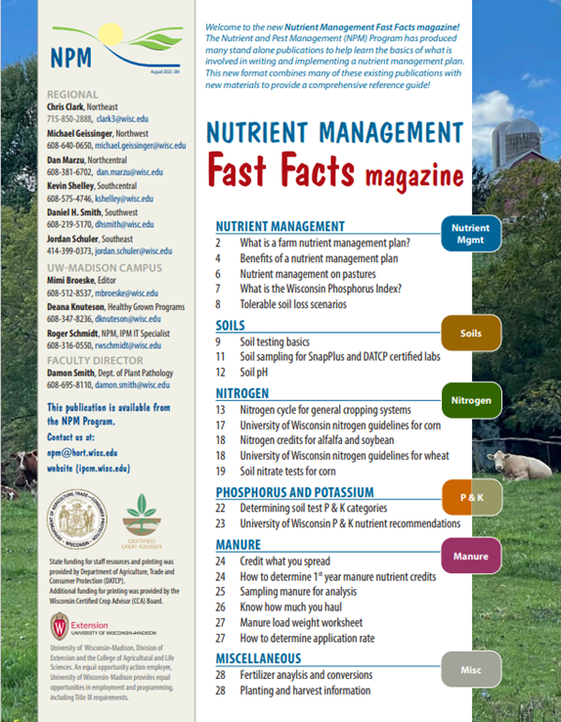
Following Along in Fast Facts?
Nitrogen: Pages 13-19 in Nutrient Management Fast Facts

Slide 3
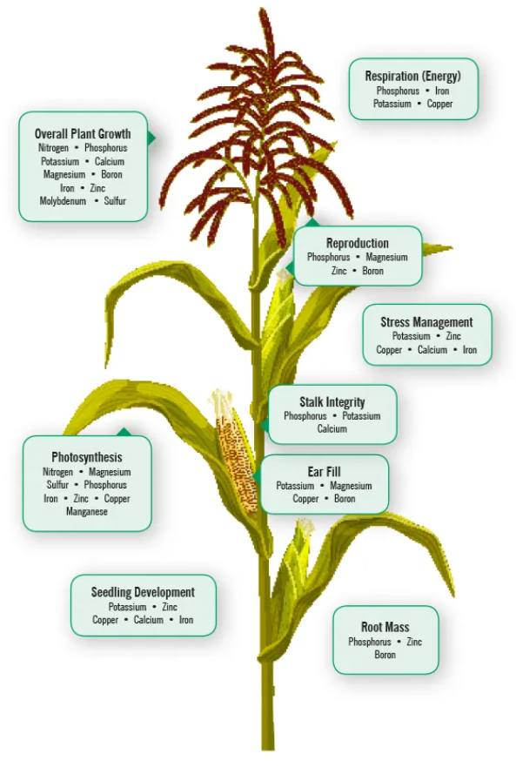
Function in Plants
Plants uptake more nitrogen (N) than any other element
N is essential for many plant cell structures such as:
Protein
Chlorophyll
Nucleic acids in DNA
Enzymes
Plant available forms of N are ammonium (NH4+) and nitrate (NO3-)
Image from Nachurs Nutrient Function & Interactions (nachurs.com)
Notes:
N1.1.1 Plants absorb more nitrogen than any other element. It is essential for structural, genetic and metabolic compounds in plant cells. ​
N1.1.4 Plants use nitrogen in the ammonium (NH4+) and nitrate (NO3-) forms.

Slide 4
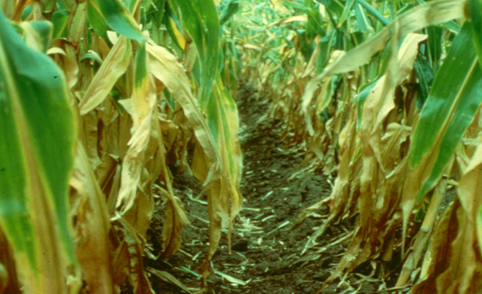
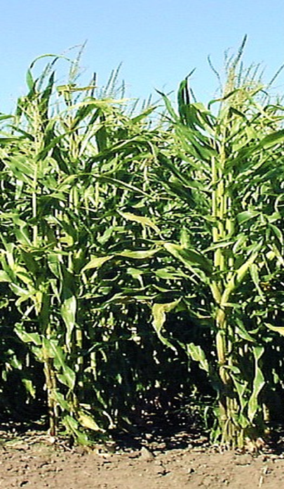
Function in Plants
Nitrogen is mobile in the plant
Deficiency symptoms (yellowing) occur in older leaves.
Excessively green plants at the end of summer can indicate too much nitrogen was available to the plant.
Notes:
N1.1.2 Nitrogen deficiency symptoms (yellowing) occur in older leaves. ​
N1.1.3 Excessively green plants at the end of summer can indicate too much nitrogen was available to the plant. ​

Slide 5
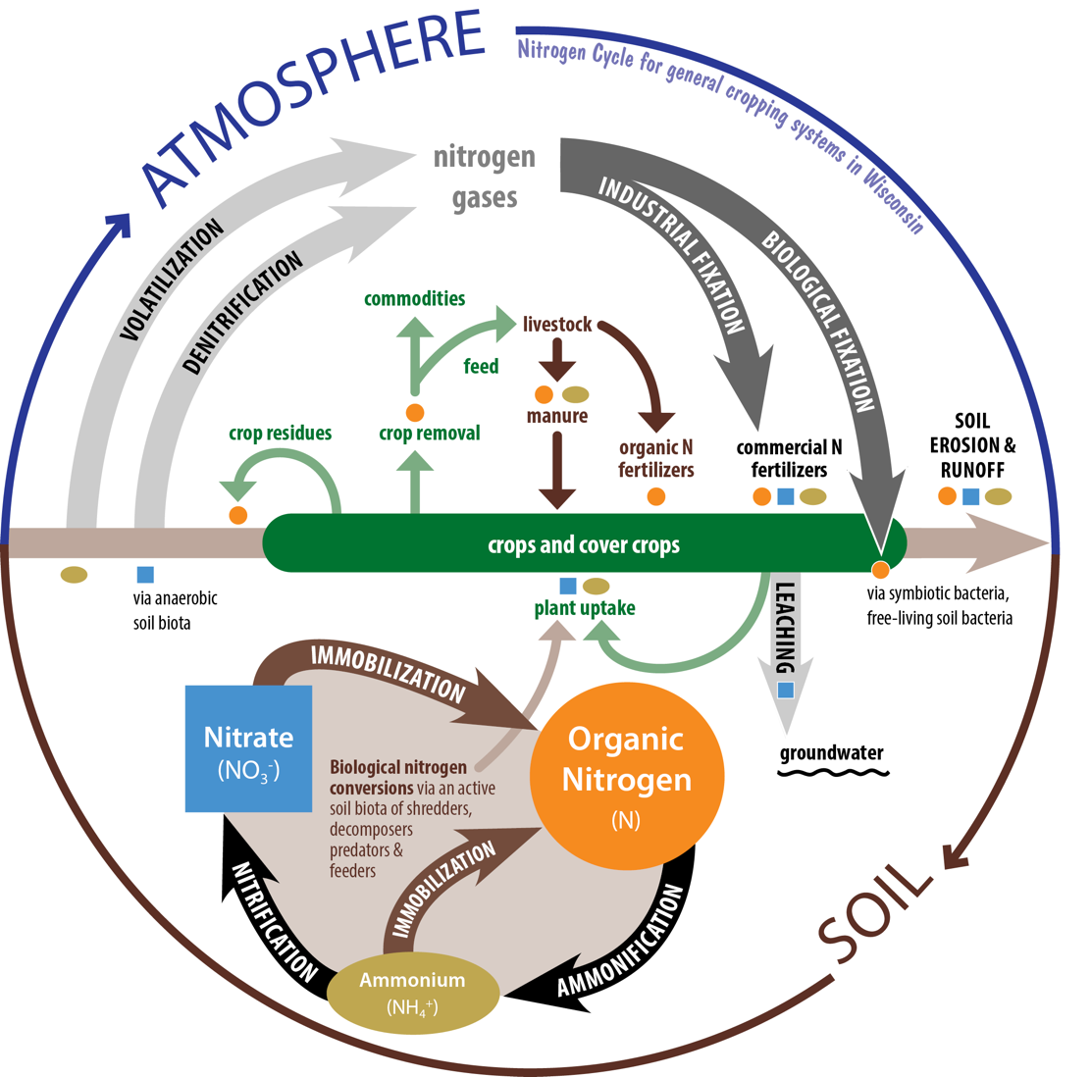
The Nitrogen Cycle
N₂
Notes:
N1.2.1 Nitrogen is present in several forms, some available and some not available for plant uptake.​
N1.2.2 Nitrogen is added into an agricultural system via biological fixation by legume plants, soil organic matter, crop residue, manures and biosolids, commercial fertilizer, and atmospheric fixation and deposition. ​
N1.2.3 During the normal nitrogen cycle, nitrogen can be lost via denitrification, volatilization, leaching, and NH4+ fixation. ​
N1.2.4 Nitrogen losses in an agronomic cropping system include harvest, leaching, runoff and erosion.
Atmosphere contains 78% nitrogen as N₂ gas - Plants cannot use this N directly
Plants use N in ammonium (NH4+) and nitrate (NO3-) forms
Nitrogen from air must be converted for plant use
Biological fixation (Rhizobia bacteria and legumes)
Chemical fixation (fertilizers)
Nitrogen can also be provided through Soil Organic Matter

Slide 6
Nitrogen Reactions
Biological fixation (symbiotic)
Atmospheric N₂ Legume Plant N
(Soil Temp. > 50 degrees F)
Notes:
This process is time and temperature dependent.
Process begins with soil temps > 50 degrees F and accelerates with warmer temps.

Slide 7
Nitrogen Reactions
Biological fixation (symbiotic)
Chemical / industrial fixation
Atmospheric N₂ + CH₄ NH₃
NH₃ N fertilizers
natural gas
ammonia
ammonia

Slide 8
Nitrogen Reactions
Biological fixation (symbiotic)
Chemical / industrial fixation
Mineralization (ammonification)
Soil Organic N NH₄⁺ - N
ammonium
(Soil Temp. > 50 degrees F)
Notes:
Most Wis. soils are 1-5% organic matter, organic soils range from 20-50+%.
About 2-3% of soil OM decomposes annually.
Process begins with soil temps > 50 degrees F and accelerates with warmer temps.

Slide 9
Nitrogen Reactions
Biological fixation (symbiotic)
Chemical / industrial fixation
Mineralization (ammonification)
Nitrification
NH₄⁺ NO₂⁻ + H⁺
NO₂⁻ NO₃⁻
ammonium
soil bacteria
nitrite
nitrite
nitrate
(Soil Temp. > 50 degrees F)
Notes:
Process begins with soil temps > 50 degrees F and accelerates with warmer temps.

Slide 10
Nitrogen Reactions
Biological fixation (symbiotic)
Chemical / industrial fixation
Mineralization (ammonification)
Nitrification
Immobilization
NO₃⁻ or NH₄⁺ Organic N
soil bacteria
inorganic N
(Soil Temp. > 50 degrees F)
Notes:
Immobilization is the conversion of plant-available nitrate or ammonium organic, unavailable N. This is caused when carbon-rich residues are added to soil. Bacteria that consume the residue temporarily tie up the available N. This N is eventually released as the organic matter decomposes.
Process begins with soil temps > 50 degrees F and accelerates with warmer temps.

Slide 11
Carbon:Nitrogen Ratio Effects on N Release
C:N ratio less than
C:N ratio more than
< 20:1
> 30:1
will release N
will tie-up N
Alfalfa hay: 12:1
Rotted manure: 15:1
Corn stalks: 60:1
Straw: 80:1
NM Fast facts magazine pg. 16

Slide 12
Nitrogen Reactions
Biological fixation (symbiotic)
Chemical / industrial fixation
Mineralization (ammonification)
Nitrification
Immobilization
Denitrification
NO₃⁻ N₂ + N₂O
soil bacteria
wet soils
low oxygen
nitrate
gases lost to air
(Soil Temp. > 50 degrees F)

Slide 13
Nitrogen Loss: Denitrification
Practices favoring loss Practices minimizing loss
Poorly drained, poorly aerated soils
Ponded, waterlogged soils
2-3 days of standing water can cause most of the nitrate-N to be lost.
Sidedress N applications on soils that are often wet
Use a nitrification inhibitor with preplant N applications to soils that are often wet.

Slide 14
Nitrogen Loss: Leaching
Practices favoring loss Practices minimizing loss
Coarse-textured soils (sands)
Nitrate-N fertilizers (UAN, ammonium nitrate)
Significant rainfall after application
Use ammonium fertilizers (anhydrous, urea, ammonium sulfate)
Delay applications (split, sidedress)

Slide 15
Nitrogen Loss: Ammonia Volatilization
Practices favoring loss Practices minimizing loss
No rain or irrigation after application
Crop residue on the soil surface
High temperatures
High soil pH
Low clay & organic matter (low CEC)
Initially moist soil followed by drying
Incorporate/inject or rainfall/irrigation after application
Maintain soil pH
Urease inhibitors (ex. Agrotain) to reduce loss from urea fertilizers
Economic benefit from inhibitors is uncertain
Winter applications of urea susceptible to loss
Preplant applications of urea on sands should be avoided
Notes:
CEC = cation exchange capacity = ability of soil to hold (+) charged cations, like NH₃⁺

Slide 16
Nitrogen Recommendations and Crediting

Slide 17
Goals of Nitrogen Management
Avoid environmental risks due to above-optimum N use
Maximize economic return with optimum N rates

Slide 18
Economic Optimum N Rate (EONR)
Cost of last increment of N added | Value of yield increase produced
=
Economic return
Crop recovery of N
Potential for N loss
As N Rates Align with EONR

Slide 19
UW Nitrogen Recommendations for Corn
Based on:
Corn & nitrogen prices
Soil yield potential
Soil texture (sands vs. others)
Previous crop
Irrigation (sands and loamy sands)
**Not Corn Yield Goal**

Slide 20
Price Adjusted N Guidelines for Corn
Maximum Return to N (MRTN)
Flexibility in rates based on economics
Cost of N
Price of Corn
Cropping Systems approach
Corn after soybeans, small grains
Corn after corn, forage legumes, green manures, etc.
Multi-state, regional approach
WI, IA, IL, MN, OH, IN, MI
Notes:
N2.1.1 University of Wisconsin uses a MRTN philosophy for base nitrogen recommendations for corn and wheat. MRTN stands for Maximum Return to Nitrogen, which determines N rate that provides for maximum economic return based on both the cost of N and an anticipated crop price.

Slide 21
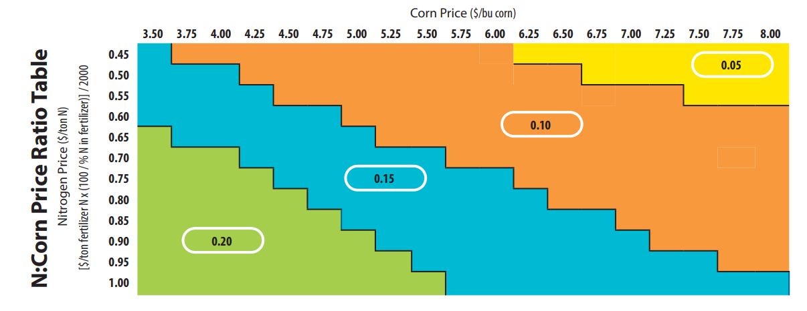
Determining MRTN Example
NM Fast facts magazine pg. 17
Notes:
N2.1.2 A MRTN example: First determine your nitrogen to corn price ratio. If nitrogen is $0.60/lb and the projected price for corn is $4.50 bu/ac, the ratio would be .15 (blue). If your field’s soil has high yield potential and the previous crop was corn, then the range for the recommended N rate is 135-160 lb/A. In the notes section, there are further considerations to take into account in refining the recommendation.

Slide 22
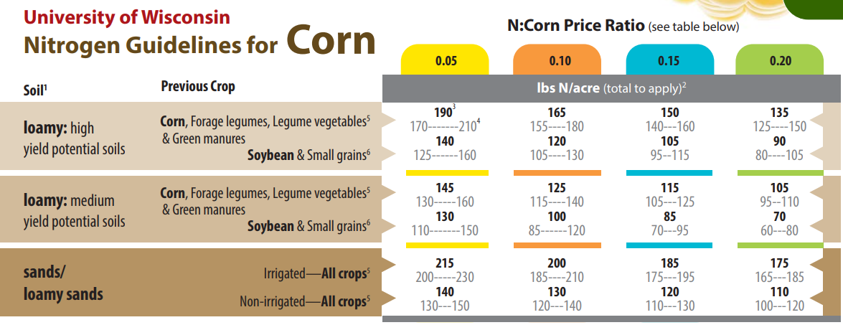
NM Fast facts magazine pg. 17
Notes:
Notes from the card image:
- These N recommendations include N in starter
- The profitability range within $1/acre of MRTN rate
- Subtract N credits for legumes or manure

Slide 23
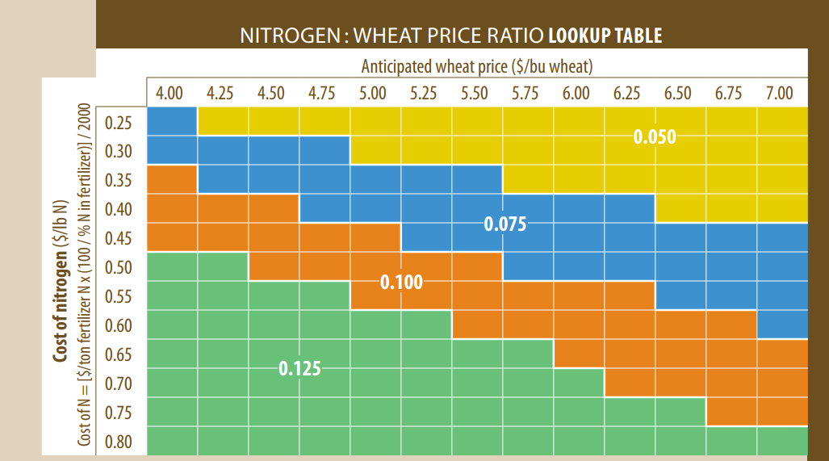
NM Fast facts magazine pg. 18

Slide 24
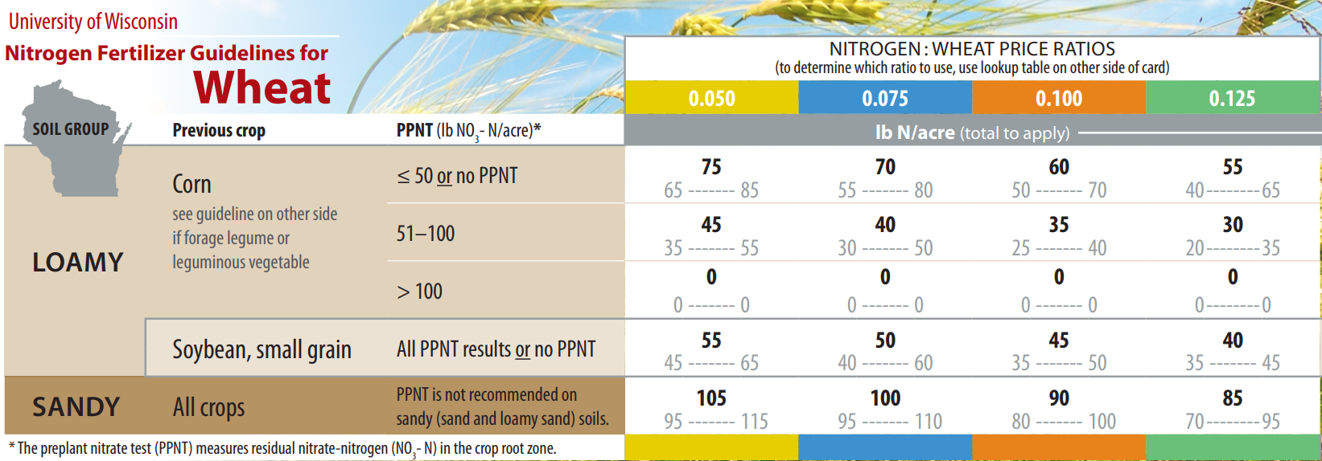
NM Fast facts magazine pg. 18

Slide 25
Manure Nitrogen Considerations

Slide 26
Manure considerations
Manure contains valuable nutrients (N, P, K)
N in manure is in two forms
Plant available N
Organically-bound N
If You Are Going To Use Manure as a Fertilizer…
Treat It Like
A Fertilizer!
Notes:
N2.2.1 Manure contains valuable nutrients including plant available nitrogen (nitrate and ammonium forms) and organically-bound nitrogen that is not immediately available but becomes available over time.​
N2.2.2 It is essential if applying manure to fields that the nutrients in the manure are credited against base fertilizer recommendations. ​
Commercial fertilizer applications to fields provide nutrients to crops.
Manure applications to fields provide nutrients to crops.

Slide 27
Need to Properly Credit Manure Nutrients
Available nutrient content
Book values
Laboratory analysis
Manure application rate
Uniform application
Total manure production
Notes:
N2.2.4 Book value averages can be used to estimate nutrients in manure or manure can be sampled and tested to determine nutrient values.
Determination of the amount of manure generated by a farm is a component of nutrient management planning - particularly if one is planning manure applications in advance.
Estimates of a farm’s manure production are also required for NM plans meeting the 590 standard. The information is also needed when designing manure storage facilities.
Detailed information on manure crediting can be found in the manure mgmt. module of this curriculum.

Slide 28
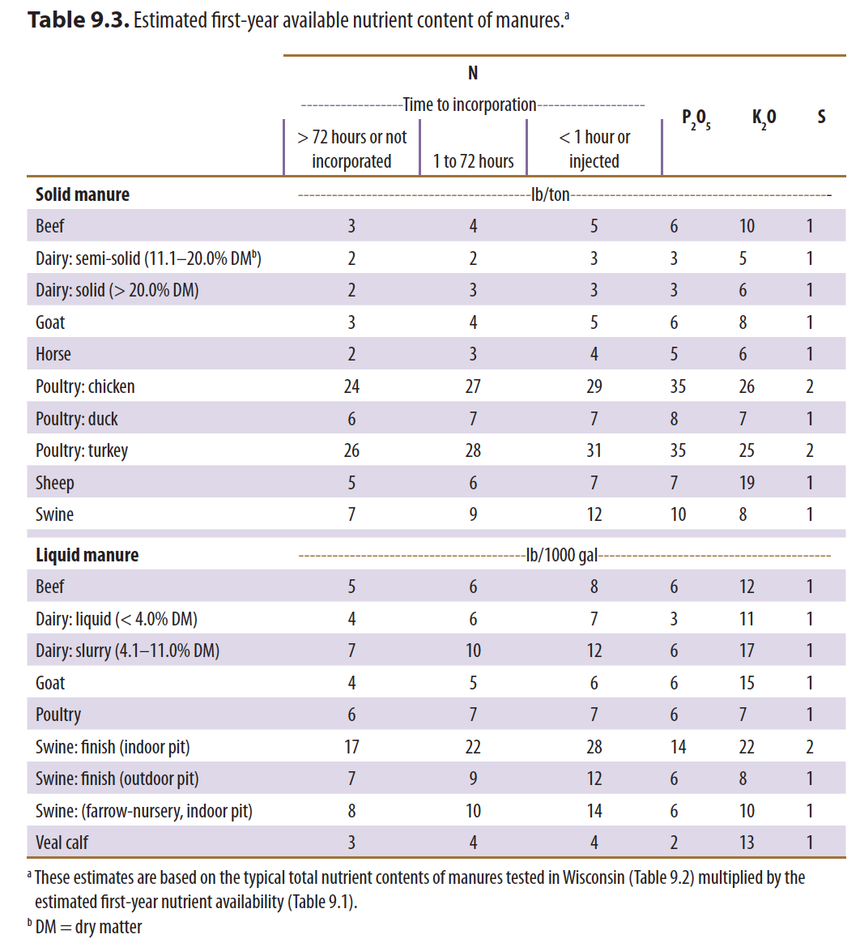
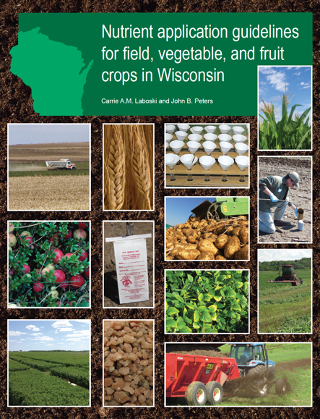
Book Value manure credits are dependent upon livestock species, manure storage method, and application method.
NM Fast facts magazine pg. 24
Notes:
N2.2.3 Manure nitrogen credits may change by the type of manure, storage, and application method.​

Slide 29
Legume Nitrogen Considerations
Notes:
N2.3.3 A legume credit example: the crop being grown the first year after terminating a good (70-100% stand density) alfalfa stand with greater than 8 inches of regrowth on medium-textured soil should have 190 lb/a nitrogen subtracted from the base N recommendation. ​
N2.3.4 With the MRTN approach to nitrogen recommendations for corn, any soybean nitrogen credit is accounted for in the base recommendation. ​

Slide 30
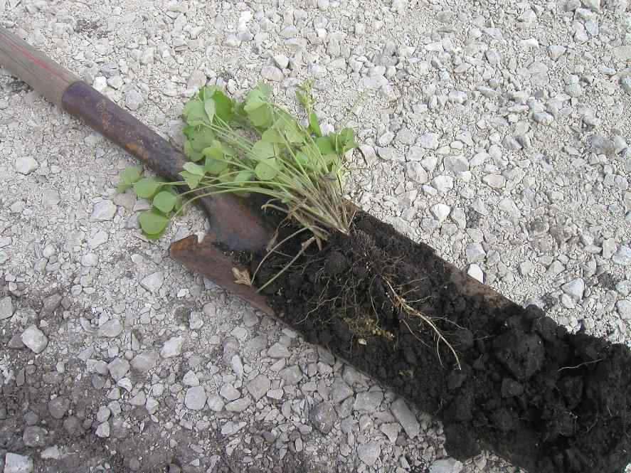
Legumes and the biological fixation of Nitrogen
N Fixation via Rhizobia (bacteria) that live symbiotically with legume roots – Nodules
Seeds of legume species should be inoculated with the correct rhizobia bacteria (inoculant)
Photo: Kevin Shelley
Notes:
N2.3.1 Legumes interact with soil bacteria to biologically fix nitrogen for the plant. After the legume is harvested, there is still plant-available nitrogen in the soil for the next crop. This nitrogen needs to be credited to the base N recommendation.​

Slide 31
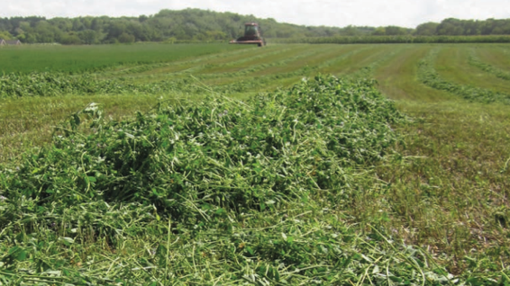
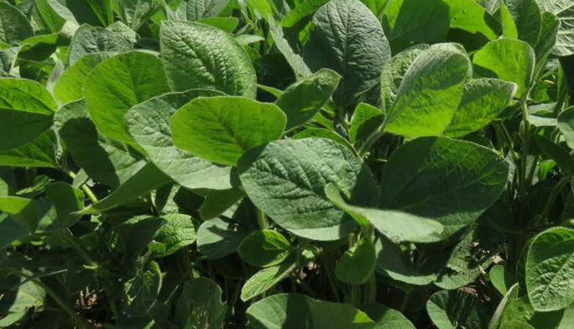
Legumes
Nitrogen credits depend on:
Crop type (Alfalfa, Soybean, Clover, etc…)
Soil texture (sands vs. others)
Harvest management
Stand density
Notes:
N2.3.2 The amount of nitrogen credited varies by the legume crop, stand density, soil type, and harvest management.​

Slide 32
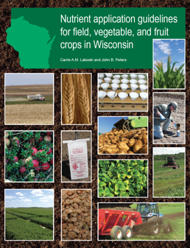
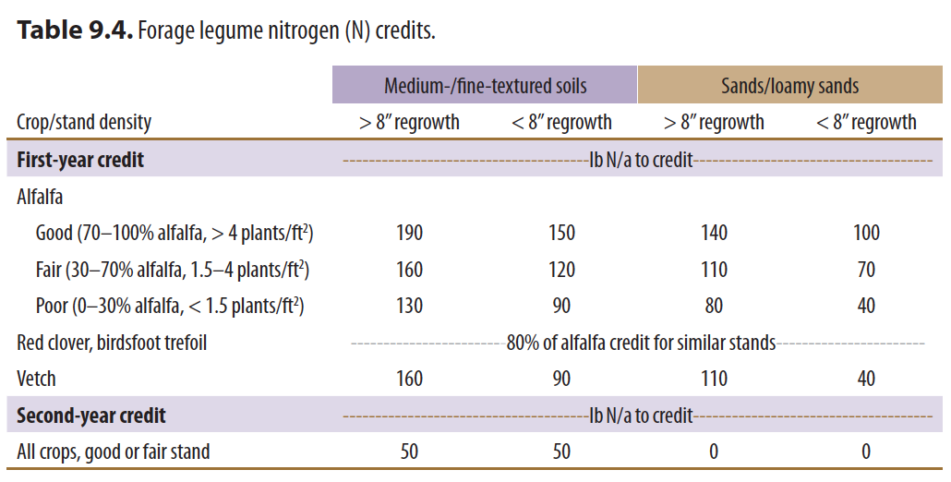
NM Fast facts magazine pg. 18

Slide 33
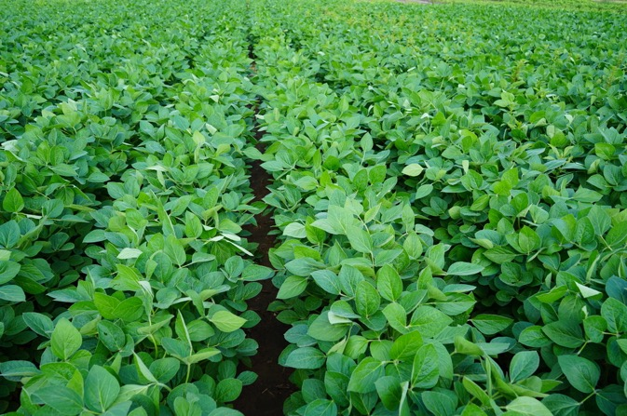
What about soybeans?
MRTN incorporates an adjustment for corn following soybean to credit the nitrogen available following soybean

Slide 34
N crediting example

Slide 35
Nutrient Crediting – Corn Silage
​ | Nitrogen​ | Phosphorus (P₂O₅)​ | Potassium (K₂O)​
Base Recommendations​ | 180​ | 60​ | 60​
Dairy manure application (12 tons/ac)​ 3-3-6 book value​ | 36​ | 36​ | 72​
Proceeding Crop= Alfalfa​ Poor stand (0-30% alfalfa, <8” regrowth)​ | 90​ | 0​ | 0​
Commercial Fertilizer that could be applied​ | 54​ | 24​ | 0​

Slide 36
Other Nitrogen Credit Considerations
Manure applied in the fall retains a full nitrogen credit the following spring.
Legume hay killed in the fall retains the same credit as hay killed in the spring.
A cool spring may delay release of nitrogen and cause an early-season nitrogen deficiency.
Notes:
Lower temperatures delay N conversions to nitrate - which is the most mobile form of N.
Remember: The assumption of 70% loss of N (total vs. available). (i.e. Losses of N are accounted when determining N credits.)
N credits are present regardless of the methods used to kill the stand - tillage, herbicide, winter-kill, etc.
Remember mineralization is temperature dependent. A cool spring may cause early season N deficiency symptoms. In almost all years, the corn will catch up as N is released with warmer temperatures.
Also remember N leaches. Abundant precipitation in the spring has the potential to result in loss of N - regardless of the source.

Slide 37
Adjusting Base Nitrogen Recommendations

Slide 38
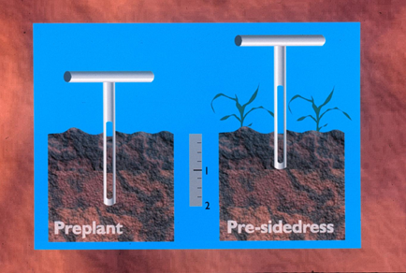
Soil Nitrate Tests for Corn
Two options:
Preplant soil nitrate test (PPNT)
Pre-sidedress soil nitrate test (PSNT)
Agronomic & environmental benefits
Predicts corn N needs
Site- and year-specific
Fast Facts NM Magazine pgs. 20 + 21
Notes:
Both tests measure soil nitrogen (in the nitrate form) that has carried over from the previous growing season and is available to this year’s crop.

Slide 39
Preplant Soil Nitrate Test (PPNT)
Measures residual (carry-over) nitrate
Corn after corn
Medium- and fine-textured soils
Normal or below normal rainfall
Available N exceeds crop need
Not applicable on sands, loamy sands
PPNT credits should be subtracted from MRTN recommendations
Rotation:
PPNT
Corn after Corn
Corn after Soybean
Corn after Alfalfa
X
Notes:
N3.1.1 The PPNT assesses nitrate carry-over from the previous growing season and is used to adjust preplant or sidedress
N application rates for corn and wheat.
N3.1.2 PPNT soil samples are collected in the early spring after frost has dissipated and prior to planting or any preplant
applications of N. PPNT samples are collected in 0 to 1-foot and 1 to 2-foot depth increments from the soil profile.
N3.1.3 PPNT credits (from lab results) should be subtracted from MRTN recommendations.

Slide 40
Pre-Sidedress Soil Nitrate Test (PSNT)
Estimates N availability from organic sources
Measures N credits from manure
Useful when manure & legume history is unknown
Partial accounting for carry-over nitrate
Short sampling & analysis time
Sidedress N – if needed
Rotation:
PPNT
Corn after Corn
Corn after Soybean
Corn after Alfalfa
X
Notes:
N3.2.1 The PSNT assesses early season N mineralization, as well as N carry-over from the previous growing season and is used to adjust sidedress N application rate to corn.
N3.2.2 PSNT soil samples should be collected when corn is at V3 to V5 (approximately 6 to 12 inches tall) or approximately two weeks before a planned sidedress N application. PSNT samples are collected from the top 1 foot of the soil profile.
N3.2.3 PSNT credits (from lab results) should be subtracted from the MRTN sidedress recommendation.
Not used on soybeans because recommendations for corn following soybeans already account for N availability based upon the rotation effect. Therefore rates should not be adjusted using PSNT.

Slide 41
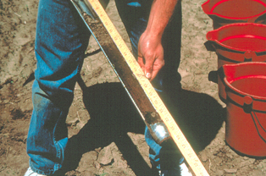
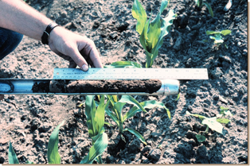
Using Soil Nitrate Tests: Corn after Corn
Preplant Test (PPNT)
Highest potential for carryover N
Adjust for N credits separately
Second year N credits
Manured sites
Pre-sidedress Test (PSNT)
Direct adjustment for N credits
Partial carryover measurement

Slide 42
Using Soil Nitrate Tests: Manured Sites
Pre-sidedress Test (PSNT)
Direct adjustment for N credit
Confirms N credit
Useful for unknown manure application rates
Preplant Test (PPNT)
Accounts for carry-over nitrate from previous years
Separate N credit needed for current or second-year manure-N applications

Slide 43
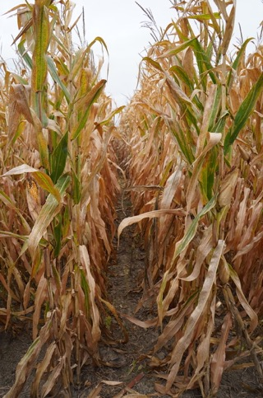
Additional Nitrogen Tests
The end of season stalk nitrate test can help evaluate current N management strategies for a field.
Plant tissue analysis provides the concentration of N, P, K, Ca, Mg, S, Zn, Mn, B, Cu, and Fe in the plant sample. A soil sample should be collected at the same time as the tissue test.
Normalized Difference Vegetation Index (NDVI) and Normalized Difference RedEdge (NDRE) are measures of the state of plant health based on how the plant reflects light at certain frequencies. The correlation between plant color and nitrogen need are being evaluated in Wisconsin and should be researched further before using for nitrogen applications.
Notes:
N3.3.1 The end of season stalk nitrate test can help evaluate current N management strategies for a field. Plants that have received inadequate N will remove N from the lower stalk and leaves during the grain filling period, while those that have received more N than needed to attain maximum yields, tend to accumulate nitrate-N in the lower stalks at the end of the season. Test results can help modify and improve future N management strategies.
N3.3.2 Plant tissue analysis provides the concentration of N, P, K, Ca, Mg, S, Zn, Mn, B, Cu, and Fe in the plant sample. It is important to follow crop-specific guidelines for plant sampling. These sampling guidelines include stage of growth, plant part, and sample size for diagnostic plant tissue analysis.
N3.3.3 Normalized Difference Vegetation Index (NDVI) and Normalized Difference RedEdge (NDRE) are measures of the state of plant health based on how the plant reflects light at certain frequencies. These indexes give a full picture of chlorophyll content which is one of the main nitrogen indicators. It is important to understand that these are newer technologies and their direct application to fertilizer rate has not yet been confirmed.

Slide 44
Managing Nitrogen Applications

Slide 45
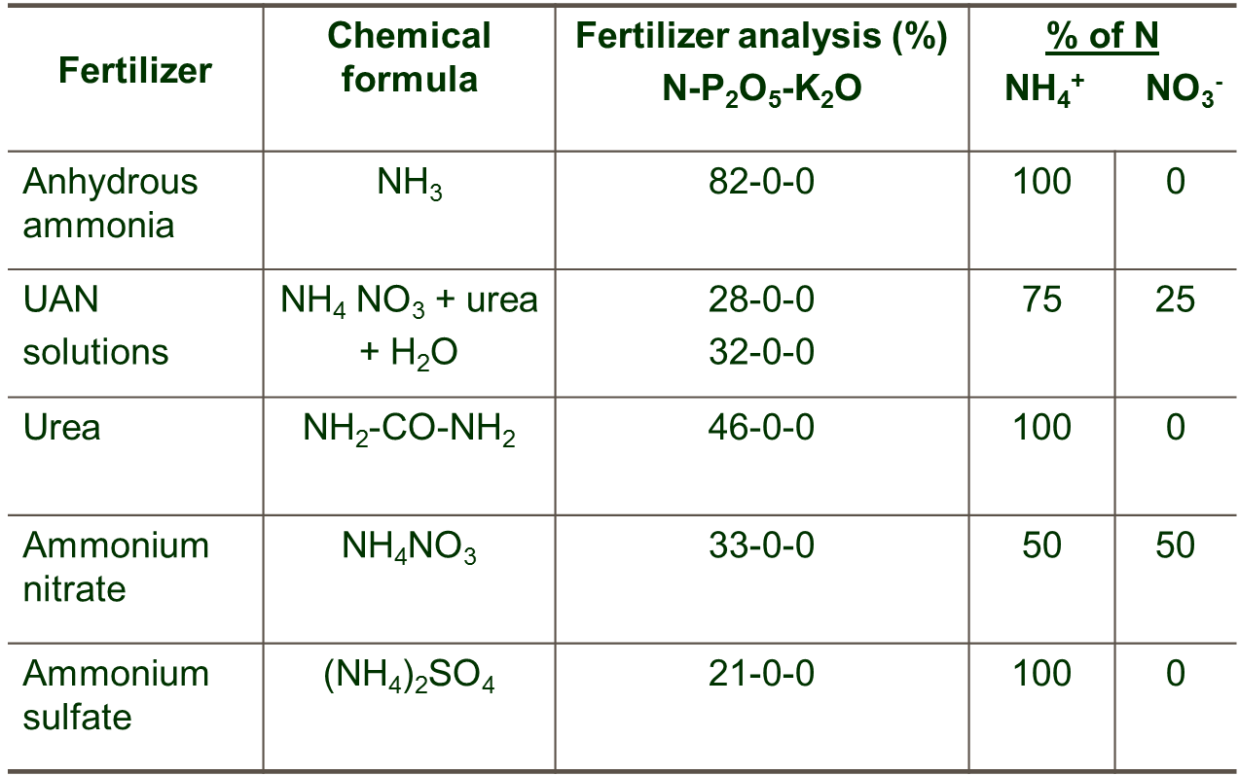
Nitrogen Fertilizers
Notes:
N4.1.1 Nitrogen fertilizers commonly used in Wisconsin includes urea (46% N), ammonium sulfate (21% N), anhydrous ammonia (82% N), 28% urea ammonium nitrate (UAN), 32% urea ammonium nitrate (UAN).

Slide 46
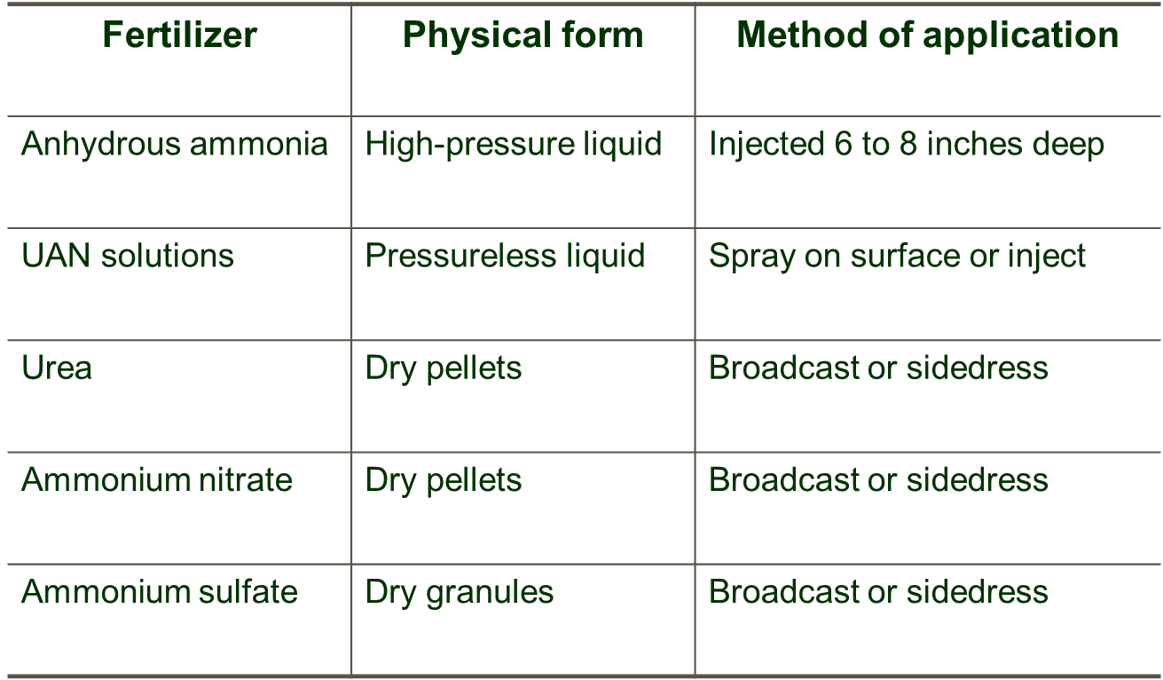
Nitrogen Fertilizers

Slide 47
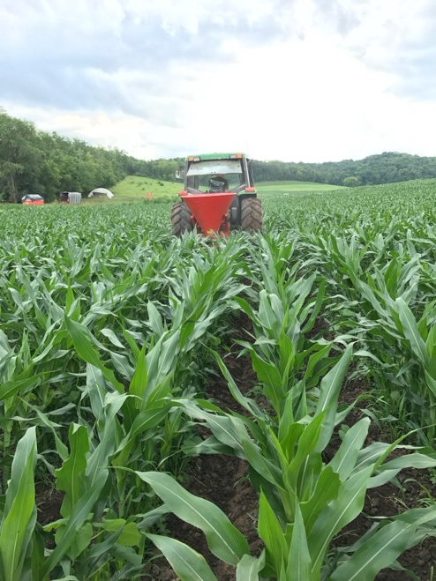
Nitrogen Fertilizers: Differences in Effectiveness?
All equally effective if losses are minimized
Flexibility in rates based on economics
Different susceptibility to loss processes
Leaching
Denitrification
Ammonia volatilization
Timing may heavily influence fertilizer purchased due to application method available.
Photo courtesy of Dan Smith
Notes:
N4.1.2 Nitrogen fertilizers are interchangeable, however, due to application methods of liquid, dry, and gas products, application timing may heavily influence fertilizer type purchased.

Slide 48
Nitrogen Application Rate
 | Nitrogen | Phosphorus (P₂O₅) | Potassium (K₂O)
Base Recommendations | 180 | 60 | 60
Dairy manure application (12 tons/ac) 3-3-6 book value | 36 | 36 | 72
Proceeding Crop= Alfalfa Poor stand (0-30% alfalfa, <8” regrowth) | 90 | 0 | 0
Commercial Fertilizer that could be applied | 54 | 24 | 0
Notes:
N4.1.3 Nitrogen application rates are adjusted based on previous crop and nutrient credits from manure and legumes.

Slide 49
Fertilizer Blends
Fertilizer blends commonly used to meet field crop needs.
Fertilizer blends are based on:
soil test values
application rate
crop need
fertilizer product purchased.
Notes:
N4.1.4 Fertilizer blends are commonly applied to Wisconsin field crops needing nitrogen and other macronutrients; these blends are based on application rate, soil test value, crop need, and fertilizer product purchased.

Slide 50
Fertilizer Blends Math Example
MRTN recommends 160 lb./ac N and the soil test values indicate a need for 60 lb./ac P₂O₅.
Products available: DAP- 18-46-0 and Urea- 46-0-0
60 lb./ac P₂O₅ / .46= 130 lb./ac DAP application
130 DAP x .18 (N in DAP)= 23 lb. N
160 lb. N (MRTN Rate) – 23 lb. (DAP) = 137 lb. N still needed
137 / .46 (N in Urea) = 298 lb./ac urea application
298 lb. urea/ac and 130 lb./ac DAP

Slide 51
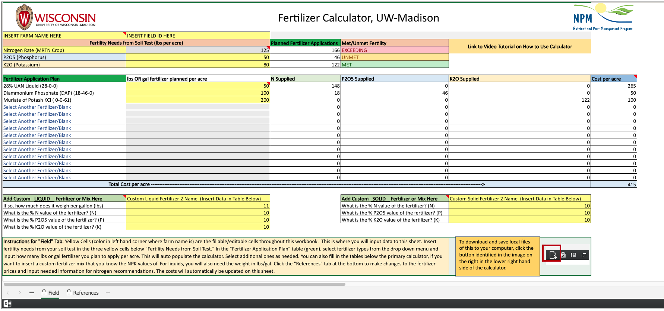
Fertilizer Calculator Available

Slide 52
N Uptake and Loss Potential

Slide 53
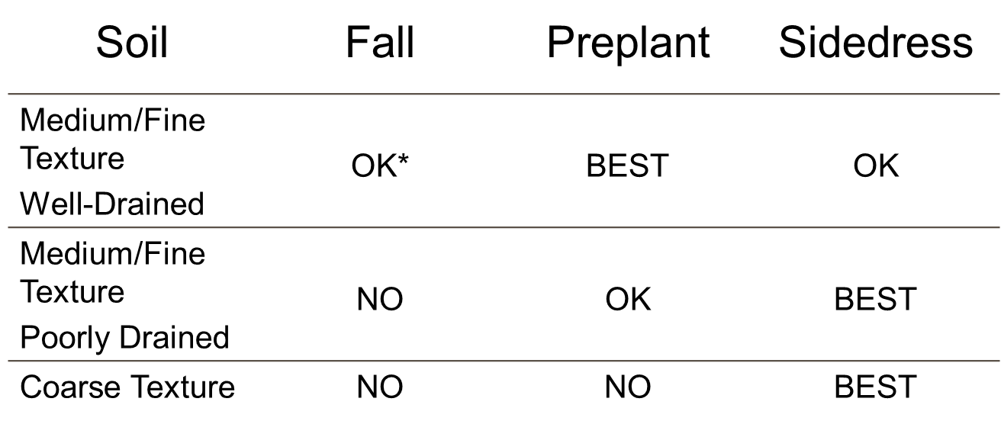
When to apply Nitrogen in Wisconsin?
* Includes use of BMPs for fall-applied N.
Notes:
N4.2.1 The best times to apply nitrogen in Wisconsin depends on soil type and soil temperature. Generally, from a water quality protection and farm economics perspective, fall applications of commercial fertilizer nitrogen should be avoided.

Slide 54
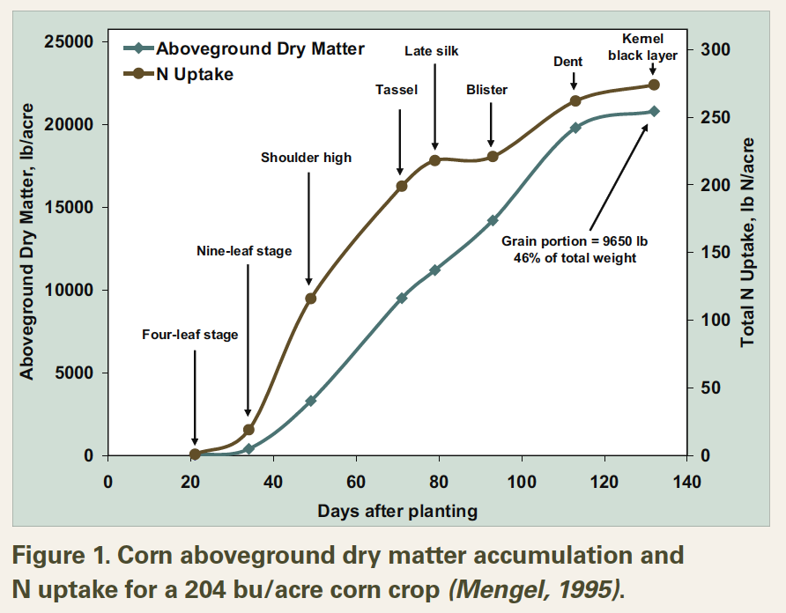
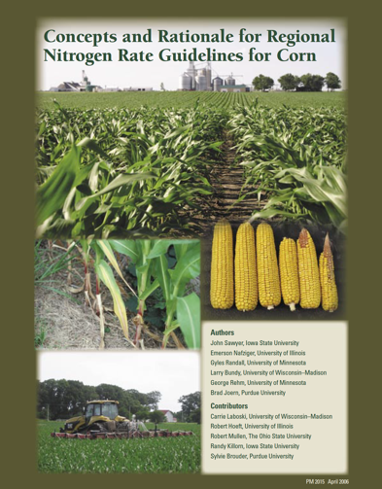
Nitrogen Uptake in Corn Example
Concepts and Rationale for Reginal Nitrogen Rate Guidelines for Corn. Sawyer et al. 2006. Iowa State Extension
Notes:
N4.2.1 The best times to apply nitrogen in Wisconsin depends on soil type and soil temperature. Generally, from a water quality protection and farm economics perspective, fall applications of commercial fertilizer nitrogen should be avoided.

Slide 55
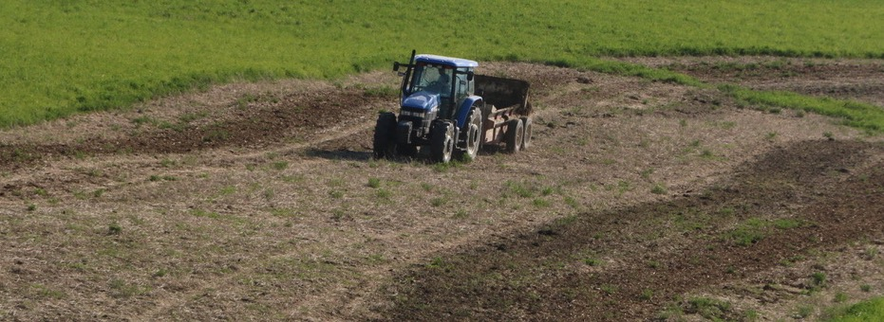
When to apply Nitrogen in via Manure?
Spring- prior to planting
Fall- after soil temperatures have dropped below 50 ℉
Notes:
N4.2.2 The best time to apply manure in Wisconsin is prior to planting or after soil temperatures have dropped below 50 degrees F in the fall.

Slide 56
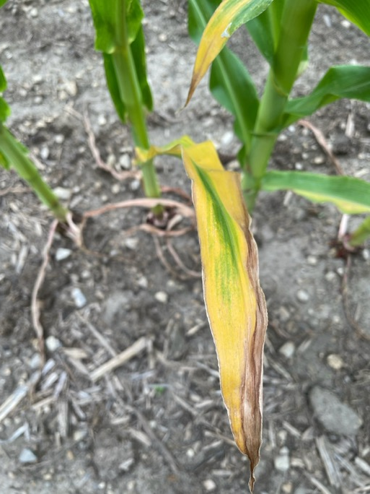
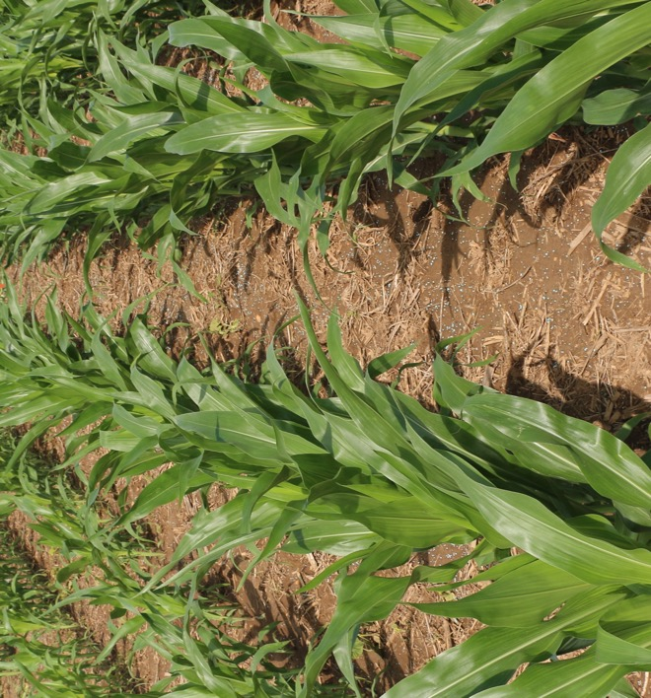
Nitrogen Application Restrictions
Environmental and Landscape restrictions
Soil temperature
Soil Type (sands, etc)
Depth to bedrock
Depth to water table
Photos courtesy of Dan Smith
Notes:
N4.2.3 Nitrogen applications are restricted by environmental and landscape restrictions include soil temperature, soil type, and proximity to bedrock.

Slide 57
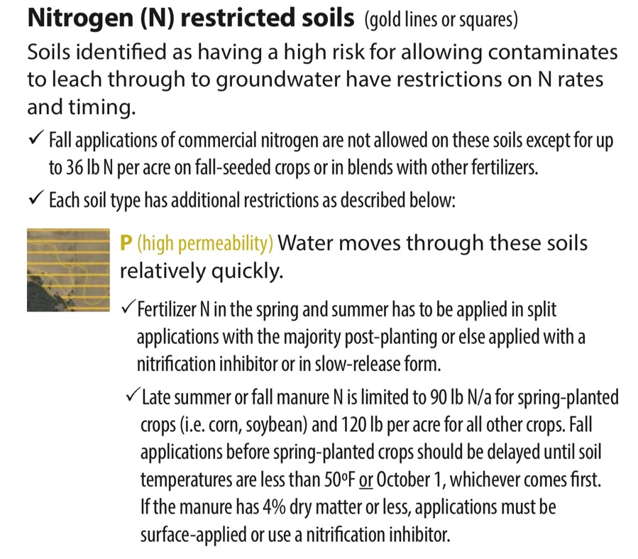
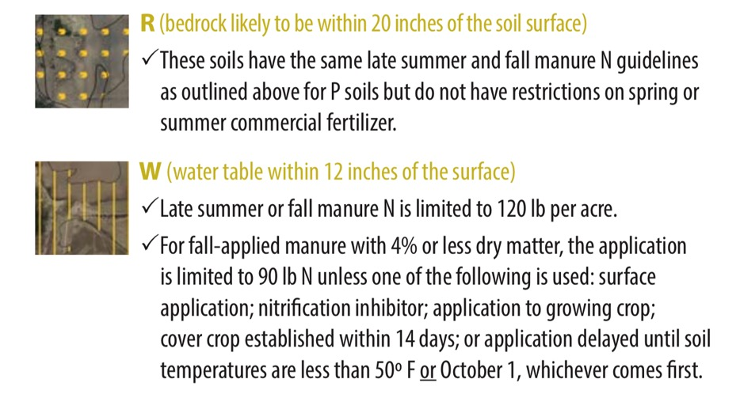
Nitrogen Application Restrictions: SnapPlus
Notes:
N4.2.4 SnapPlus can provide manure restriction and prohibition area maps.

Slide 58
Economic and Environmental Considerations of N Application Methods
Notes:
N4.3.1 Application method of N (surface, injection, broadcast, band, foliar, and incorporation) has advantages and disadvantages both environmentally and economically.

Slide 59
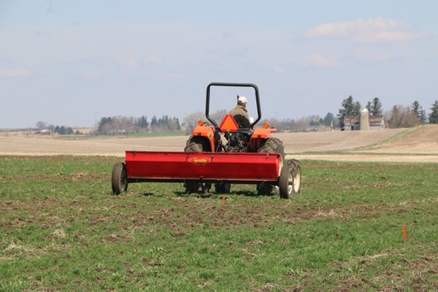
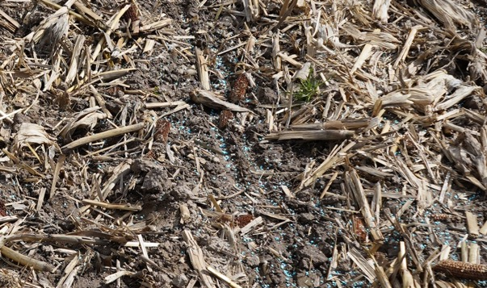
Nitrogen Placement: Surface and Foliar
Spring preplant applications- medium/fine texture well drained soils
Sidedress applications- medium/fine textured poorly drained and course texture soils
Wheat and other crop applications where incorporation is not an option
Urea and urea-containing fertilizers subject to ammonia volatilization without incorporation or rain within 2-3 days of applications
Maximum loss= 20-30% of nitrogen

Slide 60
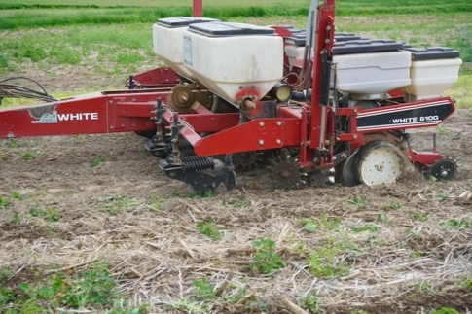
Injection/Subsurface Considerations
Starter fertilizer- subsurface applications
Always based on crop need and soil test values
Starter fertilizers usually increase corn yields when soils are in the responsive range.
Factors influencing response include soil test values, soil compaction, fertilizer rate, placement, planting date, and tillage
Broadcasted starter fertilizer applications are not likely have same effect.
Anhydrous ammonia- necessary application technique
Avoid using on sites prone to soil erosion
Fall applications only ok on well drained medium/fine texture soils using best management practices (apply when soil temperatures are below 50 ℉ and use a nitrification inhibitor)
Notes:
N4.3.2 Starter fertilizer is often desired, however, is not always necessary.

Slide 61
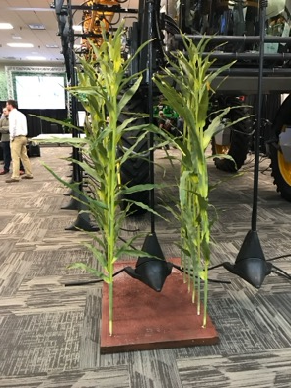
Nitrogen Placement: Broadcast and Band
Fertilizers: Urea, UAN solutions, Ammonium sulfate, and Ammonium nitrate
Will cause crop injury if nitrogen comes in contact with plant
Urea and urea-containing fertilizers subject to ammonia volatilization without incorporation or rain within 2-3 days of applications
Recommended for sandy and poorly drained soils
Maximum loss= 20-30% of nitrogen

Slide 62
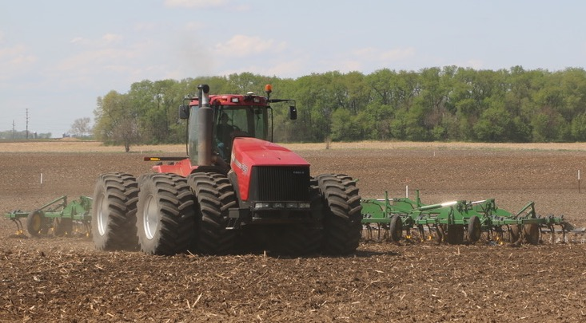
Nitrogen Placement: Incorporation
Urea and UAN solutions
Ammonia volatilization occurs without incorporation or rain within 2-3 days of applications
Maximum loss= 20-30% of nitrogen

Slide 63
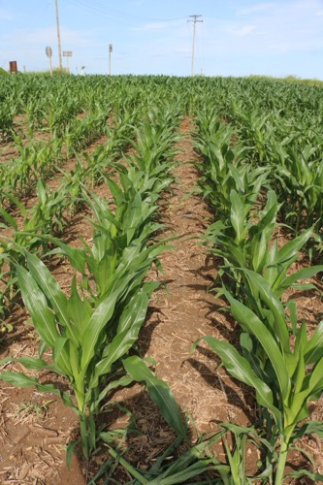
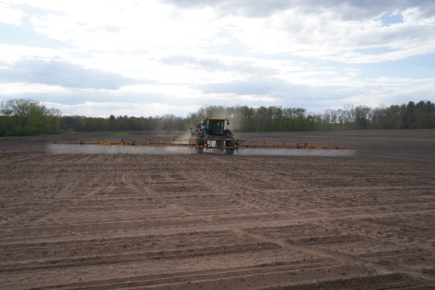
Nitrogen Placement: Multiple Applications
MRTN based rate
Subtract manure and legume credits
Yield increases are not necessarily seen on medium/fine texture soils when compared to spring applied nitrogen
Reduces risk of nitrogen losses
Notes:
N4.3.3 Split applying nitrogen has become common practice on many Wisconsin farms and is a way to reduce risk but may not always be necessary based on soil type.

Slide 64
Nitrogen Resources

Slide 65
Thanks!
Questions?
Name
Title
Nutrient and Pest Management (NPM) Program
UW-Madison Division of Extension
Email: Phone:

