Slide 2
Soils Overview

Slide 3
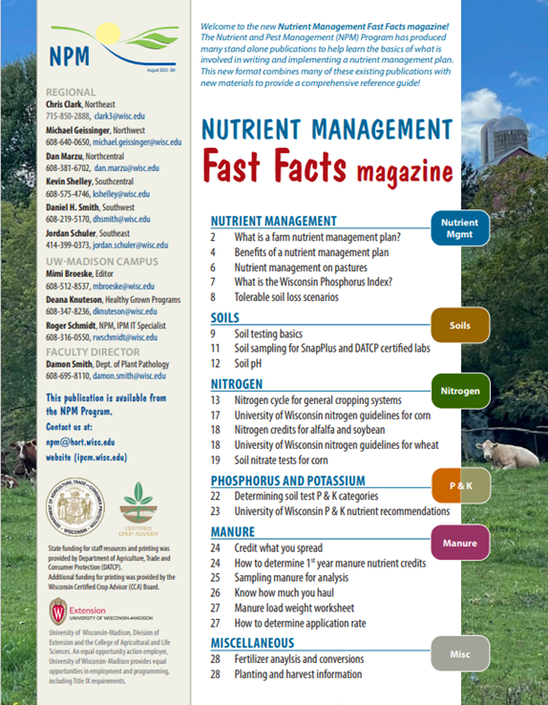
Following Along in Fast Facts?
Soils: Pages 9-12 in Nutrient Management Fast Facts

Slide 4
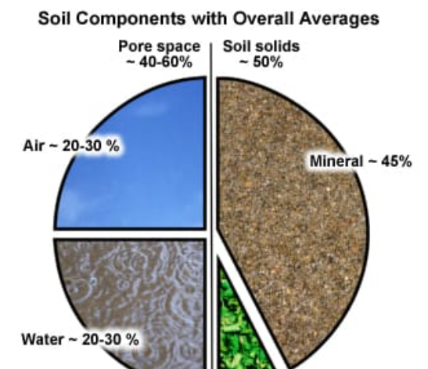
What is Soil?
A dynamic natural body composed of mineral (sand, silt, clay), organic matter, air, and water that acts on and is acted upon by living organisms in a thin layer covering the earth’s surface.
An "Ideal Soil's" components and percentages (see image)
Notes:
S1.1.1 Soil is a dynamic natural body composed of minerals, organic matter, air, and water that acts on and is acted upon by living organisms in a thin layer covering the earth’s surface.

Slide 5
Inherent vs Dynamic Properties of Soil
Inherent properties are the result of natural soil formation properties.
Include mineral composition, soil texture changes very little over time.
Dynamic soil properties, such as soil water, temperature, biological activity, pH and soil nutrient levels, change over the short-term and over short distances.
Dynamic soil properties are influenced by agricultural management.
The management of soils, including soil testing and nutrient applications, must take inherent and dynamic soil properties into account to optimize crop nutrient uptake and reduce nutrient losses to the environment.
Notes:
S1.2 Inherent vs dynamic properties
S1.2.1 Some soil properties, such as soil texture and mineral composition, are considered inherent, meaning they are the result of natural soil formation properties and change little over time. In contrast, dynamic soil properties, such as soil water, temperature, biological activity, pH and soil nutrient levels, change over the short-term and over short distances. Dynamic soil properties are influenced by agricultural management.
S1.2.2 Agricultural management of soils, including soil testing and nutrient applications, must take inherent and dynamic soil properties into account to optimize crop nutrient uptake and reduce nutrient losses to the environment.

Slide 6
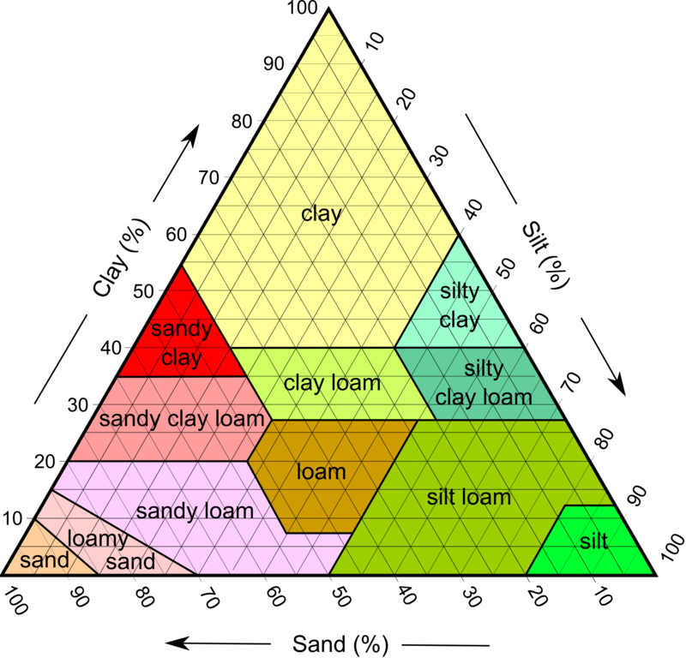
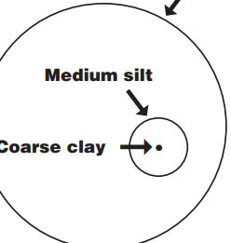
Soil Texture
Includes only the mineral fraction of soil.
Defined by particle size (sand, silt, and clay)
Each size fraction has a different impact on soil properties, function, crop growth, and nutrient management.
The USDA identifies 12 soil textures based upon the percentage of sand, silt, and clay in a soil.
The textural classes are represented on a soil textural triangle. (See image)
Soil nutrient recommendations are often differentiated by soil texture.
Sandy (1) Low yield potential
Loamy (2) High yield potential
Organic (3)
Notes:
S1.3 Soil composition
S1.3.1 Soil texture only includes the mineral fraction of soil. Soil textures is defined by particle size (sand, silt, and clay) and each size fraction has a different impact on soil properties, function, and nutrient management.
S1.3.2 The USDA identifies 12 soil textures based upon the percentage of sand, silt, and clay in a soil. The textural classifications are represented on a soil textural triangle. Soil nutrient recommendations are often differentiated by soil texture.
S1.3.3 Soil organic matter contributes to soil fertility, nutrient cycling, microbial communities, and soil water dynamics. Soil organic matter gains and losses are impacted by tillage, organic additions, and crop rotations.
For more info see Chapter 1, Chapter 2 A3358 Management of WI Soils Management of Wisconsin Soils

Slide 7
Soil Texture and Crops
Soil texture has substantial effect on crop growth
Coarse sandy soils have large pores that hold little water (droughty) and nutrients, and they are prone to wind erosion when bare.
Fine textured clays are hard to prepare for a seedbed, water moves thru slowly, (excessive wet).
Loam soils are an even mix of sand, silt, clay and are best suited for crop production.
The clay in most soils' accounts for the bulk of surface area that holds plant nutrients.

Slide 8
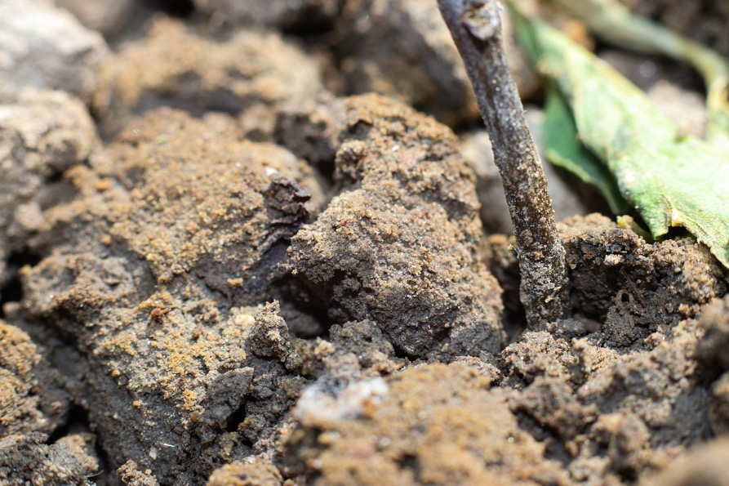
Soil Organic Matter Benefits
Store nutrients
Controls water holding capacity
On the surface it shades to control temp
Protects from rain drop impact
Provides food to soil life
Contributes to soil fertility, nutrient cycling.
Most WI soils are 1.5-4% OM
Soil organic matter gains and losses are impacted by tillage, organic additions, and crop rotations
Notes:
S1.3 Soil composition
S1.3.1 Soil texture only includes the mineral fraction of soil. Soil textures is defined by particle size (sand, silt, and clay) and each size fraction has a different impact on soil properties, function, and nutrient management.
S1.3.2 The USDA identifies 12 soil textures based upon the percentage of sand, silt, and clay in a soil. The textural classifications are represented on a soil textural triangle. Soil nutrient recommendations are often differentiated by soil texture.
S1.3.3 Soil organic matter contributes to soil fertility, nutrient cycling, microbial communities, and soil water dynamics. Soil organic matter gains and losses are impacted by tillage, organic additions, and crop rotations.
For more info see Chapter 2 A3358 Management of WI Soils Management of Wisconsin Soils

Slide 9
Soil Formation
Soil properties can vary dramatically throughout a region, as well as a single field, due to natural soil forming factors and agricultural management.
The 5 soil forming factors -
Climate
Soil organisms
Topography
Parent material
Time
Some would say humans are a 6th
Notes:
S1.4 Soil formation
S1.4.1 Soil properties can vary dramatically throughout a region, as well as a single field, due to natural soil forming factors and agricultural management.
S1.4.2 The five soil forming factors - climate, soil organisms, topography, parent material and time - influence soil horizonation, texture, organic matter content, and natural nutrient supply capacity, which in turn influences soil productivity, nutrient recommendations, and management options to reduce potential erosion and nutrient losses.
S1.4.3 Soil formation, landscape position, and groundwater hydrology influence a soil’s drainage class and potential soil productivity and management. A soil’s drainage class can influence nutrient cycling and potential nutrient loss to ground and surface waters.
For more info see Chapter 1, Chapter 3 A3358 Management of WI Soils Management of Wisconsin Soils

Slide 10
5 Soil Formation Methods
Climate-amount of local precipitation and temperature.
WI North-cooler temperatures have slowed OM decomposition, but more leaching occurs making them less fertile then in south
Topography-flat vs steep hills, soil erosion has changed depth of soil and drainage
Parent Material (Geology of area)
Bed rock- weathered in place (limestone & sandstone are common in WI)
Glacial deposits (till, outwash, moraines)
Material moved by erosion (wind/loess) or water (alluvial)
Decaying plant material in bogs (peat/muck soils)
Time-soils take a long time to form.
In WI, most were 30,000 yr ago glaciers. Eastern and Northern WI 8-15,000 years ago.
Soil organisms -Soils eat first. Depends on amount and type present.
Some would say humans are a 6th for changes, moving, use of soils
Notes:
S1.4 Soil formation
S1.4.2 The five soil forming factors - climate, soil organisms, topography, parent material and time - influence soil horizonation, texture, organic matter content, and natural nutrient supply capacity, which in turn influences soil productivity, nutrient recommendations, and management options to reduce potential erosion and nutrient losses.
S1.4 Soil formation
S1.4.1 Soil properties can vary dramatically throughout a region, as well as a single field, due to natural soil forming factors and agricultural management.
S1.4.3 Soil formation, landscape position, and groundwater hydrology influence a soil’s drainage class and potential soil productivity and management. A soil’s drainage class can influence nutrient cycling and potential nutrient loss to ground and surface waters.
For more info see Chapter 1, Chapter 3 A3358 Management of WI Soils Management of Wisconsin Soils

Slide 11
Soil Classification & Map Units
USDA-NRCS has mapped most soils in the US.
Soils are mapped as soil map units, which often include a dominate soil series and multiple minor components (series)
Farmers can identify the soil map units within their fields through USDA soil maps, their agronomists, or the Web Soil Survey. Web Soil Survey - Home (usda.gov) or SnapMaps.
Notes:
S1.5 Soil classification and map units
S1.5.1 The USDA-NRCS has mapped most soils in the US. Soil series are the lowest and most homogenous class in the soil classification system and meet clearly defined soil properties and specifications. However, soils are mapped as soil map units, which often include a dominate soil series and multiple minor components (series), miscellaneous areas, or both that do not dramatically impact the soil’s management.
S1.5.2 Farmers can identify the soil map units within their fields through USDA soil maps, their agronomists, or the Web Soil Survey.
For more info see Chapter 1, Chapter 3 A3358 Management of WI Soils Management of Wisconsin Soils

Slide 12
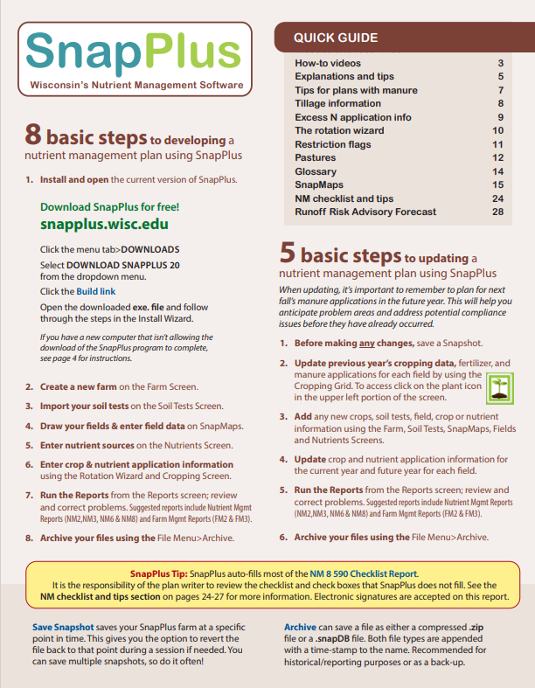
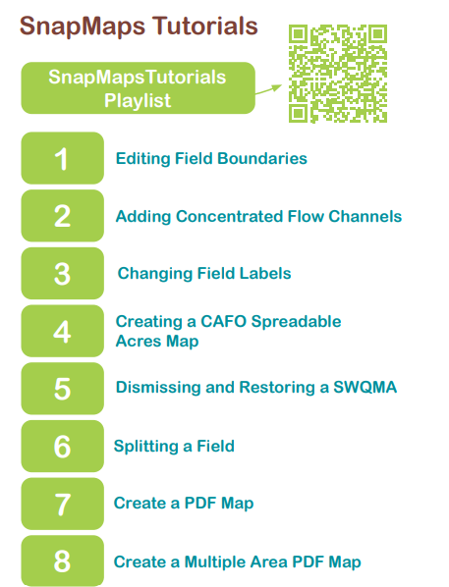
Snap Maps
SnapPlus uses the predominant, as well as the most limiting (critical) soil series within a field.
- Predominate soil series (Covers most area of field) is used to determine nutrient management recommendations for the field.
-Critical soil series: most erosion-prone soil that comprises at least 10% of the field and is used in soil erosion and P Index calculations.
Helpful Printable SnapPlus pdf resource
SnapPlusGuide_2023.pdf (wisc.edu)
SnapMaps info on pages 15-23
Video Tutorials use the QR Code
Notes:
S1.5.3 SnapPlus uses the predominant, as well as the most limiting (critical) soil series within a field. The predominate soil series is used to determine nutrient management recommendations for the field. The critical soil series is the most erosion-prone soil that comprises at least 10% of the field and is used in soil erosion and P Index calculations.

Slide 13
Soil Fertility Basics

Slide 14
Essential Plant Nutrients
Nutrient required by the plant to carry out its full life cycle
To be essential a nutrient must:
Directly contribute to plant nutrition (i.e. be involved in plant metabolism/enzyme activity)
Purpose can not be substituted by another nutrient
There are 17 plant essential nutrients
Water/Air Derived: Carbon, hydrogen, oxygen, nitrogen (aka Structural)
Soil Derived: Phosphorus, potassium, calcium, magnesium, sulfur, iron, boron, manganese, copper, zinc, molybdenum, cobalt, nickel, and chloride
Notes:
S2.1.1 Plant essential nutrients are nutrients required by the plant to carry out its life cycle (go from seed to producing seed). To be essential, a nutrient must directly contribute to plant nutrition, such as be involved in plant metabolism or enzyme activity, and it cannot be substituted by another nutrient.
S2.1.2 The 17 plant essential nutrients include carbon, hydrogen, oxygen, nitrogen, phosphorus, potassium, calcium, magnesium, sulfur, iron, boron, manganese, copper, zinc, molybdenum, nickel, and chloride. Carbon, hydrogen, and oxygen are derived from air and water. The remaining nutrients are derived from the soil.

Slide 15
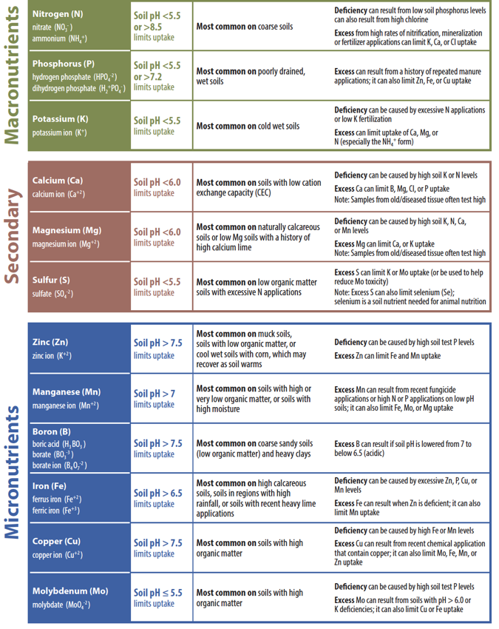
What do essential nutrients do?
Nutrients play specific roles in plant growth and metabolism. The major roles of select nutrients are outlined in the following table.
Additionally, carbon, hydrogen, and oxygen are needed for plant growth and development.

Slide 16
Soil Derived Essential Nutrients
Soil Derived Nutrients fall into 2 general categories, based on the amount needed by the crop:
Macronutrients (needed in great amounts)
Nitrogen, phosphorus, potassium, calcium, magnesium, and sulfur
Micronutrients (needed in small amounts)
Iron, boron, manganese, copper, zinc, molybdenum, nickel and chloride
Notes:
S2.1.3 Soil derived plant essential nutrients required in greater amounts are called macronutrients and include nitrogen, phosphorus, potassium, calcium, magnesium, and sulfur. Soil derived plant essential nutrients required in lesser amounts include iron, boron, manganese, copper, zinc, molybdenum, cobalt, nickel, and chloride.

Slide 17
Macronutrients
The 6 macronutrients can be split into 2 categories, based on the quantity demanded by plants:
Primary (needed in greater amounts)
nitrogen, phosphorus, potassium
Secondary (needed in lesser amounts)
calcium, magnesium, and sulfur
Notes:
S2.2.1 The six plant essential macronutrients can be split into two categories – primary and secondary – based upon the approximate quantity demanded by plants. Primary macronutrients are required in greater amounts than the secondary macronutrients.
S2.2.2 The primary macronutrients are nitrogen, phosphorus, and potassium. The secondary macronutrients are calcium, magnesium, and sulfur.
S2.2.3 Due to their high demand by plants, the need for frequent supplementation (fertilization), and/or their potential risk to water quality, nutrient management planning typically focuses on managing nitrogen, phosphorus, and potassium additions to the soil.

Slide 18
Macronutrients
Nutrient management planning typically focuses on managing:
Nitrogen (N)
Phosphorus (P)
Potassium (K)
Due to their high demand by plants, these nutrients typically need to be applied via fertilizer and pose greater risks to water quality (N, P).
Notes:
S2.2.3 Due to their high demand by plants, the need for frequent supplementation (fertilization), and/or their potential risk to water quality, nutrient management planning typically focuses on managing nitrogen, phosphorus, and potassium additions to the soil.

Slide 19
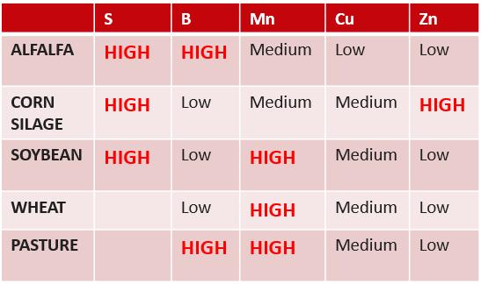
Micronutrients
Required in lesser amount than macronutrients, but just as important
Iron, boron, manganese, copper, zinc, molybdenum, nickel, and chloride
B, Mn, & Zn may be supplemented based on soil pH and crop type
Cu & Mb is more common for vegetable crops
Notes:
S2.2.1 While required in lesser amounts than the macronutrients by plants, micronutrients are no less important to plant health and productivity.
S2.2.2 Iron, boron, manganese, copper, zinc, molybdenum, cobalt, nickel, and chloride are often found in adequate amounts in many Wisconsin soils. Depending on soil pH and the crop being grown, boron, manganese, and zinc fertilizers may be more commonly applied than other micronutrient fertilizers to corn, soybeans, and alfalfa. Copper and molybdenum supplementation is more common in vegetable crops.

Slide 20
Nutrient Availability
Not all nutrients found in soil are plant-available
Plants can only use inorganic forms of nutrients
Organic nutrients (i.e. SOM, manure, plant residue) must be converted into inorganic forms by soil microbes before plants can use them
Example for nitrogen: plants only use nitrate and ammonium
Nutrients must be dissolved in soil water
Chemical form of nutrient taken up by plants is specific
Notes:
S2.4.1 Not all nutrients found in soil are plant available, as plants can only utilize the inorganic forms of nutrients. Organic nutrients, such as many of the nutrients found in soil organic matter, manure, and plant residues, must be converted into inorganic forms by soil microbes before they can be utilized by plants.
S2.4.2 The chemical form of a nutrient taken up by plants is specific. Commercial fertilizers commonly supply this chemical form or a form that can be quickly converted into the plant available form.
S2.4.3 In addition to being in the proper chemical form for plant uptake, nutrients must also be dissolved in water. Plants take up nutrients from the soil water through their root systems. Nutrients that aren’t dissolved aren’t accessible to plants.

Slide 21
Plant Uptake Forms of Nutrients
Plants take up specific chemical forms
Commercial fertilizers commonly supply this chemical form
If a nutrient is not found in the specific forms, the plants are unable to take up these nutrients and may become deficient.(See chart)
Notes:
S2.4.2 The chemical form of a nutrient taken up by plants is specific. Commercial fertilizers commonly supply this chemical form or a form that can be quickly converted into the plant available form.

Slide 22
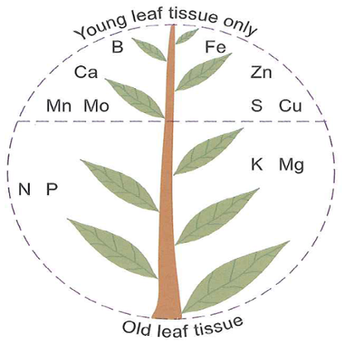
Mobile vs Immobile Nutrients
Mobile nutrients can be moved to where they are needed within the growing plant.
Deficiencies of mobile nutrients often first appear in the older leaves, as nutrients are translocated to the active growing point.
Immobile nutrients are “locked” in place within plant tissues and cannot be moved to growing plant parts.
Deficiencies of immobile nutrients often first appear in the younger, new leaves.

Slide 23
Nutrient Supply and Retention

Slide 24
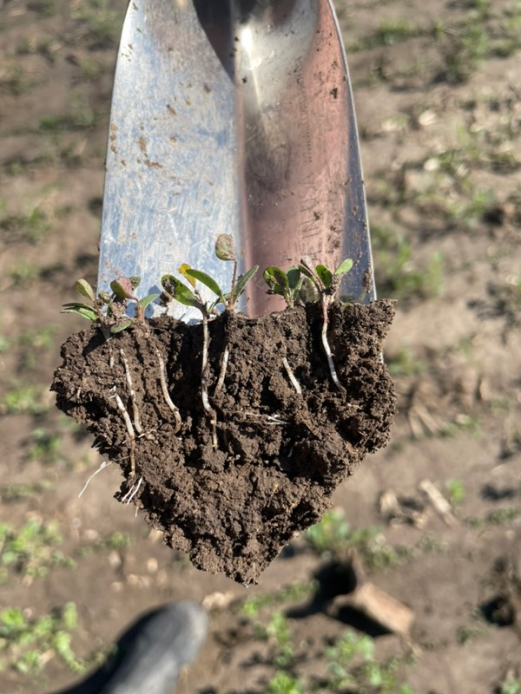
Natural Nutrients
The primary natural additions of plant available nutrients into the soil system are:
1. Decomposition of soil organic matter and soil minerals.
2. Nitrogen fixation.
3. Deposition of organic residues, and atmospheric deposition.
Agronomic practices that impact soil organic matter concentrations, as well as microbial communities who decompose soil organic matter, can impact nutrient cycling and supply.
Notes:
S3.1.1 The primary natural additions of plant available nutrients into the soil system include: decomposition of soil organic matter and soil minerals, nitrogen fixation, deposition of organic residues, and atmospheric deposition.
S3.1.2 In a non-legume agricultural system, decomposition of soil organic matter and soil minerals are the largest natural supply of plant available nutrients. In a legume system, addition of nitrogen into the system via nitrogen fixation may be significant.
S3.1.3 Agronomic practices that impact soil organic matter concentrations, as well as microbial communities who decompose soil organic matter, can impact nutrient cycling and supply.

Slide 25
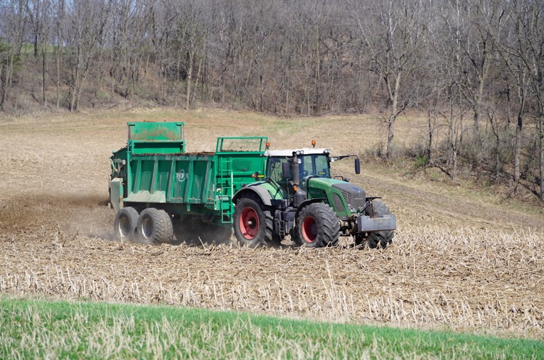
Natural Nutrient Supplies
Often natural nutrient sources like manure and legumes are supplemented with commercial fertilizers.
Manure contains most plant essential nutrients, but vary in nutrient composition based upon species, rations, handling/processing, and land application techniques.
Legumes/green manures are used to supplement nitrogen additions into the soil, but the amount of supplied nitrogen is dependent on legume species, productivity, and growth stage at termination.
Nutrient availability from manure and legumes is often dependent on decomposition to convert organic nutrients into plant available, inorganic forms.
The quick dissolution and availability of nutrients from commercial sources can result in leaching, runoff, and/or gaseous losses of the nutrients from the soil system.
Notes:
S3.2.1 Natural nutrient supplies are often supplemented with other nutrient sources, such as manure, commercial fertilizers, and/or legumes/green manures, to meet plant nutrient needs and boost plant production/yield.
S3.2.2 Manure contain most plant essential nutrients, but vary in nutrient composition based upon species, rations, handling/processing, and land application techniques. Commercial fertilizers may contain one or more plant essential nutrients in known concentrations. Legumes/green manures are used to supplement nitrogen additions into the soil, but the amount of supplied nitrogen is dependent on legume species, productivity, and growth stage at termination.
S3.2.3 Due to the varying composition/contributions of manures and legumes, proper crediting of nutrient additions in an nutrient management plan can be a challenge. In addition, nutrient availability from manure and legumes is often dependent on decomposition to convert organic nutrients into plant available, inorganic forms. While the chemical composition of commercial fertilizers makes nutrient crediting more straightforward, the often the quick dissolution and availability of nutrients can result in leaching, runoff, and/or gaseous losses of the nutrients from the soil system.

Slide 26
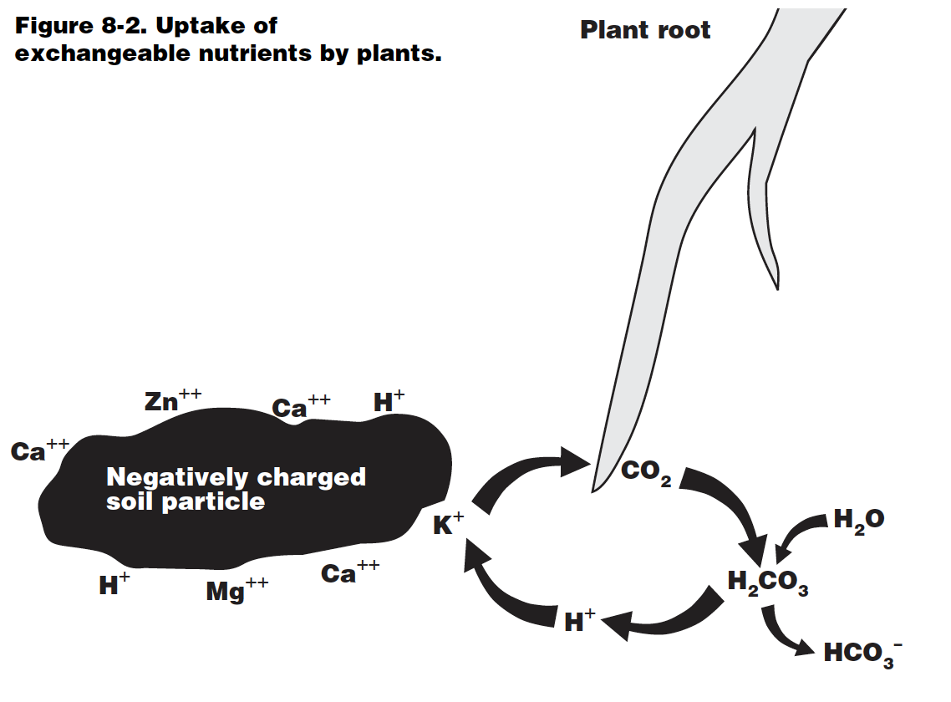
Cation Exchange Capacity (CEC)
Soils naturally contain a dominate negative charge. This negative charge is called cation exchange capacity, or CEC for short. Both clay and soil organic matter contribute negative charges to a soil’s CEC.
A soil’s cation exchange sites (negative charges) attracts positively charged nutrients and non-nutrients dissolved in the soil water.
This attraction helps reduce the leaching and/or gaseous losses of these nutrients. Additionally, cation exchange sites act as “storage” for plant essential nutrients.
Soils with higher CECs are better able to retain naturally-derived and supplementally applied nutrients.
In Wisconsin, fertilizer recommendations often consider differences in soils’ CEC and nutrient storage capacity, by recommending split, reduced amounts, and/or the use of nitrification inhibitors on coarse textured soils which have naturally low CECs.
Notes:
S3.3.1 Soils naturally contain a dominate negative charge. This negative charge is called cation exchange capacity, or CEC for short. Both clay and soil organic matter contribute negative charges to a soil’s CEC.
S3.3.2 A soil’s cation exchange sites (negative charges) attracts positively charged nutrients and non-nutrients dissolved in the soil water. This attraction helps reduce the leaching and/or gaseous losses of these nutrients. Additionally, cation exchange sites act as “storage” for plant essential nutrients.
S3.3.3 Soils with higher CECs are better able to retain naturally-derived and supplementally applied nutrients. In Wisconsin, fertilizer recommendations often take into account differences in soils’ CEC and nutrient storage capacity, by recommending split, reduced amounts, and/or the use of nitrification inhibitors on coarse textured soils which have naturally low CECs.

Slide 27
Mechanisms of Nutrient Uptake

Slide 28
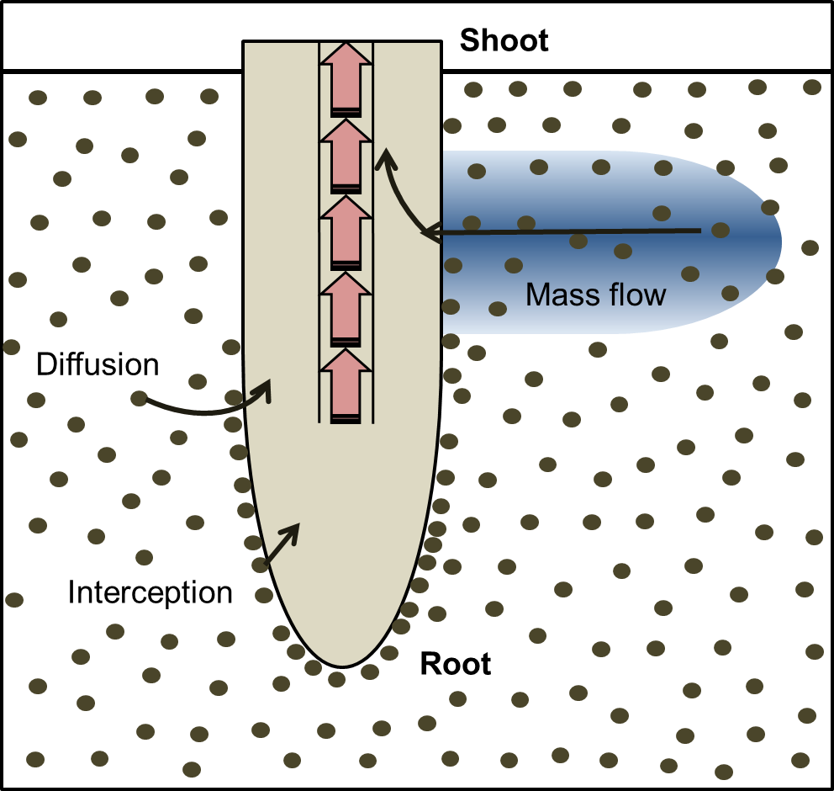
How do plants take up nutrients?
Via three mechanisms
Mass flow—nutrients taken up with water
Diffusion—driven by the concentration gradient
Root interception—root to nutrient contact
The primary mechanism for uptake for each nutrient is partially influenced by the nutrient’s mobility or tendency to move within the soil water.
https://www.rseco.org/content/411-plant-nutrition.html
Notes:
S4.1.1 Plants take up nutrients by one of three mechanisms – root interception, diffusion, and mass flow. The primary mechanism for uptake for each nutrient is partially influenced by the nutrient’s mobility or tendency to move within the soil water.

Slide 29
Mass Flow
Nutrients are taken up with water
Mobile nutrients are primarily taken up by mass flow
Nitrogen, calcium, magnesium and sulfur
Affected by change in soil water dynamics
Soil compaction, porosity, and soil moisture
Notes:
S4.1.1 Plants take up nutrients by one of three mechanisms – root interception, diffusion, and mass flow. The primary mechanism for uptake for each nutrient is partially influenced by the nutrient’s mobility or tendency to move within the soil water.
S4.1.3 Soil properties that impact root growth and water movement through the soil, such as soil compaction, porosity, and soil moisture content, can impact nutrient uptake by impacting the size of the root system, amount of soil exploited by the root system, and the movement of nutrients to the root system.

Slide 30
Diffusion
Nutrient uptake driven by concentration gradient
Immobile nutrients primarily taken up by diffusion
Phosphorus and potassium
Notes:
S4.1.2 Mobile and somewhat mobile nutrients, such as nitrogen, calcium, magnesium and sulfur, are primarily take up by mass flow. Immobile nutrients, such as phosphorus and potassium, are take up primarily by diffusion.

Slide 31
Root Interception
Root is in contact with nutrient and taken up
Affected by soil properties that impact root/root size
Soil compaction, porosity, and soil moisture content
Amount of soil exploited by the root system
Root insect or disease pressure
Notes:
S4.1.3 Soil properties that impact root growth and water movement through the soil, such as soil compaction, porosity, and soil moisture content, can impact nutrient uptake by impacting the size of the root system, amount of soil exploited by the root system, and the movement of nutrients to the root system.

Slide 32
Factors Impacting Nutrient Uptake

Slide 33
Plant Root
Anything that impacts root length, density, and root hair production will impact nutrient uptake
Can result in a plant becoming nutrient deficient even when soil nutrient levels are adequate
Soil and plant condition issues such as compaction, excess soil salts, root pruning insects or disease can decrease root growth and nutrient uptake.
Varying Degrees of Corn Rootworm Damage
Source: Tinsley, N.A., Estes, R.E. and Gray, M.E. 2012. Validation of a nested error component model to estimate damage caused by corn rootworm larvae. Journal of Applied Entomology. DOI:10.1111/j.1439-0418.2012.01776.x
Notes:
S4.2.1 As plant roots must typically come very near a nutrient in order to take it up, anything that impacts root length, density, and root hair production will impact nutrient uptake and can result in a plant becoming nutrient deficient even when soil nutrient levels are adequate. Soil and plant condition issues such as compaction, excess soil salts, root pruning insects or disease can decrease root growth and nutrient uptake.

Slide 34
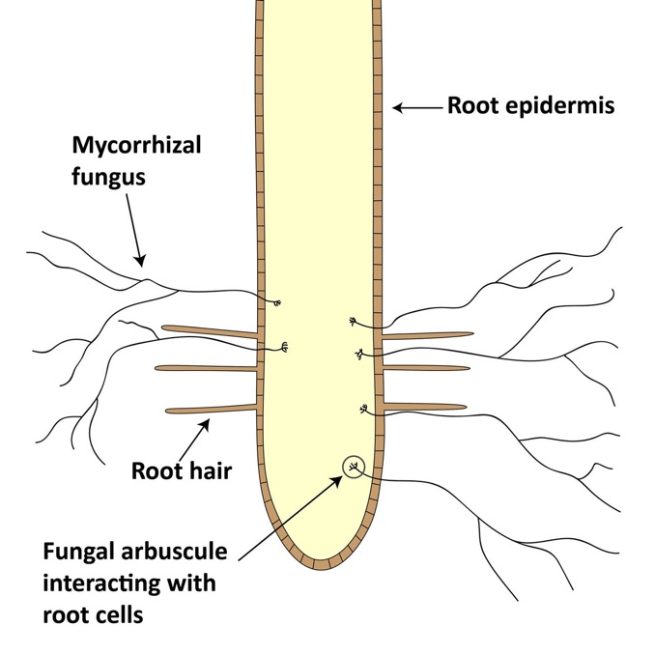
Symbiotic Mycorrhizal Fungi
Symbiotic mycorrhizal fungi aid most plants with nutrient and water uptake.
Fungal hyphae infects the plant root and then grows into the soil matrix, increasing the volume of soil explored by the plant root system.
Suppression of mycorrhizal infections may negatively affect nutrient uptake.
https://www.cropscience.bayer.us/articles/bayer/benefits-mycorrhizae-fungi
Notes:
S4.2.2 Symbiotic mycorrhizal fungi aid most plants with nutrient and water uptake. The fungal hyphae infect the plant root and then grow into the soil matrix, increasing the volume of soil explored by the plant root system. Suppression of mycorrhizal infections may result in less than optimal plant growth.

Slide 35
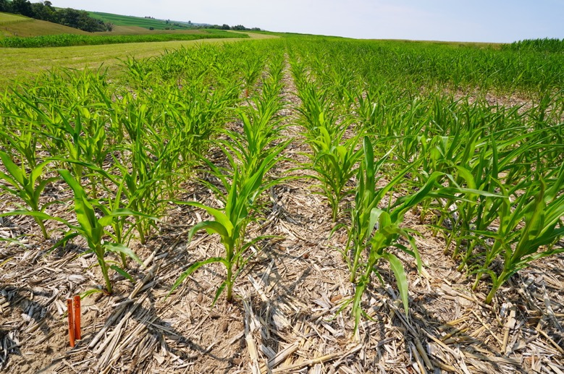
Weather/Growing Conditions
Weather conditions that suppress root growth (cool, wet conditions) or plant uptake of water (extreme humidity or drought) can result in a plant becoming nutrient deficient due to a suppressed nutrient uptake.
Notes:
S4.2.3 Weather conditions that suppress root growth (cool, wet conditions) or plant uptake of water (extreme humidity or drought) can result in a plant becoming nutrient deficient due to a suppressed nutrient uptake.

Slide 36
Fertilizer Application Placement

Slide 37
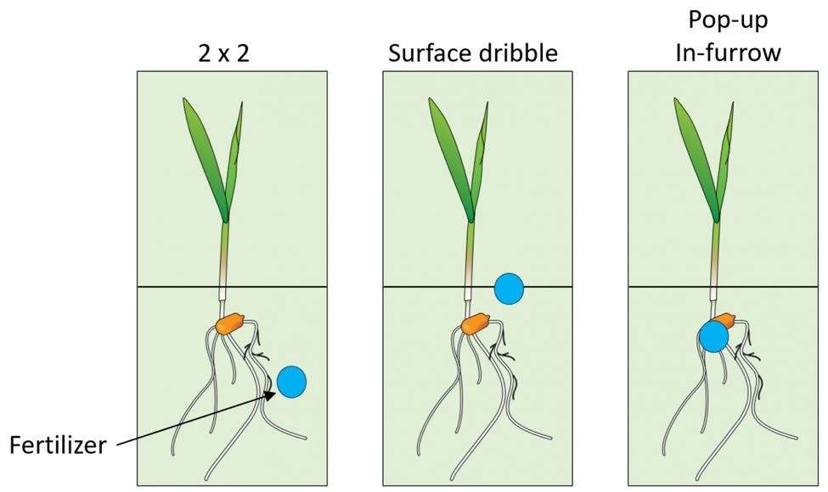
Placement of Immobile Nutrients
Placing nutrient like P and K near the plant’s root system may enhance uptake, especially in low testing soils
Nutrient placement techniques
deep banding,
2x2 starter fertilizer applications,
Y-drop applications, and/or
foliar applications (less preferable for P & K)
Graphic by Dorivar Ruiz Diaz, K-State Research and Extension.
Notes:
S4.3.1 Placement of immobile nutrients, such as P and K, near the plant’s root system may enhance uptake, particularly in soils testing low or very low for that nutrient. Nutrient placement techniques such as deep banding, 2x2 starter fertilizer applications, Y-drop applications, and/or foliar applications of nutrients are utilized by some producers.

Slide 38
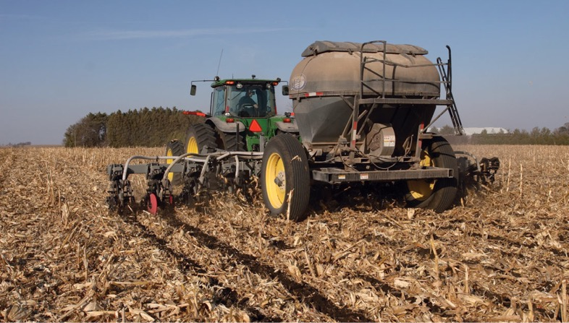
Banded Fertilizer Applications
Placement of fertilizers in bands may increase plant nutrient uptake and crop yield in certain field and weather conditions.
This includes in fields with less than optimum soil fertility levels, that are no-tilled, and/or compacted, as well as fields that are planted late.
https://www.no-tillfarmer.com/articles/86-banding-vs-broadcasting-nutrients-in-strip-till-which-is-best?v=preview
Notes:
S4.3.2 Placement of fertilizers in bands may increase plant nutrient uptake and crop yield in certain field and weather conditions. This includes in fields with less than optimum soil fertility levels, that are no-tilled, and/or compacted, as well as fields that are planted late.

Slide 39
Salt and Ammonia Gas
Farmers should consider the potential salt and/or ammonia gas production potential when choosing fertilizer type, rate, and placement
Salt and/or ammonia gas production can result in poor growth or plant death, particularly when using pop-up fertilizers or banded fertilizers in dry, coarse-textured soils
Notes:
S4.3.3 Farmers should consider the potential salt and/or ammonia gas production potential when choosing fertilizer type, rate, and placement. Salt and/or ammonia gas production can result in poor growth or plant death, particularly when using pop-up fertilizers or banded fertilizers in dry, coarse-textured soils.

Slide 40
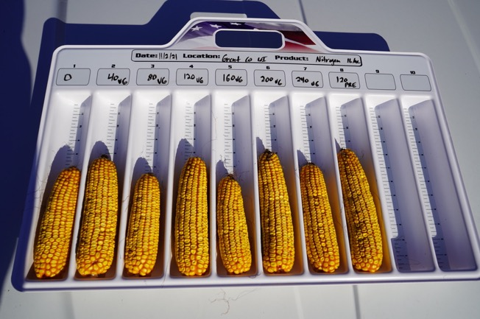
Soil Properties and Nutrient Recommendations
Wisconsin nutrient recommendations are based, in part, on inherent (soil texture, depth to bedrock, drainage class, etc.) and dynamic soil properties (soil organic matter level).
Nitrogen recommendations for corn are based on soil yield potential, irrigation status and the cost of nitrogen fertilizer as well as the anticipated price for corn.
Phosphorus and potassium recommendations are based upon soil test levels and expected crop yield.
All nutrient recommendations vary by soil texture.
Due to low CEC and/or potential for nutrient leaching, nutrient recommendations are lower for soils with textures of sand and loamy sand (sandy soil group) and muck soils (soils with at least 20% soil organic matter).
Notes:
S9.1.1 A certified nutrient management plan follows the nutrient recommendations outlined in Nutrient Application Guidelines for Fruit, Vegetable, and Fruit Crops in Wisconsin (UW-Extension pub A2809). Nutrient recommendations are based, in part, on inherent (soil texture, depth to bedrock, drainage class, etc.) and dynamic soil properties (soil organic matter level).
S9.1.2 Nitrogen recommendations for corn are based on soil yield potential, irrigation status and the cost of nitrogen fertilizer as well as the anticipated price for corn. The soil yield potential ratings for major Wisconsin soils are listed in A2809. Nitrogen recommendations for wheat vary by soil texture. Nitrogen rates for other crops are based upon soil organic matter levels.
S9.1.3 Phosphorus and potassium recommendations are based upon soil test levels and expected crop yield. Producers should identify a realistic yield goal for each crop in the rotation from each field based upon average historic crop yields.
S9.1.4 All nutrient recommendations vary by soil texture. Due to low CEC and/or potential for nutrient leaching, nutrient recommendations are lower for soils with textures of sand and loamy sand (sandy soil group) and muck soils (soils with at least 20% soil organic matter).

Slide 41
Fertilizers
Notes:
S7.1.1 Wisconsin’s nutrient management recommendations are based upon supplying crop nutrients at an economically optimal rate.
S7.1.2 Soil testing has limitations, but remains the best tool available for predicting lime, phosphorus, and potassium fertilizer needs. Additional soil and plant tissue nutrient tests are available.
7.1.3 The basic steps of a soil testing program are to: 1) provide an accurate estimate of the level of available nutrients in the soil; 2) evaluate the degree of nutrient deficiency or excess that exists for the crops grown; 3) Provide recommendations for supplemental nutrients to correct the deficiencies while balancing crop productivity and economic profitability.
7.1.4 Wisconsin nutrient recommendations are based upon more than 100 years of research and can be found in Nutrient Application Guidelines for Field, Vegetable, and Fruit Crops in Wisconsin (A2809).

Slide 42
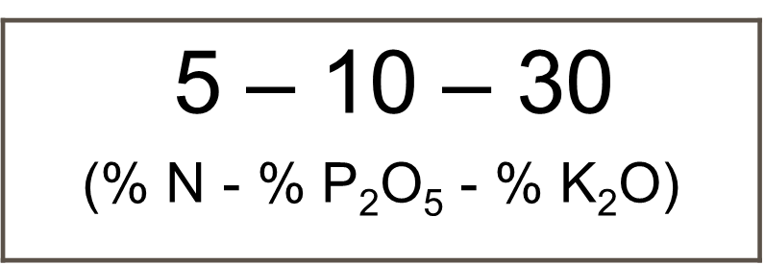
Fertilizer 101 and Fertilizer Grades
By definition, a fertilizer is substance added to the soil to increase its nutrient concentrations.
Fertilizer can be naturally occurring or manufactured substances.
Fertilizers can be solids, liquids, or gasses.
Fertilizer selection is typically based upon cost per pound of nutrient, ease of handling and application, as well as specific soil and cropping system factors, such a crop, crop growth stage, soil pH, etc.
A guaranteed analysis must be provided for all materials sold as a fertilizer.
Calculated as a % of total weight
Notes:
S9.2.1 By definition, a fertilizer is substance added to the soil to increase its nutrient concentrations. Fertilizer can be naturally occurring or manufactured substances.
S9.2.2 Fertilizers can be solids, liquids, or gasses. Fertilizer selection is typically based upon cost per pound of nutrient, ease of handling and application, as well as specific soil and cropping system factors, such a crop, crop growth stage, soil pH, etc.
S9.2.3 A guaranteed analysis must be provided for all materials sold as a fertilizer. The three numbers in a fertilizer guaranteed analysis represent the % N, % P₂O₅, and % K₂0 content of the fertilizer on a weight basis.

Slide 43
Soil Testing

Slide 44
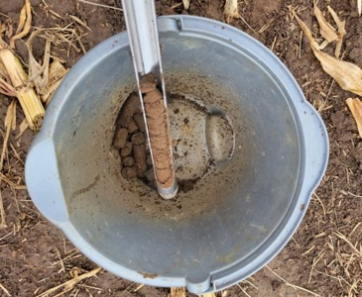
Goals and Economics of Soil Testing
Predicts the probability of a crop response to a nutrient application
Improved understanding of nutrient variability within a field
Monitor changes in nutrient status over time
Allocate on farm and commercial nutrient sources
Increase farm profitability
Protect local surface and groundwater quality
Notes:
S6.1.1 The proper collection of soil samples and interpretation of soil test results assists farmers in allocating on-farm and commercial nutrient sources in an agronomically and economically efficient manner.
S6.1.2 Proper interpretation and application of soil test results can result in nutrient applications that protect local surface and groundwater quality.
S6.1.3 Regular soil testing often provides a positive economic return through improved on-farm and commercial nutrient allocation and management.
S6.1.4 The basis of soil testing is to predict the probably of crop response to applied nutrients, thereby balancing crop productivity and profitability.

Slide 45
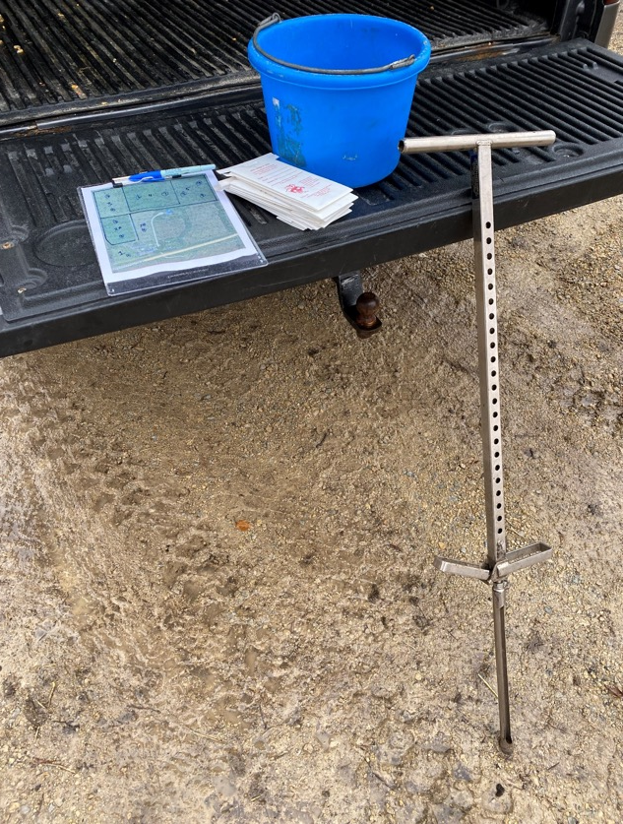
Soil Sampling Tools
Supplies Needed
Soil probe
Plastic Bucket (mixing composite sample)
Sample bags
Field/pasture maps
Permanent marker
Box/container for sample bags
Notes:
S6.3.1 Recommended soil sampling equipment includes: a field map with sampling areas clearly delineated, soil probe or auger, clean plastic bucket, and prelabeled soil sample bags. If collecting georeferenced samples, a GPS unit will be required.
S6.3.2 Soil sampling tools and supplies for sample collection should be selected upon soil texture/parent material and soil moisture level to ensure consistent and proper sample depth and volume collection, as well as to improve ease of sample extraction.
S6.3.3 Field maps and management history should be used to identify areas for sampling. General sampling points should be marked and labeled on the map post collection.

Slide 46
Soil Testing Procedures
Every 4 years or less
Maximum of 5 acres per sample
Remove soil surface residue at sample location
10 cores per sample
Sample timing
Avoid areas not typical of the field:
Dead furrows;
Lime, sludge or manure piles or animal droppings
Fences or roads
Fertilizer bands
Eroded or low spots
Notes:
S6.2.1 Sample collection timing can impact soil test results, so sample collection should be consistent between sampling periods.
S6.2.2 Soil sampling is required, at minimum, every 4 years for an approved NMP.
S6.2.3 Soil sampling more frequently than every four years may be warranted when producing high value crops, in high yielding corn silage and alfalfa rotations, or in fields with sand or loamy sand textures.
S6.2.4 Many agricultural fields are sampled so that a single recommendation is provided for the whole field. However, when nutrients will be varible rate applied to a field, site specific sampling is required.
S6.2.6 In-field soil sampling points should be based on the recommended collection pattern and in-field variability, avoiding any areas that are not representative of the field.
S6.3.4 Soil samples should be collected following the basic protocols for proper whole field soil sampling (minimum 10 cores for every 5 acres, all samples thoroughly mixed before placing in sample bag).

Slide 47
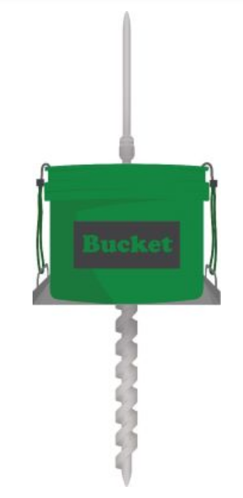
Soil Sample Depth
Moldboard: depth of tillage
Chisel or offset disk: ¾ of depth of tillage
No-till:
Fertilizer recommendations: 6 inches
If acid layer present: 2 inches for pH
Source: Soil Sample gov.bc.ca
Notes:
S6.2.5 In a moldboard plow system, soil samples should be collected to either the depth of tillage or at minimum, 6 inches. Specific sampling depth protocols are recommended for chisel plow/offset disking, ridge till, and no-till systems.
What are some basic guidelines for various tillage practices?
Below are guidelines to sampling soil in various tillage practices regardless of if using the traditional, grid-point or zone sampling methods:
Moldboard plow: sample to the depth of tillage
Chisel plow or offset disk: sample to ¾ of depth of tillage
Strip till or ridge till: sample equal number of soil cores from ridges and furrows or the area between the rows. If fertilizer was not banded in the strips or ridges, collect cores at the six inch depth on the ridges. In the furrow, take samples at four inches. Combine the cores to make a composite sample.
No-till: no-tilled fields of over five years may develop an acidic layer at the surface from nitrogen fertilizer applications. This acidic layer may cause triazine herbicides to lose effectiveness. To test the pH, sample at a two inch depth. It is important to note the sample depth on the soil submission form to be tested for pH. A phosphorus and potassium test can be requested to determine if these nutrients are also building up on the soil surface. A six inch sample is still required to determine fertilizer recommendations.

Slide 48
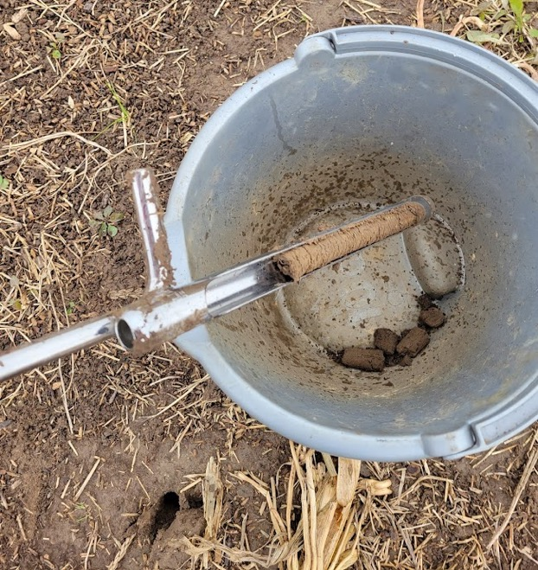
Other Soil Sampling Strategies
Grid-point sampling
Zone sampling
Contour strip sampling
Pasture sampling

Slide 49
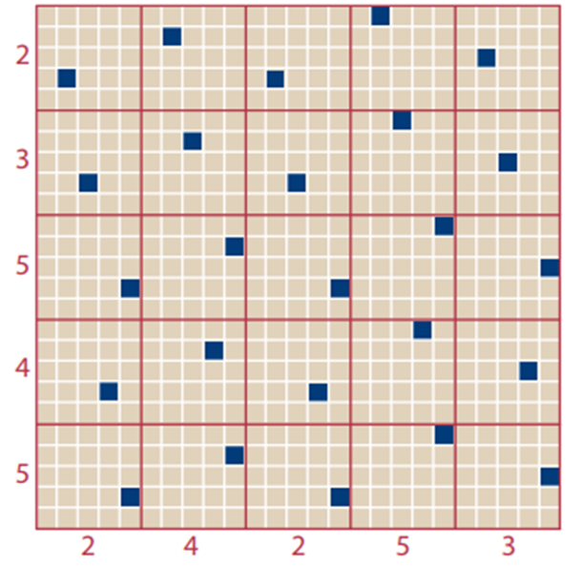
Other Soil Sampling Strategies
Grid-point sampling
Random, unaligned grid pattern prevents sampling in nutrient bands
Grids and points developed with GPS technology
Grids may be 1, 2.5, or 5 acres
Take 10 cores in a 10 ft area around the point
Zone sampling
Contour strip sampling
Pasture sampling
unaligned grid pattern for grid sampling
Notes:
What is grid point sampling?
Grid-point sampling is the process that uses a global positioning system (GPS) to develop equal size grids and sampling points for a field. To accurately capture nutrient variability throughout the field, the grids are as small as one acre or as large as two to two and half acres in size. The sample point is identified with geographical coordinates. Ten cores in a ten-foot area are taken around this point to make a sample. It is recommended to stagger the sampling points throughout the field to reduce bias in sampling similar areas in the field. Instead of using the soil test results to make a blanket fertilizer application recommendation, grid-point soil test results are used to make variable rate recommendations allowing the farmer to apply nutrients where they are needed.
Used where nutrients will be applied variably
Can be useful if purchase/rent new round and past history isn’t well known
Pro- good assessment of nutrient variability
Con – expensive
Choose grid size based on P and K responsiveness categories
- 1 ac if P or K are in responsive categories (below H)
- 2 to 2.5 ac if both P and K are in non-responsive categories (VH & EH)

Slide 50
Other Soil Sampling Strategies
Limed 5 years ago
Never limed
Grid-point sampling
Zone sampling
Utilizes information from yield maps, aerial images, or other precision agriculture maps to develop sampling areas that appear similar.
Sampling can be done through traditional soil sampling process or utilizing grid-point sampling.
Contour strip sampling
Pasture sampling
2 zones
Sand
Loam
Muck
2 zones
3 zones
Formerly 2 fields
now all 1 field
Notes:
What is zone sampling?
Zone sampling is another process that uses technology to determine sampling areas. Zone sampling uses information from yield maps, aerial photographs, or other precision agriculture maps to develop sampling areas that appear similar. Sampling can be done through the traditional soil sampling process or using a grid-point sampling. If grid-point sampling is done and the results show no or little difference between areas, take the average of the sample results to create a general fertilizer recommendation for the field.
Used where management may be different across a field
Zone borders and/or sampling points can be georeferenced
Plus/minus- provides an assessment of variability better than whole field, not as good as grid
More cost effective than grid sampling
Zone delineation – based on knowledge of the field
- soil and/or yield maps
- topography/elevation map
- past history
- nutrient maps from previous grid sampling
Follow whole field sampling intensity guidelines, considering the zone as a field

Slide 51
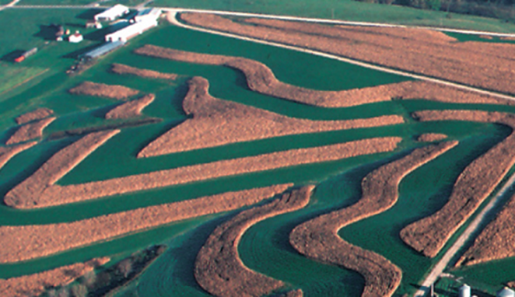
Other Soil Sampling Strategies
Grid-point sampling
Zone sampling
Contour strip sampling
More than 5 acres, use traditional sampling methods
Less than 5 acres, may combine strips if cropping and management histories are identical.
Pasture sampling
Source: SNAPPlus Help
Notes:
How do I sample contour strips?
Contour strips should be sampled separate if the strip is five acres or more using the traditional soil sampling techniques. If the strips are less than five acres, then the strips can be combined if the cropping and management histories are the same. Grid-point sampling contours may cause unusable soil test results if the grid covers more than one strip and all the cores come from one strip or if cores are taken from the edge of a strip.

Slide 52
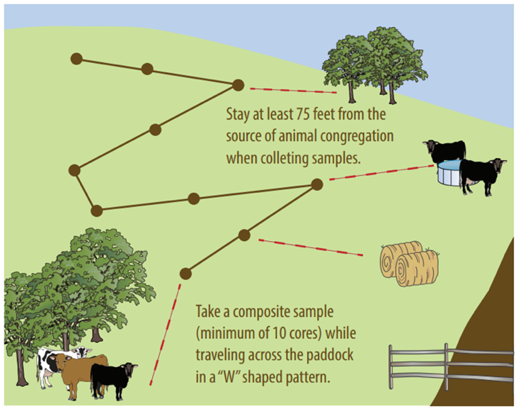
Other Soil Sampling Strategies
Grid-point sampling
Zone sampling
Contour strip sampling
Pasture sampling
Use traditional sampling techniques keeping away from areas where animals congregate
May combine congregation areas as a separate sample
Notes:
How do I sample contour strips?
Contour strips should be sampled separate if the strip is five acres or more using the traditional soil sampling techniques. If the strips are less than five acres, then the strips can be combined if the cropping and management histories are the same. Grid-point sampling contours may cause unusable soil test results if the grid covers more than one strip and all the cores come from one strip or if cores are taken from the edge of a strip.

Slide 53
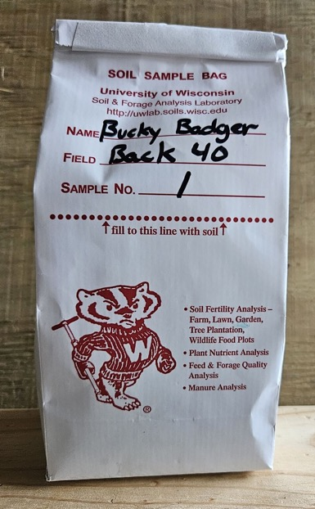
Submitting Your Samples
Notes:
S6.3.5 All sample bags should be appropriately labeled and the laboratory soil submission form should be completed accurately and with sufficient farm and field information to generate the proper recommendations and reports.
S6.3.6 You should ensure that the field name specified for the soil samples matches the field name in SnapPlus to allow for easy data import into SnapPlus.
Fill out the soil information sheet completely and send to lab with soil samples!
Provides lab with needed information on:
Field identification
Soil series
Crops to be grown and realistic yield goals
Manure and legume credits
If application rates and/or stand conditions are known

Slide 54
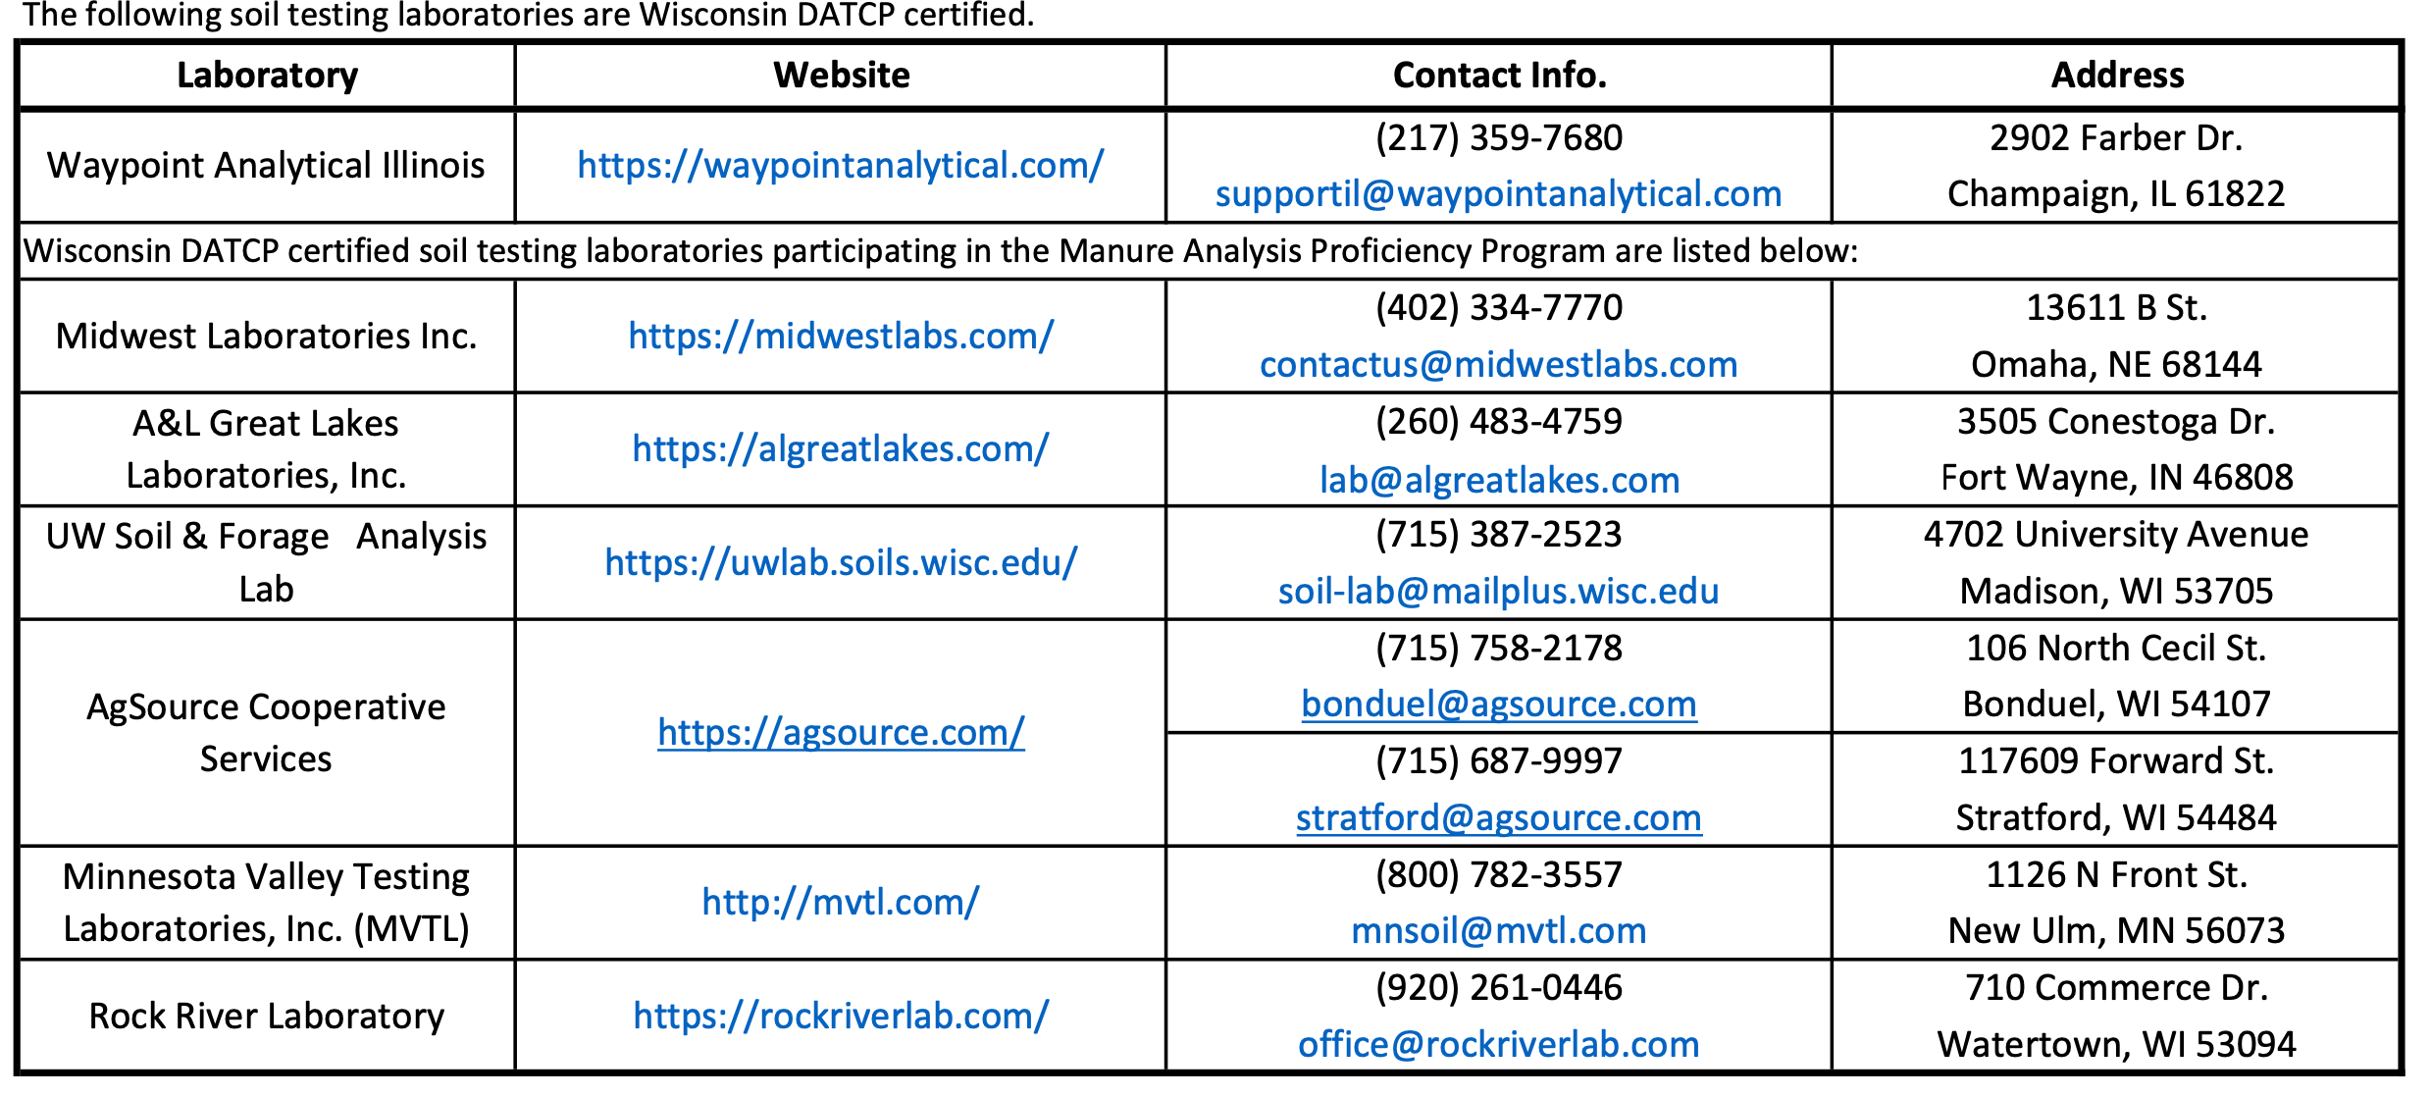
May 2024 Wisconsin Certified Soil & Manure Testing Laboratories
Verify at time of sample submission the lab is certified by WI DATCP and provides the correct results for WI Nutrient Management Planning
Notes:
S6.4.1 If soils are wet, they should be allowed to air dry before storing and/or shipping to the testing laboratory. Fresh, non-dried soils can be taken directly to the lab.
S6.4.2 Many commercial soil testing labs are available, but each offers different services and pricing.
S6.4.3 For a certified NMP, soil samples must be analyzed at a DATCP-certified lab using the appropriate protocols.
S6.4.4 When using a certified out-of-state laboratory, you should verify WI approved extraction methods are used.

Slide 55
How to Read Your Soil Report
Notes:
S7.1.1 Wisconsin’s nutrient management recommendations are based upon supplying crop nutrients at an economically optimal rate.
S7.1.2 Soil testing has limitations, but remains the best tool available for predicting lime, phosphorus, and potassium fertilizer needs. Additional soil and plant tissue nutrient tests are available.
7.1.3 The basic steps of a soil testing program are to: 1) provide an accurate estimate of the level of available nutrients in the soil; 2) evaluate the degree of nutrient deficiency or excess that exists for the crops grown; 3) Provide recommendations for supplemental nutrients to correct the deficiencies while balancing crop productivity and economic profitability.
7.1.4 Wisconsin nutrient recommendations are based upon more than 100 years of research and can be found in Nutrient Application Guidelines for Field, Vegetable, and Fruit Crops in Wisconsin (A2809).

Slide 56
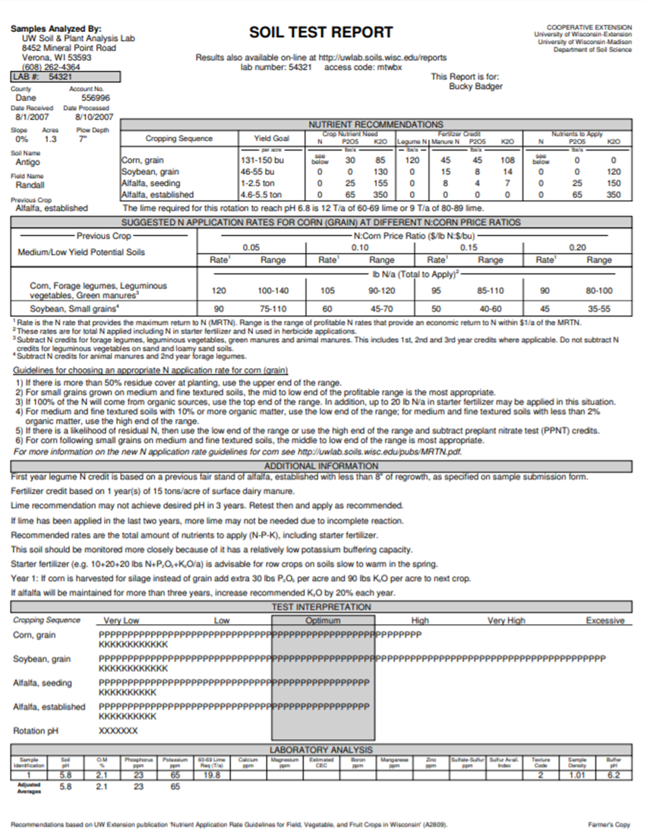

Slide 57
What the Soil Test Report Provides
Nutrient Recommendations
Nutrient Credits
Nitrogen (N), Phosphorus (P₂O₅), & Potassium (K₂O)
Manure
Legumes
Lab Results
Required: Soil pH, (Buffer pH) organic matter %, phosphorus & potassium
Add Tests: Ca/Mg CEC Base Saturation, Secondary & Micronutrients
Lime Recommendations
Plant Available levels

Slide 58
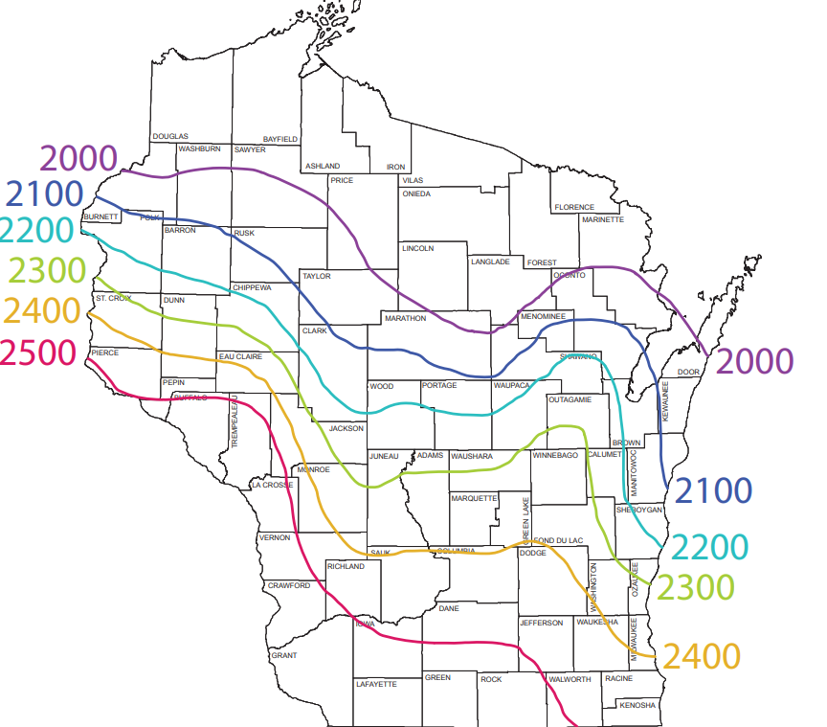
The more information you provide the better your rec’s will be. WHY?
UW Rec uses added info:
NRCS Soil Group- Sandy, Loamy or Organic
Soil Yield Potential-response of soil N in corn trails (L, M,H)
Location- GDD Less than 2100 or over 2100
Other- previous crop, irrigation, drainage class, depth to bedrock.

Slide 59
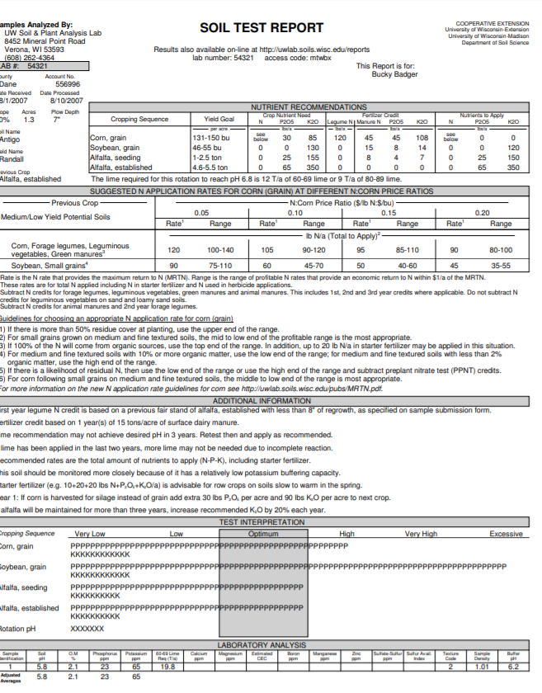
Example Soil Report 3 Main Parts

Slide 60
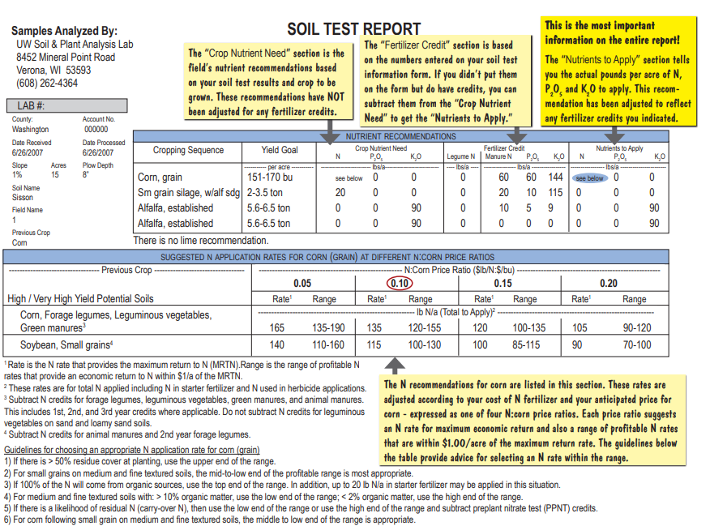

Slide 61
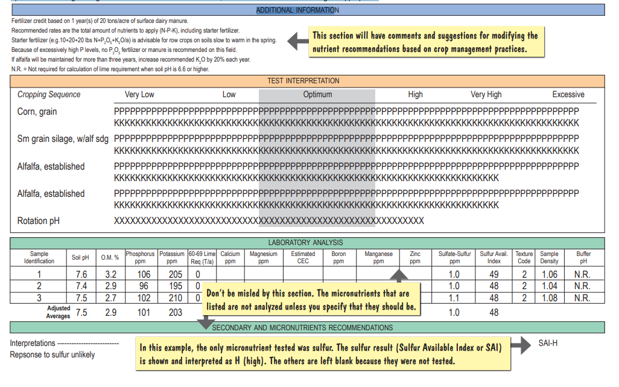
Notes:
S7.4.1 A soil test report provides the current soil fertility status of the sampled field along with recommendations for supplemental nutrients and lime.
S7.4.2 A routine soil test indicates the plant-available levels of phosphorus, potassium, and any additional soil nutrients you have asked to be analyzed, like sulfur, or soil micronutrients such as boron, zinc, manganese, and others. It also includes measurement of soil pH, which is the acidity of the soil.
S7.4.3 The soil test report can be broken into three main sections: 1) Nutrient Recommendations, 2) Test Interpretations, and 3) Laboratory Analysis.
S7.4.4 The top left corner of the report identifies the location (by county) of the sample, date received and processed by the lab, soil series name, field ID, along with field acreage, slope, and plow depth. The previous crop is also listed.
S7.4.5 In the Nutrient Recommendations section, the crop nutrient need, manure and/or legume nutrient credits, and the recommended N, P2O5 and K2O rates are shown for each crop provided in the planned crop rotation. In addition, the tons of lime required to meet the target pH for the rotation are listed.
S7.4.6 Nitrogen recommendations for corn or wheat, based upon the Maximum Return to Nitrogen or MRTN approach, are listed in the second table (if applicable).
S7.4.7 In the Additional Information area, additional explanations and recommendations based upon the submitted field information are listed.
S7.4.8 The Test Interpretations section displays a graphic interpretation of soil fertility levels relative to nutrient demands of the intended crops with optimum soil test levels highlighted in grey. Also, the optimum pH for the crop rotation is illustrated.
S7.4.9 The Laboratory Analysis section lists the individual soil test results from each sample to the lab average values. Results for soil pH, organic matter, P, K. etc. are found here along with any secondary or micronutrients if requested.
S7.4.10 If planning on using SnapPlus to write a NMP, request that the lab provide an electronic file (Excel spreadsheet). For more information, watch the SnapPlus Connection: Importing Soil Sample Test Results.

Slide 62
Soil Test Categories & Wisconsin Fertilizer Recommendations
Soil Test Category | Recommendation | Probability of Yield Increase
Very Low | Crop Removal + Build | >90%
Low | Crop Removal + Build | 60-90%
Optimum | Crop Removal | 30-60%
High | ½ Crop Removal | 5-30%
Very High | ¼ Crop Removal | 2-5%
Excessively High | No Application Recommended | <2%
Soil
Fertilizer + Manure + Legume
Soil
Fertilizer + Manure + Legume
Soil
Fertilizer + Manure + Legume
Soil
F + M + L
Soil
F + M + L
Soil
Notes:
VL: occur over 4 to 8 years, response to secondary or micronutrients is likely on high demanding crops and medium on medium demanding crops
L: Response to secondary or micronutrients is possible for high demanding crops but unlikely for medium or low demanding crops
O: economically and environmentally the most desirable soil test, optimize yields apply equal amounts that are removed, response to secondary or micronutrients is unlikely of crop demand level
H:
VH: only used for potassium, gradual drawdown is recommended
EH: no fertilizer is recommended

Slide 63
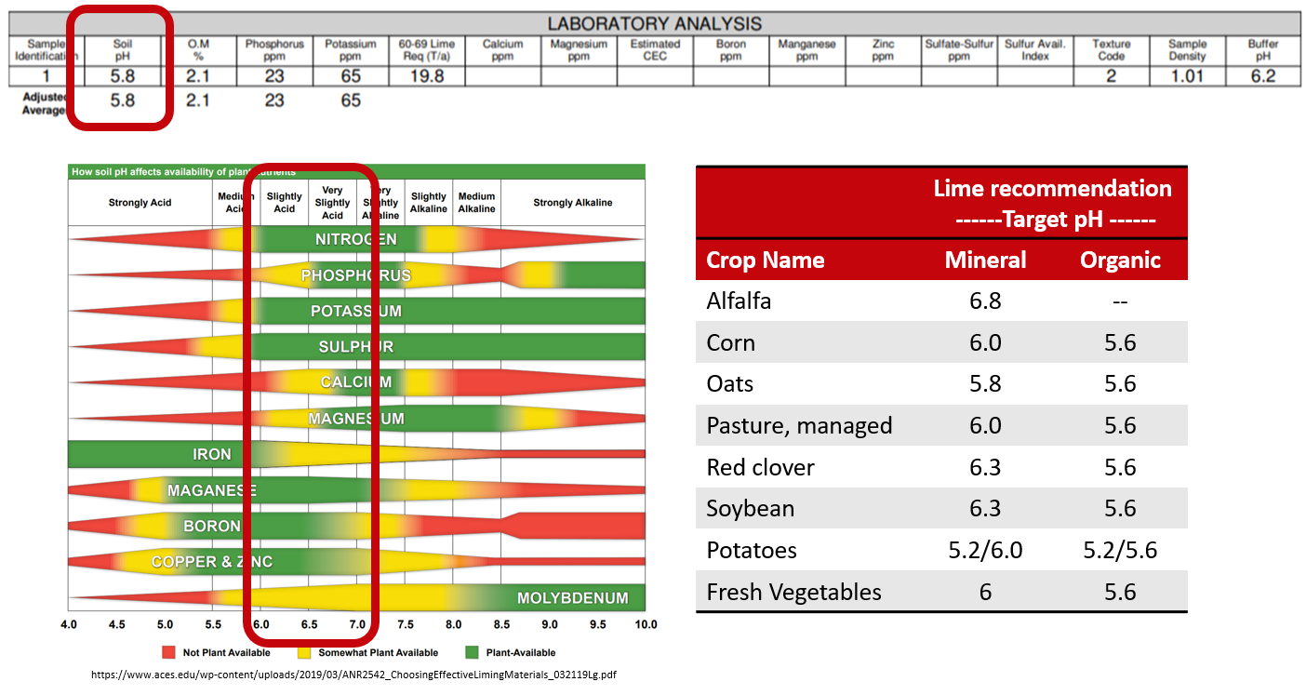
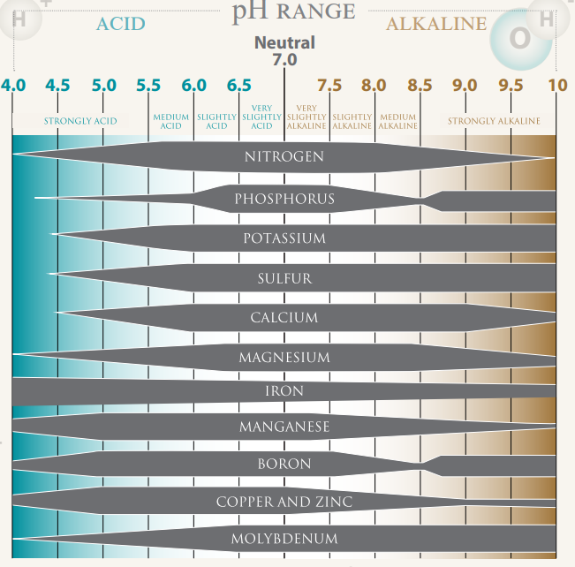
pH

Slide 64
Do I need lime?
How much lime?
Notes:
This is the result for pH based on crop rotation target pH. Final pH is determined by the most sensitive crop. Here is an example of the chart found in A2809 that lists pH recommendations of the various crops grown in Wisconsin.
In the laboratory analysis is a lime recommendation based on the crop rotation. On the top of the page there is a recommendation written out. Notice the difference in the recommendations for 60-69 lime. The reason for this difference is that UW recommendations limit lime applications to 12 tons per acre for crops with the exception to potatoes that is limited to 8 tons per acre in a given year.
Lastly, the buffer pH is the ability of the soil to resist change. It is the measure of the reserve acidity of the soil. The lower this number the more lime is needed to increase the soil pH. This is used to calculate the amount of lime needed apply to increase the pH.

Slide 65
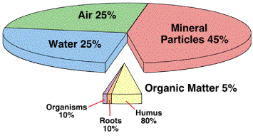
Organic Matter % (OM)
Source: University of Illinois

Slide 66
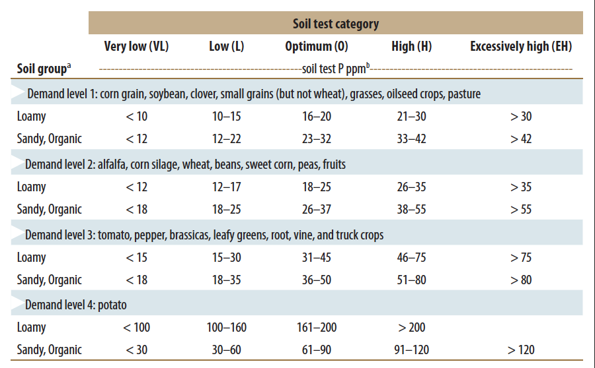
Phosphorus (P)
Find the highest demanding crop in your rotation? (Light Blue)
What is the dominate soil group for the field? (Loamy, Sand/organic)
Find your soil analysis test category
Very Low, Low
Optimal High
High, Excessively High

Slide 67
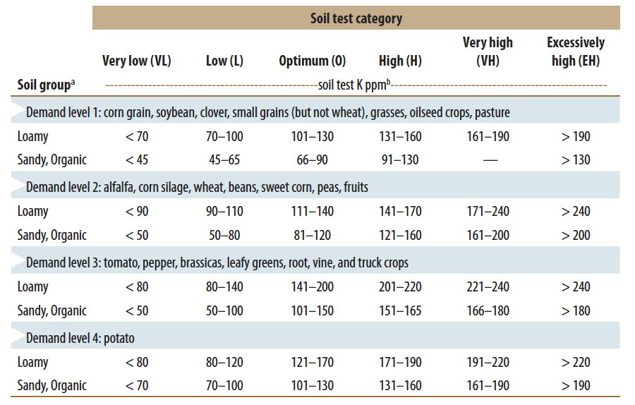
Potassium (K)
Find the highest demanding crop in your rotation? (Light Blue)
What is the dominate soil group for the field? (Loamy, Sand/organic)
Find your soil analysis test category
Very Low, Low
Optimal High
High, Excessively High

Slide 69
Remember
Phosphorus was Excessively High
Potassium was Optimum
Notes:
Nutrient recommendations based on soil test results.
These recommendations are based on the soil test categories discussed earlier. A chart is found on fast facts for corn, soybean and alfalfa, for more crops check out A2809 that provides the recommendations based on crop, yield goal, and soil test category.

Slide 71
This chart includes the most important info:
Soybean crop needs 85 units of K2O
We plan to apply 0-0-60 as a potassium fertilizer
85 ÷ .60 = a little over 140 pounds of 0-0-60

Slide 72
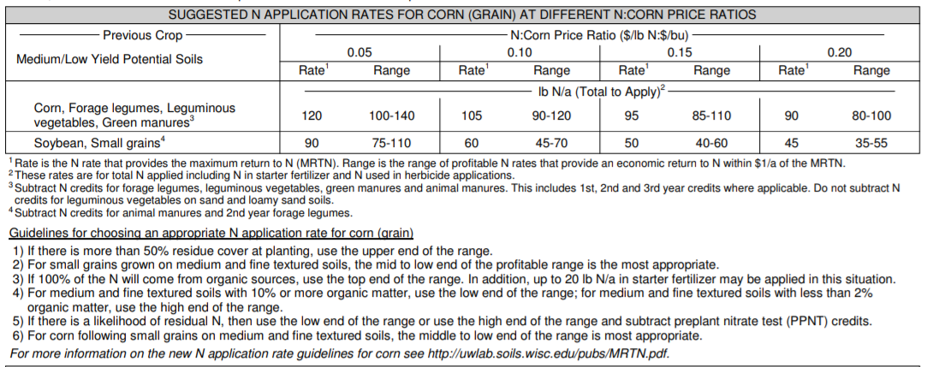
Notes:
Below the Nutrient Recommendation box is the Maximum Return to Nitrogen box to give recommendations on nitrogen rates. Unlike phosphorus and potassium, which is based on crop and yield, nitrogen recommendations are based on a ratio of the price of nitrogen and the crop of corn. Dan will cover this in more detail later in the workshop.

Slide 73
Take Away Message
Soil testing all starts with taking good soil samples.
The more info you provide about soil sample on the submission sheet the better the recommendations will be.
Soil type, location, yield goal, crop rotation
Maintain ideal soil pH.
Nutrient changes for low and excessively high testing fields.
Utilize your experts to answer questions based on lab results.
Lab
Agronomist/CCA
UW Extension NPM

Slide 74
Soil pH

Slide 75
What is soil pH?
0
1
2
3
Acidity
pH = -log[H⁺]
4
Concentration of acid
in soil water
1000x
5
10x
6
7
8
9
10
11
Alkalinity
12
Inverse relationship
More acid = lower pH
Logarithmic Scale (base 10)
13
14
Notes:
S5.1 Soil pH
S5.1.1 Soil pH is a measure of the acidity/alkalinity of a soil. This is an important soil metric to know, as the optimal range of soil pH for plant and microbial productivity often varies by species.
S5.1.2 Soil pH is the measurement of the concentration of hydrogen ions (acid) in the soil solution. It is reported on a scale of 0 to 14, with 0 being extremely acid and 14 being extremely alkaline (low acid). A pH of 7.0 is neutral.
S5.1.3 Soil pH is based on a logarithmic scale (base 10). This means for every unit increase or decrease in soil pH the concentration of acid in the soil changes tenfold.

Slide 76
NATURAL CAUSES
Mineral weathering
Decomposition of organic matter
Plant uptake
Leaching
HUMAN CAUSES
NH₄⁺ based fertilizer
Elemental S fertilizer
Grain & biomass removal
Change in soil pH
CHEMICAL & BIOLOGICAL EFFECTS OF CHANGE IN pH
Availability of most essential nutrients
Activity of microorganisms
Solubility of non-essential nutrients including heavy metals
Performance of some herbicides
Notes:
S5.2 Soil acidity causes
S5.2.1 Soil pH naturally decreases over time due to weathering of minerals, decomposition of organic matter, plant uptake, leaching of base cations, and natural rainfall.
S5.2.2. The addition of ammonium-based nitrogen and elemental sulfur fertilizers, increased leaching of anions (such as nitrate), as well as harvesting plant grains and biomass in agricultural systems also results in the acidification of soils.
S5.3 Soil pH impacts
S5.3.1 Soil pH has a direct impact on the availability of plant nutrients by influencing the chemical form of the nutrient present, the activity of nitrogen-fixing bacteria, and plant growth and productivity. When soils become strongly acidic (pH<5.5), aluminum, as well as other toxic metals, often become soluble significantly limiting plant growth.
S5.3.2 As a general rule of thumb, macronutrients (N, P, K, Ca, Mg, S) and Mo have increased plant availability at neutral pHs, while micronutrients (except Mo) are more plant available at lower pHs.

Slide 77
Wisconsin pH Levels
Notes:
How does soil pH vary across Wisconsin?
Wisconsin, generally soils forming on top of carbonate bedrock (soils in the east and south) will have higher soil pHs than those forming over the top of igneous rocks (soils in the central and western portions of the state). Agricultural management practices can have a dramatic impact on soil pH. Therefore, soil testing is the only way to know the pH of your soil.

Slide 78
Effect of N fertilizer on Plano Silt Loam pH
Nitrogen applied each year for 5 years | Soil pH after 5 years | Aglime needed to return soil pH to 6.1
Pounds N per acre |  | Tons per acre
0 | 6.11 | 0.00
40 | 6.10 | 0.31
80 | 6.02 | 0.65
120 | 5.98 | 0.96
160 | 5.81 | 2.03
200 | 5.68 | 2.72
Source: A3588 Management of Wisconsin Soils
Notes:
S5.2.2. The addition of ammonium-based nitrogen and elemental sulfur fertilizers, increased leaching of anions (such as nitrate), as well as harvesting plant grains and biomass in agricultural systems also results in the acidification of soils.

Slide 79
Amount of Calcium Carbonate needed to replace basic cations
Crop | Yield | CaCO3 equivalent of excess cations
Corn grain | 50 bushel/acre | 20 pounds/acre
Corn silage | 8 tons/acre | 200 pounds/acre
Oats | 75 bushels/acre | 5 pounds/acre
Soybean | 45 bushels/acre | 95 pounds/acre
Alfalfa | 4 tons/acre | 515 pounds/acre
Source: A3588 Management of Wisconsin Soils
Notes:
S5.2.2. The addition of ammonium-based nitrogen and elemental sulfur fertilizers, increased leaching of anions (such as nitrate), as well as harvesting plant grains and biomass in agricultural systems also results in the acidification of soils.

Slide 80
Target pH
Notes:
S5.4 Target pH values
S5.4.1 The acceptable range of pHs for most Wisconsin crops are listed in University of Wisconsin Extension publication A2809, along with the target pH when liming an acidic soil. A soil should be limed to reach the target pH of the crop with the highest pH requirement within the rotation.
S5.4.2 Crops do not require a single specific pH to optimize productivity. They will grow well within a range of acceptable pHs. In the case of legume crops, the acceptable range of pHs for the crop also take into account the optimal pH ranges for the symbiotic bacteria that live with the crop.
S5.4.3 While crops will often grow outside of the specified acceptable pH range, crop productivity may be limited. However, acid sensitive crops, such as alfalfa, may cease to grow when the soil pH drops too far below the acceptable range of pHs.

Slide 81
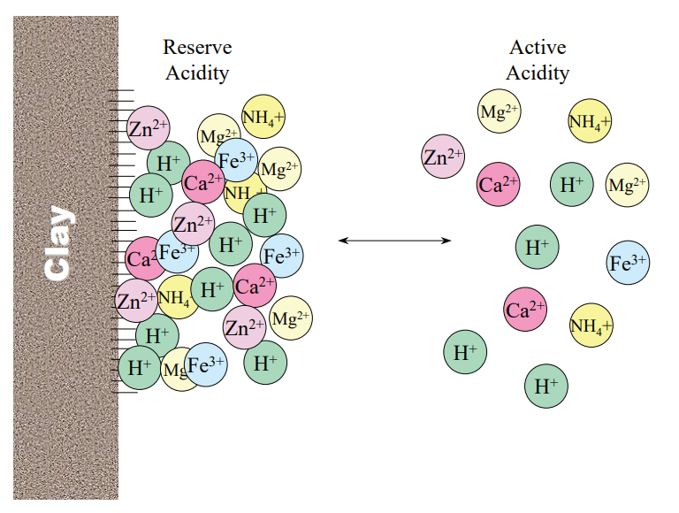
How much lime?
Do I need to lime?
Source: https://extensionpublications.unl.edu/assets/pdf/ec155.pdf
Notes:
S8.1.1 A soil’s pH is influenced by both active acidity, those H+ ions in the soil water, and exchangeable acidity, those H+ on the cation exchange sites.
S8.1.2 In order to change a soil’s pH, we must add enough lime to neutralize both active and exchangeable acidity. Neutralizing only active acidity will not result in a change in soil pH, as the H+ on the CEC will simply exchange with other cations and replace the neutralized H+ in the soil solution.
S8.1.3 When evaluating a soil’s pH and lime need, the pH reported on a soil test is a measurement of active acidity. The reported buffer pH is a measurement of both active and exchangeable acidity.
S8.1.4 The reported soil pH is used to answer the question, “Does my soil need lime?”. The buffer pH is used to answer the question, “How much lime should I apply to my soil to reach my target pH?”.
S8.2.1 A soil’s buffering capacity is defined as its ability to resist a change in pH. A soil’s buffering capacity is directly related to its CEC. Soils with higher CECs, such as those with higher clay and/or organic matter contents, are more resistant to pH change.
S8.2.2 Buffering capacity impacts the amount of lime required to induce a pH change. Given the same soil pH, a soil with a high buffering capacity will require more lime than a soil with low buffering capacity to increase the soil pH.
S8.2.3 Buffering capacity impacts the frequency lime may need to be applied to a soil. Given the same management practices, a soil with a high buffering capacity will require lime less frequently than a soil with low buffering capacity to maintain the soil within an ideal range for plant growth.

Slide 82
Incorporation decreases neutralizing reaction time
Reaction takes 2 to 3 years to occur
Adjustment if incorporating below 7 inches
Top-dress 1 ton/acre to no-till fields
More than 5 years in no-till management
Surface pH (0-2 inches) >.2 units below required pH
Retest 3 to 4 years
Plow depth (inches) | Multiplier
0-7.0 | 1.00
7.1-8.0 | 1.15
8.1-9.0 | 1.31
>9.0 | 1.46
Notes:
S8.3.1 In order to be a liming material, a compound must contain a basic cation (typically Ca, Mg, or K) and neutralize acidity. Common limes in Wisconsin include dolomite (calcium-magnesium carbonate) limestones.
S8.3.2 In order to change the soil pH, lime must dissolve into the soil solution. Finer ground lime will dissolve more quickly than coarser lime, given the same composition, and therefore, change the soil pH more quickly.

Slide 83
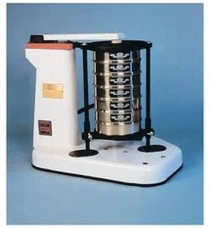
Lime Neutralizing Index
Liming Material | Neutralizing agent | CaCO₃ equivalent of pure material (%)
Dolomitic limestone | CaCO₃•MgCO₃ | 110-118
Calcitic limestone | CaCO₃ | 100
Determined by:
Purity (% CaCO₃ equivalent)
Fineness (particle size)
Expressed as Neutralizing Index (NI)
NI = (purity factor) x (fineness factor)
Others:
Hydrated Lime & air-slaked lime: High CaCO₃ equivalent may cause over liming
Paper mill sludge: 1 yd³ equivalent to 1 ton of 60-69 lime
Wood ash: High in potassium, spread for potassium rate not lime
Fly ash: Reacts quickly due to fine particle size, but difficult to spread
Water treatment: Needs to be tested due to lime composition
Marl: Calcareous shells and mud found in wetlands where mollusks were active
 | Coarse | Particle size |  | Fine
 | <8 | 8-20 | 20-60 | >60
 | ------% of lime reacted------
Percent effectiveness | 0 | 20 | 60 | 100
Photo source: Fischer scientific
Notes:
S8.3.3 In Wisconsin, liming material effectiveness is evaluated using a neutralizing index. The neutralizing index takes into account the composition, purity and fineness of liming materials. Only materials that react within three years after application are factored into the neutralizing index.
S8.3.4 Lime is typically sold by neutralizing index zones of 10. Lime requirements listed on a soil test report are typically given for 60-69 limes and 80-89 limes. The amount of lime with neutralizing indexes other than those given on the soil test report can be calculated.

Slide 84
Soil Test Lime Recommendations
Limit of 12 tons per acre or if prior to potatoes 8 tons
Sandy soils with <1% OM minimum application is 1 ton lime per acre
For soils with >1% OM minimum application is 2 tons lime per acre
Incorporate at least 6 to 12 months prior to planting pH sensitive crops such as alfalfa
Lime requirement (ton/acre) of lime being used =
(ton/acre of 60-69 lime recommended) x (65 ÷ NI of lime being used)
Notes:
When is the best time to lime soil?
Lime should be applied and incorporated at least 6 to 12 months prior to planting an acid sensitive crop such as alfalfa.
What are typical application rates for lime?
Application rates for lime should never exceed 12 ton/acre (8 ton/acre for potato). The minimum application rate is 1 ton/acre on sandy soils with <1% OM; all other soils 2 ton/acre.
How often should I lime my soil?
Lime recommendations are made using the target pH for the most acid-sensitive crop in a 4-year rotation. No additional lime should be applied until the most recent application has had 2-3 years to equilibrate with the soil.

Slide 85
Adjusting High pH
 | Soil organic matter content (%)
Desired reduction in soil pH | 0.5-2 | 2-4 | 4-6 | 6-8 | 8-10 | >10
 | --------------------- pounds S/1,000 square feet --------------------
0.25 | 6 | 18 | 28* | 40* | 53* | 62*
0.50 | 12 | 35* | 56* | 80* | 106* | 125*
1.00 | 24* | 70* | 112* | 120* | 212* | 250*
* Do not apply more than 20 pounds/1,000 sq feet per year. Retest between applications.
Notes:
8.4.1 Alkaline soils are soils with a pH greater than 7. In Wisconsin, many soils naturally contain various amounts of carbonate limestone or marl, resulting in natural soil pHs above 7.
S8.4.2 Acidification of alkaline soils on a large scale is typically not economical. On a small scale or for high value crops, elemental sulfur is often used to lower the soil pH over time.
S8.4.3 Due to presence of naturally occurring liming materials in alkaline soils, the soils are buffered against pH change. Therefore, changing pH is difficult and requires repeated applications of acidifying materials.

Slide 86
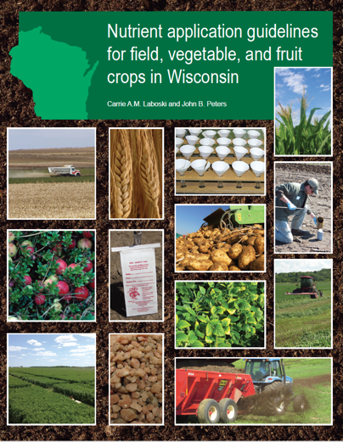
Resources

Slide 87
Thanks!
Questions?
Name
Title
Nutrient and Pest Management (NPM) Program
UW-Madison Division of Extension
Email: Phone:

