Slide 1
Wisconsin Ag Climate Outlook Week of May 20, 2024
Natasha Paris
Crops Educator – Adams, Green Lake, Marquette, Waushara Cos.
natasha.paris@wisc.edu
Kristin Foehringer
NRCS State Working Lands Climate Smart Specialist
kristin.foehringer@usda.gov
Dennis Todey
Director, Midwest Climate Hub
dennis.todey@usda.gov
Josh Bendorf
Ag Climatologist Fellow, Midwest Climate Hub
joshua.bendorf@usda.gov
Steve Vavrus
State Climatologist of Wisconsin
sjvavrus@wisc.edu
Bridgette Mason
Assistant State Climatologist of Wisconsin
bmmason2@wisc.edu

Slide 2
Key Points
Navigate to select slides by clicking on the links below.
Last week, many in the state received at least a half inch of rainfall, with temps a few degrees above normal.
Soil moisture levels are near or above normal for this time of year, with over 70% of the state out of any USDM category.
Near normal temps & precip to wrap up May, with projections for summer leaning warmer.
For this week’s agronomic recommendations from UW Extension, click here.
For GDD plots at select stations, click here.
For NASS crop progress maps, click here.

Slide 3
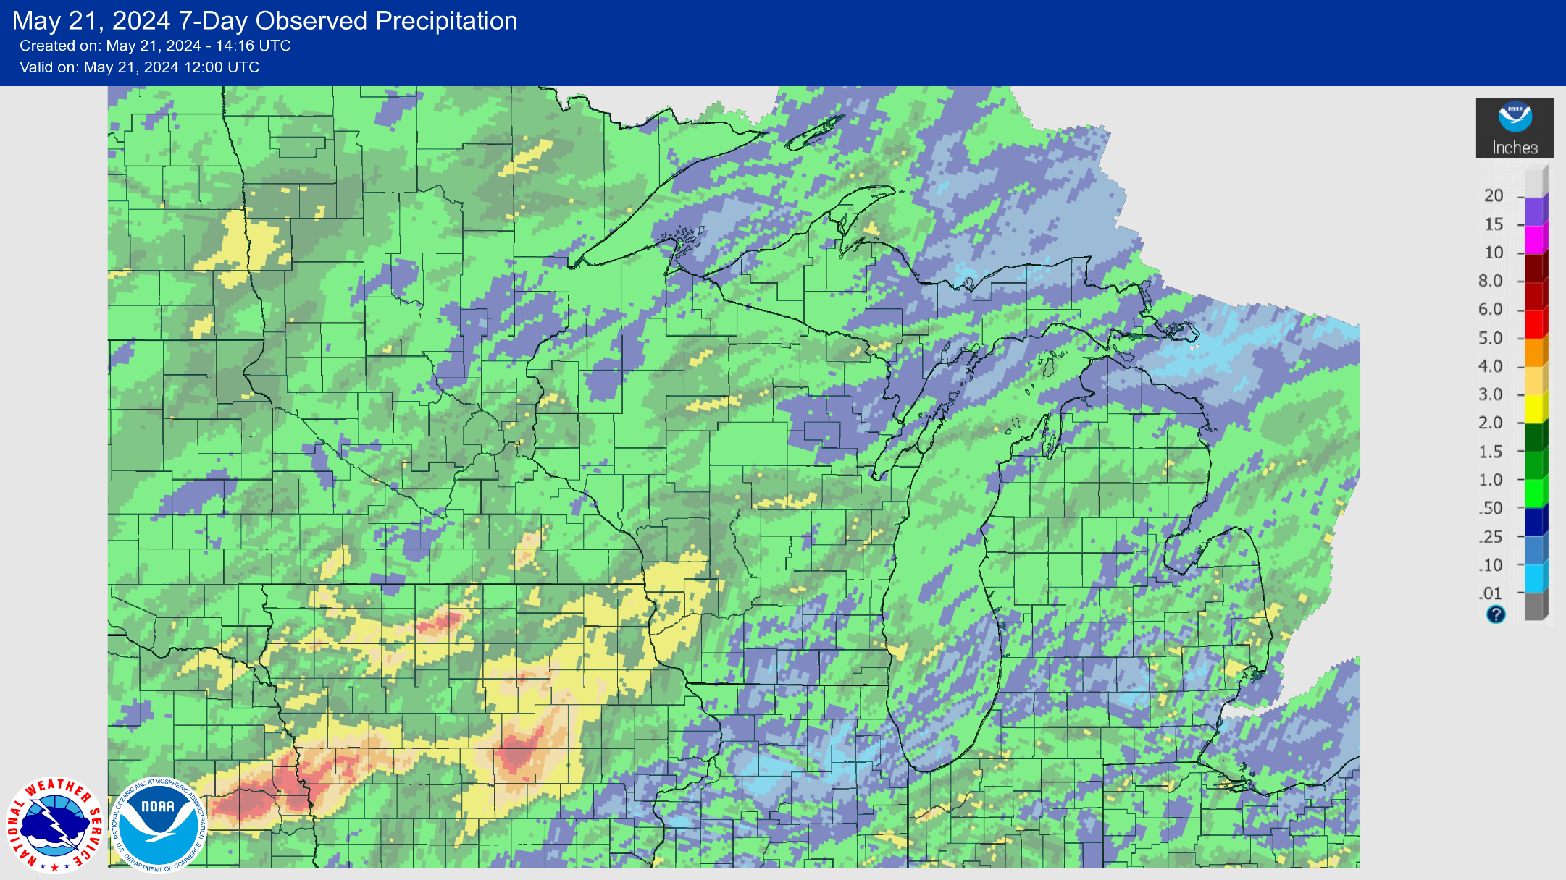
7 Day Precip
Majority of the state saw 0.5-2” of precip last week.
Areas in yellow saw >2” of precip. Highest totals in the Driftless Region.
NOTE: this map was updated before Tuesday night’s storms.
https://water.weather.gov/precip/

Slide 4
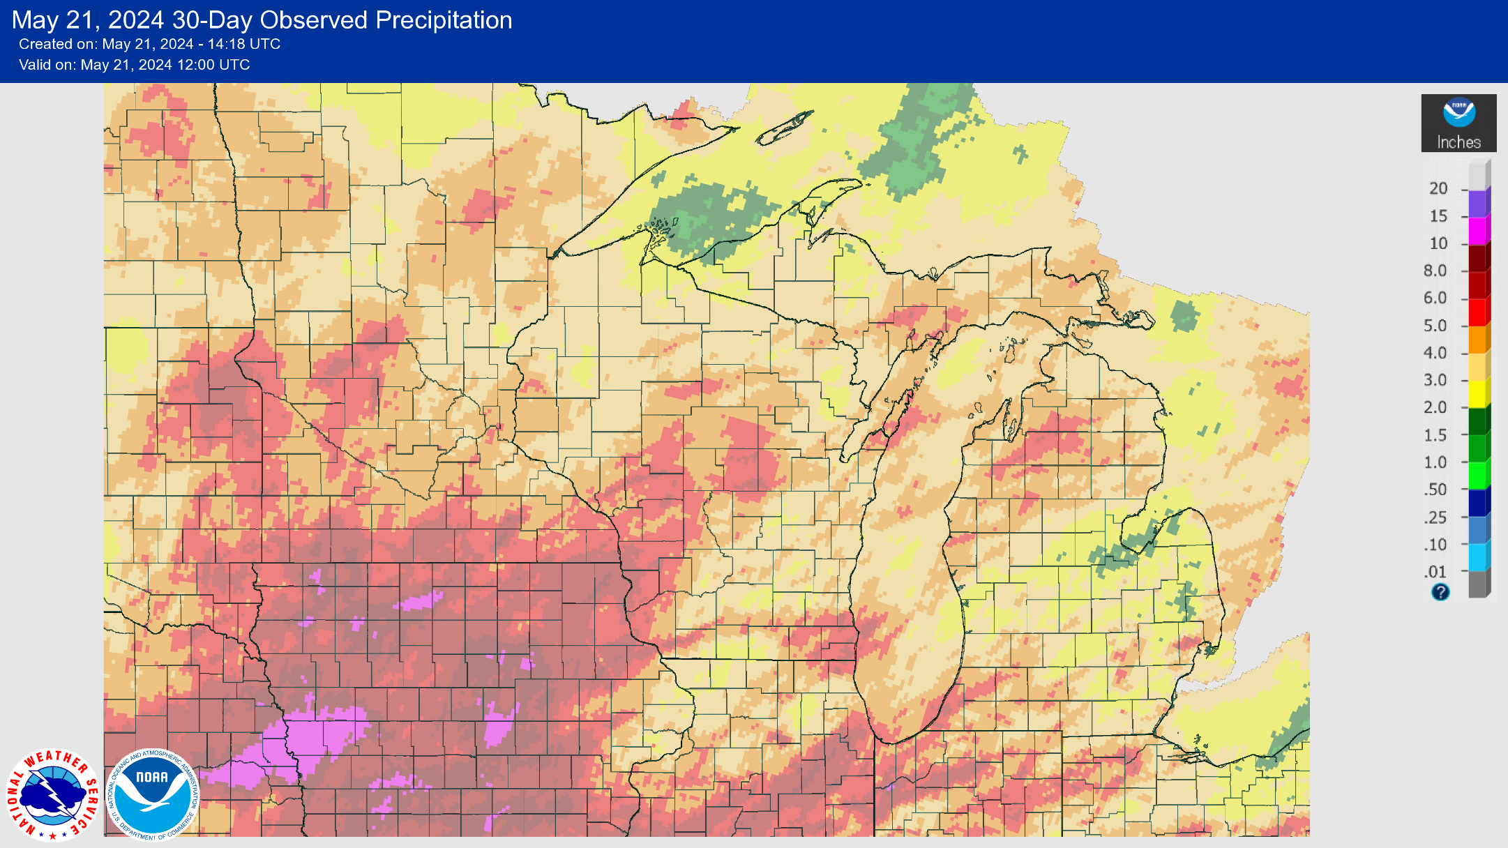
30 Day Precip
Most of the state has seen 3-5+” of precip over the past month.
>5” in the Driftless Region, Central Sands, and far SE.
Pockets of 3” or less scattered.
https://water.weather.gov/precip/

Slide 5
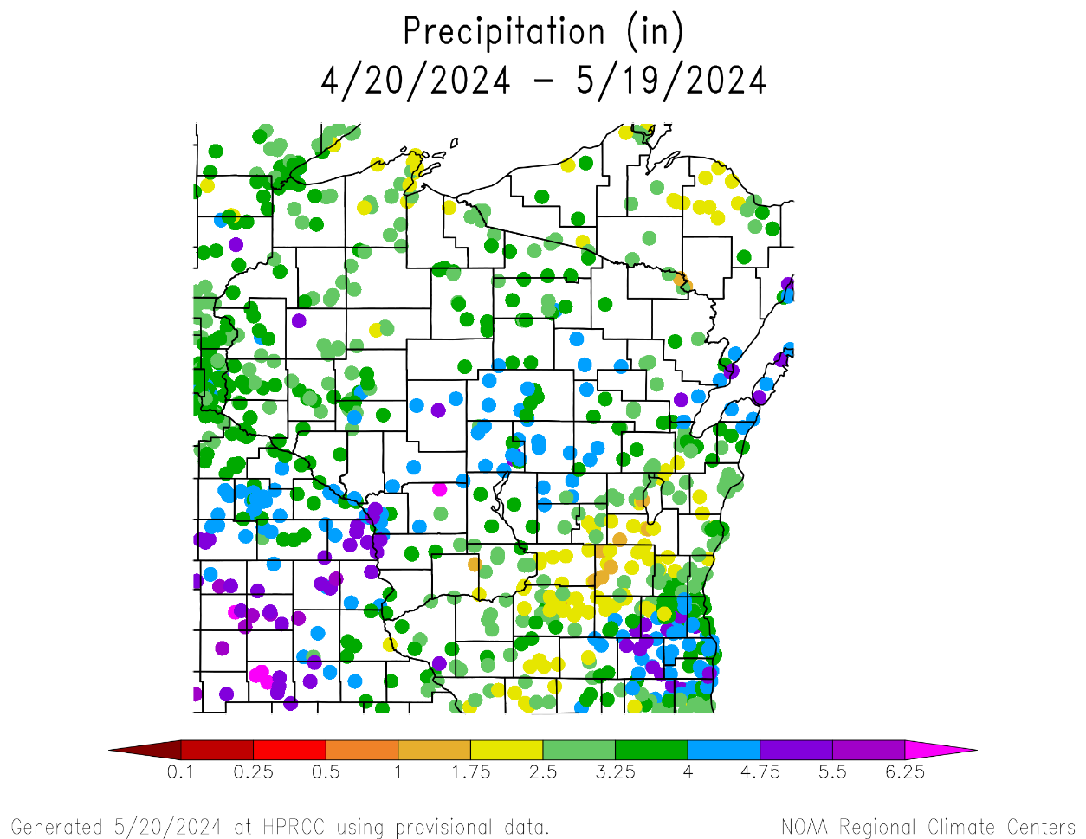
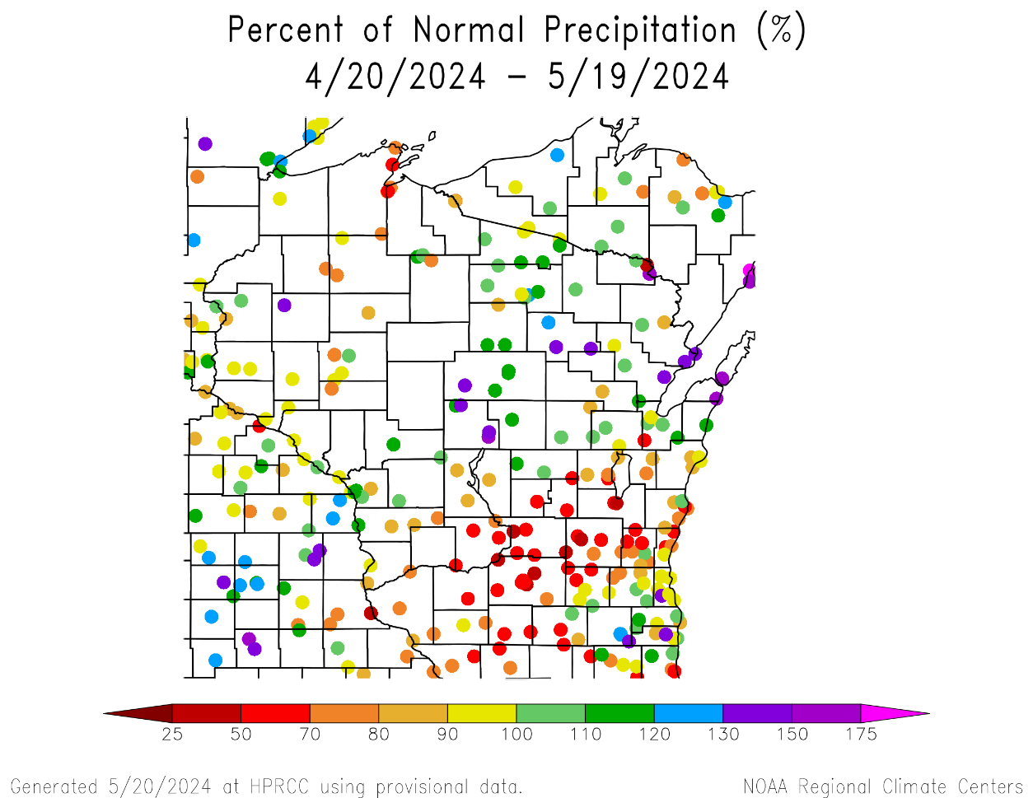
30 Day Precip Total/% Avg.
30-day totals of 5+” around La Crosse, Green Bay, and Waukesha/Whitewater
3-4” common across the state; near or slightly above the 30-year average
Lowest totals from Madison up through the Fox Cities; <70% of climatological average
https://hprcc.unl.edu/maps.php?map=ACISClimateMaps

Slide 6
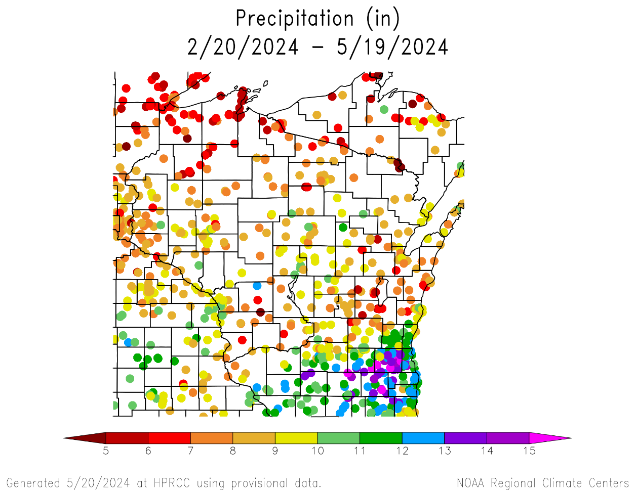
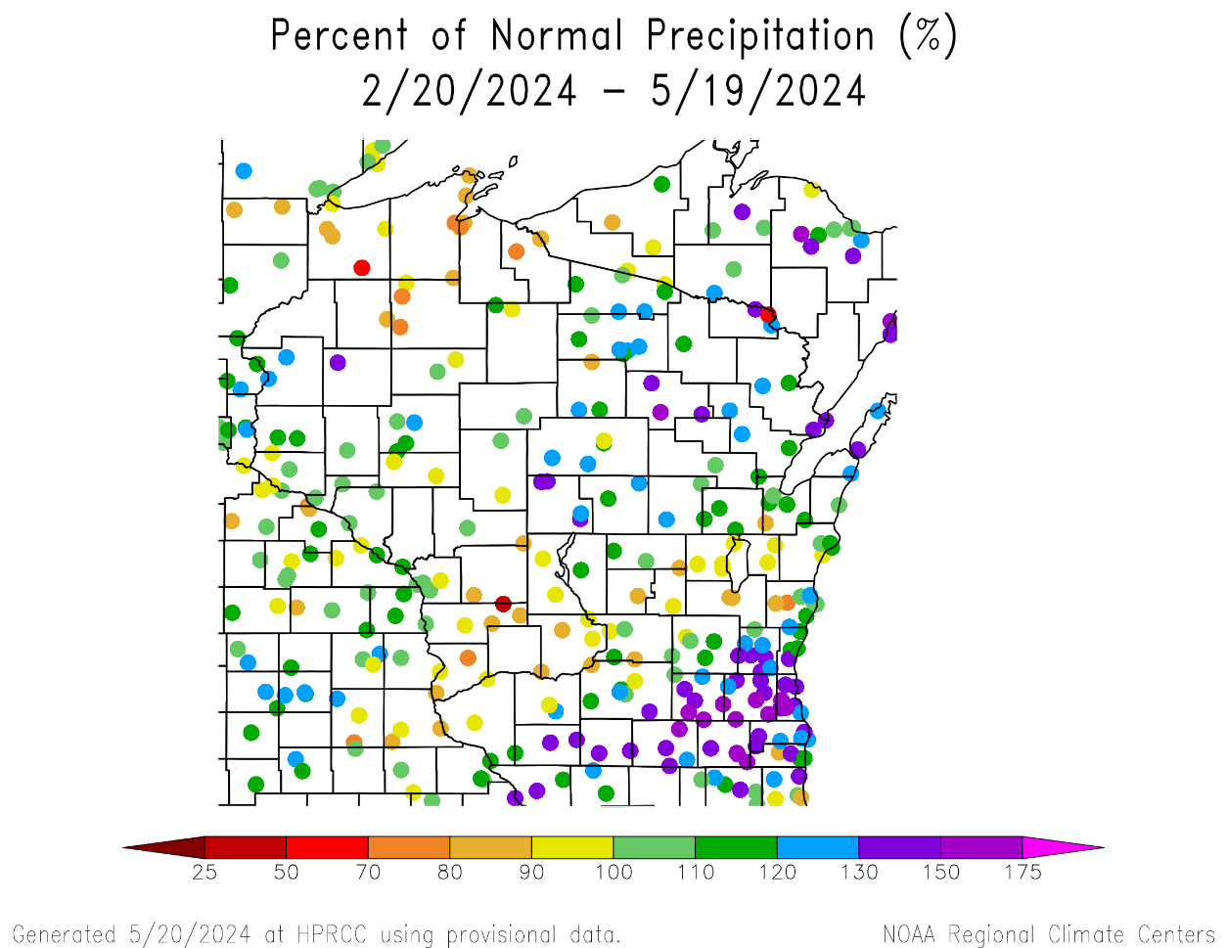
90 Day Precip Total/% Avg.
Highest precip totals near to the IL state line → 1 foot or more for some; 130+” of average is common
Many stations are at 90% of 30-year average or greater
<90% of average can be found at stations in the far NW, Driftless, and Fox Cities area (7” or less)
https://hprcc.unl.edu/maps.php?map=ACISClimateMaps

Slide 7
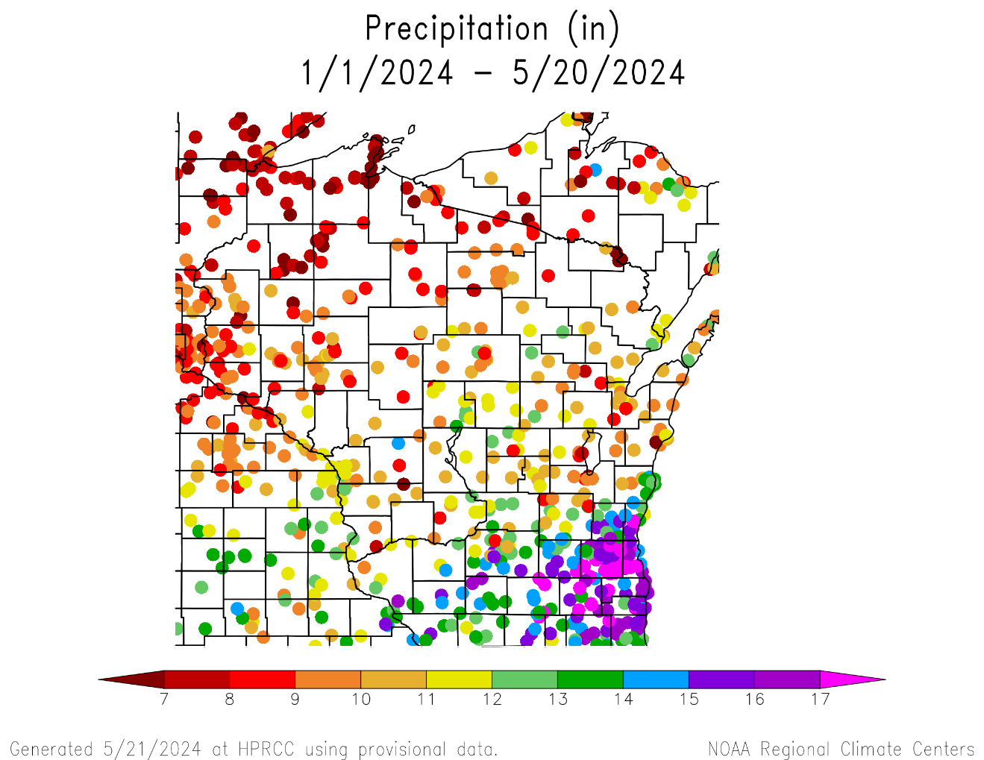
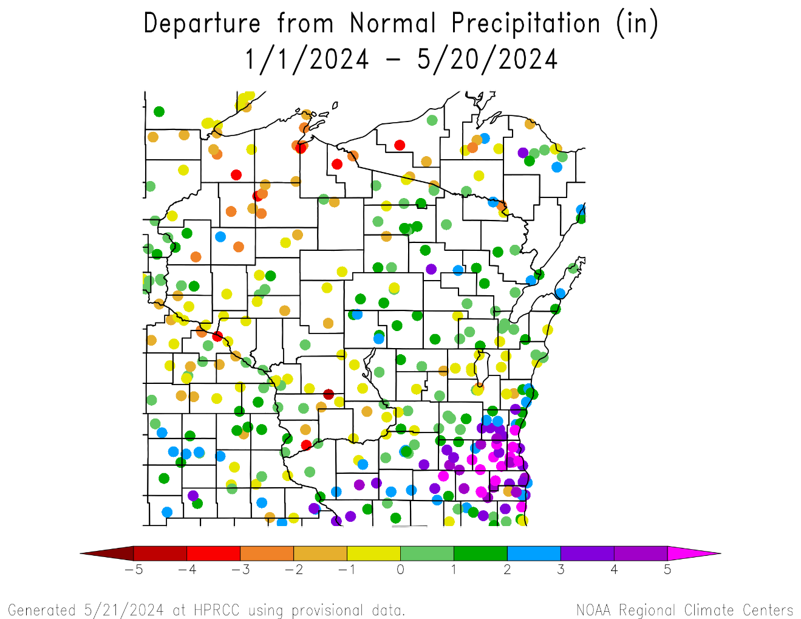
2024 Precipitation (so far)
https://hprcc.unl.edu/maps.php?map=ACISClimateMaps

Slide 8
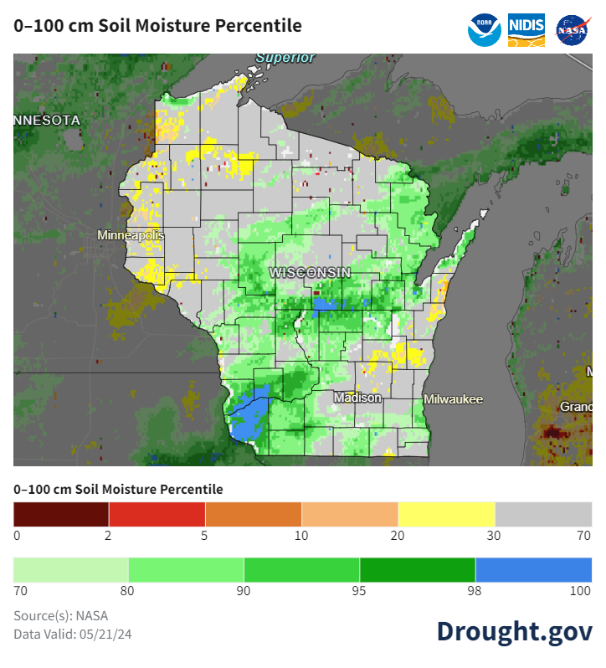
Soil Moisture Models
Moisture improvement in the state with the accumulated precip from last week, particularly in the SW.
Wetter-than-normal conditions in the SW corner up through the central sands and NE.
Model Notes:
Red areas = top 5 driest in 100 years.
Dark red areas = top 2 driest in 100 years.
It’s worth noting that each soil moisture model has their own characteristics and input variables, so there tends to be variation between models. Thus, it’s worthwhile to look at multiple models opposed to just one.
https://weather.msfc.nasa.gov/sport/case_studies/lis_CONUS.html
https://www.drought.gov/states/wisconsin

Slide 9
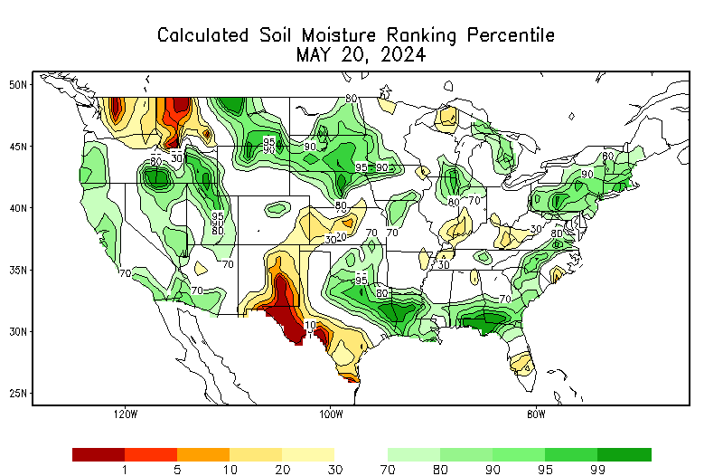
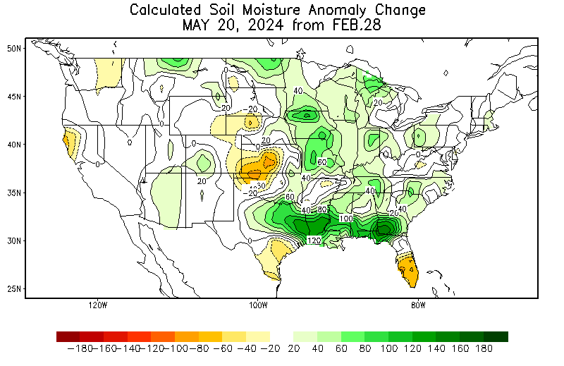
Soil Moisture Models
Soil moisture improvement statewide since late winter.
https://www.cpc.ncep.noaa.gov/products/Soilmst_Monitoring/US/Soilmst/Soilmst.shtml

Slide 10
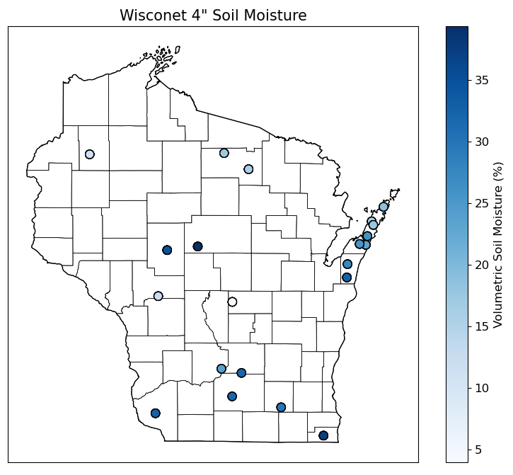
Soil Moisture - Wisconet
https://wisconet.wisc.edu/

Slide 11
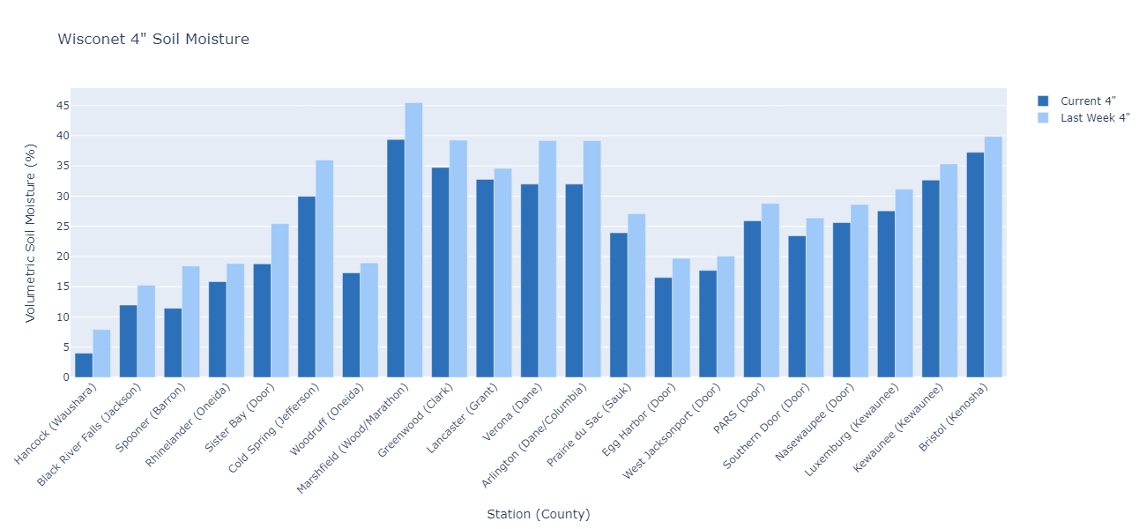
Soil Moisture - Wisconet
Current: 7-day average ending on 5/20
Last Week: 7-day average ending on 5/13
https://wisconet.wisc.edu/

Slide 12
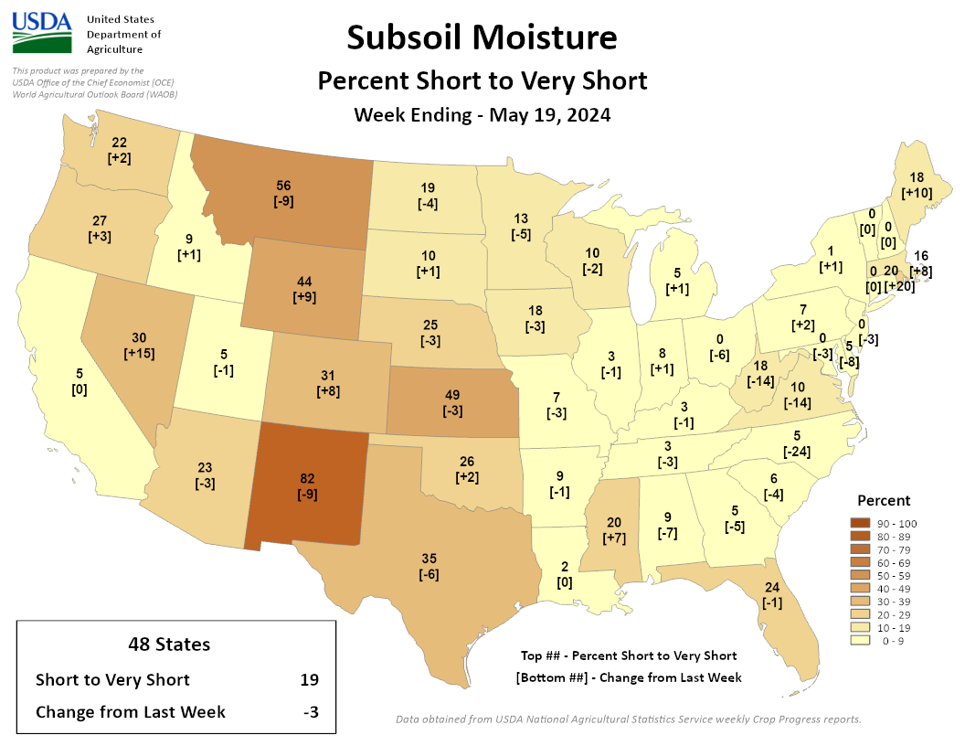
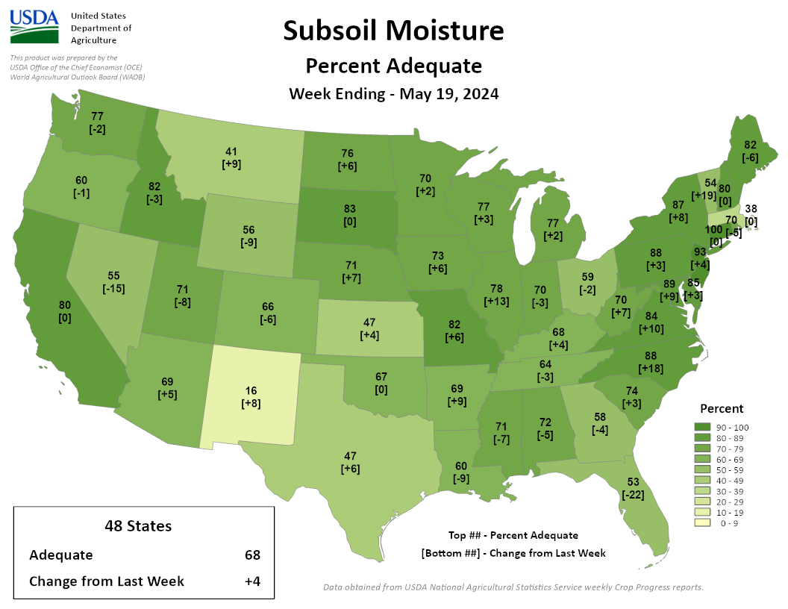
NASS Subsoil Moisture
https://agindrought.unl.edu/Other.aspx

Slide 13
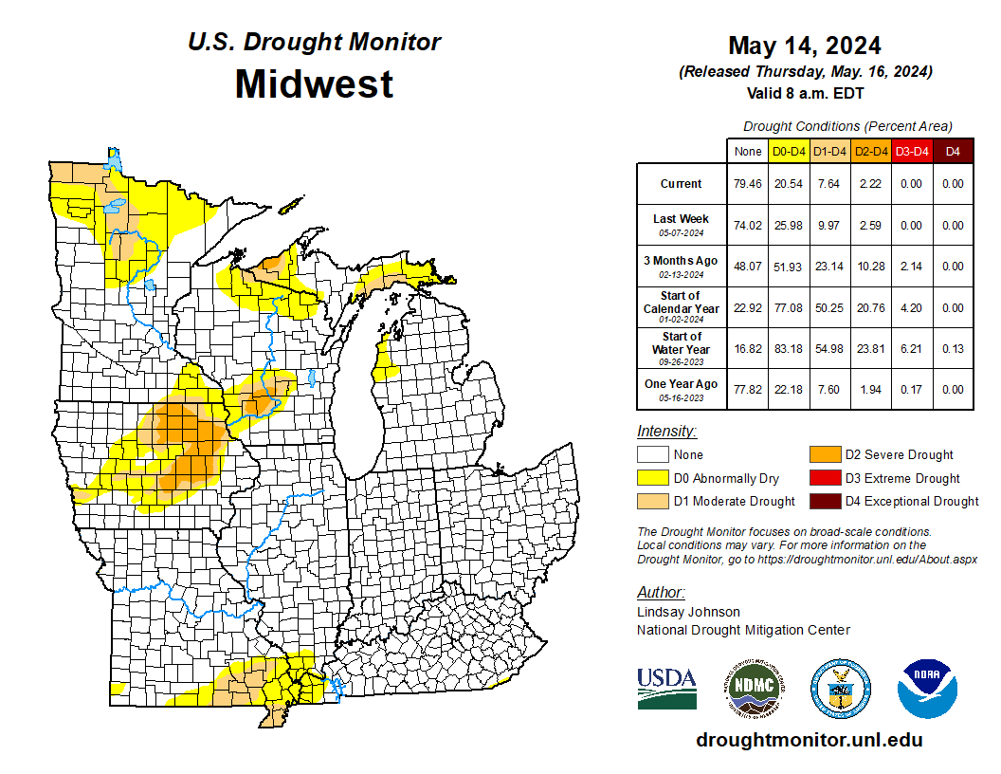
US Drought Monitor
Compared to last week:
Continued decreases in drought category area.
Nearly 80% of the Midwest is outside of D0-D4.
Majority of drought is in IA, WI, & MN.
Large area of D2 remains in Iowa.
D3 and D4 drought are non-existent in the Midwest.
Note: D0 is not considered drought.
http://droughtmonitor.unl.edu/

Slide 14
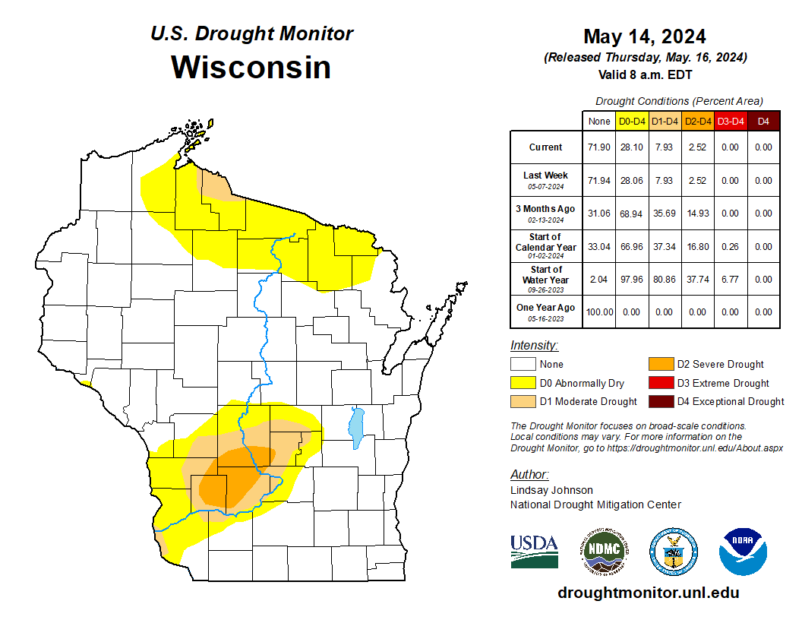
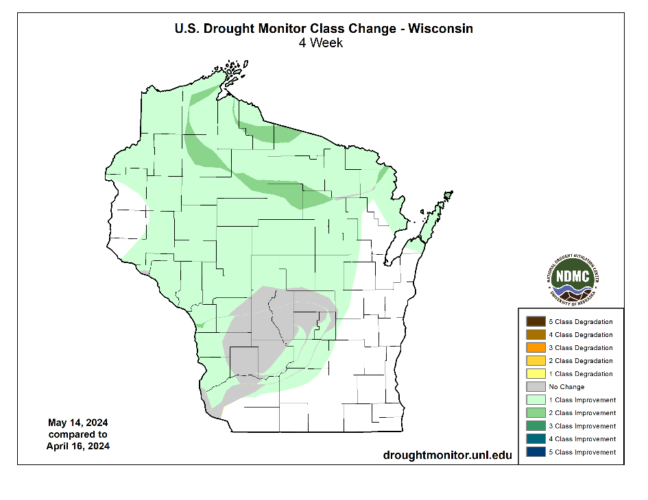
US Drought Monitor
Amount of state in:
D1-D4 – 7.9% --
D2-D4 – 2.5% --
D3-D4 – 0.0% --
D4 – 0.0% --
Note: ↑↓ indicate change from last week. Red up arrows indicate increase in drought area; vice-versa for green arrows.
http://droughtmonitor.unl.edu/

Slide 15
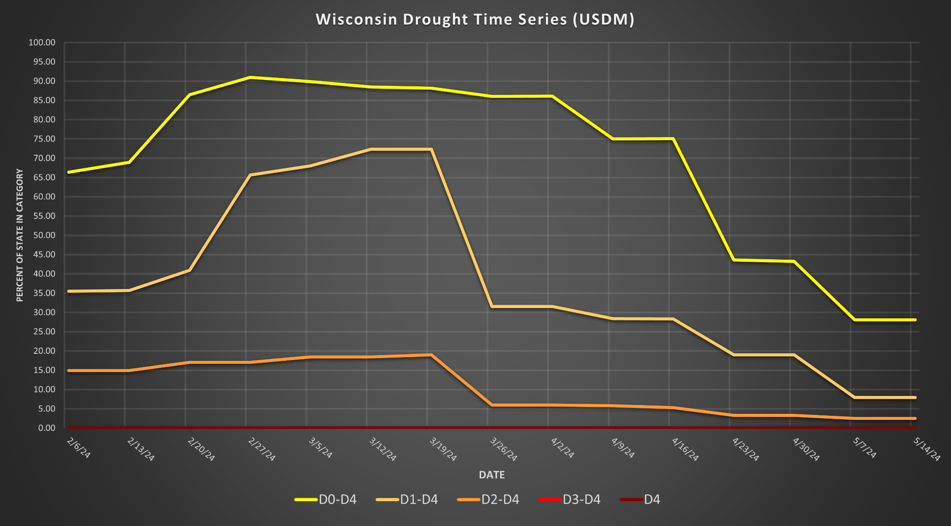
USDM Time Series
http://droughtmonitor.unl.edu/

Slide 16
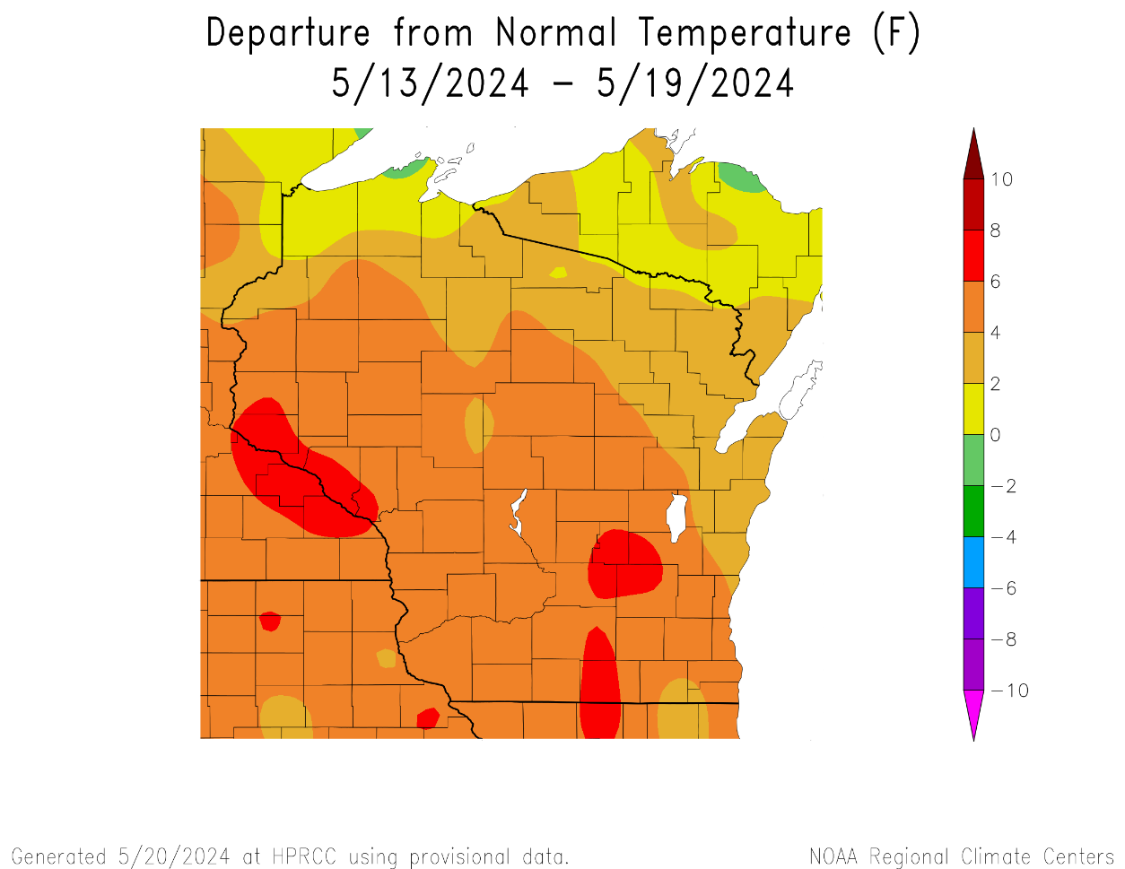
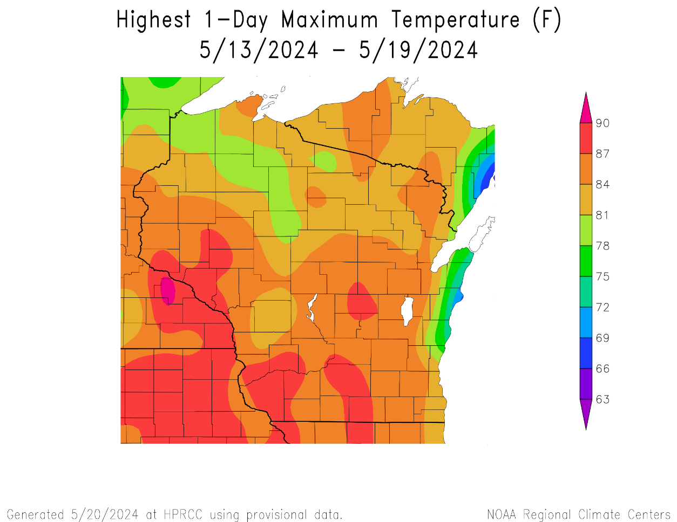
7 Day Temperatures
Temps were 4-6°F above normal for most last week; >6°F above normal in the areas in red.
Maximum temps for the week reached the mid to upper 80’s for most; especially S and W.
https://hprcc.unl.edu/maps.php?map=ACISClimateMaps

Slide 17
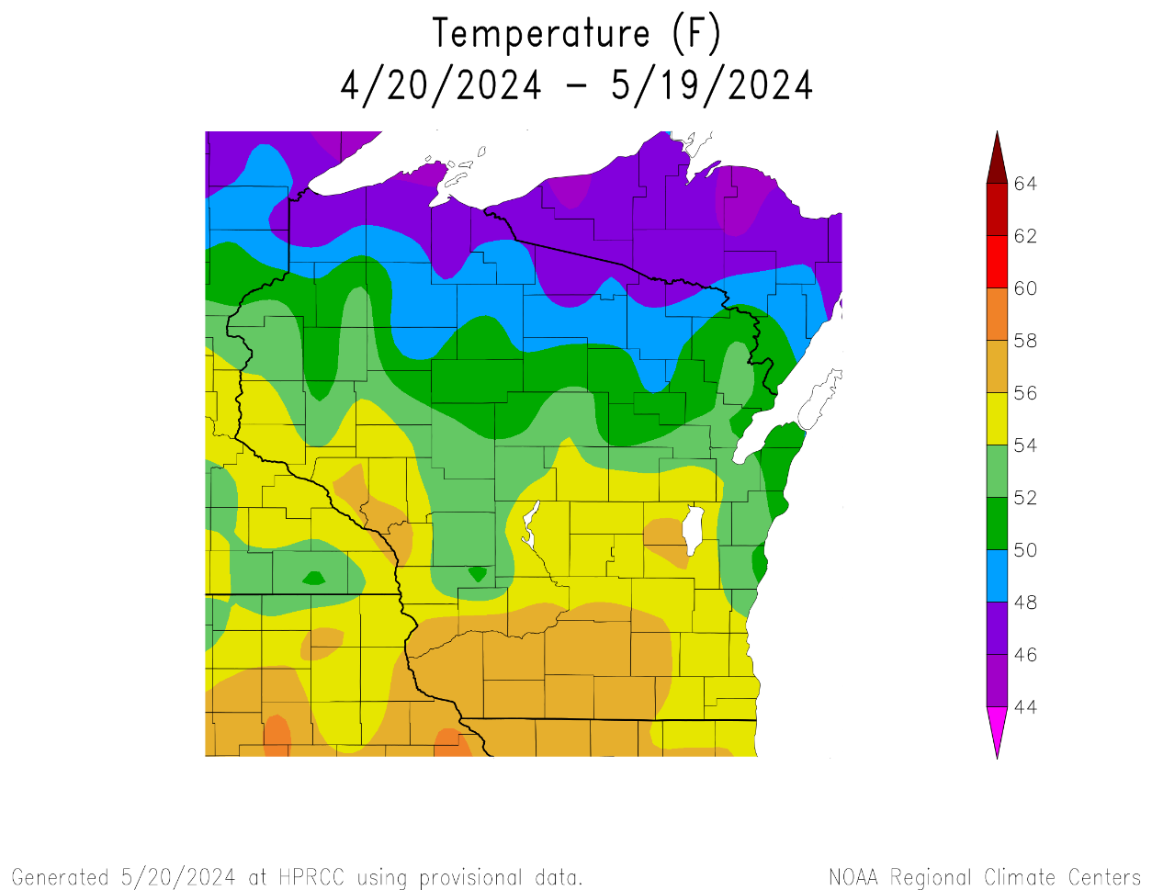
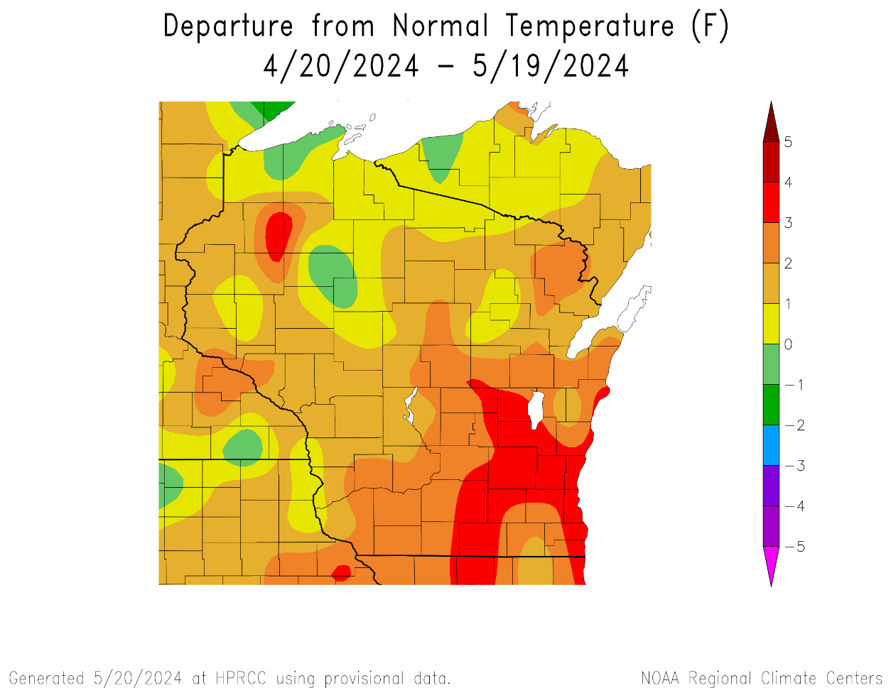
30 Day Temperatures
Temperatures for the month of April ranged from 54-58°F in the S to 46-50°F in the far N.
Warmer in the southeast → 3-4°F above normal.
Cooler in the northwest/north central → within -/+1°F of long-term normal.
https://hprcc.unl.edu/maps.php?map=ACISClimateMaps

Slide 18
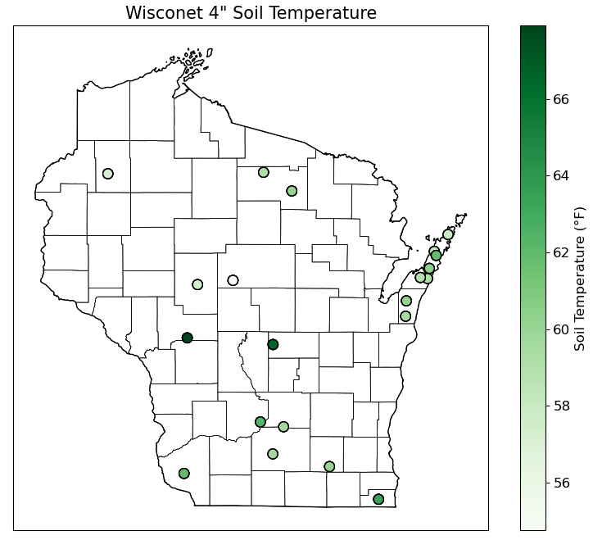
Soil Temperature - Wisconet
https://wisconet.wisc.edu/

Slide 19
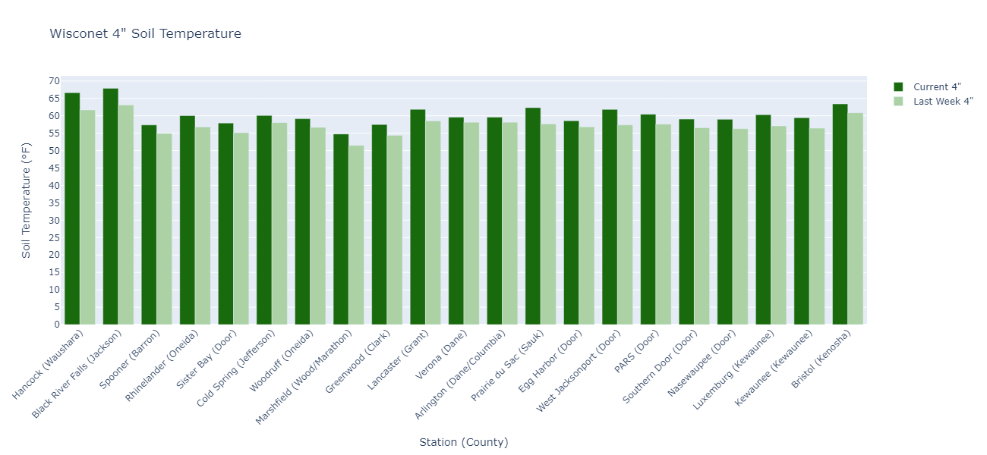
Soil Temperature - Wisconet
Current: 7-day average ending on 5/20
Last Week: 7-day average ending on 5/13
https://wisconet.wisc.edu/

Slide 20
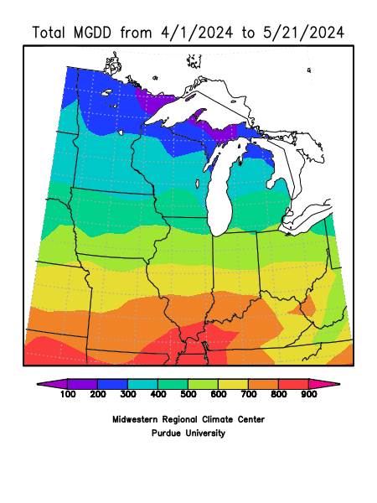
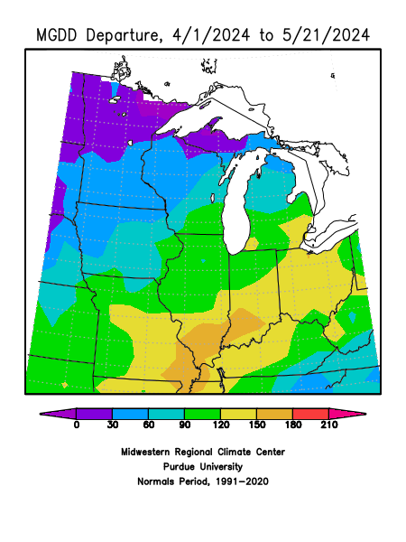
Growing Degree Days Since April 1
All of WI is tracking ahead of average on degree days
Southeast WI is 60 GDD further ahead of the average than in the Northwest
To calculate GDD for your corn variety and planting date, use this tool.
To see specific degree models for pests in your location, use the Vegetable Disease & Insect Forecasting Network.
https://mrcc.purdue.edu/

Slide 21
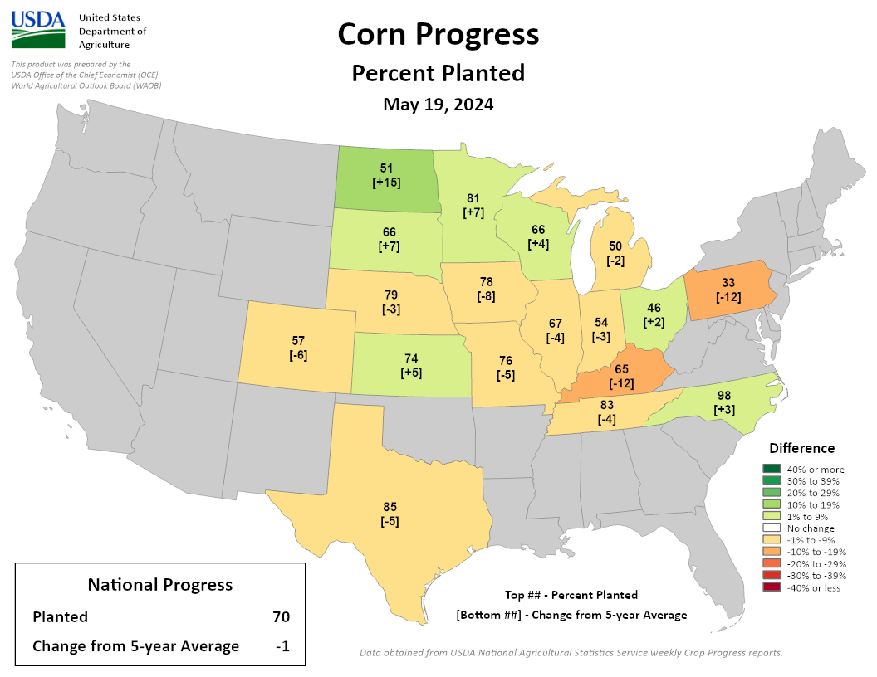
NASS Crop Progress – Corn
Planting is running ahead of the 5-year average in WI and states to the N & W. Behind average pace to the S.
Wisconsin → 66% complete; ahead of the 5-year average pace. 26% increase from last week.
https://agindrought.unl.edu/Other.aspx

Slide 22
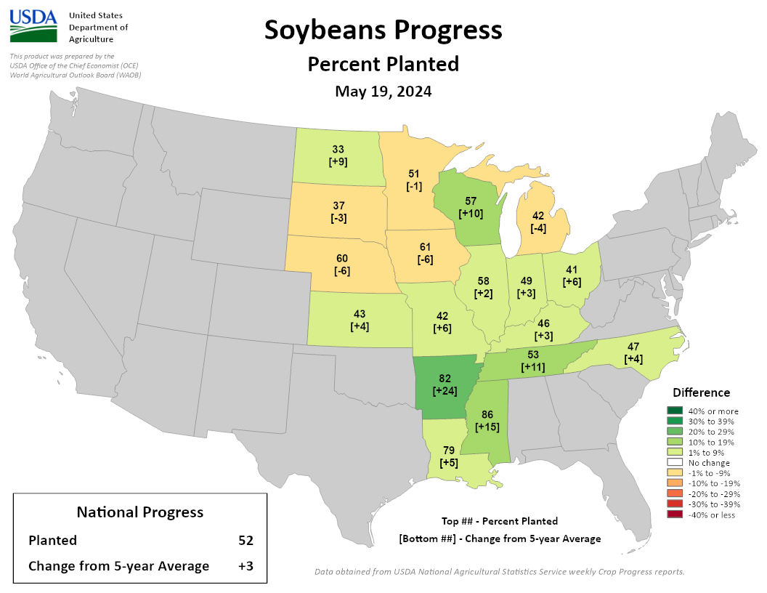
NASS Crop Progress – Soybean
Planting is running at or ahead of the 5-year average in WI and states to the S.
Wisconsin → 57% complete; 10% ahead of the 5-year average pace. 20% increase from last week.
https://agindrought.unl.edu/Other.aspx

Slide 23
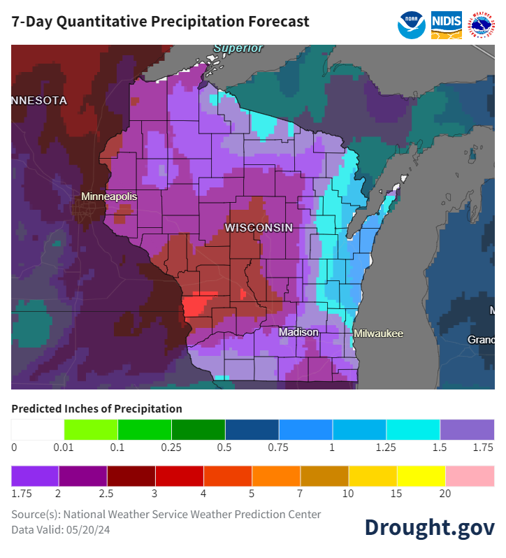
7 Day Precip Forecast
Another week is forecasted for the state → higher totals in the W (2” or more)
Strong storms with heavy rainfall forecasted for Tuesday night (5/21).
More chances into the weekend and early next week.
Forecast for 4/30/24 thru 5/7/24
(12Z = 7am CDT)
https://www.wpc.ncep.noaa.gov/qpf/p168i.gif
https://www.drought.gov/states/wisconsin

Slide 24
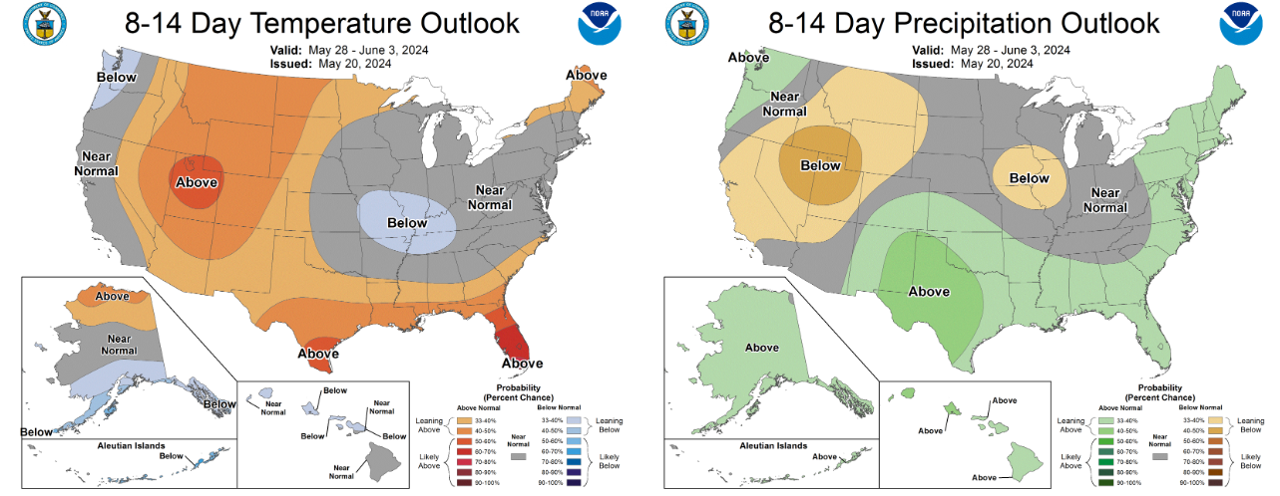
8-14 Day Temp & Precip Outlook
End of May into first days of June: Temperatures leaning near normal. Precipitation leaning near or below (SW) normal.
http://www.cpc.ncep.noaa.gov/

Slide 25
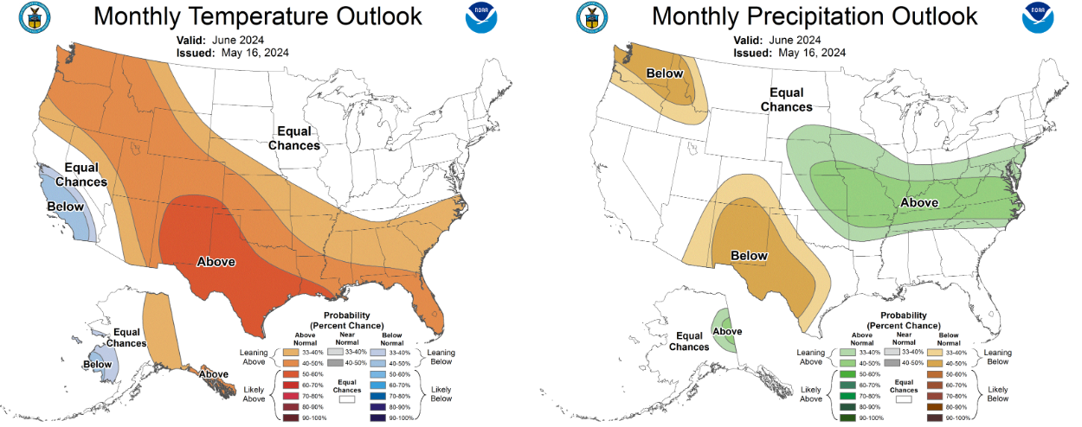
30 Day Temp & Precip Outlook
Month of June: Temperature & precipitation are showing equal chances.
http://www.cpc.ncep.noaa.gov/

Slide 26
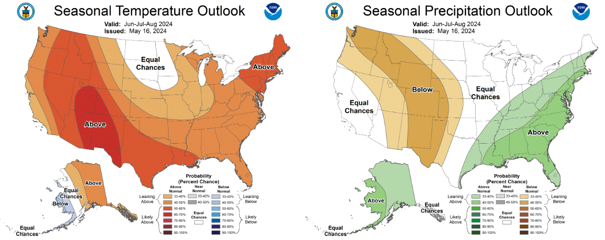
90 Day Temp & Precip Outlook
Summer 2024: Temperatures leaning towards above normal. Precipitation indications are for equal chances of above/at/below average.
http://www.cpc.ncep.noaa.gov/

Slide 27
Take-Home Points
Current conditions:
A half inch or more of rain fell across the state this past week, bringing yearly totals to near or above the 30-year average for many stations.
Temperatures at least 2°F above normal for most last week, with daily highs topping out in the mid to upper 80’s
Impact:
Slight declines in soil moisture at most Wisconet stations despite the rainfall, but models indicate that soil moisture levels are near or wetter than normal.
Soil temperatures are near 60°F at Wisconet sites, a jump from last week.
No change in the US Drought Monitor in the state from last week.
Corn and soybean planting made big strides over the past week and continue to outpace the 5-year average.
Outlook:
The rainy trend is forecasted to continue into this next week – some could see multiple inches of precip.
Near normal temps & precip to wrap up May, with uncertainty for June conditions (equal chances).
The warmer-than-normal conditions have a higher probability to continue through the summer.
A transition to La Niña is expected by June.

Slide 28
Agronomic Considerations
Planting Considerations
Soil temperatures are now adequate for planting throughout the state.
Soil moisture is adequate or even high in most places. Be cautious about planting into muddy conditions, especially with more rain forecasted.
Cover crop termination:
If local soil conditions are dry, consider an earlier cover crop termination to reduce evapotranspiration.
If local soil conditions are wet, consider delaying cover crop termination until crop planting or later to manage excess soil moisture for planting.
Nutrient & Herbicide Applications
Consider doing tissue testing and pre-sidedress nitrate testing after crop has emerged to assess fertilizer need.
Early planted corn and soybeans have emerged. Properly staging your crop assists with timing future applications. Growth stage guides available for corn, soybean and wheat at Growing Guides – Integrated Pest and Crop Management – UW–Madison (wisc.edu)
Manure Applications
Runoff risk is moderate to severe for the next week across the state. Be mindful of the possibility of runoff and plan manure applications accordingly. Check the DATCP runoff risk advisory forecast here.
Pest Management
Black cutworm feeding damage is expected to begin this week in Southern Wisconsin, and true armyworms are also still likely. Sign up to receive text alerts when pests are in your region here.
Alfalfa weevil damage is increasing in the southern part of the state.
Consider applying a fungicide on winter wheat as conditions have been right for Fusarium Head Blight and vomitoxin development, read more here.
Forage Management
Watch alfalfa for lodging as RFQ values from lab testing are outpacing predictions based on PEAQ readings, favorable conditions have led to a crop that grows quite tall before entering reproductive stages

Slide 29
User Survey
Are you a regular user of the Wisconsin Ag Climate Outlook (WACO)? Or maybe you are viewing these slides for the first time this week? Either way, we want to hear your feedback on this new resource! Please take a few minutes and fill out this survey:
LINK TO SURVEY
Your feedback will help us better serve your ag-climate data needs through WACO.
If you have any trouble accessing or filling out the survey, please email Josh Bendorf at Joshua.Bendorf@usda.gov.
Thank you!!
-The WACO Team

Slide 30
Citizen Science Opportunity
CoCoRaHS – Community Collaborative Rain, Hail, & Snow Network
The Mission
(From cocorahs.org)
Provide accurate high-quality precipitation data for end-users;
Increasing the density of precipitation data available throughout the country;
Encouraging citizens to have fun participating in meteorological science and heightening their awareness about weather;
Providing weather education opportunities.
Sign Up Here: https://cocorahs.org/Content.aspx?page=application

Slide 31
Contact Info
Photo Credit: USDA
Natasha Paris
Crops Educator – Adams, Green Lake, Marquette, Waushara Cos.
natasha.paris@wisc.edu
Kristin Foehringer
NRCS State Working Lands Climate Smart Specialist
kristin.foehringer@usda.gov
Dennis Todey
Director, Midwest Climate Hub
dennis.todey@usda.gov
Josh Bendorf
Ag Climatologist Fellow, Midwest Climate Hub
joshua.bendorf@usda.gov
Steve Vavrus
State Climatologist of Wisconsin
sjvavrus@wisc.edu
Bridgette Mason
Assistant State Climatologist of Wisconsin
bmmason2@wisc.edu

