Slide 1
Wisconsin Ag Climate Outlook Week of April 22, 2024
Natasha Paris
Crops Educator – Adams, Green Lake, Marquette, Waushara Cos.
natasha.paris@wisc.edu
Kristin Foehringer
NRCS State Working Lands Climate Smart Specialist
kristin.foehringer@usda.gov
Dennis Todey
Director, Midwest Climate Hub
dennis.todey@usda.gov
Josh Bendorf
Ag Climatologist Fellow, Midwest Climate Hub
joshua.bendorf@usda.gov
Steve Vavrus
State Climatologist of Wisconsin
sjvavrus@wisc.edu
Bridgette Mason
Assistant State Climatologist of Wisconsin
bmmason2@wisc.edu

Slide 2
Key Points
Soil moisture levels improved slightly from last week due in part to rainfall.
Temperatures have been near or slightly above average for this time of year, with 4” soil temps in the mid to upper 40s.
Corn and soybean planting has begun in the state.
Be on the lookout for some rainy days and the risk of freeze during this next week.

Slide 3
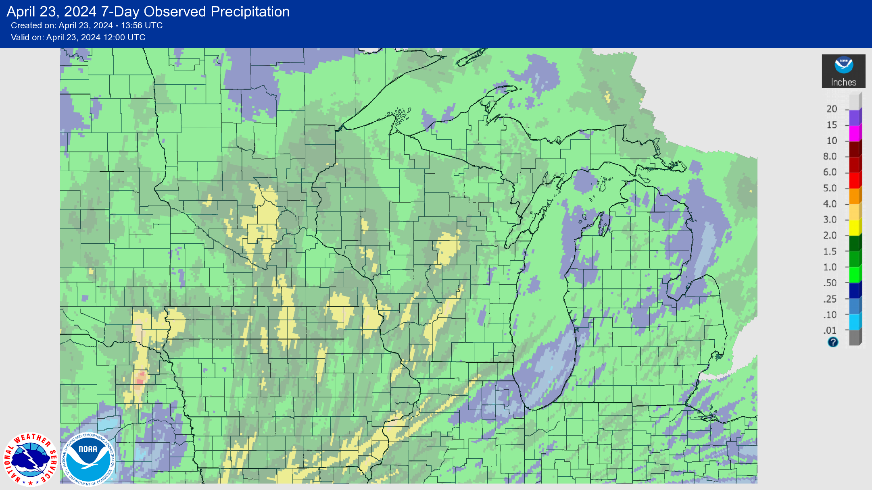
7 Day Precip
Majority of the state saw 1” or more of precip last week.
Areas in yellow saw >2” of precip.
Severe winds accompanied the storms that brought a lot of this rain.
https://water.weather.gov/precip/

Slide 4
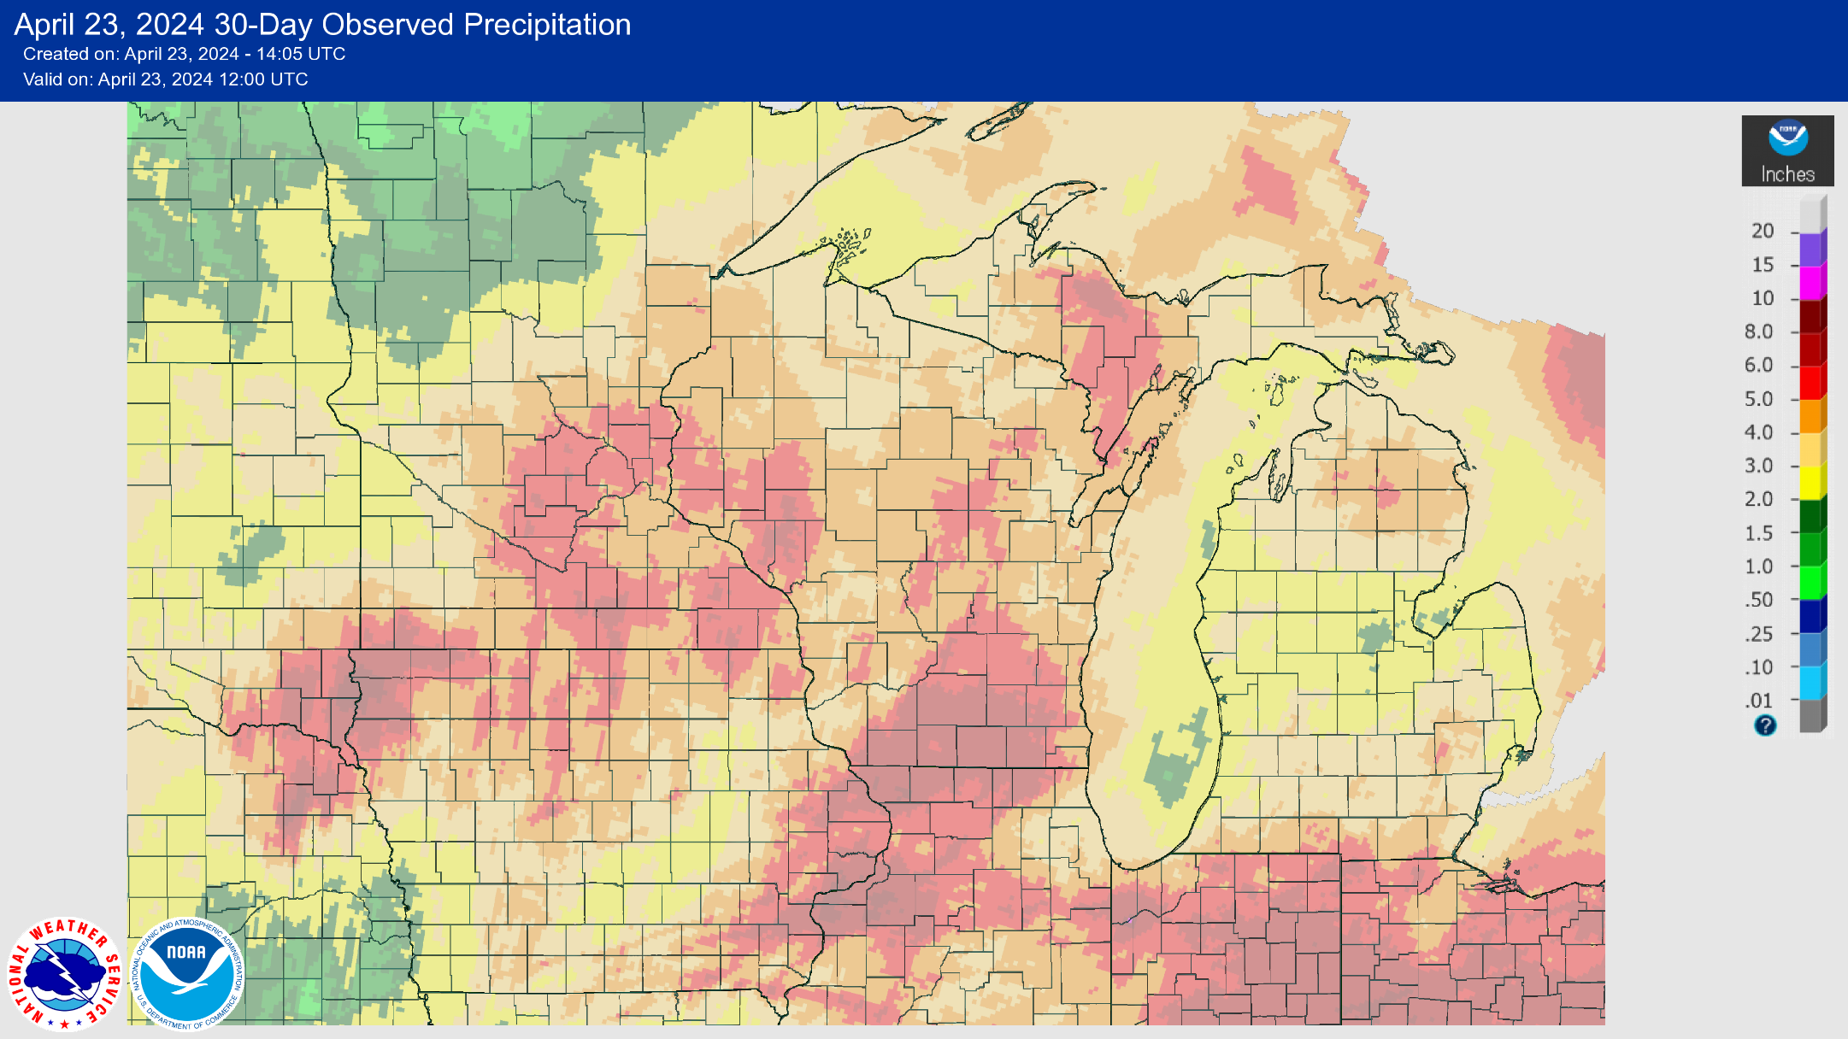
30 Day Precip
Most of the state has seen 4-6+” of precip over the past month.
Highest amounts in the SC part of the state → >6” widespread.
https://water.weather.gov/precip/

Slide 5
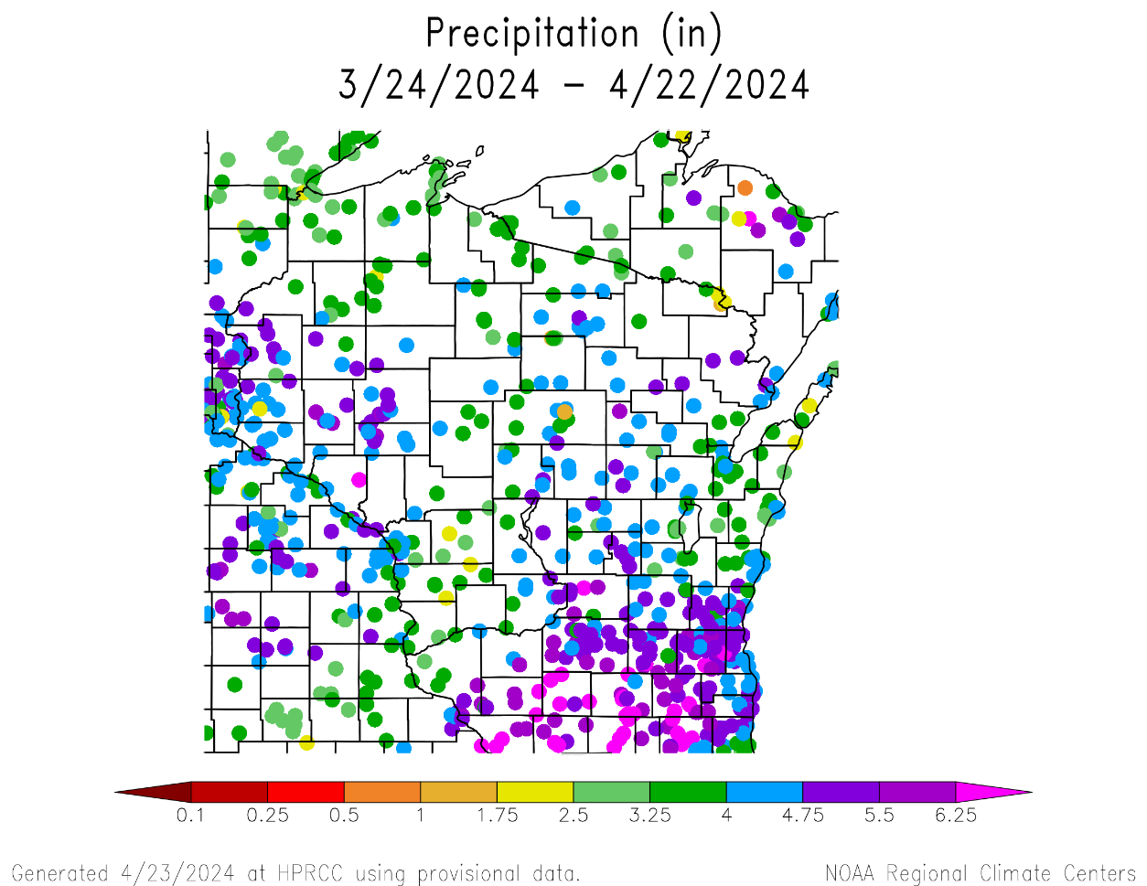
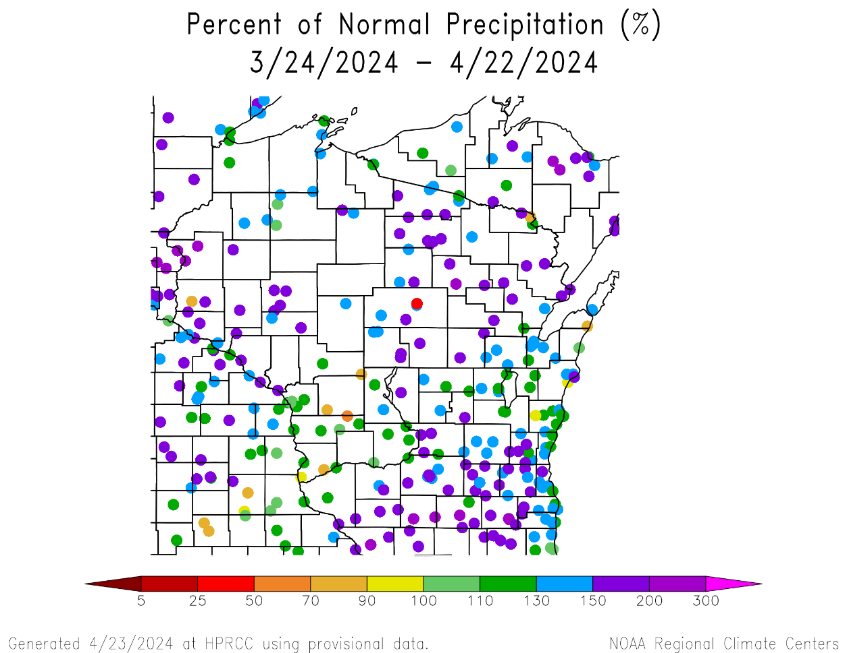
30 Day Precip Total/% Avg.
Highest precip totals in the SC/SE (5-6+”); 150-200+% of average.
Majority of stations are above the long-term 30-day average.
Below average totals at stations in the Driftless Region & along the Lake Michigan shoreline.
https://hprcc.unl.edu/maps.php?map=ACISClimateMaps

Slide 6
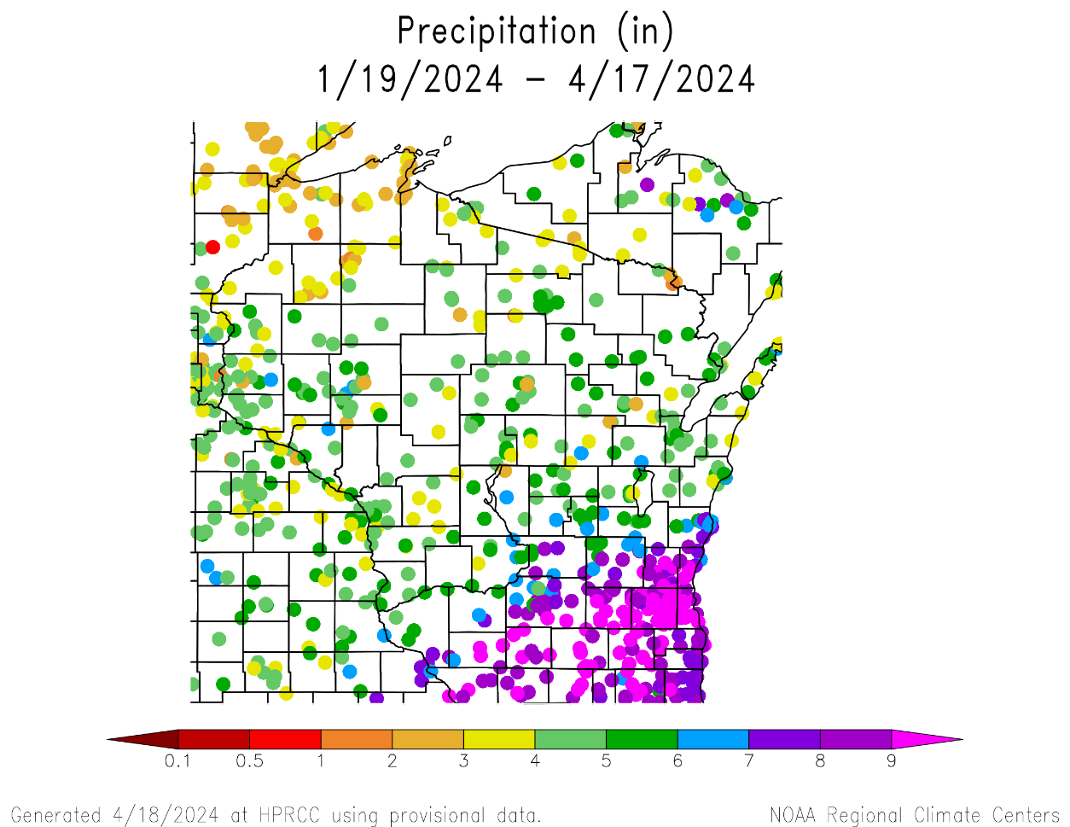
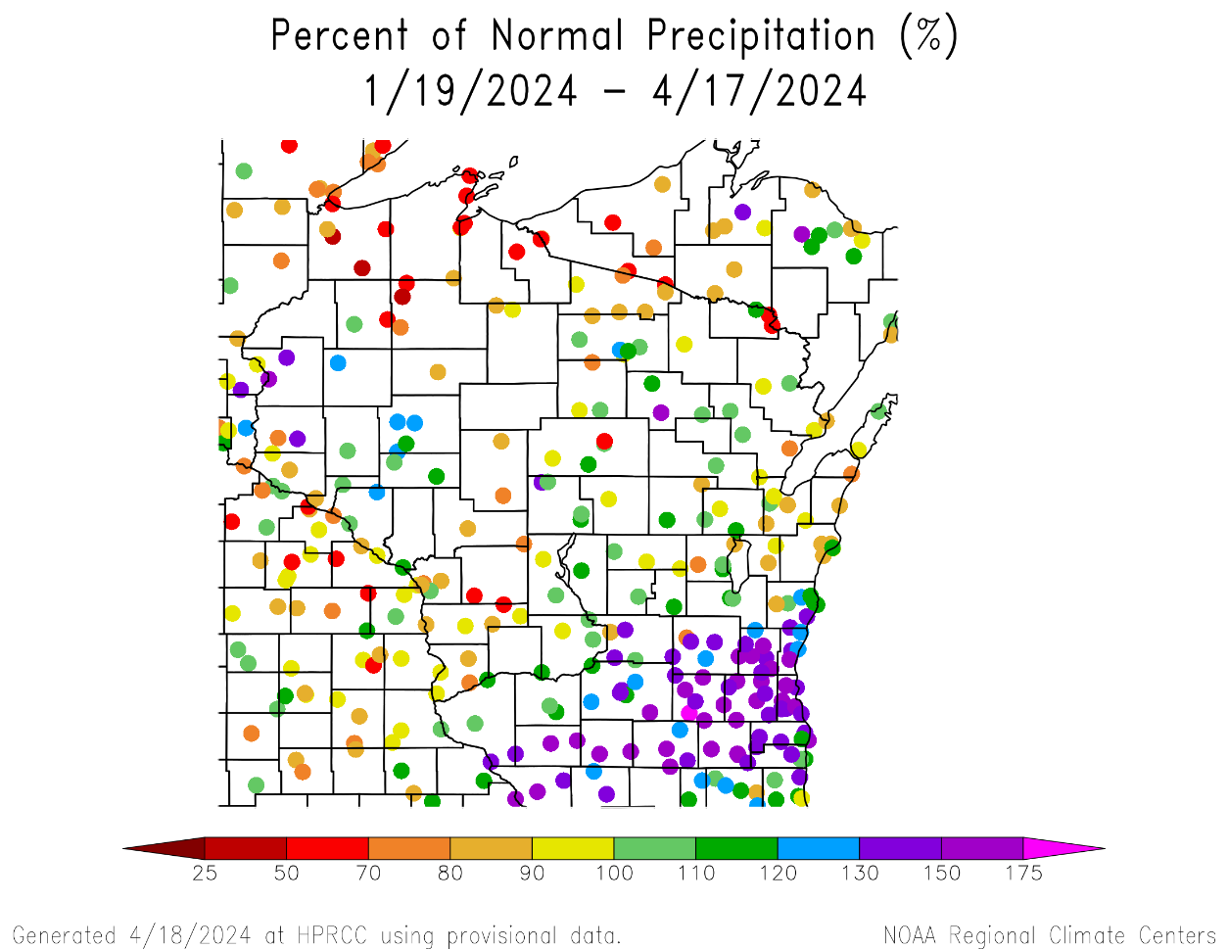
90 Day Precip Total/% Avg.
Highest precip totals in the SE (>9”) and lowest in the NW (<3”).
150+% of long-term average precip common from Dubuque to Sheboygan (& points south).
50-90% of average is common across the NC/NW.
https://hprcc.unl.edu/maps.php?map=ACISClimateMaps

Slide 7
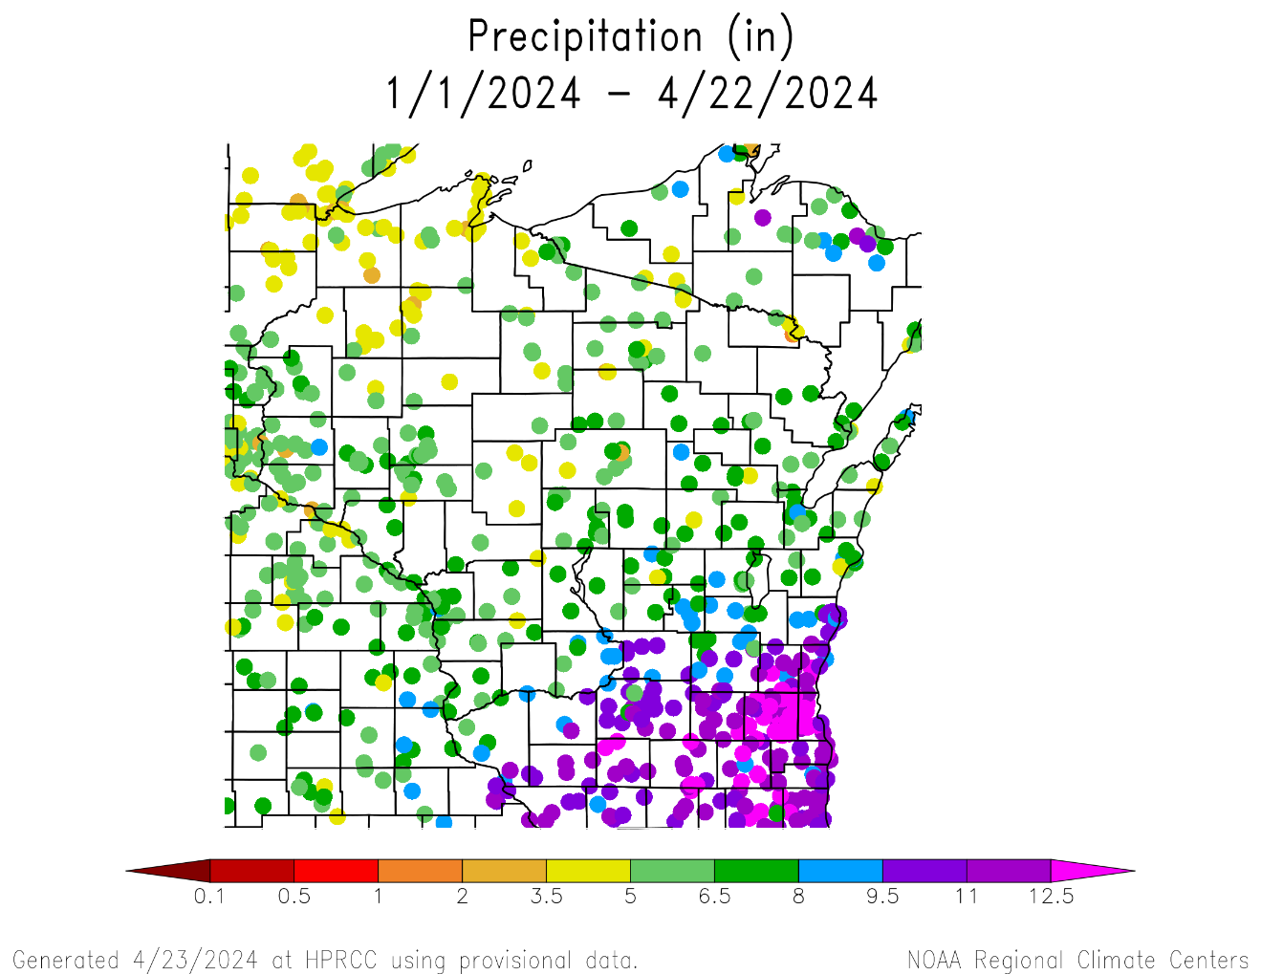
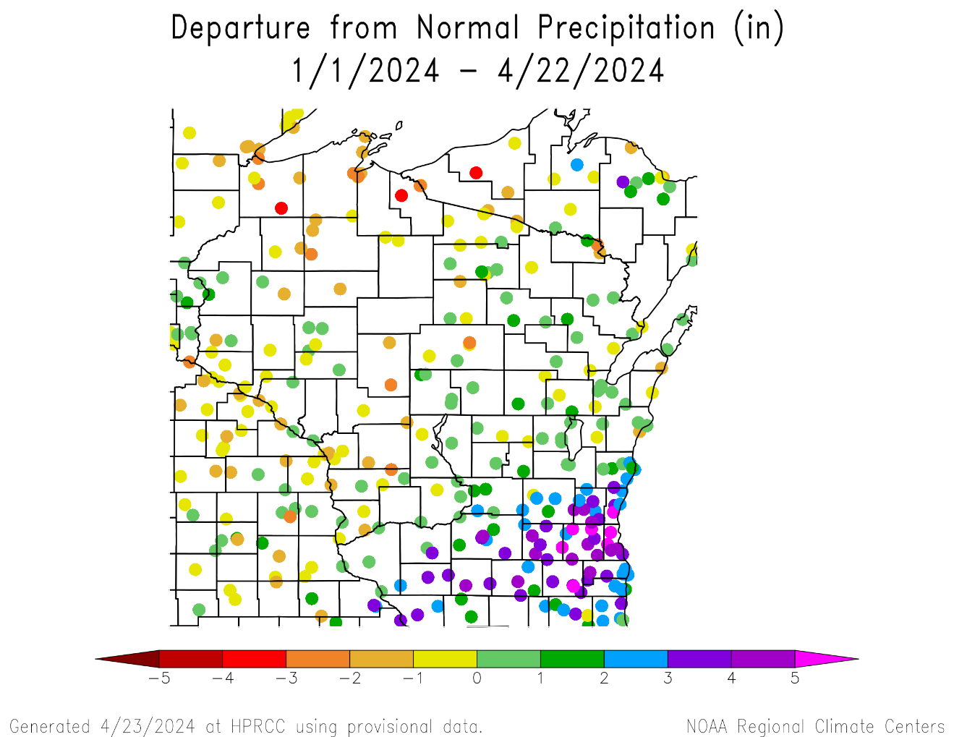
Precipitation since Jan. 1
https://hprcc.unl.edu/maps.php?map=ACISClimateMaps

Slide 8
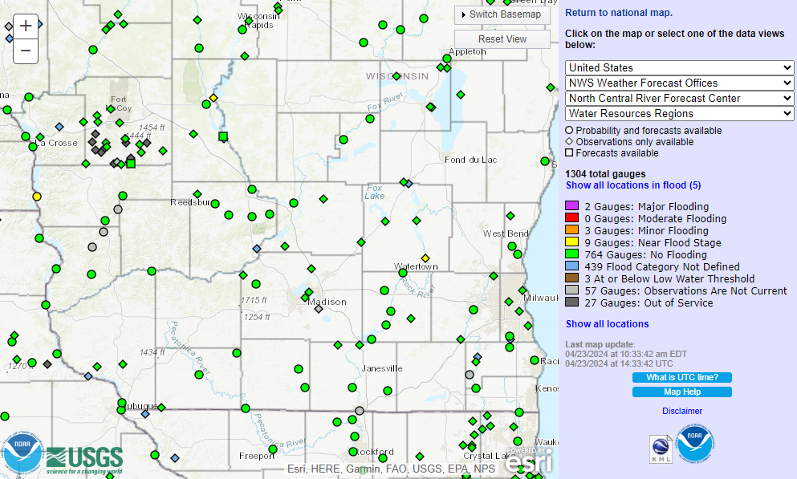
River Levels
Only a few gauges remain near flood stage (yellow). The majority are running at normal levels.
https://water.weather.gov/ahps/

Slide 9
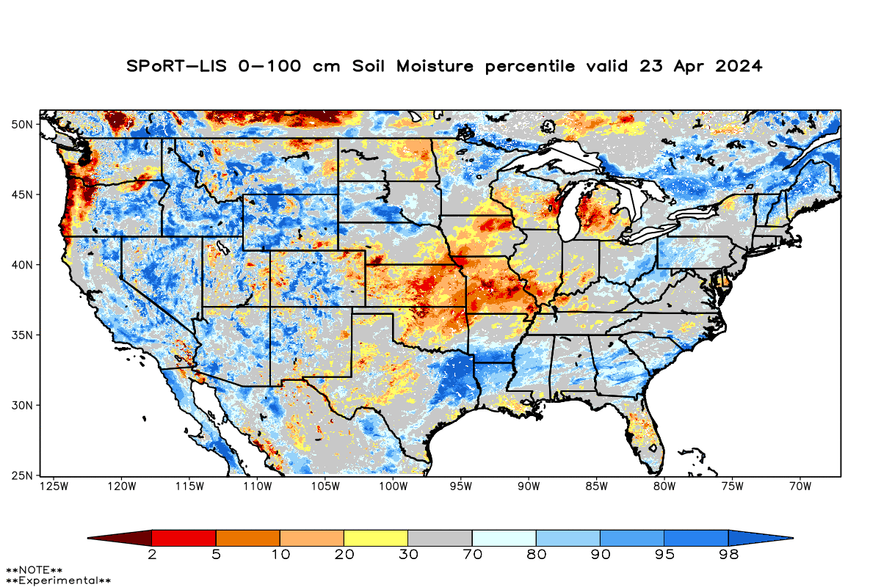
Soil Moisture Models
Moisture improvement in the central & southern regions with the precip received last week.
Driest soil moisture conditions in east central area, according to this model.
Model Notes:
Red areas = top 5 driest in 100 years.
Dark red areas = top 2 driest in 100 years.
It’s worth noting that each soil moisture model has
their own characteristics and input variables, so
there tends to be variation between models. Thus,
it’s worthwhile to look at multiple models opposed
to just one.
https://weather.msfc.nasa.gov/sport/case_studies/lis_CONUS.html

Slide 10
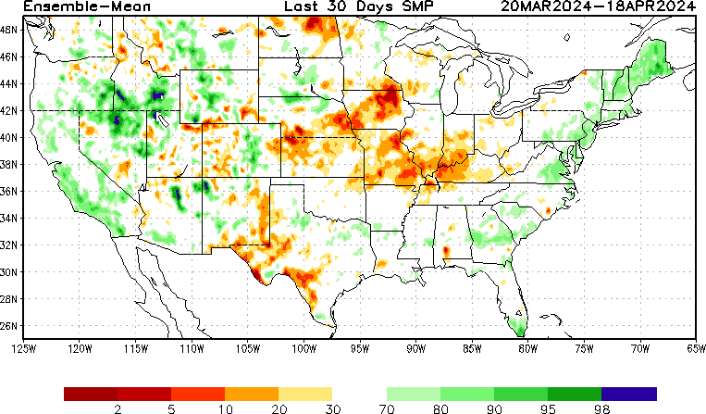
Soil Moisture Models
https://www.cpc.ncep.noaa.gov/products/Drought/Monitoring/smp_new.shtml#

Slide 11
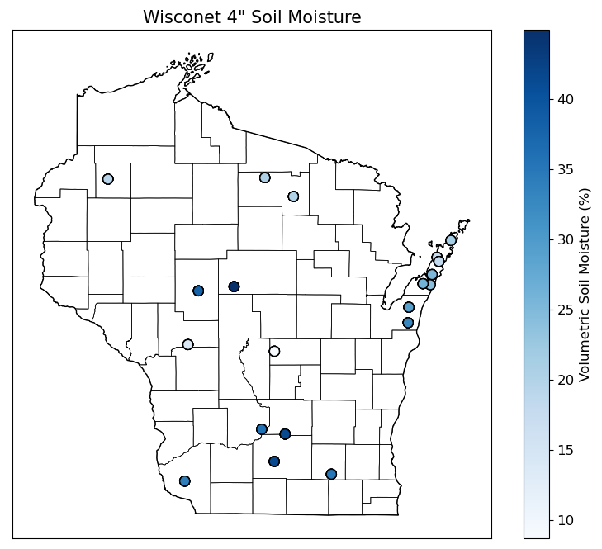
Soil Moisture - Wisconet
https://wisconet.wisc.edu/

Slide 12
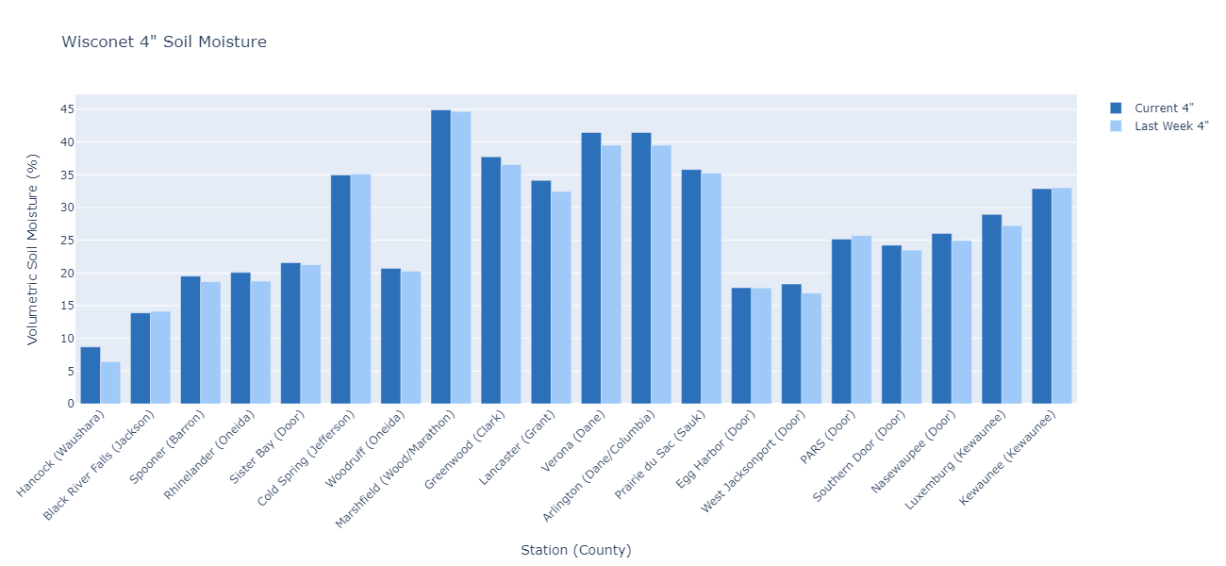
Soil Moisture - Wisconet
Current: 7-day average ending on 4/22
Last Week: 7-day average ending on 4/15
https://wisconet.wisc.edu/

Slide 13
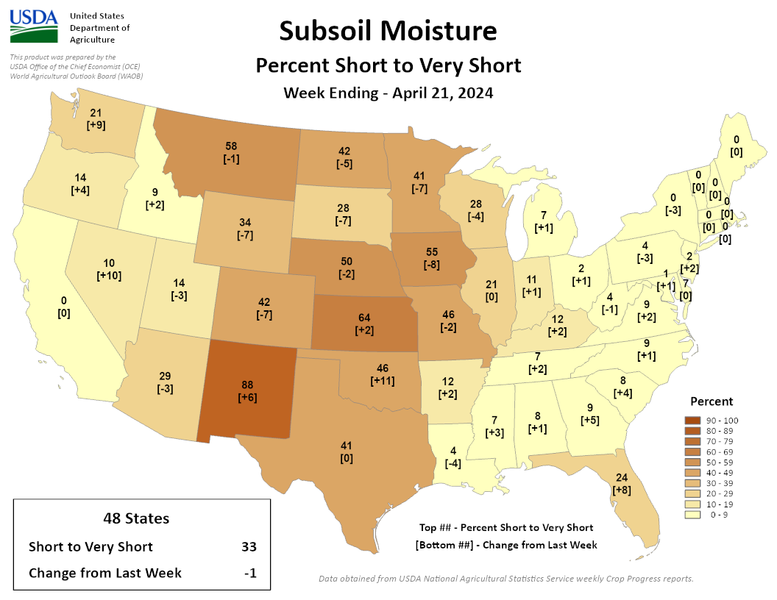
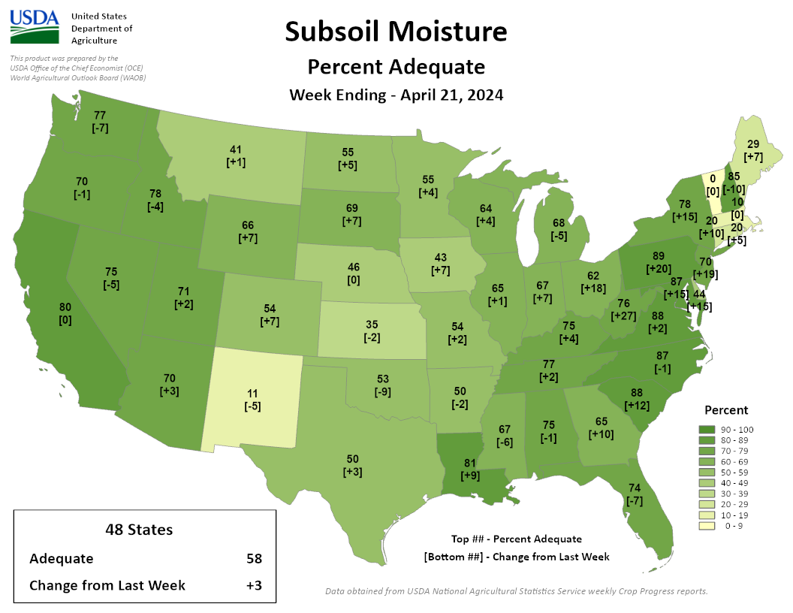
NASS Subsoil Moisture
https://agindrought.unl.edu/Other.aspx

Slide 14
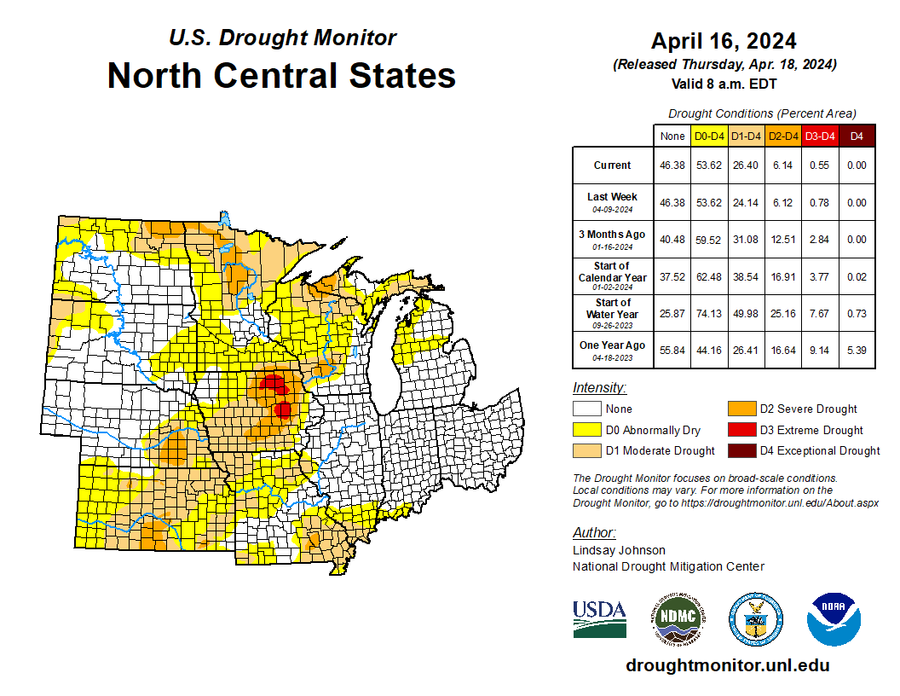
US Drought Monitor
Compared to last week:
Minor changes in drought category area (-/+).
Ohio is drought-free
Indiana, Michigan (lower), & Illinois are mostly drought-free.
D3 level drought persists in eastern IA.
199th consecutive week of IA having at least D1 conditions somewhere in the state
Note: D0 is not considered drought.
http://droughtmonitor.unl.edu/

Slide 15
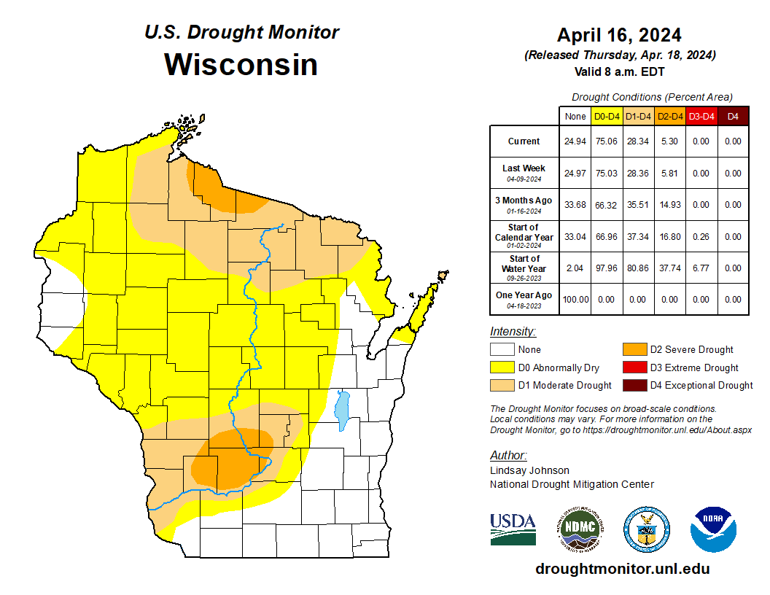
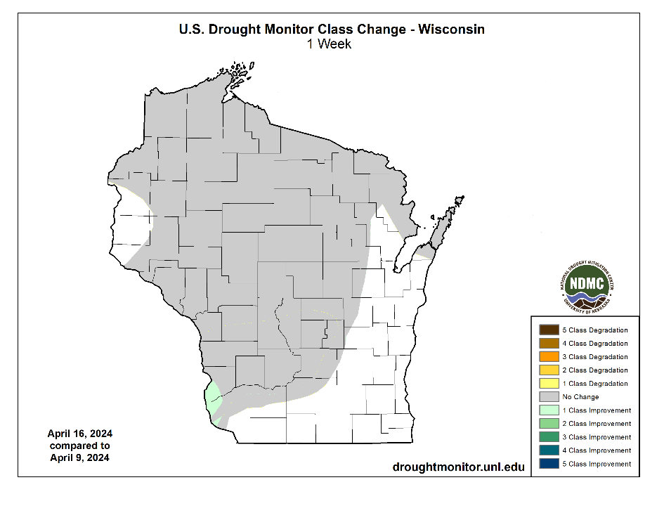
US Drought Monitor
Amount of state in:
D1-D4 – 28.3% --
D2-D4 – 5.3% ↓
D3-D4 – 0.0% --
D4 – 0.0% --
Note: ↑↓ indicate change from mid-February. Red up arrows indicate increase in drought area; vice-versa for green arrows.
http://droughtmonitor.unl.edu/

Slide 16
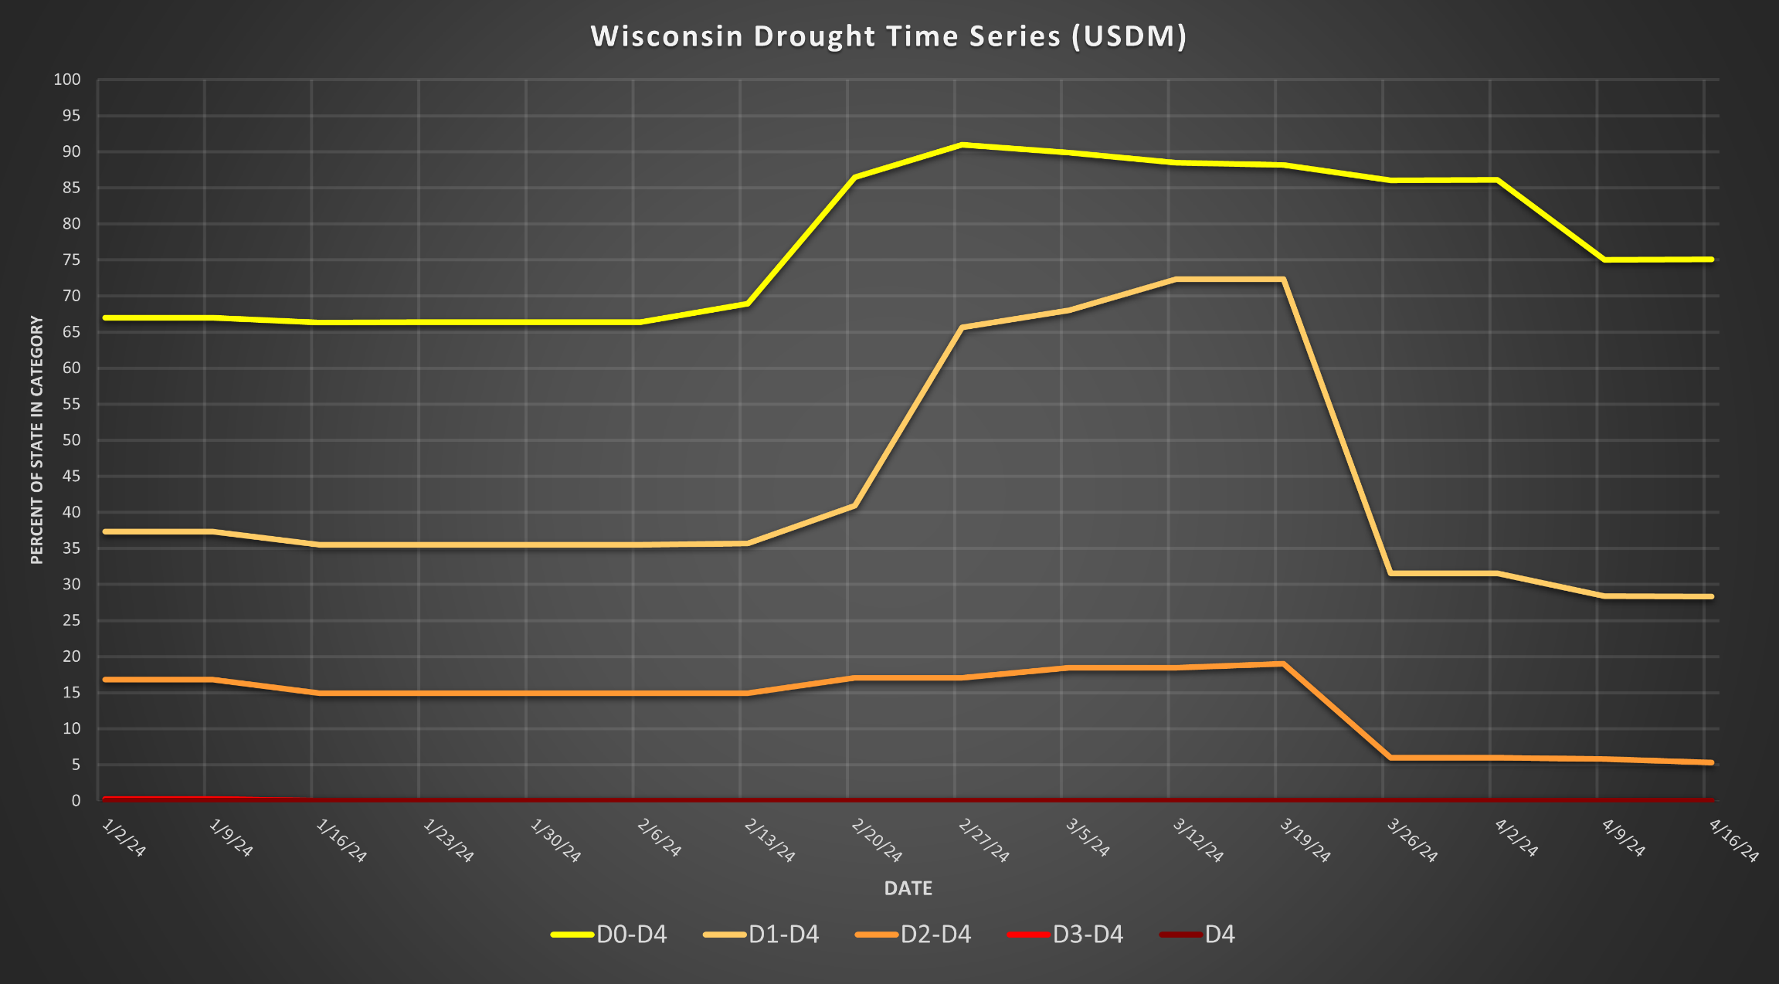
USDM Time Series
http://droughtmonitor.unl.edu/

Slide 17
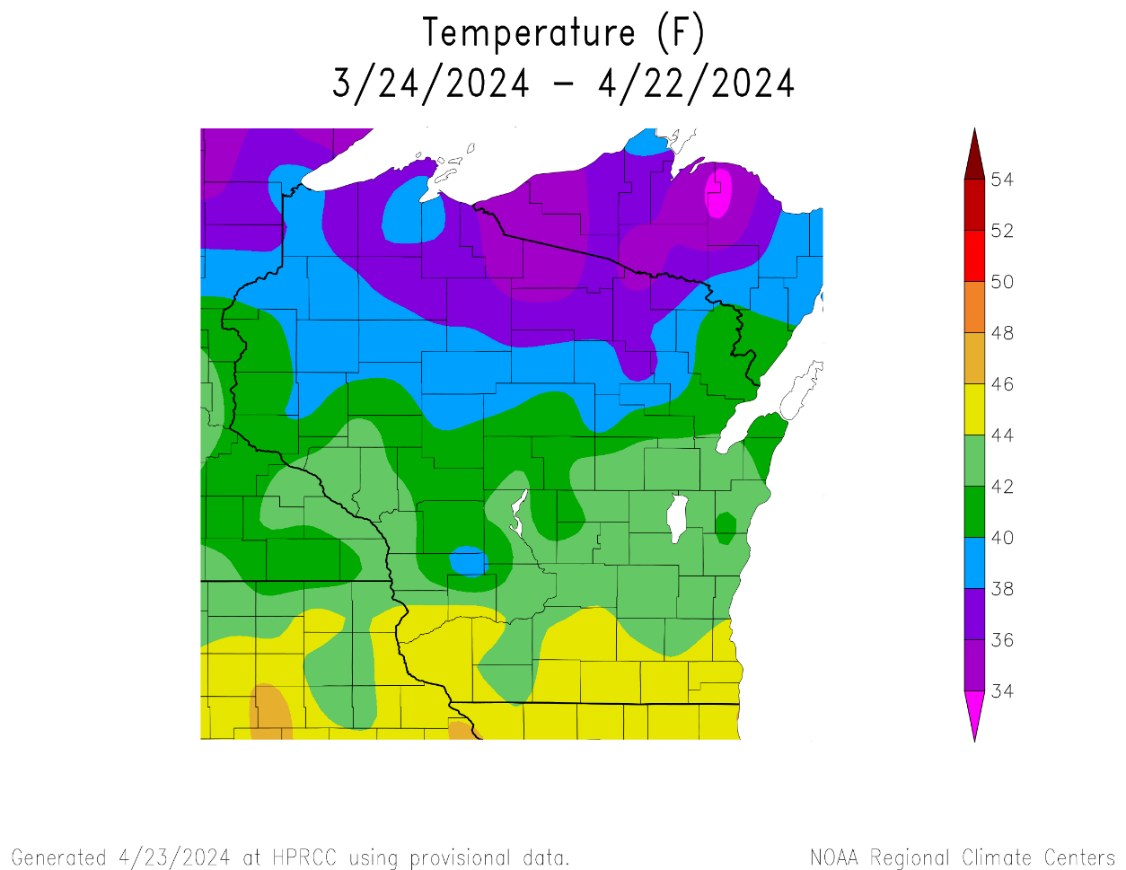
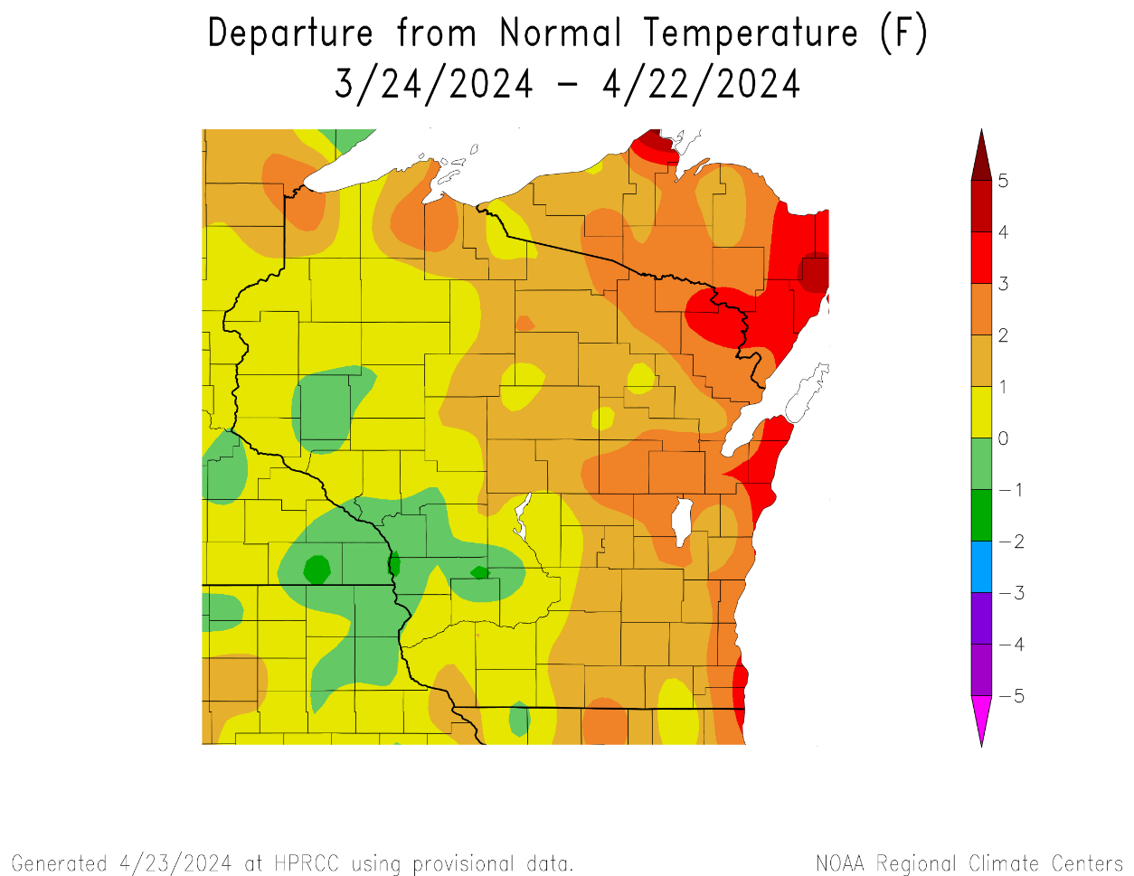
30 Day Temperatures
Temperatures over the last 30 days ranged from 42-46°F in the S to 34-38°F in the far N.
Warmer closer to Lake Michigan → 2-4°F above normal.
Cooler over in the Driftless Region → near normal or <1-2°F below normal
https://hprcc.unl.edu/maps.php?map=ACISClimateMaps

Slide 18
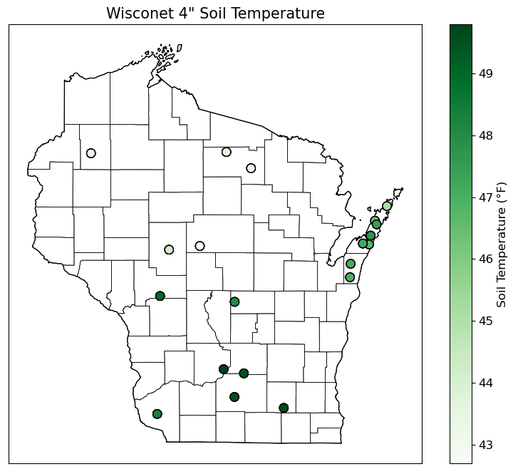
Soil Temperature - Wisconet
https://wisconet.wisc.edu/

Slide 19
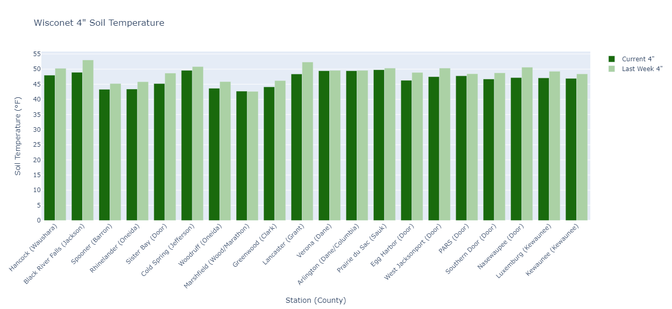
Soil Temperature - Wisconet
Current: 7-day average ending on 4/22
Last Week: 7-day average ending on 4/15
https://wisconet.wisc.edu/

Slide 20
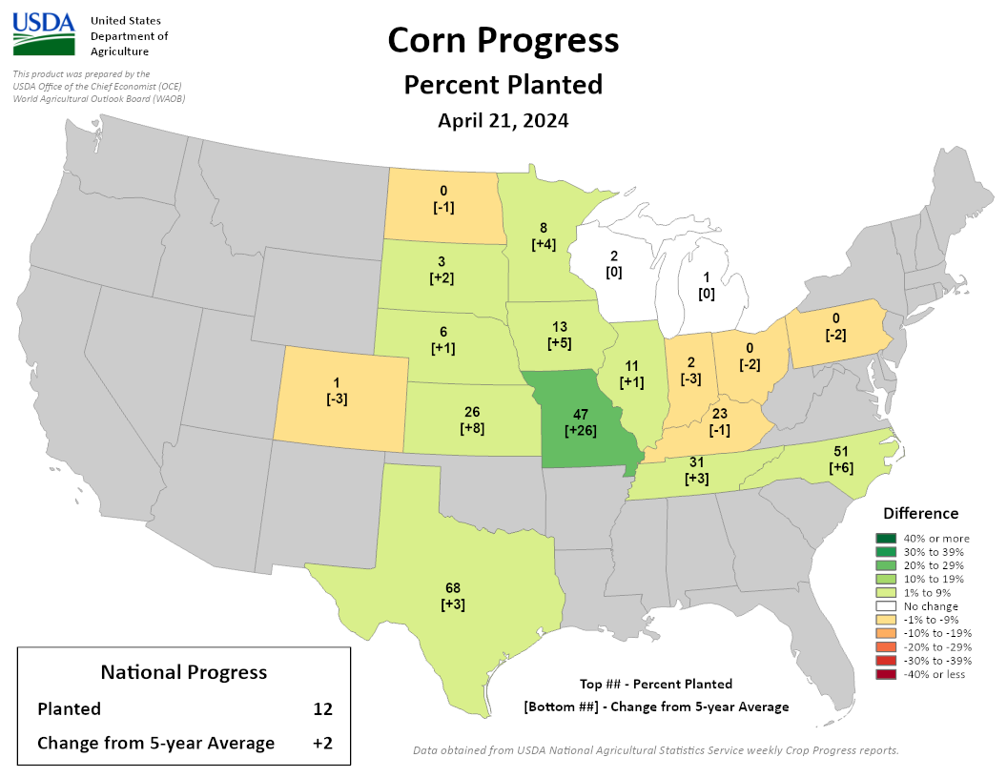
NASS Crop Progress – Corn
Planting is running at or ahead of the 5-year average in WI and state to the S and W.
Wisconsin → 2% complete; on pace with the 5-year average.
https://agindrought.unl.edu/Other.aspx

Slide 21
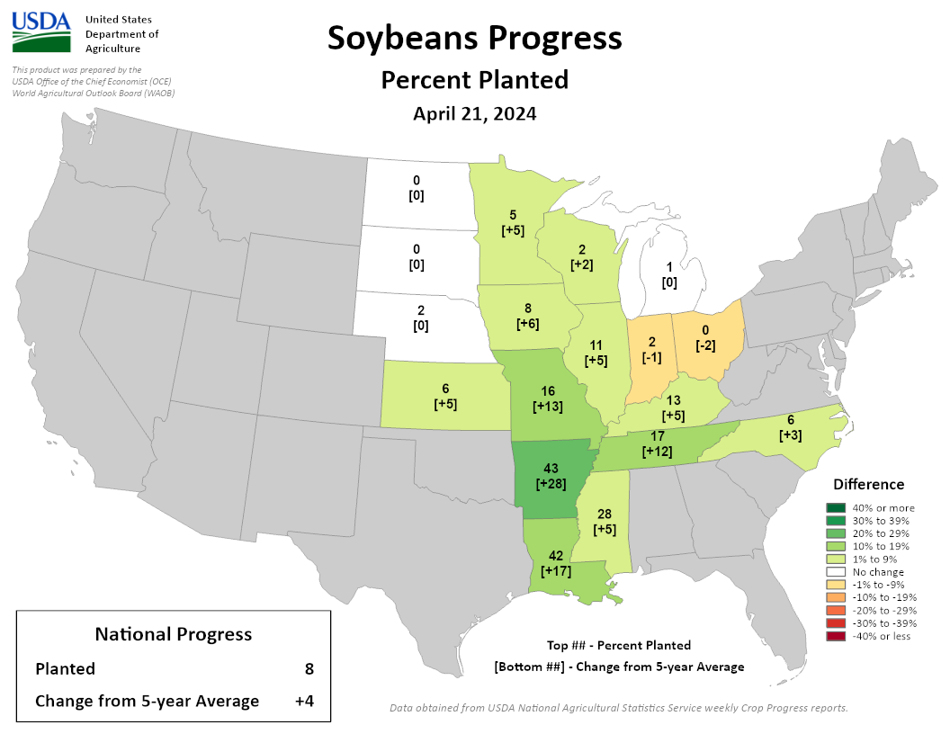
NASS Crop Progress – Soybean
Planting is running at or ahead of the 5-year average in WI and state to the S and W.
Wisconsin → 2% complete; ahead of the 5-year average.
https://agindrought.unl.edu/Other.aspx

Slide 22
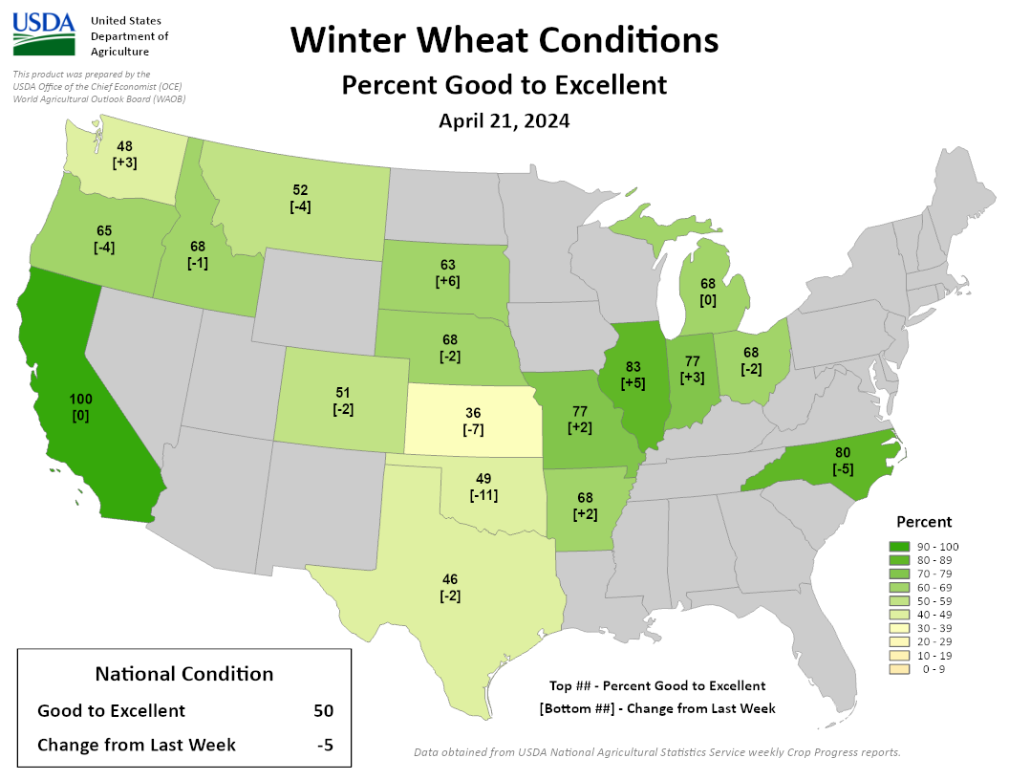
NASS Crop Progress – Winter Wheat
In states around Wisconsin, winter wheat condition is >70-80% good to excellent.
Improvement from last week.
https://agindrought.unl.edu/Other.aspx

Slide 23
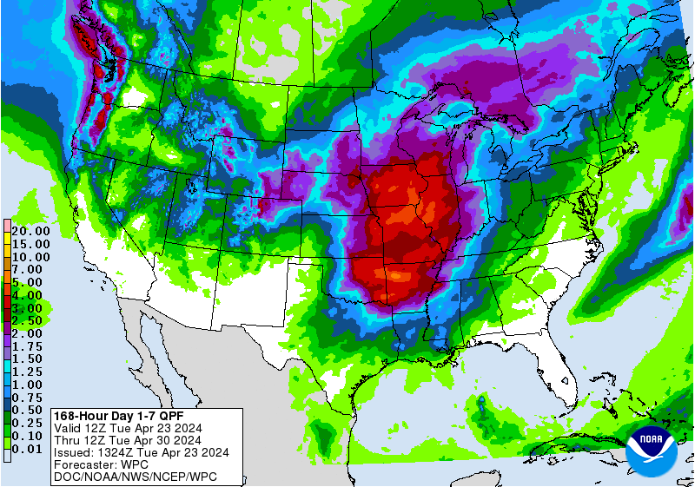
7 Day Precip Forecast
A very active week is forecasted for the state → 2.0” or more for most.
Multiple rounds of precip forecasted to impact the state Friday through Monday.
Forecast for 4/23/24 thru 4/30/24
(12Z = 7am CDT)
https://www.wpc.ncep.noaa.gov/qpf/p168i.gif

Slide 24
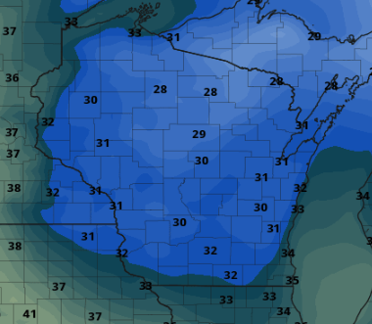
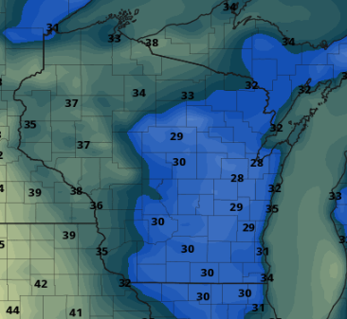
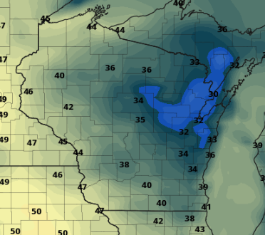
Freeze/Frost Risk
Morning of April 24
Morning of April 25
Morning of April 26
NAM model forecast - https://www.pivotalweather.com/

Slide 25
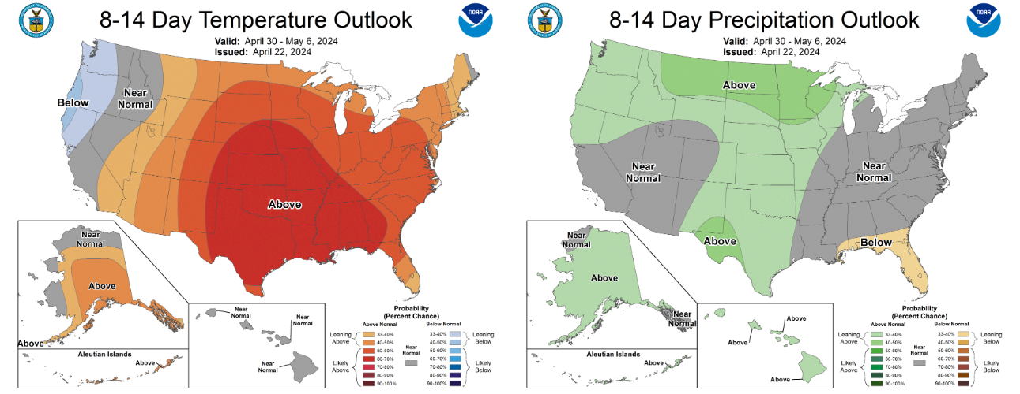
8-14 Day Temp & Precip Outlook
Beginning of May: Temperatures likely to be above normal. Precipitation is leaning above normal.
http://www.cpc.ncep.noaa.gov/

Slide 26
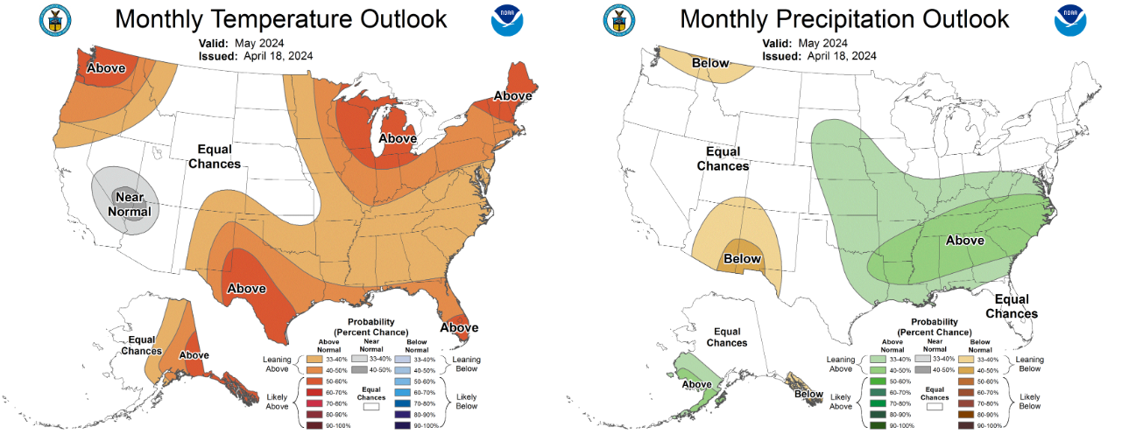
30 Day Temp & Precip Outlook
Month of May: Temperatures likely to be above normal. Precipitation is showing equal chances.
http://www.cpc.ncep.noaa.gov/

Slide 27
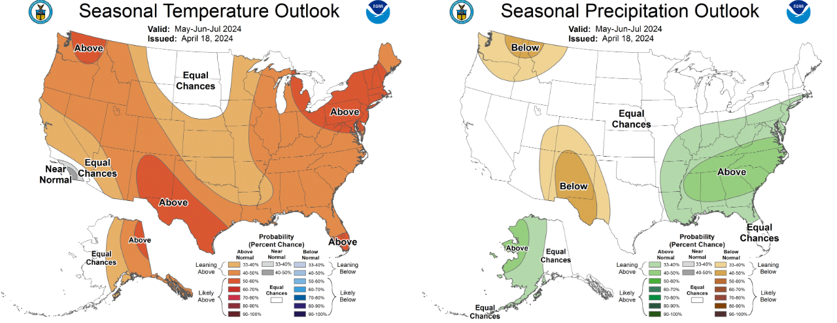
90 Day Temp & Precip Outlook
Late Spring into Summer: Temperatures leaning towards above normal. Precipitation indications are for equal chances of above/at/below average.
http://www.cpc.ncep.noaa.gov/

Slide 28
Take-Home Points
Current conditions:
At least 1” of rainfall for many in the state last week, capping a 30-day period where many have seen above-normal precip totals.
April temps have been at or a few degrees above normal for most.
Impact:
Soil moisture conditions improved slightly for most Wisconet stations.
Soil temperatures are in the mid to upper 40s statewide.
US Drought Monitor conditions in the state remain mostly unchanged from last week; removal of D2 drought from the Prairie du Chien area.
Corn and soybean planting is underway in the state, running near the 5-year average pace.
Outlook:
A rainy week is forecasted to wrap up April – some could see multiple inches of precip.
May will likely be warmer-than-average, with some uncertainty for precip (“equal chances”).
The warmer-than-normal conditions have a higher probability to persist into early summer.
A transition to La Nina is expected by June.

Slide 29
Agronomic Considerations
Planting Considerations
If planting early, consider planting depth adjustments to ensure planting into moisture. Also, check insurance policies.
Tillage may be tempting to dry out topsoil, but subsoil is often still dry so consider using methods which conserve soil moisture.
Nutrient & Herbicide Applications
Consider using a preplant nitrate test to assess if there is nitrogen left over from last year due to drought conditions.
Observe soil moisture conditions before doing fieldwork to avoid soil compaction.
Read herbicide labels from products used last year to assess if carryover is a possibility due to warmth and lack of moisture.
Manure Applications
DATCP is forecasting widespread moderate to severe runoff risk by later in the week, so consider delaying application until after precipitation.
Early season manure applications into warm soil conditions may lead to increased mineralization/nitrification and potential for N loss if receive “typical” heavy spring rainfall events, particularly if not applied to a growing cover crop or if the cash crop will not be planted soon after application.
Small Grains
Wheat N typically goes on at green up, which will be earlier than normal with warm conditions.
Potential for earlier planting of spring grains, if warmer weather continues. However, there is still a risk with potential for freeze.
Breaking Dormancy
Potential risk of freeze damage this week for perennial fruit crops that have budded out.
When seeding alfalfa, be aware that it can germinate at 32-34°F but will die if temperatures drop below 24°F, so it is best to wait to plant alfalfa until those low temperatures are unlikely.

Slide 30
User Survey
Are you a regular user of the Wisconsin Ag Climate Outlook (WACO)? Or maybe you are viewing these slides for the first time this week? Either way, we want to hear your feedback on this new resource! Please take a few minutes and fill out this survey:
LINK TO SURVEY
Your feedback will help us better serve your ag-climate data needs through WACO.
If you have any trouble accessing or filling out the survey, please email Josh Bendorf at Joshua.Bendorf@usda.gov.
Thank you!!
-The WACO Team

Slide 31
Citizen Science Opportunity
CoCoRaHS – Community Collaborative Rain, Hail, & Snow Network
The Mission
(From cocorahs.org)
Provide accurate high-quality precipitation data for end-users;
Increasing the density of precipitation data available throughout the country;
Encouraging citizens to have fun participating in meteorological science and heightening their awareness about weather;
Providing weather education opportunities.
Sign Up Here: https://cocorahs.org/Content.aspx?page=application

Slide 32
Contact Info
Photo Credit: USDA
Natasha Paris
Crops Educator – Adams, Green Lake, Marquette, Waushara Cos.
natasha.paris@wisc.edu
Kristin Foehringer
NRCS State Working Lands Climate Smart Specialist
kristin.foehringer@usda.gov
Dennis Todey
Director, Midwest Climate Hub
dennis.todey@usda.gov
Josh Bendorf
Ag Climatologist Fellow, Midwest Climate Hub
joshua.bendorf@usda.gov
Steve Vavrus
State Climatologist of Wisconsin
sjvavrus@wisc.edu
Bridgette Mason
Assistant State Climatologist of Wisconsin
bmmason2@wisc.edu

