Slide 1
Wisconsin Ag Climate Outlook Week of April 15, 2024
Natasha Paris
Crops Educator – Adams, Green Lake, Marquette, Waushara Cos.
natasha.paris@wisc.edu
Kristin Foehringer
NRCS State Working Lands Climate Smart Specialist
kristin.foehringer@usda.gov
Dennis Todey
Director, Midwest Climate Hub
dennis.todey@usda.gov
Josh Bendorf
Ag Climatologist Fellow, Midwest Climate Hub
joshua.bendorf@usda.gov
Steve Vavrus
State Climatologist of Wisconsin
sjvavrus@wisc.edu
Bridgette Mason
Assistant State Climatologist of Wisconsin
bmmason2@wisc.edu

Slide 2
Key Points
Despite abundant precipitation 4/16-4/17, a combination of week-long dryness and warmth decreased 7-day average soil moisture and increased soil temperature.
US Drought Monitor showed slight improvement for parts of the state, but remains largely unchanged since last week.
Late April likely to see above-normal temps with a slight lean toward above-normal precip.

Slide 3
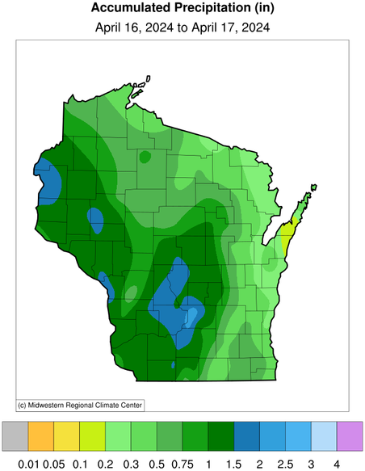
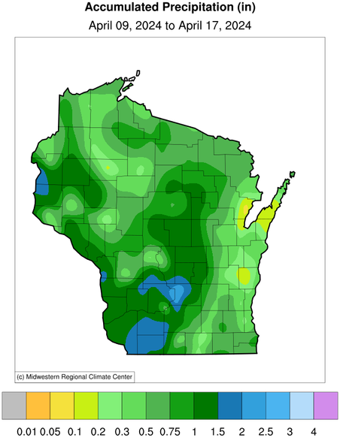
24 Hour and 7 Day Precip
The SW and NW received much-needed precip (1-2”) over the last week, while areas around Green Bay saw just 0.1-0.2”
Most of the 7-day precip fell as rain between Tue (4/16)-Wed (4/17)
24 Hour
7 Day
https://mrcc.purdue.edu/CLIMATE/

Slide 4
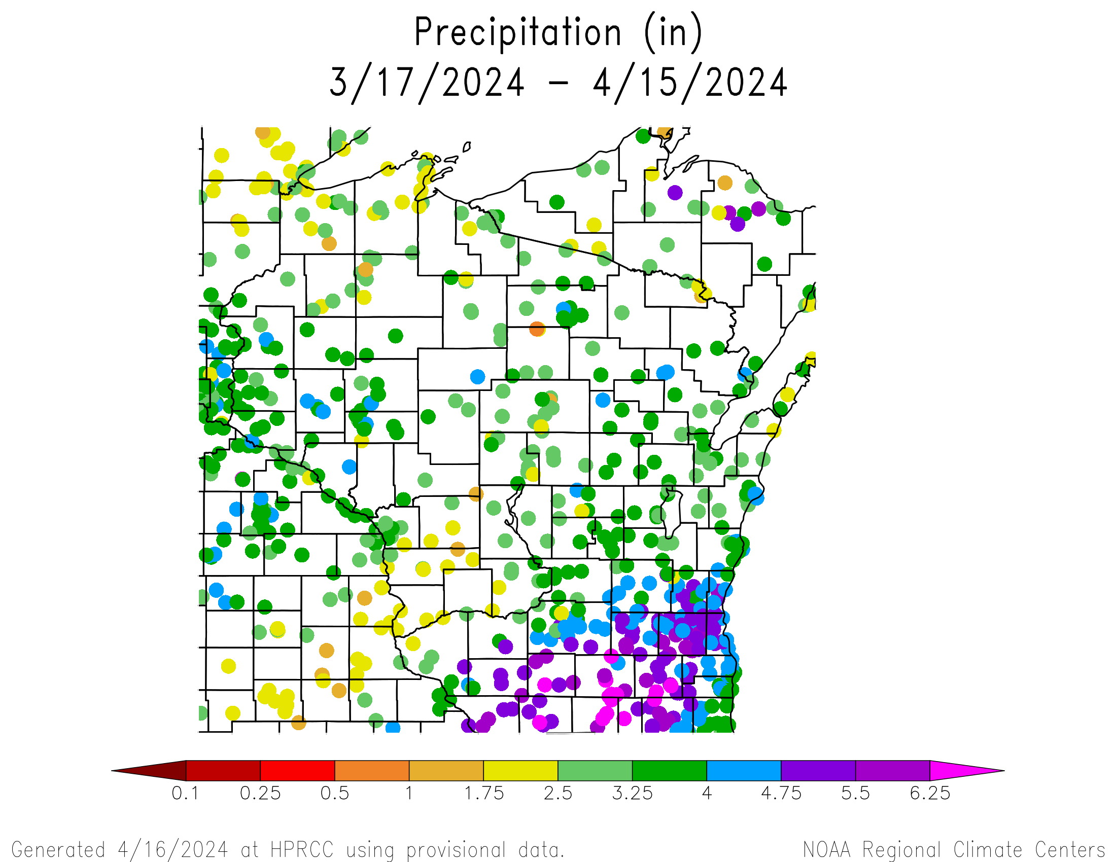
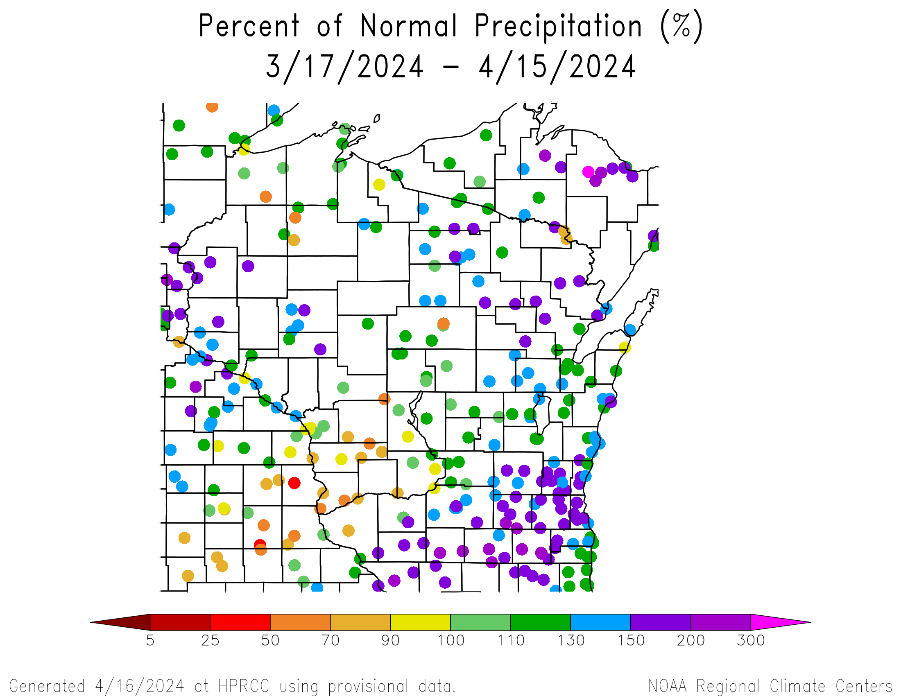
30 Day Precip Total/% Normal.
Highest precip totals in the SE (>4”) and lowest in the Driftless & far NW (<2.5”)
Majority of stations at or above normal, except for some in the SW and NW
https://hprcc.unl.edu/maps.php?map=ACISClimateMaps

Slide 5
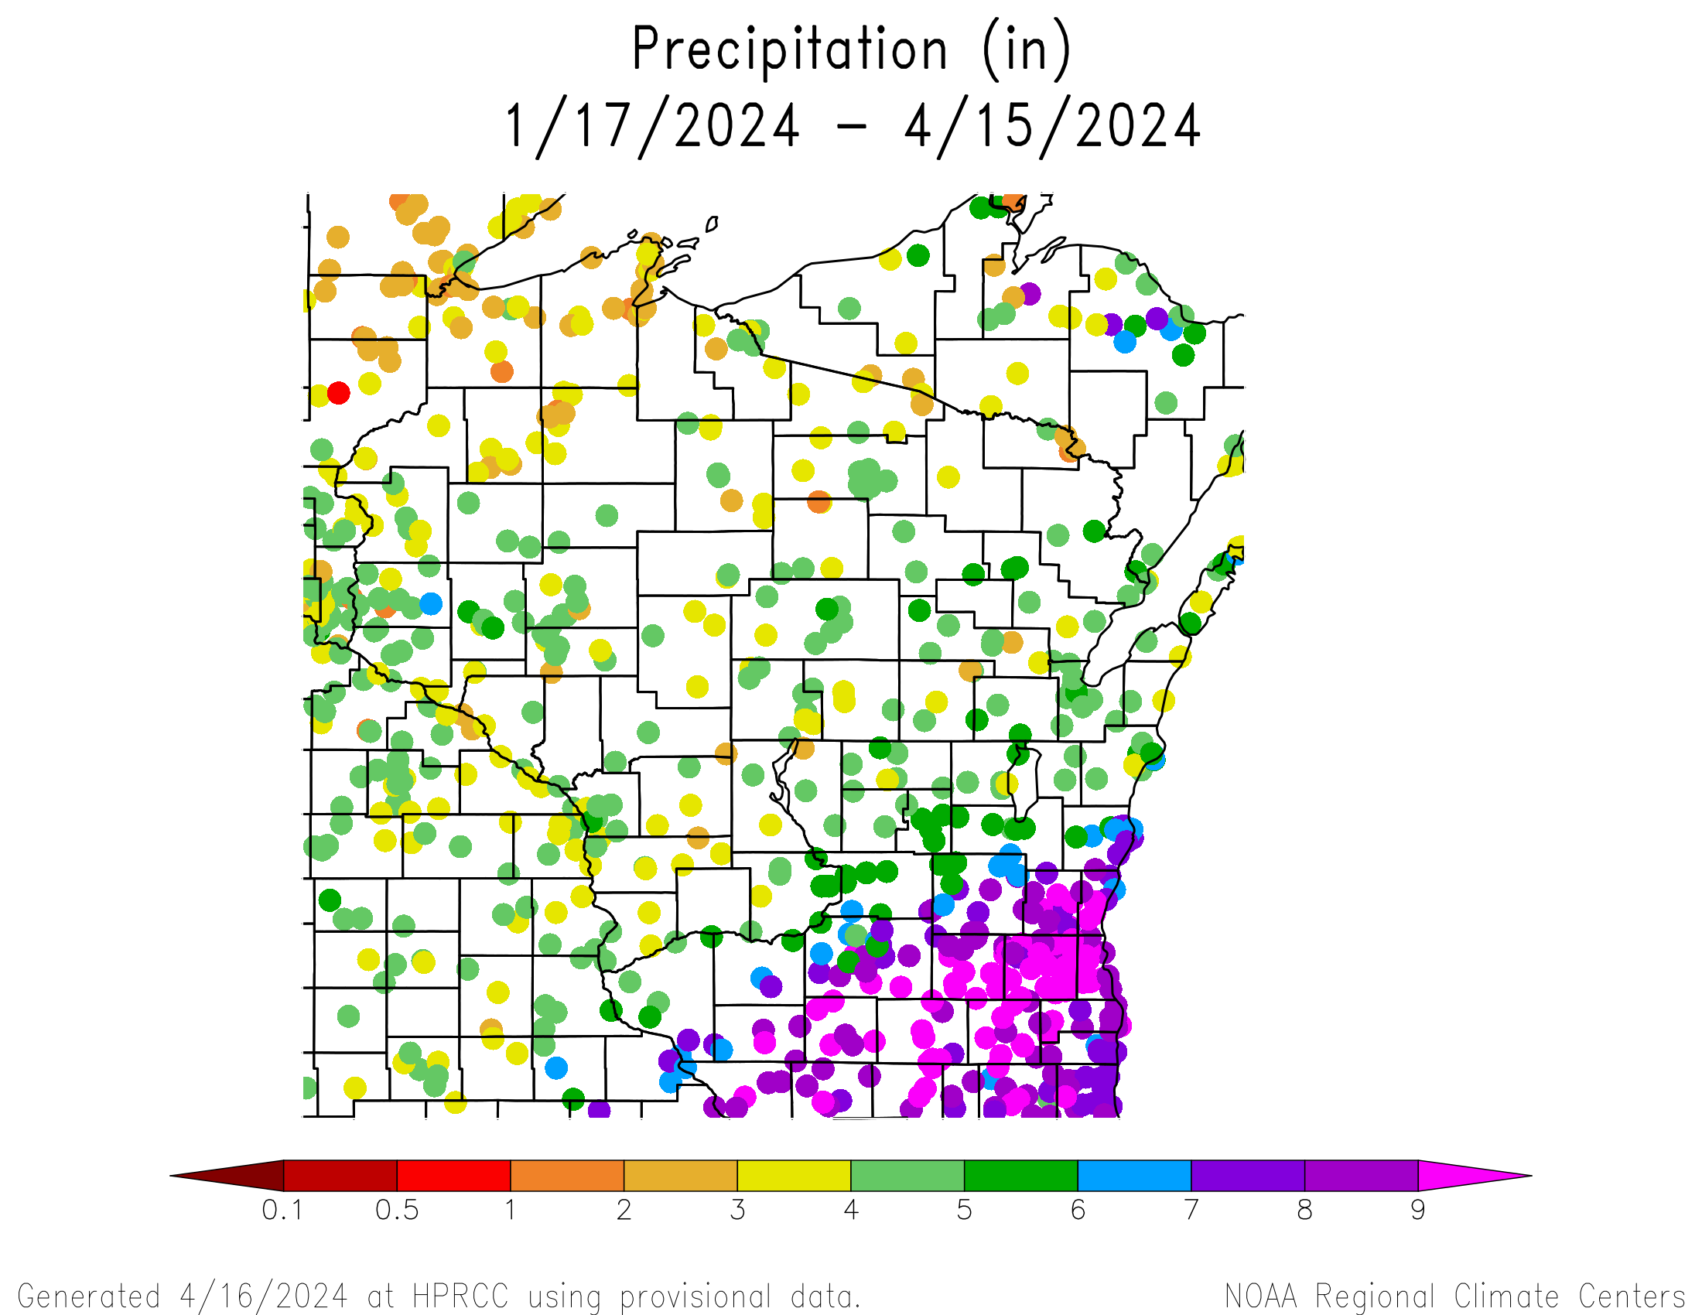
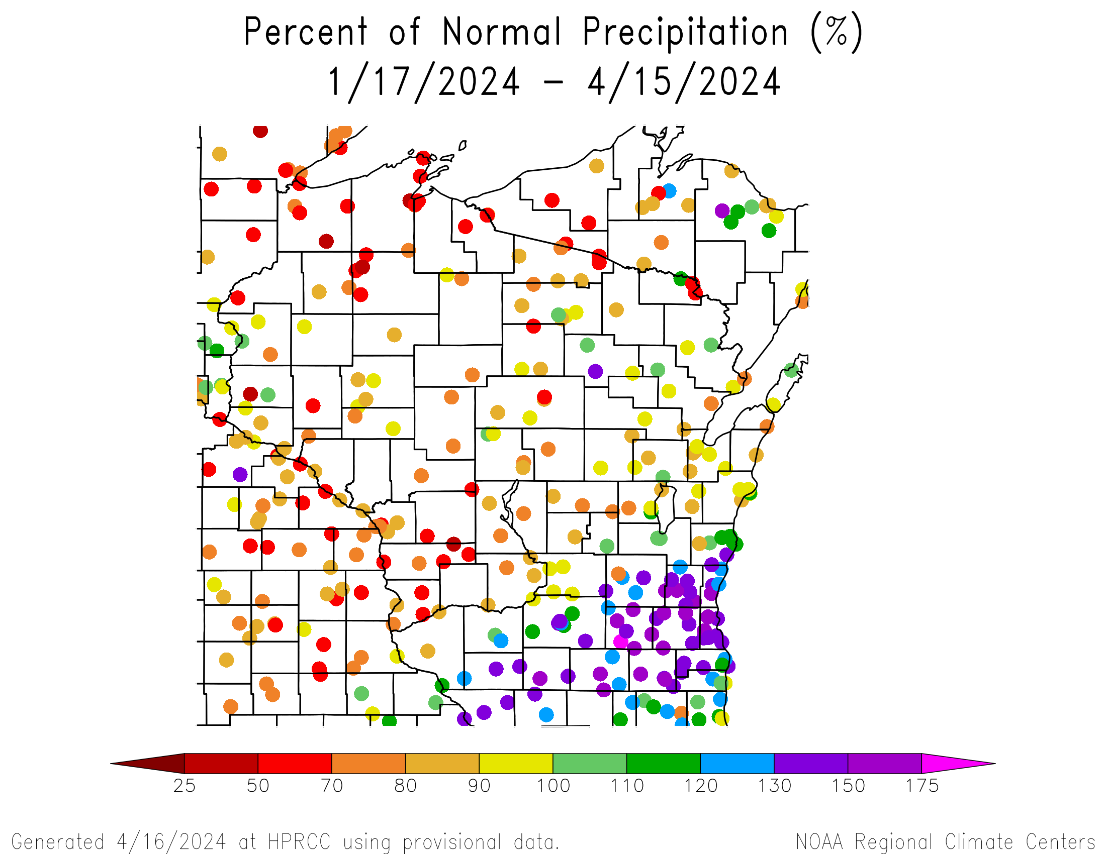
90 Day Precip Total/% Normal.
Highest precip totals in the SE (>7”) and lowest in the NW (<3”)
130+% of normal precip in the SE
<100% of normal across much of the state, with multiple stations recording <70% of normal
https://hprcc.unl.edu/maps.php?map=ACISClimateMaps

Slide 6
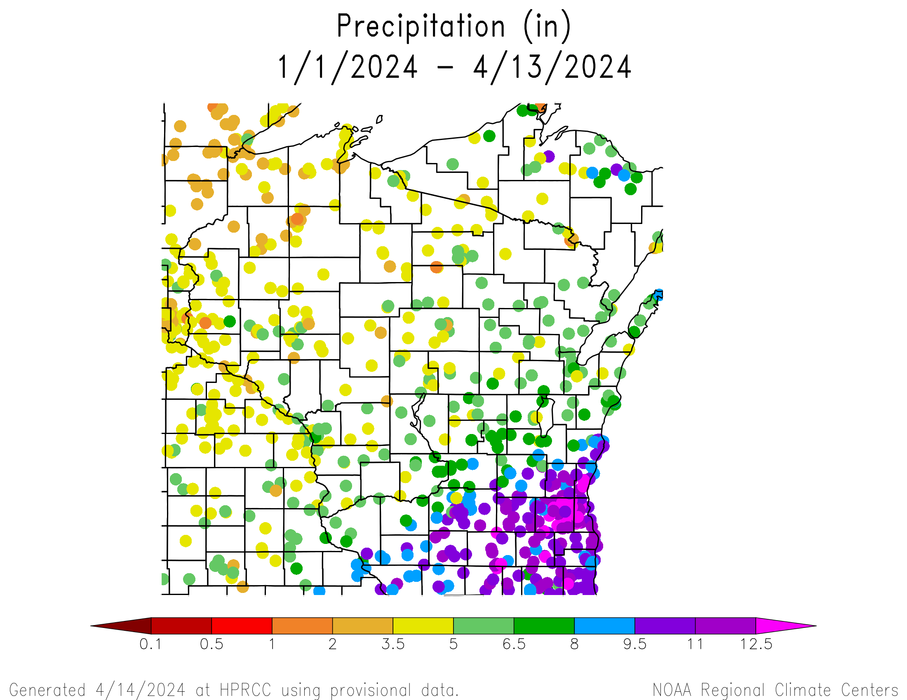
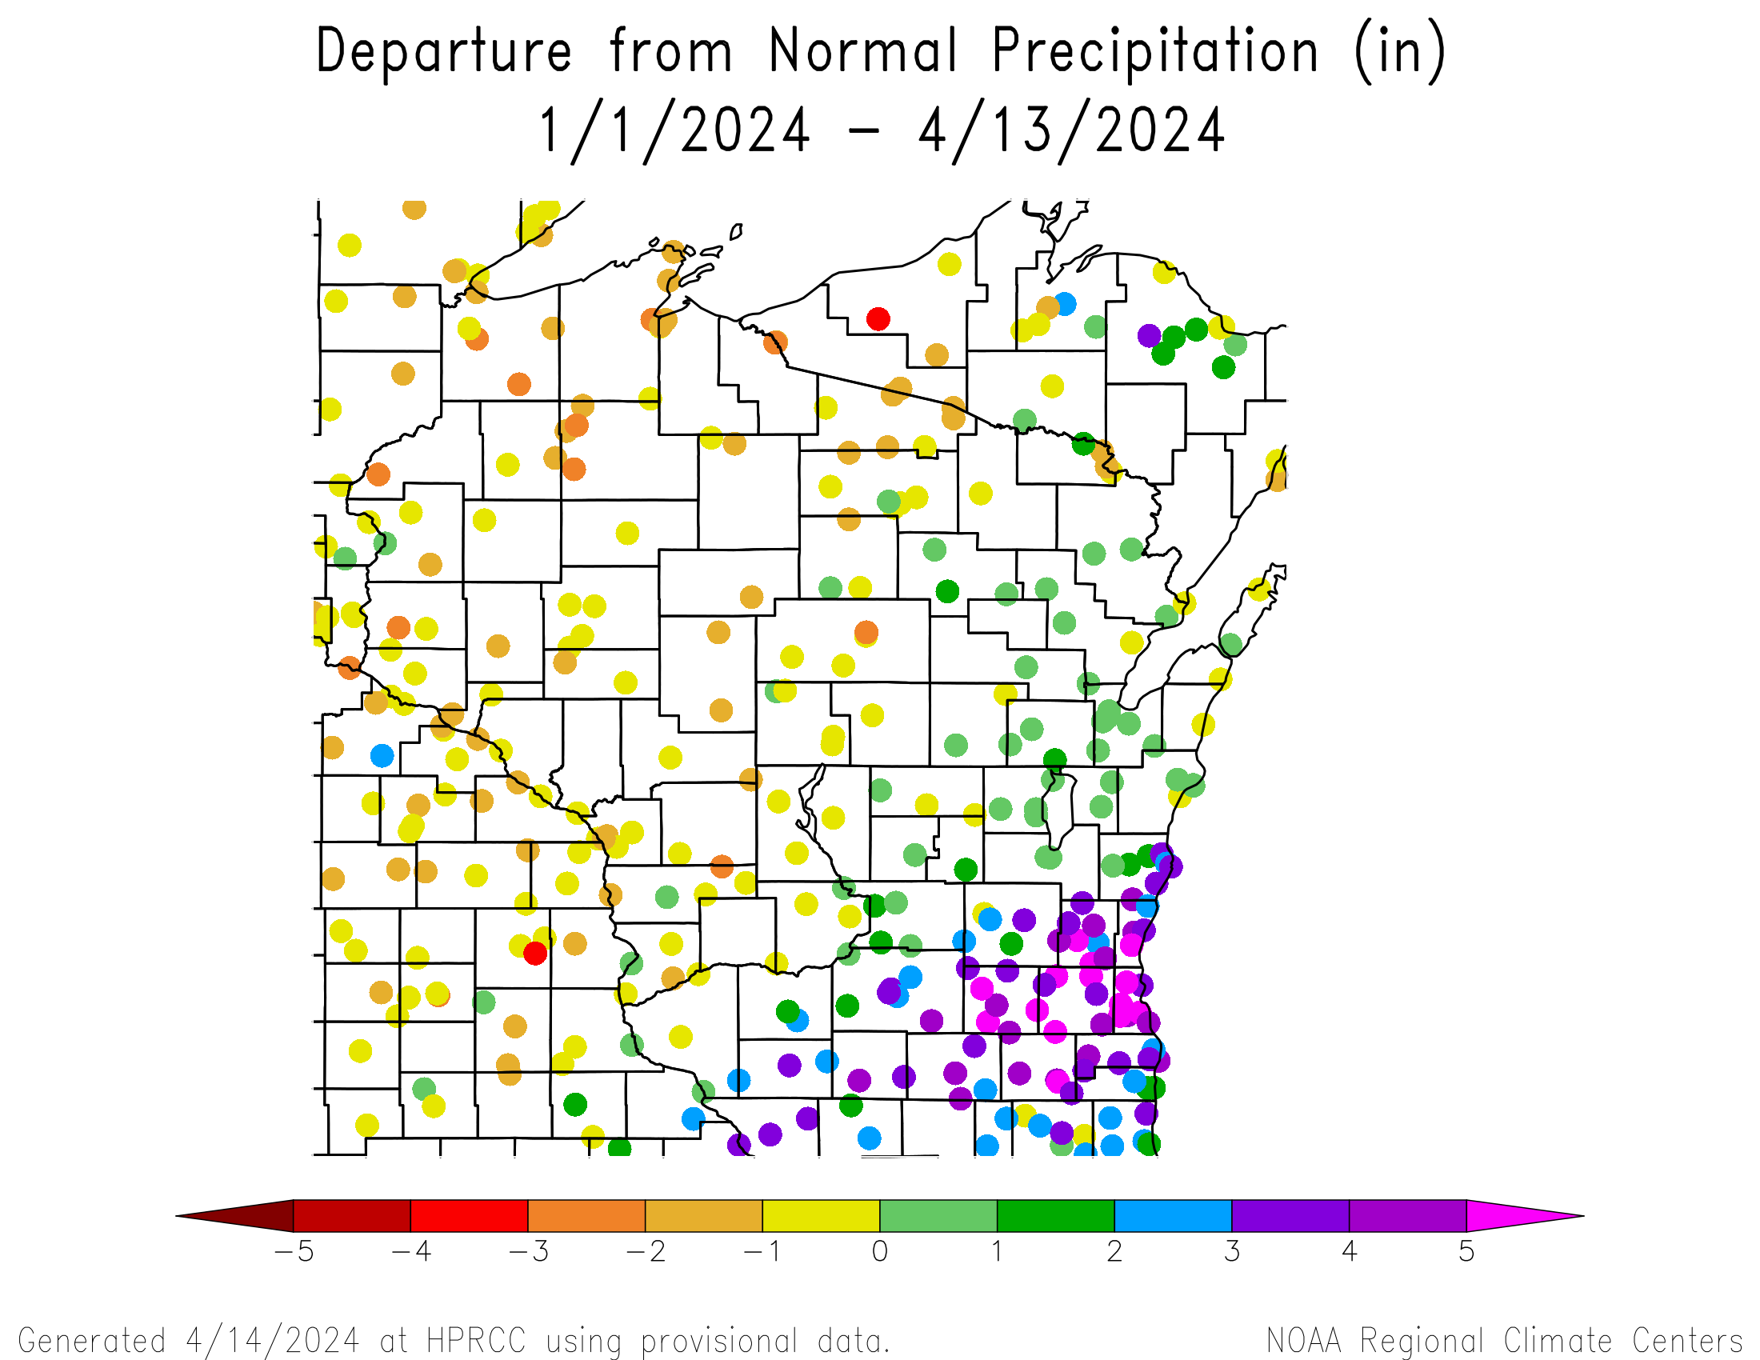
Precipitation since Jan. 1
https://hprcc.unl.edu/maps.php?map=ACISClimateMaps

Slide 7
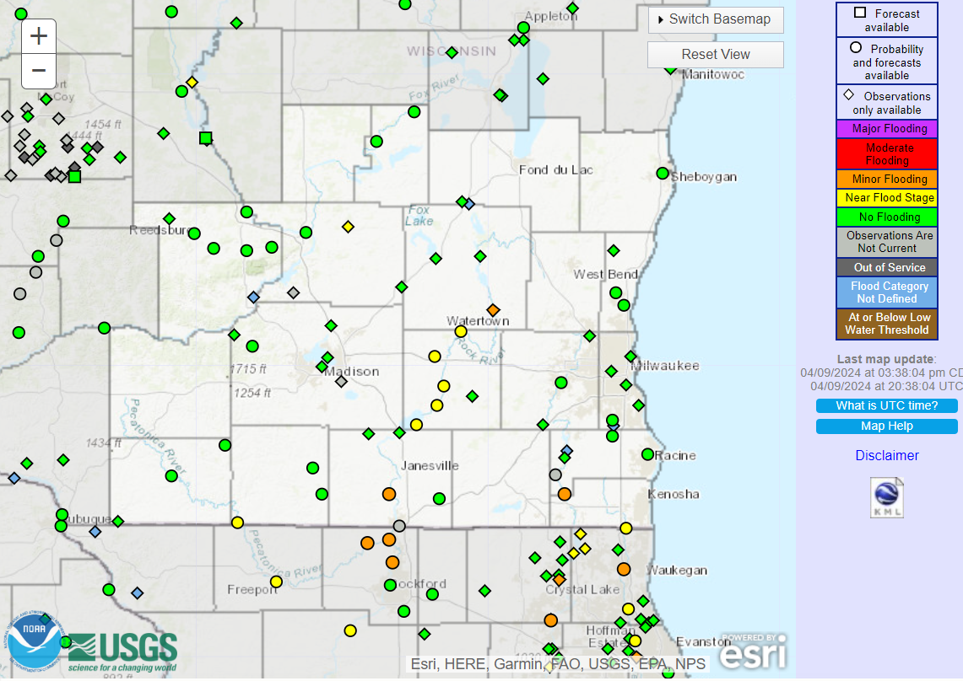
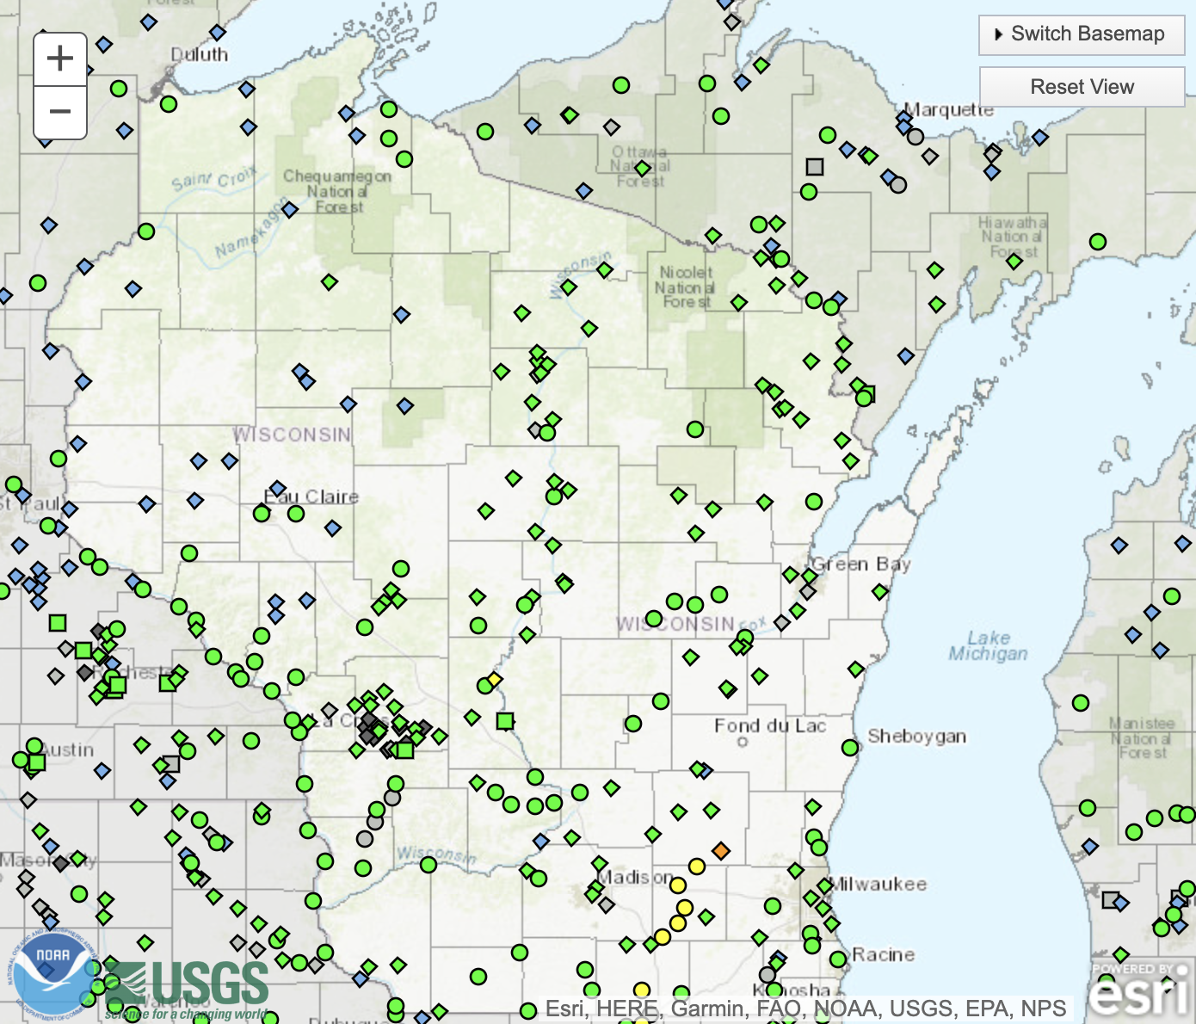
River Levels
With the lack of precipitation this past week, flooding is not present for most of Wisconsin.
There remain a handful of stations near or at minor flood stage in SE WI.
https://water.weather.gov/ahps/
https://www.weather.gov/lot/hydrology_definitions

Slide 8
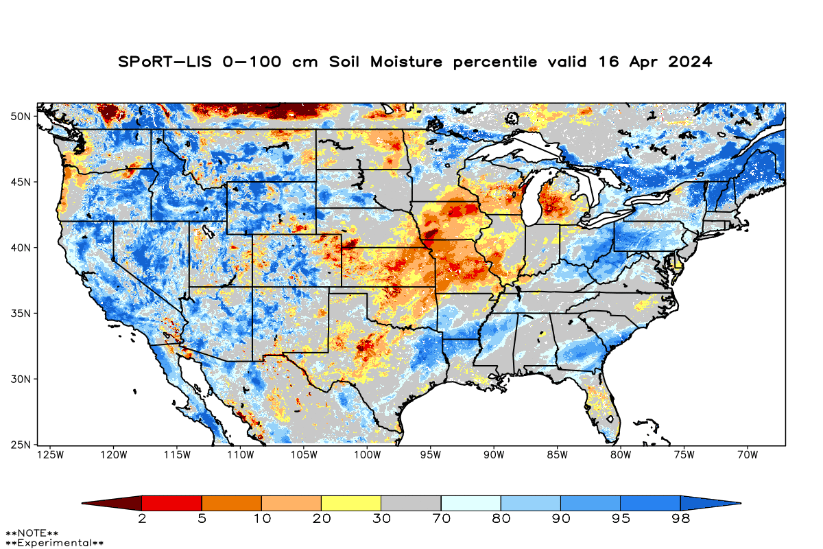
Soil Moisture Models
Expansion of dry soils across the southern half of the state due to the lack of precipitation
Driest soil moisture conditions remain for the Door County area, according to this model.
Model Notes:
Red areas: top 5 driest in 100 years
Dark red areas: top 2 driest in 100 years
It’s worth noting that each soil moisture model has their own characteristics and input variables, so there tends to be variation between models. Thus, it’s worthwhile to look at multiple models opposed to just one.
https://weather.msfc.nasa.gov/sport/case_studies/lis_CONUS.html

Slide 9
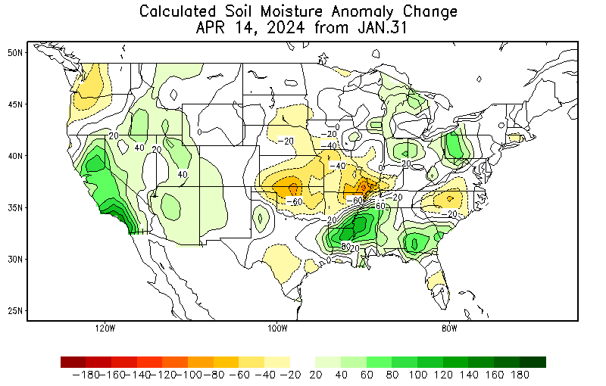
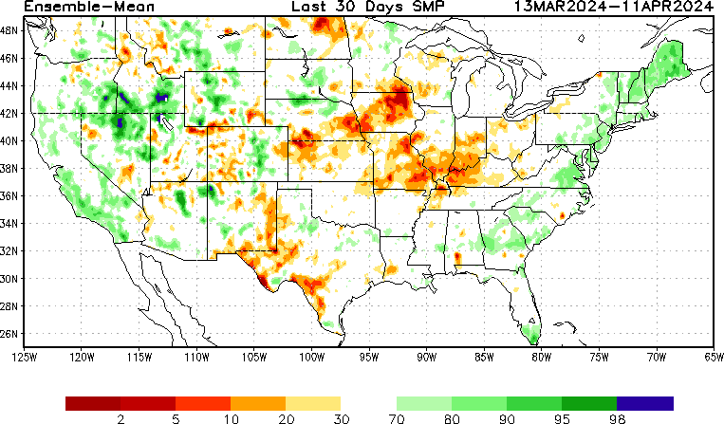
Soil Moisture Models
Soil moisture improvement in SE WI since January
30-day soil moisture percentile continues to show drier conditions in SW and N WI
https://www.cpc.ncep.noaa.gov/products/Soilmst_Monitoring/US/Soilmst/Soilmst.shtml
https://www.cpc.ncep.noaa.gov/products/Drought/Monitoring/smp_new.shtml#

Slide 10
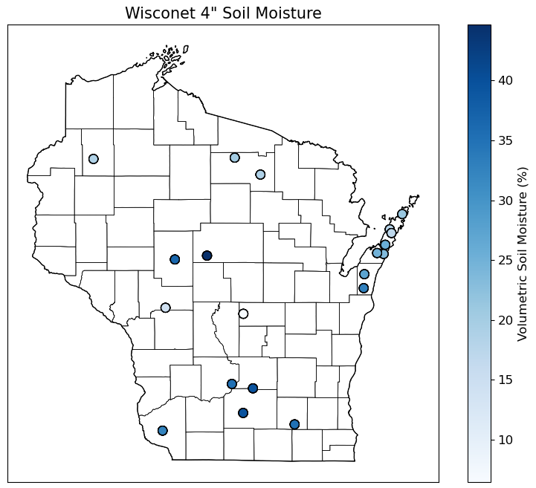
Soil Moisture - Wisconet
4” soil moisture over the last 7 days (4/9-4/15) ranged from 5-45%
https://wisconet.wisc.edu/

Slide 11
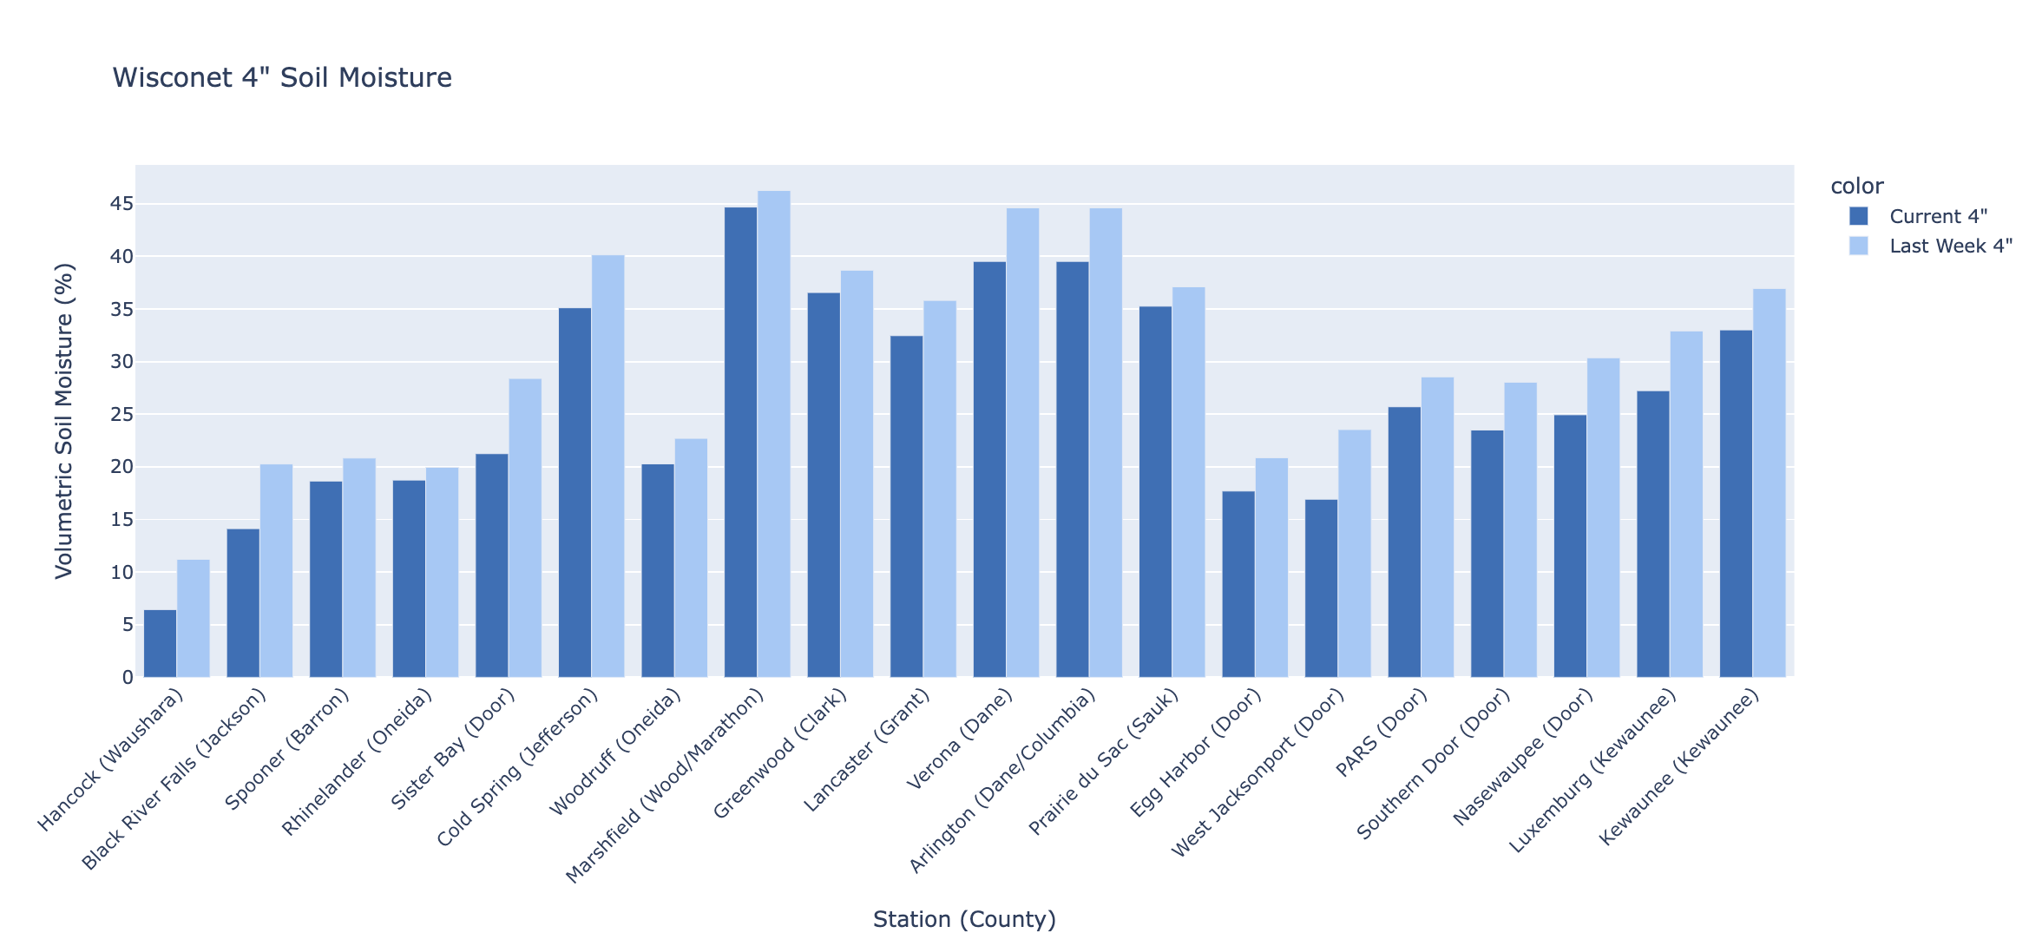
Soil Moisture - Wisconet
Current: 7-day average ending on 4/15
Last Week: 7-day average ending on 4/8
https://wisconet.wisc.edu/

Slide 12
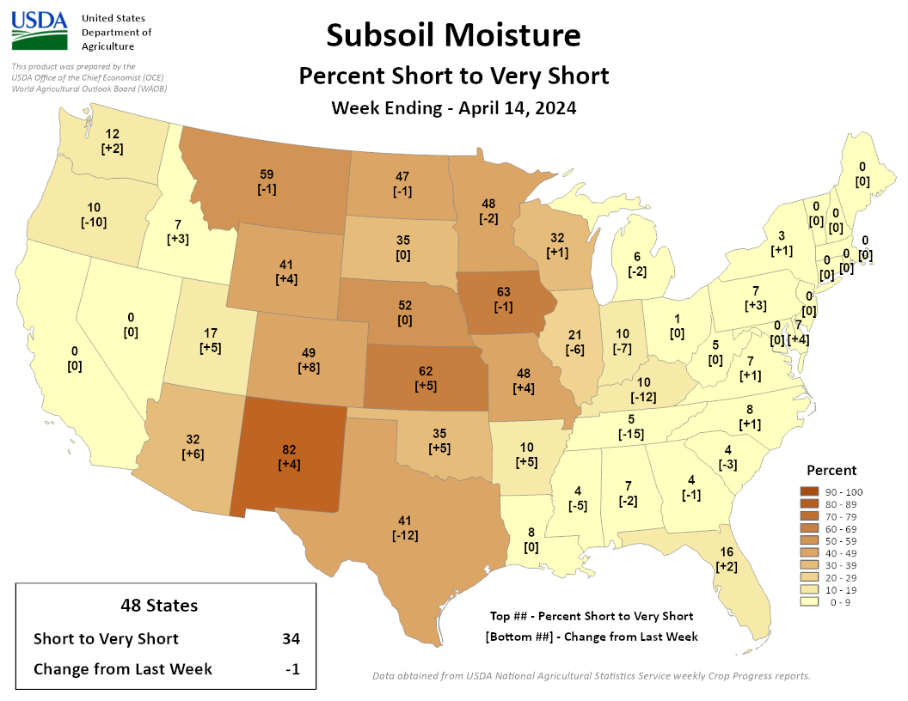
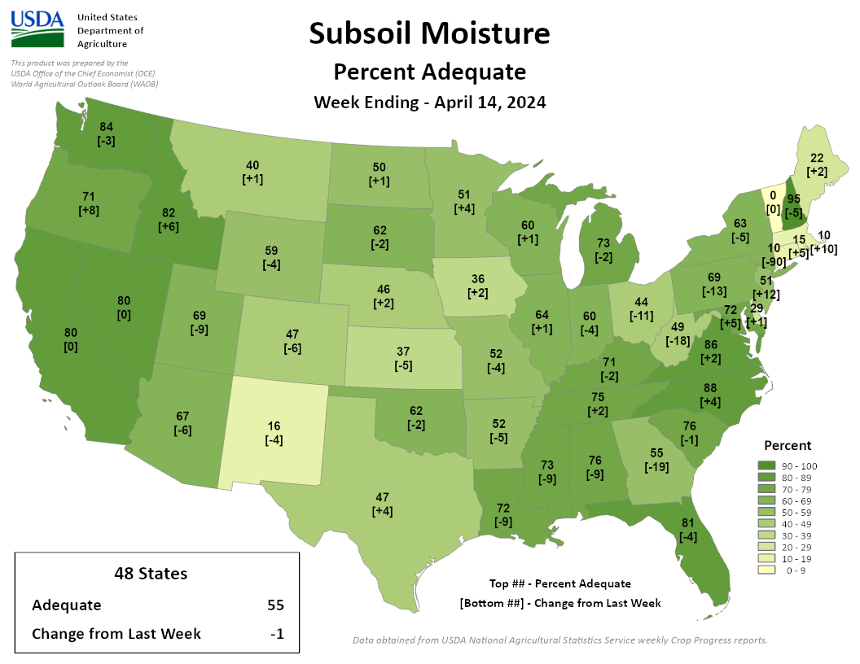
NASS Subsoil Moisture
https://agindrought.unl.edu/Other.aspx

Slide 13
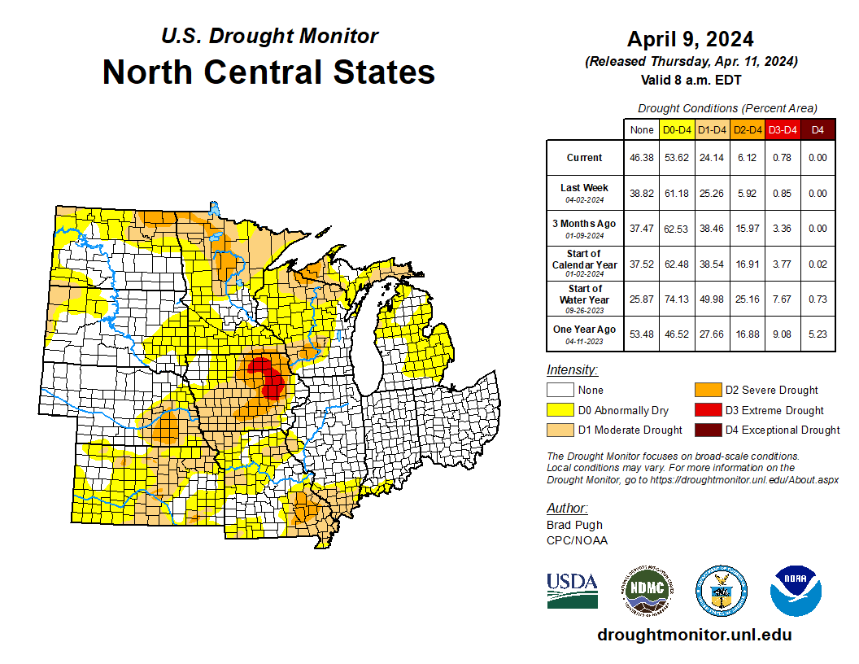
US Drought Monitor
Compared to last week:
Minor changes in drought category area (-/+)
Ohio is drought-free
Lower Michigan & Indiana are nearly drought-free
D3 level drought persists in eastern IA
198th consecutive week of IA having at least D1 conditions somewhere in the state
Note: D0 is not considered drought.
http://droughtmonitor.unl.edu/

Slide 14
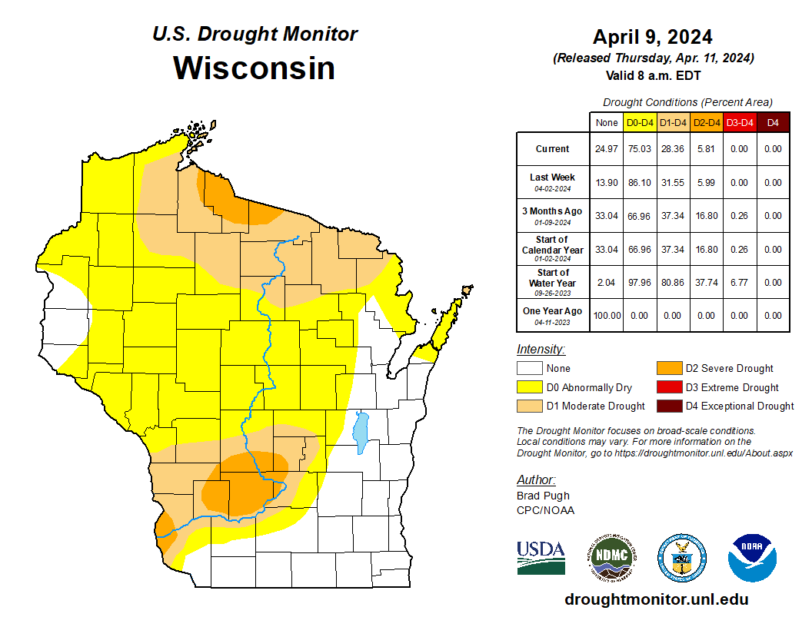
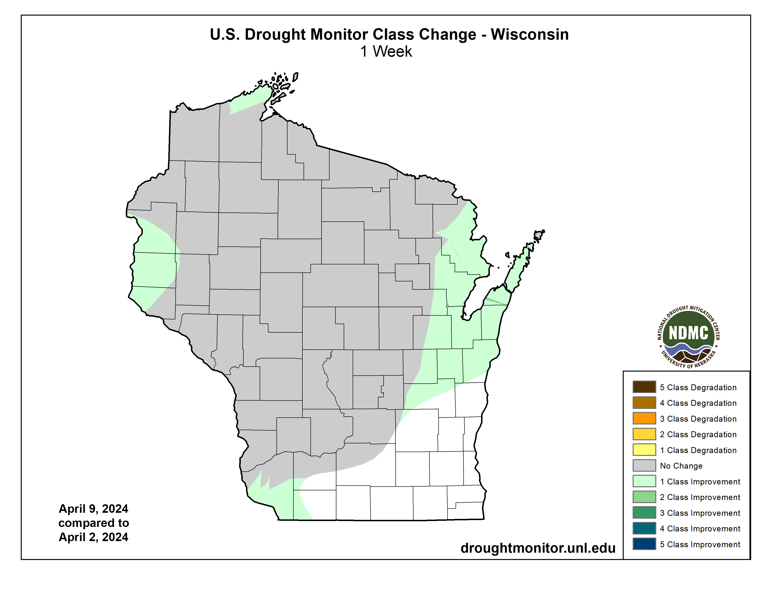
US Drought Monitor
Amount of state in:
D1-D4 – 28.36% ↓
D2-D4 – 5.81% ↓
D3-D4 – 0.0% --
D4 – 0.0% --
Note: ↑↓ indicate change from previous week. Red up arrows indicate increase in drought area; vice-versa for green arrows.
http://droughtmonitor.unl.edu/

Slide 15
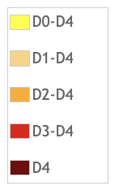
USDM Time Series
http://droughtmonitor.unl.edu/

Slide 16
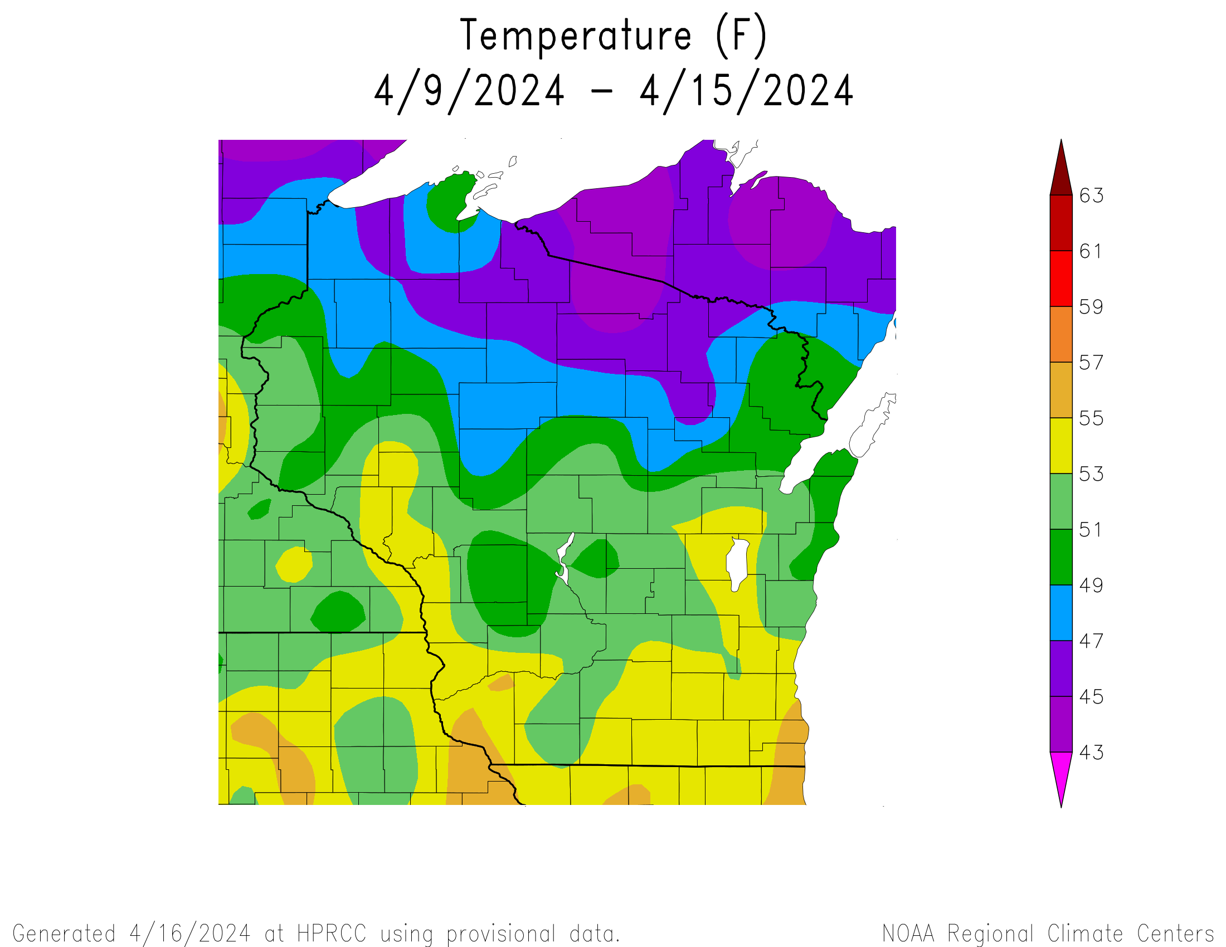
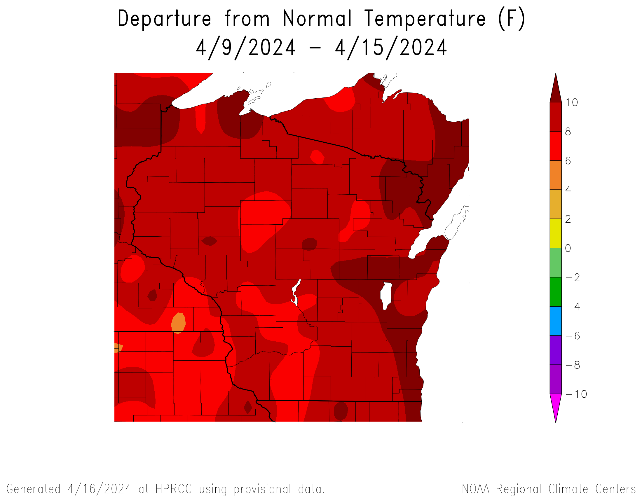
7 Day Temperatures
Temperatures over the last 7 days ranged from 51-55°F in the S to 45-49°F in the N
The entire state was 6-10°F warmer-than-normal
https://hprcc.unl.edu/maps.php?map=ACISClimateMaps

Slide 17
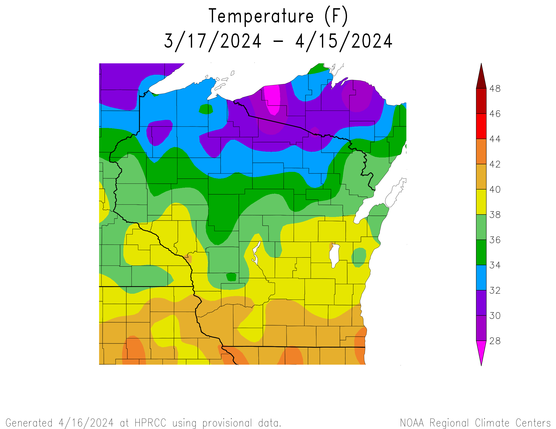
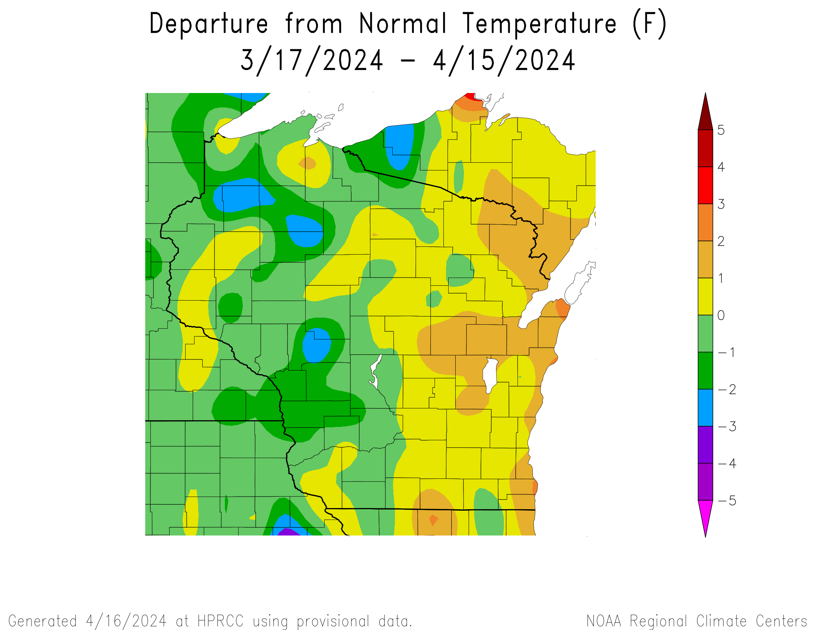
30 Day Temperatures
Temperatures over the last 30 days ranged from 38-42°F in the S to 30-36°F in the N
Generally, eastern WI was 0-2°F above average while western WI was 0-3°F below average
https://hprcc.unl.edu/maps.php?map=ACISClimateMaps

Slide 18
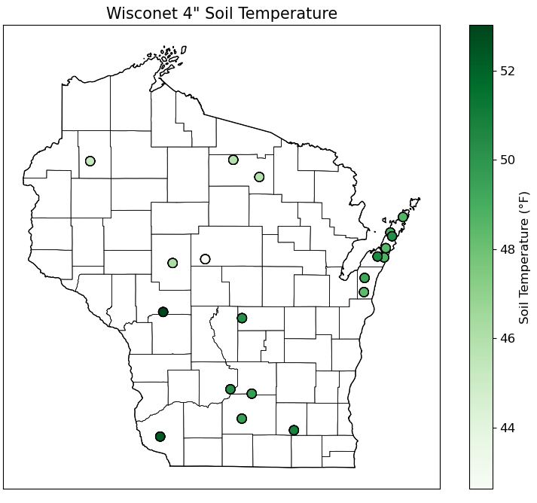
Soil Temperature - Wisconet
4” soil temperatures over the last 7 days (4/9-4/15) ranged from 43-53°F
https://wisconet.wisc.edu/

Slide 19
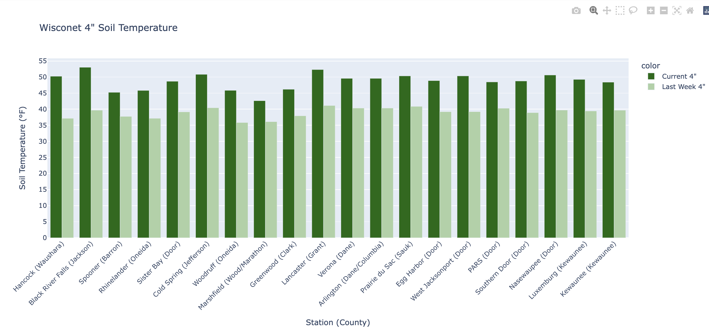
Soil Temperature - Wisconet
Current: 7-day average ending on 4/15
Last Week: 7-day average ending on 4/8
https://wisconet.wisc.edu/

Slide 20
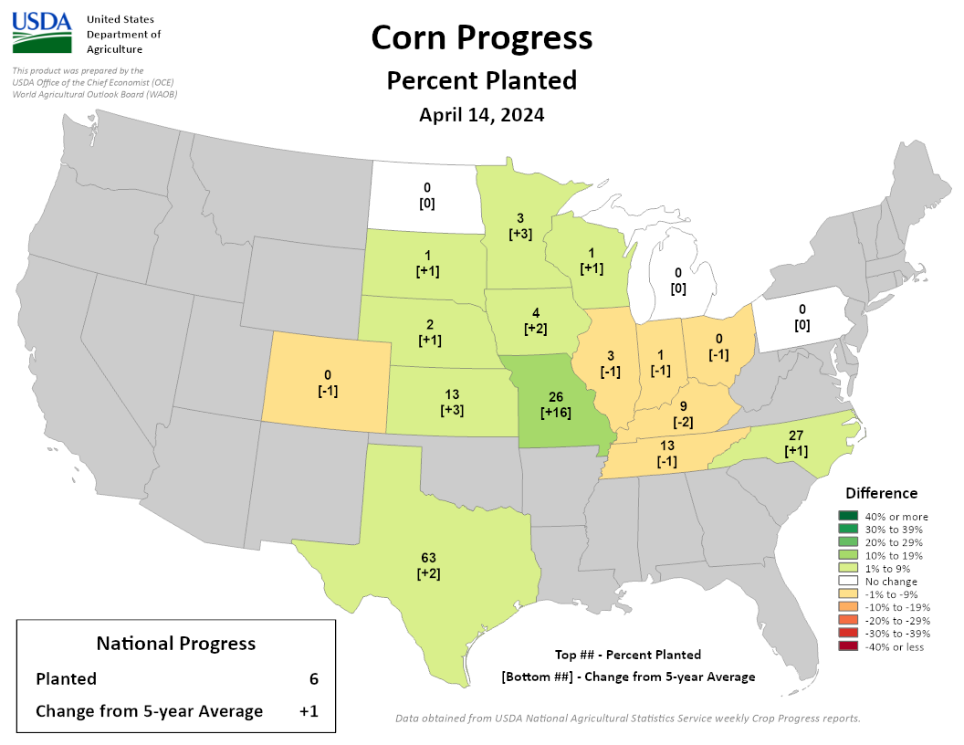
NASS Crop Progress – Corn
Scattered corn planting was reported in eastern and southern WI
This is slightly ahead of schedule for WI
States to the west (south-southeast) are slightly ahead of (behind) schedule, with the exception of Missouri being greatly ahead
https://agindrought.unl.edu/Other.aspx

Slide 21
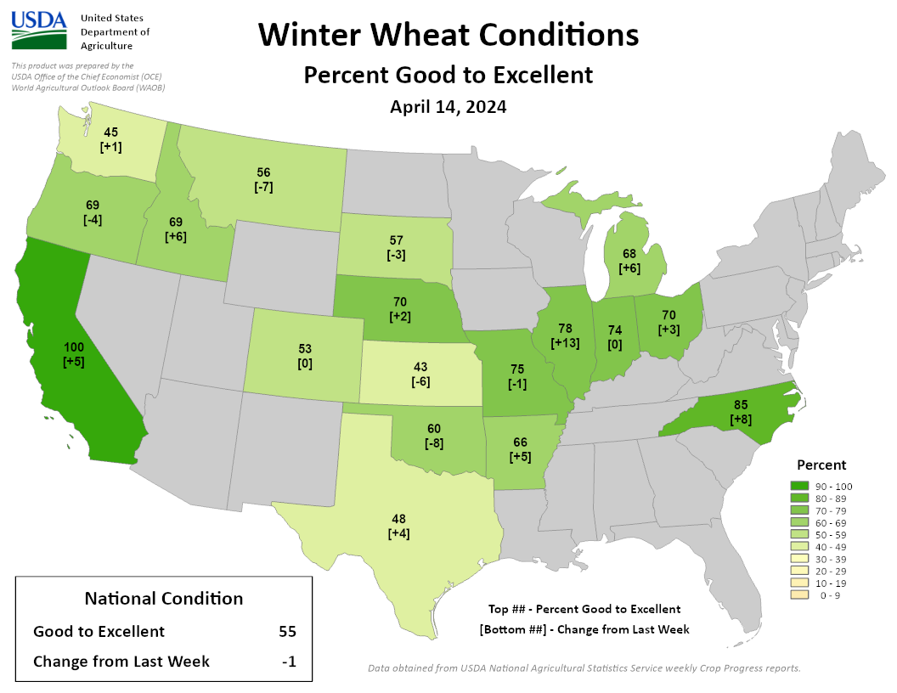
NASS Crop Progress – Winter Wheat
In states around Wisconsin, winter wheat condition is >68% good to excellent.
https://agindrought.unl.edu/Other.aspx

Slide 22
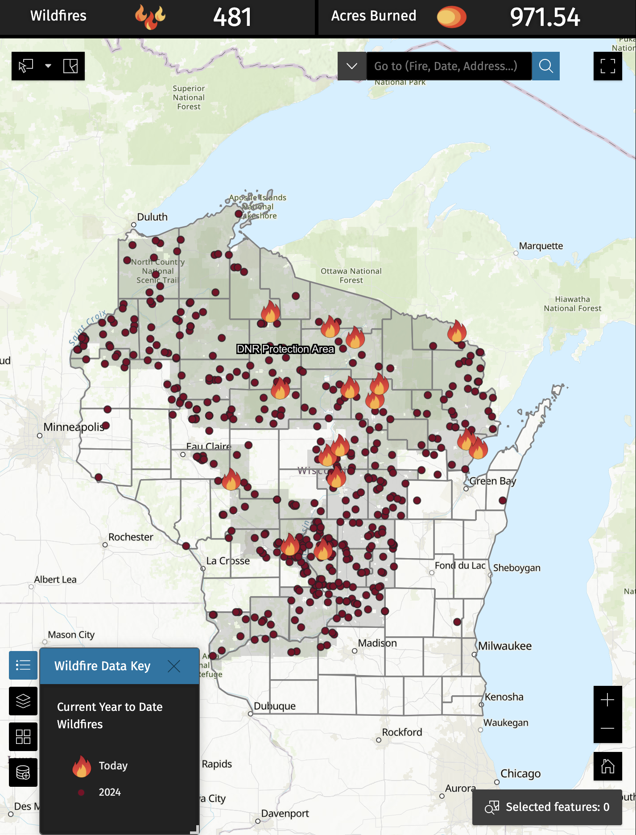
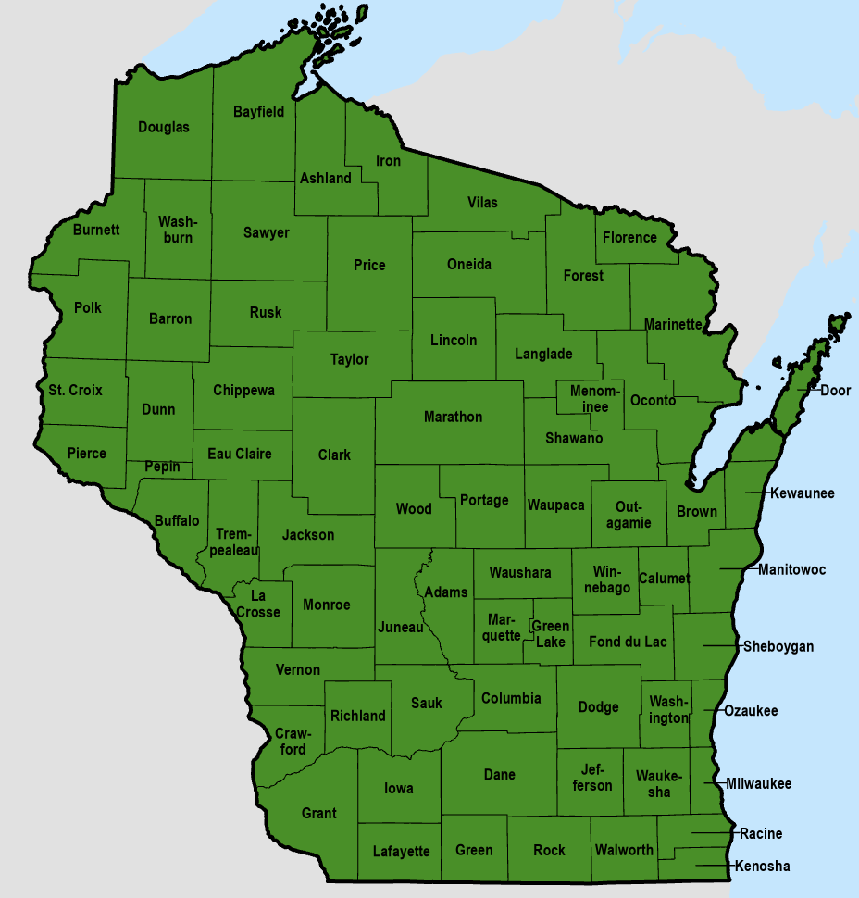
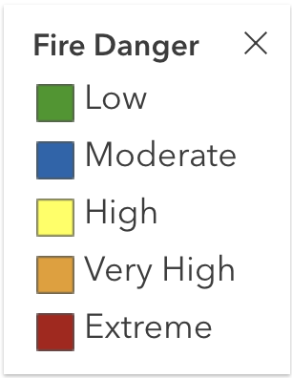
Wildfire Concerns
After Tue (4/16)-Wed (4/17) rain, fire danger dropped to low
However, wildfires have been an increased concern for WI this year, especially when hot, dry, and windy conditions are present
Please check DNR WisBurn for fire danger conditions before burning and have fire safety plans in place
As of 10:30am on 4/17/24
As of 3:30pm on 4/16/24
https://apps.dnr.wi.gov/wisburn/#/
https://dnrmaps.wi.gov/wildfiredashboard/

Slide 23
7 Day Precip Forecast
Please note that there is a server malfunction at NOAA causing this 7-day forecast product to not be updated since Monday (4/15).
If you’d like to check for an update, please head to: https://water.weather.gov/precip/.
There looks to be the potential for precip on Thu (4/18) and Mon (4/22), but feel free to check https://www.weather.gov/ for your local forecast.
https://www.wpc.ncep.noaa.gov/qpf/day1-7.shtml

Slide 24
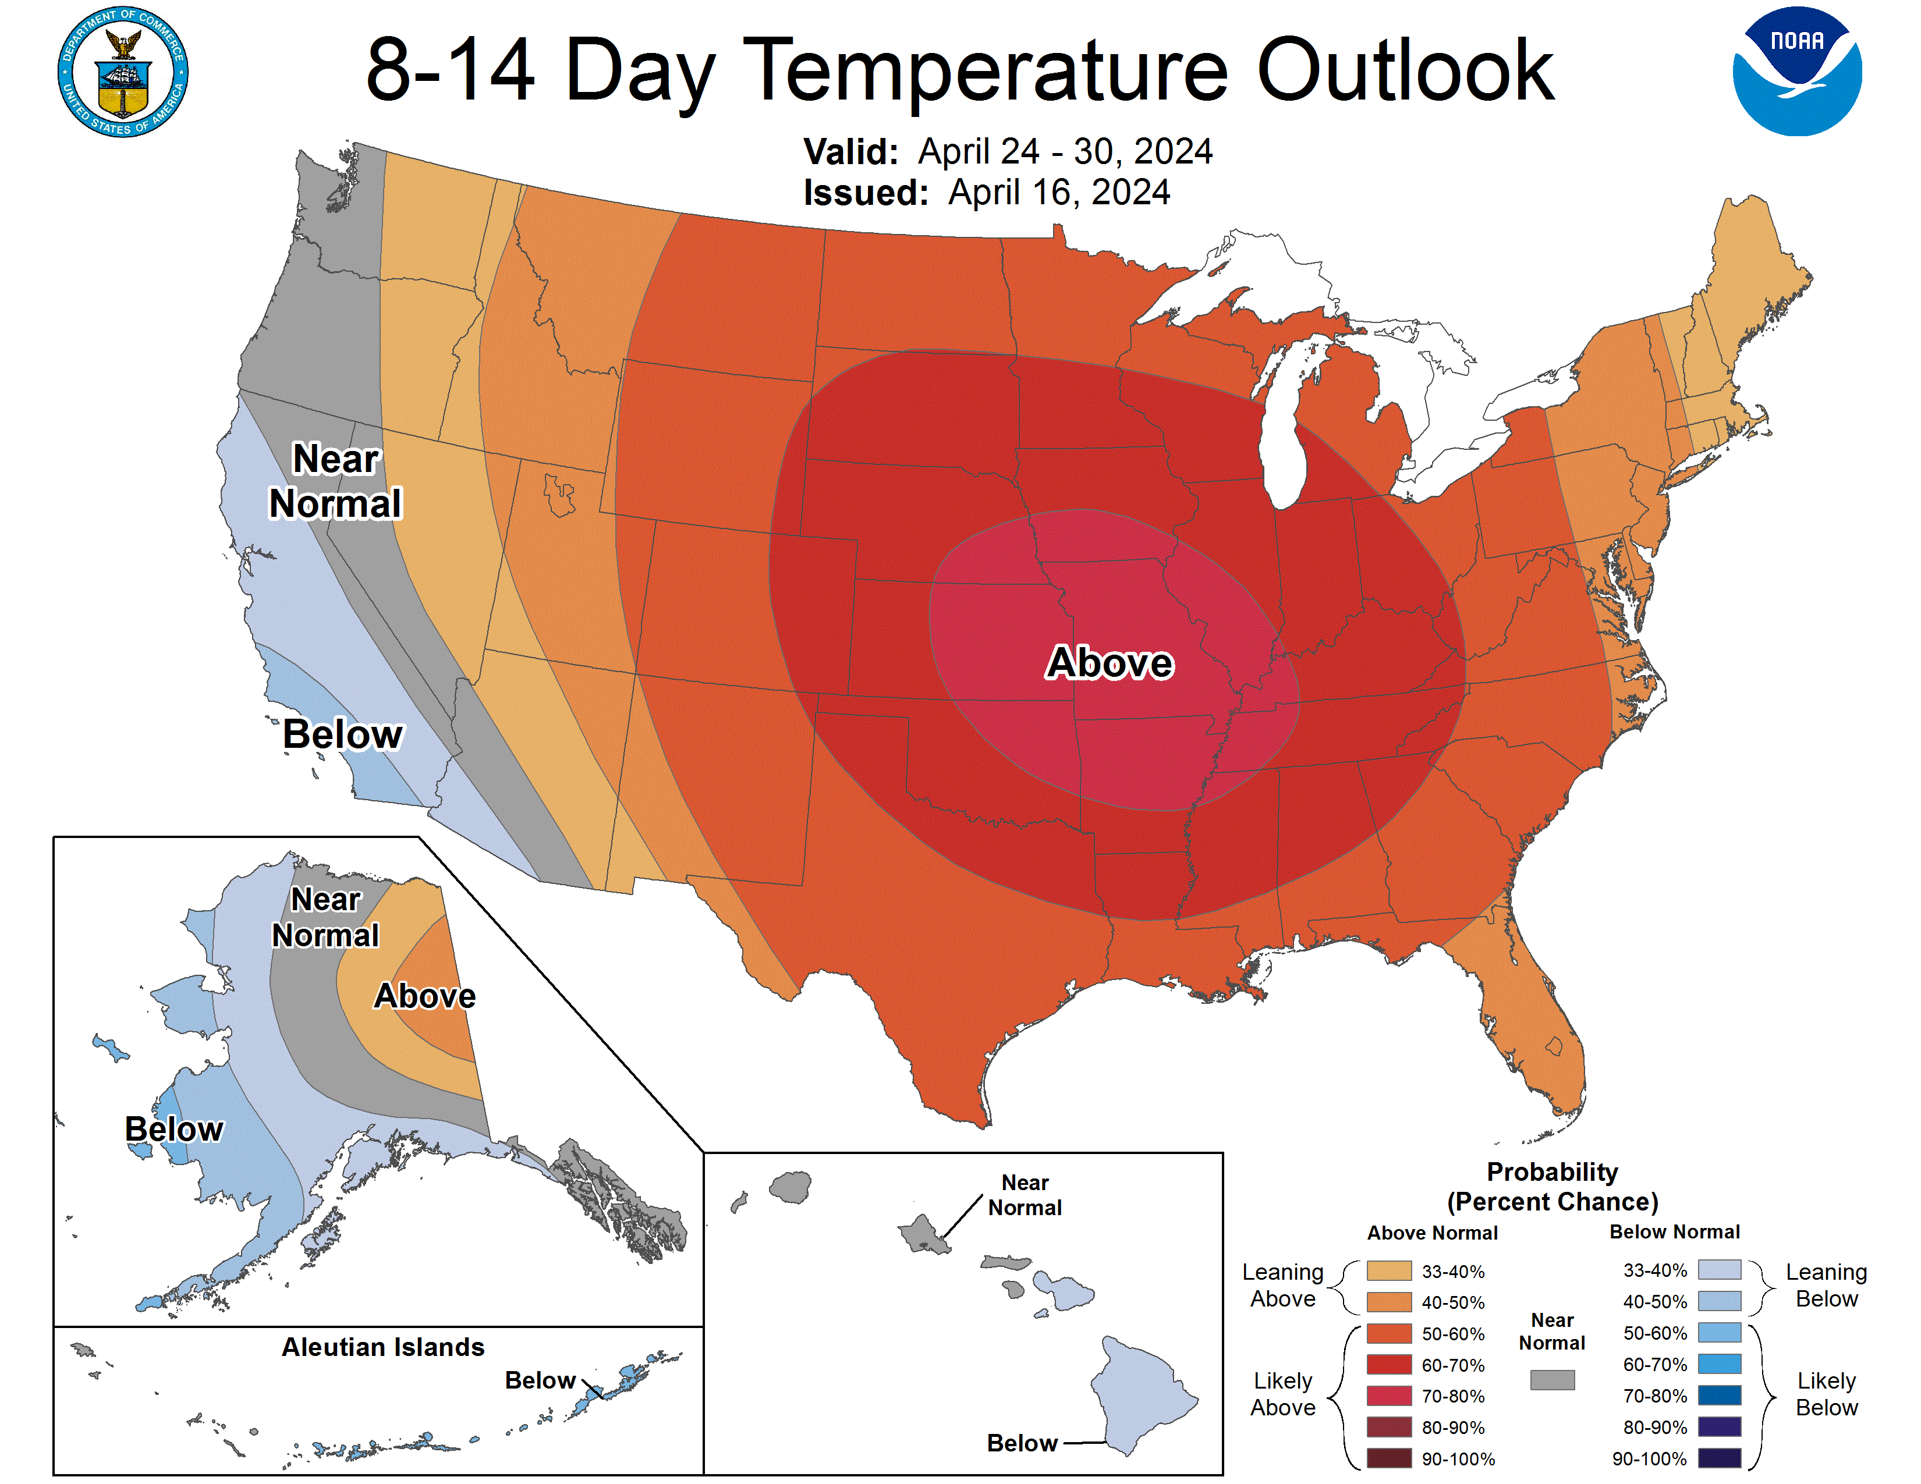
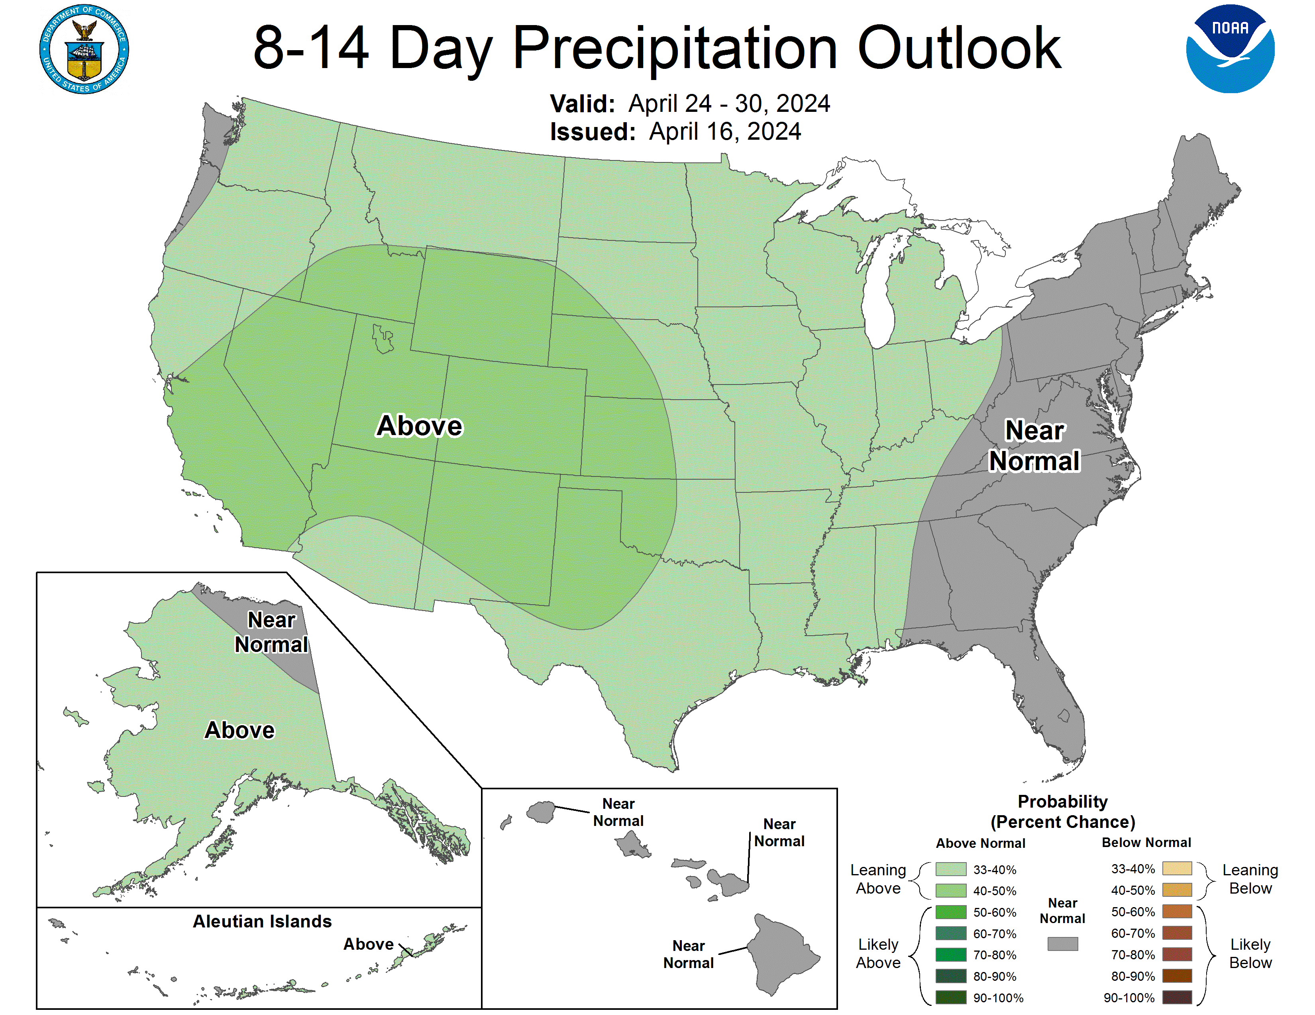
8-14 Day Temp & Precip Outlook
Third/fourth week in April: Temperatures will likely be above normal. Precipitation leaning above normal.
http://www.cpc.ncep.noaa.gov/

Slide 25
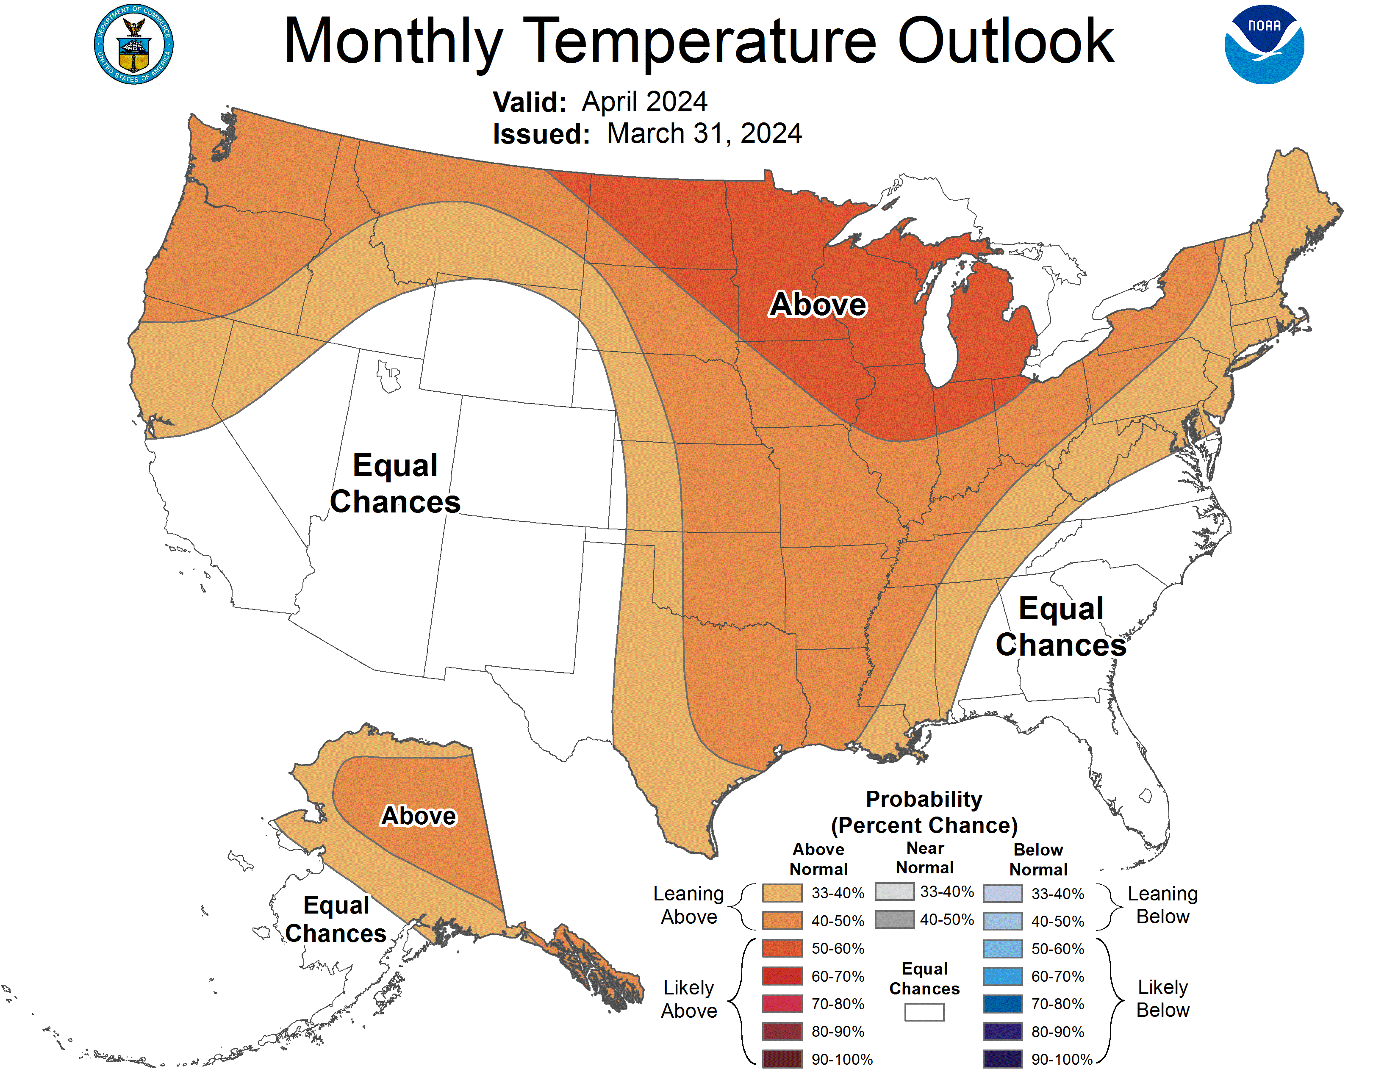
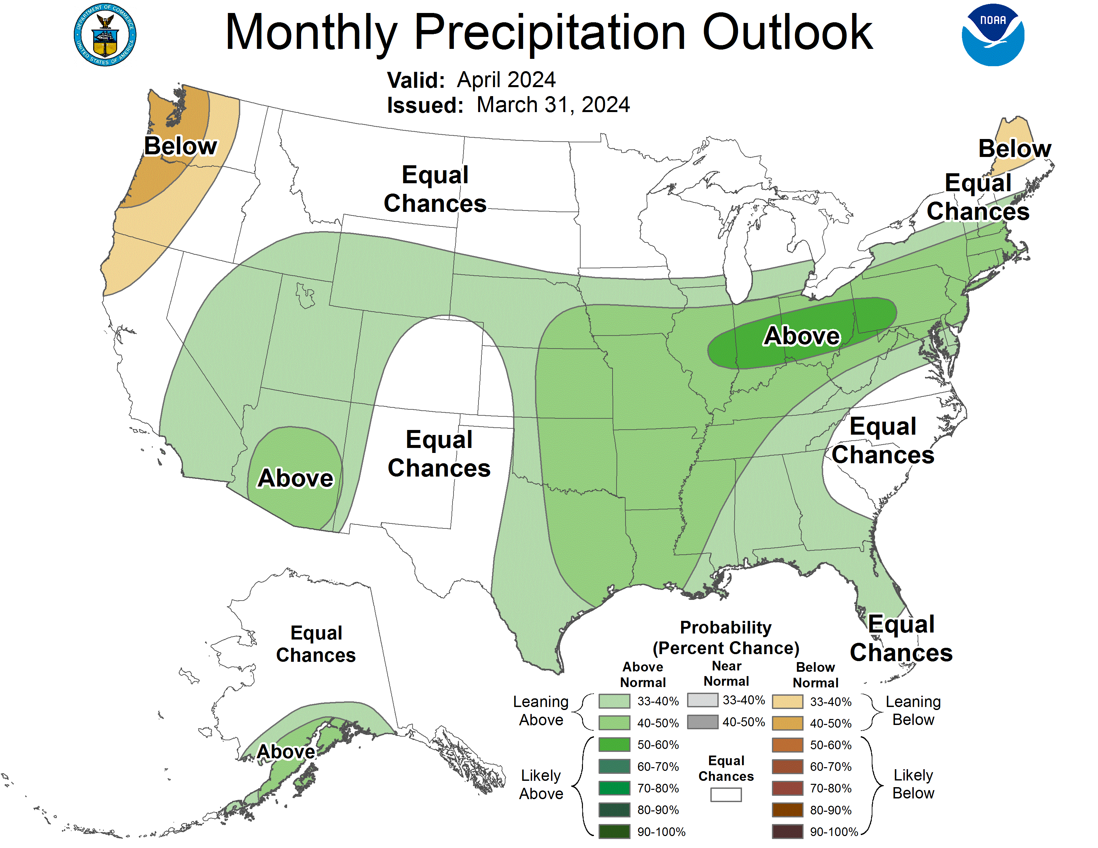
30 Day Temp & Precip Outlook
Month of April: Temperature likely to be above normal. Equal chances for precipitation, except for above normal near the IL border.
http://www.cpc.ncep.noaa.gov/

Slide 26
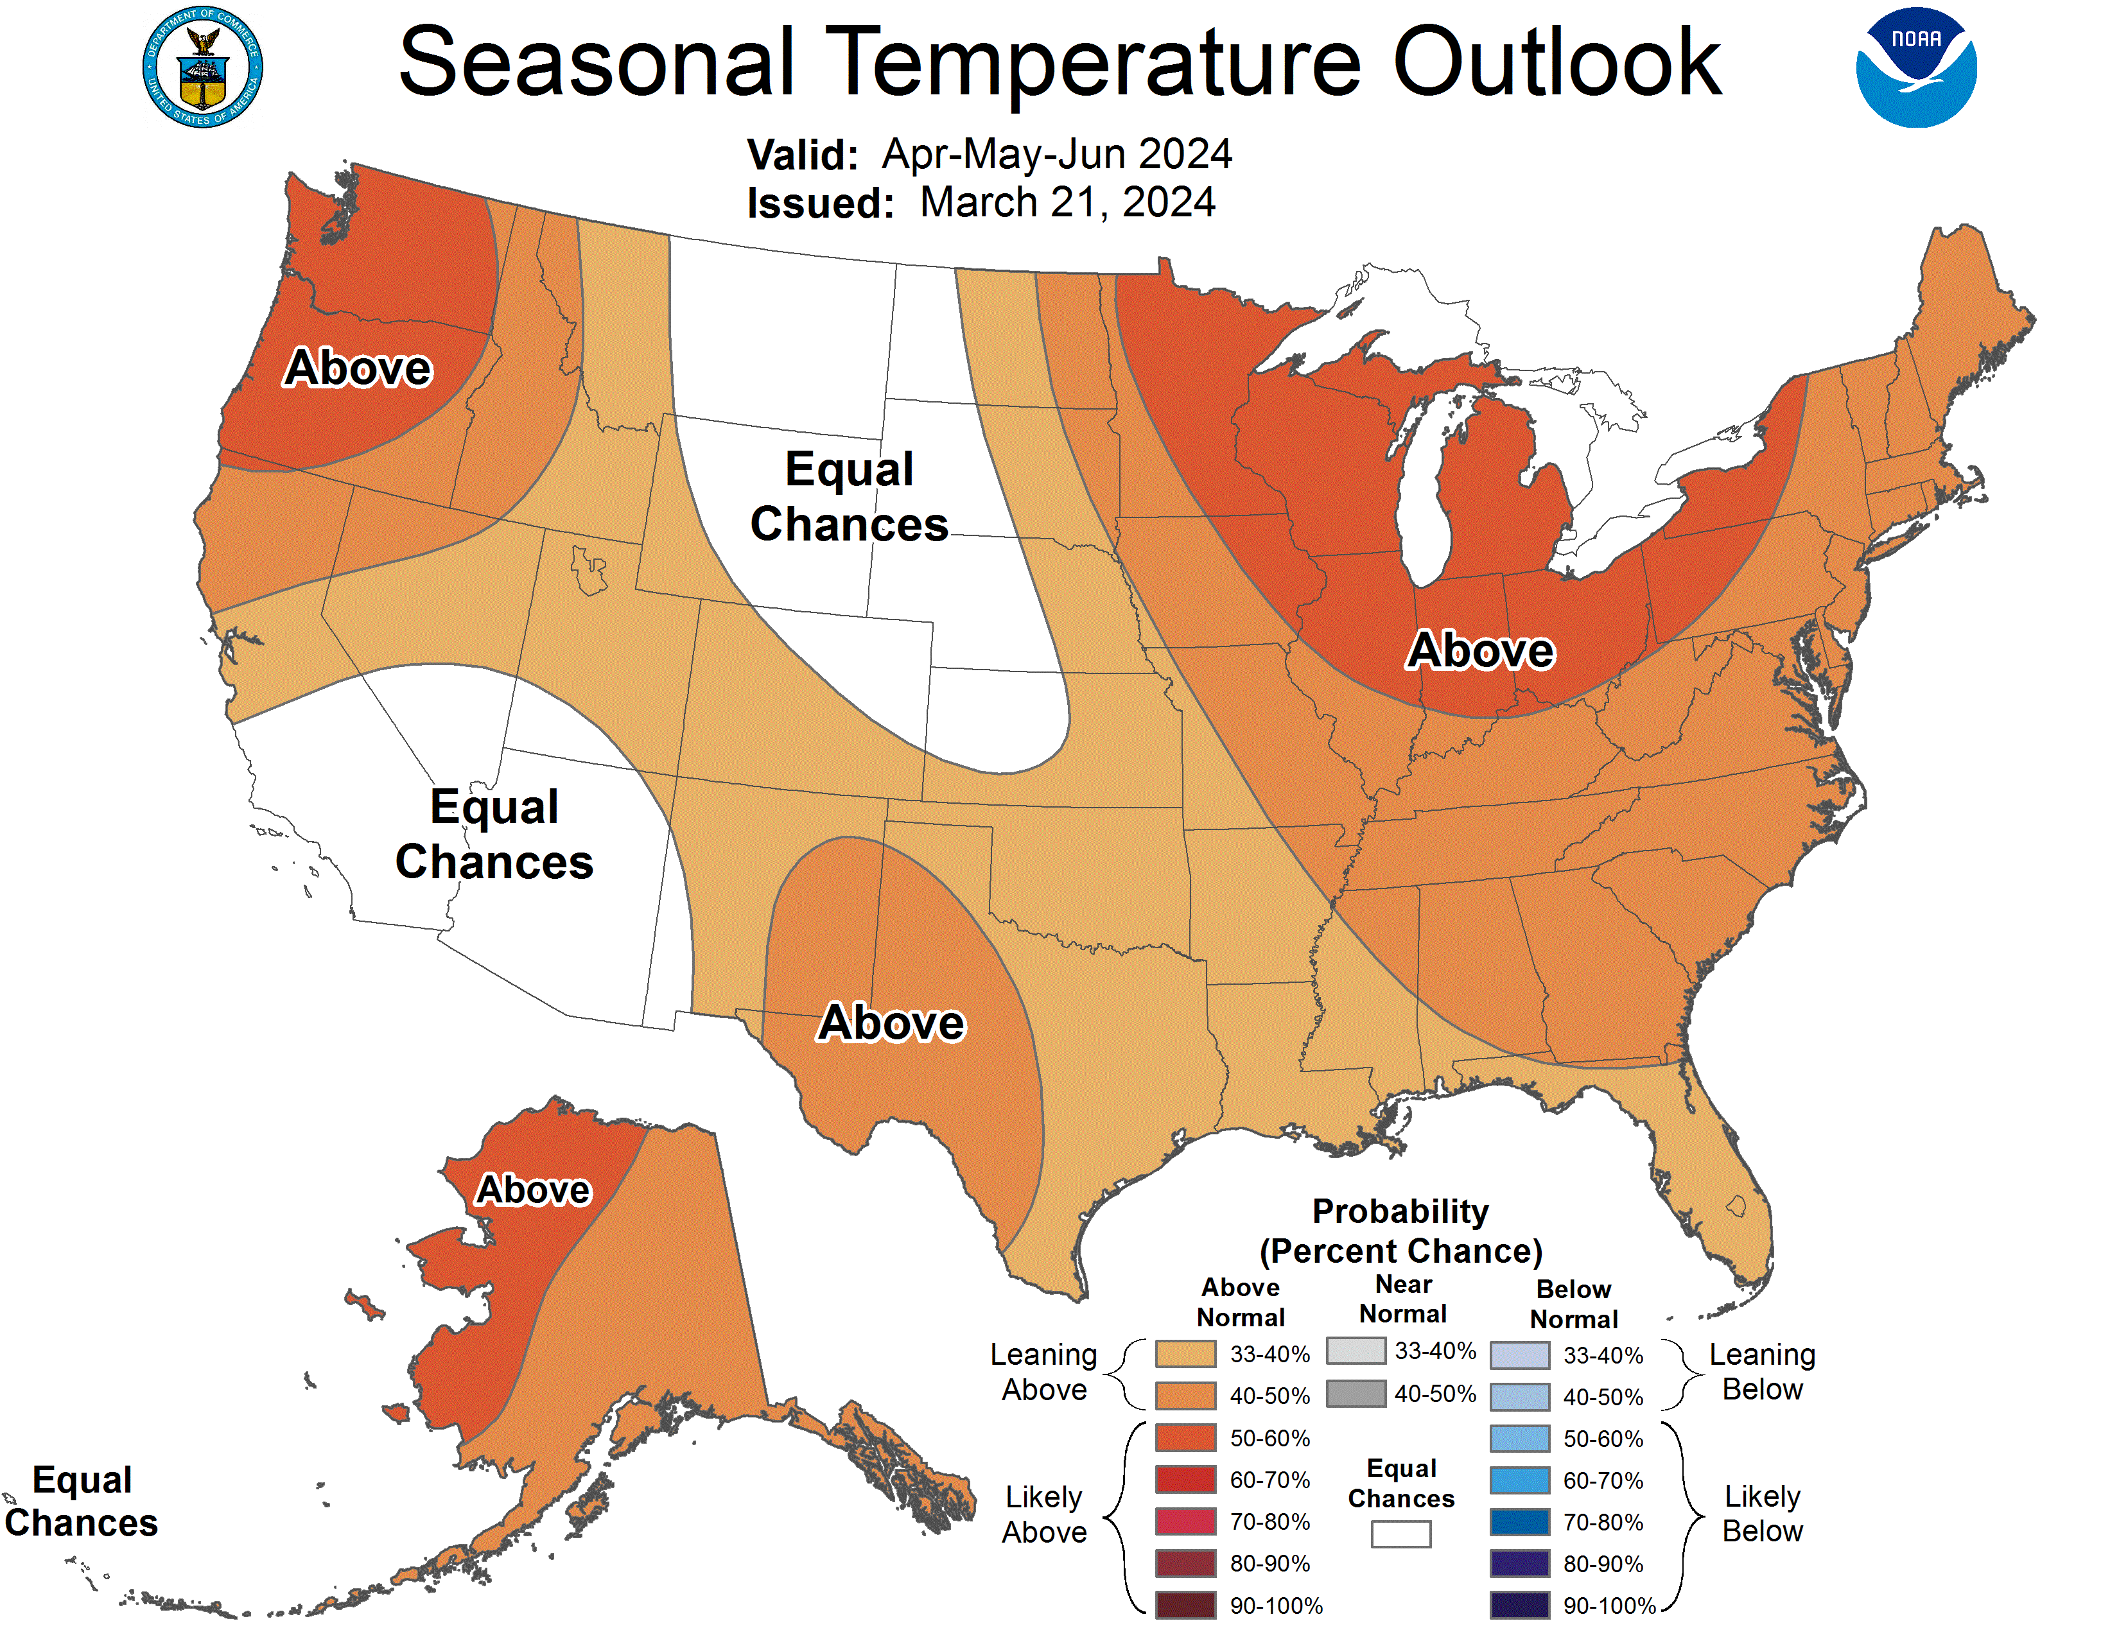
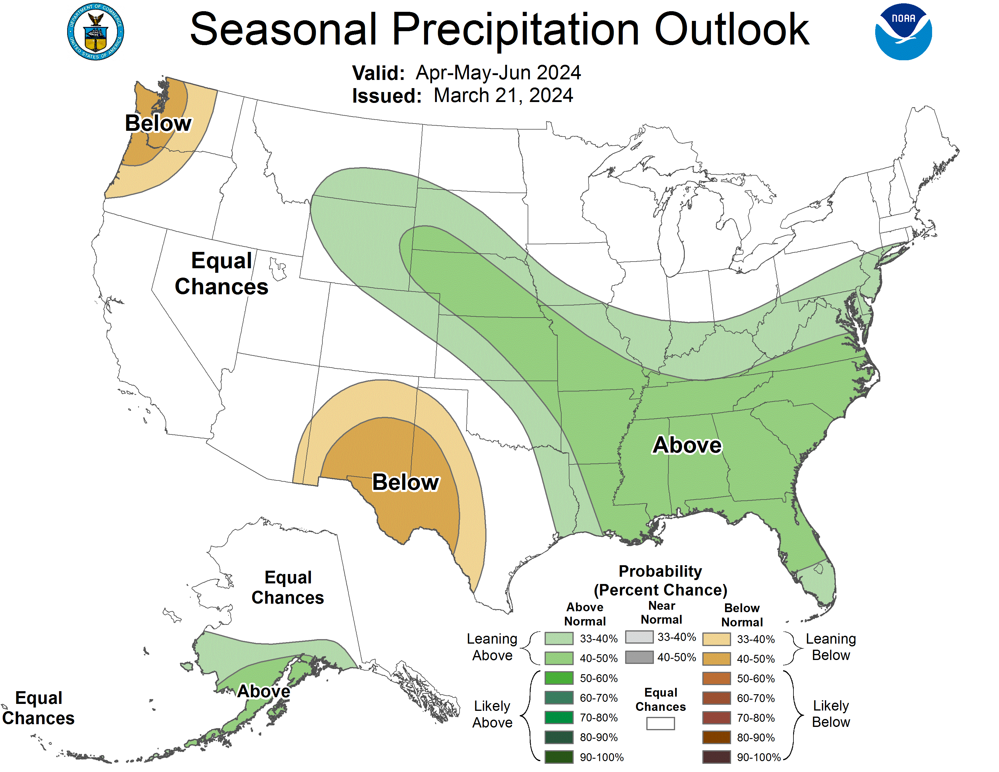
90 Day Temp & Precip Outlook
Spring into Early Summer: Temperature likely to be above normal. Precipitation indications are for equal chances of above/near/below normal.
http://www.cpc.ncep.noaa.gov/

Slide 27
Take-Home Points
Current conditions:
Little precipitation over the last week (<0.5” statewide), until 4/16-17 when an additional ~0.2-2.5” fell statewide.
All of WI saw temperatures 6-10°F above normal over the last week.
Impact:
4” soil moisture dropped slightly since last week with minimal 7-day precipitation.
4” soil temperature increased with last week’s temperatures being warmer-than-normal.
US Drought Monitor showed slight improvements, mostly for NE WI, but remains largely unchanged from last week.
Scattered corn planting has been reported in eastern and southern WI.
Wildfire concerns have eased with precipitation, but still need to be considered in decision-making.
Outlook:
Chances of precip for southern WI Thu (4/18) and statewide Mon (4/22).
Temperatures are likely to be warmer-than-normal, with the chance for above-normal precip for the last week of April.
Warmer-than-normal conditions likely to persist through spring, with uncertainty about precip.
Warm conditions due in part to continued El Niño; however, a transition to La Niña is expected by June.

Slide 28
Agronomic Considerations
Planting Considerations
Monitor soil moisture to avoid compaction, with recent precipitation it is advisable to wait with field work.
Consider termination timing of cover crops to preserve deep soil moisture.
If planting early, consider planting depth adjustments to ensure planting into moisture. Also, check insurance policies.
Nutrient & Herbicide Applications
Consider using a preplant nitrate test to assess if there is nitrogen left over from last year due to drought conditions.
Ensure daytime, nighttime, & soil temperatures are conducive for the necessary duration for effective herbicide applications. Remember, pre-emergent herbicides require moisture for activation and consider duration of effectiveness if planting early.
Read herbicide labels from products used last year to assess if carryover is a possibility due to warmth and lack of moisture.
Manure Applications
DATCP is forecasting low-to-moderate runoff risk in the Southwest part of the state.
Early season manure applications into warm soil conditions may lead to increased mineralization/nitrification and potential for N loss if receive “typical” heavy spring rainfall events, particularly if not applied to a growing cover crop or if the cash crop will not be planted soon after application.
Small Grains
Wheat has greened up in much of the state, so time to make decisions about nitrogen application.
Potential for earlier planting of spring grains, if warmer weather continues. However, there is still a risk with potential for freeze.
Breaking Dormancy
Likely early breaking of dormancy for overwintering crops – potential for increased winterkill if temperatures snap back to cold.
When seeding alfalfa, be aware that it can germinate at 32-34°F but will die if temperatures drop below 24°F, so it is best to wait to plant alfalfa until those low temperatures are unlikely.

Slide 29
User Survey
Are you a regular user of the Wisconsin Ag Climate Outlook (WACO)? Or maybe you are viewing these slides for the first time this week? Either way, we want to hear your feedback on this resource! Please take a few minutes and fill out this survey:
LINK TO SURVEY
SPECIAL REQUEST: As we head into this growing season, we understand the lack of precipitation and overall drought is likely on your mind. Please feel free to share your drought concerns, request relevant drought information that could help you manage your practices, or share management practices that have or haven’t worked for you in drought conditions so that we can better serve your needs through WACO!
If you have any trouble accessing or filling out the survey, please email Josh Bendorf at Joshua.Bendorf@usda.gov.
Thank you!
-The WACO Team

Slide 30
Citizen Science Opportunity
CoCoRaHS – Community Collaborative Rain, Hail, & Snow Network
The Mission
(From cocorahs.org)
Provide accurate high-quality precipitation data for end-users;
Increasing the density of precipitation data available throughout the country;
Encouraging citizens to have fun participating in meteorological science and heightening their awareness about weather;
Providing weather education opportunities.
Sign Up Here: https://cocorahs.org/Content.aspx?page=application

Slide 31
Contact Info
Photo Credit: USDA
Natasha Paris
Crops Educator – Adams, Green Lake, Marquette, Waushara Cos.
natasha.paris@wisc.edu
Kristin Foehringer
NRCS State Working Lands Climate Smart Specialist
kristin.foehringer@usda.gov
Dennis Todey
Director, Midwest Climate Hub
dennis.todey@usda.gov
Josh Bendorf
Ag Climatologist Fellow, Midwest Climate Hub
joshua.bendorf@usda.gov
Steve Vavrus
State Climatologist of Wisconsin
sjvavrus@wisc.edu
Bridgette Mason
Assistant State Climatologist of Wisconsin
bmmason2@wisc.edu

