Slide 1
Wisconsin Ag Climate Outlook Week of April 8, 2024
Natasha Paris
Crops Educator – Adams, Green Lake, Marquette, Waushara Cos.
natasha.paris@wisc.edu
Kristin Foehringer
NRCS State Working Lands Climate Smart Specialist
kristin.foehringer@usda.gov
Dennis Todey
Director, Midwest Climate Hub
dennis.todey@usda.gov
Josh Bendorf
Ag Climatologist Fellow, Midwest Climate Hub
joshua.bendorf@usda.gov
Steve Vavrus
State Climatologist of Wisconsin
sjvavrus@wisc.edu
Bridgette Mason
Assistant State Climatologist of Wisconsin
bmmason2@wisc.edu

Slide 2
Key Points
A major snowstorm impacted the sate last week, bringing several inches of snow that melted within days of falling.
The rainfall & snowmelt last week helped to improve soil moisture conditions from last week.
After a wet & wintry start to the month, mid-April probabilities are leaning towards above-normal temps & above-normal precip.

Slide 3
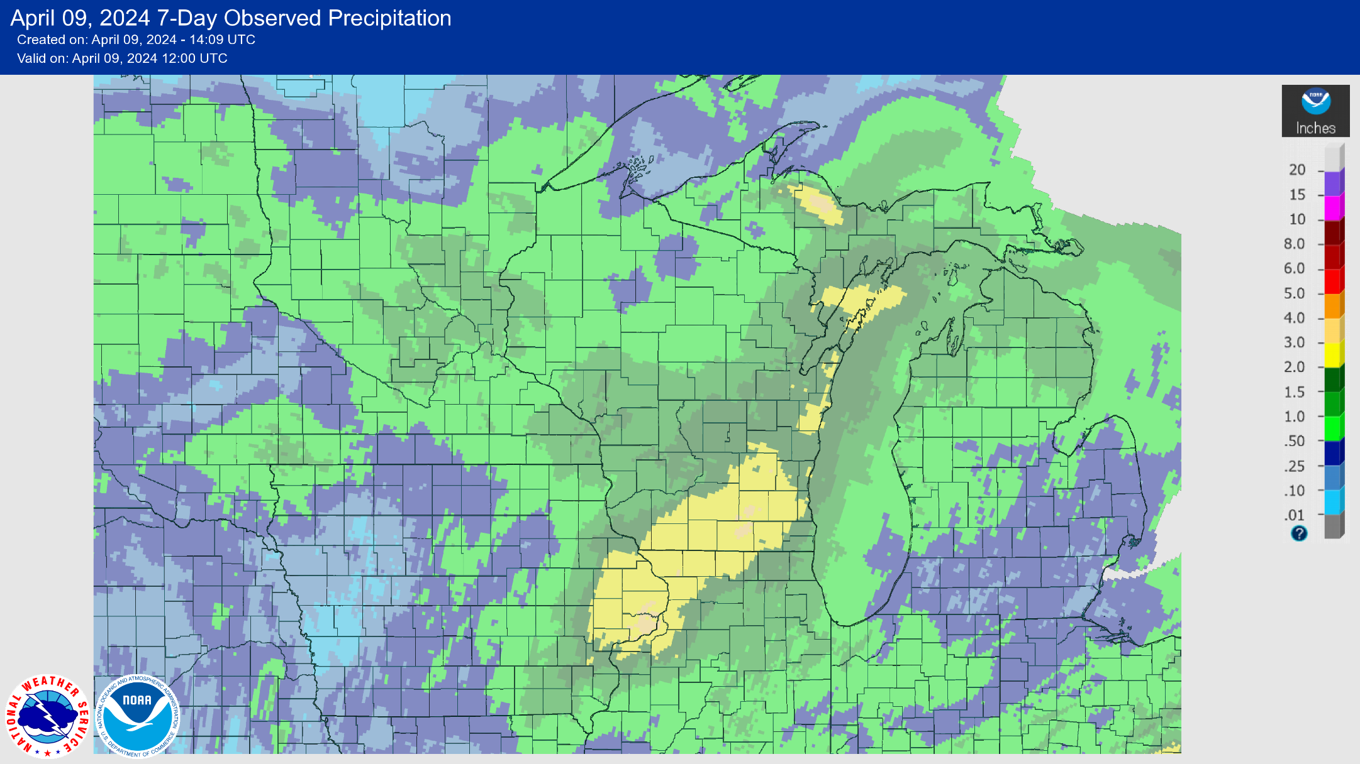
7 Day Precip
Southern 2/3 of the state saw >1” of precip this past week.
A good portion of this fell as snow.
Highest amounts in the South Central → 2-3+”
https://water.weather.gov/precip/

Slide 4
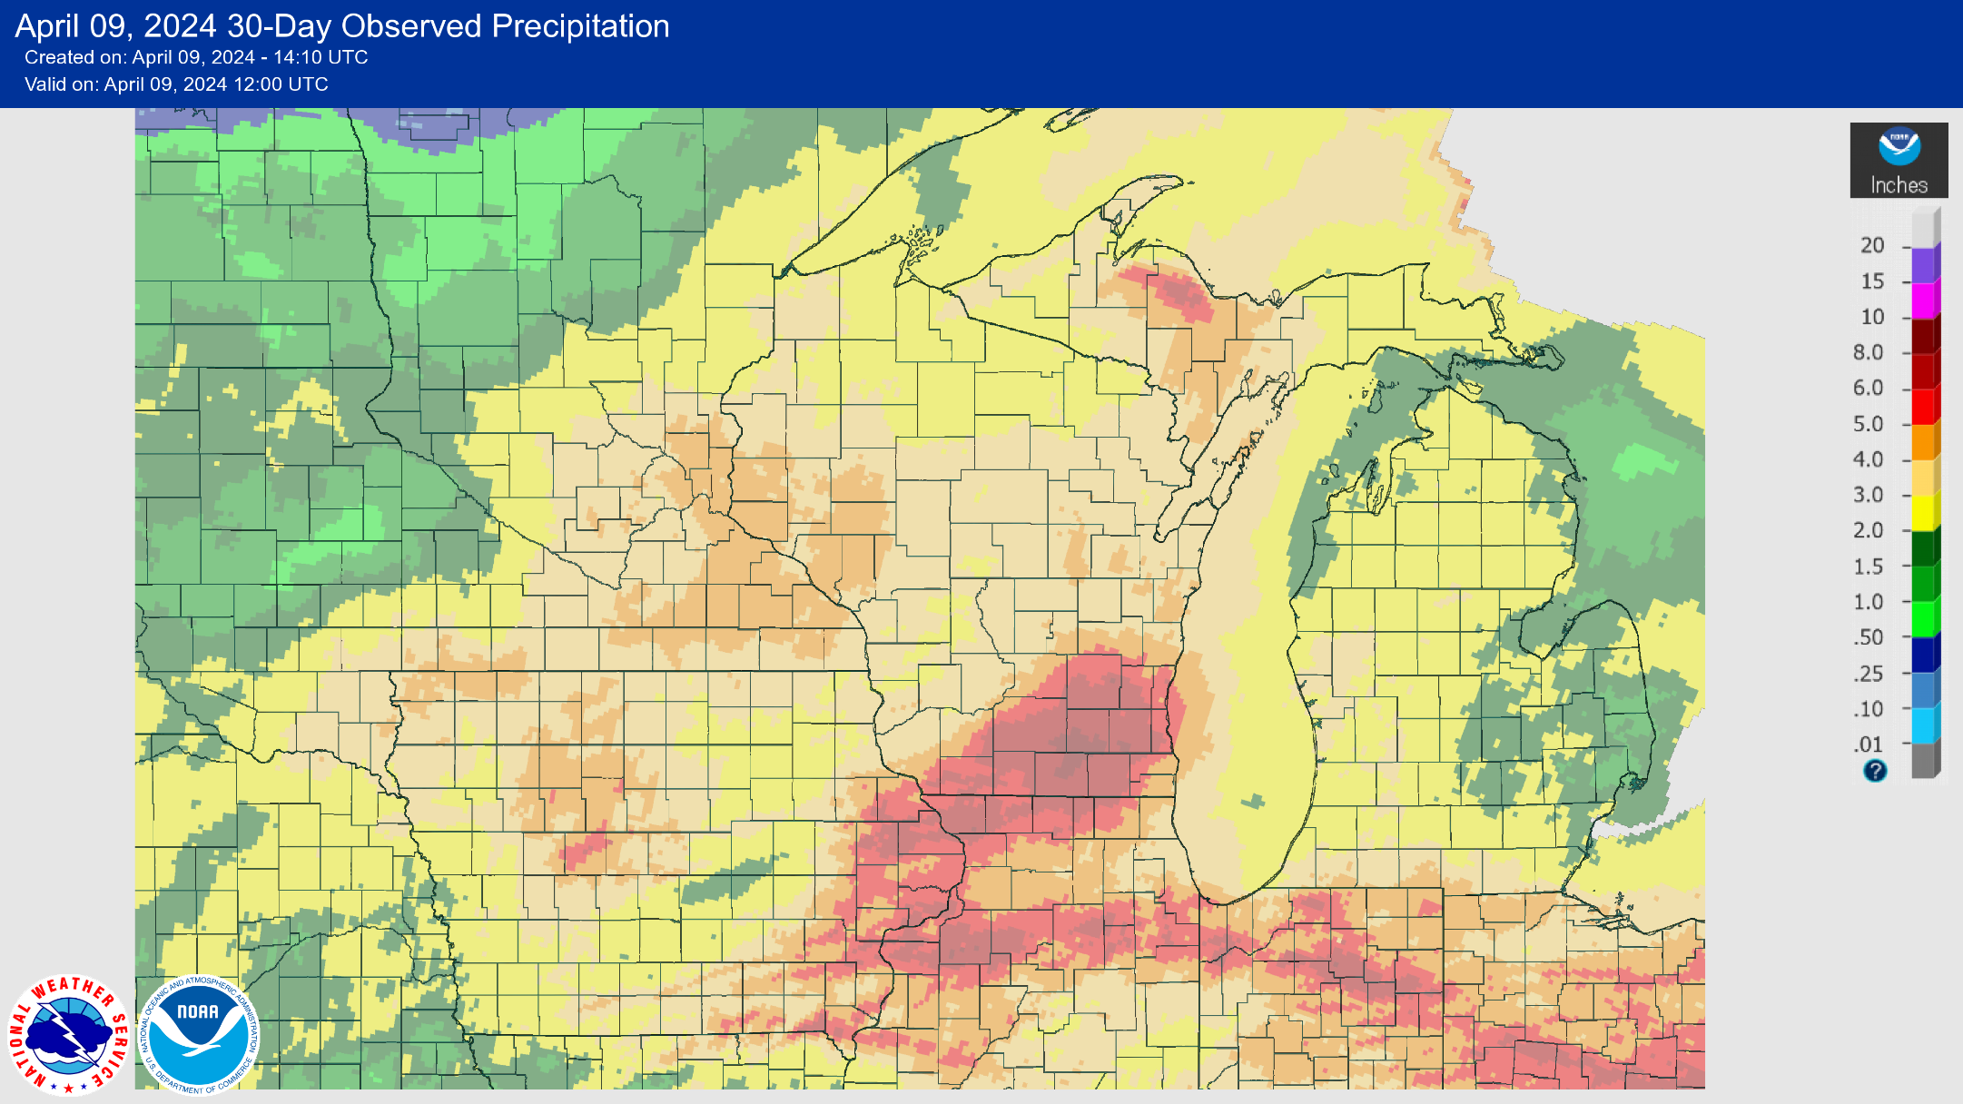
30 Day Precip
Most of the state has seen 3-5+” of precip over the past month.
Highest amounts in the SE → 5-8” widespread from Dubuque to Milwaukee.
https://water.weather.gov/precip/

Slide 5
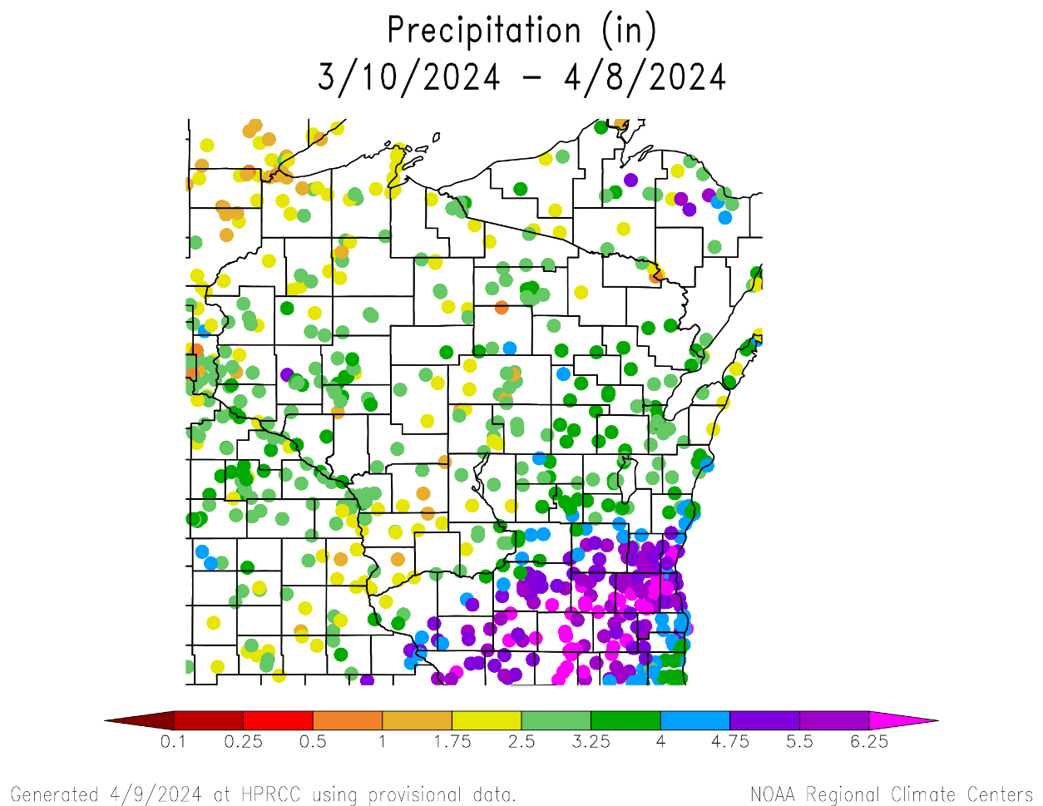
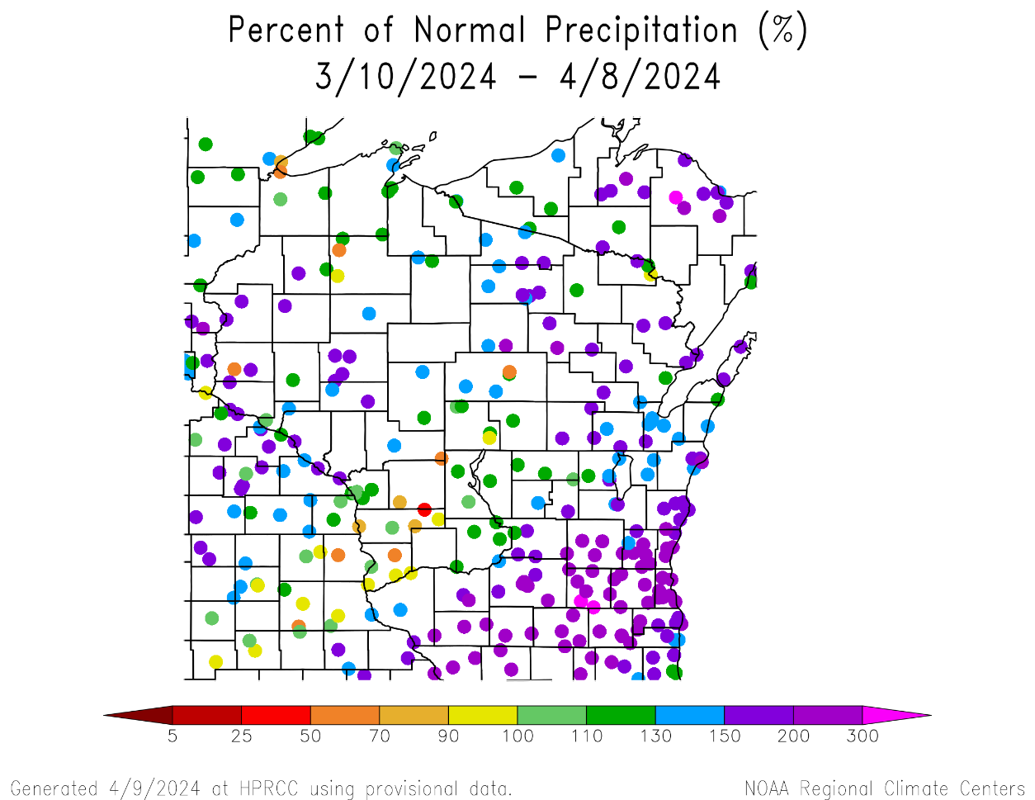
30 Day Precip Total/% Avg.
Highest precip totals in the SE (>5”) and lowest in the Driftless & far NW (<2.5”).
Majority of stations at or above long-term average
Exception of some stations in the SW and NW
https://hprcc.unl.edu/maps.php?map=ACISClimateMaps

Slide 6
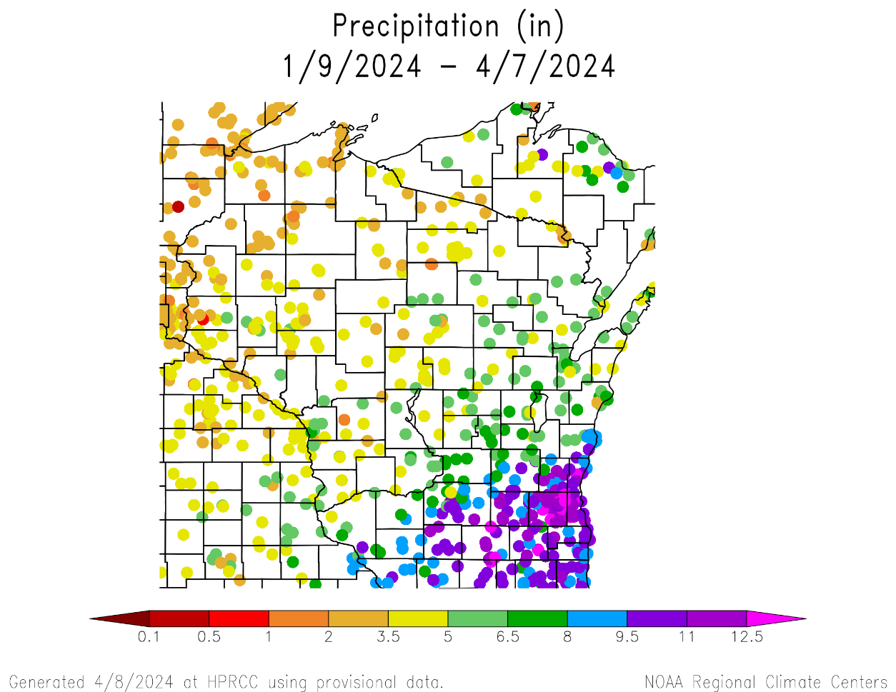
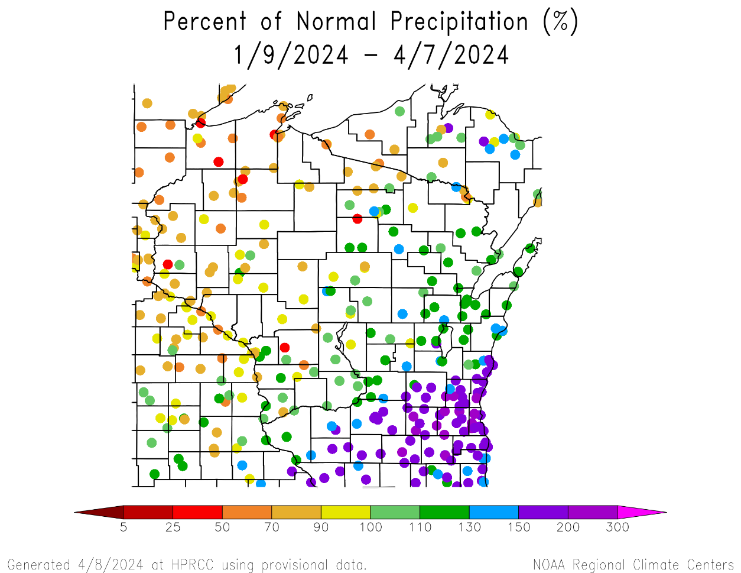
90 Day Precip Total/% Avg.
Highest precip totals in the SE (>8”) and lowest in the NW (<3.5”).
150+% of long-term average precip in the SE.
<100% of average was common across stations in the N and W.
https://hprcc.unl.edu/maps.php?map=ACISClimateMaps

Slide 7
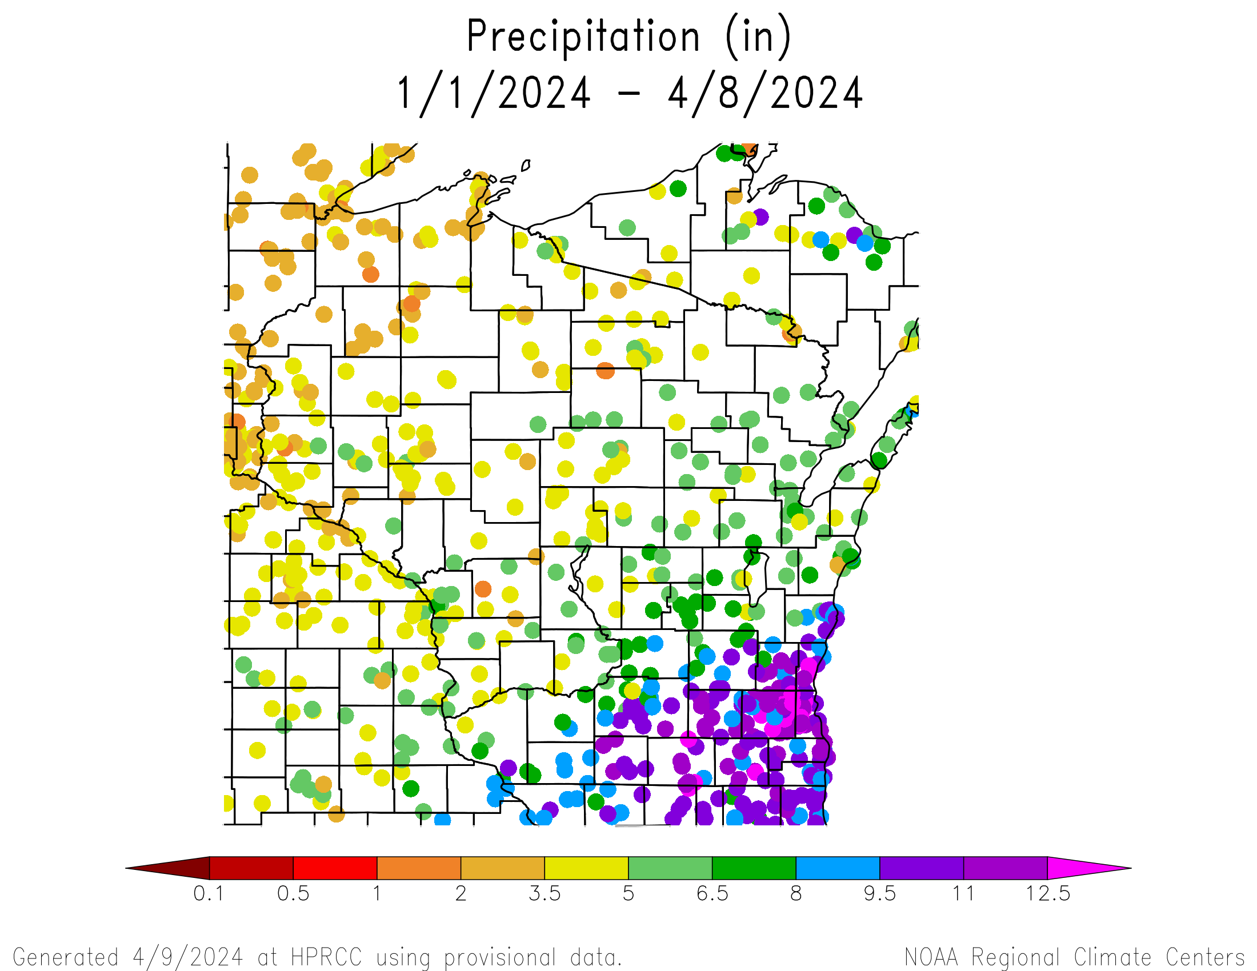
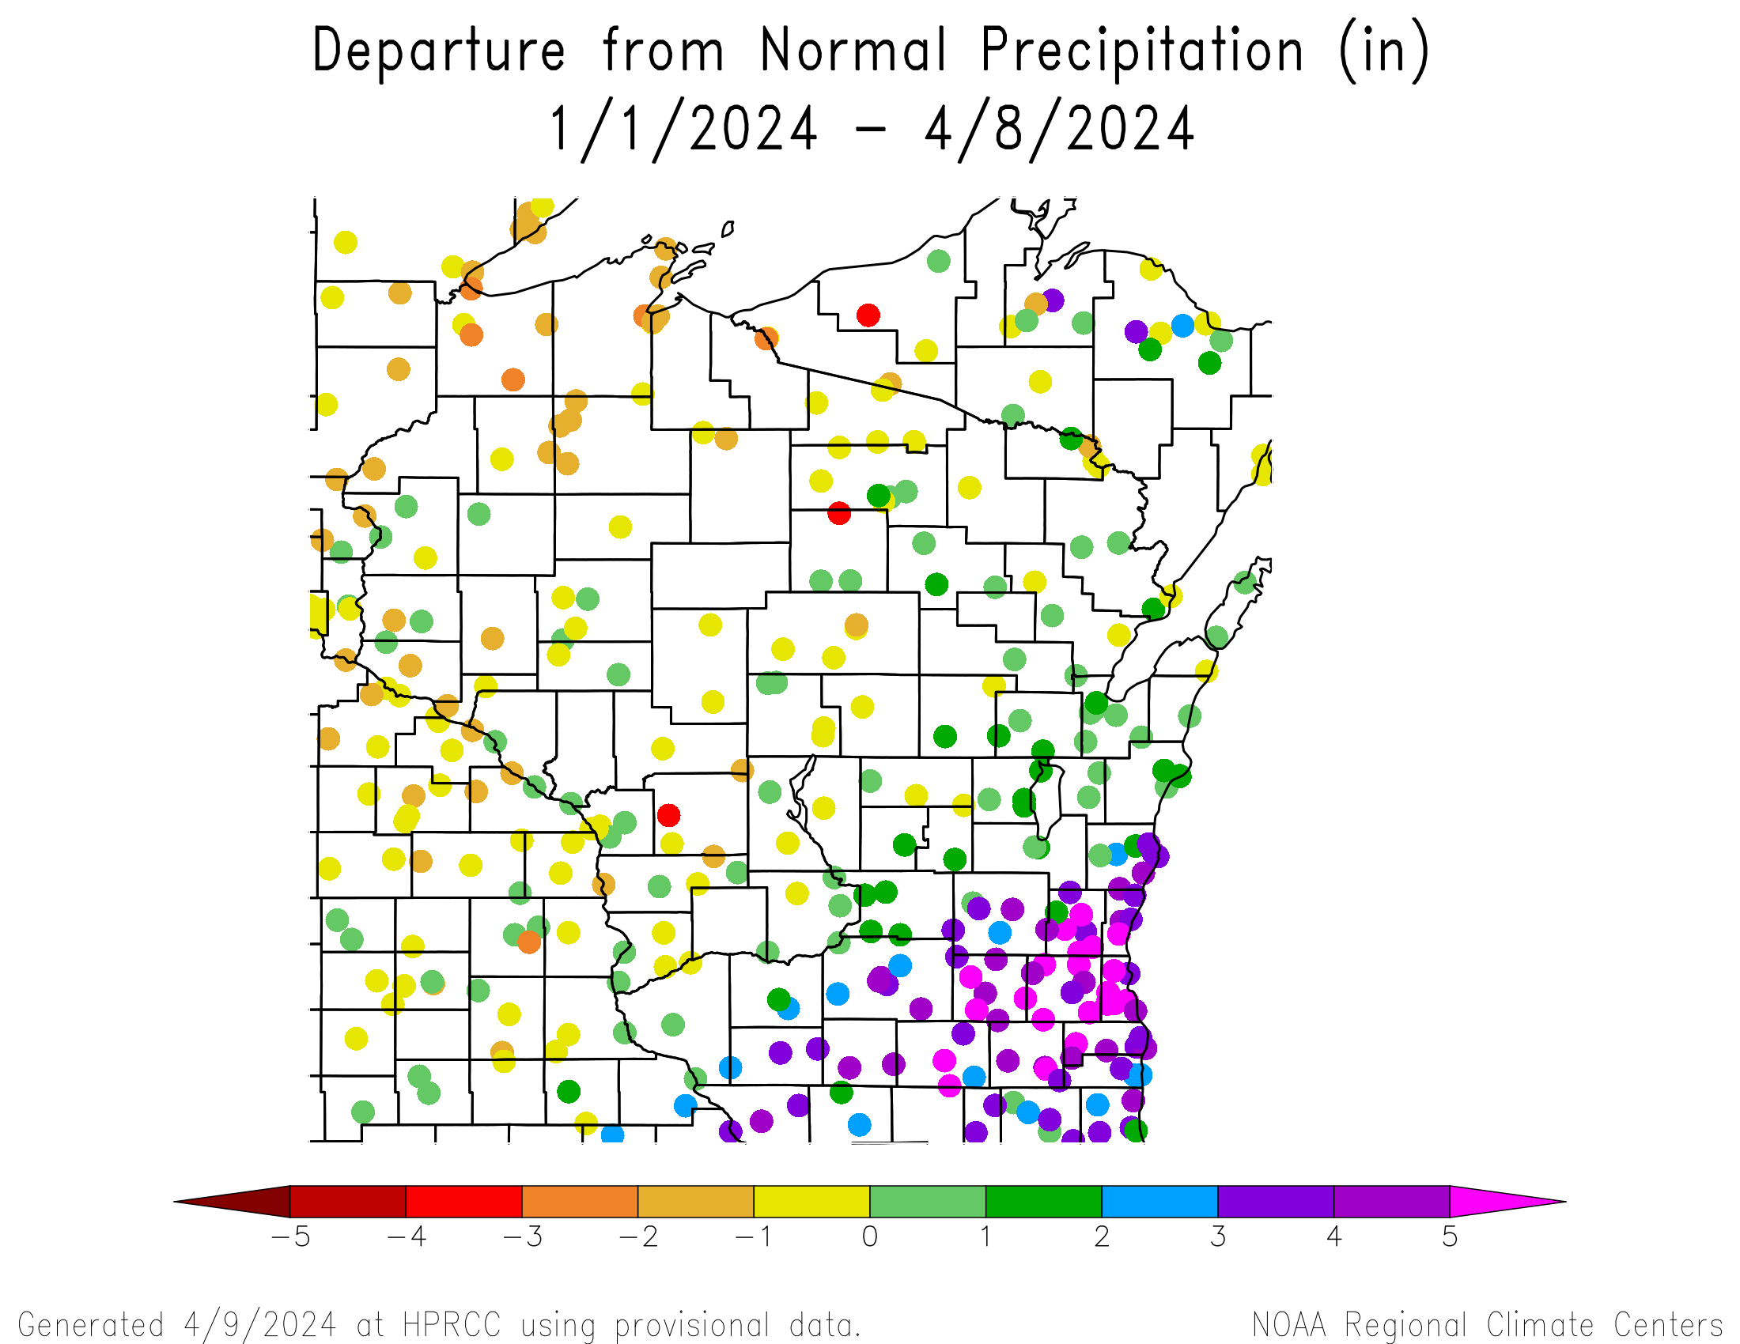
Precipitation since Jan. 1
https://hprcc.unl.edu/maps.php?map=ACISClimateMaps

Slide 8
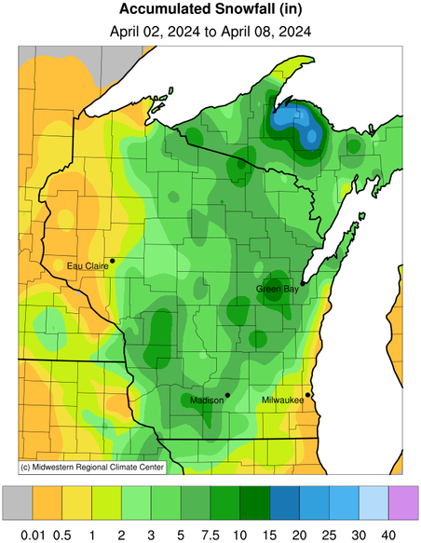
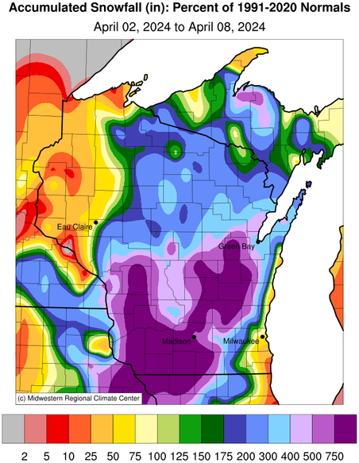
Early Spring Snow (…& lots of it!)
The entire state saw some snowfall last week during this late-season storm.
Highest amounts in the Appleton area (>10”).
Many areas saw more than double or triple their normal weekly snowfall totals.
This was a very wet snowfall which will be helpful in replenishing soil moisture.
https://mrcc.purdue.edu/CLIMATE

Slide 9
Highest Snow Totals
Name | Station Type | County | Total Snowfall (in)
SHIOCTON | COOP | Outagamie | 18.1
LA CROSSE WFO | COOP | La Crosse | 16.6
WILD ROSE 0.5 E | CoCoRaHS | Waushara | 12.2
LAC VIEUX DESERT | COOP | Vilas | 12.0
LA FARGE | COOP | Vernon | 11.0
ELDORADO 2.3 S | CoCoRaHS | Fond du Lac | 10.4
RIPON | COOP | Fond du Lac | 10.4
WARRENS 4.7 WSW | CoCoRaHS | Monroe | 10.1
APPLETON | COOP | Outagamie | 9.5
DODGEVILLE 2.7 NE | CoCoRaHS | Iowa | 9.4
ARLINGTON | COOP | Columbia | 9.3
WIS RAPIDS GRAND AV B | COOP | Wood | 9.1
MT. HOREB WWTP | COOP | Dane | 9.0
Total snow accumulation between April 2-9, 2024
https://scacis.rcc-acis.org/

Slide 10
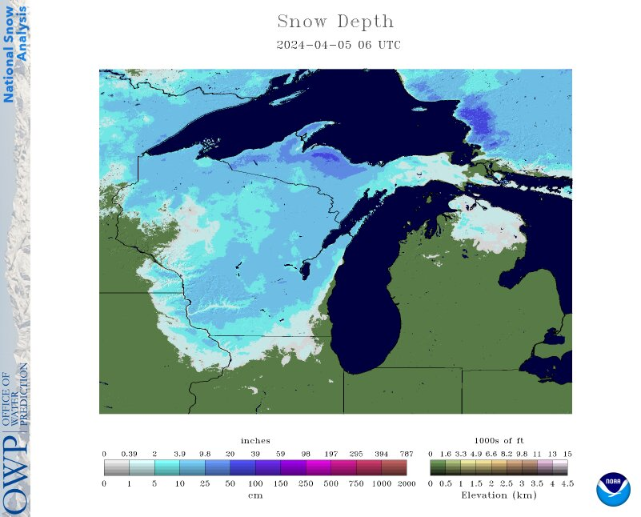
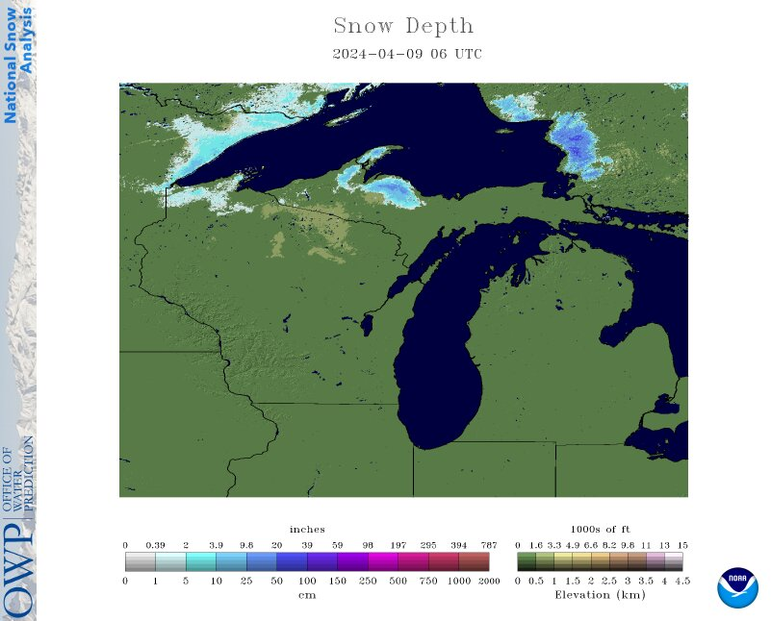
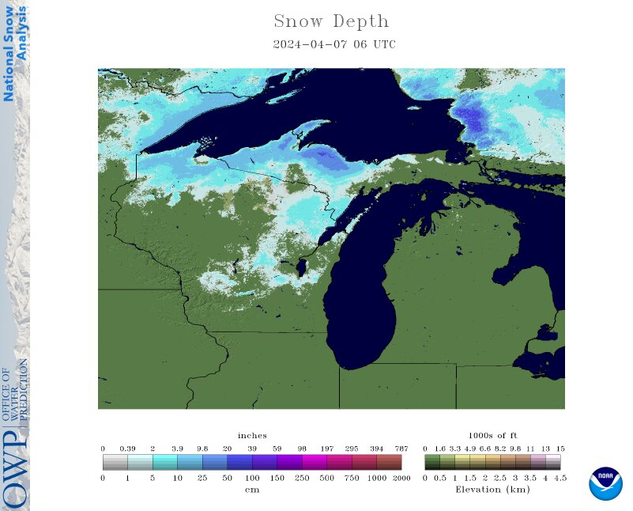
The snow didn’t last long!
April 7th
April 5th
April 9th
https://www.nohrsc.noaa.gov/nsa/

Slide 11
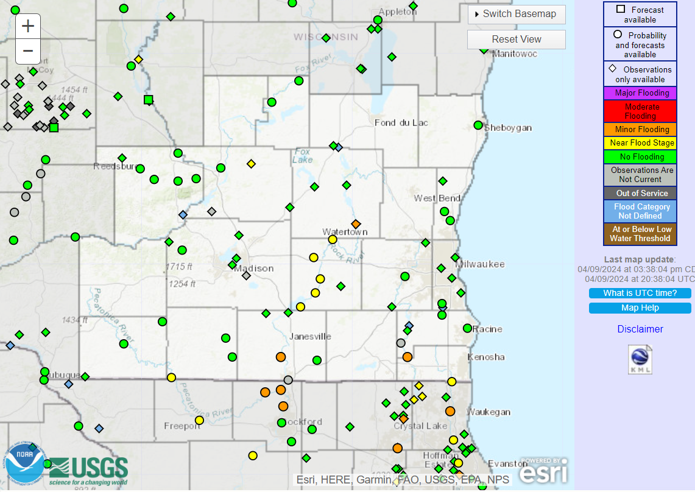
River Levels
With the higher-than-average precipitation and the melting snow, several river gauges in SE WI are near or at minor flood stage.
Always be aware of the hazards of flood waters!
https://water.weather.gov/ahps/

Slide 12
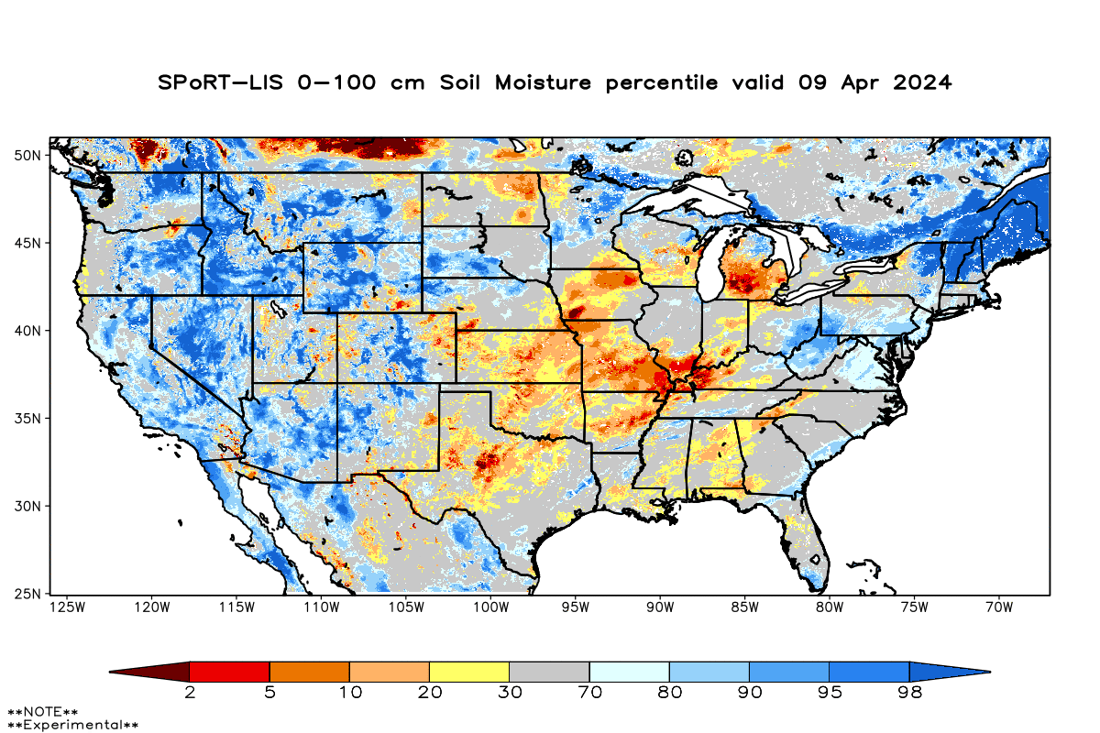
Soil Moisture Models
Continued improvement in soil moisture conditions (less area in red/orange)
Early April snowstorm brought a good shot of moisture.
Driest soil moisture conditions in Green Bay/Door County area, according to this model.
Model Notes:
Red areas would be top 5 driest in 100 years. Dark red = top 2 driest.
https://weather.msfc.nasa.gov/sport/case_studies/lis_CONUS.html

Slide 13
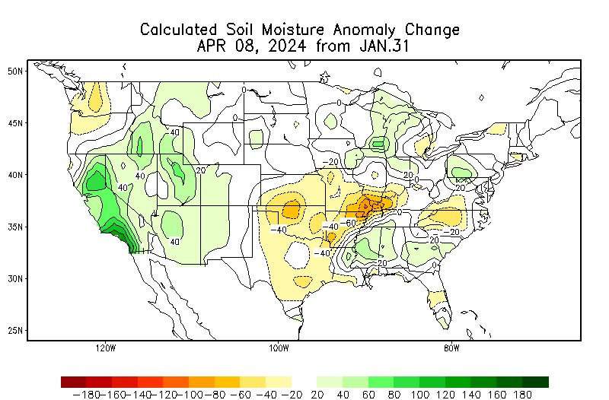
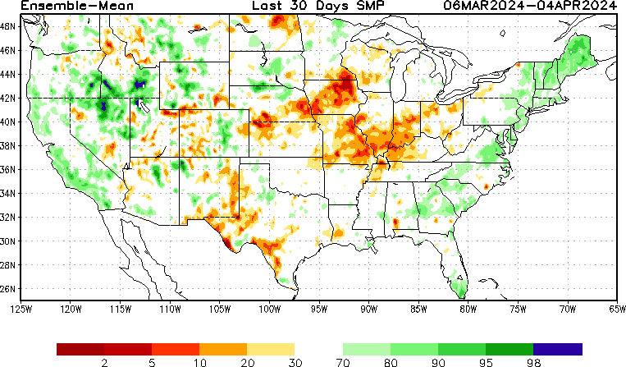
Soil Moisture Models
Soil moisture improvement in E/SE WI since January
https://www.cpc.ncep.noaa.gov/products/Soilmst_Monitoring/US/Soilmst/Soilmst.shtml
https://www.cpc.ncep.noaa.gov/products/Drought/Monitoring/smp_new.shtml#

Slide 14
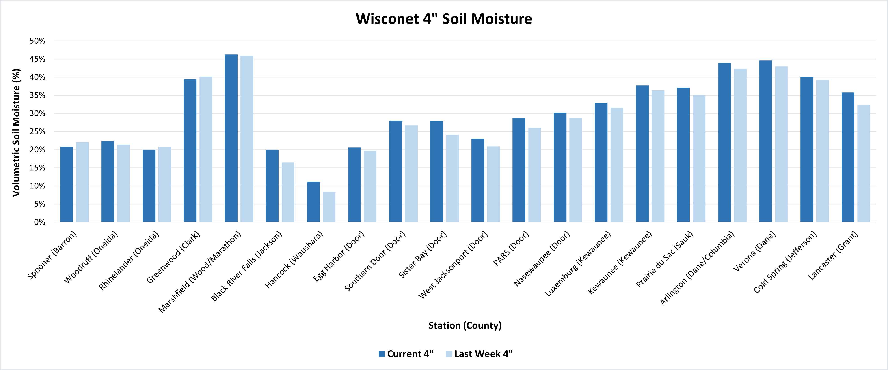
Soil Moisture - Wisconet
Current: 7-day average ending on 4/8
Last Week: 7-day average ending on 4/1
https://wisconet.wisc.edu/

Slide 15
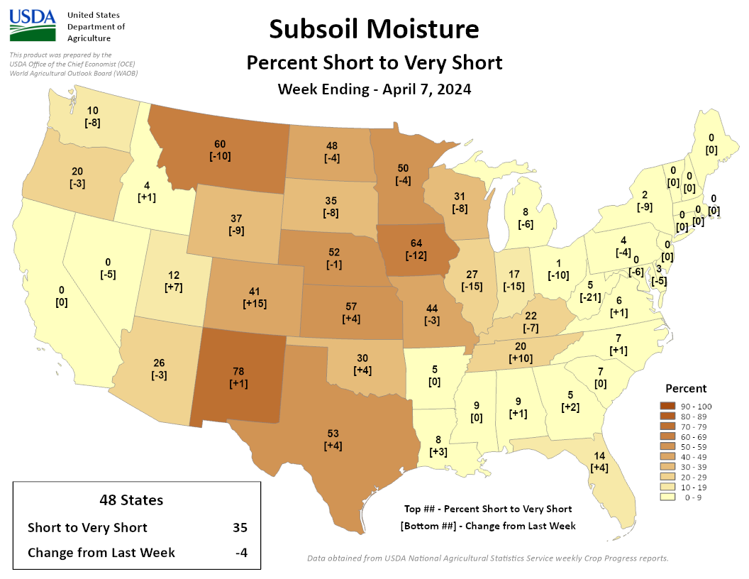
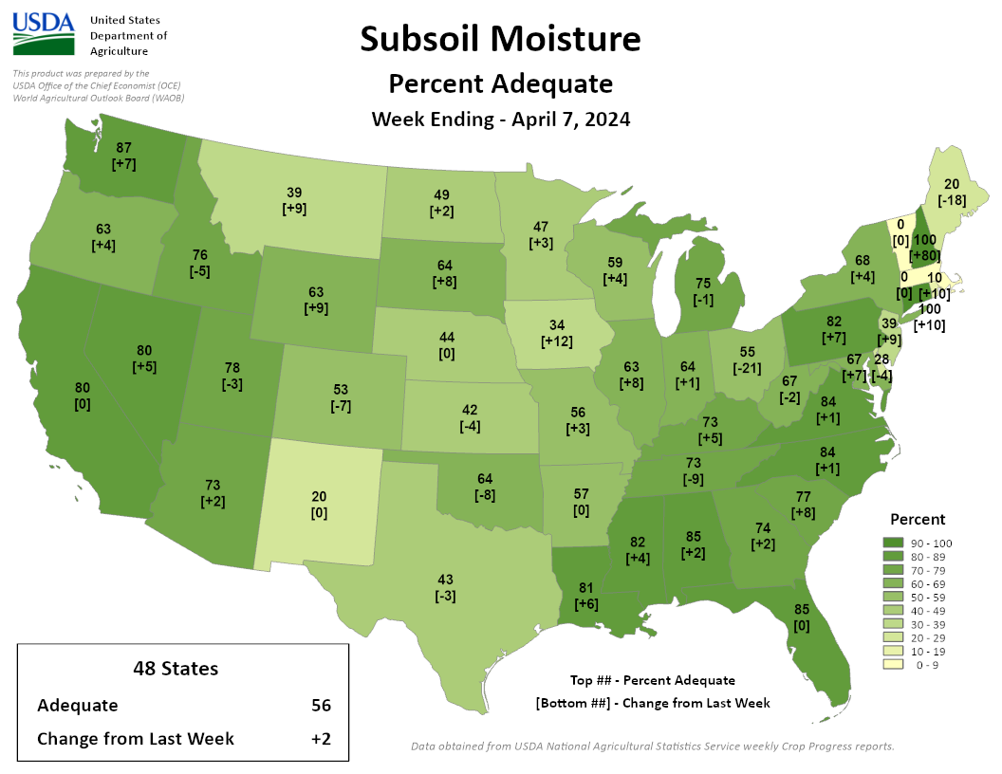
NASS Subsoil Moisture
https://agindrought.unl.edu/Other.aspx

Slide 16
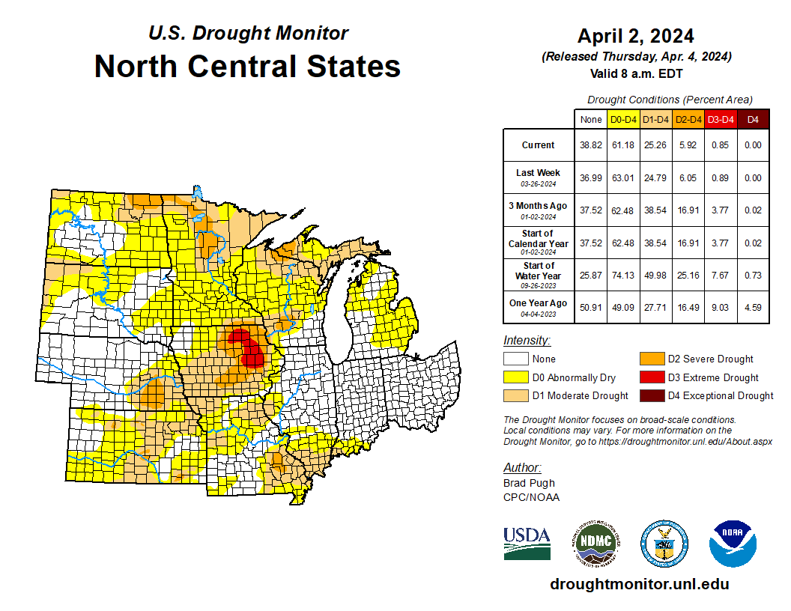
US Drought Monitor
Compared to last week:
Minor changes in drought category area (-/+).
Ohio & Indiana are nearly drought-free.
D3 level drought persists in eastern IA.
Note: D0 is not considered drought.
http://droughtmonitor.unl.edu/

Slide 17
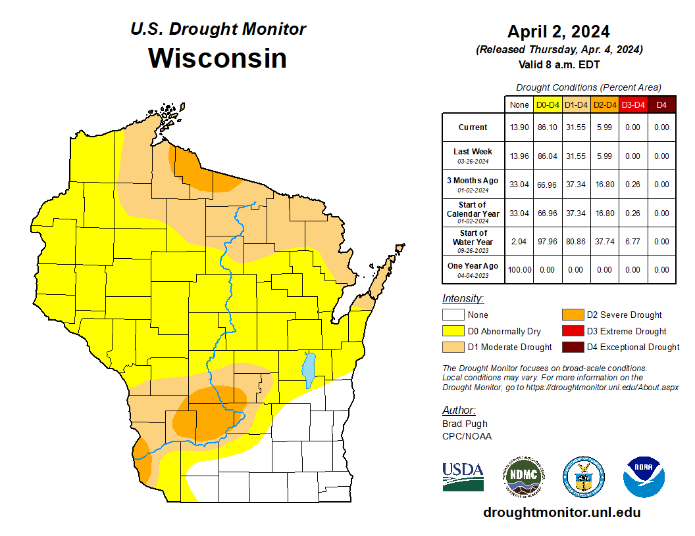
US Drought Monitor
Amount of state in:
D1-D4 – 31.6% --
D2-D4 – 6.0% --
D3-D4 – 0.0% --
D4 – 0.0% --
Note: ↑↓ indicate change from mid-February. Red up arrows indicate increase in drought area; vice-versa for green arrows.
http://droughtmonitor.unl.edu/

Slide 18
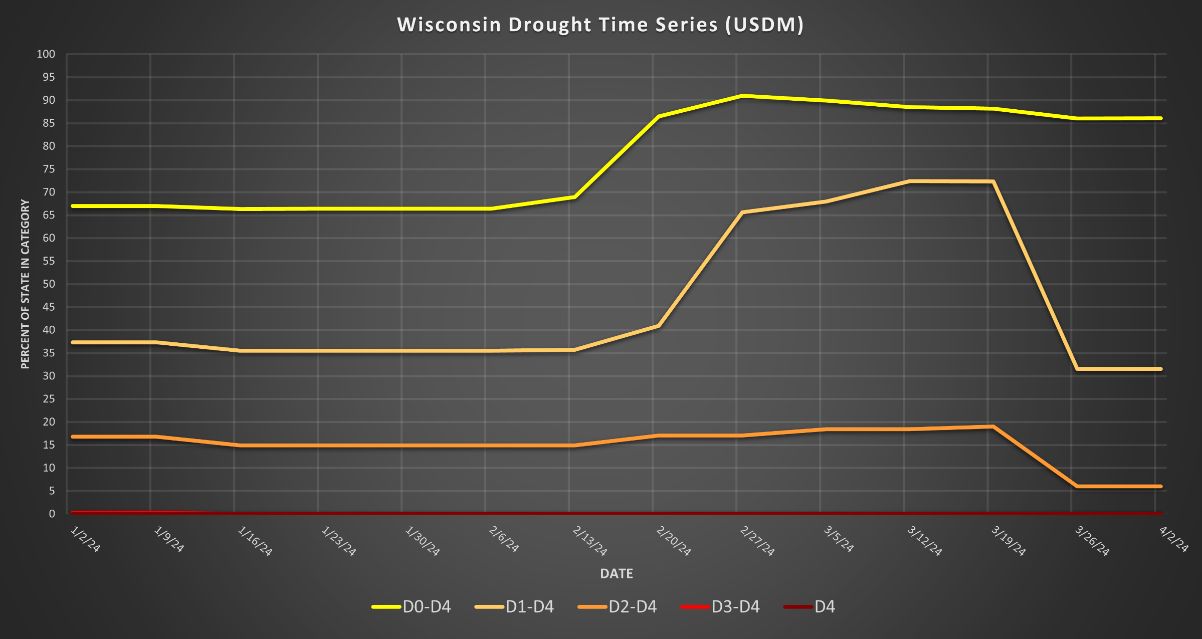
USDM Time Series
http://droughtmonitor.unl.edu/

Slide 19
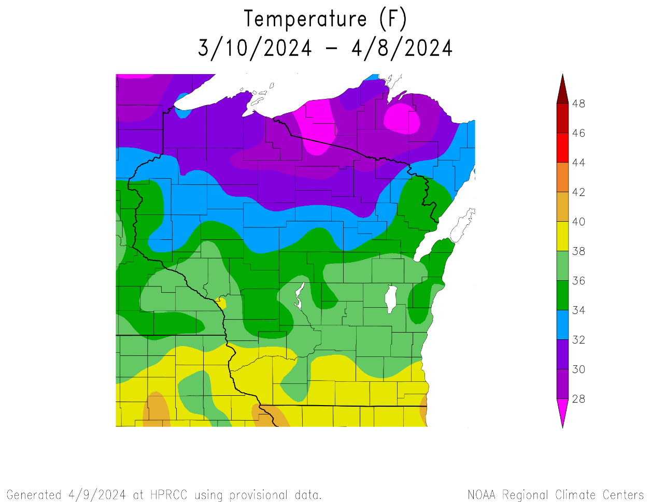
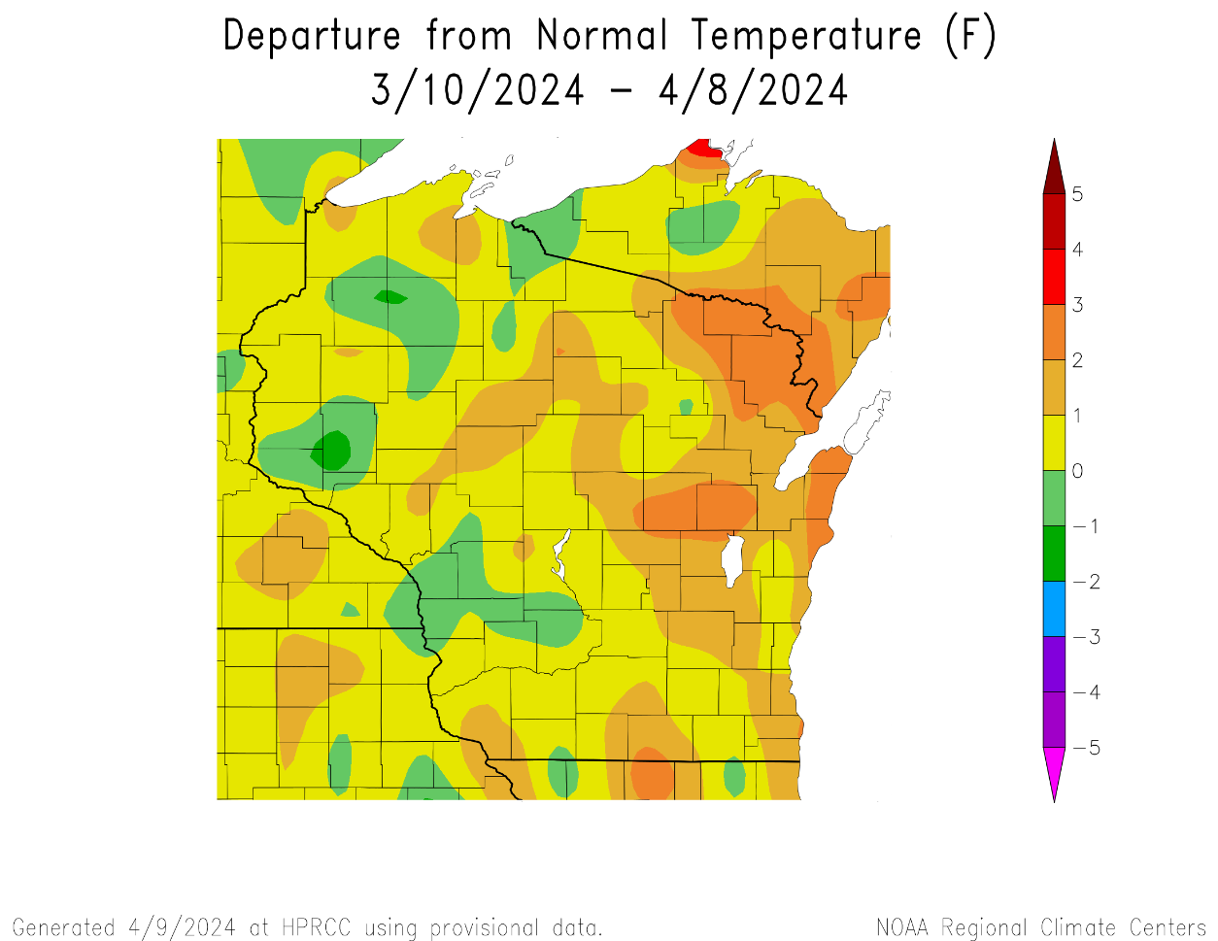
30 Day Temperatures
Temperatures over the last 30 days ranged from 36-40°F in the S to 28-32°F in the far N.
Most of the state was within -/+ 1°F of average.
2°F or higher than average for some in the E and NE.
https://hprcc.unl.edu/maps.php?map=ACISClimateMaps

Slide 20
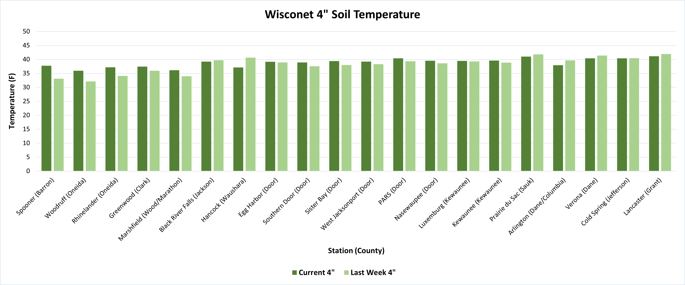
Soil Temperature - Wisconet
Current: 7-day average ending on 4/8
Last Week: 7-day average ending on 4/1
https://wisconet.wisc.edu/

Slide 21
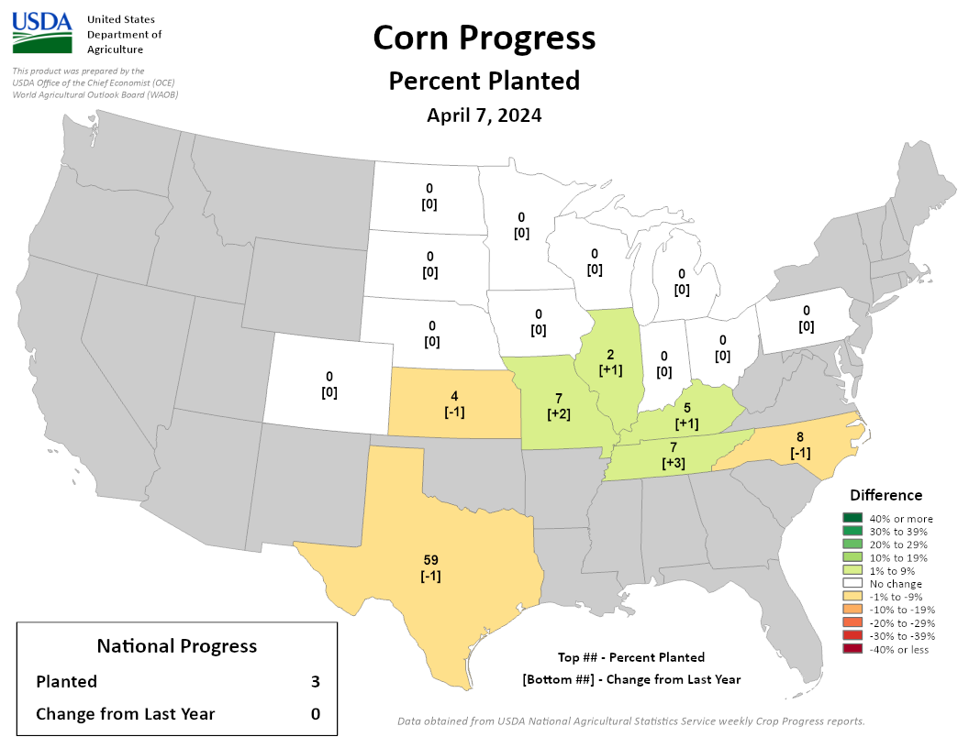
NASS Crop Progress – Corn
Planting has begun for some in states to the south of Wisconsin.
This is ahead of schedule for those states.
https://agindrought.unl.edu/Other.aspx

Slide 22
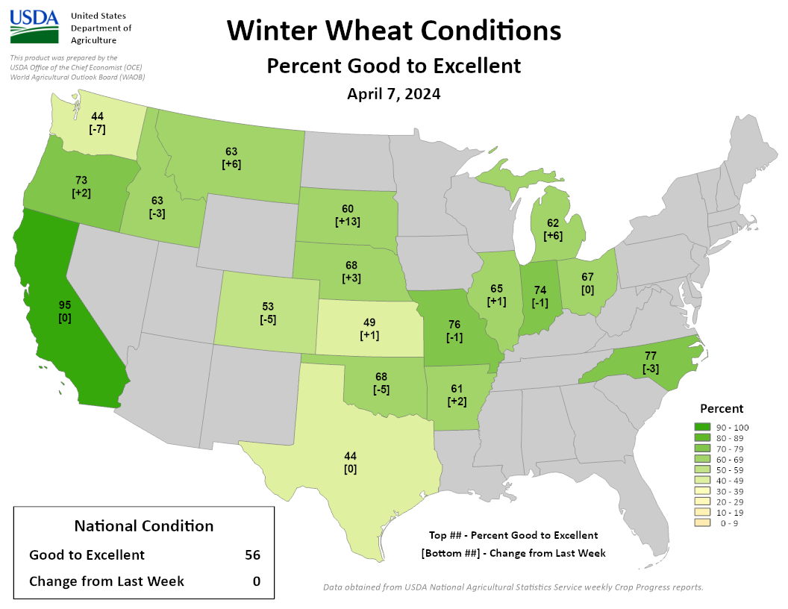
NASS Crop Progress – Winter Wheat
In states around Wisconsin, winter wheat condition is >60% good to excellent.
Similar to last week
https://agindrought.unl.edu/Other.aspx

Slide 23
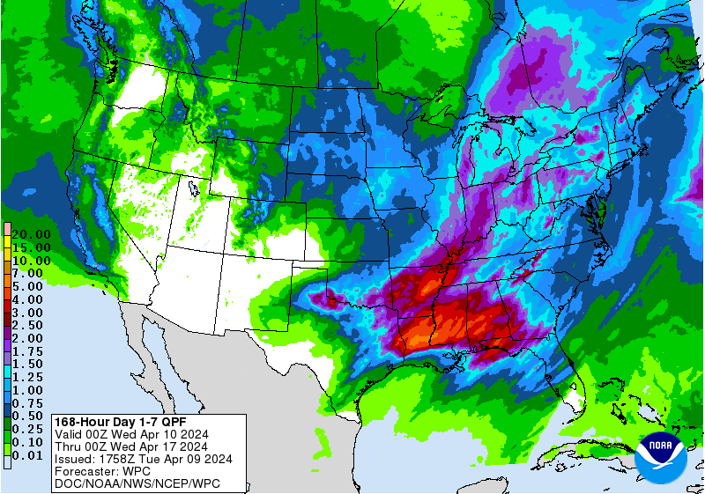
7 Day Precip Forecast
Chances of multiple rounds of precip over the next week → 1.0” or more for some.
Rain late Thursday into early on Friday.
Another chance of rain early next week.
Forecast for 4/9/24 thru 4/16/24
https://www.wpc.ncep.noaa.gov/qpf/p168i.gif

Slide 24
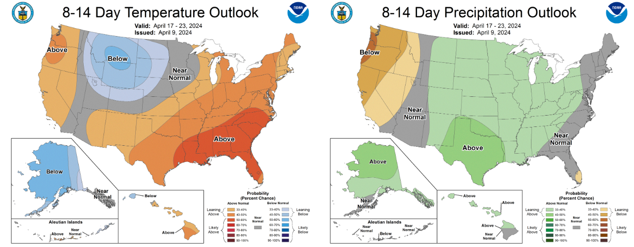
8-14 Day Temp & Precip Outlook
Third/fourth week in April: Temperatures leaning above to near normal. Precipitation is leaning above normal.
http://www.cpc.ncep.noaa.gov/

Slide 25
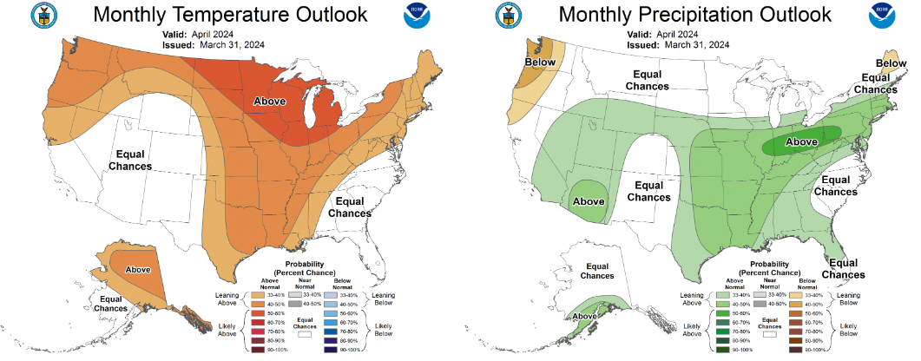
30 Day Temp & Precip Outlook
Month of April: Temperatures likely to be above normal. Precipitation is showing equal chances; leaning above normal near the IL line.
http://www.cpc.ncep.noaa.gov/

Slide 26
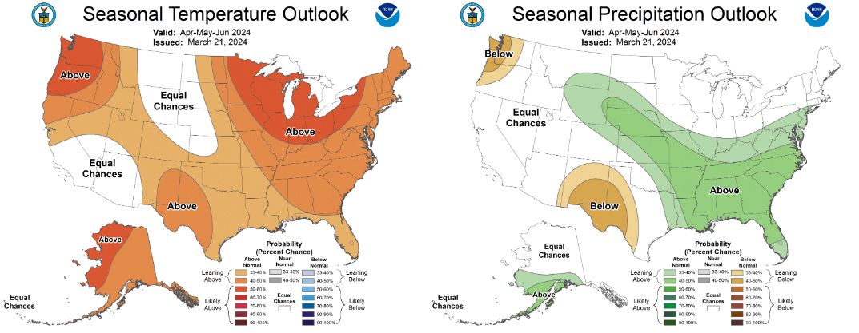
90 Day Temp & Precip Outlook
Spring into Early Summer: Temperatures likely to be above normal. Precipitation indications are for equal chances of above/at/below average.
http://www.cpc.ncep.noaa.gov/

Slide 27
Take-Home Points
Current conditions:
Substantial late-season snowfall event that melted within days of falling.
April started out colder-than-average in the south, and a bit warmer-than-average in the north. Over the past 30 days, temps have been -/+ 1°F from average for most in WI.
Impact:
Soil moisture conditions continued to improve with the snow melt.
US Drought Monitor conditions in the state remain mostly unchanged from last week.
Corn planting has been reported to be underway south of WI, but not yet in the state itself.
Outlook:
A few chances for precipitation (rain) are forecasted for the next 7 days.
The rest of April is looking to be warmer-than-average for most, with some uncertainty for precip (“equal chances”).
The warmer-than-normal conditions have a higher probability to persist through April due in part to continued El Nino.
However, a transition to La Nina is expected by June.

Slide 28
Agronomic Considerations
Planting Considerations
Drier field conditions should allow for a good planting season.
Consider termination timing of cover crops to preserve soil moisture.
If planting early, consider planting depth adjustments to ensure planting into moisture. Also check insurance policies.
Nutrient & Herbicide Applications
Consider using a preplant nitrate test to assess if there is nitrogen left over from last year due to drought conditions
Observe soil moisture conditions before doing fieldwork so as to avoid soil compaction.
Ensure daytime, nighttime, & soil temperatures are conducive for the necessary duration for effective herbicide applications…Remember pre-emergent herbicides require moisture for activation and consider duration of effectiveness if planting early.
Read herbicide labels from products used last year to assess if carryover is a possibility due to warmth and lack of moisture.
Manure Applications
DATCP is forecasting Runoff Risk in the coming week, especially in the southern part of the state
Early season manure applications into warm soil conditions may lead to increased mineralization/nitrification and potential for N loss if receive “typical” heavy spring rainfall events, particularly if not applied to a growing cover crop or if the cash crop will not be planted soon after application.
Small Grains
Wheat N typically goes on a green up…will be earlier than normal with warm conditions.
Potential for earlier planting of spring grains, if warmer weather continues. However, there is still a risk with potential for freeze.
Breaking Dormancy
Likely early breaking of dormancy for overwintering crops – potential for increased winterkill if temperatures snap back to cold.
When seeding alfalfa be aware that it can germinate at 32-34°, but will die if temperatures drop below 24°, so it is best to wait to plant alfalfa until those low temperatures are unlikely.

Slide 29
User Survey
Are you a regular user of the Wisconsin Ag Climate Outlook (WACO)? Or maybe you are viewing these slides for the first time this week? Either way, we want to hear your feedback on this new resource! Please take a few minutes and fill out this survey:
LINK TO SURVEY
Your feedback will help us better serve your ag-climate data needs through WACO.
If you have any trouble accessing or filling out the survey, please email Josh Bendorf at Joshua.Bendorf@usda.gov.
Thank you!!
-The WACO Team

Slide 30
Citizen Science Opportunity
CoCoRaHS – Community Collaborative Rain, Hail, & Snow Network
The Mission
(From cocorahs.org)
Provide accurate high-quality precipitation data for end-users;
Increasing the density of precipitation data available throughout the country;
Encouraging citizens to have fun participating in meteorological science and heightening their awareness about weather;
Providing weather education opportunities.
Sign Up Here: https://cocorahs.org/Content.aspx?page=application

Slide 31
Contact Info
Photo Credit: USDA
Natasha Paris
Crops Educator – Adams, Green Lake, Marquette, Waushara Cos.
natasha.paris@wisc.edu
Kristin Foehringer
NRCS State Working Lands Climate Smart Specialist
kristin.foehringer@usda.gov
Dennis Todey
Director, Midwest Climate Hub
dennis.todey@usda.gov
Josh Bendorf
Ag Climatologist Fellow, Midwest Climate Hub
joshua.bendorf@usda.gov
Steve Vavrus
State Climatologist of Wisconsin
sjvavrus@wisc.edu
Bridgette Mason
Assistant State Climatologist of Wisconsin
bmmason2@wisc.edu

