Slide 1
Wisconsin Ag Climate Outlook Week of April 1, 2024
Natasha Paris
Crops Educator – Adams, Green Lake, Marquette, Waushara Cos.
natasha.paris@wisc.edu
Kristin Foehringer
NRCS State Working Lands Climate Smart Specialist
kristin.foehringer@usda.gov
Dennis Todey
Director, Midwest Climate Hub
dennis.todey@usda.gov
Josh Bendorf
Ag Climatologist Fellow, Midwest Climate Hub
joshua.bendorf@usda.gov
Steve Vavrus
State Climatologist of Wisconsin
sjvavrus@wisc.edu
Bridgette Mason
Assistant State Climatologist of Wisconsin
bmmason2@wisc.edu

Slide 2
Key Points
Northern parts of the state received snow last week, and a lot of the snowpack has melted with soil temps above freezing.
Notable improvements in soil moisture from last week, with a subsequent reduction of area in drought.
Likely to be warmer and wetter than normal heading into the month of April.

Slide 3
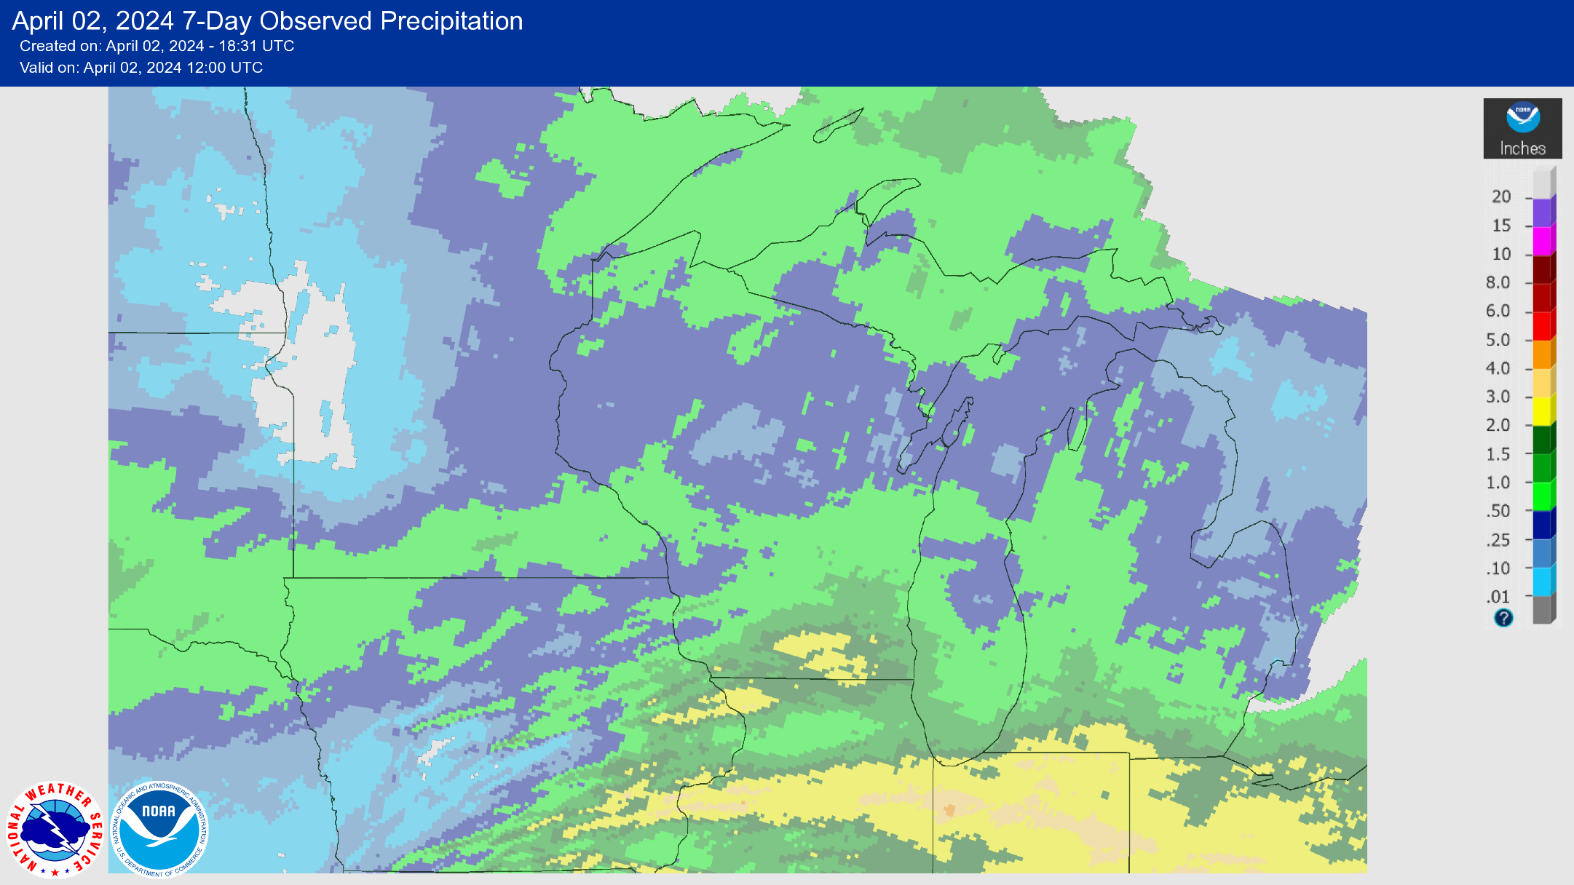
7 Day Precip
Most of the state saw <1” of precip this past week.
Highest amounts in the South Central → 2-3”
https://water.weather.gov/precip/

Slide 4
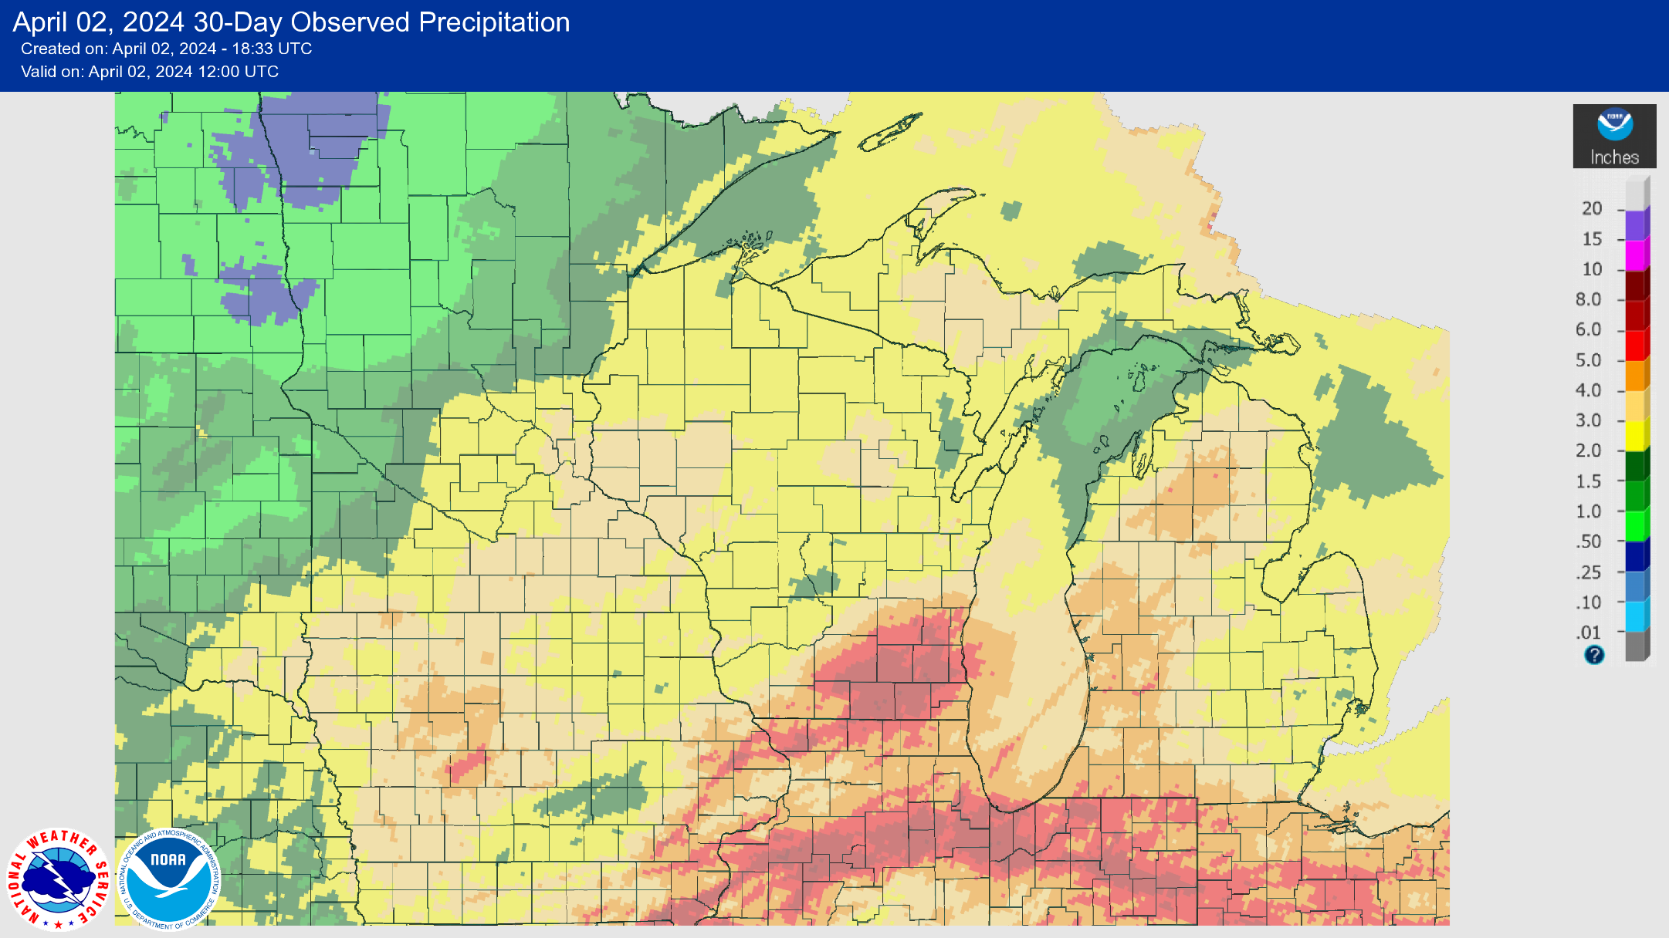
30 Day Precip
Most of the state has seen 2-4” of precip since March 2nd.
Highest amounts in the SE → 5-8” in locations between Milwaukee & Madison.
https://water.weather.gov/precip/

Slide 5
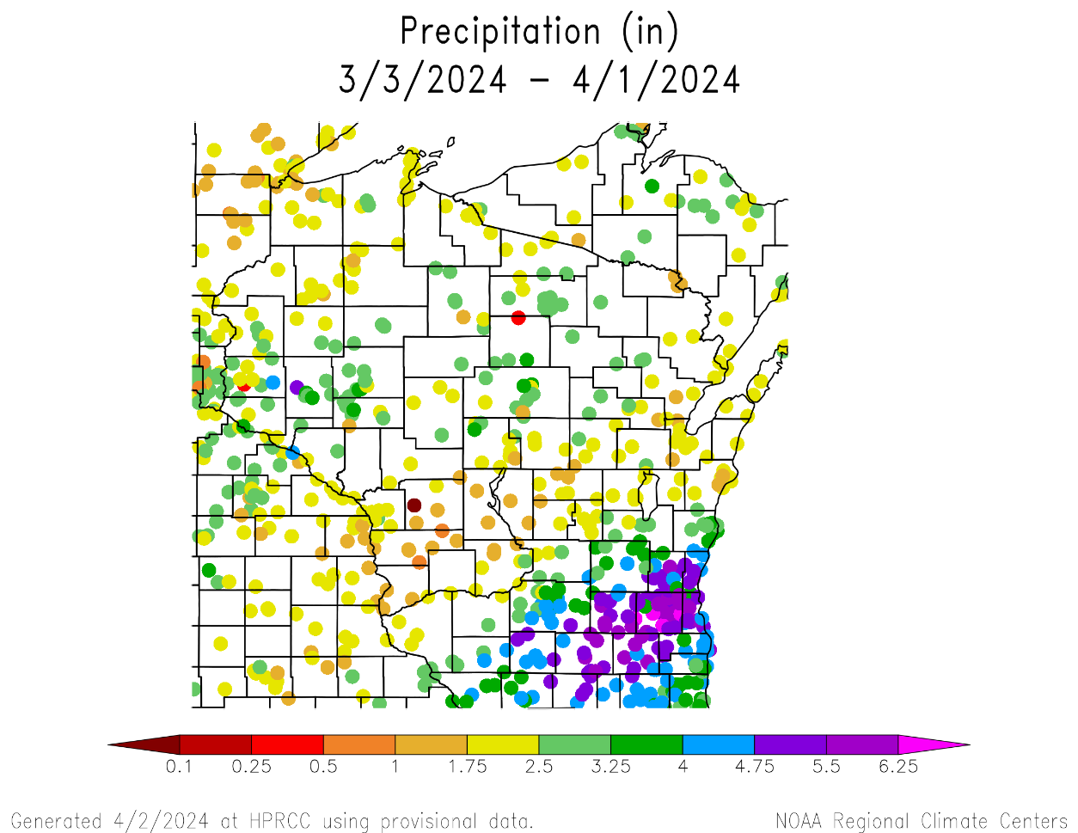
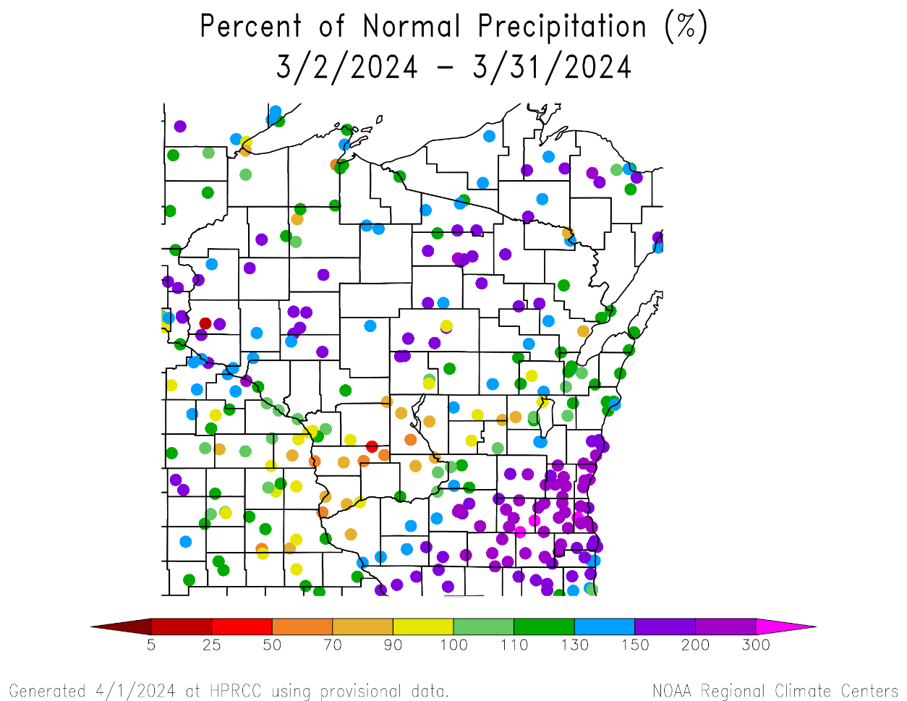
30 Day Precip Total/% Avg.
Highest precip totals in the SE (>4”) and lowest in Vernon/Monroe Cos. (<2”).
200+% of long-term average precip at stations in the SE.
Below-average precip across the Driftless & central parts of the state.
https://hprcc.unl.edu/maps.php?map=ACISClimateMaps

Slide 6
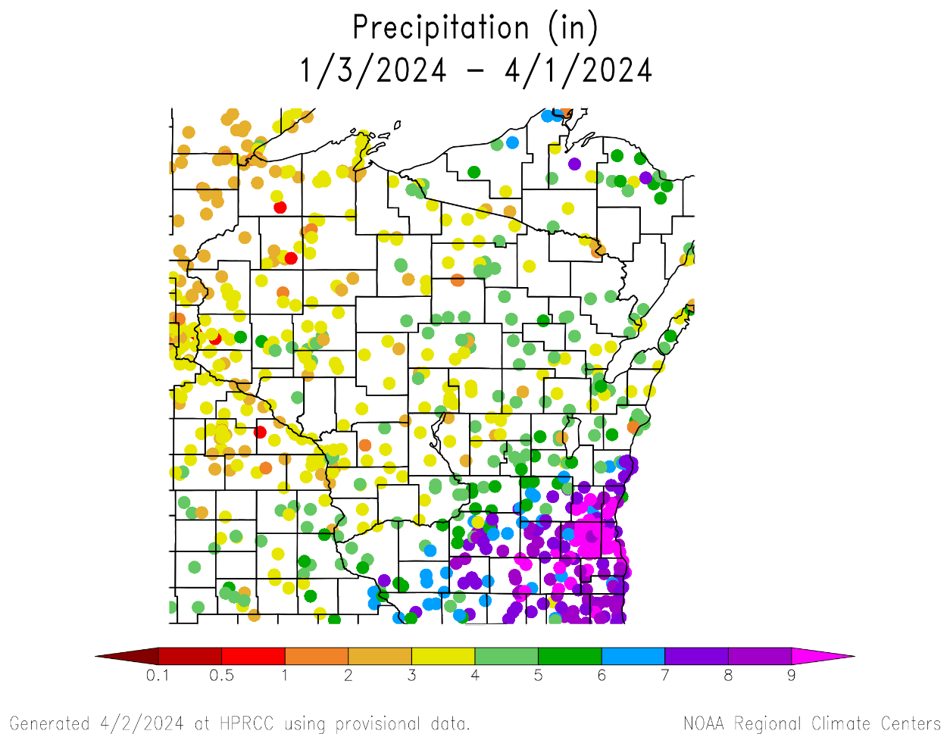
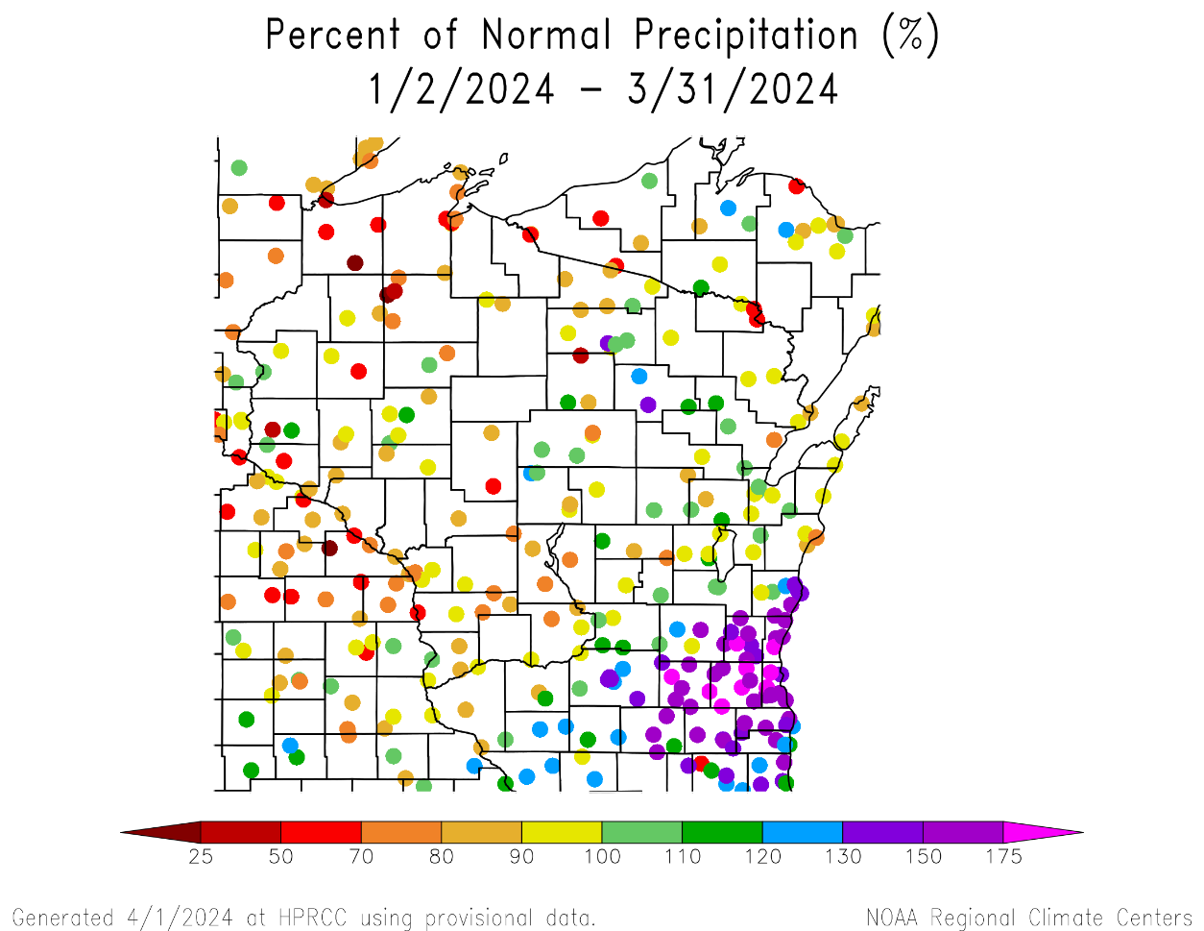
90 Day Precip Total/% Avg.
Highest precip totals in the SE (>7”) and lowest in the NW (<3”).
150+% of long-term average precip in the SE.
<100% of average was common across stations in the N and W.
https://hprcc.unl.edu/maps.php?map=ACISClimateMaps

Slide 7
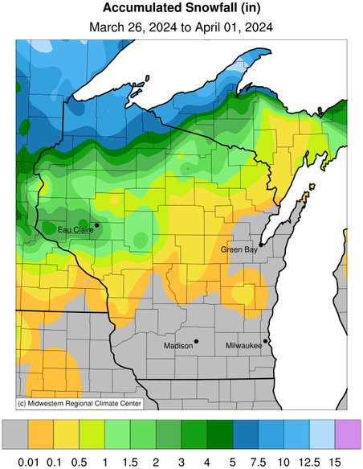
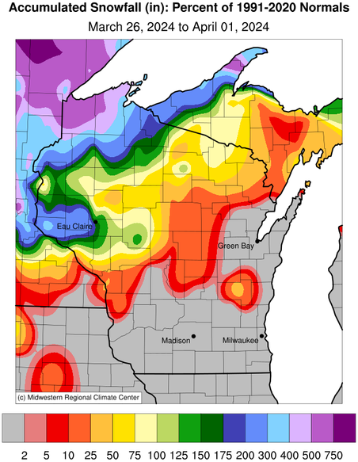
Weekly Snowfall Recap
No snowfall in southern 2 tiers of counties in the state.
Highest totals along the Lake Superior lakeshore (5+”)
Totals >200% of 30-year average
<1” for areas in the middle of the state.
https://mrcc.purdue.edu/CLIMATE

Slide 8
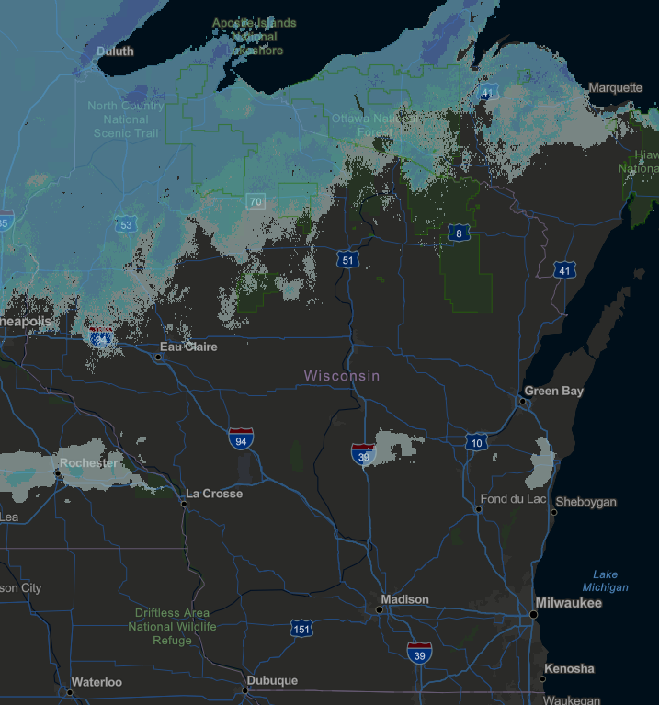
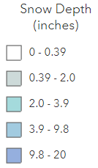
Current Snow Depth
Map is from the morning of April 2nd
https://www.fs.usda.gov/Internet/FSE_DOCUMENTS/fseprd1045012.html

Slide 9
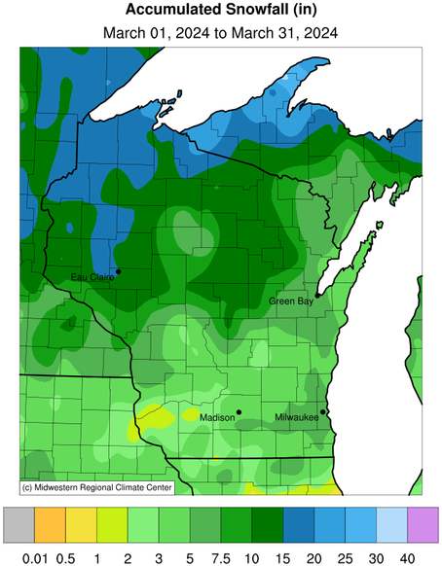
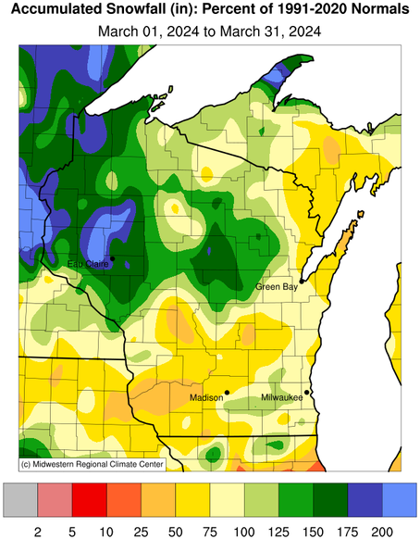
March Snowfall Recap
March snowfall helped make up some of the earlier-season deficit in the NW and NC
5-10” was common in the NW and NC, in some cases >200% of average.
https://mrcc.purdue.edu/CLIMATE

Slide 10
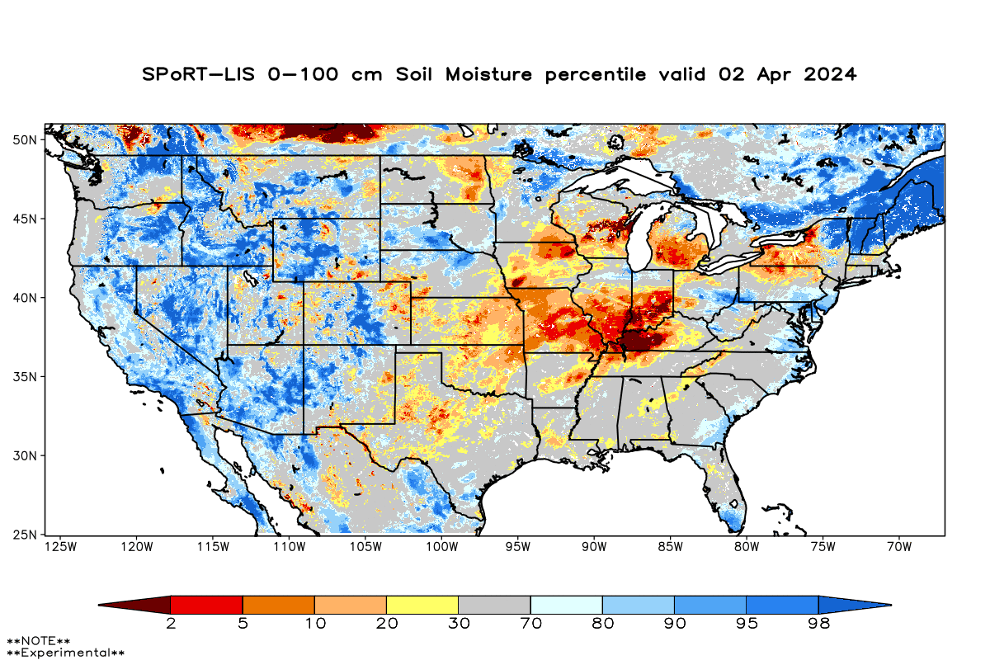
Soil Moisture Models
Reduction in red and orange areas (drier than normal) from last week.
Higher March snowfall brought relief to the North.
Driest soil moisture conditions in Green Bay/Door County area, according to this model.
Model Notes:
Red areas would be top 5 driest in 100 years. Dark red = top 2 driest.
https://weather.msfc.nasa.gov/sport/case_studies/lis_CONUS.html

Slide 11
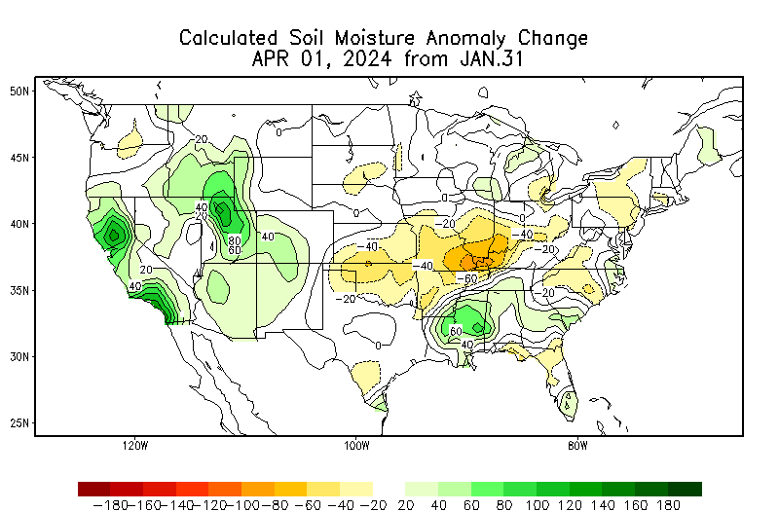
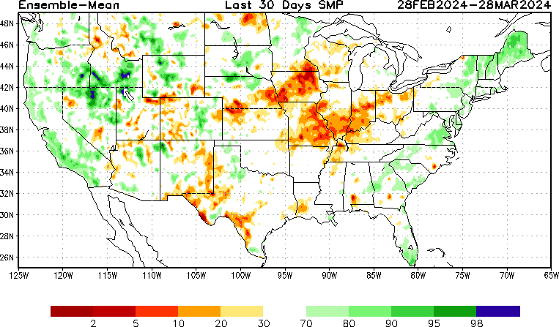
Soil Moisture Models
Soil moisture improvement since January
https://www.cpc.ncep.noaa.gov/products/Soilmst_Monitoring/US/Soilmst/Soilmst.shtml
https://www.cpc.ncep.noaa.gov/products/Drought/Monitoring/smp_new.shtml#

Slide 12
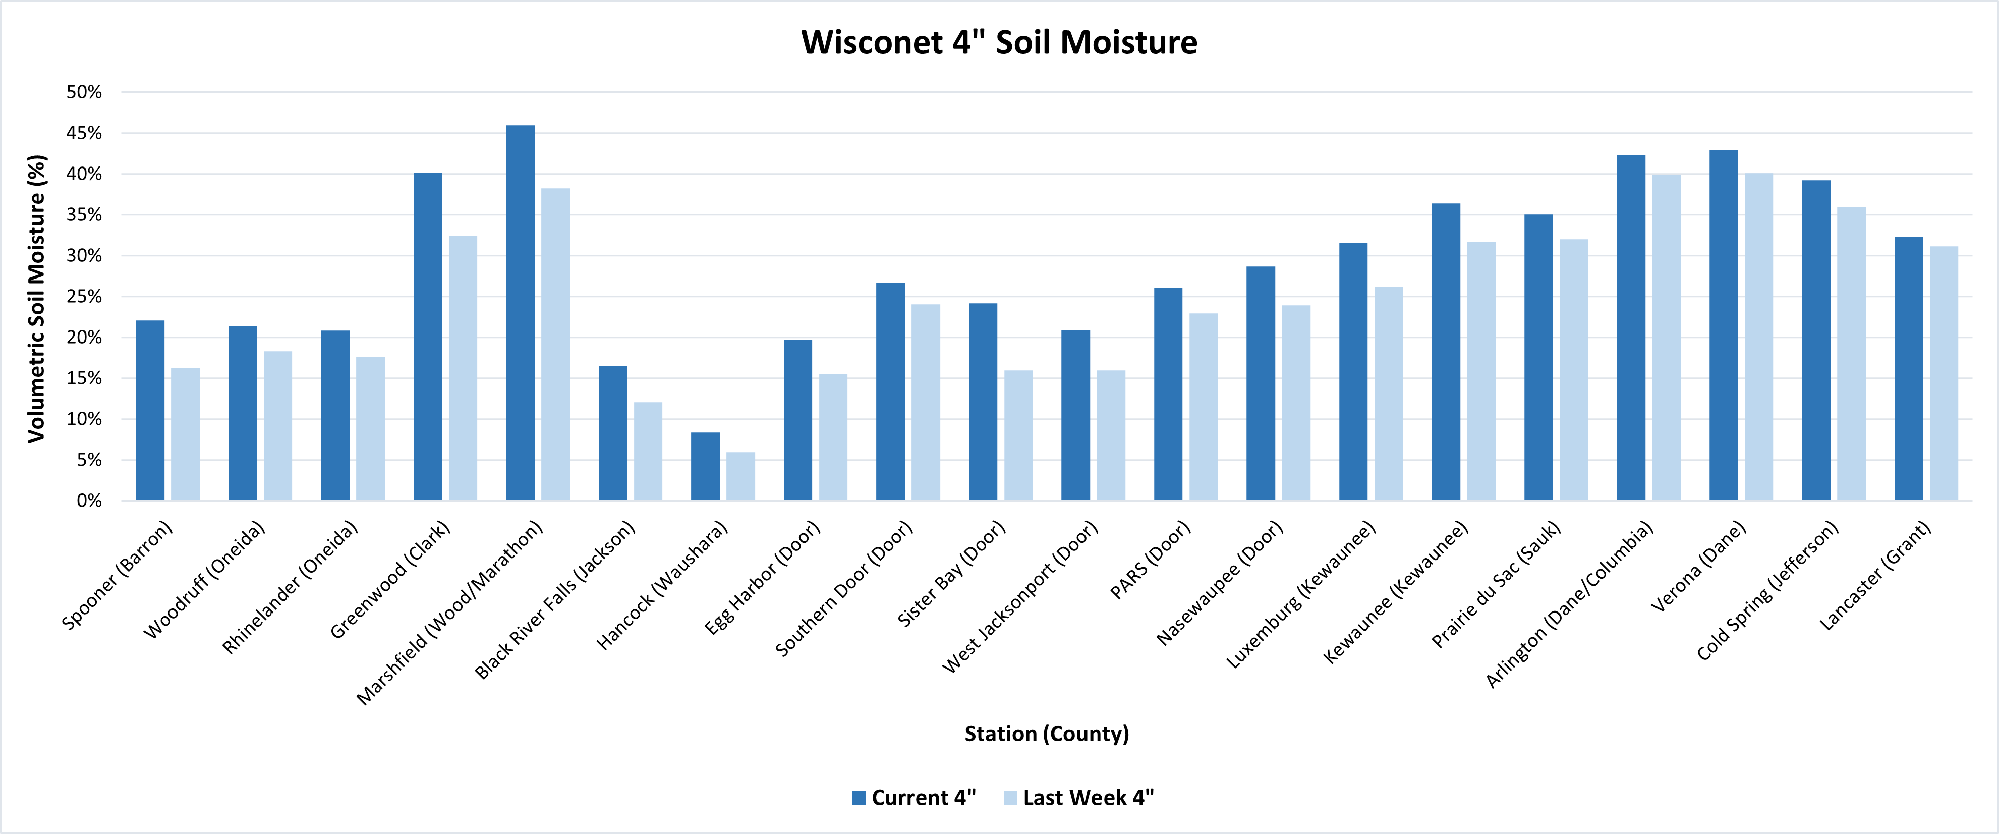
Soil Moisture - Wisconet
Current: 7-day average ending on 4/1
Last Week: 7-day average ending on 3/25
https://wisconet.wisc.edu/

Slide 13
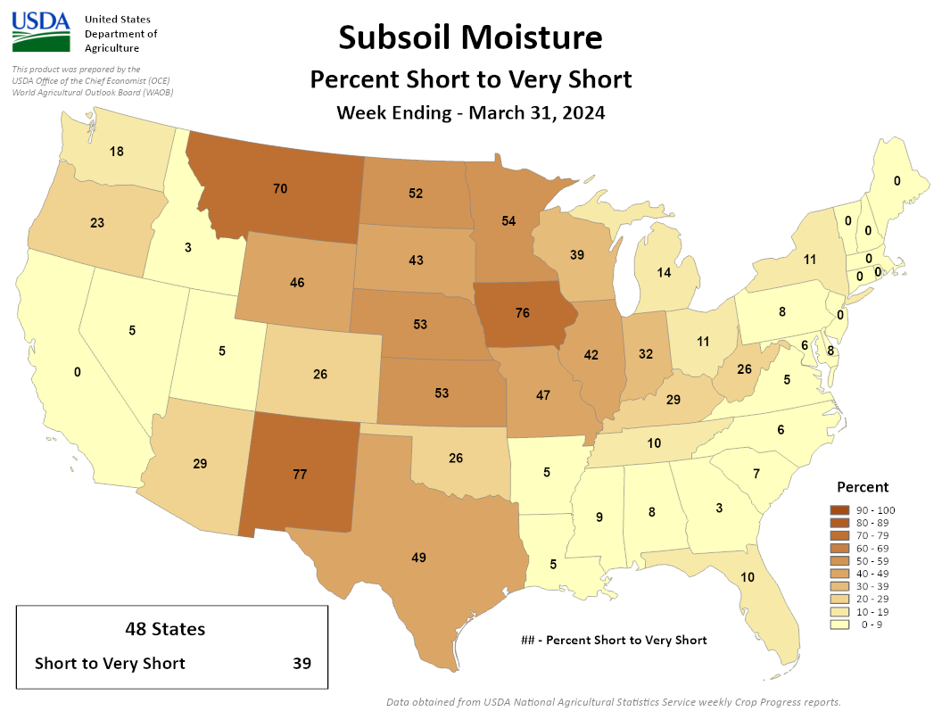
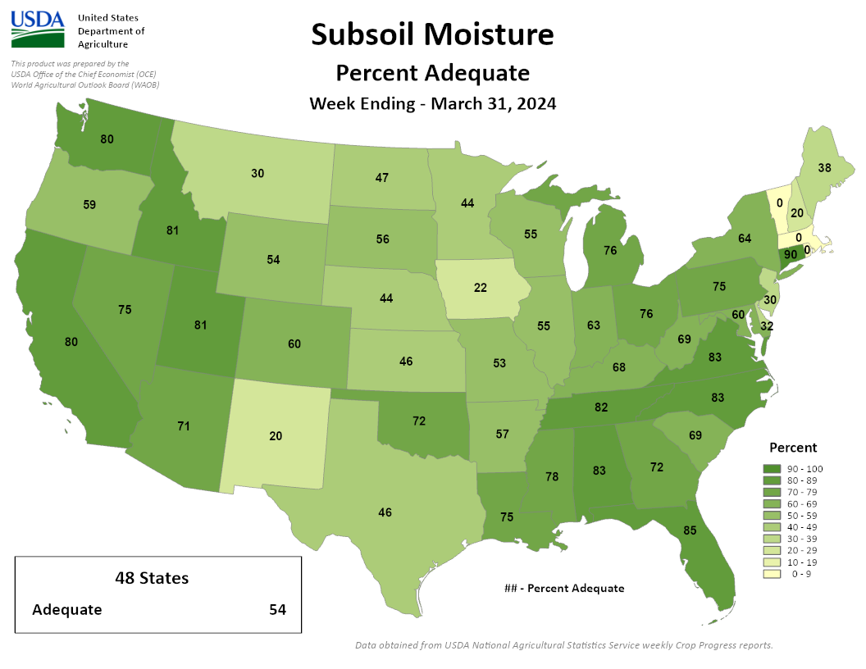
NASS Subsoil Moisture
https://agindrought.unl.edu/Other.aspx

Slide 14
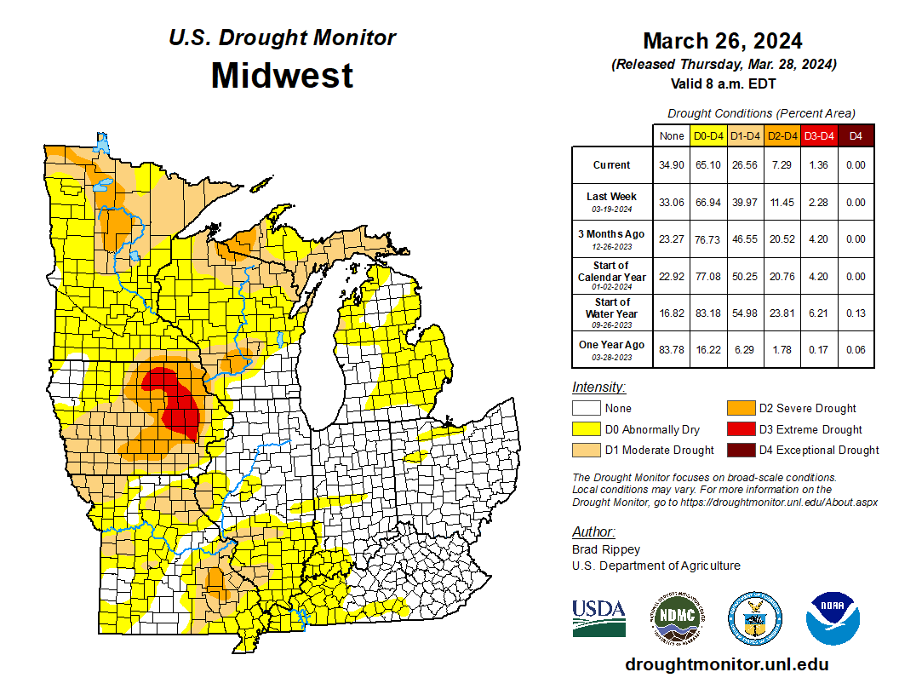
US Drought Monitor
Compared to last week:
Reductions in all drought category areas.
Area in D1 or higher drought down by over 13%.
Area in D3-D4 drought down from 2.3% to 1.4%.
Most of the areas in drought are west of the Mississippi River and in the U.P.
All of the D3 area is eastern IA.
Note: D0 is not considered drought.
http://droughtmonitor.unl.edu/

Slide 15
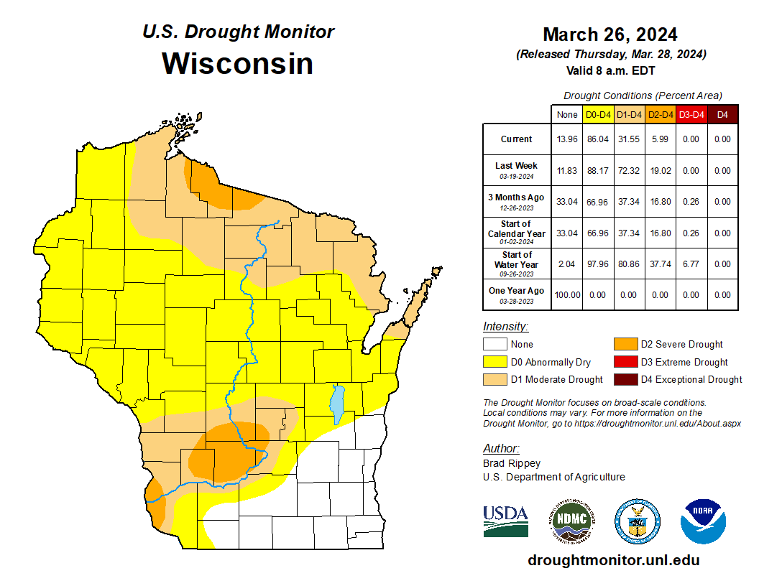
US Drought Monitor
Amount of state in:
D1-D4 – 31.6% ↓
D2-D4 – 6.0% ↓
D3-D4 – 0.0% --
D4 – 0.0% --
Note: ↑↓ indicate change from mid-February. Red up arrows indicate increase in drought area; vice-versa for green arrows.
http://droughtmonitor.unl.edu/

Slide 16
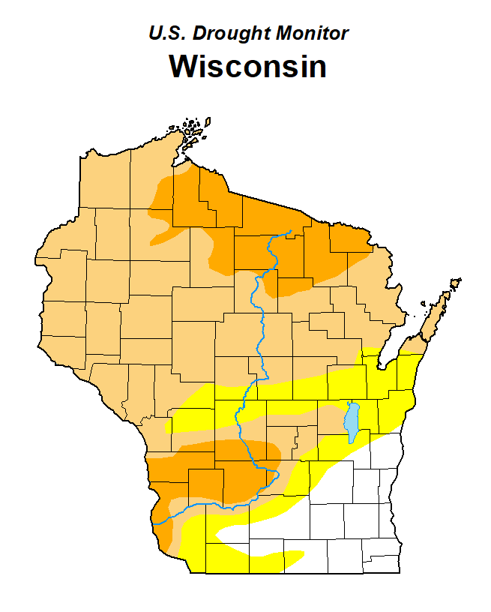
Drought Area Reduction
http://droughtmonitor.unl.edu/

Slide 17
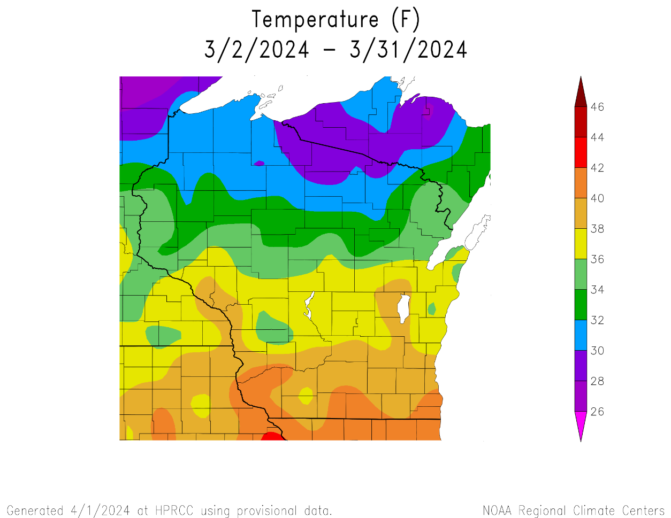
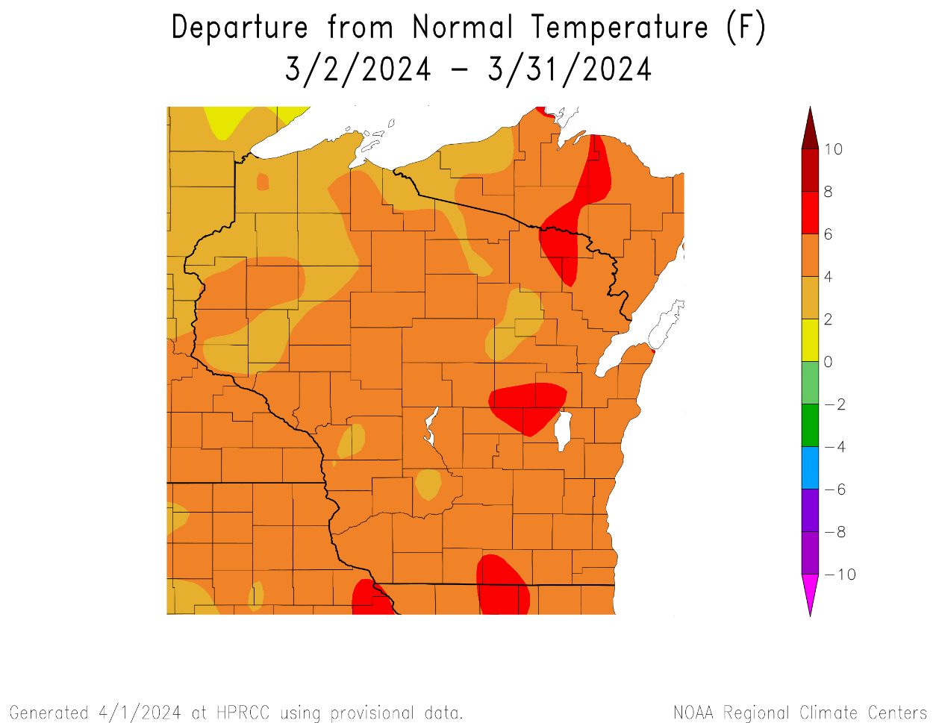
30 Day Temperatures
Temperatures over the last 30 days ranged from 38-42°F in the S to 28-32°F in the far N.
The entire state was above average in temperature.
4°F or higher for most (areas in dark orange/red).
https://hprcc.unl.edu/maps.php?map=ACISClimateMaps

Slide 18
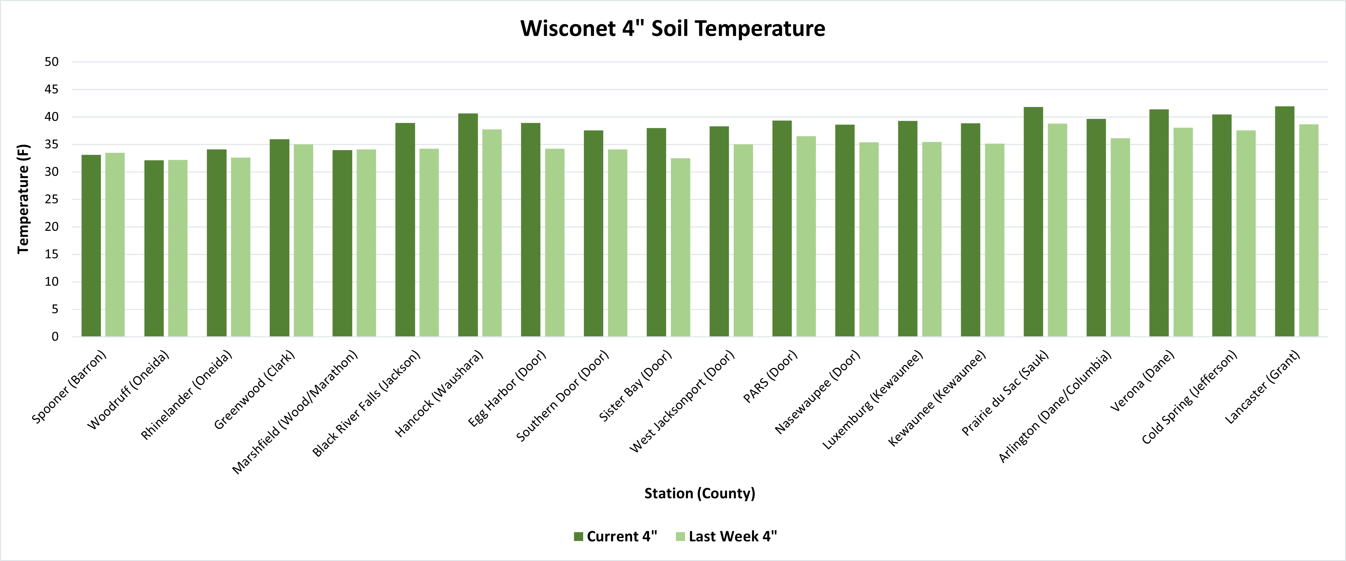
Soil Temperature - Wisconet
Current: 7-day average ending on 4/1
Last Week: 7-day average ending on 3/25
https://wisconet.wisc.edu/

Slide 19
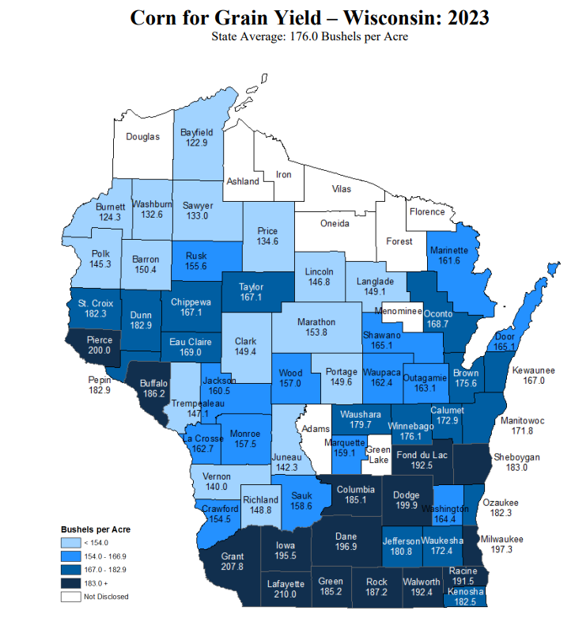
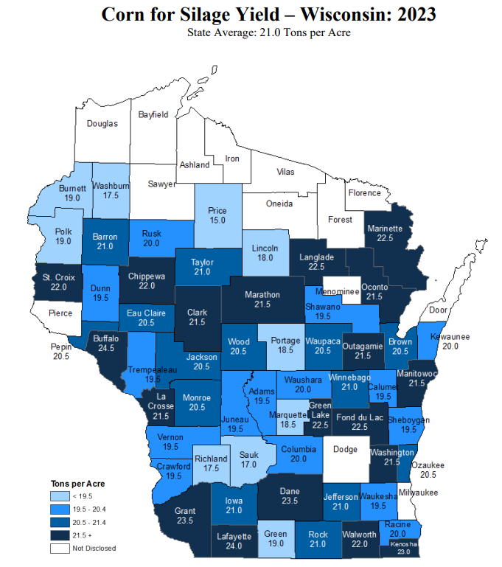
NASS 2023 Yield Estimates
https://www.nass.usda.gov/Statistics_by_State/Wisconsin/Publications/County_Estimates/index.php

Slide 20
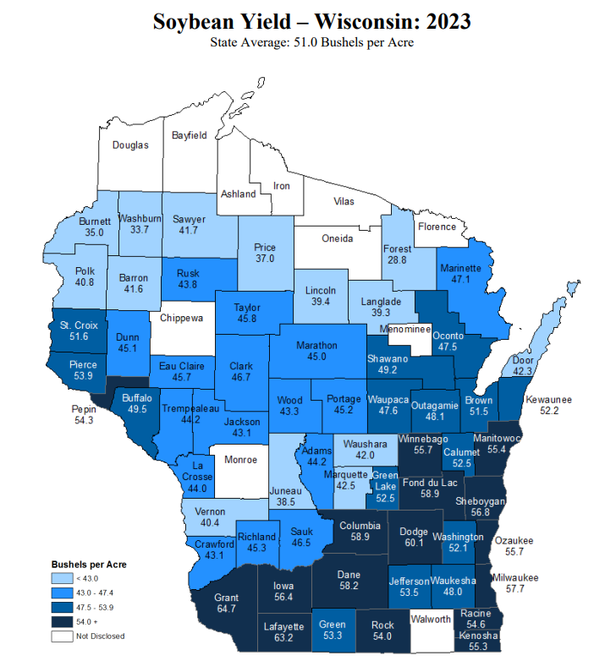
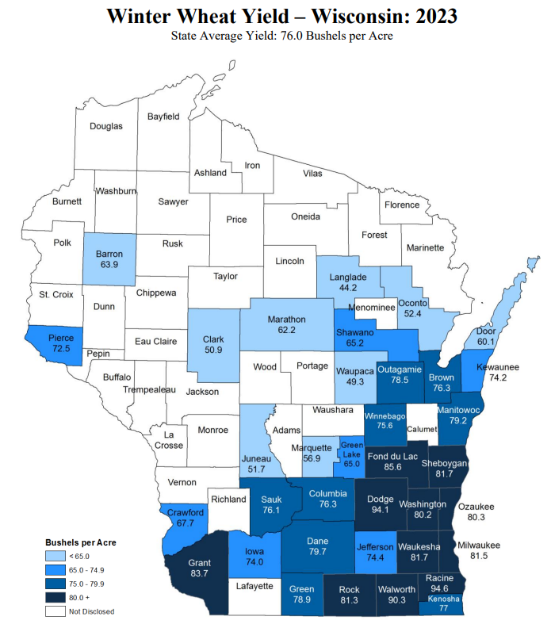
NASS 2023 Yield Estimates
https://www.nass.usda.gov/Statistics_by_State/Wisconsin/Publications/County_Estimates/index.php

Slide 21
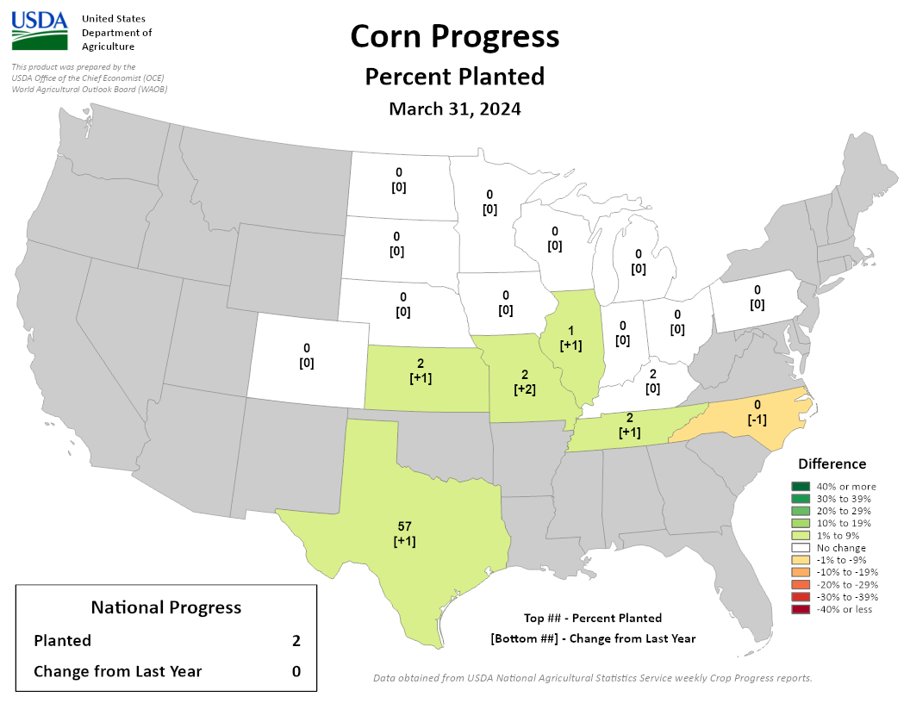
NASS Crop Progress – Corn
Planting has begun for some in states to the south of Wisconsin.
This is ahead of schedule for those states.
https://agindrought.unl.edu/Other.aspx

Slide 22
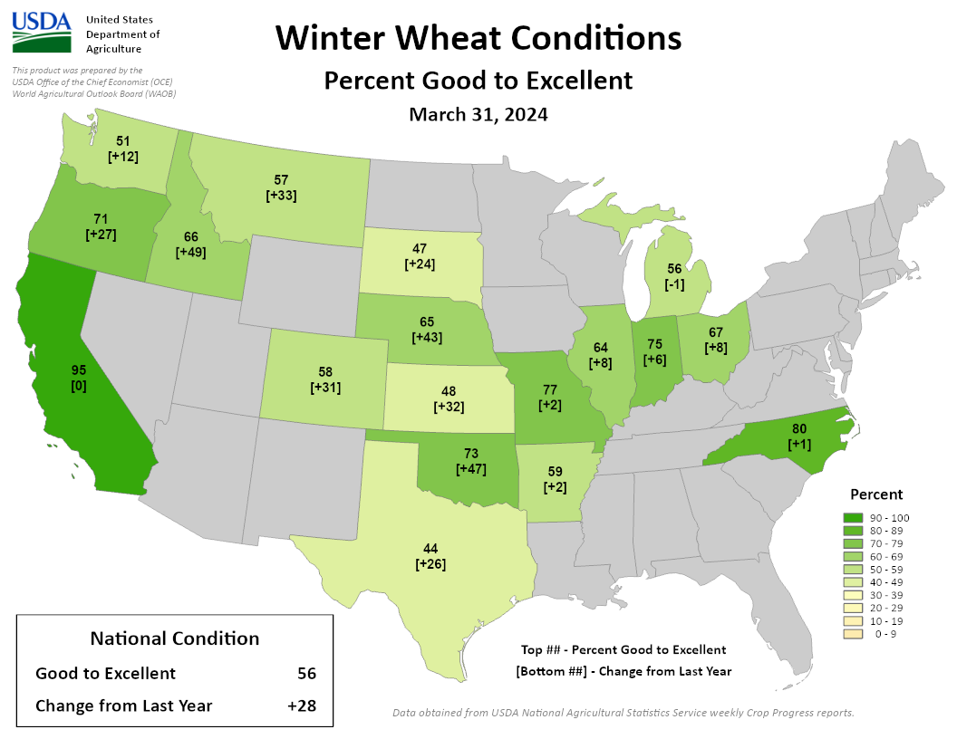
NASS Crop Progress – Winter Wheat
In states to the south of Wisconsin, winter wheat condition is >60% good to excellent.
Better than last year at this time.
https://agindrought.unl.edu/Other.aspx

Slide 23
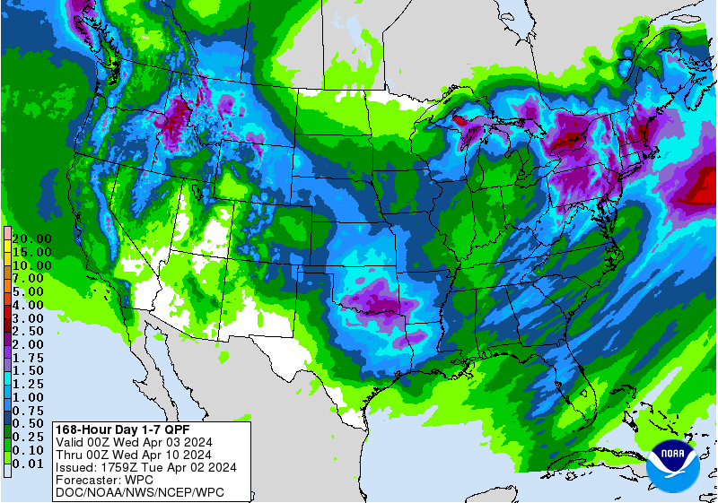
7 Day Precip Forecast
Chances of multiple rounds of precip over the next week → 1.0” or more for some.
Substantial winter storm moving through on Wednesday.
Second possible round on Sunday into Monday.
Forecast for 4/2/24 thru 4/9/24
https://www.wpc.ncep.noaa.gov/qpf/p168i.gif

Slide 24
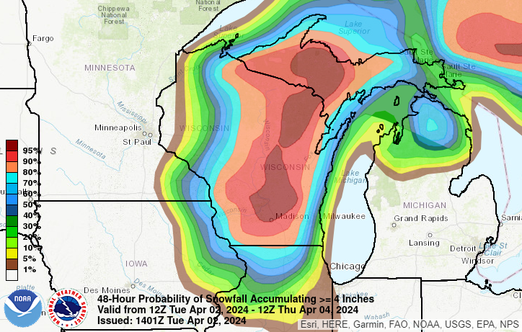
Mid-Week Snowfall
High probability (>80%) for several inches of snow across the middle of the state.
Be aware of travel impacts!
Moisture will help further alleviate drought (once melted).
Forecast for 4/2/24 (7 am) thru 4/4/24 (7 am)
https://www.wpc.ncep.noaa.gov/qpf/p168i.gif

Slide 25
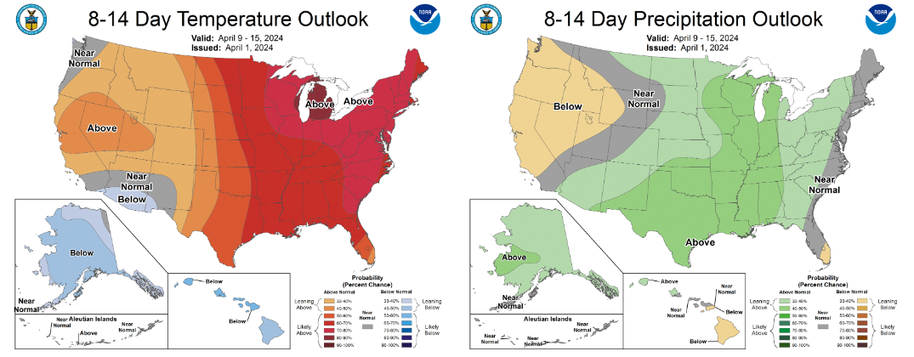
8-14 Day Temp & Precip Outlook
Second week in April: Temperatures & precipitation are likely to be above normal.
http://www.cpc.ncep.noaa.gov/

Slide 26
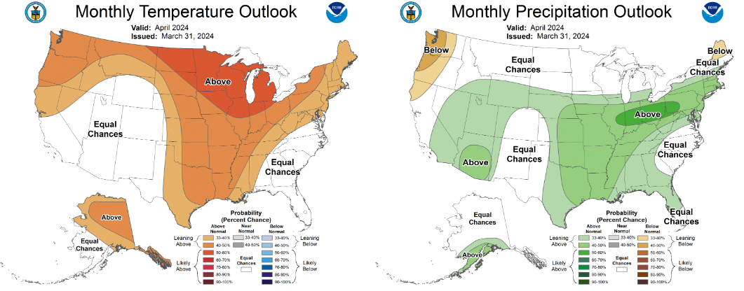
30 Day Temp & Precip Outlook
Month of April: Temperatures likely to be above normal. Precipitation is showing equal chances; leaning above normal near the IL line.
http://www.cpc.ncep.noaa.gov/

Slide 27
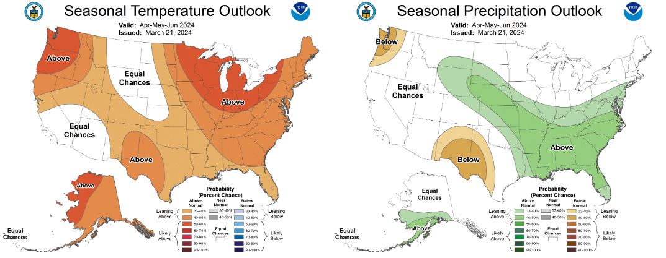
90 Day Temp & Precip Outlook
Spring into Early Summer: Temperatures likely to be above normal. Precipitation indications are for equal chances of above/at/below average.
http://www.cpc.ncep.noaa.gov/

Slide 28
Take-Home Points
Current conditions:
Snowfall in the north (and subsequent melting) brought some moisture relief.
March was a warmer-than-average month, wrapping up with some near-normal temps.
Impact:
Soil moisture conditions were notably improved with the precipitation and snow melt.
D1+ drought area drastically decreased in the state by >40%.
Corn planting has begun in the Midwest, with winter wheat making progress.
Outlook:
A strong winter system is forecasted to drop several inches of snow across a large portion of WI this week.
Early to mid-April is likely to have above normal temps and precip.
The warmer-than-normal conditions have a higher probability to persist through April due in part to continued El Nino.
However, a transition to La Nina is expected by June.

Slide 29
Agricultural Considerations
Planting Considerations
Watch for soil moisture to increase with this week’s wet snow, and monitor for planting conditions.
Nutrient & Herbicide Applications
As always, producers should be considering climate and soil moisture conditions when setting their crop yield goals and apply nutrients accordingly.
Ensure daytime, nighttime, & soil temperatures are conducive for the necessary duration for effective herbicide applications
Manure Applications
Warmer drier winter has provided a late winter/early spring manure application window (this was an observation when flying into Madison).
Early season manure applications into warm soil conditions may lead to increased mineralization/nitrification and potential for N loss if receive “typical” heavy spring rainfall events, particularly if not applied to a growing cover crop or if the cash crop will not be planted soon after application.
With increased precipitation be aware of runoff potential at manured or tilled sites, and adjust nutrient plans accordingly.
Small Grains
Wheat N typically goes on a green up…will be earlier than normal with warm conditions.
Potential for earlier planting of spring grains, if warmer weather continues. However, there is still a risk with potential for freeze.
Livestock
If calving outdoors, be sure to create a dry spot for calves to get dry to maintain core temperature.
Breaking Dormancy
Likely early breaking of dormancy for overwintering crops – potential for increased winterkill if temperatures snap back to cold.

Slide 30
User Survey
Are you a regular user of the Wisconsin Ag Climate Outlook (WACO)? Or maybe you are viewing these slides for the first time this week? Either way, we want to hear your feedback on this new resource! Please take a few minutes and fill out this survey:
LINK TO SURVEY
Your feedback will help us better serve your ag-climate data needs through WACO.
If you have any trouble accessing or filling out the survey, please email Josh Bendorf at Joshua.Bendorf@usda.gov.
Thank you!!
-The WACO Team

Slide 31
Citizen Science Opportunity
CoCoRaHS – Community Collaborative Rain, Hail, & Snow Network
The Mission
(From cocorahs.org)
Provide accurate high-quality precipitation data for end-users;
Increasing the density of precipitation data available throughout the country;
Encouraging citizens to have fun participating in meteorological science and heightening their awareness about weather;
Providing weather education opportunities.
Sign Up Here: https://cocorahs.org/Content.aspx?page=application

Slide 32
Contact Info
Photo Credit: USDA
Natasha Paris
Crops Educator – Adams, Green Lake, Marquette, Waushara Cos.
natasha.paris@wisc.edu
Kristin Foehringer
NRCS State Working Lands Climate Smart Specialist
kristin.foehringer@usda.gov
Dennis Todey
Director, Midwest Climate Hub
dennis.todey@usda.gov
Josh Bendorf
Ag Climatologist Fellow, Midwest Climate Hub
joshua.bendorf@usda.gov
Steve Vavrus
State Climatologist of Wisconsin
sjvavrus@wisc.edu
Bridgette Mason
Assistant State Climatologist of Wisconsin
bmmason2@wisc.edu

