Slide 1
Wisconsin Ag Climate Outlook Week of March 25, 2024
Natasha Paris
Crops Educator – Adams, Green Lake, Marquette, Waushara Cos.
natasha.paris@wisc.edu
Kristin Foehringer
NRCS State Working Lands Climate Smart Specialist
kristin.foehringer@usda.gov
Dennis Todey
Director, Midwest Climate Hub
dennis.todey@usda.gov
Josh Bendorf
Ag Climatologist Fellow, Midwest Climate Hub
joshua.bendorf@usda.gov
Steve Vavrus
State Climatologist of Wisconsin
sjvavrus@wisc.edu
Bridgette Mason
Assistant State Climatologist of Wisconsin
bmmason2@wisc.edu

Slide 2
Key Points
Snowfall totals for the winter of 2023-24 were far below average for many across the state.
Soil moisture conditions remain dry for most due in part to the lack of snow, and the area in drought has increased.
The trend of warmer-than-average temperatures looks to continue into the spring planting season.

Slide 3
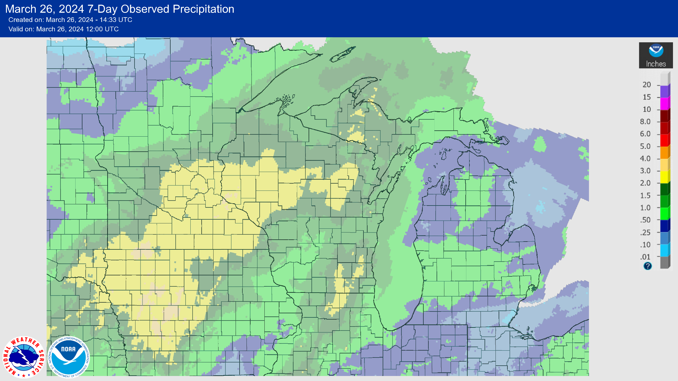
7 Day Precip
Most of the state saw at least 1” of precip this past week.
Highest amounts in the NW/NC → 2-3”, with >3” in parts of Pierce County.
https://water.weather.gov/precip/

Slide 4
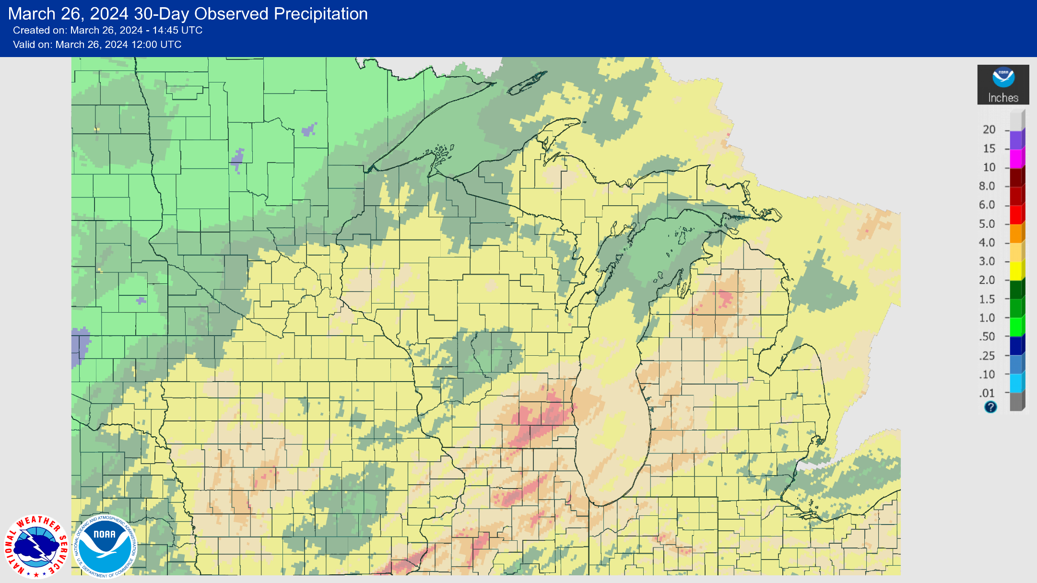
30 Day Precip
Most of the state saw at least 2” of precip this past month.
Highest amounts in the SE → 5+” in locations between Milwaukee & Madison.
https://water.weather.gov/precip/

Slide 5
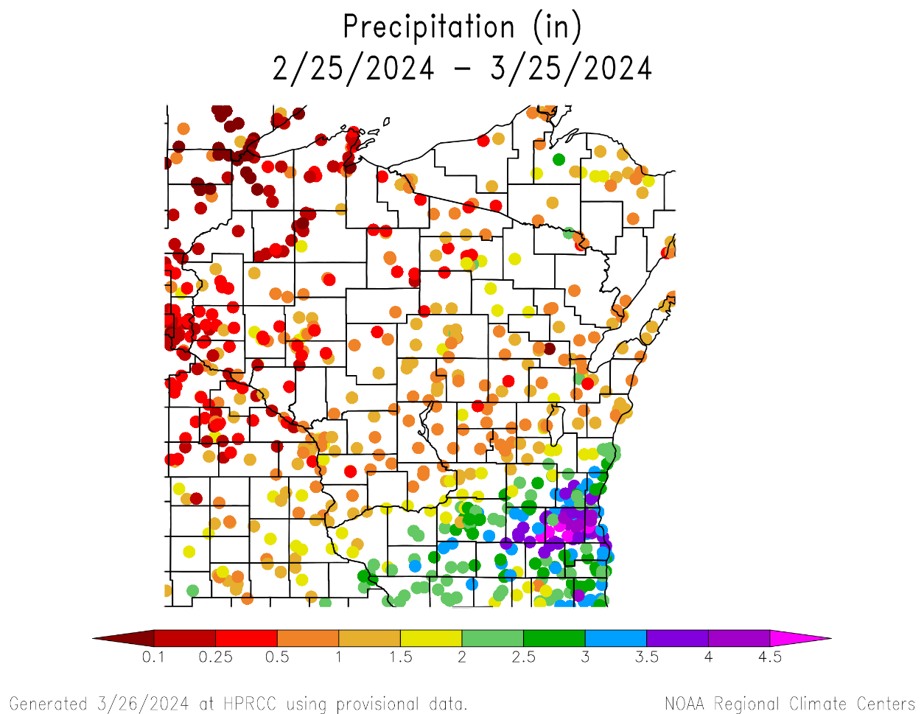
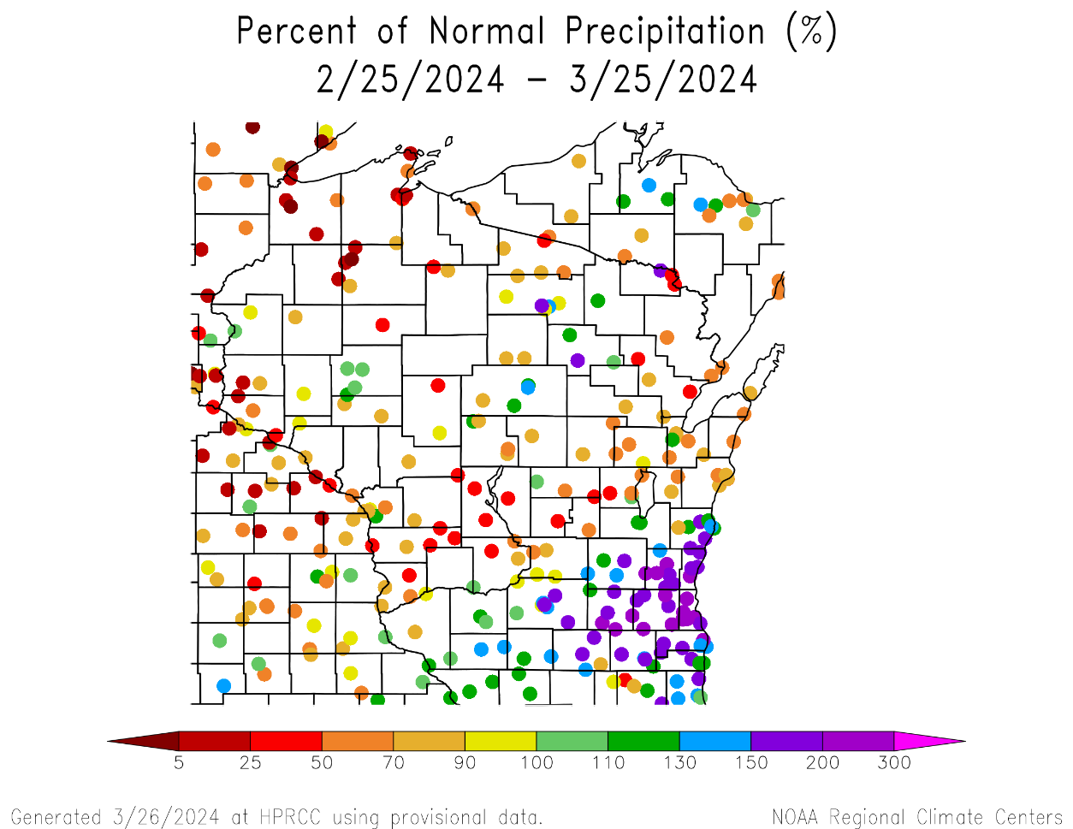
30 Day Precip Total/% Avg.
Highest precip totals in the SE (>3”) and lowest in the NW (<1”).
150+% of long-term average precip in the SE.
Mixed bag in the rest of the state → many locations in the C and NW saw <50% of average.
https://hprcc.unl.edu/maps.php?map=ACISClimateMaps

Slide 6
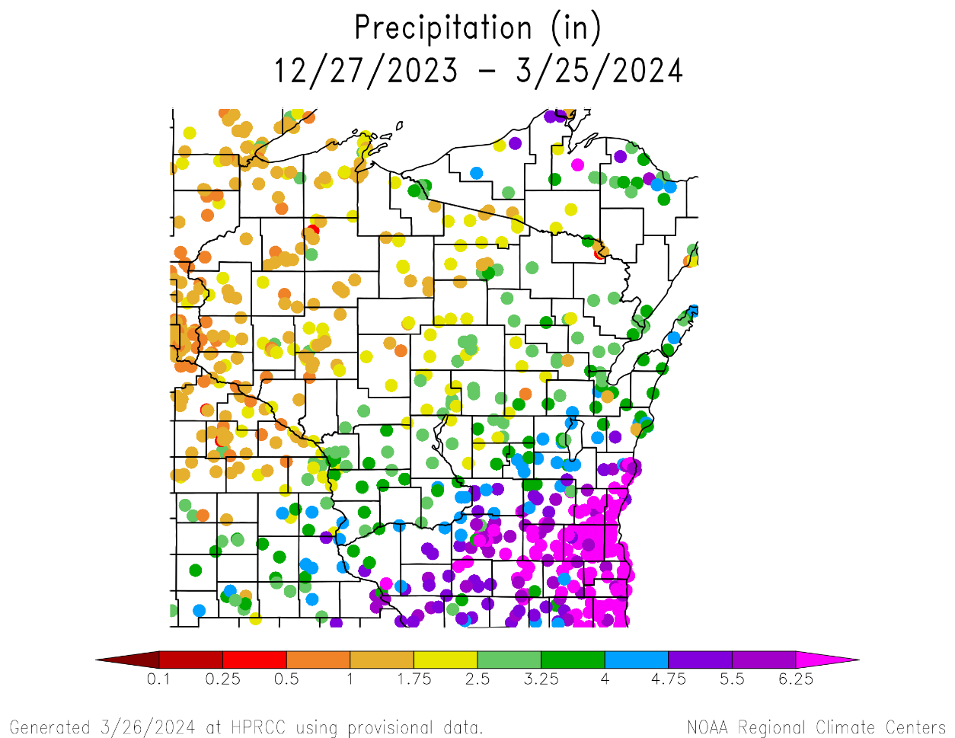
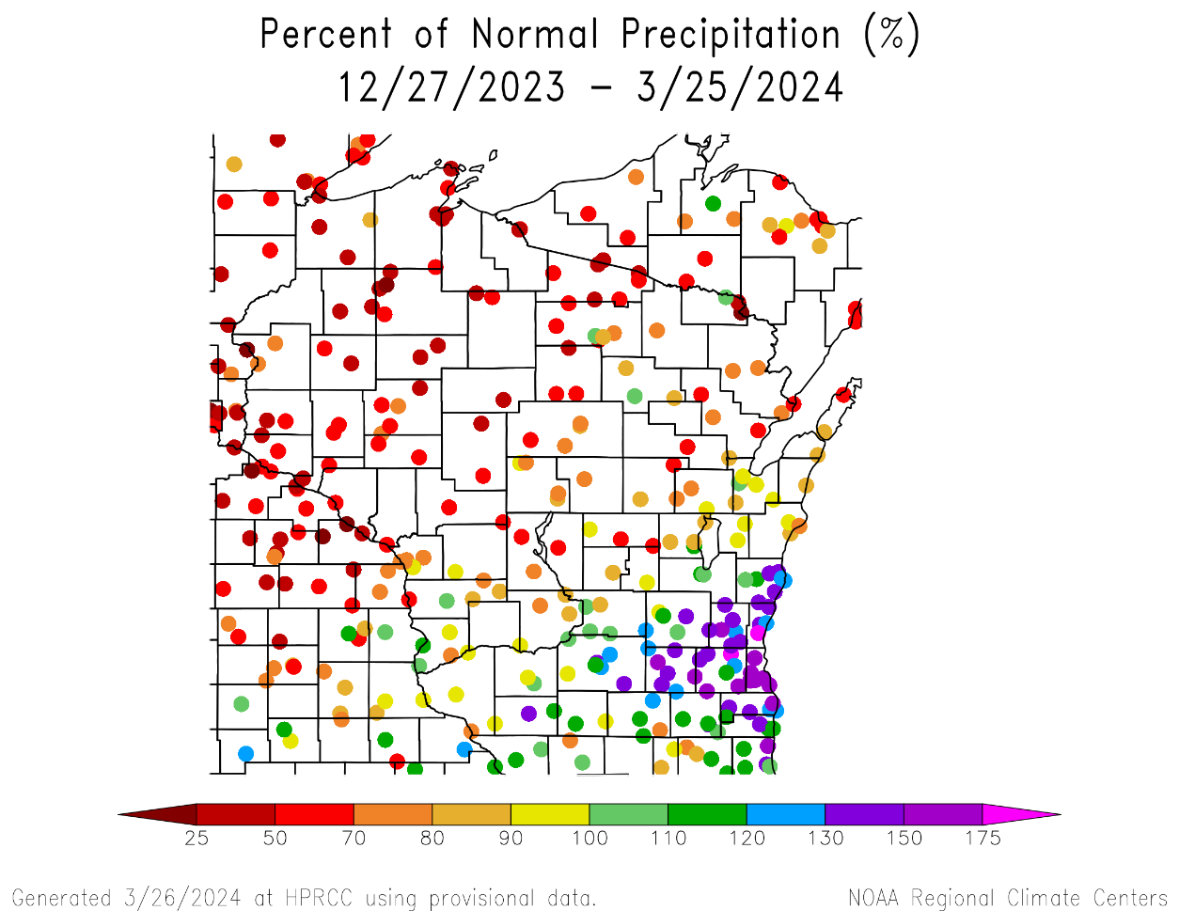
90 Day Precip Total/% Avg.
Highest precip totals in the SE (>6”) and lowest in the NW (<2”).
150+% of long-term average precip in the SE.
<70% of average was common across stations in the N and W.
https://hprcc.unl.edu/maps.php?map=ACISClimateMaps

Slide 7
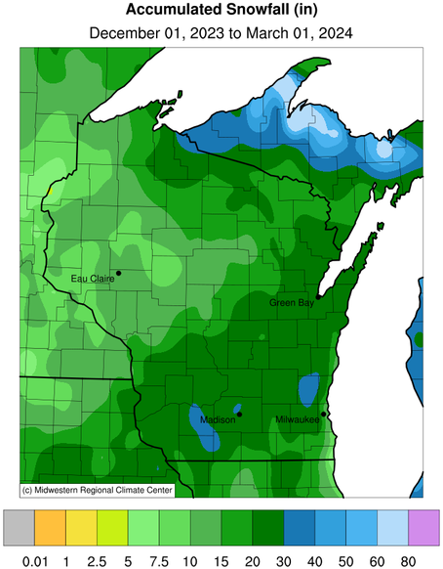
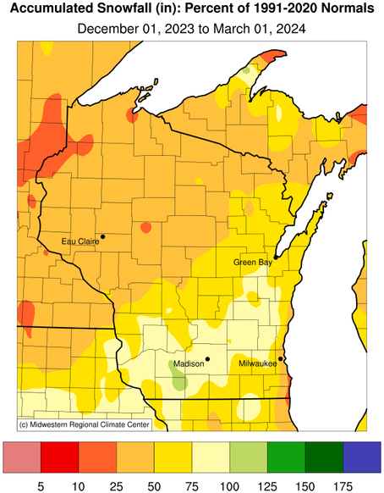
Winter Snowfall Recap
Seasonal snowfall totals (12/1 to 3/1) ranged from 10-30” for most in WI
30-40” in pockets in the S, E, and N.
<10” for some in the NW.
Snowfall was below normal for almost the entire state → <50% of seasonal average in the NW and NC.
https://mrcc.purdue.edu/CLIMATE

Slide 8
Station-Level Snowfall Totals
Station | City | Winter 2023-24 Total¹ | Rank (Lowest) | Low Record (Year) | First Year of Record
KDLH | Duluth, MN | 15.7” | 1st | New Record | 1948
KMSP | Twin Cities, MN | 11.1” | 6th | 5.2” (1943-44) | 1939
KEAU | Eau Claire | 13.3” | 9th | 7.9” (1957-58) | 1950
KAUW | Wausau | 15.1” | 4th | 15.1” (1943-44) | 1942
KGRB | Green Bay | 30.5” | 66th | 9.0” (1943-44) | 1887
KLSE | La Crosse | 15.6” | 18th | 5.8” (1943-44) | 1939
KMKE | Milwaukee | 19.5” | 10th | 0.0” (1939-40)² | 1939
KMSN | Madison | 30.2” | 47th | 3.1” (1960-61) | 1940
KDBQ | Dubuque, IA | 33.7” | 50th | 8.3” (2001-02) | 1951
https://scacis.rcc-acis.org/
(1) Period is from Dec. 1st to March 1st the following year.
(2) This year was missing a large amount of daily data

Slide 9
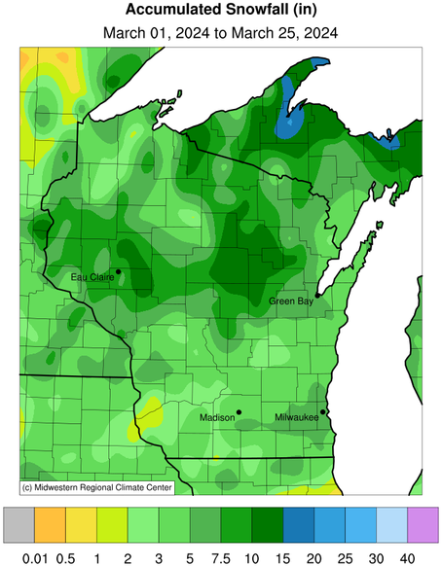
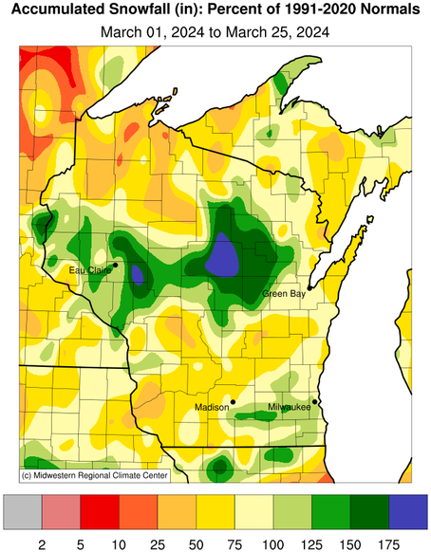
March Snowfall Recap
March snowfall helped make up some of the earlier-season deficit in the NW and NC
5-10” was common in the NW and NC, in some cases >150% of average.
https://mrcc.purdue.edu/CLIMATE

Slide 10
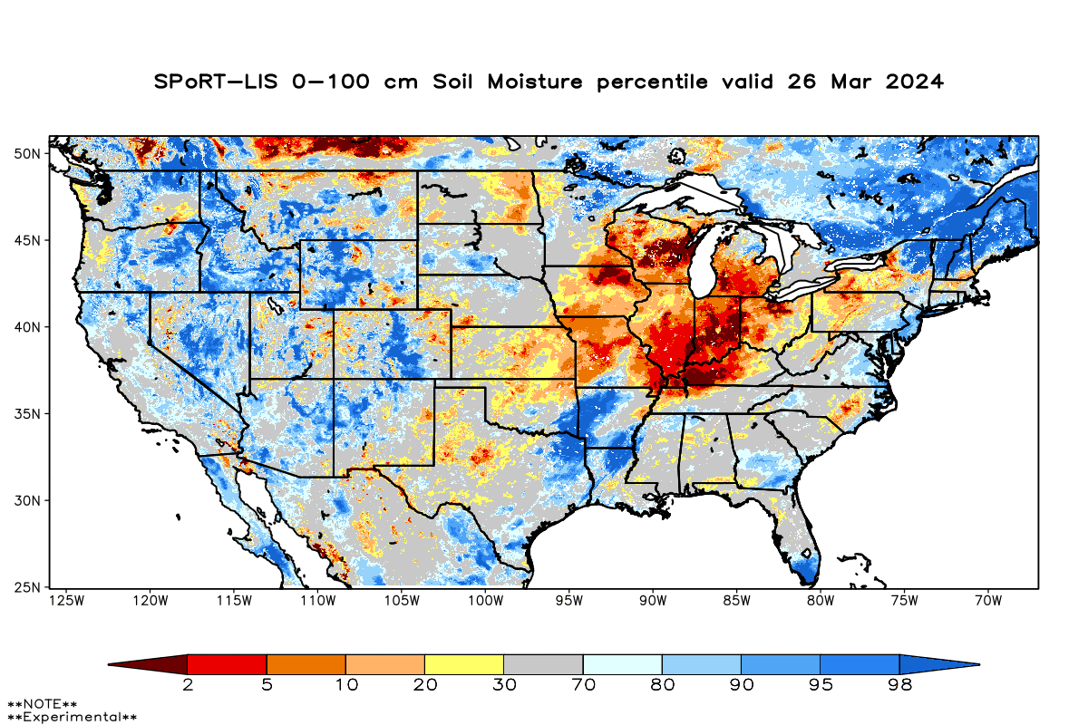
Soil Moisture Models
Most of the state remains drier than normal.
Driest soil moisture conditions in central part of the state; less dry to the north and south.
Model Notes:
Red areas would be top 5 driest in 100 years. Dark red = top 2 driest.
https://weather.msfc.nasa.gov/sport/case_studies/lis_CONUS.html

Slide 11
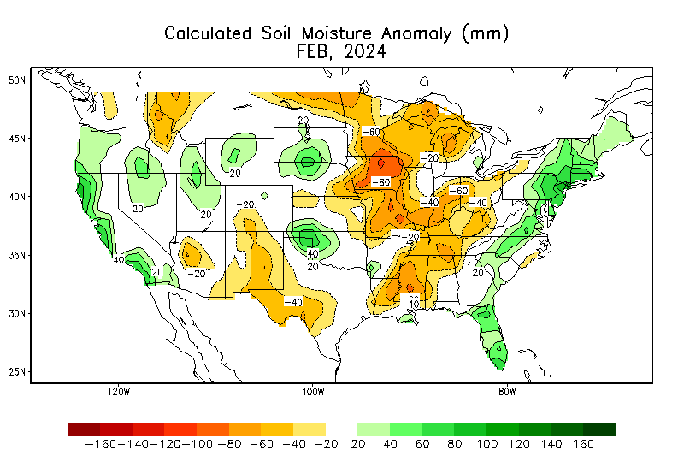
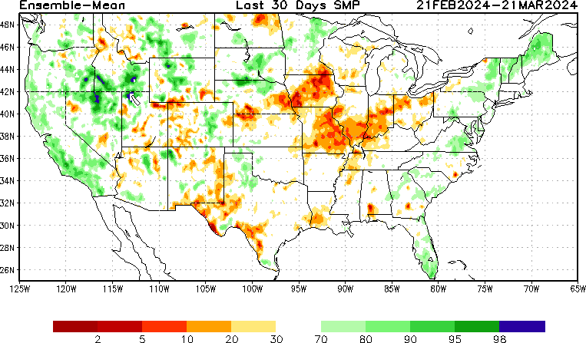
Soil Moisture Models
https://www.cpc.ncep.noaa.gov/products/Soilmst_Monitoring/US/Soilmst/Soilmst.shtml
https://www.cpc.ncep.noaa.gov/products/Drought/Monitoring/smp_new.shtml#

Slide 12
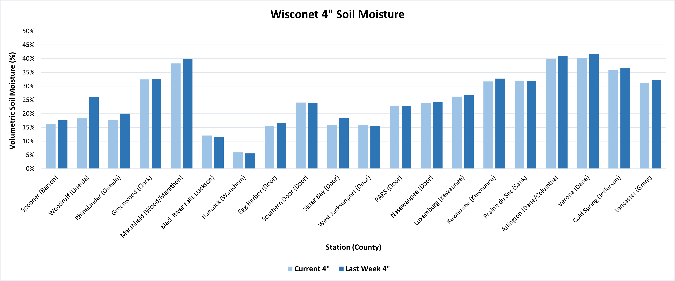
Soil Moisture - Wisconet
Current: 7-day average ending on 3/25
Last Week: 7-day average ending on 3/18
https://wisconet.wisc.edu/

Slide 13
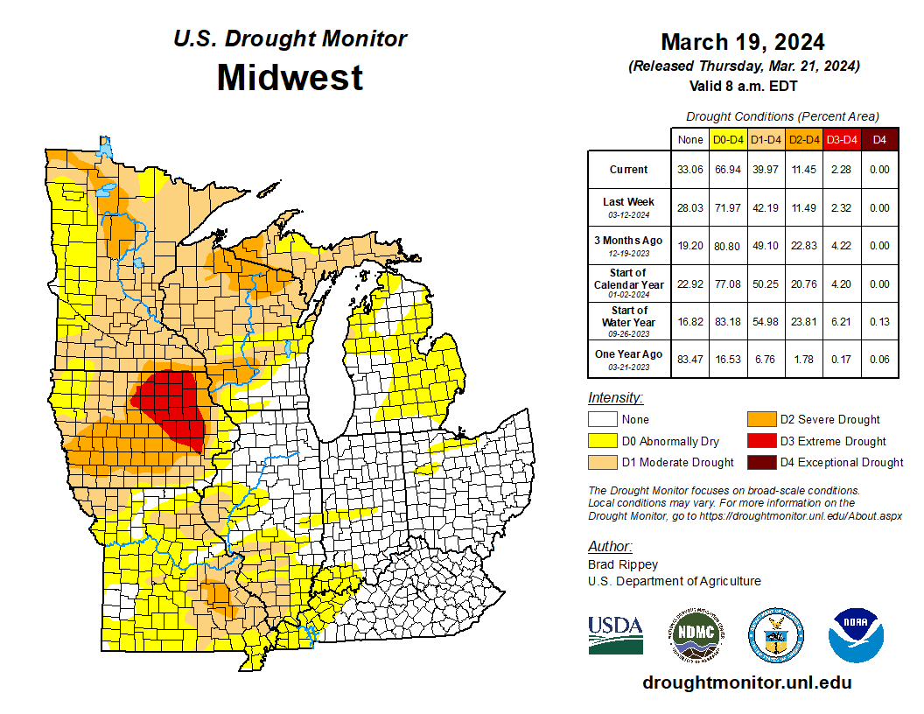
US Drought Monitor
Compared to 3 months ago:
Reductions in all drought category areas.
Area in D1 or higher drought down by nearly 10%.
Area in D3-D4 drought down from 4.2% to 2.3%.
Most of the areas in drought are west of the Mississippi River.
Majority of D3 is eastern IA.
Note: D0 is not considered drought.
http://droughtmonitor.unl.edu/

Slide 14
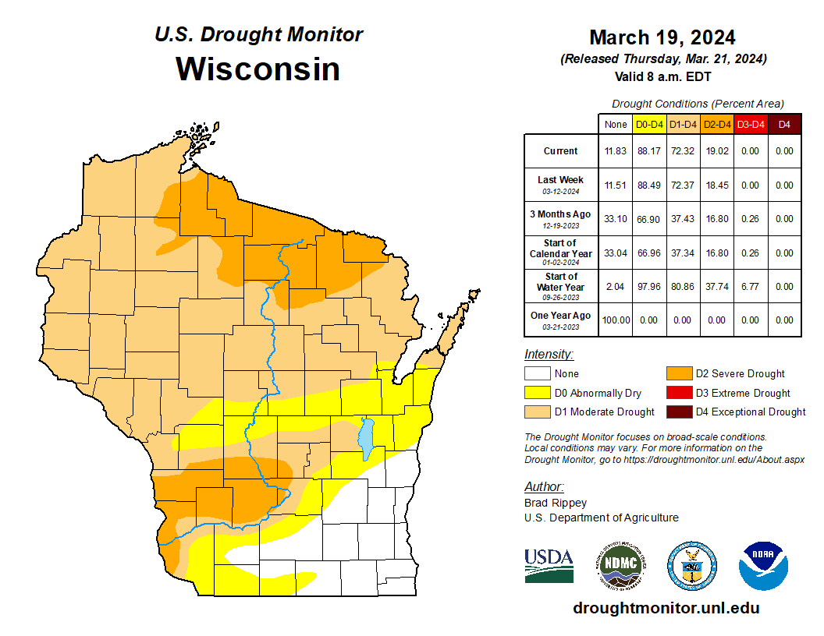
US Drought Monitor
Amount of state in:
D1-D4 – 72.3% ↑
D2-D4 – 19.0% ↑
D3-D4 – 0.0% --
D4 – 0.0% --
Note: ↑↓ indicate change from mid-February. Red up arrows indicate increase in drought area; vice-versa for green arrows.
http://droughtmonitor.unl.edu/

Slide 15
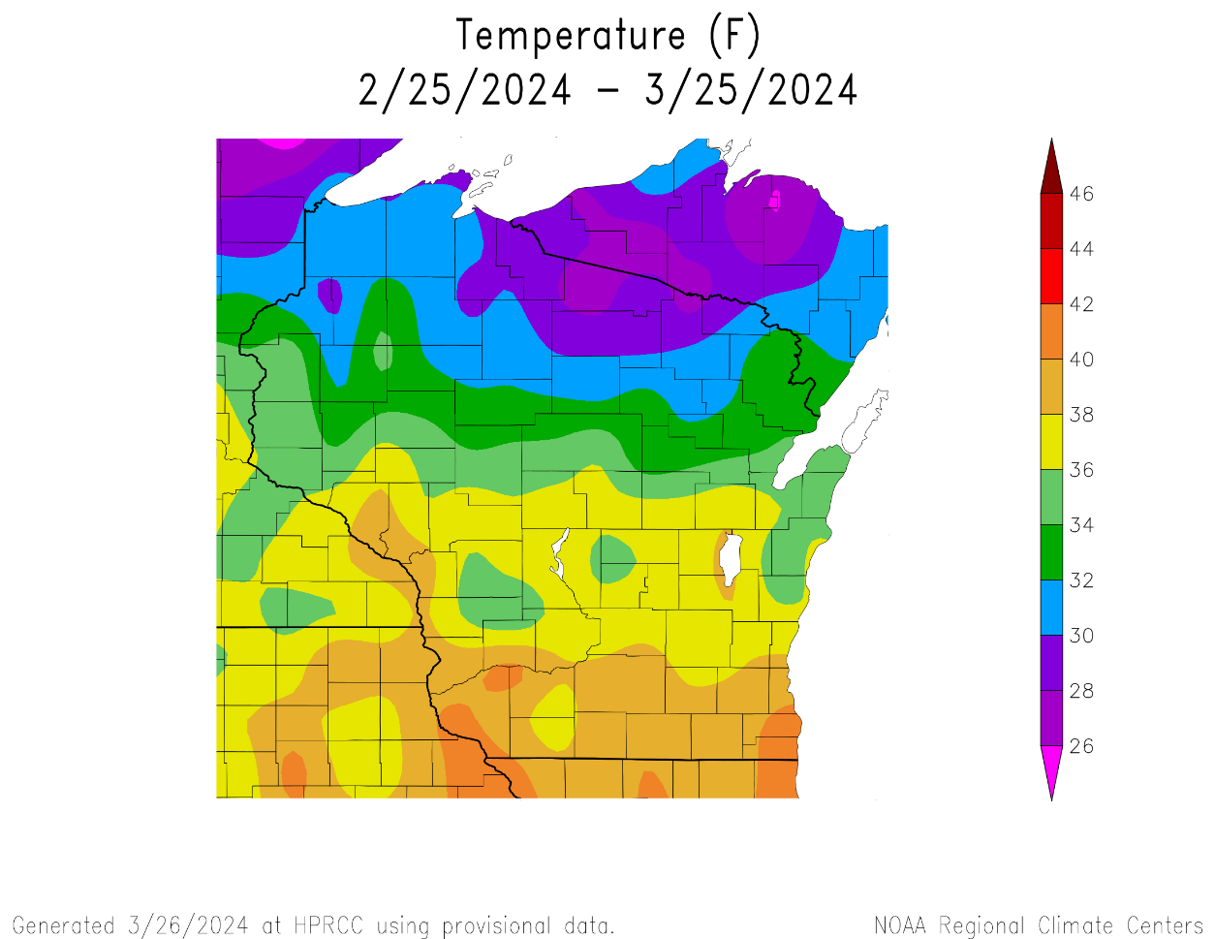
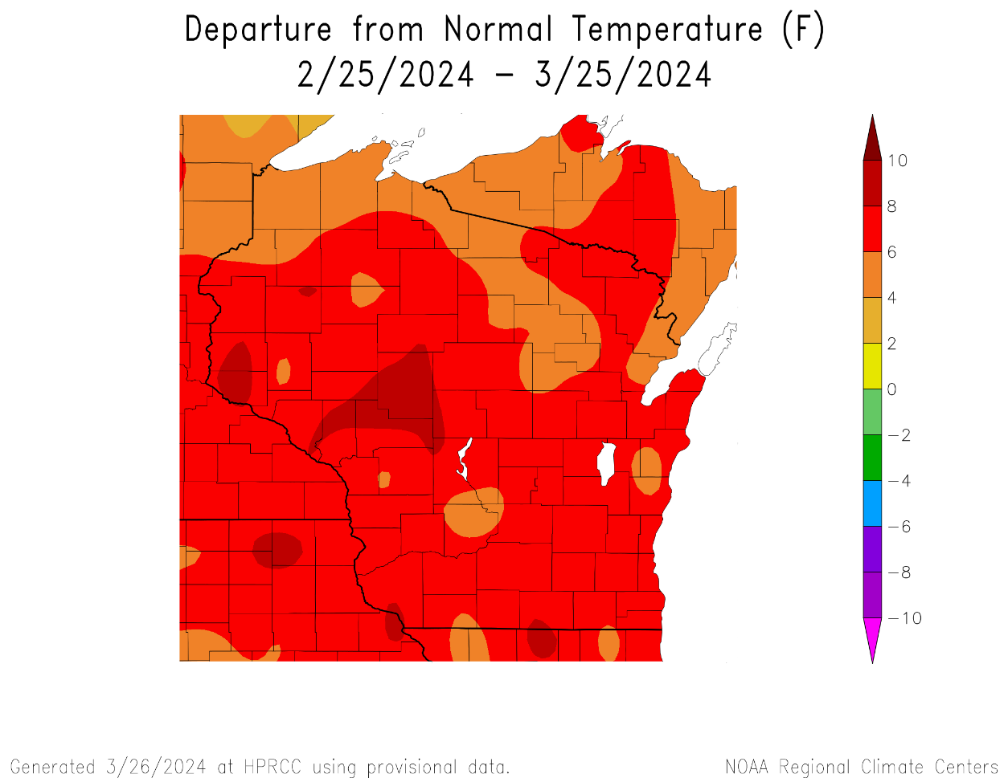
30 Day Temperatures
Temperatures over the last 30 days ranged from 38-40°F in the S to 26-30°F in the far N.
The entire state was above average in temperature.
6°F or higher for most (areas in red).
https://hprcc.unl.edu/maps.php?map=ACISClimateMaps

Slide 16
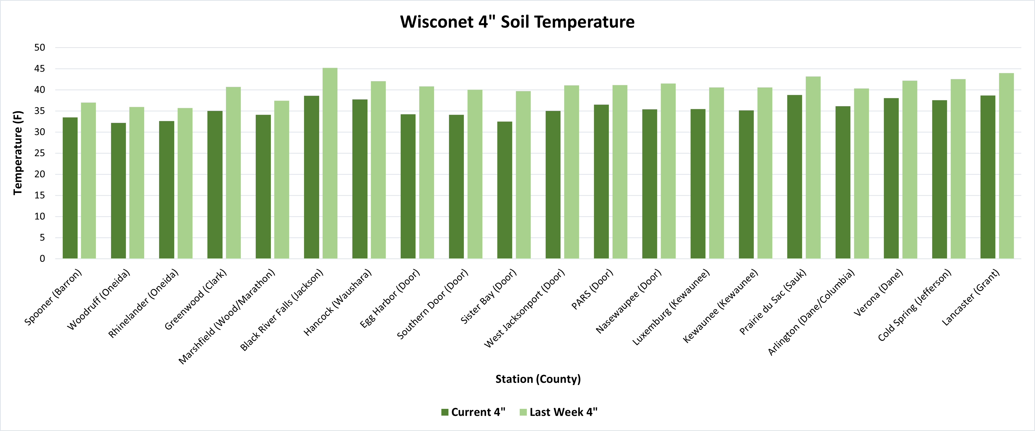
Soil Temperature - Wisconet
Current: 7-day average ending on 3/25
Last Week: 7-day average ending on 3/18
https://wisconet.wisc.edu/

Slide 17
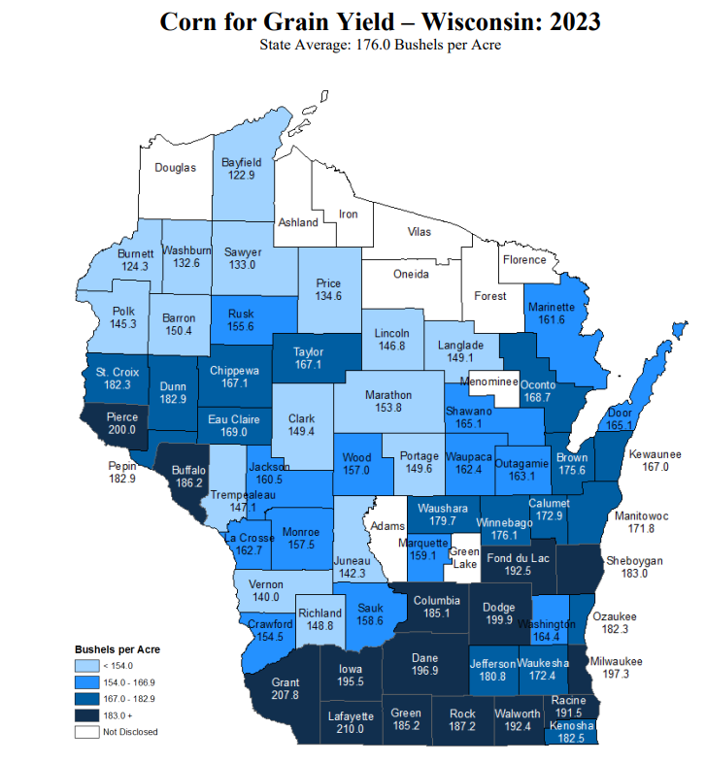
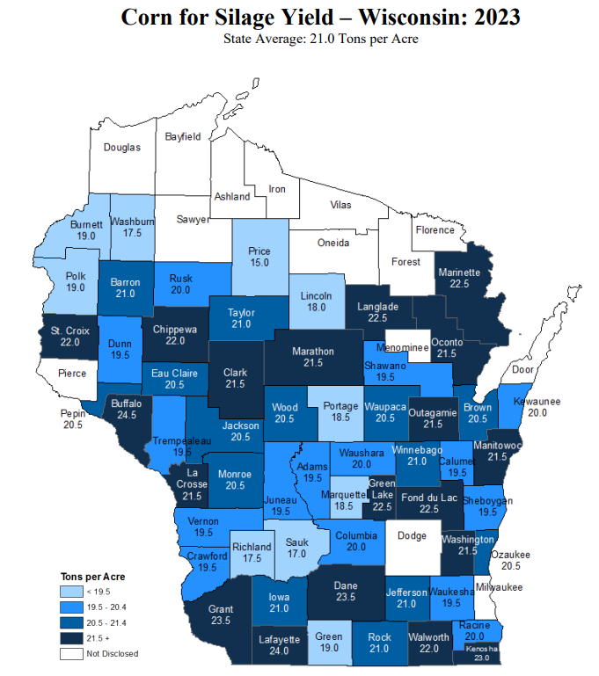
NASS 2023 Yield Estimates
https://www.nass.usda.gov/Statistics_by_State/Wisconsin/Publications/County_Estimates/index.php

Slide 18
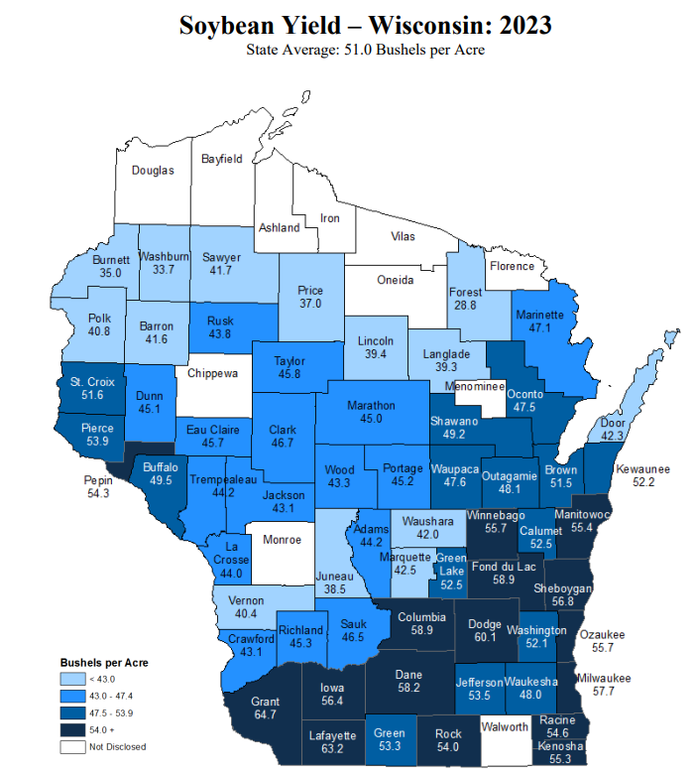
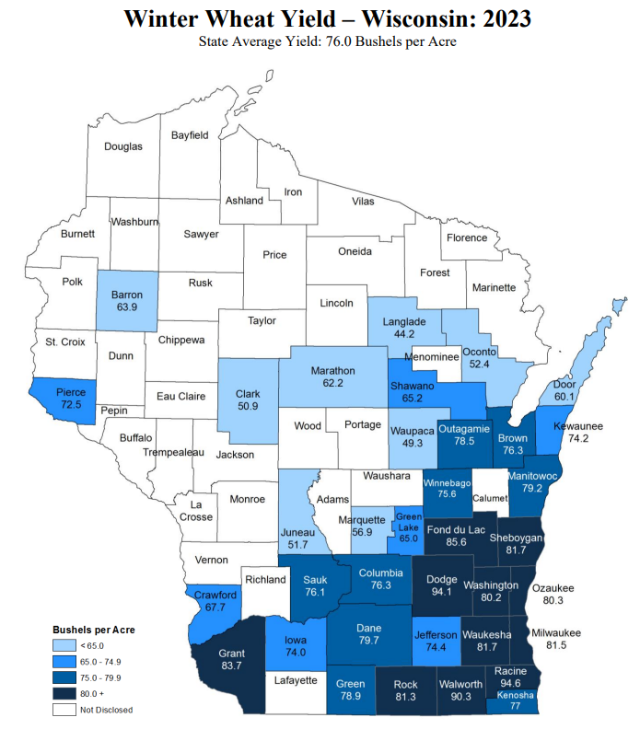
NASS 2023 Yield Estimates
https://www.nass.usda.gov/Statistics_by_State/Wisconsin/Publications/County_Estimates/index.php

Slide 19
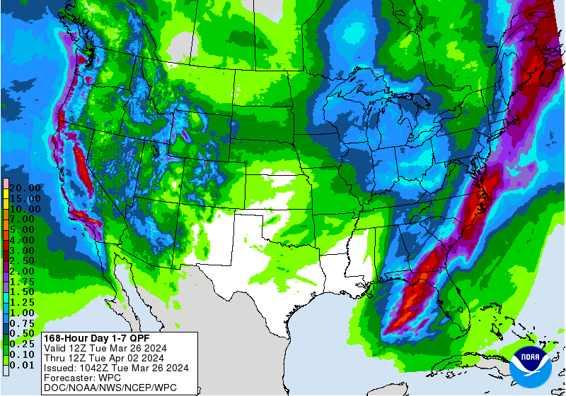
7 Day Precip Forecast
Chances of multiple rounds of precip over the next week → 0.5” or more.
Precip could fall as snow or rain depending on temperatures.
Forecast for 3/26/24 thru 4/1/24
https://www.wpc.ncep.noaa.gov/qpf/p168i.gif

Slide 20
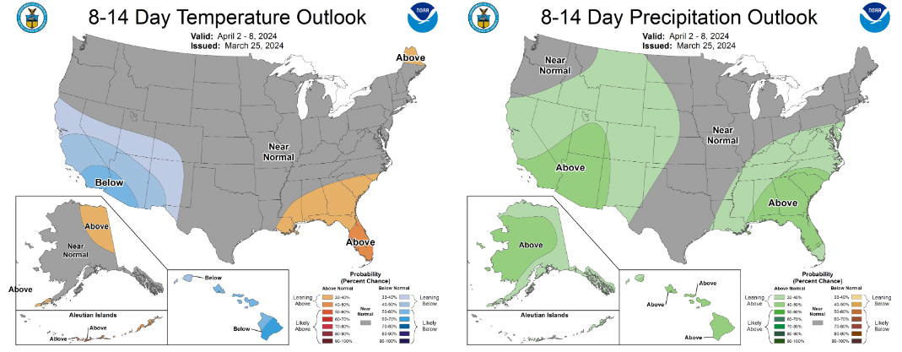
8-14 Day Temp & Precip Outlook
First week in April: Temperatures & precipitation are likely to be near normal.
http://www.cpc.ncep.noaa.gov/

Slide 21
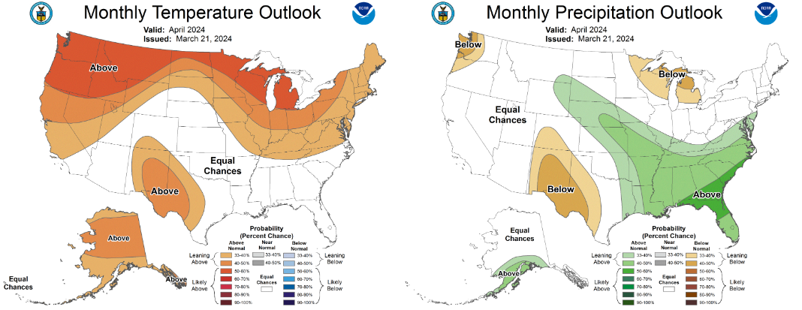
30 Day Temp & Precip Outlook
Month of April: Temperatures likely to be above normal. Precipitation is leaning below normal for most.
http://www.cpc.ncep.noaa.gov/

Slide 22
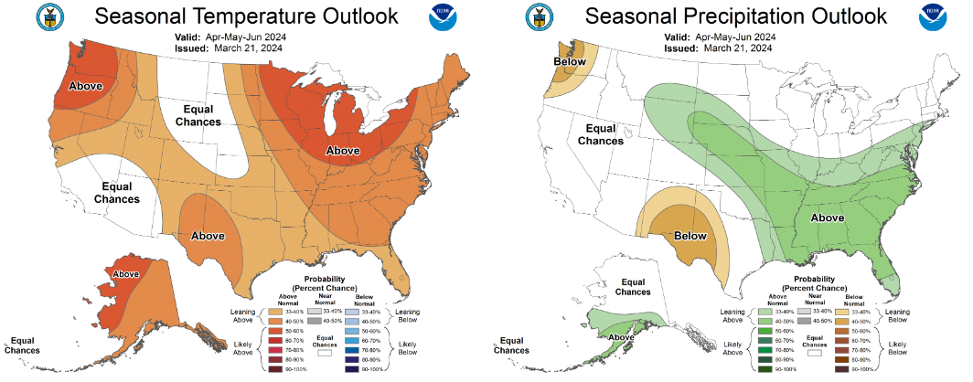
90 Day Temp & Precip Outlook
Spring into Early Summer: Temperatures likely to be above normal. Precipitation indications are for equal chances of above/at/below average.
http://www.cpc.ncep.noaa.gov/

Slide 23
Take-Home Points
Current conditions:
Far below-average seasonal snowfall totals were common across the N and W. Some snow events in March brought some relief.
The dryness was accompanied by late winter temperatures that were much warmer than average.
Impact:
Soil moisture conditions remain drier than normal for many in the central part of the state.
D1+ drought area has increased in coverage by >30% since late December, due in part to low snowfall totals.
Field work has begun for some farmers with the warmer-than-average March.
Outlook:
March is projected to wrap up with near-normal temperatures, with a few opportunities for precip over the next week for most.
The warmer-than-normal conditions have a higher probability to persist into April due in part to continued El Nino.
However, a transition to La Nina is expected by June.

Slide 24
Agronomic Considerations
Planting Considerations
Drier field conditions should allow for a good planting season.
Consider termination timing of cover crops to preserve soil moisture.
If planting early, consider planting depth adjustments to ensure planting into moisture.
Nutrient & Herbicide Applications
As always, producers should be considering climate and soil moisture conditions when setting their crop yield goals and apply nutrients accordingly.
Herbicides may have longer carryover if not enough cold or precipitation occurred over winter, check labels for rotational restrictions.
Ensure both day and nighttime temperatures are conducive for the necessary duration for effective herbicide applications…Remember pre-emergent herbicides require moisture for activation and consider duration of effectiveness if planting early.
Manure Applications
Warmer drier winter has provided a late winter/early spring manure application window (this was an observation when flying into Madison).
Early season manure applications into warm soil conditions may lead to increased mineralization/nitrification and potential for N loss if receive “typical” heavy spring rainfall events, particularly if not applied to a growing cover crop or if the cash crop will not be planted soon after application.
Small Grains
Wheat N typically goes on a green up…will be earlier than normal with warm conditions.
Potential for earlier planting of spring grains, if warmer weather continues. However, there is still a risk with potential for freeze.
Breaking Dormancy
Likely early breaking of dormancy for overwintering crops – potential for increased winterkill if temperatures snap back to cold.

Slide 25
User Survey
Are you a regular user of the Wisconsin Ag Climate Outlook (WACO)? Or maybe you are viewing these slides for the first time this week? Either way, we want to hear your feedback on this new resource! Please take a few minutes and fill out this survey:
LINK TO SURVEY
Your feedback will help us better serve your ag-climate data needs through WACO.
If you have any trouble accessing or filling out the survey, please email Josh Bendorf at Joshua.Bendorf@usda.gov.
Thank you!!
-The WACO Team

Slide 26
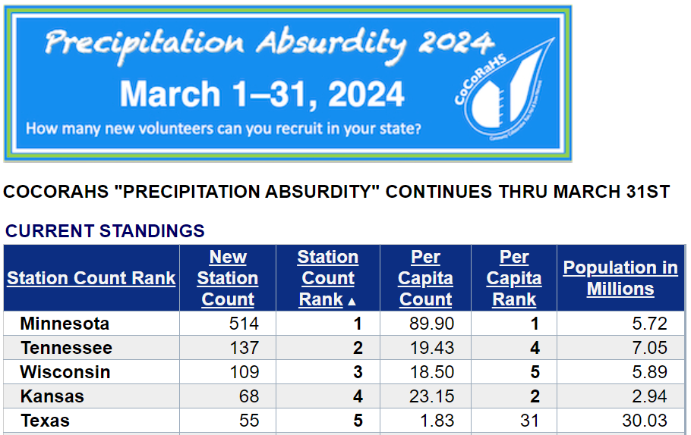
Citizen Science Opportunity
CoCoRaHS – Community Collaborative Rain, Hail, & Snow Network
The Mission
(From cocorahs.org)
Provide accurate high-quality precipitation data for end-users;
Increasing the density of precipitation data available throughout the country;
Encouraging citizens to have fun participating in meteorological science and heightening their awareness about weather;
Providing weather education opportunities.
Sign Up Here: https://cocorahs.org/Content.aspx?page=application

Slide 27
Contact Info
Photo Credit: USDA
Natasha Paris
Crops Educator – Adams, Green Lake, Marquette, Waushara Cos.
natasha.paris@wisc.edu
Kristin Foehringer
NRCS State Working Lands Climate Smart Specialist
kristin.foehringer@usda.gov
Dennis Todey
Director, Midwest Climate Hub
dennis.todey@usda.gov
Josh Bendorf
Ag Climatologist Fellow, Midwest Climate Hub
joshua.bendorf@usda.gov
Steve Vavrus
State Climatologist of Wisconsin
sjvavrus@wisc.edu
Bridgette Mason
Assistant State Climatologist of Wisconsin
bmmason2@wisc.edu

