Slide 1
Wisconsin Ag Climate Outlook Updated February 21, 2024
Dennis Todey
Director, Midwest Climate Hub
dennis.todey@usda.gov
Josh Bendorf
Ag Climatologist Fellow, Midwest Climate Hub
joshua.bendorf@usda.gov
Natasha Paris
Crops Educator – Adams, Green Lake, Marquette, Waushara Cos.
natasha.paris@wisc.edu
Kristin Foehringer
NRCS State Working Lands Climate Smart Specialist
kristin.foehringer@usda.gov
Steve Vavrus
State Climatologist of Wisconsin
sjvavrus@wisc.edu

Slide 2
Key Points
February has thus far been a warm and dry month, with very little snowfall, on track to be one of the two warmest Februarys on record.
Soil moisture levels remain dry, with some improvement in areas that received higher 30-day precip totals.
February will wrap up warmer-than-average, with predictions leaning warmer-than-average for March.

Slide 3
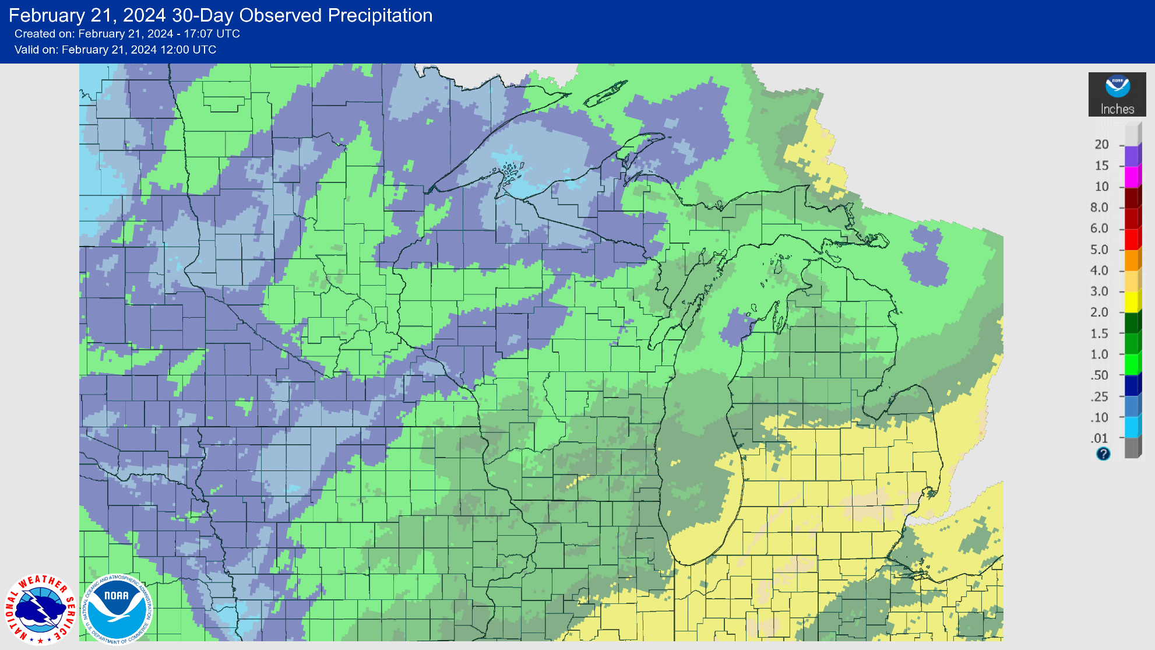
30 Day Precip
Monthly totals of <2” for nearly the entire state
Localized areas of 1.5-2” in the south
https://water.weather.gov/precip/

Slide 4
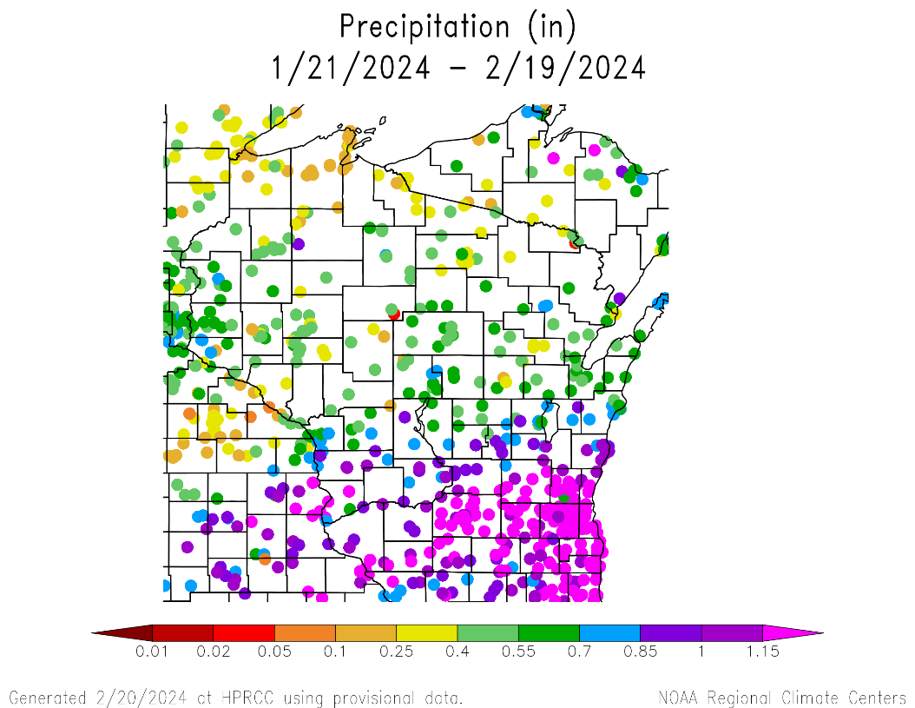
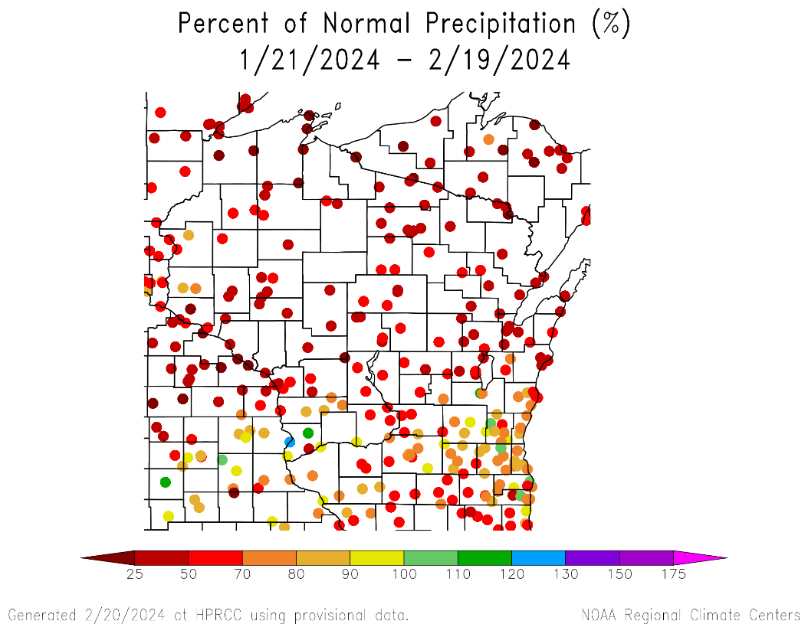
30 Day Precip Total/% Avg.
The majority of WI has been very dry over the last 30 days.
<70% of normal 30-day precip totals for the central and northern counties.
70-100% in the S/SE; >100% at a few stations.
https://hprcc.unl.edu/maps.php?map=ACISClimateMaps

Slide 5
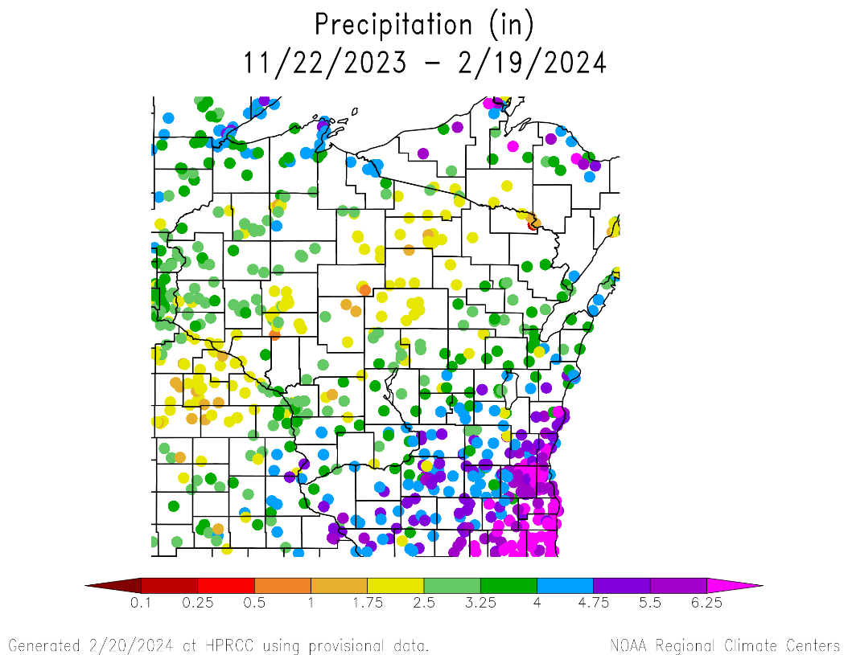
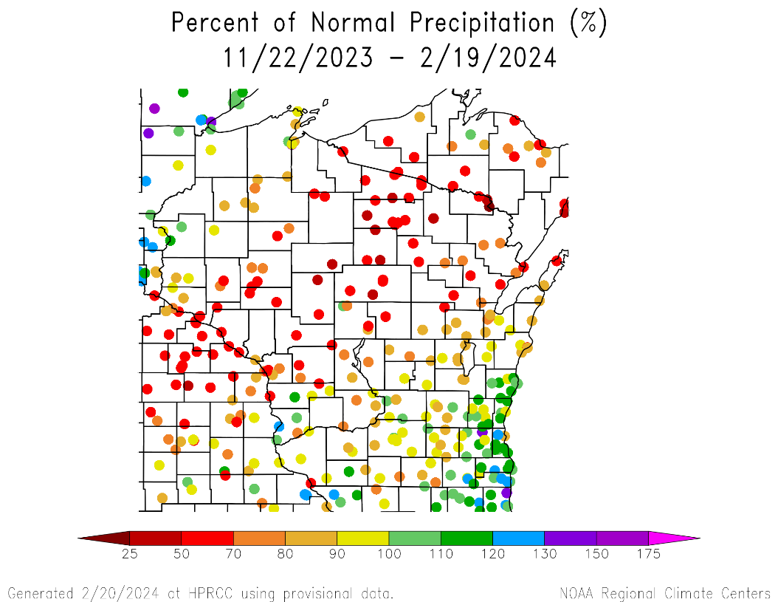
90 Day Precip Total/% Avg.
Lowest totals in a belt stretching from WC to NE (≤2.5”).
<70% of average
Highest totals in the SE and SC (≥5”).
>100% of average
https://hprcc.unl.edu/maps.php?map=ACISClimateMaps

Slide 6
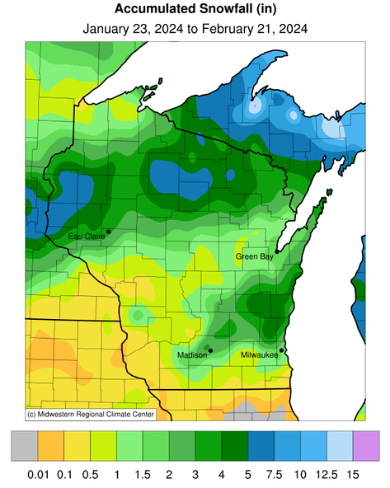
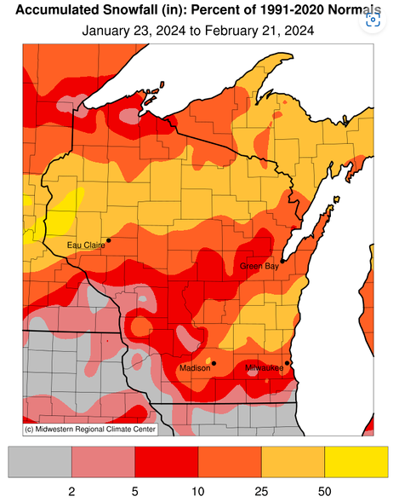
February (Lack of) Snowfall
Snow totals ranging from <1” (S, SW) to >5” (NC, NW)
Snowfall <50% of normal for most of the state; <5% in the SW
https://mrcc.purdue.edu/CLIMATE

Slide 7
Seasonal Snowfall
Station | City | Winter 2023-24 Total¹ | Rank (Lowest) | Low Record (Year) | First Year of Record
KMSP | Twin Cities, MN | 11.0” | 6th | 5.2” (1943-44) | 1939
KEAU | Eau Claire | 12.3” | 7th | 7.9” (1957-58) | 1950
KAUW | Wausau | 13.8” | 4th | 10.8” (1943-44) | 1942
KLSE | La Crosse | 14.6” | 16th | 5.8” (1943-44) | 1939
KDLH | Duluth, MN | 14.7” | 1st | New Record | 1948
KMKE | Milwaukee | 18.2” | 9th | 0.0” (1939-40)² | 1939
KGRB | Green Bay | 28.0” | 59th | 9.0” (1943-44) | 1887
KMSN | Madison | 29.4” | 45th | 3.1” (1960-61) | 1940
(1) As of February 20th; period begins on December 1st
(2) This year was missing a large amount of daily data
https://scacis.rcc-acis.org/

Slide 8
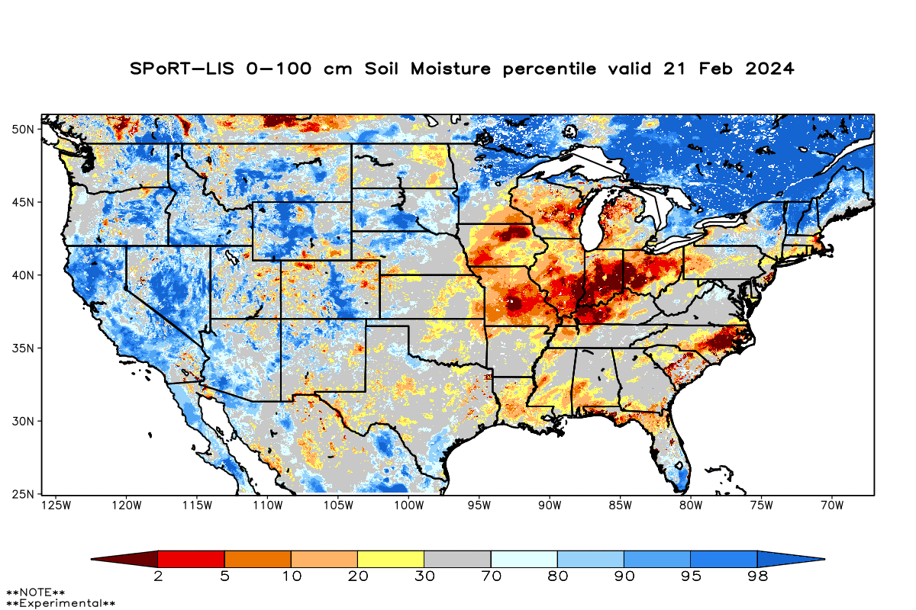
Modeled Soil Moisture
Most of the state remains drier than normal.
Soil conditions improved to the S and E where precip amounts were higher.
Model Notes:
Red areas would be top 5 driest in 100 years. Dark red = top 2 driest.
https://weather.msfc.nasa.gov/sport/case_studies/lis_CONUS.html
https://www.cpc.ncep.noaa.gov/products/Soilmst_Monitoring/US/Soilmst/Soilmst.shtml
https://www.cpc.ncep.noaa.gov/products/Drought/Monitoring/smp_new.shtml#

Slide 9
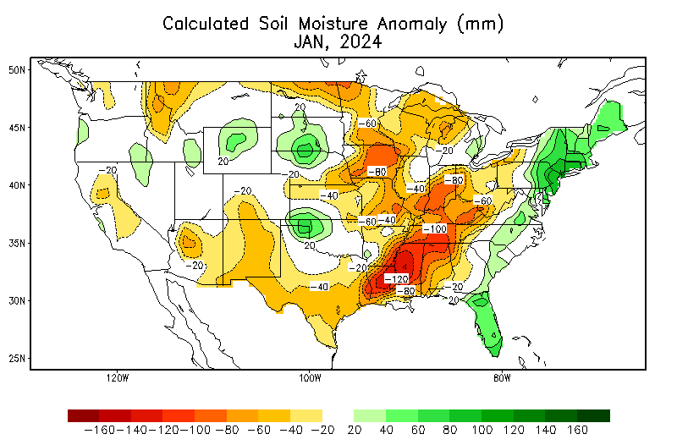
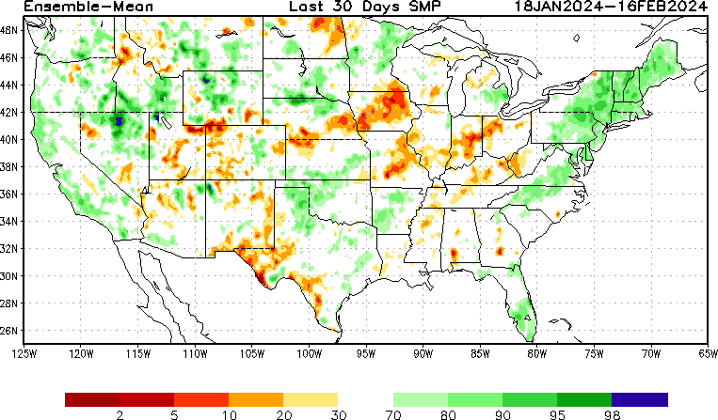
Modeled Soil Moisture
https://weather.msfc.nasa.gov/sport/case_studies/lis_CONUS.html
https://www.cpc.ncep.noaa.gov/products/Soilmst_Monitoring/US/Soilmst/Soilmst.shtml
https://www.cpc.ncep.noaa.gov/products/Drought/Monitoring/smp_new.shtml#

Slide 10
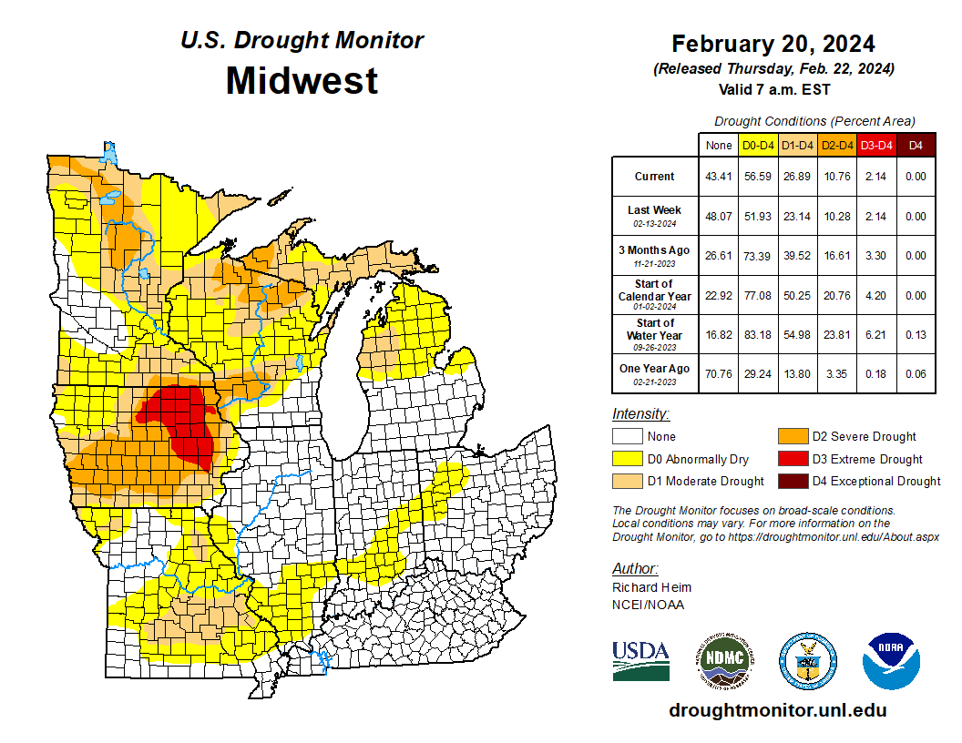
US Drought Monitor
Decreases in all drought severity categories across the region.
Just over 26% of the region is in D1+ drought.
Majority of D3 is eastern IA.
Note: D0 is not considered drought.
http://droughtmonitor.unl.edu/

Slide 11
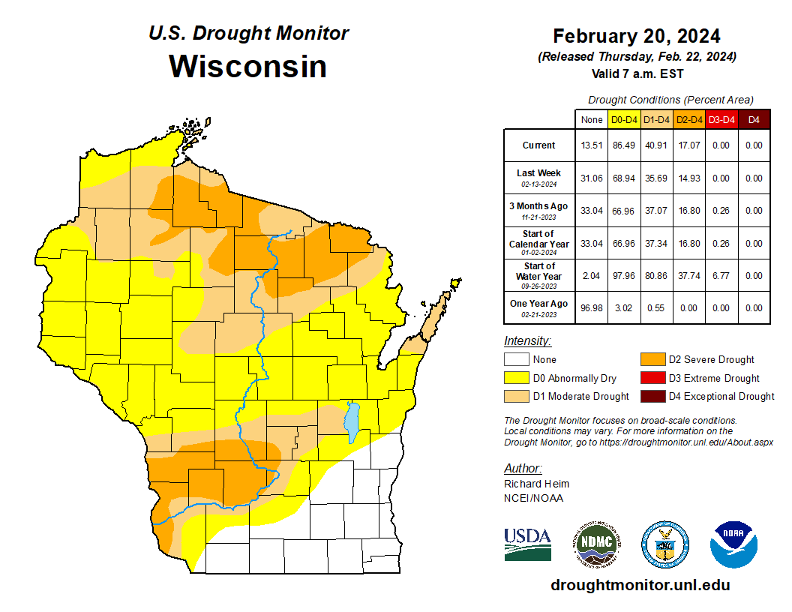
US Drought Monitor
Amount of state in:
D1-D4 – 40.9% ↑
D2-D4 – 17% ↑
D3-D4 – 0.0% --
D4 – 0.0% --
Note: ↑↓ indicate change from mid-January. Red up arrows indicate increase in drought area; vice-versa for green arrows.
http://droughtmonitor.unl.edu/

Slide 12
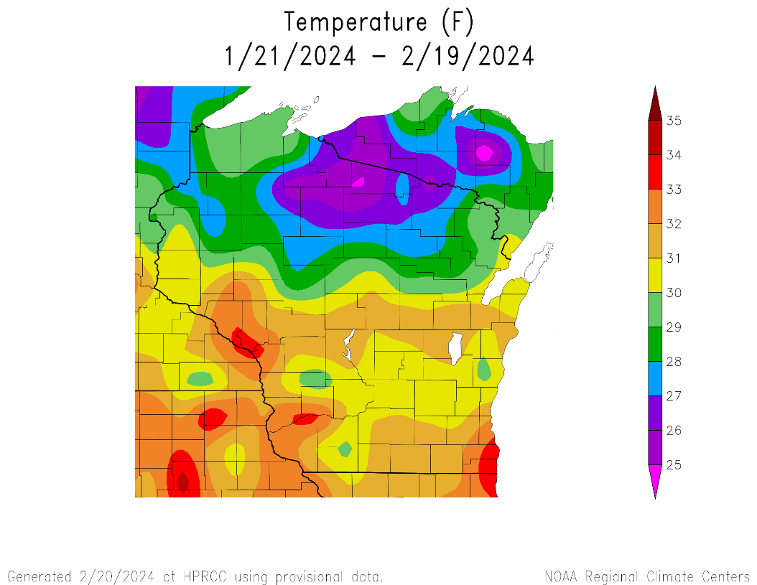
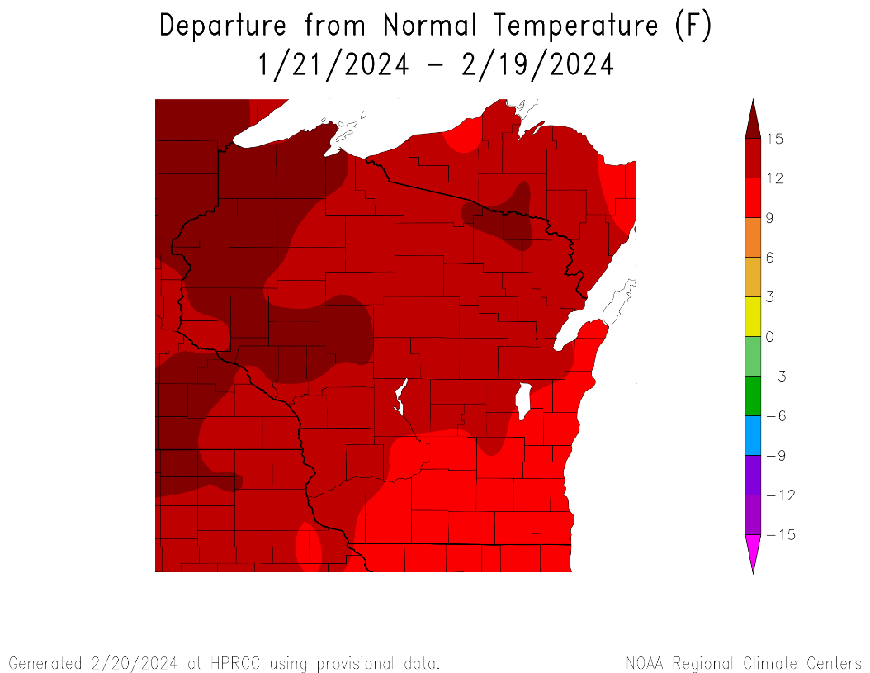
30 Day Temperatures
Ranging from mid-20s in the NC to mid-30s in the W/SW and far SE.
Averages ≥32°F around Racine/Kenosha, Boscobel, & Winona, MN.
Monthly averages across the state were 9°F+ above normal for all.
https://hprcc.unl.edu/maps.php?map=ACISClimateMaps

Slide 13
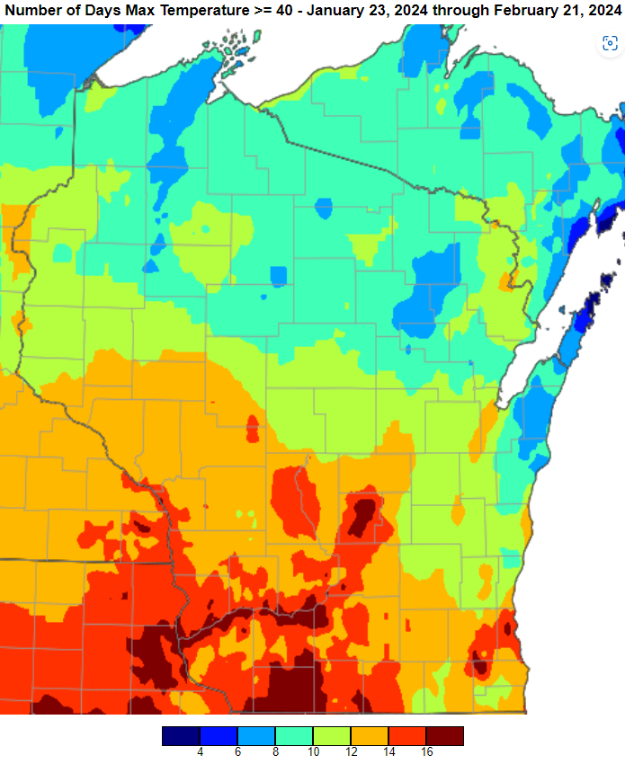
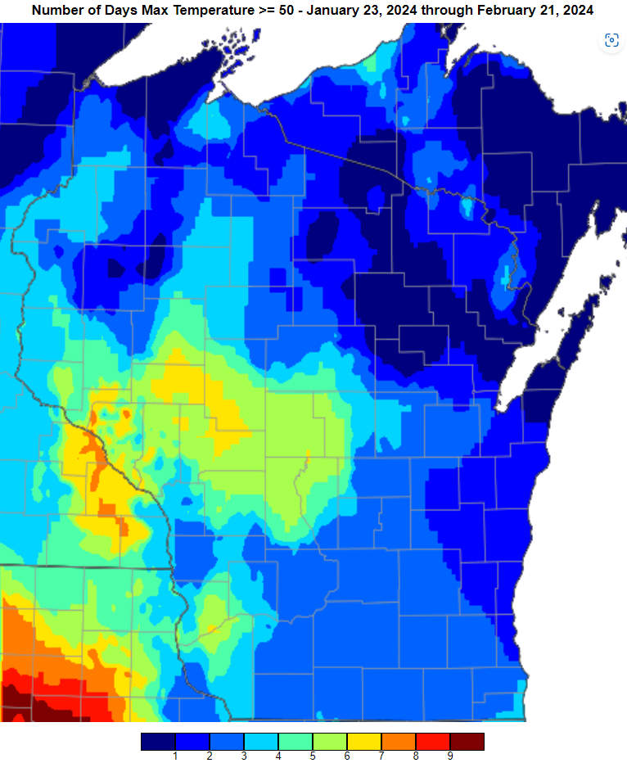
February Warmth
https://scacis.rcc-acis.org/

Slide 14
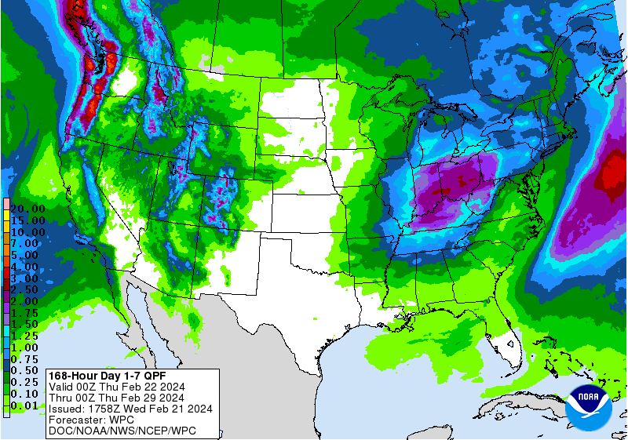
7 Day Forecast Precip
Minimal chances of precip over the next week.
Precip could fall as snow or rain depending on temperatures.
Forecast for 2/22/24 thru 2/28/24
https://www.wpc.ncep.noaa.gov/qpf/p168i.gif

Slide 15
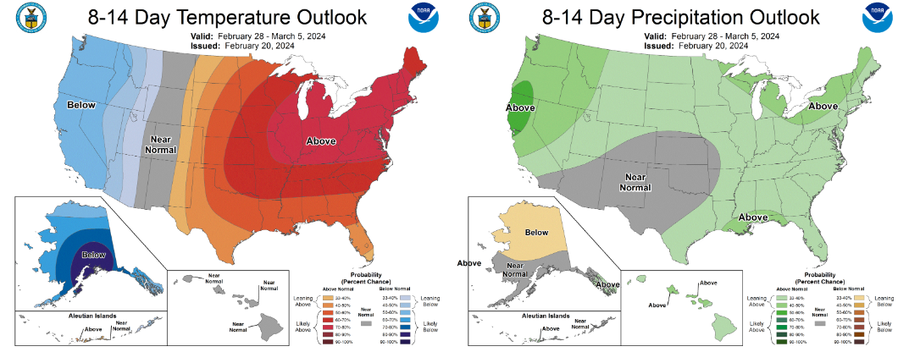
8-14 Day Temp & Precip Outlook
Late Feb. – Early Mar.: Temperatures likely to be above normal. Precipitation is leaning above normal.
http://www.cpc.ncep.noaa.gov/

Slide 16
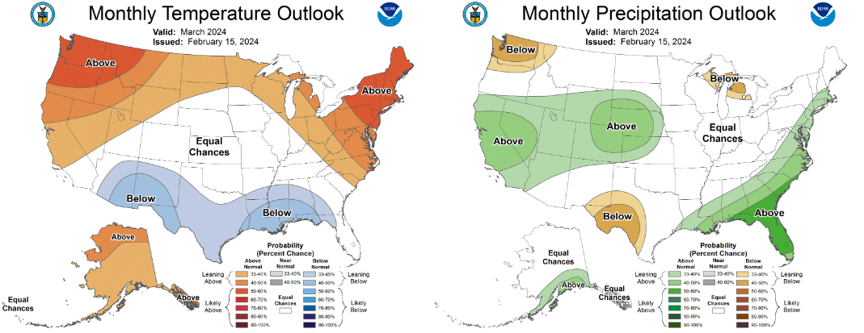
30 Day Temp & Precip Outlook
The month of March: Temperatures are leaning above normal. Precipitation has equal chances (except for far NE).
http://www.cpc.ncep.noaa.gov/

Slide 17
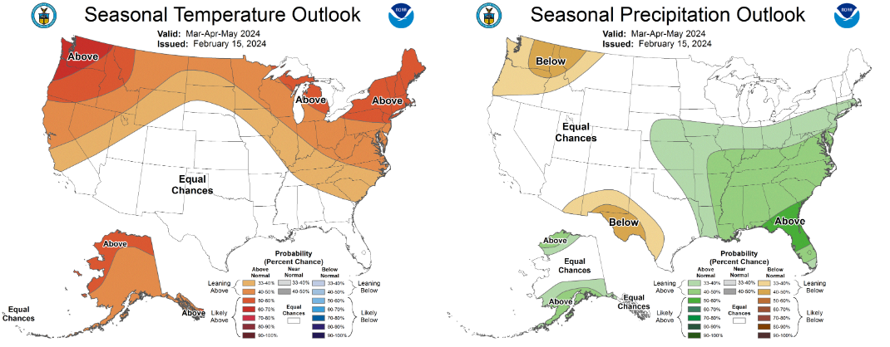
90 Day Temp & Precip Outlook
March – May: Temperatures leaning towards above average. Precipitation is showing equal chances.
El Nino is a major driver of these conditions. However, a switch to La Nina is forecasted by June.
http://www.cpc.ncep.noaa.gov/

Slide 18
Take Home
Current conditions:
Late January – February has been much drier than usual, due in part to a lack of snowfall.
The dryness was accompanied by temperatures that were much warmer than average.
Impact:
Soil moisture conditions remain drier than normal, although with some improvement in the S/SE.
Drought conditions have increased since late January.
Chilling hour accumulation in WI range from 1200-1700 hours (higher to the S and E), adequate for most apples.
Outlook:
The trend of warmer than average temps look to continue into the first week of March.
The warmer-than-normal conditions have a higher probability to persist into spring due in part to El Nino.
However, a transition to La Nina is expected by June.

Slide 19
User Survey!
Are you a regular user of the Wisconsin Ag Climate Outlook (WACO)? Or maybe you are viewing these slides for the first time this week? Either way, we want to hear your feedback on this new resource! Please take a few minutes and fill out this survey:
LINK TO SURVEY
Your feedback will help us better serve your ag-climate data needs through WACO.
If you have any trouble accessing or filling out the survey, please email Josh Bendorf at Joshua.Bendorf@usda.gov.
Thank you!!
-The WACO Team

Slide 20
For More Information
Photo Credit: USDA
Dennis Todey
Director, Midwest Climate Hub
dennis.todey@usda.gov
Josh Bendorf
Ag Climatologist Fellow, Midwest Climate Hub
joshua.bendorf@usda.gov
Natasha Paris
Crops Educator – Adams, Green Lake, Marquette, Waushara Cos.
natasha.paris@wisc.edu
Kristin Foehringer
NRCS State Working Lands Climate Smart Specialist
kristin.foehringer@usda.gov
Steve Vavrus
State Climatologist of Wisconsin
sjvavrus@wisc.edu

