Slide 1
Wisconsin Ag Climate Weekly Outlook Updated October 24, 2023
Dennis Todey
Director, Midwest Climate Hub
dennis.todey@usda.gov
Josh Bendorf
ORISE Fellow, Midwest Climate Hub
joshua.bendorf@usda.gov
Bridgette Mason
ORISE Fellow, Midwest Climate Hub
bridgette.mason@usda.gov
Natasha Paris
Crops Educator – Adams, Green Lake, Marquette, Waushara Cos.
natasha.paris@wisc.edu
Kristin Foehringer
NRCS State Working Lands Climate Smart Specialist
kristin.foehringer@usda.gov
Steve Vavrus
State Climatologist of Wisconsin
sjvavrus@wisc.edu

Slide 2
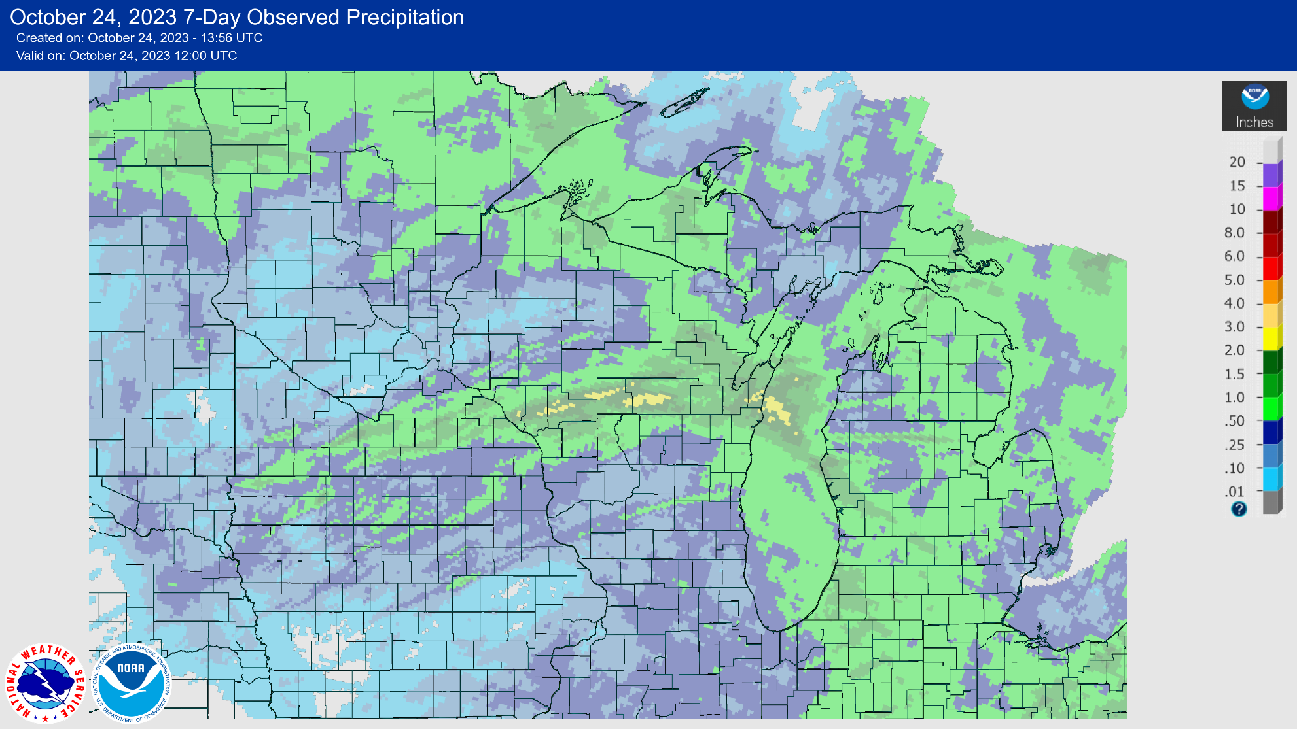
Last Week Precip
https://water.weather.gov/precip/
Central part of the state received the most precip last week (1-3”).
Lowest totals in the NW and SC regions.

Slide 3
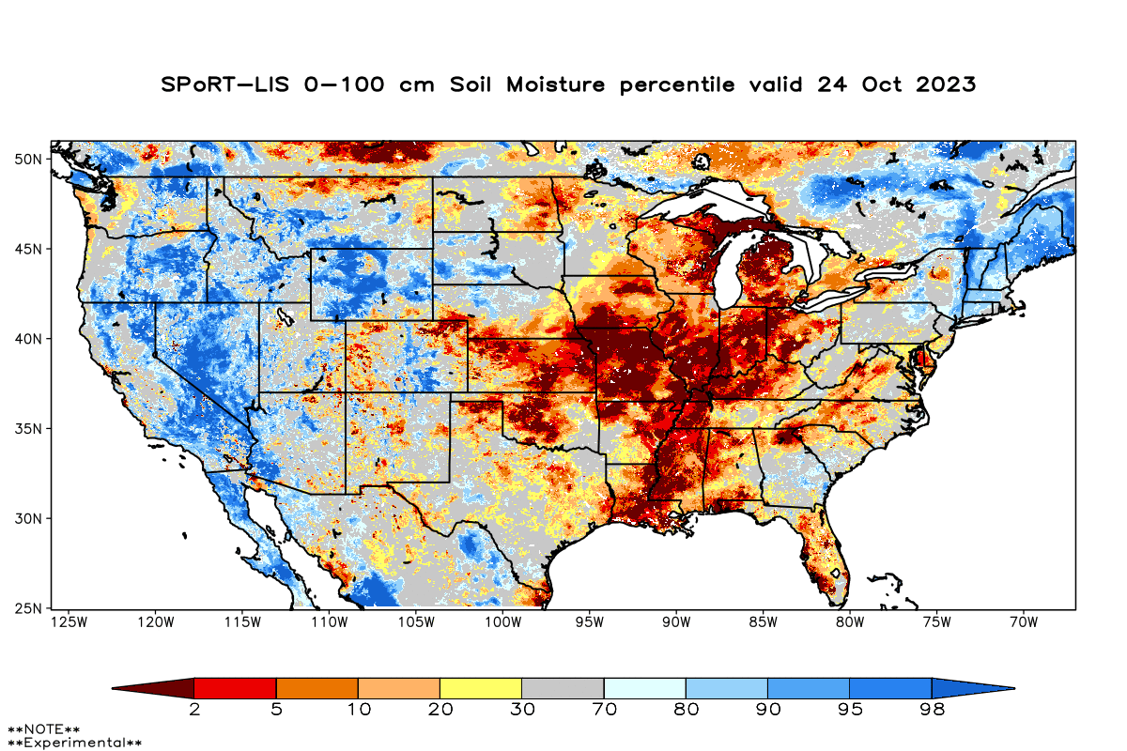
Modeled Soil Moisture
Dry soils showing across the entire Midwest Region.
In WI, soils are driest in the E and NE.
Model Notes:
Red areas would be top 5 driest in 100 years. Dark red = top 2 driest.
https://weather.msfc.nasa.gov/sport/case_studies/lis_CONUS.html
https://www.cpc.ncep.noaa.gov/products/Soilmst_Monitoring/US/Soilmst/Soilmst.shtml
https://www.cpc.ncep.noaa.gov/products/Drought/Monitoring/smp_new.shtml#

Slide 4
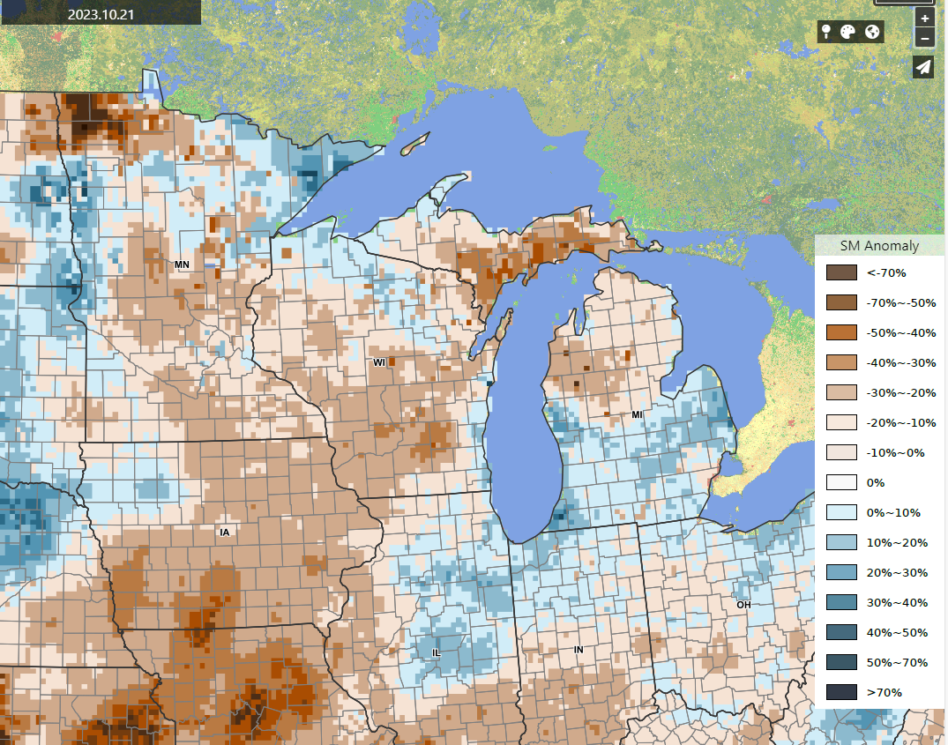
Modeled Soil Moisture
Alternate product from GMU and partners.
Some disagreement with SPoRT-LIS (last slide) in the E; this model suggests abnormal wetness in the E.
Abnormally dry across most of the state; most dry in SC WI.
Variable conditions across the Corn Belt.
Model Notes:
Model compares to time of year – suggests that soils are drier/wetter than is typical for this time of the season.
https://nassgeo.csiss.gmu.edu/CropCASMA/

Slide 5
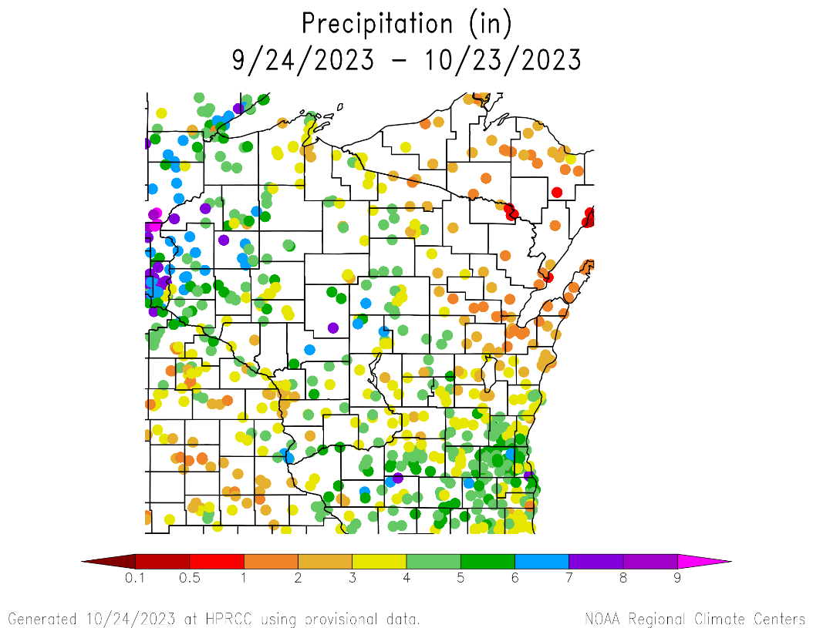
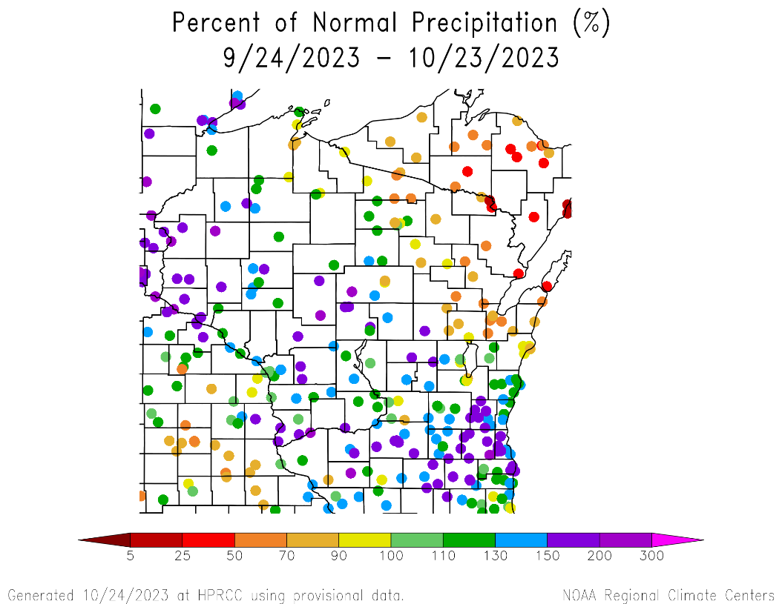
30 Day Precip Total/% Avg.
Monthly totals ≥3” common across the state, with some stations reporting ≥6”
Totals ≤2” common in NE WI.
110%+ of normal precip across the state (except for NE).
https://hprcc.unl.edu/maps.php?map=ACISClimateMaps

Slide 6
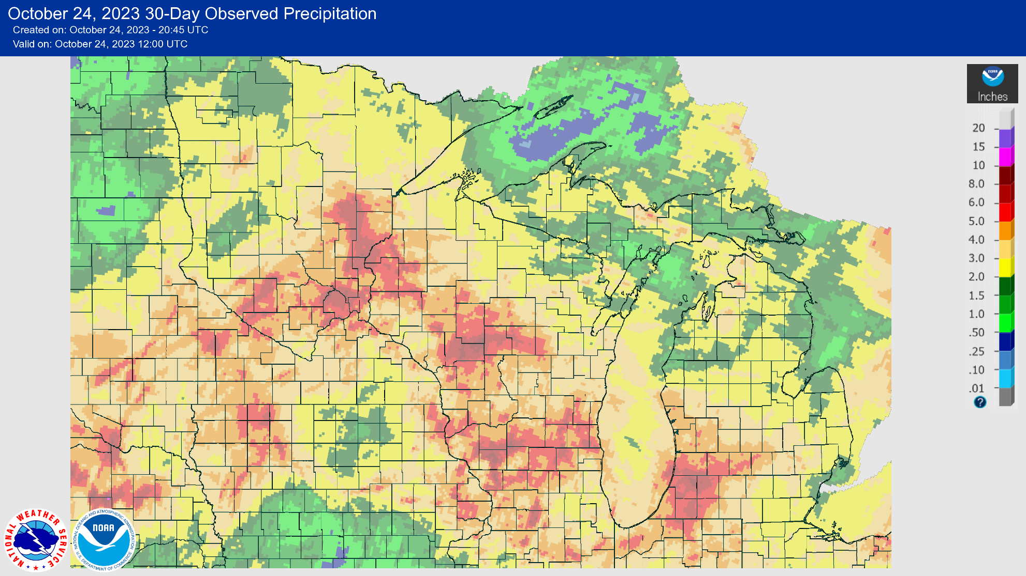
30 Day Precip – NOAA/NWS
https://water.weather.gov/precip/
Note: this map is created using both measured precipitation at ground sites and radar estimates of total precipitation.

Slide 7
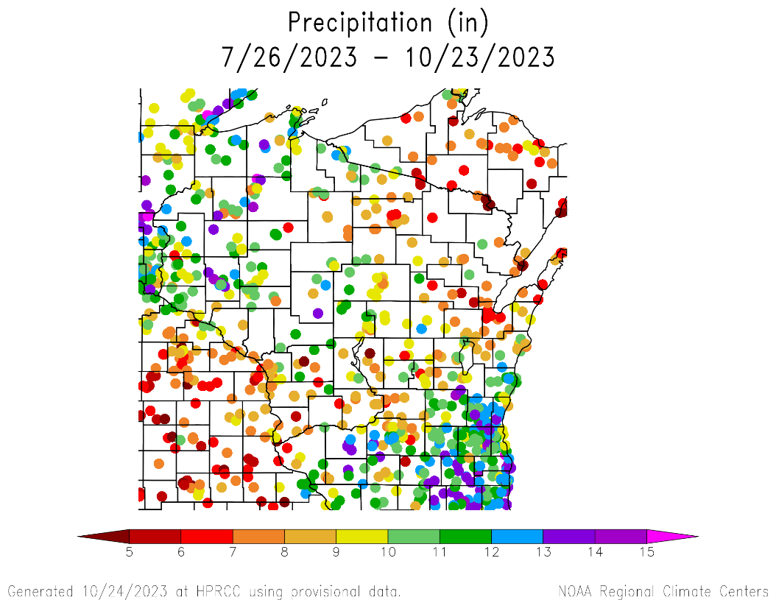
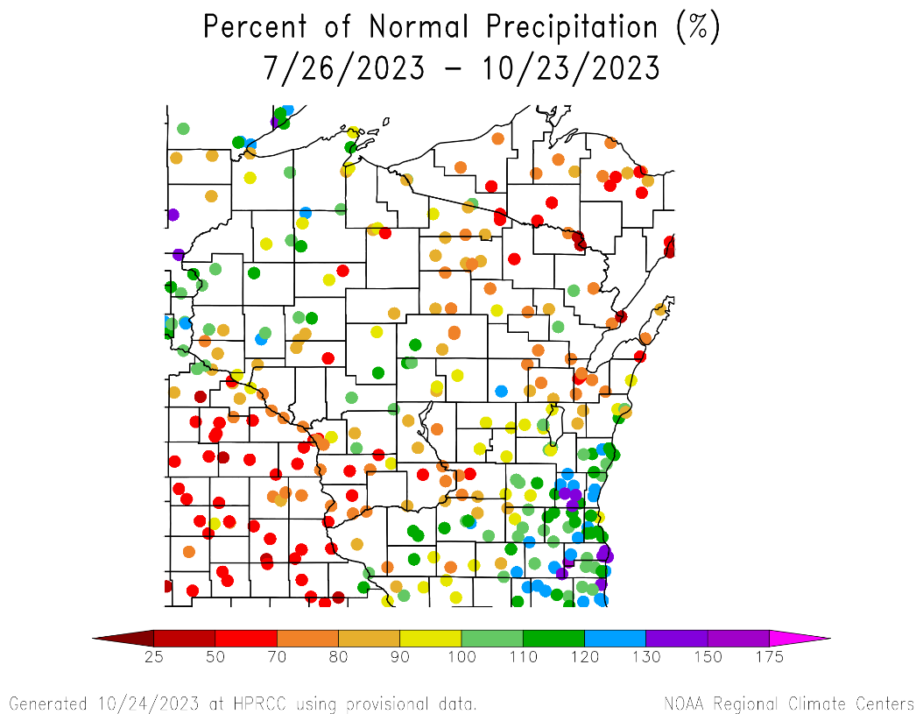
90 Day Precip Total/% Avg.
Total range from <5” at stations in the SW and NE to >12” in the SE and NW.
Percentages are a mixed bag
<70% of normal in SW and NE
>100% of normal in NW and SE
https://hprcc.unl.edu/maps.php?map=ACISClimateMaps

Slide 8
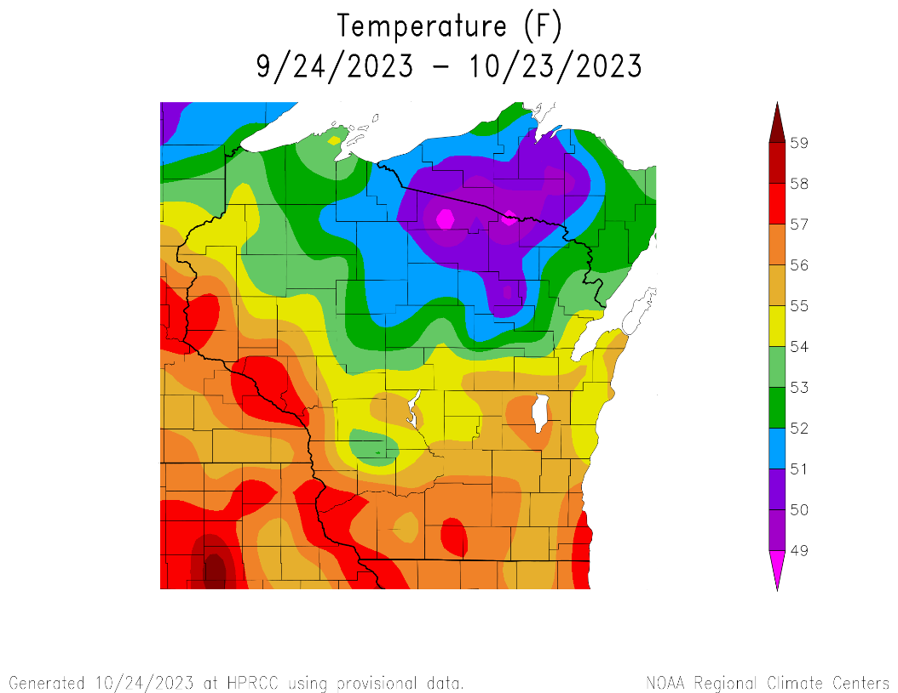
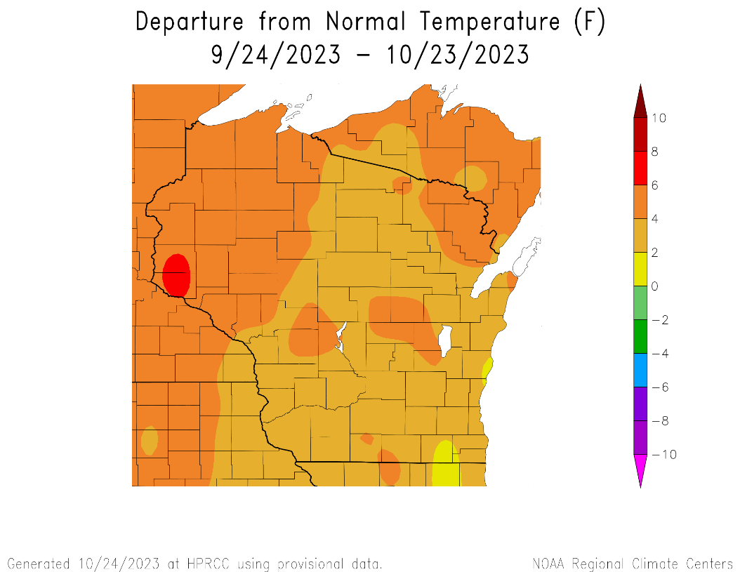
30 Day Temperatures
Highest average T along the Mississippi River and SE/SC (mid to upper 50’s).
≤50°F in far NC WI.
Monthly averages were 2-4°F above normal across most of the state.
https://hprcc.unl.edu/maps.php?map=ACISClimateMaps

Slide 9
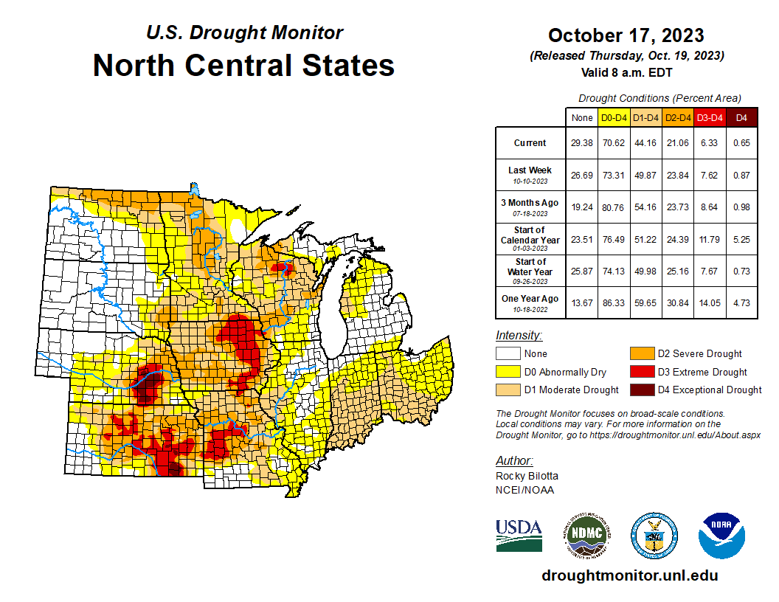
US Drought Monitor
Continued improvement across the region.
See current percent area compared to previous periods.
Areas of D3 have been reduced in SW WI but remain in/near Oneida Co. and far NW Grant Co.
Note: D0 is not considered drought.
http://droughtmonitor.unl.edu/

Slide 10
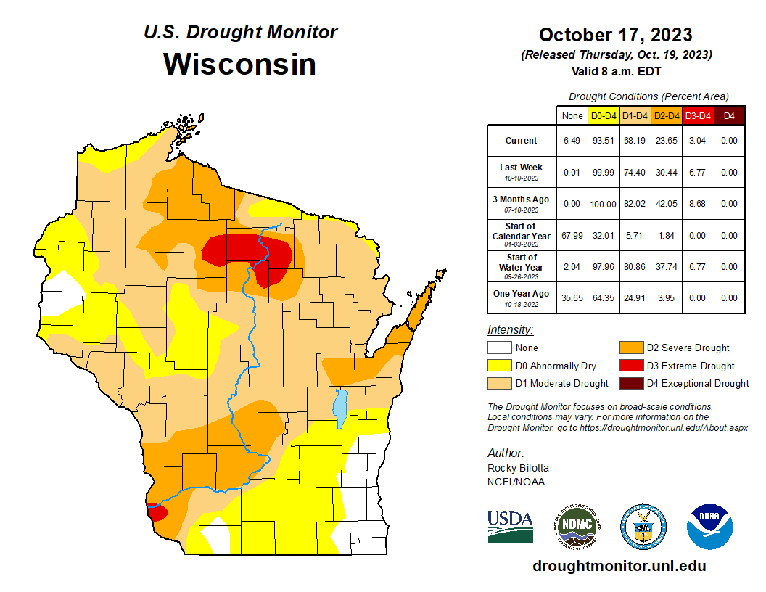
US Drought Monitor
Amount of state in:
D1-D4 – 68.2% ↓
D2-D4 – 23.7% ↓
D3-D4 – 3.4% ↓
D4 – 0.0% --
Note: ↑↓ indicate change from the previous week. Red up arrows indicate increase in drought area; vice-versa for green arrows.
http://droughtmonitor.unl.edu/

Slide 11
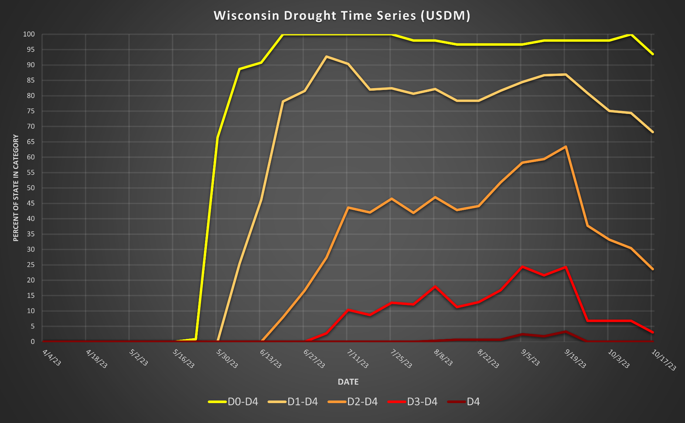
Drought in WI – Last 6 months
http://droughtmonitor.unl.edu/

Slide 12
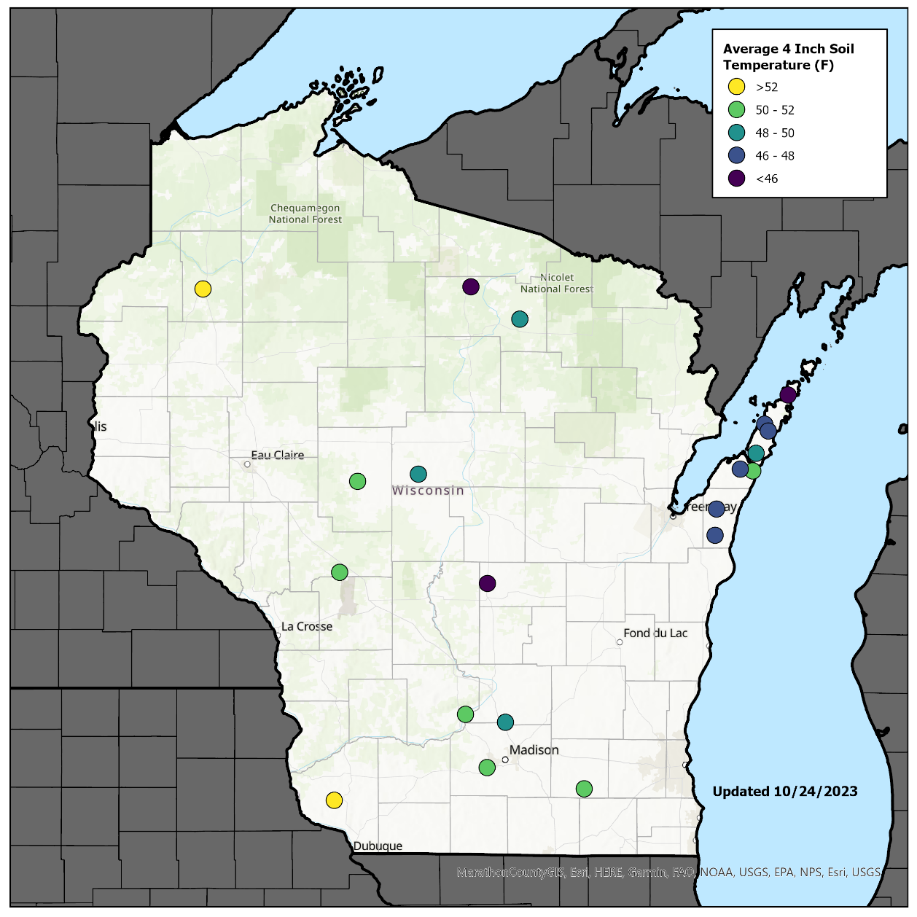
Soil Temperature 4”
Data for 10/23/23
Most stations are sitting around 48-50°F.*
Some stations in the S and W are around 52°F.
N/NE stations are cooler, closer to 46-48°F.
Note: consider using this data when making fall management decisions, such as fall fertilizer applications.
*Data shown for Arlington is from 10/18 (most recent data available). All other sites are displayed on this map with data from 10/23.
http://wisconet.wisc.edu/ → More stations to come soon!

Slide 13
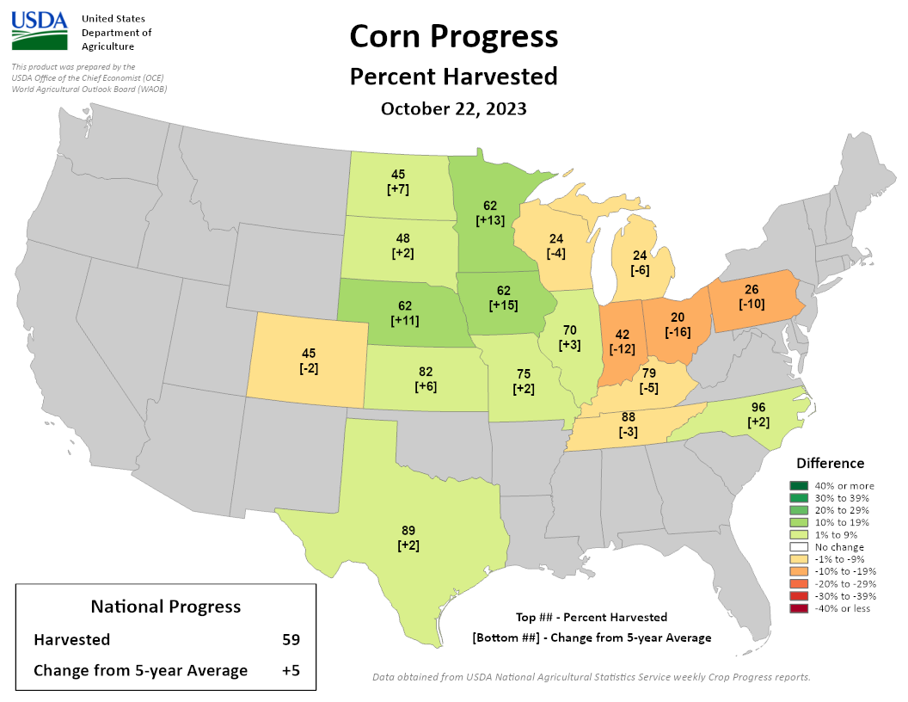
Corn Progress (NASS)
Corn Harvested (NASS):
Wisconsin: 24% (-4%)
National: 59% (+5%)
Corn harvest running behind the 5-year average in WI and states to the E. Trending ahead of average to the S and W.
https://agindrought.unl.edu/Other.aspx

Slide 14
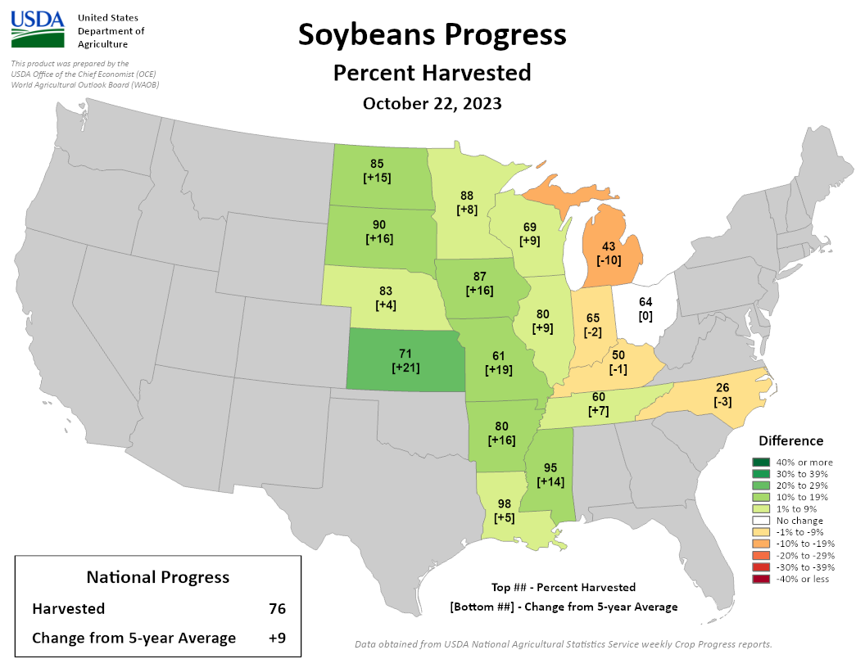
Soybean Progress (NASS)
Soybean Harvested (NASS):
Wisconsin: 69% (+9%)
National: 76% (+9%)
Soybeans still ahead of the 5-year average nationally and in WI. Trending behind average to the E.
https://agindrought.unl.edu/Other.aspx

Slide 15
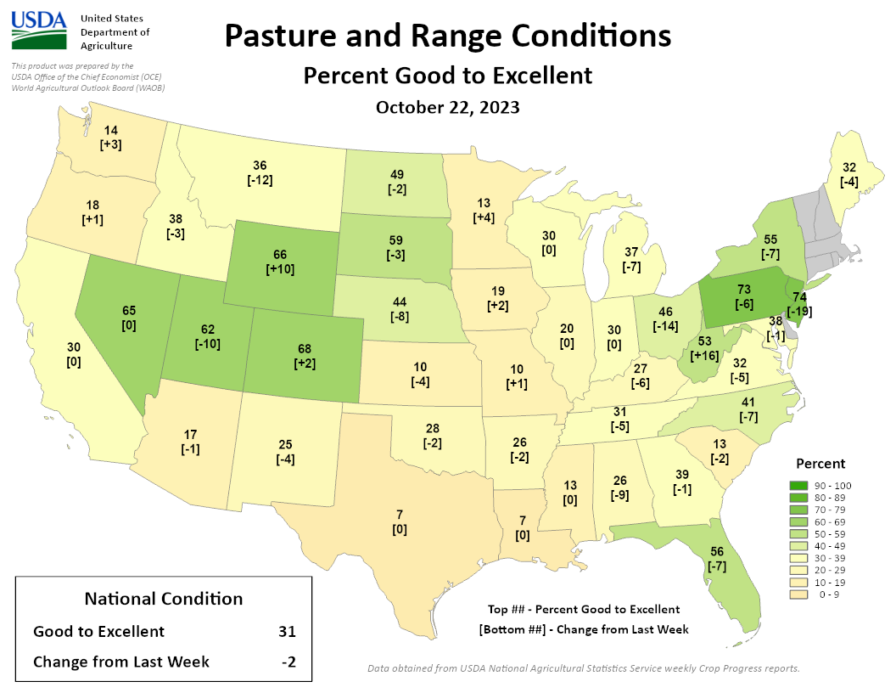
Pasture Conditions (NASS)
Pasture and Range Conditions (NASS):
Conditions show minimal changes across the region. Challenges persist in the central Midwest.
Wisconsin: 30% (0%)
National: 31% (-2%)
https://agindrought.unl.edu/Other.aspx

Slide 16
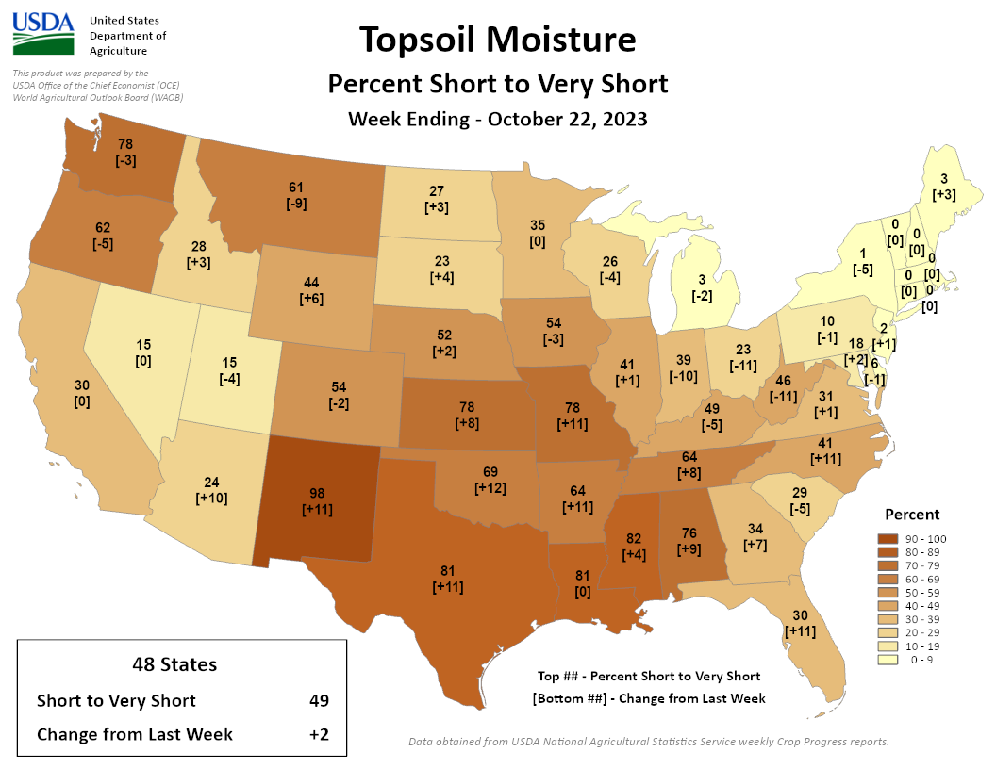
Soil Moisture Conditions (NASS)
Soil moisture S-VS (NASS):
Wisconsin: 26% (-4%)
National: 49% (+2%)
Conditions improving slightly in WI and areas to the E. Areas to the SW of the state are getting worse.
https://agindrought.unl.edu/Other.aspx

Slide 17
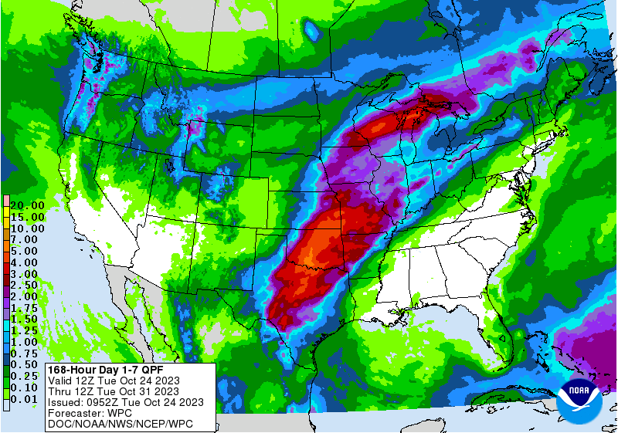
7 Day Forecast Precip
Chances for precipitation expected to continue throughout the week.
The highest totals are forecasted across central WI.
All areas in WI are forecasted to get some rain.
Forecast for 10/24/23 thru 10/30/23
https://www.wpc.ncep.noaa.gov/qpf/p168i.gif

Slide 18
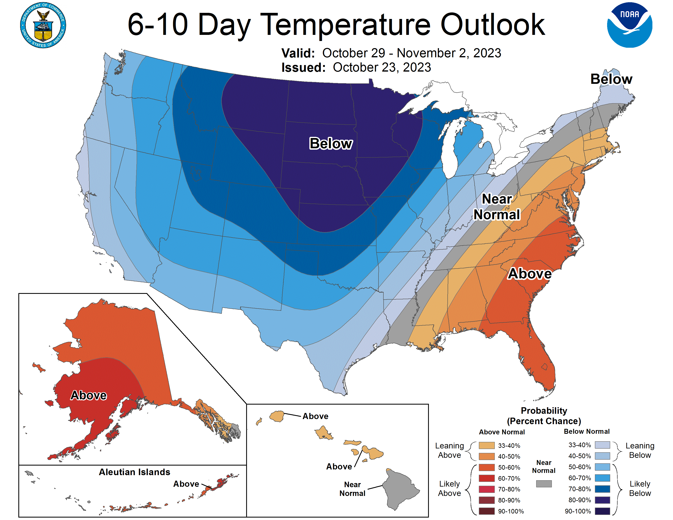
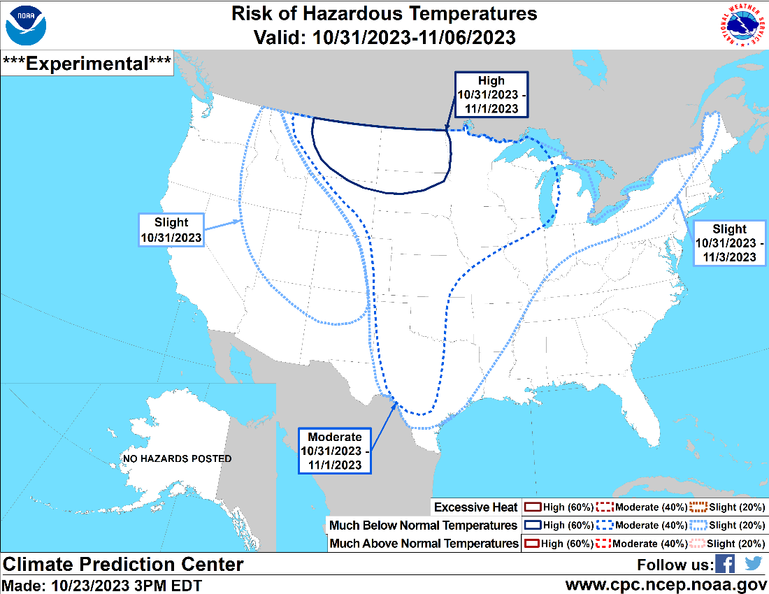
6-10 Day Temp Outlook
The weekend into early next week: Temperatures very likely below average. Be aware of frost/freeze.
http://www.cpc.ncep.noaa.gov/

Slide 19
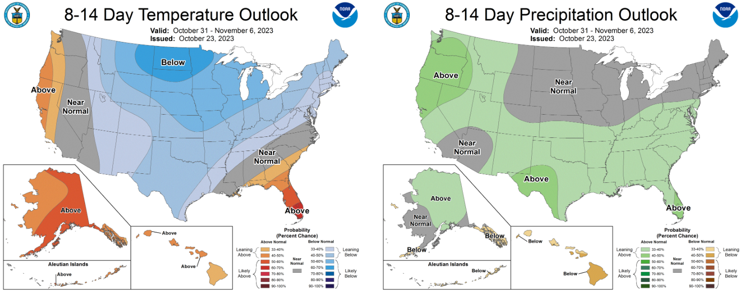
8-14 Day Temp & Precip Outlook
The first week of November: Temperatures likely to be below average. Precipitation forecasted to be near normal.
http://www.cpc.ncep.noaa.gov/

Slide 20
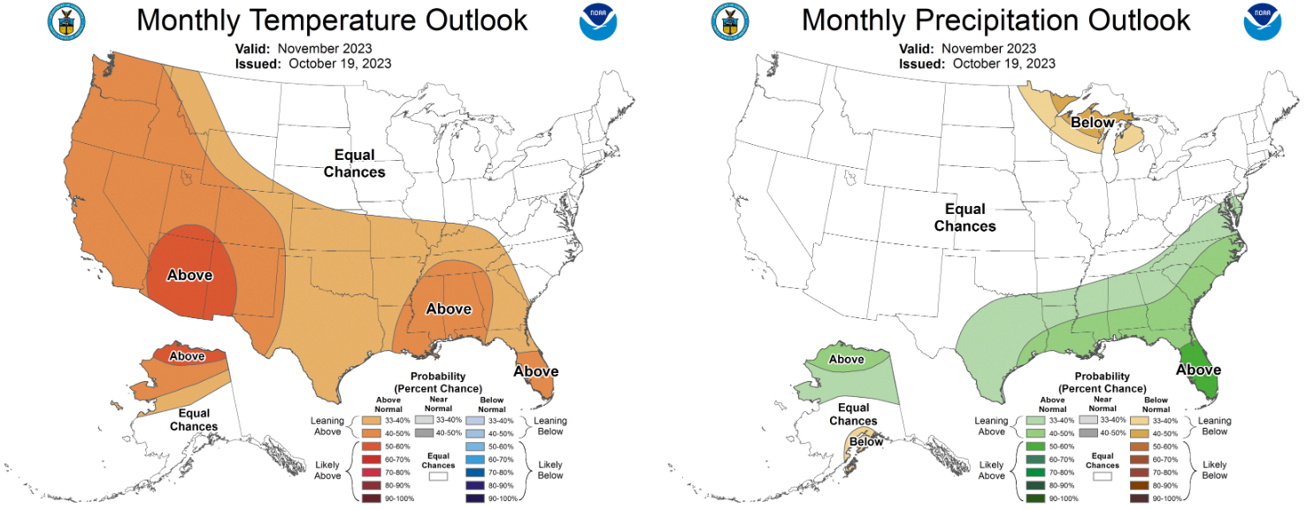
30 Day Temp & Precip Outlook
The month of November: No strong indicators for temperature for this period (“equal chances”). Precipitation forecasted to be below normal in the N/NE; no indication elsewhere.
http://www.cpc.ncep.noaa.gov/

Slide 21
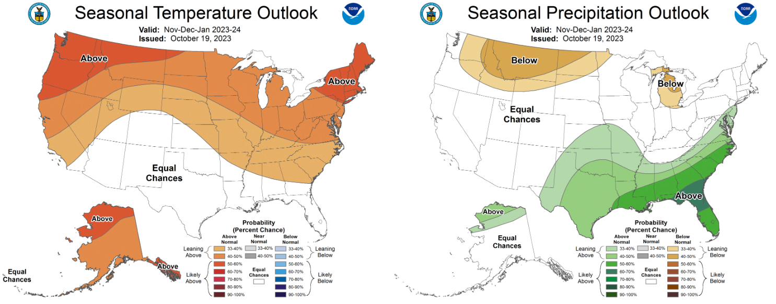
90 Day Temp & Precip Outlook
November – January: Temperatures likely to be above average. No indication on precipitation departure from average. El Nino is a major driver of these conditions.
http://www.cpc.ncep.noaa.gov/

Slide 22
Take Home
Current conditions:
Some recent rains helped alleviate dryness regionally. Overall, drought persists across most of the state.
Temperatures mostly moderate.
Impact:
Drought conditions have been improving with recent rains.
Recent rains have slowed down corn harvest for some (trending behind 5 yr. avg.)
Expected rains could help for cover crops, pastures/grass, and start of soil moisture recharge. Rains may cause some harvest delays.
Outlook:
Much colder temperatures heading into the weekend and next week.
Cool down forecasted to continue into the first week of November.
Precipitation chances increasing for the upcoming week, especially in central WI.
However, there is still a ways to go on improving dry conditions.

Slide 23
Blank
Fill me in

Slide 24
For More Information
Dennis Todey, Director
515-294-2013
dennis.todey@usda.gov
Laurie Nowatzke
Coordinator, Midwest Climate Hub
laurie.nowatzke@usda.gov
Steve Vavrus
State Climatologist of Wisconsin
sjvavrus@wisc.edu
National Laboratory for Agriculture and the Environment
Attn: Midwest Climate Hub
1015 N University Blvd
Ames, Iowa 50011-3611

